Slide 1
Accessible Map
Screenshot of the web-app

Slide 2
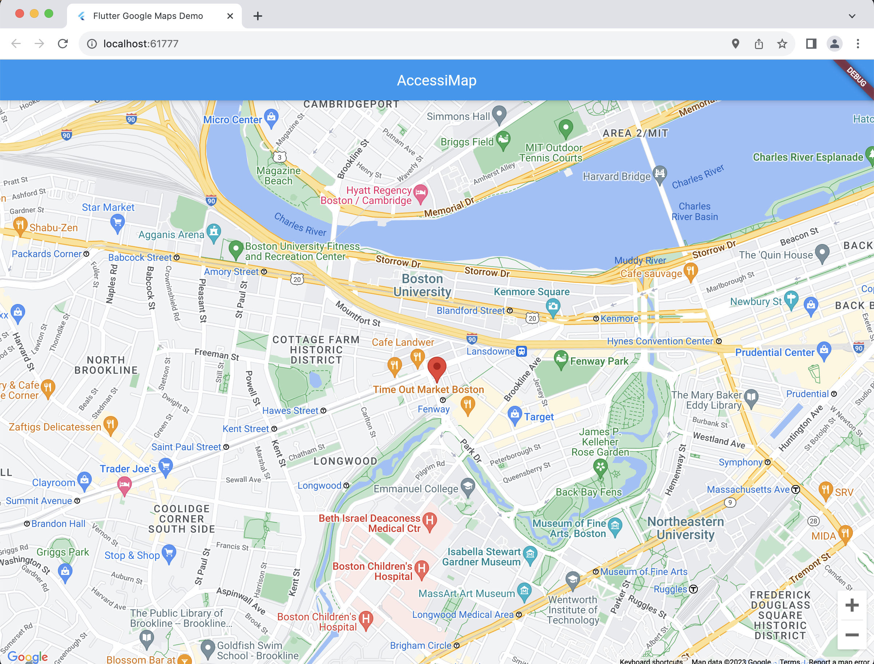

Slide 3
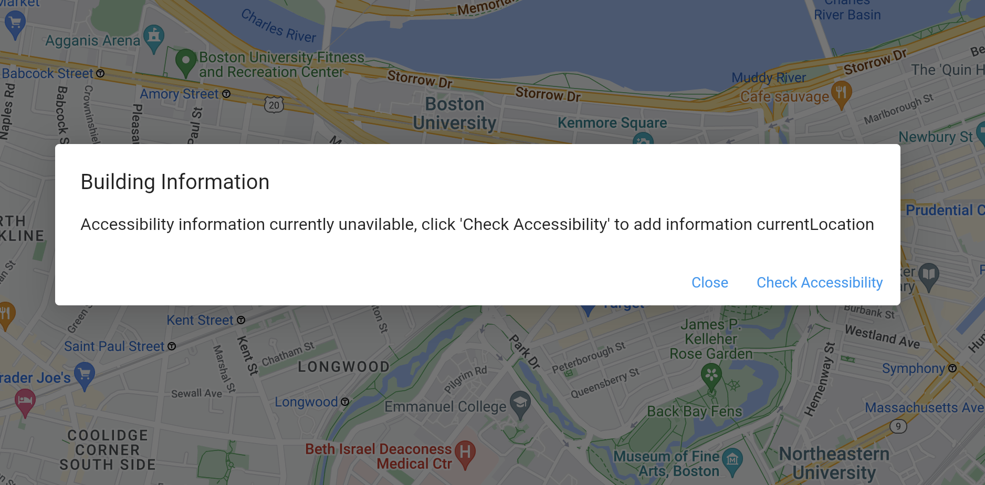
When the building don’t have existing details

Slide 4
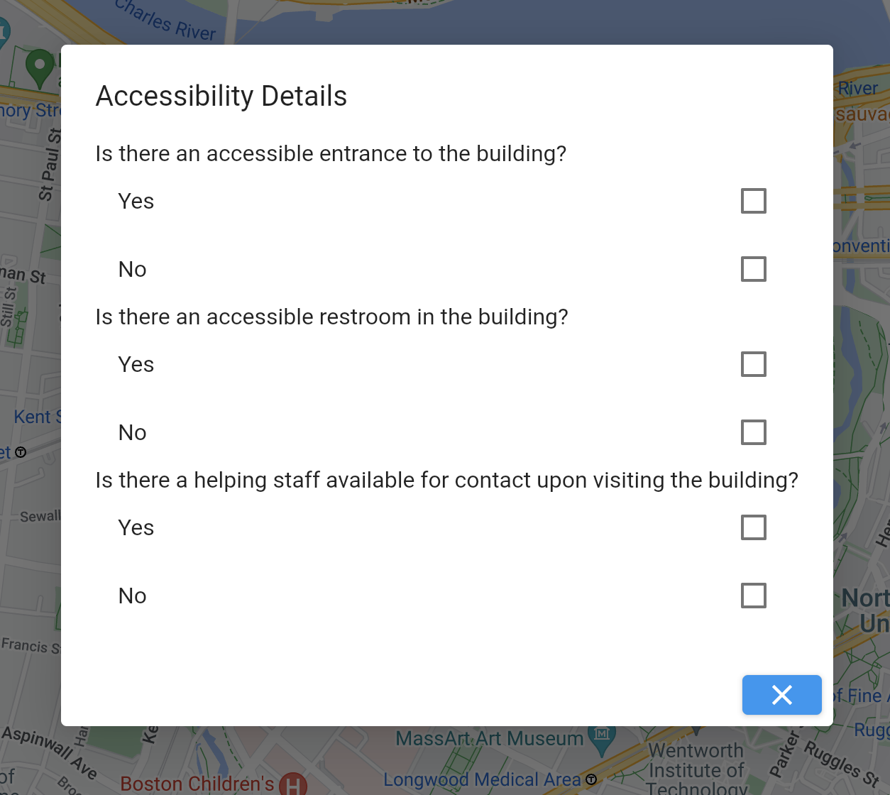
Add accessibility details by completing the survey

Slide 5
