Slide 1
Cryptocurrency Cafe
Remembar: Charlie Harding and Joey Weate

Slide 2
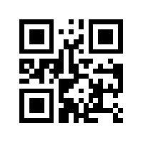
Remembar: Mission Statement
To encourage the spread of Pointcoin by providing an easier way to spend and share Pointcoins.

Slide 3
Remembar: What do we do?
Create fast access to your public address
Generate a unique QR code
Public Address
Message
Amount

Slide 4
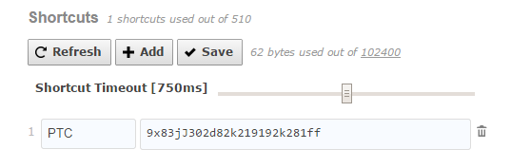
Remembar: How do we do it?
Fast Access to public address
User input: Shorthand command, Public Address
Output: When shorthand command is typed, Remembar changes the command to your Public Address

Slide 5
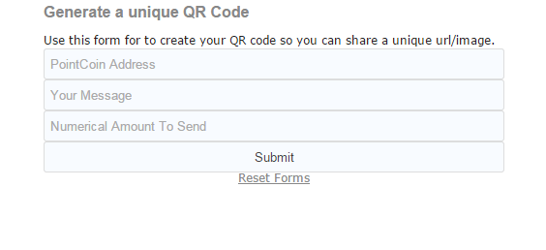
Remembar: How do we do it?
Generate a unique QR code
User input: Address, Message, Amount

Slide 6
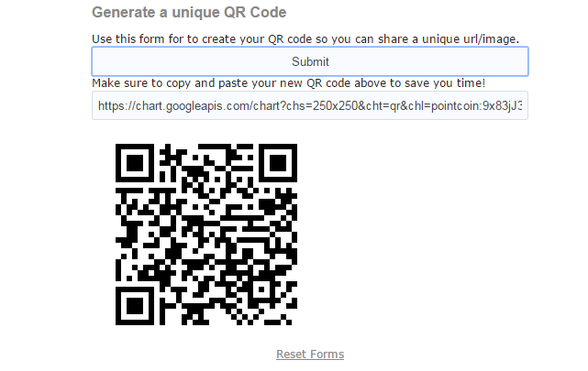
Remembar: How do we do it?
Generate a unique QR code
Output: unique QR code

Slide 7
Remembar: Demo

Slide 8
Remembar: Uses
Fast Access to public address
Sharing Address Online (Transactions, Forums, etc)
Mistake Free
Generate a unique QR code
Transactions
Seller generates the QR, buyer reads the code and only has to confirm payment to block chain
Mobile, Convenient

Slide 10
Remembar: Trusting Us
What’s stopping us from generating a wrong QR code?
Send more than desired amount
Send money to our address
We do not handle the transaction. No private keys, just a more convenient way to transact.

Slide 11
Remembar: Feedback
Questions, Comments, Concerns?

Slide 12
Cryptocurrency Cafe
PointCoin Remembar

