Slide 1
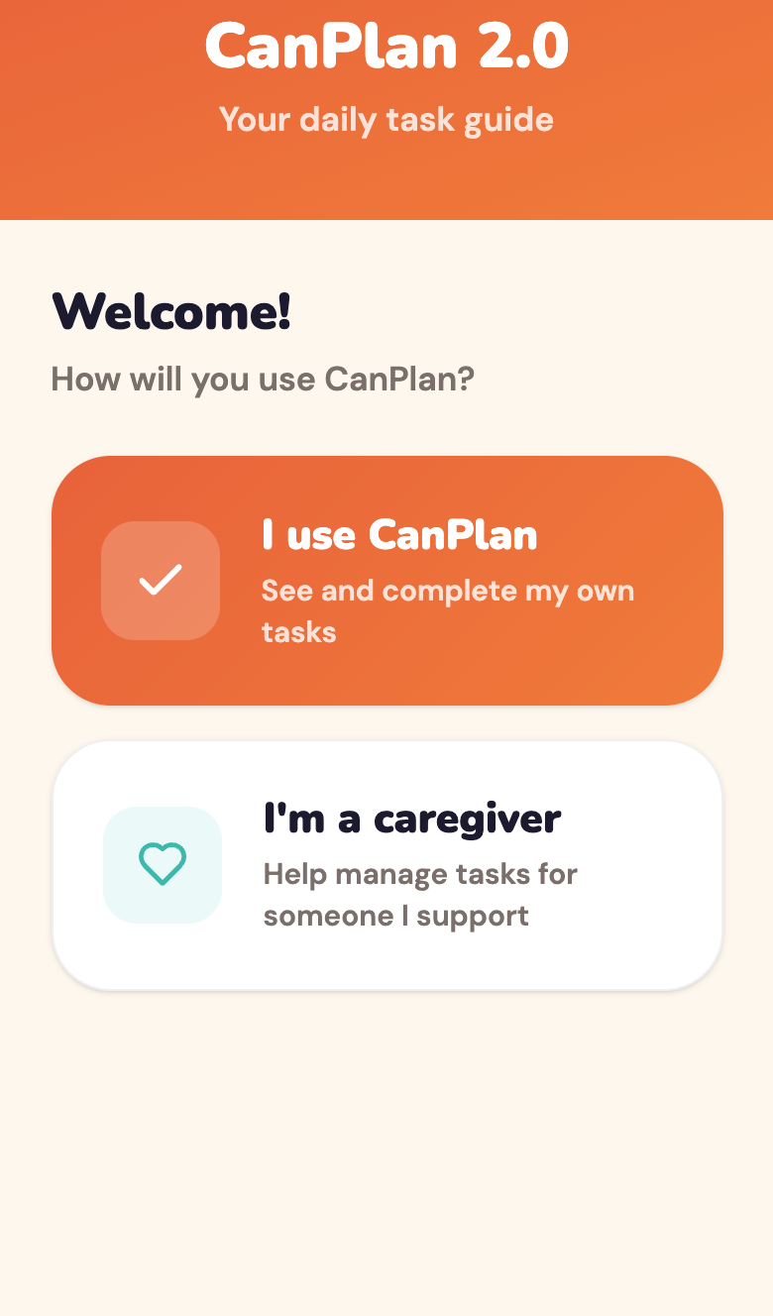
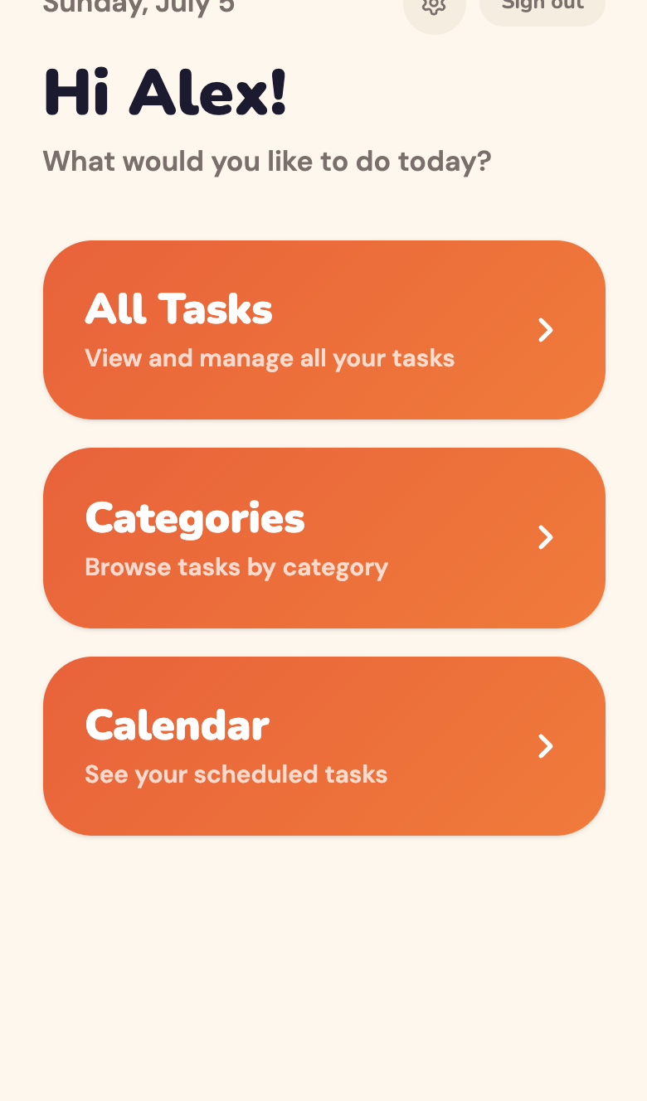
USER PORTAL
20 sec
A calm, welcoming first step
Onboarding & Home
Choose your role
One tap: use it yourself, or as a caregiver — switch anytime.
Plain, kind language
“What would you like to do today?” — no jargon, no clutter.
Few, large choices
Just three big buttons keep cognitive load low.
Warm, consistent palette
Soft cream and orange feel safe, not clinical.
CanPlan 2.0 · UI/UX Design
Notes:
[Slide 1 of 4 — ~20 seconds]
This is CanPlan's front door. From the very first screen we lower cognitive load: one clear choice — are you the person using it, or a caregiver? The home screen greets you by name and asks, in plain language, what you'd like to do, with just three big, friendly buttons. Warm colours and rounded shapes make it feel safe, not clinical.

Slide 2
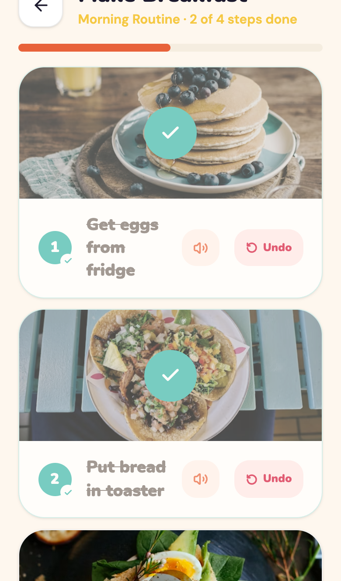
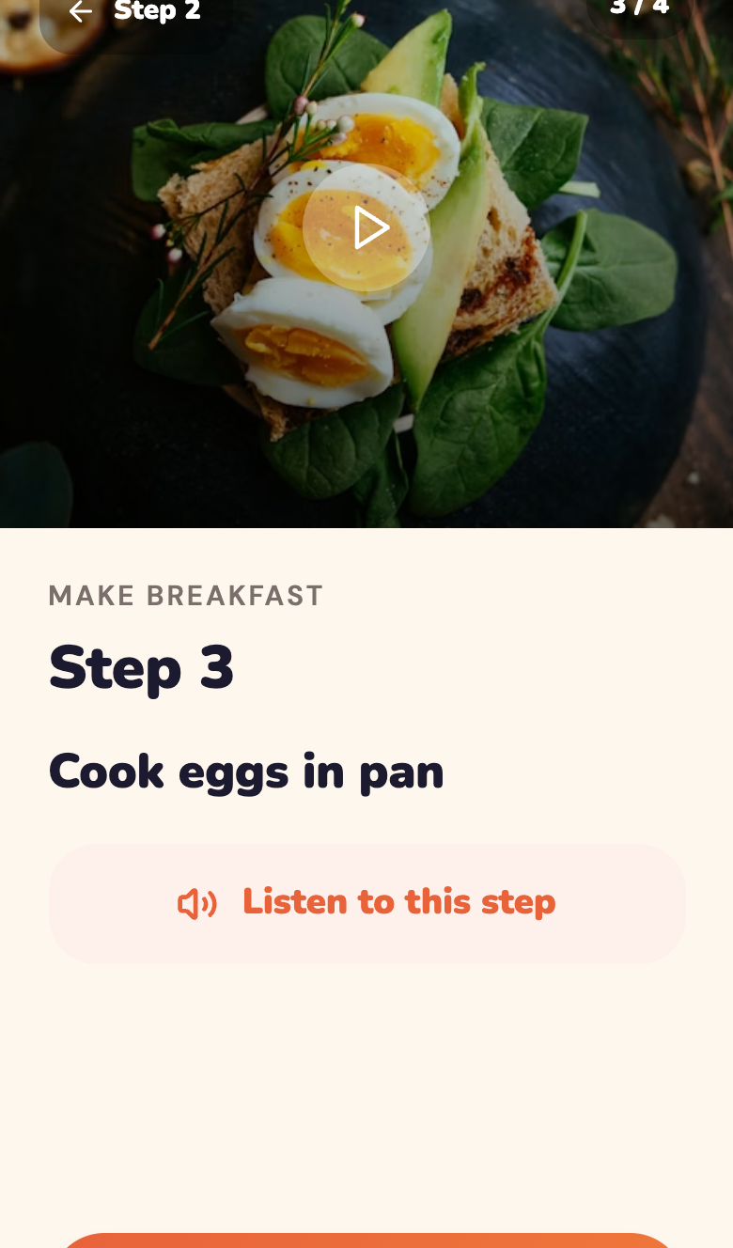
USER PORTAL
20 sec
Every task, broken into simple steps
Guided Task Experience
A photo or video per step
See exactly what to do — not just read it.
Listen to any step
Built-in audio supports people who don't read easily.
One step at a time
Full-screen focus removes every distraction.
Clear, kind progress
A progress bar and “3 of 4 done” build confidence.
CanPlan 2.0 · UI/UX Design
Notes:
[Slide 2 of 4 — ~20 seconds]
This is the heart of the app. Every task is broken into small, visual steps — a photo or short video shows exactly what to do. Anyone who struggles with reading can tap 'Listen to this step'. In step view we go full-screen, one step at a time, so there's no distraction — and a progress bar with 'two of four done' gives constant, reassuring feedback.

Slide 3
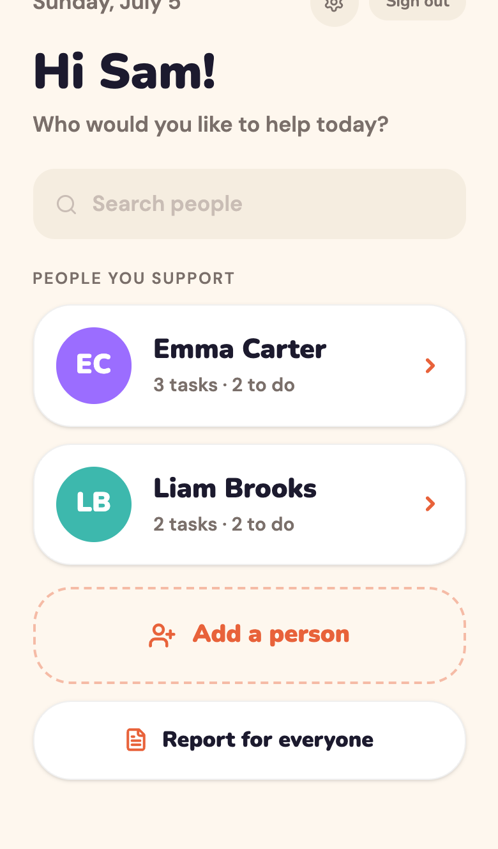
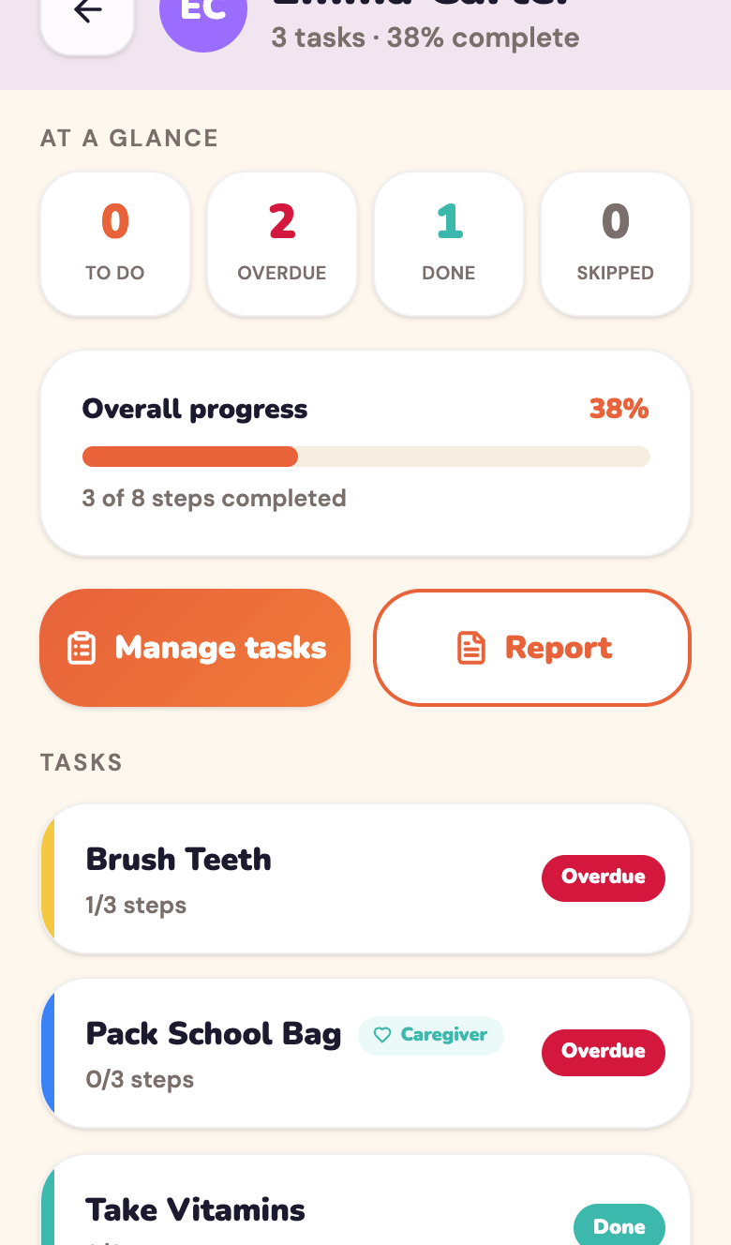
CAREGIVER PORTAL
20 sec
Support many people, at a glance
Caregiver Home & Overview
People you support
Manage several people from one simple list.
At-a-glance stats
To-do, overdue, done and skipped in seconds.
Progress you can trust
Overall percentage and steps completed.
Caregiver tags
See which tasks a caregiver added or edited.
CanPlan 2.0 · UI/UX Design
Notes:
[Slide 3 of 4 — ~20 seconds]
Now the caregiver side — same visual language, a different job. A caregiver like Sam sees everyone they support in one list, with how many tasks each has left. Open a person and you get an at-a-glance dashboard: to-do, overdue, done, skipped, and overall progress. Caregiver-added tasks are clearly tagged, so nothing gets confused.

Slide 4
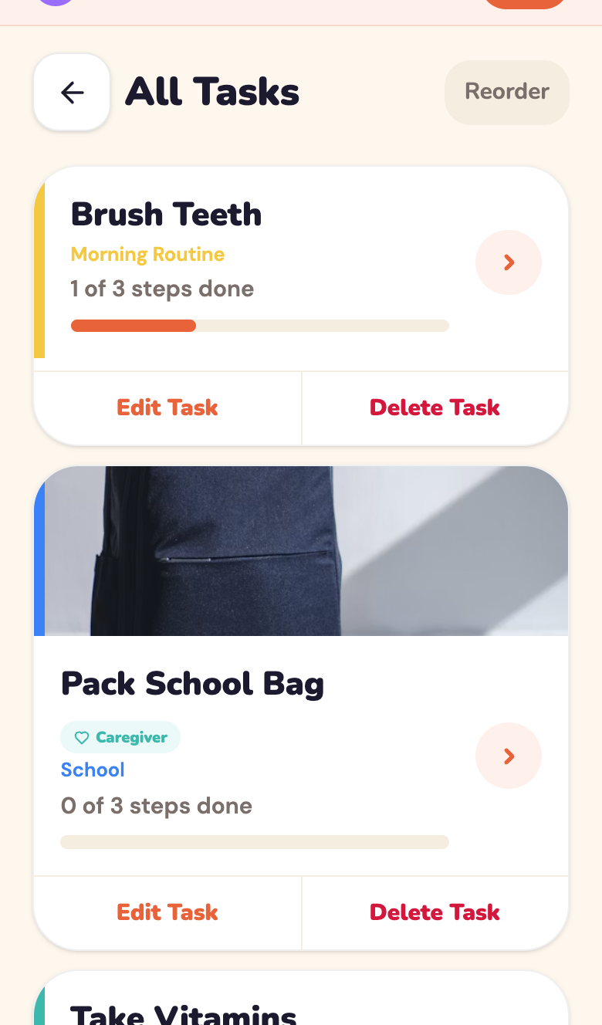
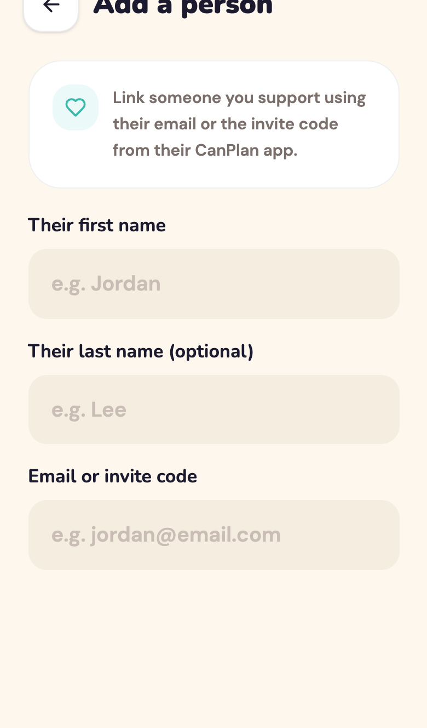
CAREGIVER PORTAL
20 sec
Full control, one design system
Manage, Add & Report
Manage every task
Add, edit, reorder or delete for each person.
Add a person in seconds
Link someone new with one simple form.
Reports built in
Share progress with families or support staff.
One consistent system
Both portals share components, colour and style.
CanPlan 2.0 · UI/UX Design
Notes:
[Slide 4 of 4 — ~20 seconds]
Caregivers get full control — add, edit, reorder or remove any task, and link a new person in seconds. Built-in reports make it easy to share progress with families or support staff. Crucially, both portals are built from one design system — the same components, colours and rounded style — so whichever side you're on, CanPlan feels like one calm, coherent product.

