Slide 1
Chapter 3.5 A simple Intro towards Core-Set ------From a Layered Sampling Perspective
李钊佚
2021 Nov. 29th

Slide 2
Synopsis
@1: What is Core-Set and Why we need Core-Set?
@2: Core-Set for K-Median Algorithm(ke chen et al, SIAM2009)
@3: Core-Set for Streaming Data
@4: More about Core-Set and References

Slide 3
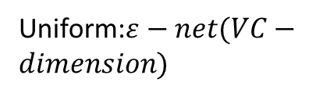

@1: What is Core-Set and Why we need Core-Set?
The Motivation of introducing Core-Set concepts for us：
Reducing the scale of data is important as we are doing data-mining tasks and machine learning tasks with mass data.
Let us suppose that all of the data could be formally defined as the matrix $R^{s×d}$, in which parameter s represents the amount of data points and parameter d represents the dimensionality of each data point.
So Now all we need is to reduce the scale of the matrix $R^{s×d}$, namely reduce the parameter s or d.
Data Matrix
Input data size s
Uniform:$ε−net(VC−dimension)$
Sampling
Non-Uniform: Core-Set
Input data dimensionality d
PCA, LDA, JL-Transform etc.

Slide 4

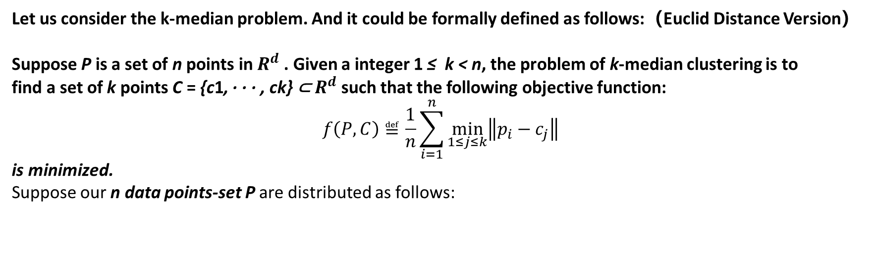
Now we are considering reducing the param s and there is a naïve sampling method – uniformly sampling.
But uniformly sampling would always behave unacceptably for its performance on algorithmic approximation ratio.
Let us consider the k-median problem. And it could be formally defined as follows:（Euclid Distance Version）
Suppose P is a set of n points in $R^{d}$ . Given a integer 1 ≤ k < n, the problem of k-median clustering is to
find a set of k points C = {c1, · · · , ck} ⊂ $R^{d}$ such that the following objective function:
$$f\left(P,C\right)≝\frac{1}{n}\sum_{i=1}^{n}{\min_{1≤j≤k}\left\|p_{i}−c_{j}\right\|}$$
is minimized.
Suppose our n data points-set P are distributed as follows:
The worst case:
The algorithmic approximation-ratio would be $∞$ if we did not sample the right one single point.
Because Optimal-Cost $≈$ 0 and Real-Cost $≈d/n$,
Approx $=$ $\frac{Real−Cost}{Optimal−Cost}$ $≈∞$
distance =d
one single point
There are n-1 points and any distance between two of them approach to zero.
Uniformly Sampling Result

Slide 5
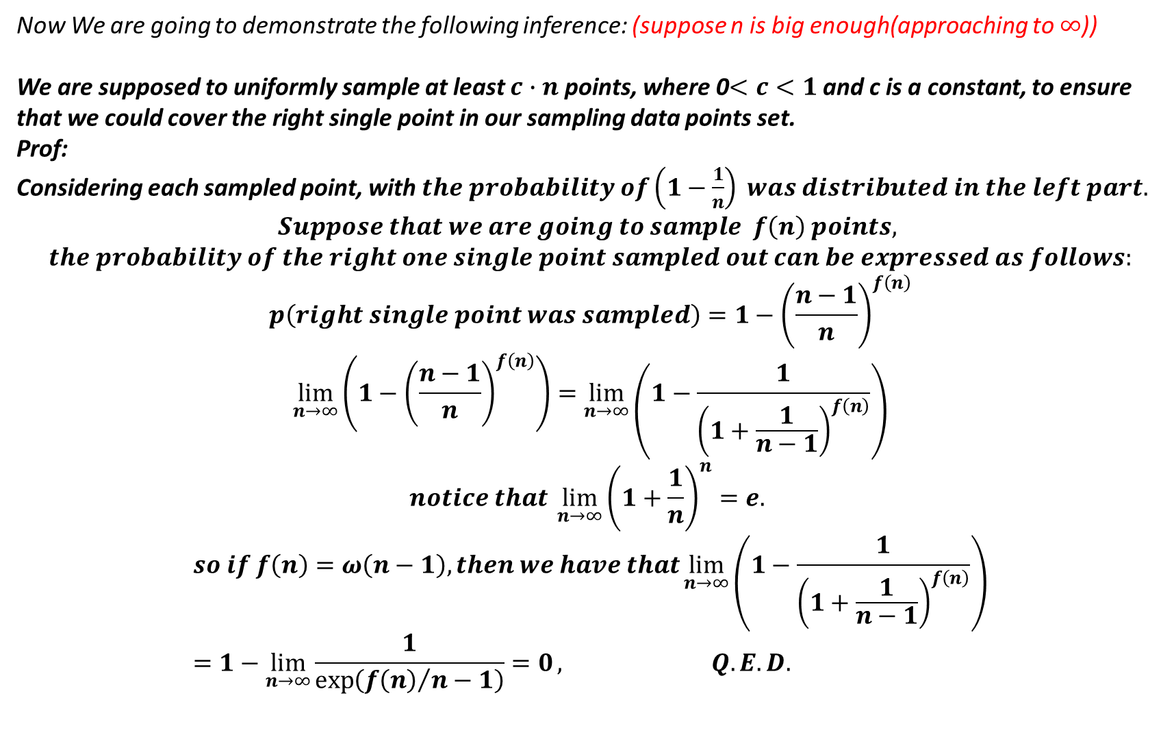
Now We are going to demonstrate the following inference: (suppose n is big enough(approaching to $∞$))
We are supposed to uniformly sample at least $c∙n$ points, where 0$<c<1$and c is a constant, to ensure that we could cover the right single point in our sampling data points set.
Prof:
Considering each sampled point, with $the probability of（1−\frac{1}{n}） was distributed in the left part.$
$$Suppose that we are going to sample f\left(n\right) points,$$
$$the probability of the right one single point sampled out can be expressed as follows:$$
$$p\left(right single point was sampled\right)=1−{\left(\frac{n−1}{n}\right)}^{f\left(n\right)}$$
$$\lim_{n→∞}\left(1−{\left(\frac{n−1}{n}\right)}^{f\left(n\right)}\right)=\lim_{n→∞}\left(1−\frac{1}{{\left(1+\frac{1}{n−1}\right)}^{f\left(n\right)}}\right)$$
$$notice that \lim_{n→∞}{{\left(1+\frac{1}{n}\right)}^{n}}=e.$$
$$so if f\left(n\right)=ω\left(n−1\right), then we have that\lim_{n→∞}\left(1−\frac{1}{{\left(1+\frac{1}{n−1}\right)}^{f\left(n\right)}}\right)=1−\lim_{n→∞}{\frac{1}{\exp\left({f\left(n\right)}/{n−1}\right)}=0}, Q.E.D.$$

Slide 6
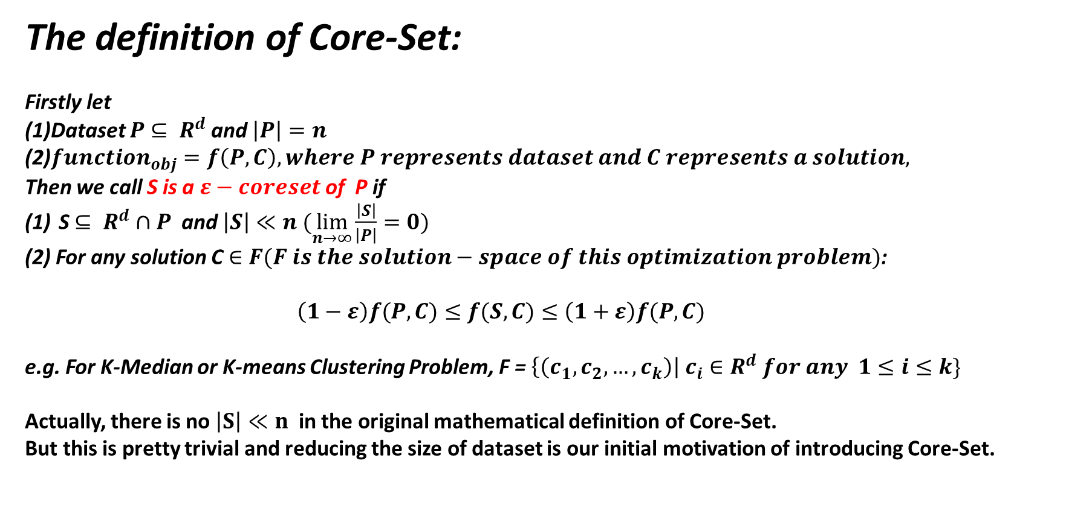
The definition of Core-Set:
Firstly let
(1)Dataset $P$ $⊆ R^{d}$ and $\left|P\right|=n$
(2)$function_{obj}=f\left(P,C\right), where P represents dataset and C represents a solution,$
Then we call S is a $ε−coreset$ of P if
S $⊆ R^{d}∩P$ and $\left|S\right|≪n (\lim_{n→∞}{\frac{\left|S\right|}{\left|P\right|}}=0)$
(2) For any solution C $∈F(F is the solution−space of this optimization problem)$:
$\left(1−ε\right)f(P,C)≤f(S,C)≤\left(1+ε\right)f(P,C)$
e.g. For K-Median or K-means Clustering Problem, F = $\left\{\left(c_{1},c_{2},…,c_{k}\right)\right| c_{i}∈R^{d} for any 1≤i≤k\}$
Actually, there is no $\left|S\right|≪n$ in the original mathematical definition of Core-Set.
But this is pretty trivial and reducing the size of dataset is our initial motivation of introducing Core-Set.

Slide 7
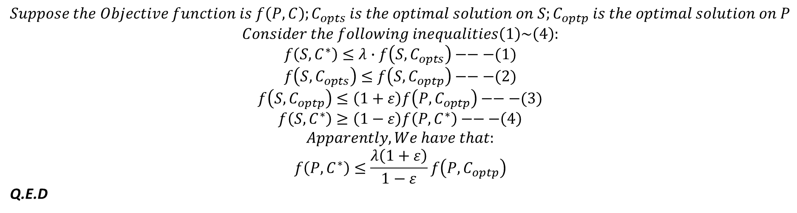
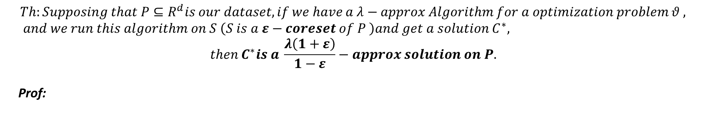
$$Th:Supposing that P⊆R^{d}is our dataset, if we have a λ−approx Algorithm for a optimization problem θ , and we run this algorithm on S \left(S is a ε−coreset of P \right)and get a solution C^{∗},$$
$$then C^{∗}is a \frac{λ\left(1+ε\right)}{1−ε}−approx solution on P.$$
Prof:
$$Suppose the Objective function is f\left(P,C\right);C_{opts} is the optimal solution on S;C_{optp} is the optimal solution on P$$
$$Consider the following inequalities\left(1\right)\sim \left(4\right):$$
$$f\left(S,C^{∗}\right)≤λ∙f\left(S,C_{opts}\right)−−−(1)$$
$$f\left(S,C_{opts}\right)≤f\left(S,C_{optp}\right)−−−(2)$$
$$f\left(S,C_{optp}\right)≤\left(1+ε\right)f\left(P,C_{optp}\right)−−−(3)$$
$$f\left(S,C^{∗}\right)≥\left(1−ε\right)f\left(P,C^{∗}\right)−−−\left(4\right)$$
$$Apparently, We have that:$$
$$f\left(P,C^{∗}\right)≤\frac{λ\left(1+ε\right)}{1−ε}f\left(P,C_{optp}\right)$$
Q.E.D

Slide 8
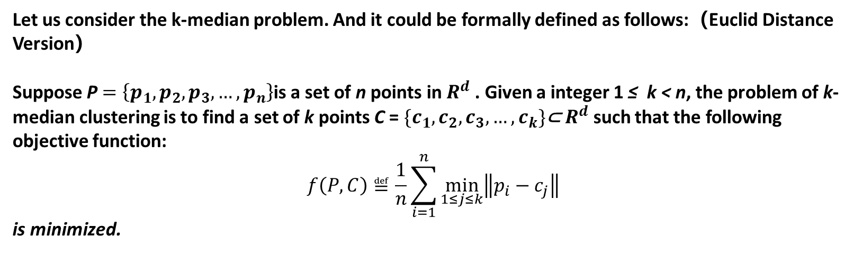
@2: Core-Set for K-Median Algorithm
Let us consider the k-median problem. And it could be formally defined as follows:（Euclid Distance Version）
Suppose P $=\left\{p_{1},p_{2},p_{3},…,p_{n}\right\}$is a set of n points in $R^{d}$ . Given a integer 1 ≤ k < n, the problem of k-median clustering is to find a set of k points C = $\{c_{1},c_{2},c_{3},…,c_{k}\}$⊂ $R^{d}$ such that the following objective function:
$$f\left(P,C\right)≝\frac{1}{n}\sum_{i=1}^{n}{\min_{1≤j≤k}\left\|p_{i}−c_{j}\right\|}$$
is minimized.

Slide 9


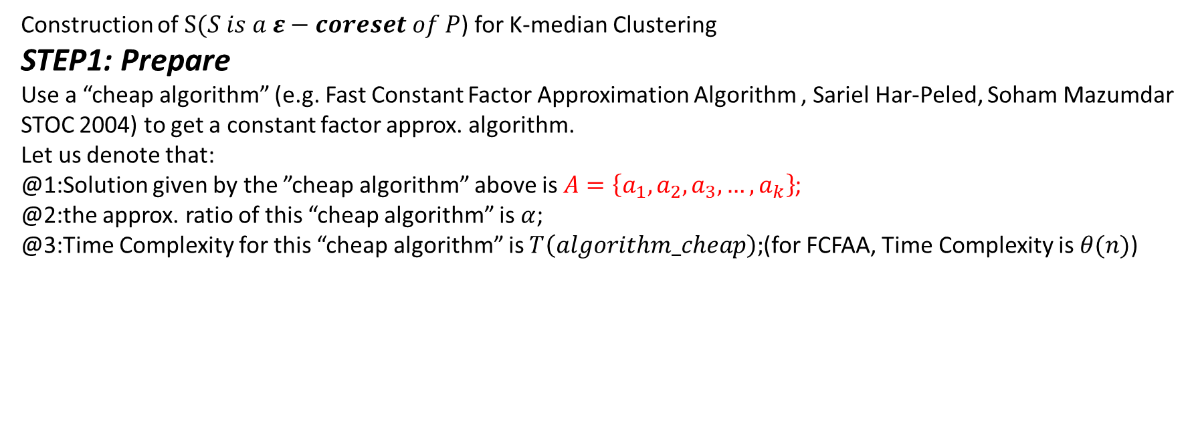



Construction of $S(S is a ε−coreset of P$) for K-median Clustering
STEP1: Prepare
Use a “cheap algorithm” (e.g. Fast Constant Factor Approximation Algorithm , Sariel Har-Peled, Soham Mazumdar STOC 2004) to get a constant factor approx. algorithm.
Let us denote that:
@1:Solution given by the ”cheap algorithm” above is $A=\left\{a_{1},a_{2},a_{3},…,a_{k}\right\}$;
@2:the approx. ratio of this “cheap algorithm” is $α$;
@3:Time Complexity for this “cheap algorithm” is $T\left(algorithm_cheap\right);$(for FCFAA, Time Complexity is$θ(n)$)
$$a_{3}$$
$$a_{1}$$
$$a_{k}$$
$$a_{4}$$
$$a_{k−1}$$

Slide 10



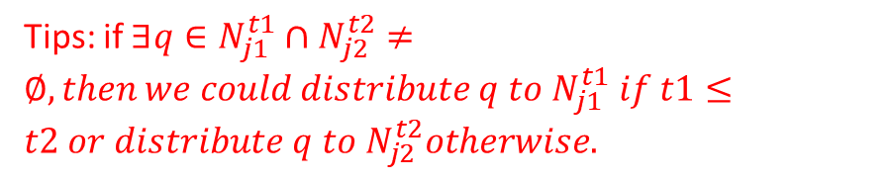







STEP2: Partition the data point space into layers
Tips: if $∃q∈N_{j1}^{t1}∩N_{j2}^{t2}≠∅, then we could distribute q to N_{j1}^{t1} if t1≤t2 or distribute q to N_{j2}^{t2}otherwise.$
$$a_{3}$$
$$a_{1}$$
$$a_{k}$$
$$2R$$
$$R$$
$$a_{2}$$
$$a_{k−1}$$
$$4R$$
$$for ∀a_{j}\left(1≤j≤k\right), partition for φ+1 layers;$$
$$φ= \log_{2}\left(αn\right);R= \frac{1}{α}f\left(P,A\right);$$
$$Layer\#1:Ball\left(a_{j},R\right)≜N_{j}^{0};$$
$$Layer\#2:Ball\left(α_{j},2R\right)\backslash Ball\left(α_{j},R\right)≜N_{j}^{1};$$
$$Layer\#3:Ball\left(α_{j},2^{2}R\right)\backslash Ball\left(α_{j},2R\right)≜N_{j}^{2};$$
$$…$$
$$Layer\#φ:Ball\left(α_{j},2^{φ}R\right)\backslash Ball\left(α_{j},2^{φ−1}R\right)≜N_{j}^{φ};$$
$$2^{φ−1}R$$

Slide 11

Why $φ and R?$
$$Th:dataset P ⊆∪_{j=1}^{k}Ball\left(a_{j},2^{φ}R\right)$$
Prof:
$ifP ⊆∪_{j=1}^{k}Ball\left(a_{j},2^{φ}R\right) is false, then ∃p_{i}∉$ $∪_{j=1}^{k}Ball\left(a_{j},2^{φ}R\right).$
$$\overset{⇒}{}\min_{1≤j≤k}\left\|p_{i}−a_{j}\right\|>2^{φ}R−−−1$$
$$2^{φ}R=2^{\log_{2}{αn}}∙\frac{1}{α}f\left(P,A\right)$$
$$=αn∙\frac{1}{α}f\left(P,A\right)$$
$$=n∙f\left(P,A\right)$$
$$=\sum_{i=1}^{n}{\min_{1≤j≤k}}\left\|p_{i}−a_{j}\right\|−−−2$$
Taking 1 and 2 into consideration:
$$\overset{⇒}{}\min_{1≤j≤k}\left\|p_{i}−a_{j}\right\|>\sum_{i=1}^{n}{\min_{1≤j≤k}}\left\|p_{i}−a_{j}\right\|$$
Contradict!
$$\overset{⇒}{}P ⊆∪_{j=1}^{k}Ball\left(a_{j},2^{φ}R\right)$$

Slide 12
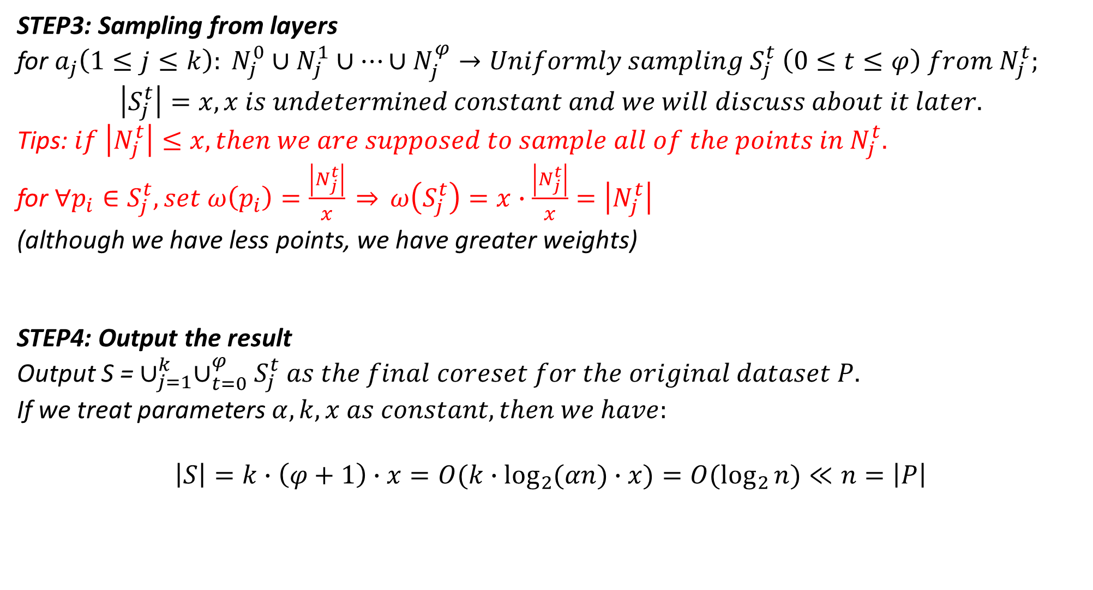
STEP3: Sampling from layers
for $a_{j}\left(1≤j≤k\right): N_{j}^{0}∪N_{j}^{1}∪…∪N_{j}^{φ}→Uniformly sampling S_{j}^{t} \left(0≤t≤φ\right) from N_{j}^{t};$
$$\left|S_{j}^{t}\right|=x, x is undetermined constant and we will discuss about it later.$$
Tips: $if \left|N_{j}^{t}\right|≤x,then we are supposed to sample all of the points in N_{j}^{t}.$
for $∀p_{i}∈S_{j}^{t}, set ω\left(p_{i}\right)=\frac{\left|N_{j}^{t}\right|}{x} \overset{⇒}{} ω\left(S_{j}^{t}\right)=x∙\frac{\left|N_{j}^{t}\right|}{x}=\left|N_{j}^{t}\right|$
(although we have less points, we have greater weights)
STEP4: Output the result
Output S = $∪_{j=1}^{k}∪_{t=0}^{φ}S_{j}^{t} as the final coreset for the original dataset P.$
If we treat parameters $α,k,x as constant,then we have:$
$$\left|S\right|=k∙\left(φ+1\right)∙x=O(k∙\log_{2}{(αn})∙x)=O(\log_{2}{n})≪n=\left|P\right|$$

Slide 13






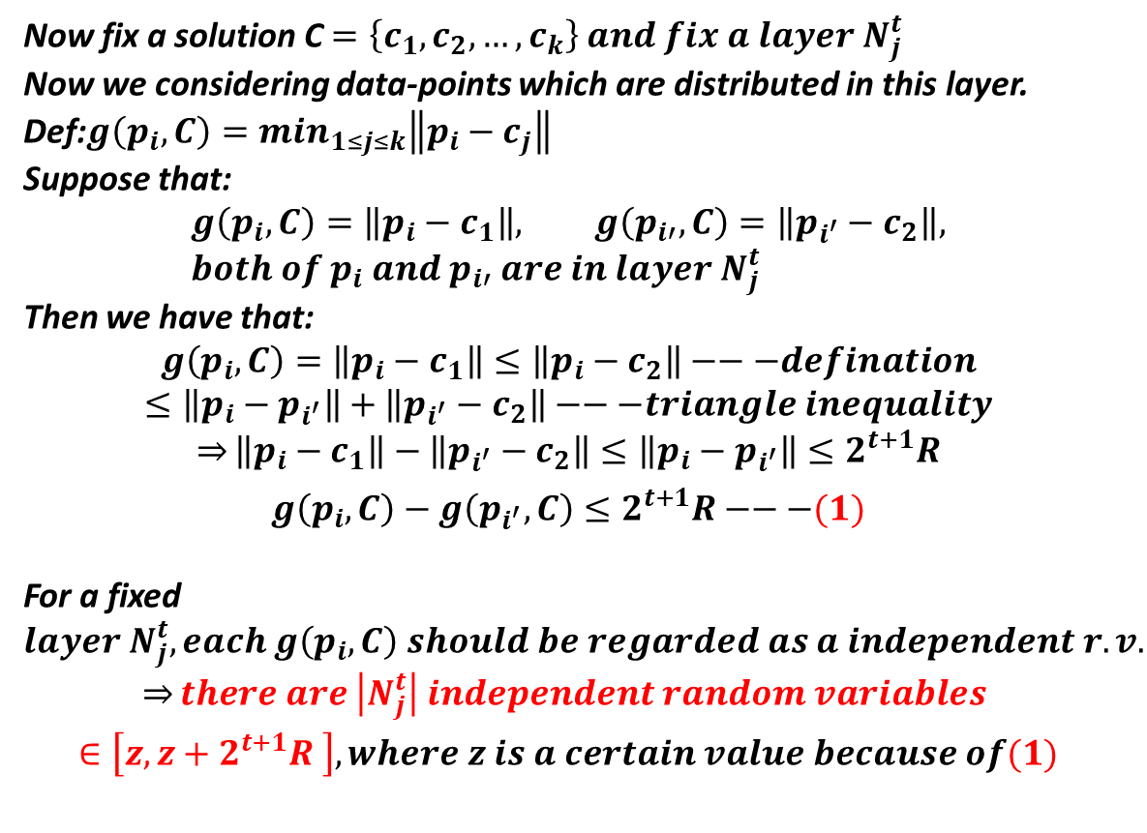














Now we are going to determine $x= ?$
Now fix a solution C $=\left\{c_{1},c_{2},…,c_{k}\right\} and fix a layer N_{j}^{t}$
Now we considering data-points which are distributed in this layer.
Def:$g\left(p_{i},C\right)=\min_{1≤j≤k}\left\|p_{i}−c_{j}\right\|$
Suppose that:
$$g\left(p_{i},C\right)=\left\|p_{i}−c_{1}\right\|, g\left(p_{i′},C\right)=\left\|p_{i^{′}}−c_{2}\right\|, {both of p}_{i} and{ p}_{i′} are in layer N_{j}^{t}$$
Then we have that:
$$g\left(p_{i},C\right)=\left\|p_{i}−c_{1}\right\|≤\left\|p_{i}−c_{2}\right\|−−−defination$$
$$≤\left\|p_{i}−p_{i^{′}}\right\|+\left\|p_{i^{′}}−c_{2}\right\|−−−triangle inequality$$
$$\overset{⇒}{}\left\|p_{i}−c_{1}\right\|−\left\|p_{i^{′}}−c_{2}\right\|≤\left\|p_{i}−p_{i^{′}}\right\|≤2^{t+1}R$$
$$g\left(p_{i},C\right)−g\left(p_{i^{′}},C\right)≤2^{t+1}R−−−(1)$$
For a fixed $layer N_{j}^{t}, each g\left(p_{i},C\right) should be regarded as a independent r.v.$
$$\overset{⇒}{}there are \left|N_{j}^{t}\right| independent random variables$$
$$∈\left[z, z+2^{t+1}R \right], where z is a certain value because of(1)$$
$$2^{t}R$$
$$2^{t−1}R$$
$$aj$$
$$p_{i}$$
$$p_{i′}$$
$$Now we are going to use Hoeffding Bound to decide x for ensuring our sampling result could represent$$
$$all of the data−points in this layer N_{j}^{t}(with a high probability).$$

Slide 14
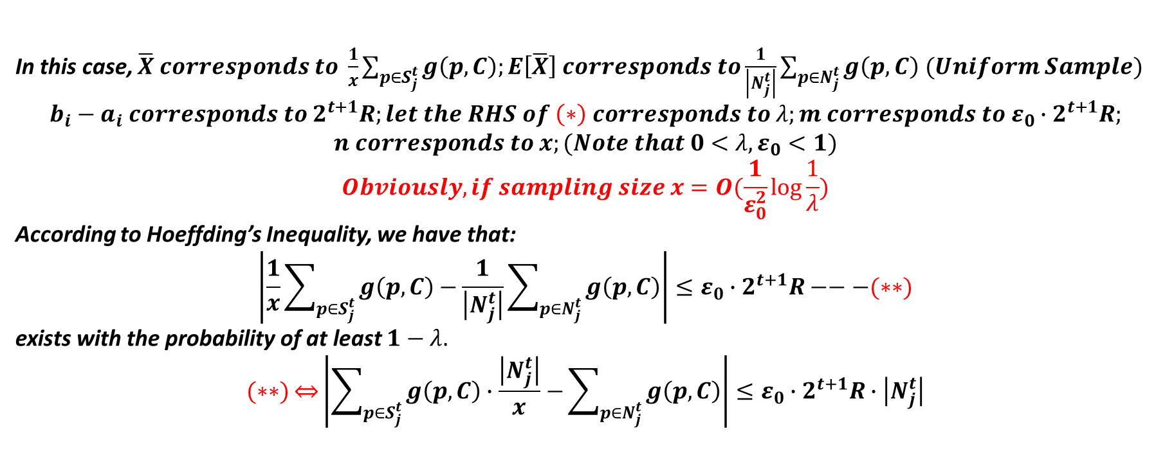
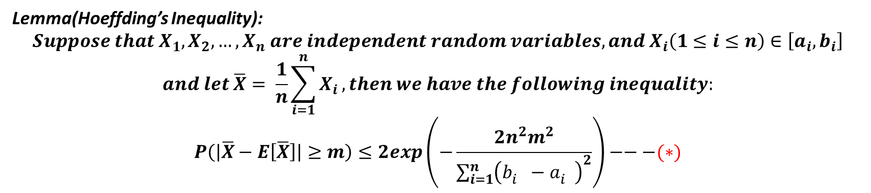
Lemma(Hoeffding’s Inequality):
$$Suppose that X_{1},X_{2},…,X_{n} are independent random variables, and X_{i}\left(1≤i≤n\right)∈\left[a_{i},b_{i}\right]$$
$$and let \overline{X}= \frac{1}{n}\sum_{i=1}^{n}{X_{i}},then we have the following inequality:$$
$$P\left(\left|\overline{X}−E\left[\overline{X}\right]\right|≥m\right)≤2exp\left(−\frac{2n^{2}m^{2}}{\sum_{i=1}^{n}{{\left(b_{i}^{}−a_{i}^{}\right)}^{2}}}\right)−−−(∗)$$
In this case, $\overline{X} corresponds to \frac{1}{x}\sum_{p∈S_{j}^{t}}{g\left(p,C\right);E\left[\overline{X}\right] corresponds to\frac{1}{\left|N_{j}^{t}\right|}\sum_{p∈N_{j}^{t}}{g\left(p,C\right) (Uniform Sample)} }$
$$b_{i}−a_{i} corresponds to 2^{t+1}R;let the RHS of \left(∗\right) corresponds to λ;m corresponds to ε_{0}∙2^{t+1}R;$$
$$n corresponds to x;(Note that 0<λ,ε_{0}<1)$$
$$Obviously, if sampling size x=O(\frac{1}{ε_{0}^{2}}\log{\frac{1}{λ}})$$
According to Hoeffding’s Inequality, we have that:
$$\left|\frac{1}{x}\sum_{p∈S_{j}^{t}}{g\left(p,C\right)−}\frac{1}{\left|N_{j}^{t}\right|}\sum_{p∈N_{j}^{t}}{g\left(p,C\right)}\right|≤ε_{0}∙2^{t+1}R−−−(∗∗)$$
exists with the probability of at least $1−λ.$
$$(∗∗)\overset{⇔}{}\left|\sum_{p∈S_{j}^{t}}{g\left(p,C\right)∙\frac{\left|N_{j}^{t}\right|}{x}−}\sum_{p∈N_{j}^{t}}{g\left(p,C\right)}\right|≤ε_{0}∙2^{t+1}R∙\left|N_{j}^{t}\right|$$

Slide 15
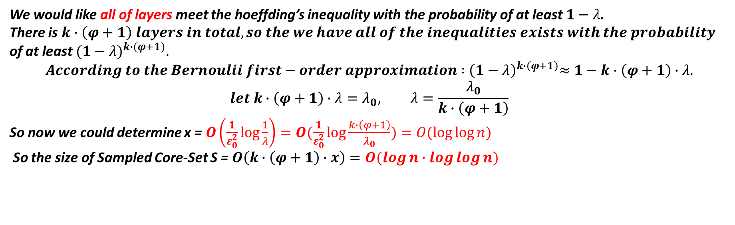
We would like all of layers meet the hoeffding’s inequality with the probability of at least $1−λ$.
There is $k∙\left(φ+1\right) layers in total, so the we have all of the inequalities exists with the probability$
of at least${ (1−λ)}^{k∙(φ+1)}.$
$$According to the Bernoulii first−order approximation :{ \left(1−λ\right)}^{k∙\left(φ+1\right)}≈1−k∙\left(φ+1\right)∙λ.$$
$$let k∙\left(φ+1\right)∙λ=λ_{0}, λ=\frac{λ_{0}}{k∙\left(φ+1\right)}$$
So now we could determine x = $O\left(\frac{1}{ε_{0}^{2}}\log{\frac{1}{λ}}\right)=O(\frac{1}{ε_{0}^{2}}\log{\frac{k∙\left(φ+1\right)}{λ_{0}})=O(\log{\log{n}})}$
So the size of Sampled Core-Set S = $O\left(k∙\left(φ+1\right)∙x\right)=O(\log{n}∙\log{\log{n)}}$

Slide 16
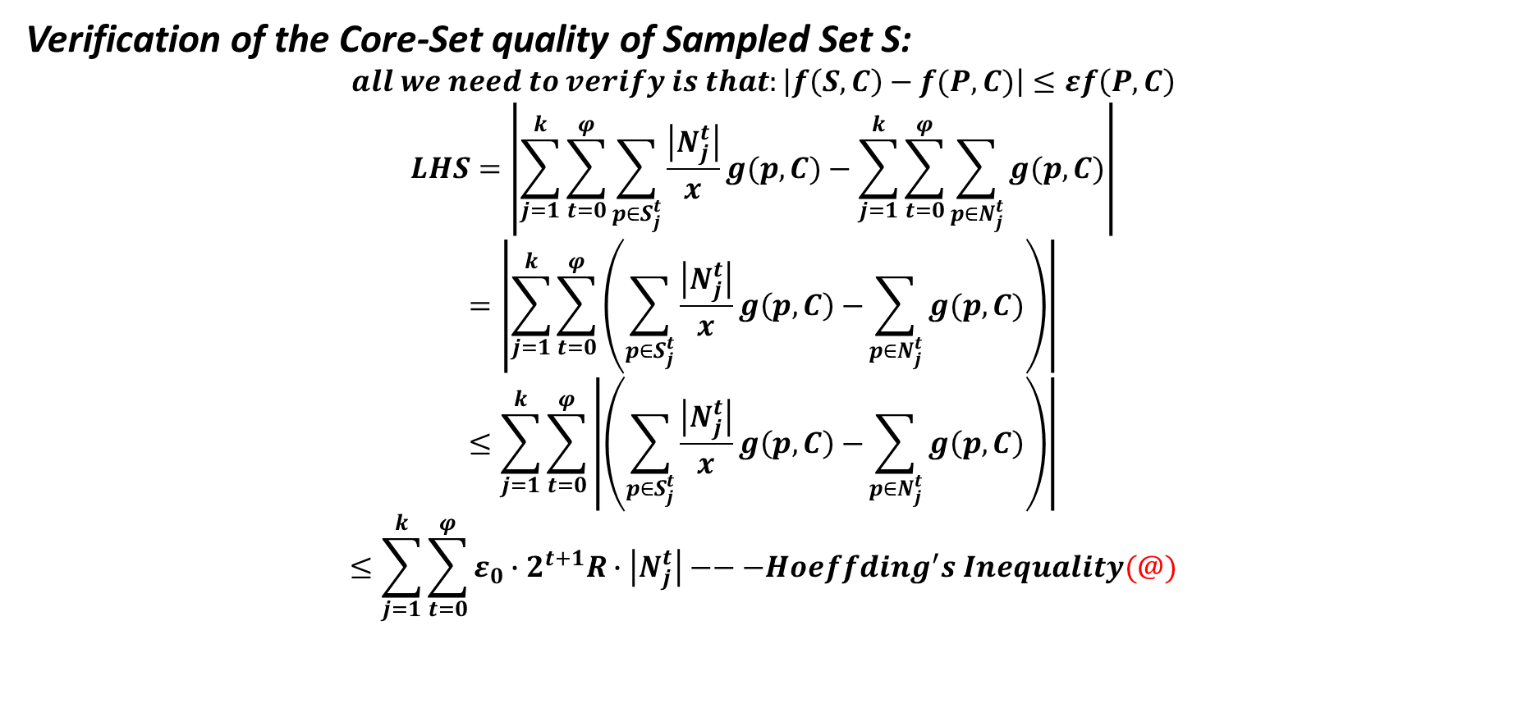
Verification of the Core-Set quality of Sampled Set S:
$$all we need to verify is that:\left|f\left(S,C\right)−f(P,C)\right|≤εf\left(P,C\right)$$
$$LHS=\left|\sum_{j=1}^{k}{\sum_{t=0}^{φ}{\sum_{p∈S_{j}^{t}}{\frac{\left|N_{j}^{t}\right|}{x}g(p,C)−\sum_{j=1}^{k}{\sum_{t=0}^{φ}{\sum_{p∈N_{j}^{t}}{g(p,C)}}}}}}\right|$$
$$=\left|\sum_{j=1}^{k}{\sum_{t=0}^{φ}{\left(\sum_{p∈S_{j}^{t}}{\frac{\left|N_{j}^{t}\right|}{x}g\left(p,C\right)−}\sum_{p∈N_{j}^{t}}{g(p,C)}\right)}}\right|$$
$$≤\sum_{j=1}^{k}{\sum_{t=0}^{φ}{\left|\left(\sum_{p∈S_{j}^{t}}{\frac{\left|N_{j}^{t}\right|}{x}g\left(p,C\right)−}\sum_{p∈N_{j}^{t}}{g\left(p,C\right)}\right)\right|}}$$
$$≤\sum_{j=1}^{k}{\sum_{t=0}^{φ}{ε_{0}∙2^{t+1}R∙\left|N_{j}^{t}\right|}}−−−Hoeffding^{′}s Inequality(@)$$

Slide 17
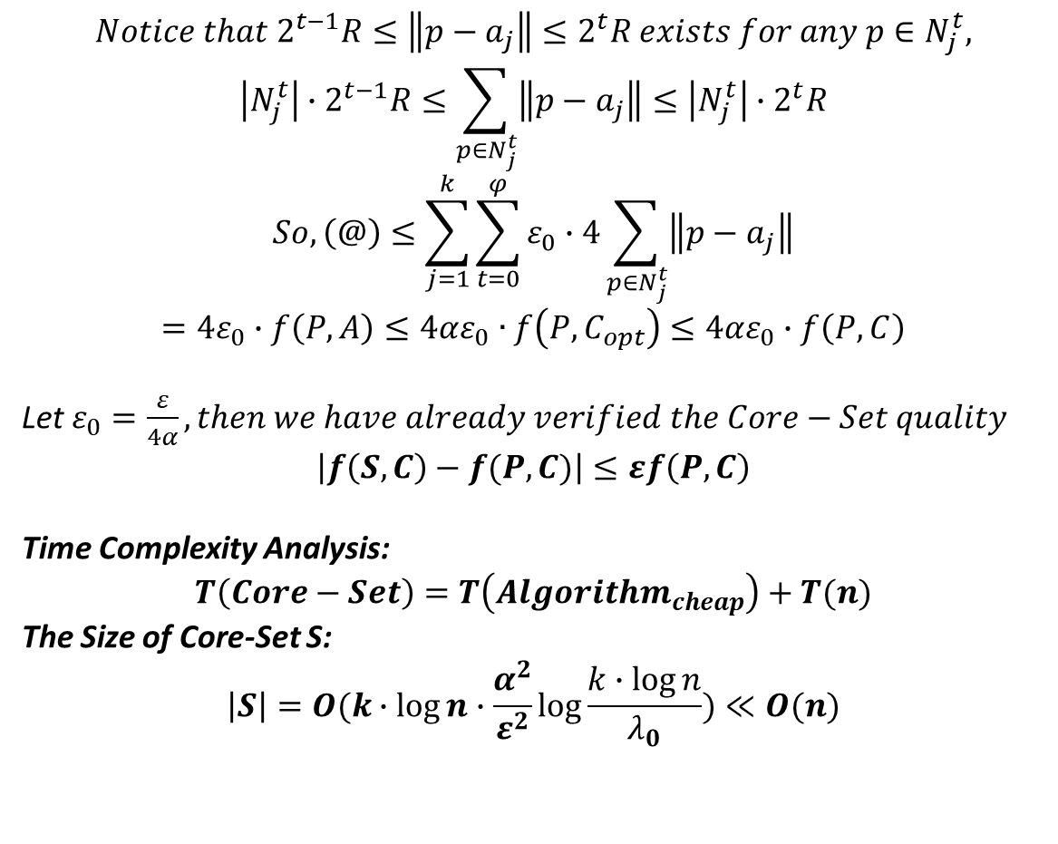

$$Notice that 2^{t−1}R≤\left\|p−a_{j}\right\|≤2^{t}R exists for any p∈N_{j}^{t},$$
$$\left|N_{j}^{t}\right|∙2^{t−1}R≤\sum_{p∈N_{j}^{t}}{\left\|p−a_{j}\right\|}≤\left|N_{j}^{t}\right|∙2^{t}R$$
$$So, \left(@\right)≤\sum_{j=1}^{k}{\sum_{t=0}^{φ}{ε_{0}∙4\sum_{p∈N_{j}^{t}}{\left\|p−a_{j}\right\|}}}$$
$$=4ε_{0}∙f\left(P,A\right)≤4αε_{0}∙f\left(P,C_{opt}\right)≤4αε_{0}∙f\left(P,C\right)$$
Let $ε_{0}=\frac{ε}{4α}, then we have already verified the Core−Set quality$
$$\left|f\left(S,C\right)−f(P,C)\right|≤εf\left(P,C\right)$$
Time Complexity Analysis:
$$T\left(Core−Set\right)=T\left(Algorithm_{cheap}\right)+T(n)$$
The Size of Core-Set S:
$$\left|S\right|=O(k∙\log{n}∙\frac{α^{2}}{ε^{2}}\log{\frac{k∙\log{n}}{λ_{0}}})≪O(n)$$
$$2^{t}R$$
$$2^{t−1}R$$
$$aj$$
$$p_{}$$

Slide 18
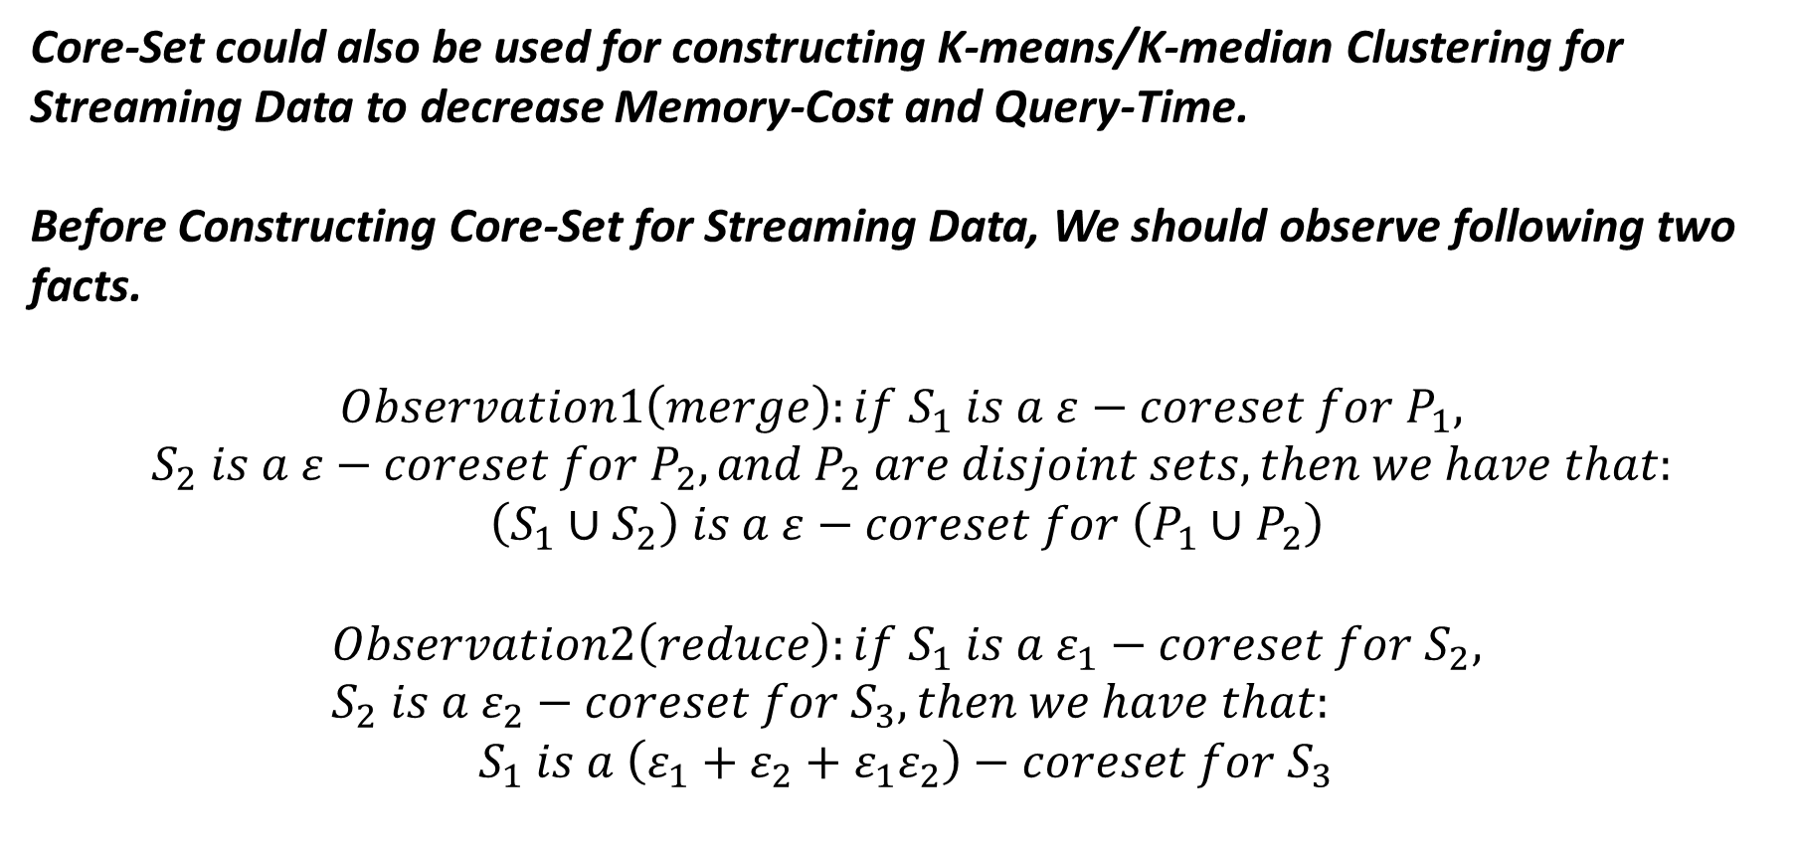
@3: Core-Set for Streaming Data
Core-Set could also be used for constructing K-means/K-median Clustering for Streaming Data to decrease Memory-Cost and Query-Time.
Before Constructing Core-Set for Streaming Data, We should observe following two facts.
$$Observation1\left(merge\right):if S_{1} is a ε−coreset for P_{1},$$
$${ S}_{2} is a ε−coreset for P_{2}, and P_{2} are disjoint sets, then we have that:$$
$$\left(S_{1}∪S_{2}\right) is a ε−coreset for \left(P_{1}∪P_{2}\right)$$
$$Observation2\left(reduce\right):if S_{1} is a ε_{1}−coreset for S_{2}, S_{2} is a ε_{2}−coreset for S_{3}, then we have that:$$
$$S_{1} is a \left(ε_{1}+ε_{2}+ε_{1}ε_{2}\right)−coreset for S_{3}$$
Observation2 is obviously according to the concept of coreset.
Observation1 is obviously for k-means/k-median situation.

Slide 19


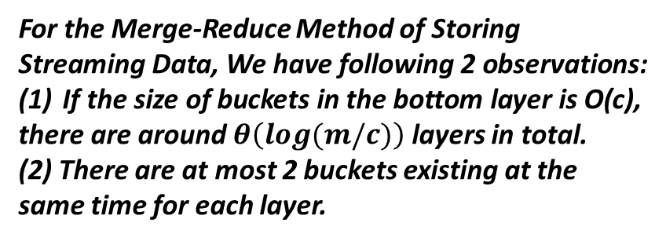

Construct Core-Set Tree(CT) for Streaming Data
Suppose that we do have m data in total.
$$\frac{m}{8}$$
$$\frac{m}{8}$$
$$\frac{m}{8}$$
$$\frac{m}{8}$$
$$\frac{m}{8}$$
$$\frac{m}{8}$$
$$\frac{m}{8}$$
$$\frac{m}{8}$$
m/4
m/4
m/4
m/4
m/2
m/2
For the Merge-Reduce Method of Storing Streaming Data, We have following 2 observations:
If the size of buckets in the bottom layer is O(c),
there are around $θ\left(log(m/c)\right)$ layers in total.
(2) There are at most 2 buckets existing at the same time for each layer.
m

Slide 20



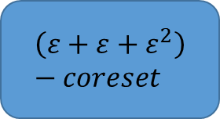



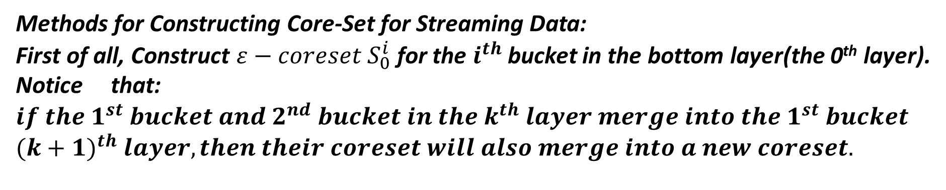


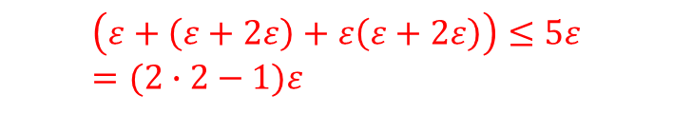
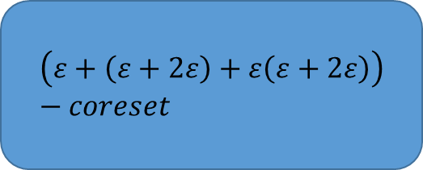

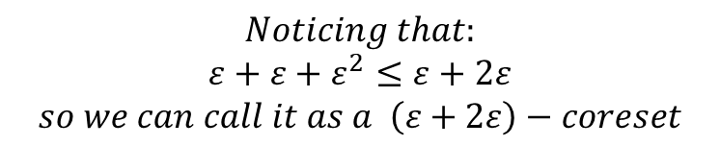

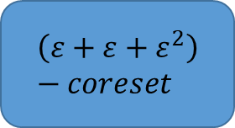


Methods for Constructing Core-Set for Streaming Data:
First of all, Construct $ε−coreset{ S}_{0}^{i}$for the $i^{th}$ bucket in the bottom layer(the 0th layer).
Notice that: $if {the 1}^{st} bucket and 2^{nd} bucket in the k^{th} layer merge into the 1^{st} bucket$
${(k+1)}^{th} layer, then their coreset will also merge into a new coreset.$
$$P_{0}$$
$$P_{1}$$
$$S_{0}$$
$$ε−coreset$$
$$S_{1}$$
$$ε−coreset$$
$$ε−coreset$$
$$ε−coreset$$
$$ε−coreset$$
$$S_{0}∪S_{1}$$
$$P_{0}∪P_{1}$$
$$\left(ε+ε+ε^{2}\right)−coreset$$
$$\left(ε+ε+ε^{2}\right)−coreset$$
Construct $ε−coreset S_{3} for S_{0}∪S_{1}$
$then S_{3} is a \left(ε+ε+ε^{2}\right)−coreset for P_{0}∪P_{1}$
$$Noticing that:$$
$$ε+ε+ε^{2}≤ε+2ε$$
$$so we can call it as a \left(ε+2ε\right)−coreset$$
$$\left(ε+\left(ε+2ε\right)+ε\left(ε+2ε\right)\right)−coreset$$
$$\left(ε+\left(ε+2ε\right)+ε\left(ε+2ε\right)\right)≤5ε=(2∙2−1)ε$$

Slide 21
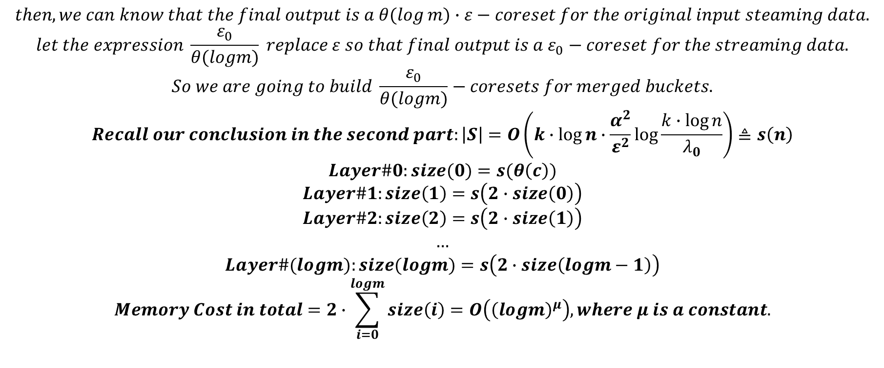
$$then, we can know that the final output is a θ(\log{m)∙ε}−coreset for the original input steaming data.$$
$$let the expression \frac{ε_{0}}{θ(logm)} replace ε so that final output is a ε_{0}−coreset for the streaming data.$$
$$So we are going to build \frac{ε_{0}}{θ(logm)}−coresets for merged buckets.$$
$$Recall our conclusion in the second part:\left|S\right|=O\left(k∙\log{n}∙\frac{α^{2}}{ε^{2}}\log{\frac{k∙\log{n}}{λ_{0}}}\right)≜s\left(n\right)$$
$$Layer\#0:size(0)=s(θ\left(c\right))$$
$$Layer\#1:size\left(1\right)=s\left(2∙size\left(0\right)\right)$$
$$Layer\#2:size\left(2\right)=s\left(2∙size\left(1\right)\right)$$
$$…$$
$$Layer\#(logm):size(logm)=s\left(2∙size\left(logm−1\right)\right)$$
$$Memory Cost in total=2∙\sum_{i=0}^{logm}{size\left(i\right)}=O\left({\left(logm\right)}^{μ}\right), where μ is a constant.$$
Warning of Math!!!

Slide 22
@4: More about Core-Set and References
References:
(1)Prof.Hu Ding’s Hand-Written Notes in Algorithm on Big Data-Course@2021SP.
(2)Sariel Har-Peled and Soham Mazumdar. On coresets for k-means and k-median clustering. STOC,2004
(3)Ke Chen. On coresets for k-median and k-means clustering in metric and Euclidean spaces and their applications. SIAM,2009
(4)Olivier, Mario, et.al. Practical Coreset Constructions for Machine Learning
(5)Hu Ding, Zixing Wang. Layered Sampling for Robust Optimization Problems. ICML,2020
(6)Yu Zhang, et.al. Streaming K-means Clustering with Fast Queries. IEEE-ICDE,2017
Tips:
If you want to get more precise results, please refer to (3)
If you want to put this Layered Sampling Method into other Machine Learning Problems(e.g. Linear Regression), please refer to (5)
If you want to know other methods(e.g. sensitivity and Importance Sampling), please refer to (4)
If you want to know more about the construction of coresets on streaming data, please refer to (6)

