Slide 1

Data Structures and Algorithm COMP9024 25T0
T13A & T14A lab
January 16th 2025 Thursday
Content of today:
1. singly linked list & doubly inked list
2. Assessment 1
3. Q & A
Joffrey Ji ( z5450981@ad.unsw.edu.au )

Slide 2
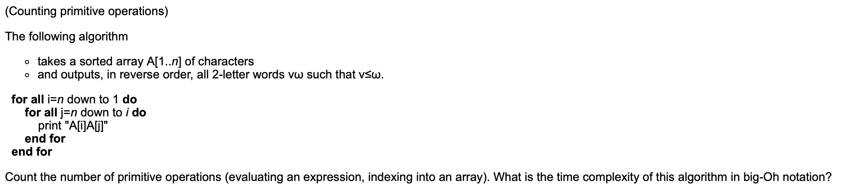
Question 2_1_1

Slide 5
Operation of Singly Linked List
1. Traversing a singly linked list
2. Append a node to the end of a list
3. Prepend a node to the start of a list
(head)
(head)
(head)
D
N
D
N
D
N
D
N
D
N
D
N
D
N
D
N
D
N
4. Inserting a new node to a specific position of a list
5. Deleting a node from a list
6. Updating a node in the list
(head)
(head)
(head)
D
N
D
N
D
N
D
N
D
N
D
N
D
N
D
N

Slide 6
Operation of Doubly Linked List
1. Traversing a doubly linked list
2. Append a node to the end of a list
3. Prepend a node to the start of a list
(head)
(head)
(head)
P
D
N
P
D
N
P
D
N
P
D
N
P
D
N
P
D
N
P
D
N
P
D
N
P
D
N
4. Inserting a new node to a specific position of a list
5. Deleting a node from a list
6. Updating a node in the list
(head)
(head)
(head)
P
D
N
P
D
N
P
D
N
P
D
N
P
D
N
P
D
N
P
D
N
P
D
N

Slide 7
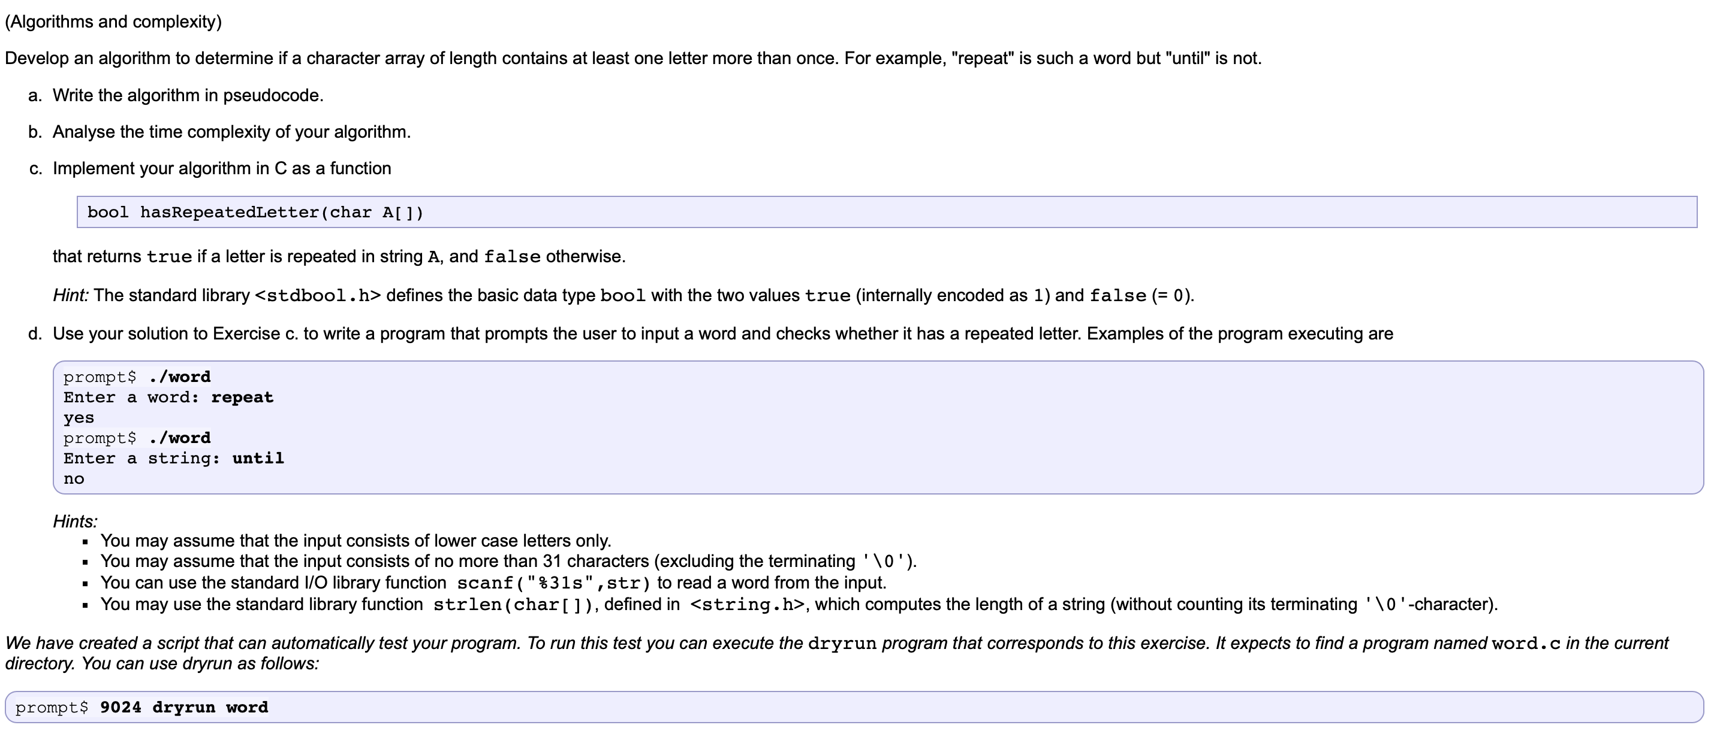
Question 3

Slide 8
Data Structures and Algorithm COMP9024 25T0
T13A & T14A lab
January 16th 2025 Thursday
~Questions and Suggestions~
Thanks for listening
Joffrey Ji ( z5450981@ad.unsw.edu.au )

