Slide 1
JogAmp Fast Media & Processing
Across devices – Desktop & Mobile
SIGGRAPH 2013 – Anaheim
July 24, 2013
Dominik Ströhlein
Erik Brayet
Jens Hohmuth
Julien Gouesse
Mark Raynsford
Alan Sambol
Harvey Harrison
Rami Santina
Sven Gothel
Wade Walker
Xerxes Ranby

Slide 2
10 Years ...
2003-06-06 GlueGen, JOGL, JOAL
2008-04-30 JOGL Release 1.1.1
2009-07-24 JOCL
2009-11-09 Independent Project
2010-05-07 JogAmp Project Name, Server, ..
2010-11-23 JogAmp RC 2.0-rc1
2013-07-17 JogAmp Release 2.0.2

Slide 3
… used by
GLG2D, ..

Slide 4
GLG2D
Problem:
  Traditional Java2D uses a CPU based rendering engine.
  Modern Java2D uses a hidden GPU based rendering engine.
Replaces CPU Java2D rendering engine with an painting using OpenGL.
Accelerate the most common ways that applications use Java2D drawing.
Uses the latest JogAmp JOGL libraries for the OpenGL implementation.
GLG2D

Slide 5
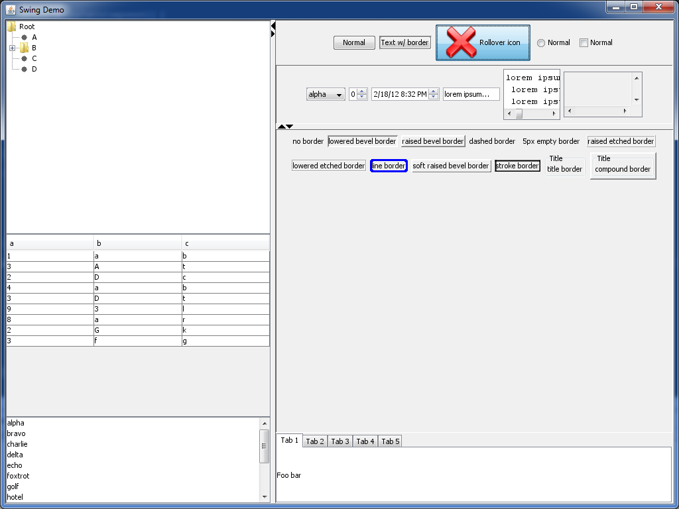
GLG2D
Swing behaves exactly as before, except that it' being painted to an OpenGL canvas instead.
GLG2D

Slide 6

GLG2D
– More Information
Project Pages:
  Github:
  https://github.com/brandonborkholder/glg2d
  Homepage: http://brandonborkholder.github.io/glg2d/
GLG2D

Slide 7
Java3D – I'm not Dead!
Work underway as early as 1997
1.5.2 released Feb2008, GPLv2 w/ classpath
Abandoned in 2008 for JavaFX...coming soon?
Native OpenGL, D3D backends and Jogl 1.1
1.6 devel branch in SVN....with a handful of fixes – vecmath, j3dcore, j3dutils but no release
No longer functions on contemporary OSX
Java3D

Slide 8
Jogl2 Port Feb 2012
Julien Gouesse did initial work
August Lammersdorf gave invaluable advice
Harvey Harrison current victim maintainer
Pure Java project, all native backends removed
Jogl2 is the only supported backend
Assume Java6 minimum (remove Java 1.3 compat code – not kidding)
Java3D

Slide 9
The Future
Very mature API
NO API CHANGES
Drop in replacement for 1.5.2
Support existing users, advise others to start with something more 'alive'
1.6.0-final when contemporary OSX regressions are fixed
Java3D

Slide 10
RTFS
Harvey Harrison <harvey.harrison@gmail.com>
https://github.com/hharrison/vecmath
https://github.com/hharrison/j3dcore
https://github.com/hharrison/j3dutils
http://jogamp.org/deployment/java3d/
http://forum.jogamp.org
Java3D

Slide 11
Sweethome3d
http://www.sweethome3d.com
Used for the applet version on Java7/MacOSX
Mostly a drop-in replacement
Wider use expected after Java7u40
Java3D

Slide 12
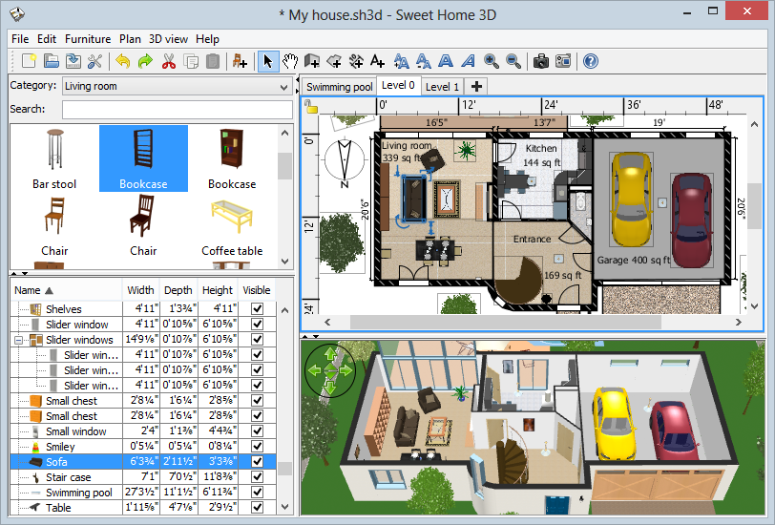
Sweethome3d
Java3D

Slide 13
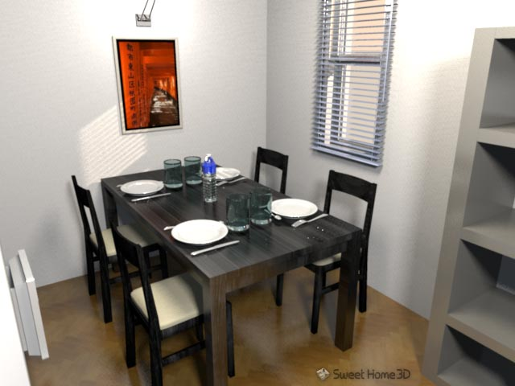
Sweethome3d
Java3D

Slide 14
VZome
http://vzome.com/
Worked well out of the box
Worked with webstart even with recent JVM updates
Java3D

Slide 15
VZome
Java3D

Slide 16
XTour
Planning software for VIMS instrument on the Cassini Probe orbiting Saturn
Used to plan observation, visualize likely results from a given command stream
Client-Server solution
Java3D

Slide 17
XTour
Updated Java3d removed need for installation on client machines
Worked out of the box, drop in replacement
Avoided rewriting application
Java3D

Slide 18
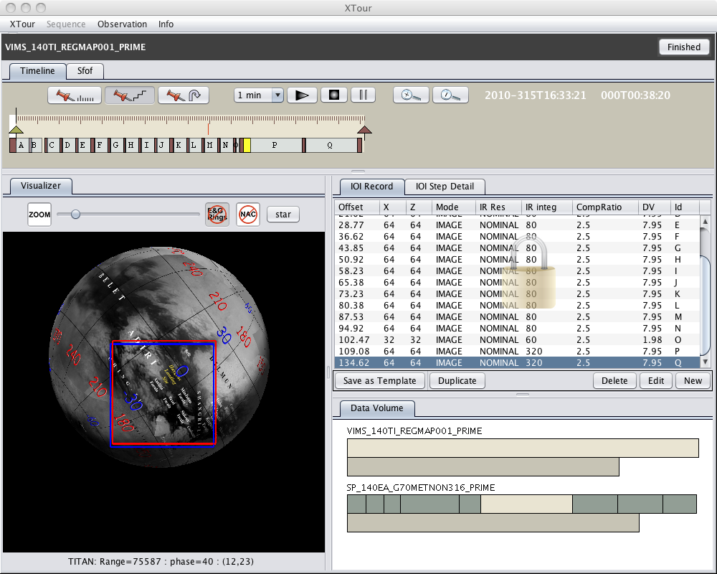
XTour
Java3D

Slide 19
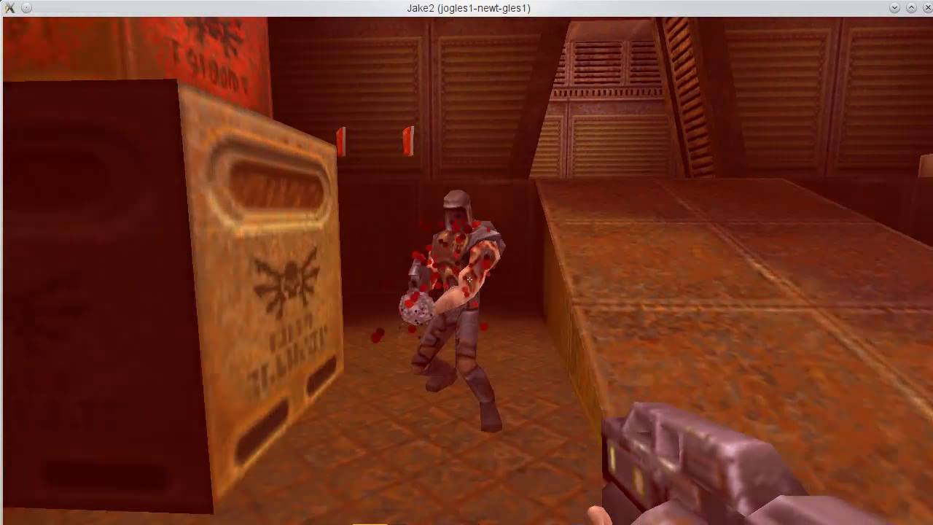
Jake2
FFP on ES2 hardware
JOGL1 to JOGL2 porting example
JOAL / JOGL testbed
Deployment (NApplet / Webstart)
Jake2

Slide 20

Cross-platform API for game and real-time application development.
Flexible workflow, NOT one size fit all.
Availability on desktop and mobile utilizing the JogAmp backend.
Released under the Apache 2.0 license.

Slide 21
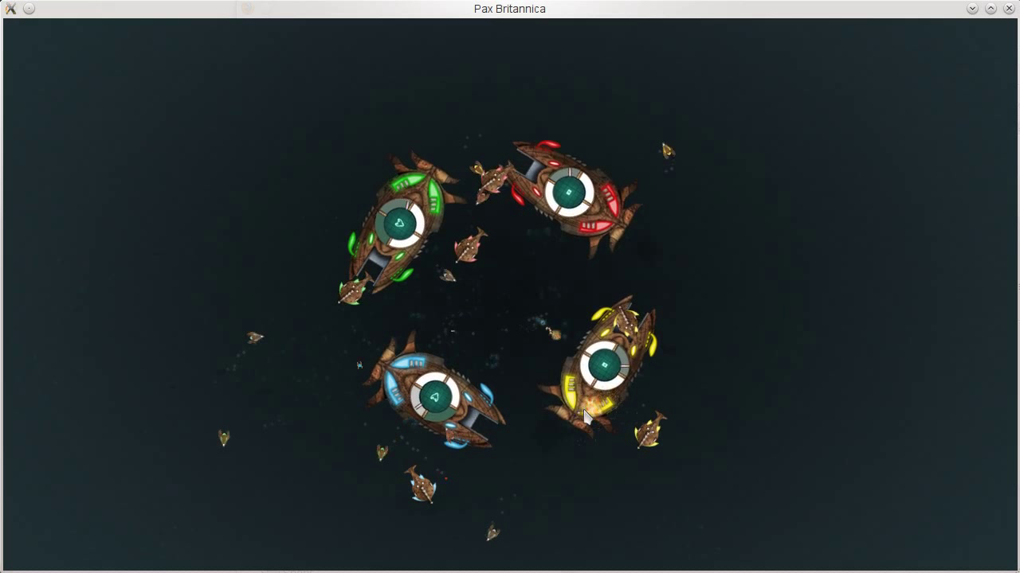

Slide 22
– More Information
Project Pages:
  Github:
  https://github.com/libgdx/libgdx
  Homepage: http://libgdx.badlogicgames.com/
  Twitter:https://twitter.com/badlogicgames
  Blog:
  http://www.badlogicgames.com/

Slide 23

Project Pages:
  Homepage: http://jmonkeyengine.org

Slide 24


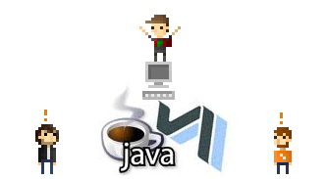
Project Pages:
  Homepage: http://jmonkeyengine.org

Slide 25
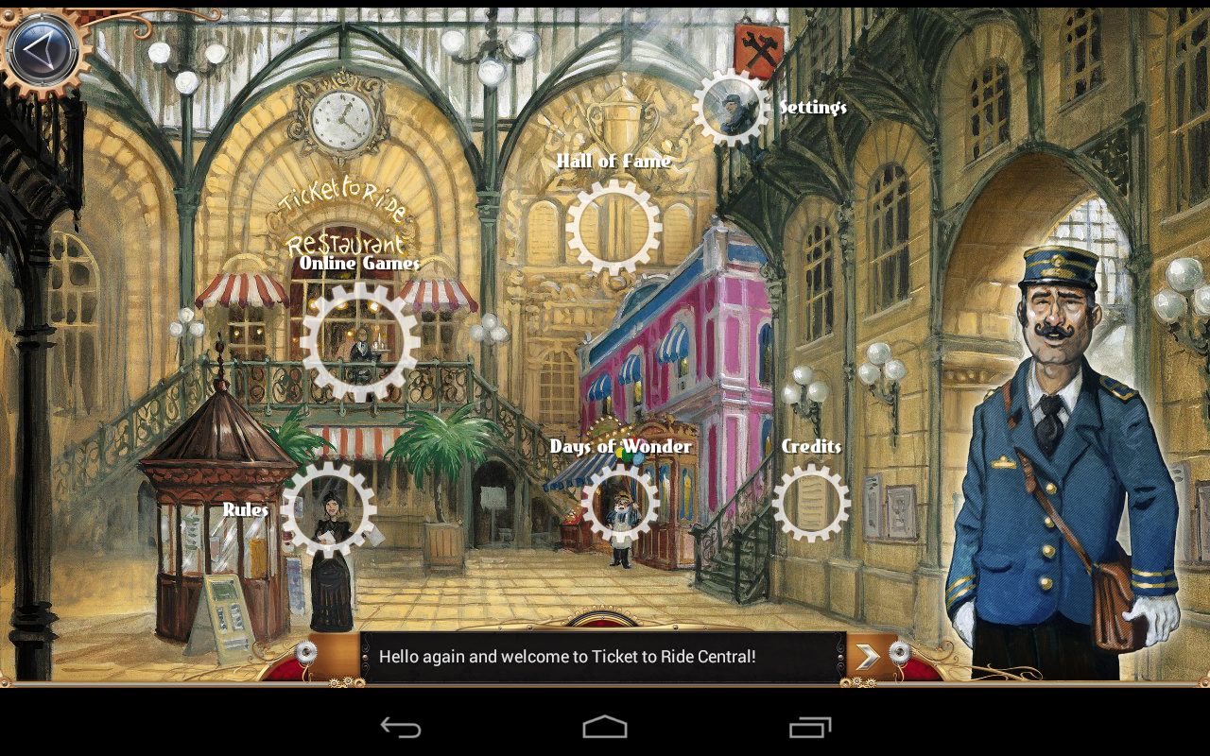
Ticket to Ride

Slide 26
Ticket to Ride
Video game adapted from the board game
Solo game offline
Multiplayers game online
  Client and server written in Java
Available as Java applet, plain installer, via Steam (Windows, MacOS, Linux), via Google Play, via Amazon App store

Slide 27
Ticket to Ride
Java + JOGL + JOAL
Runs (almost) everywhere:
  Applet (no JOGL, but code shared with other clients)
  Desktop (Windows, MacOS, Linux)
  Mobile & tablets (Android) with a few platform-specific optimizations like native image loading
Passed Google Android Validation

Slide 28

Java Library in Development since 2007
  Open source at Sourceforge since April 2008
  Several major releases so far (latest: 1.3.3)
  BSD-License
Use it to build interactive user interfaces for games and other interactive applications
  Can be extended and styled easily and provides many visual effects
  However, it is different from AWT/Swing or your other usual GUI framework

Slide 29
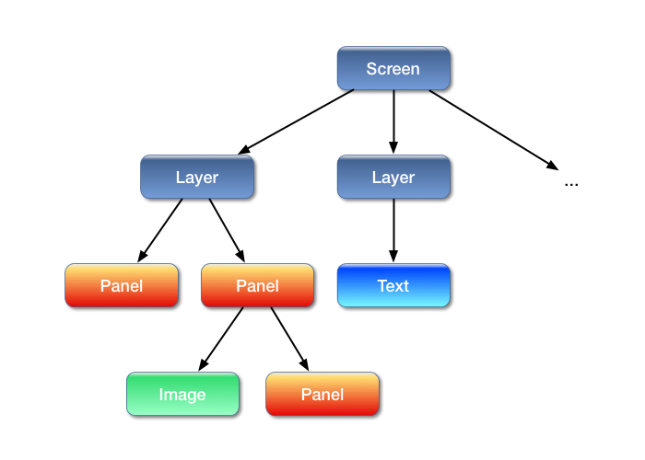
Think of Nifty as a scenegraph

Slide 30
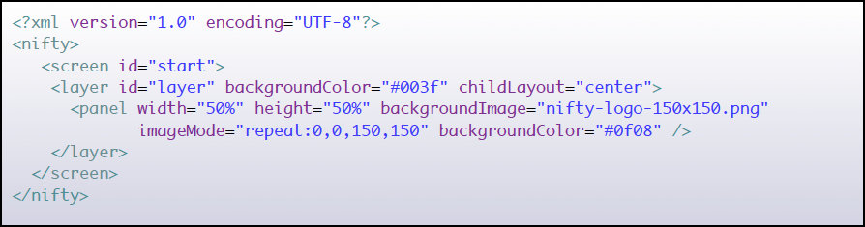
Scenegraph is stored in XML
Can be dynamically modified at runtime

Slide 31
Existing adapters to several libaries available:
  JOGL, LWJGL, jMonkeyEngine, Slick2D, Java2D
  Need a different one? a SPI (Service Provider Interface) is available and can be easily implemented by yourself!
  Seamless integration with your rendering workflow
General use-cases for Nifty:
  Interactive Menus and Displays
  Game Option screens
  In-Game HUD Displays
  Anything that displays icons or text with Java and wants to do that in a somewhat nifty way ;)

Slide 32
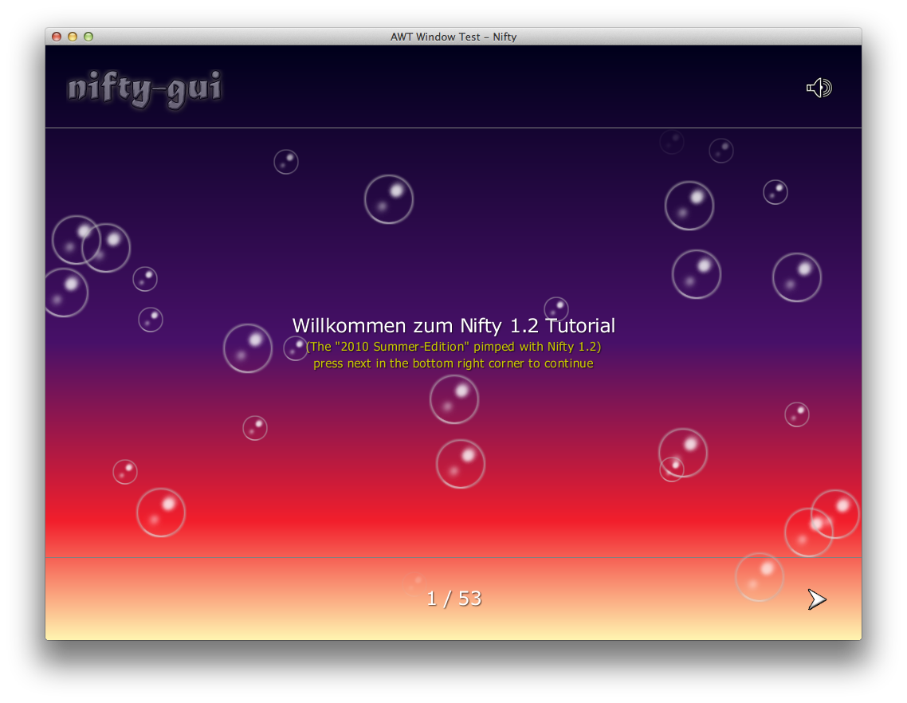
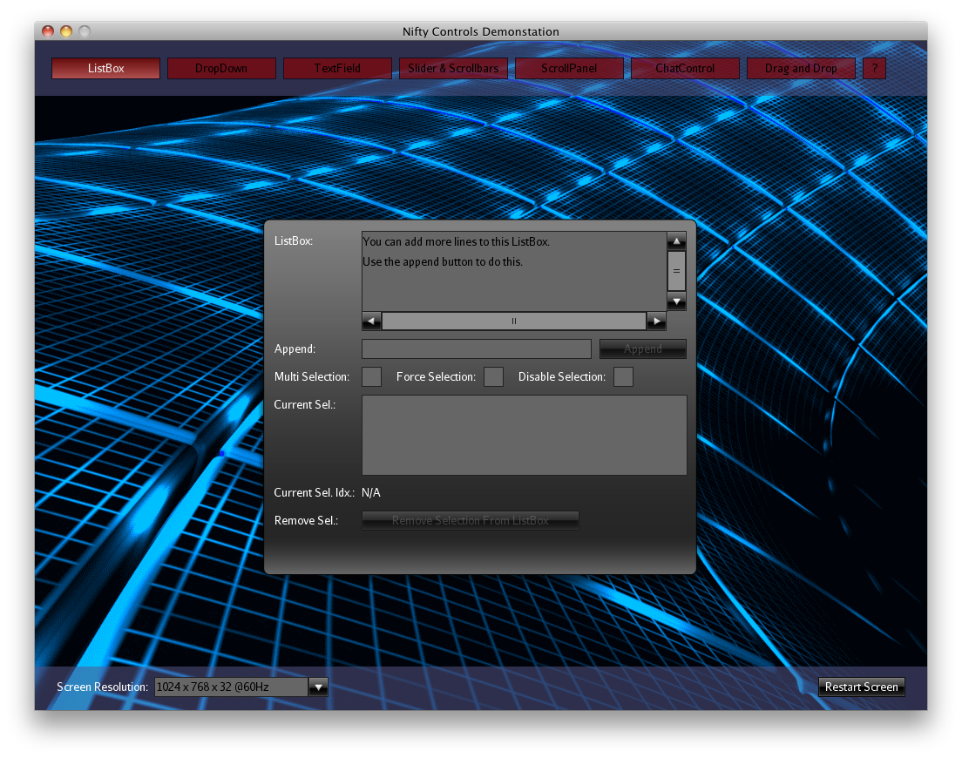

Slide 33

– More Information
Project Pages:
  Github:
  https://github.com/void256/nifty-gui
  Sourceforge: https://sourceforge.net/projects/nifty-gui/
  Twitter:
  https://twitter.com/niftygui
  Blog:
  http://nifty-gui.lessvoid.com/

Slide 34
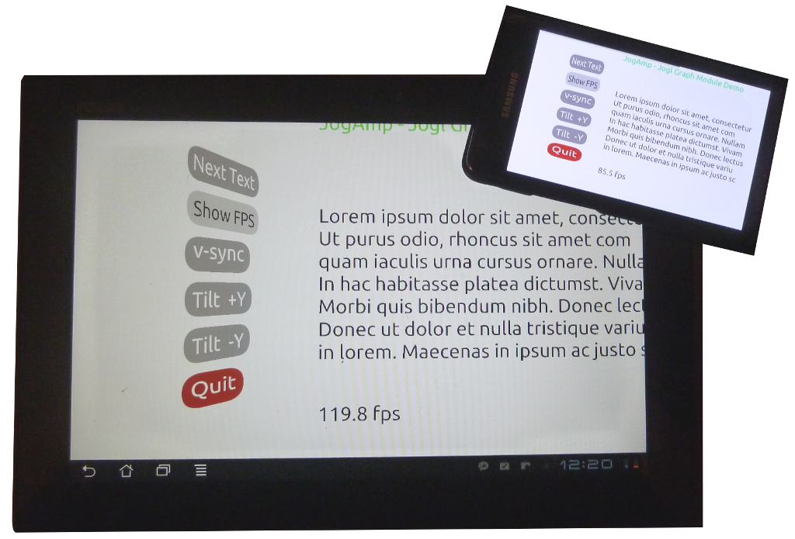
Graph API
Resolution Independent
Shapes and Curves
Graph

Slide 35

Resolution Independent Curve Rendering API
Based on Paper:
  R Santina, “Resolution Independent NURBS Curve Rendering using Programmable Graphics Pipeline”, presented in GraphiCon2011.
NOT Loop/Blinn
Patent Free
Can Render Bezier, Bsplines, NURBS
Graph

Slide 36
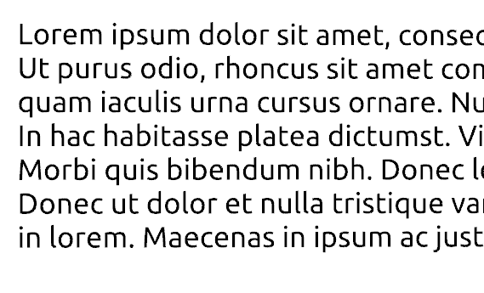

Resolution Independent Curve Rendering API
Why?
  Resolution Independent Text Rendering
  GPU based - Fast
  Seamless integration into Renderer (Scenegraph,...)
  New User Interface – across devices
  http://jogamp.org/deployment/jogamp-current/jogl-test-applets.html
  http://www.youtube.com/watch?v=Rqsu46ifMaw
Graph

Slide 37
GPU based Resolution Independent UI
Abstracted from the windowing toolkit
Support multithreading
Seamless integration into
  A native window (HUD)
  A custom Scenegraph (2D plane within 3D)
High Quality rendering
Super Fast
Graph

Slide 38
GPU based Resolution Independent UI
Abstracted from the windowing toolkit
Support multithreading
Seamless integration into
  A native window (HUD)
  A custom Scenegraph (2D plane within 3D)
High Quality rendering
Super Fast
Graph

Slide 39

MyHMI
Primary guidance in MyHMI framework development:
  vehicle infotainment and instrument cluster applications
extensions of those applications
  automation and process control industries

Slide 40
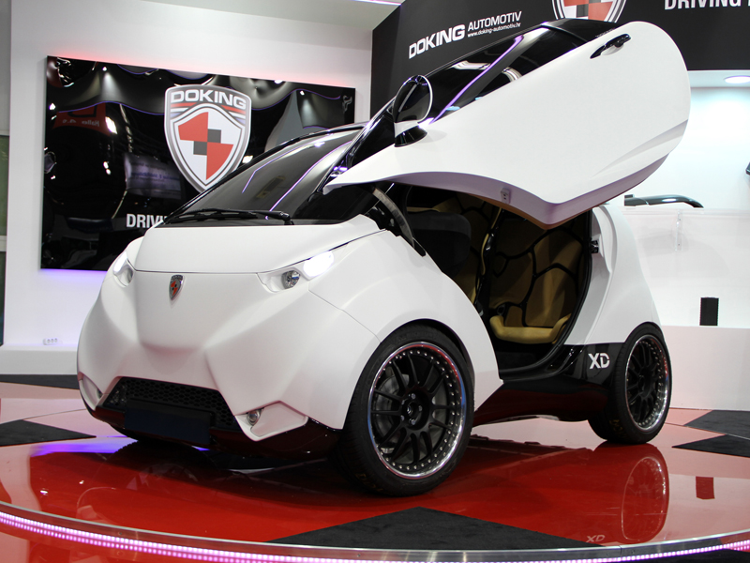
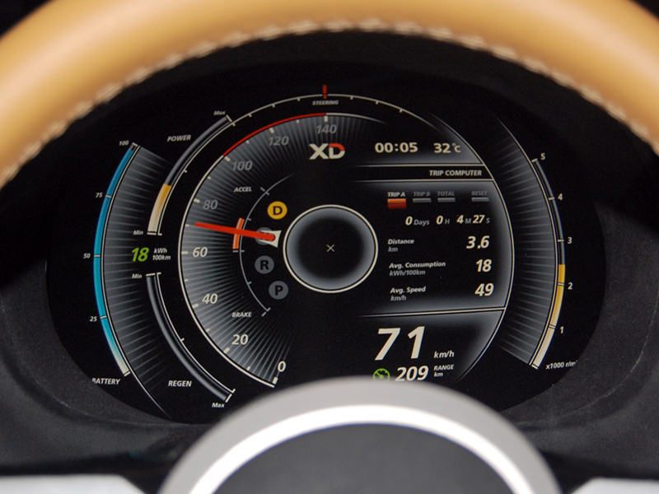
Beginnings of MyHMI development

Slide 41
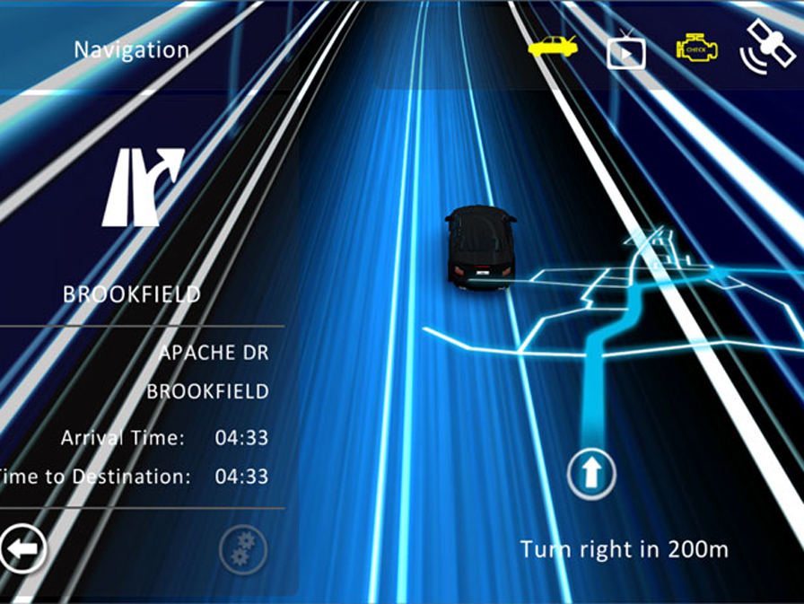
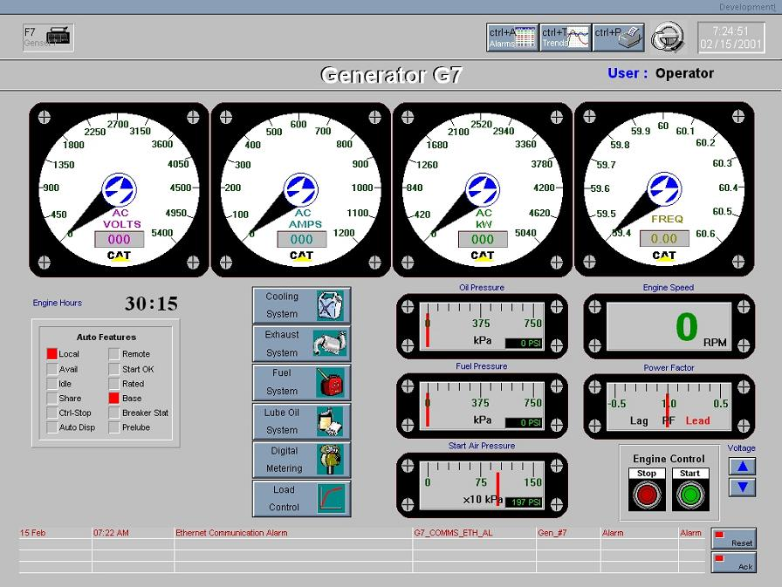
What HMI trends resulted in?
Deep gap in HMIs market:
Graphically expressive HMI solutions, with propreritary communication
and processing mechanisms
Solutions with vast processing and communication possibilities, but plain graphics

Slide 42
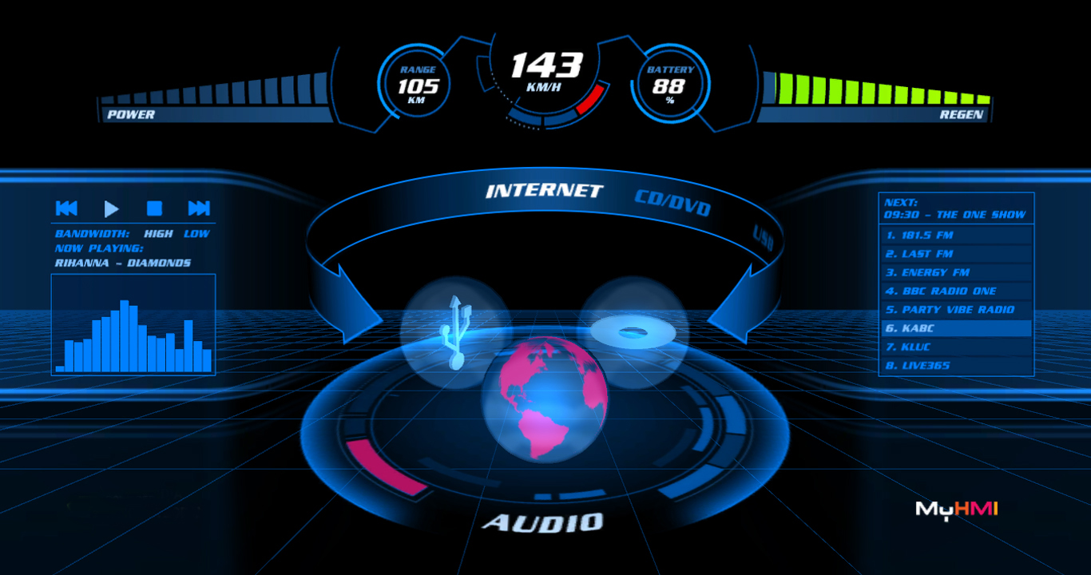
Bridging the gap

Slide 43
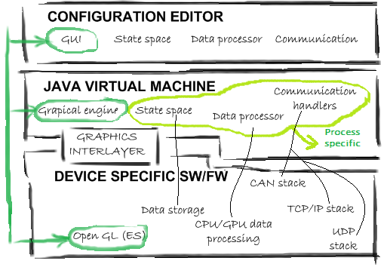
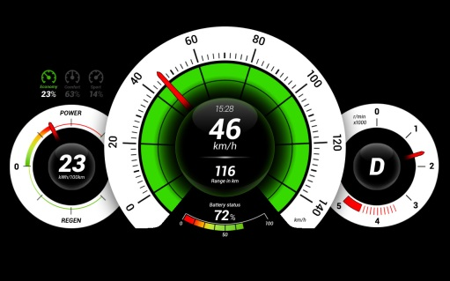
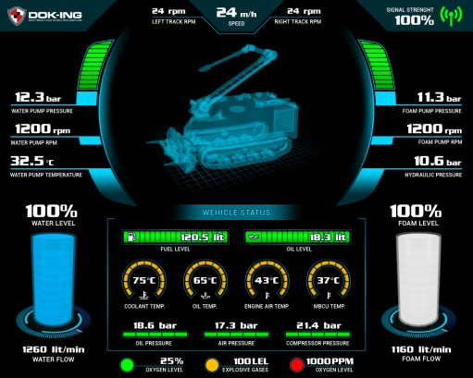
MyHMI & Jogamp
Designed as a multiplatform framework
  Java → CPU agnostic development
  Jogamp's Jogl → GPU agnostic development

Slide 44
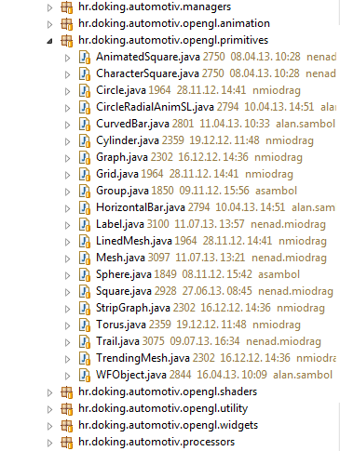
MyHMI framework
Modules
  Display (widgets, primitives, animations)
  Communication (UDP, TCP/IP, CAN, serial...)
  Data processing

Slide 45
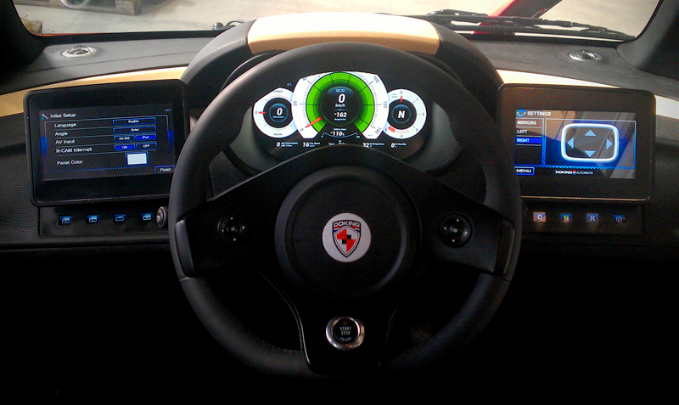
MyHMI approvals in industries
LOOX instrument cluster

Slide 46
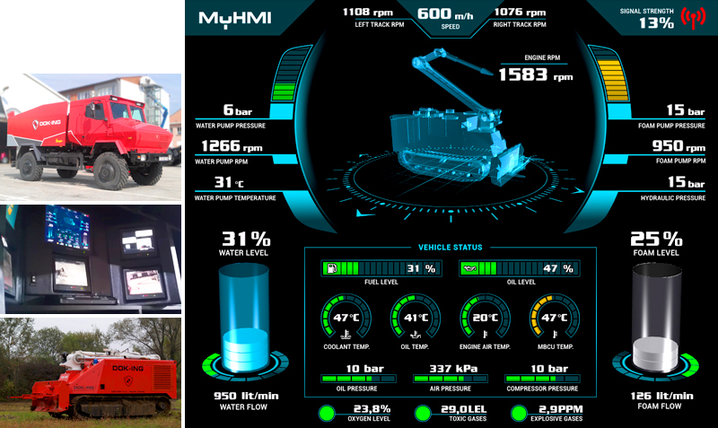
MyHMI approvals in industries
UNIMOG control center

Slide 47
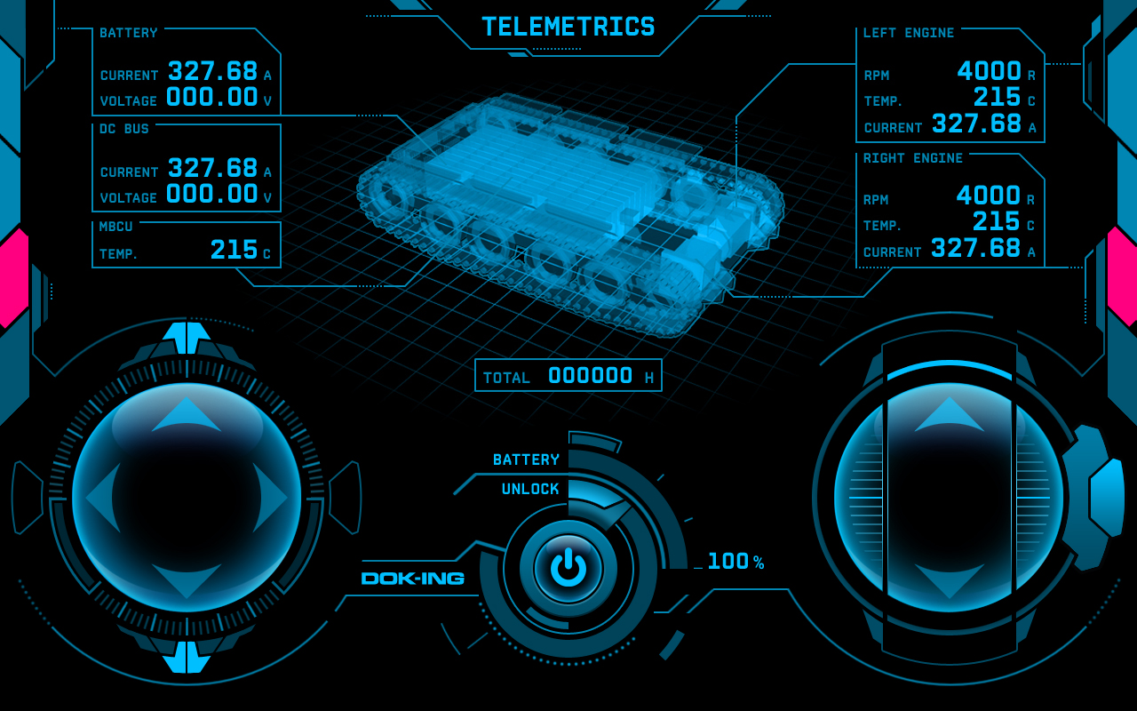
MyHMI approvals in industries
SCADA / remote control

Slide 48
jspatial
http://io7m.com/software/jspatial
code@io7m.com
jspatial

Slide 49
Why?
Computers lack spatial awareness!
Example: For efficiency reasons, when implementing collision detection for physical simulations, we want to limit comparisons between pairs of bodies to those that are in close proximity to each other.
By subdividing the world into small spaces, and only comparing the pairs of bodies within those spaces, we reduce the number of necessary comparisons by orders of magnitude.

Slide 50
Trees

Slide 51
Trees
The jspatial package offers multiple implementations of quadtree and octtree data structures.

Slide 52
Quadtrees
Quadtrees recursively divide a 2D space into quadrants.
A quadtree initially contains one cell and is divided into smaller cells upon insertion of an arbitrarily-sized object.

Slide 53
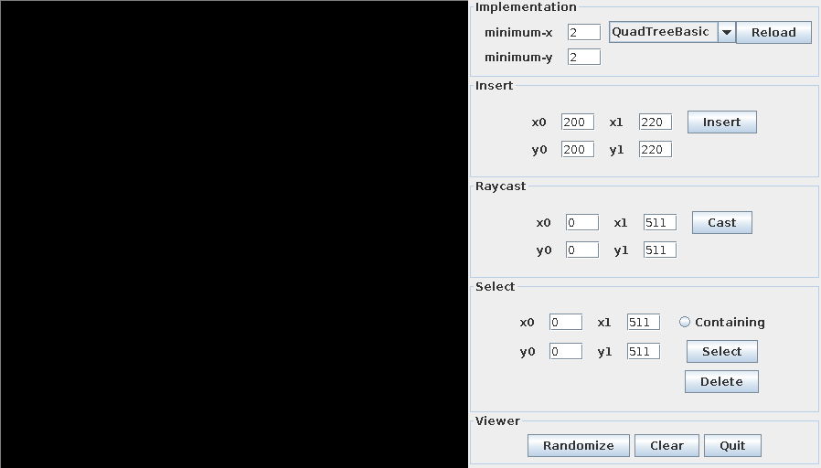
Quadtrees

Slide 54
Quadtrees
Note how the space has been divided into quads...

Slide 55
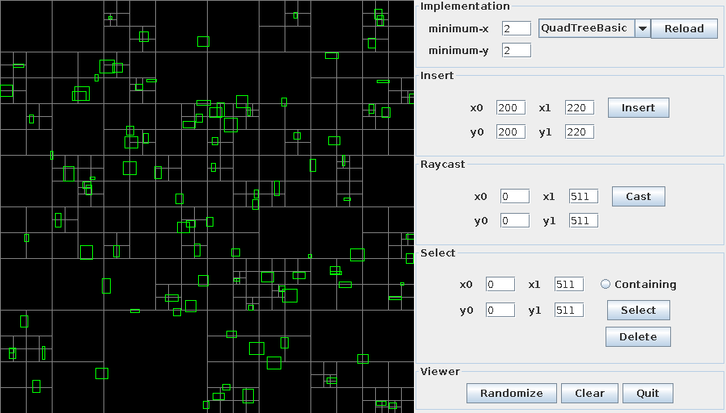
Quadtrees
Object insertion is fast and requires no preprocessing

Slide 56
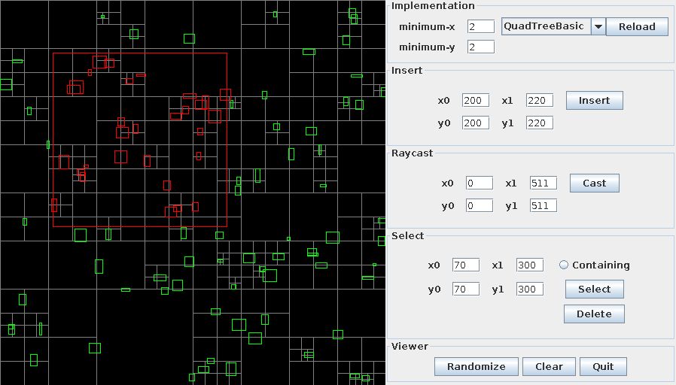
Quadtrees
Determining which objects are contained or overlapped by an area is efficient

Slide 57
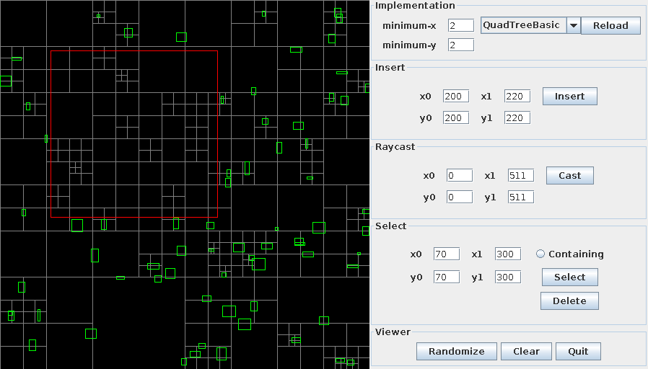
Quadtrees
Objects may be removed from the tree efficiently

Slide 58
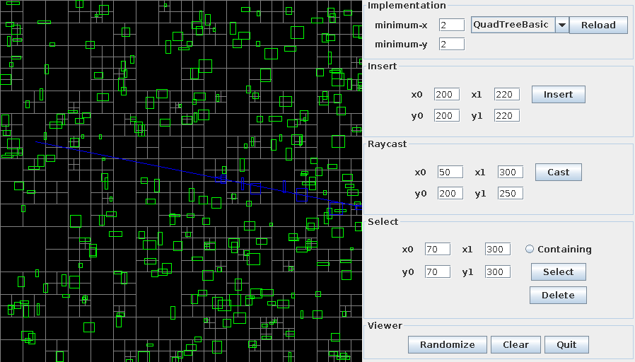
Quadtrees
Ray casting queries are supported

Slide 59
Quadtrees
Multiple variations on the basic quadtree algorithm are included.

Slide 60
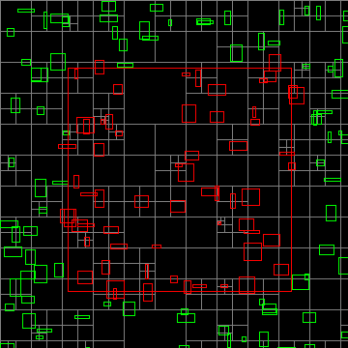
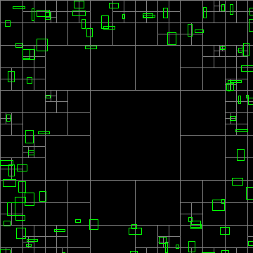
QuadTreePrune
The QuadTreePrune algorithm aggressively removes empty tree cells

Slide 61
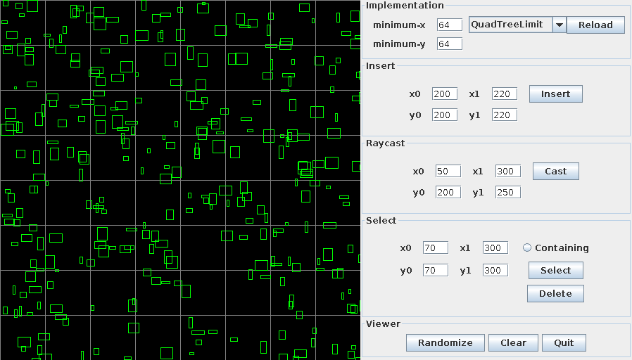
QuadTreeLimit
The QuadTreeLimit algorithm places a lower bound on the size of cells

Slide 62
Quadtrees
The jspatial package does not pretend to know which algorithm is right for you.
The implementations share common interface types, meaning that developers can choose from any of the implementations without needing to modify code.

Slide 63
Octtrees
Interestingly, the Quadtree algorithms generalize to three dimensions.

Slide 64
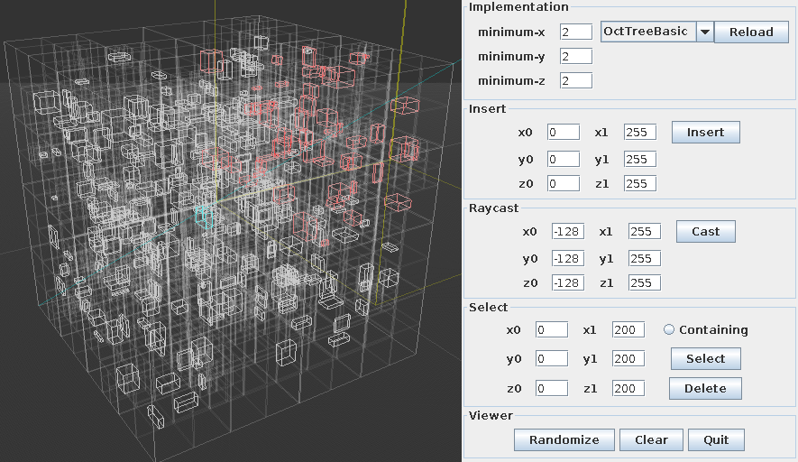
Octtrees
All of the previous queries are supported in three dimensions

Slide 65
Octtrees
As with quadtrees, the jspatial package does not pretend to know which algorithm is right for you.
The implementations share common interface types, meaning that developers can choose from any of the implementations without needing to modify code.
Deja vu!

Slide 66
Usage
Have your object implement either of the QuadTreeMember or OctTreeMember interfaces (or both, if you're that way inclined).
The interfaces consist of a pair of trivial functions that request the axis-aligned bounds of the object.

Slide 67
Usage
Initialize a quadtree or octtree using the available constructors.
Insert your objects into a tree.
Query the tree.
You're done!

Slide 68
Usage
The package comes with a tutorial, API documentation, and some example viewer programs. The viewers have been used to provide the screenshots in this presentation.
The example viewers use Swing and JOGL (http://jogamp.org/) for rendering, but the jspatial package itself is completely renderering-system-agnostic.
Yes, the package works on Android!

Slide 69
Engineering
Of course, all of the features of jspatial package would be meaningless if developers could not use the software due to poor engineering practices on behalf of the author.
So, jspatial works well because...

Slide 70
Engineering
Minimalism
    Packages on io7m.com strive to do one thing well, and nothing more.
Type safety
  All packages on io7m.com strive to use the type-checker to eliminate as many classes of bugs as possible, and to enforce program invariants statically.
The jspatial package is no exception.

Slide 71
Engineering
Ease of use
  All packages on io7m.com strive to be easy to use in terms of APIs.
  Interfaces are designed to statically disallow incorrect usage.
The jspatial package is no exception.

Slide 72
Engineering
Well-documented
  All packages on io7m.com come with complete documentation, including tutorials and generated JavaDoc.
The jspatial package is no exception.

Slide 73
Engineering
Well-tested
  All packages on io7m.com come with extensive and exhaustive batteries of unit tests.
The jspatial package is no exception.
(Currently, the package has 96.5% test coverage of all instructions and branches).

Slide 74
Engineering
Well-versioned
  All packages on io7m.com use semantic versioning (http://semver.org/), meaning that you can trust that APIs will not change underneath your application without warning, and that all backwards-incompatible changes are clearly indicated.
The jspatial package is no exception.

Slide 75
Engineering
Well-supported
  The author offers direct support from #io7m on Freenode (http://freenode.net/).
Please note that I do need to sleep occasionally. Be patient!

Slide 76
Engineering
Permissively licensed
  All packages on io7m.com are licensed under the ISC license – the shortest and most liberal BSD-type license in current use. Use in closed and/or commercial programs is permitted and encouraged.
The jspatial package is no exception.
Copyright © 2013 <code@io7m.com> http://io7m.com
Permission to use, copy, modify, and/or distribute this software for any
purpose with or without fee is hereby granted, provided that the above
copyright notice and this permission notice appear in all copies.
THE SOFTWARE IS PROVIDED "AS IS" AND THE AUTHOR DISCLAIMS ALL WARRANTIES
WITH REGARD TO THIS SOFTWARE INCLUDING ALL IMPLIED WARRANTIES OF
MERCHANTABILITY AND FITNESS. IN NO EVENT SHALL THE AUTHOR BE LIABLE FOR
ANY SPECIAL, DIRECT, INDIRECT, OR CONSEQUENTIAL DAMAGES OR ANY DAMAGES
WHATSOEVER RESULTING FROM LOSS OF USE, DATA OR PROFITS, WHETHER IN AN
ACTION OF CONTRACT, NEGLIGENCE OR OTHER TORTIOUS ACTION, ARISING OUT OF
OR IN CONNECTION WITH THE USE OR PERFORMANCE OF THIS SOFTWARE.

Slide 77
Engineering
Easily deployed
  All packages on io7m.com are deployed to Maven Central (http://search.maven.org/) and can therefore be used instantly with any build system that uses Maven packages.
  Compiled packages, source code, and documentation are also available from their respective project pages on io7m.com.
  Source code is managed by the Fossil SCM (http://fossil-scm.org/).

Slide 78
Thanks!
Mark Raynsford
http://io7m.com/
code@io7m.com
PGP: 0x60824220

Slide 79
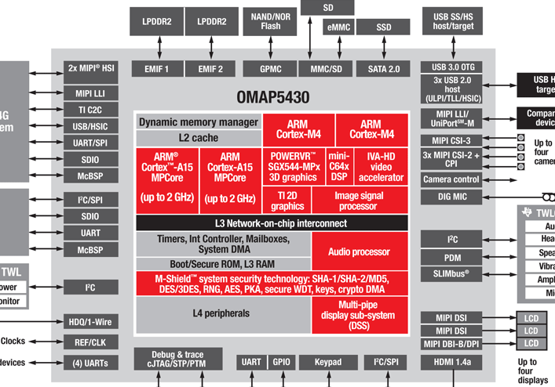
General Love
Agnostic CPU for general purpose

Slide 80
Dedicated Love
Fast Discrete Graphics, Audio, Video ...

Slide 81
General Love
Dedicated Love
Intel x32, amd64
ARM 32 and 64 bit
SuperH
PowerPC
Sparc
MIPS
Immaginative Technologies PowerVR SGX
ARM Mali
Qualcomm Andreno
Vivante
BCM VideoCore
Nvidia Tegra
Special DSPs (Audio/Video)
Heterogenous CPUs (big.LITTLE)
Java
OpenGL, OpenCL, OpenAL, ..

Slide 82
Practical Love
JOGAMP makes the bare metal loveable
  No restrictions to original API
  Platform neutrality
  Hard to use for domain specific problems
    CAD, Games, ..
Domain Specific APIs close the Circle
  SciLab, Java3D, Ardor3D, jME3, libGDX ..
  Specialized Solutions

Slide 83


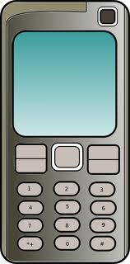
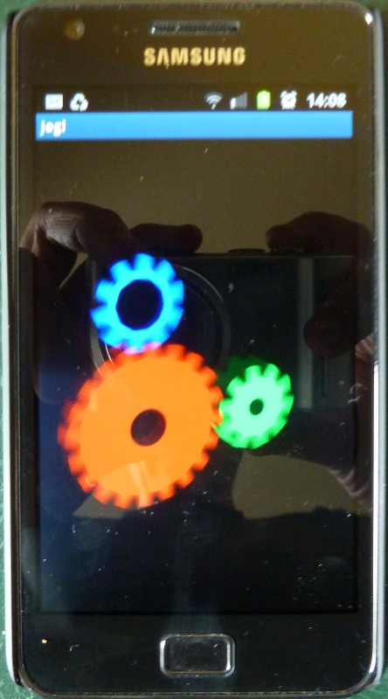

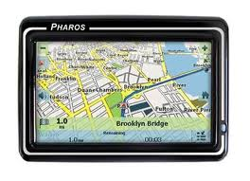
Love in all shapes & Colors ..
JogAmp
JOGL – JOCL – JOAL ...

Slide 84
About US
Open & Vendor Independent
BSD License
Java Graphics, Audio, Media & Processing
High Performance Bindings
One Stop Community Platform
  SCM, Bugtracking, Build Server, Mailinglist/Forum,..
Commercial Support
http://jogamp.org

Slide 85
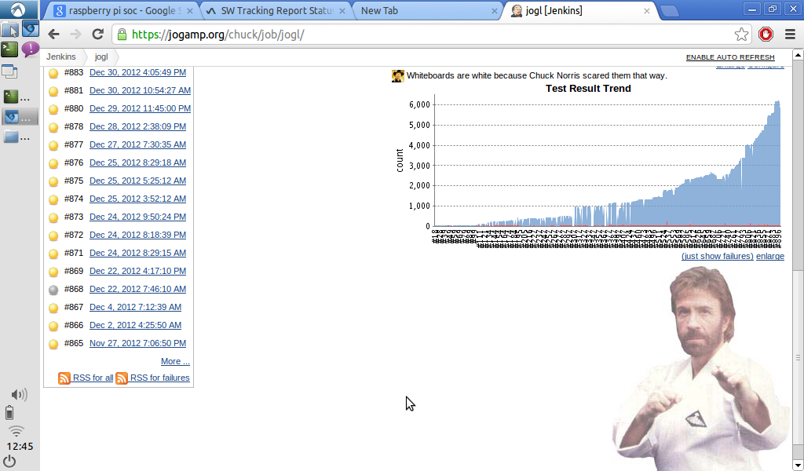
Progressive Love

Slide 86
JogAmp Continuity / Maturity
Maturity
  Version 1
    JSR-231
  Version 2
    OpenGL Profiles (ES 1+2, GL 2 + 3 + 4 )
    Windowing Toolkit Abstraction
    Continuity Build/Test Server http://jogamp.org/chuck/
    90 GlueGen + 529 JOGL Unit Tests
Community Effort
  Ports [FreeBSD, ARM-HF, ..]
  Engine & Device Support
  Bug Entries, Test Cases & Fixes
  Code Reviews, Communication & General Help

Slide 87
JogAmp Deployment
Preinstalled Bundles
  Modularized JARs
  Android APKs (modular, or all-in-one)
  Maven
Online / Cached
  Automatic Native-JAR loading support
  Applet
    Classical
    JNLP
  Webstart (JNLP)

Slide 88
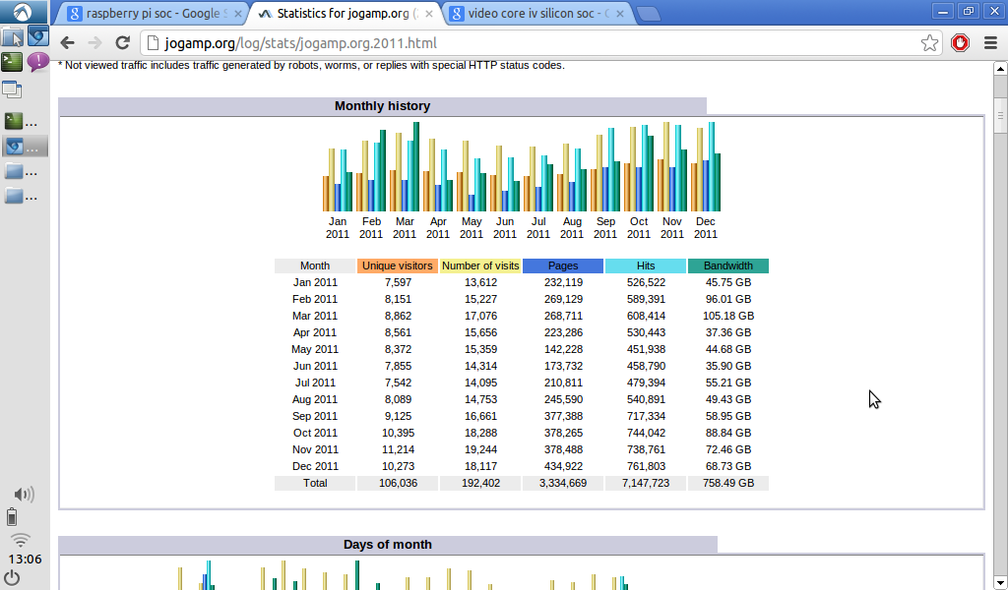
.. and Voyeurism - 2011

Slide 89
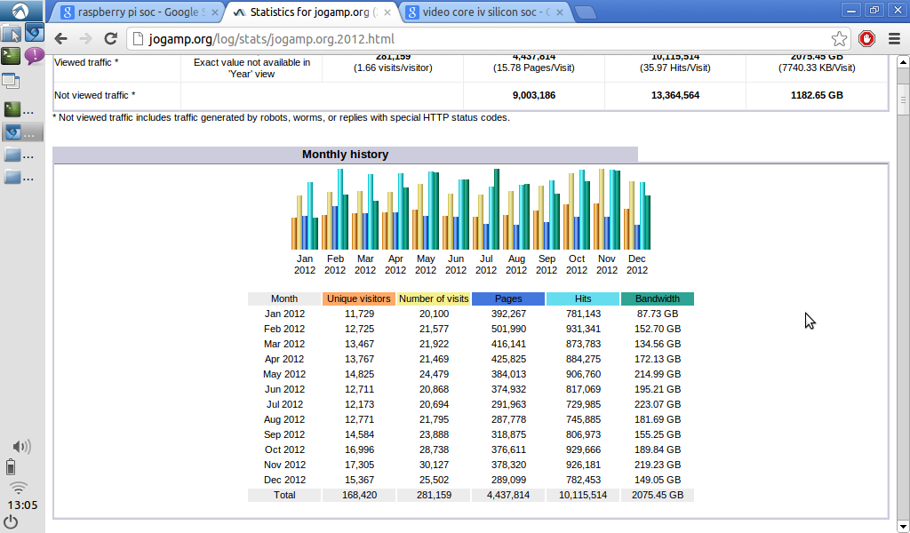
.. and Voyeurism - 2012

Slide 90
DEMOS
JOGL/JOCL
  Desktop (Any)
  Android (Any)
  AC 100 (tegra2)
Jake2
  AC100 (tegra2)
  MeeGo (PowerVR SGX)
LibGDX
  Raspberry Pi (BCM)
  AC 100 (tegra2)
JME3
  Desktop (Any)

Slide 91
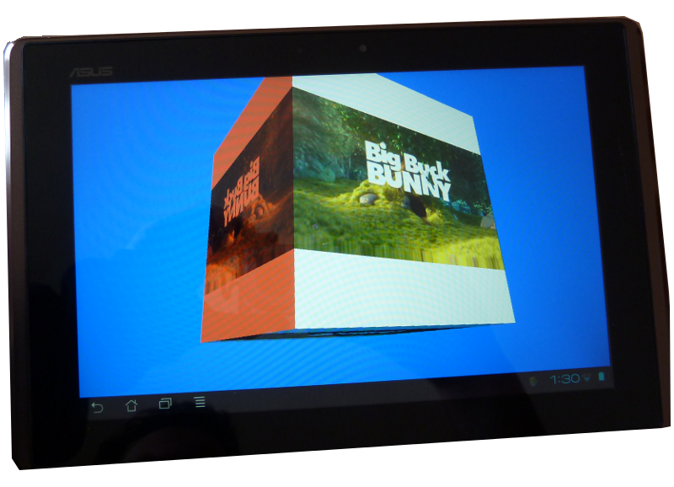
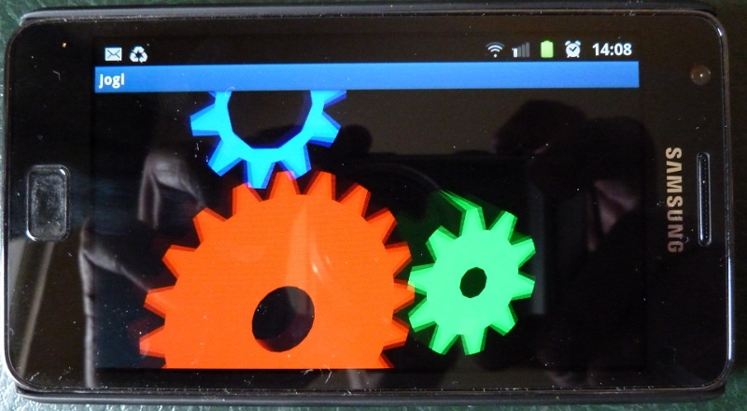
Android

Slide 92
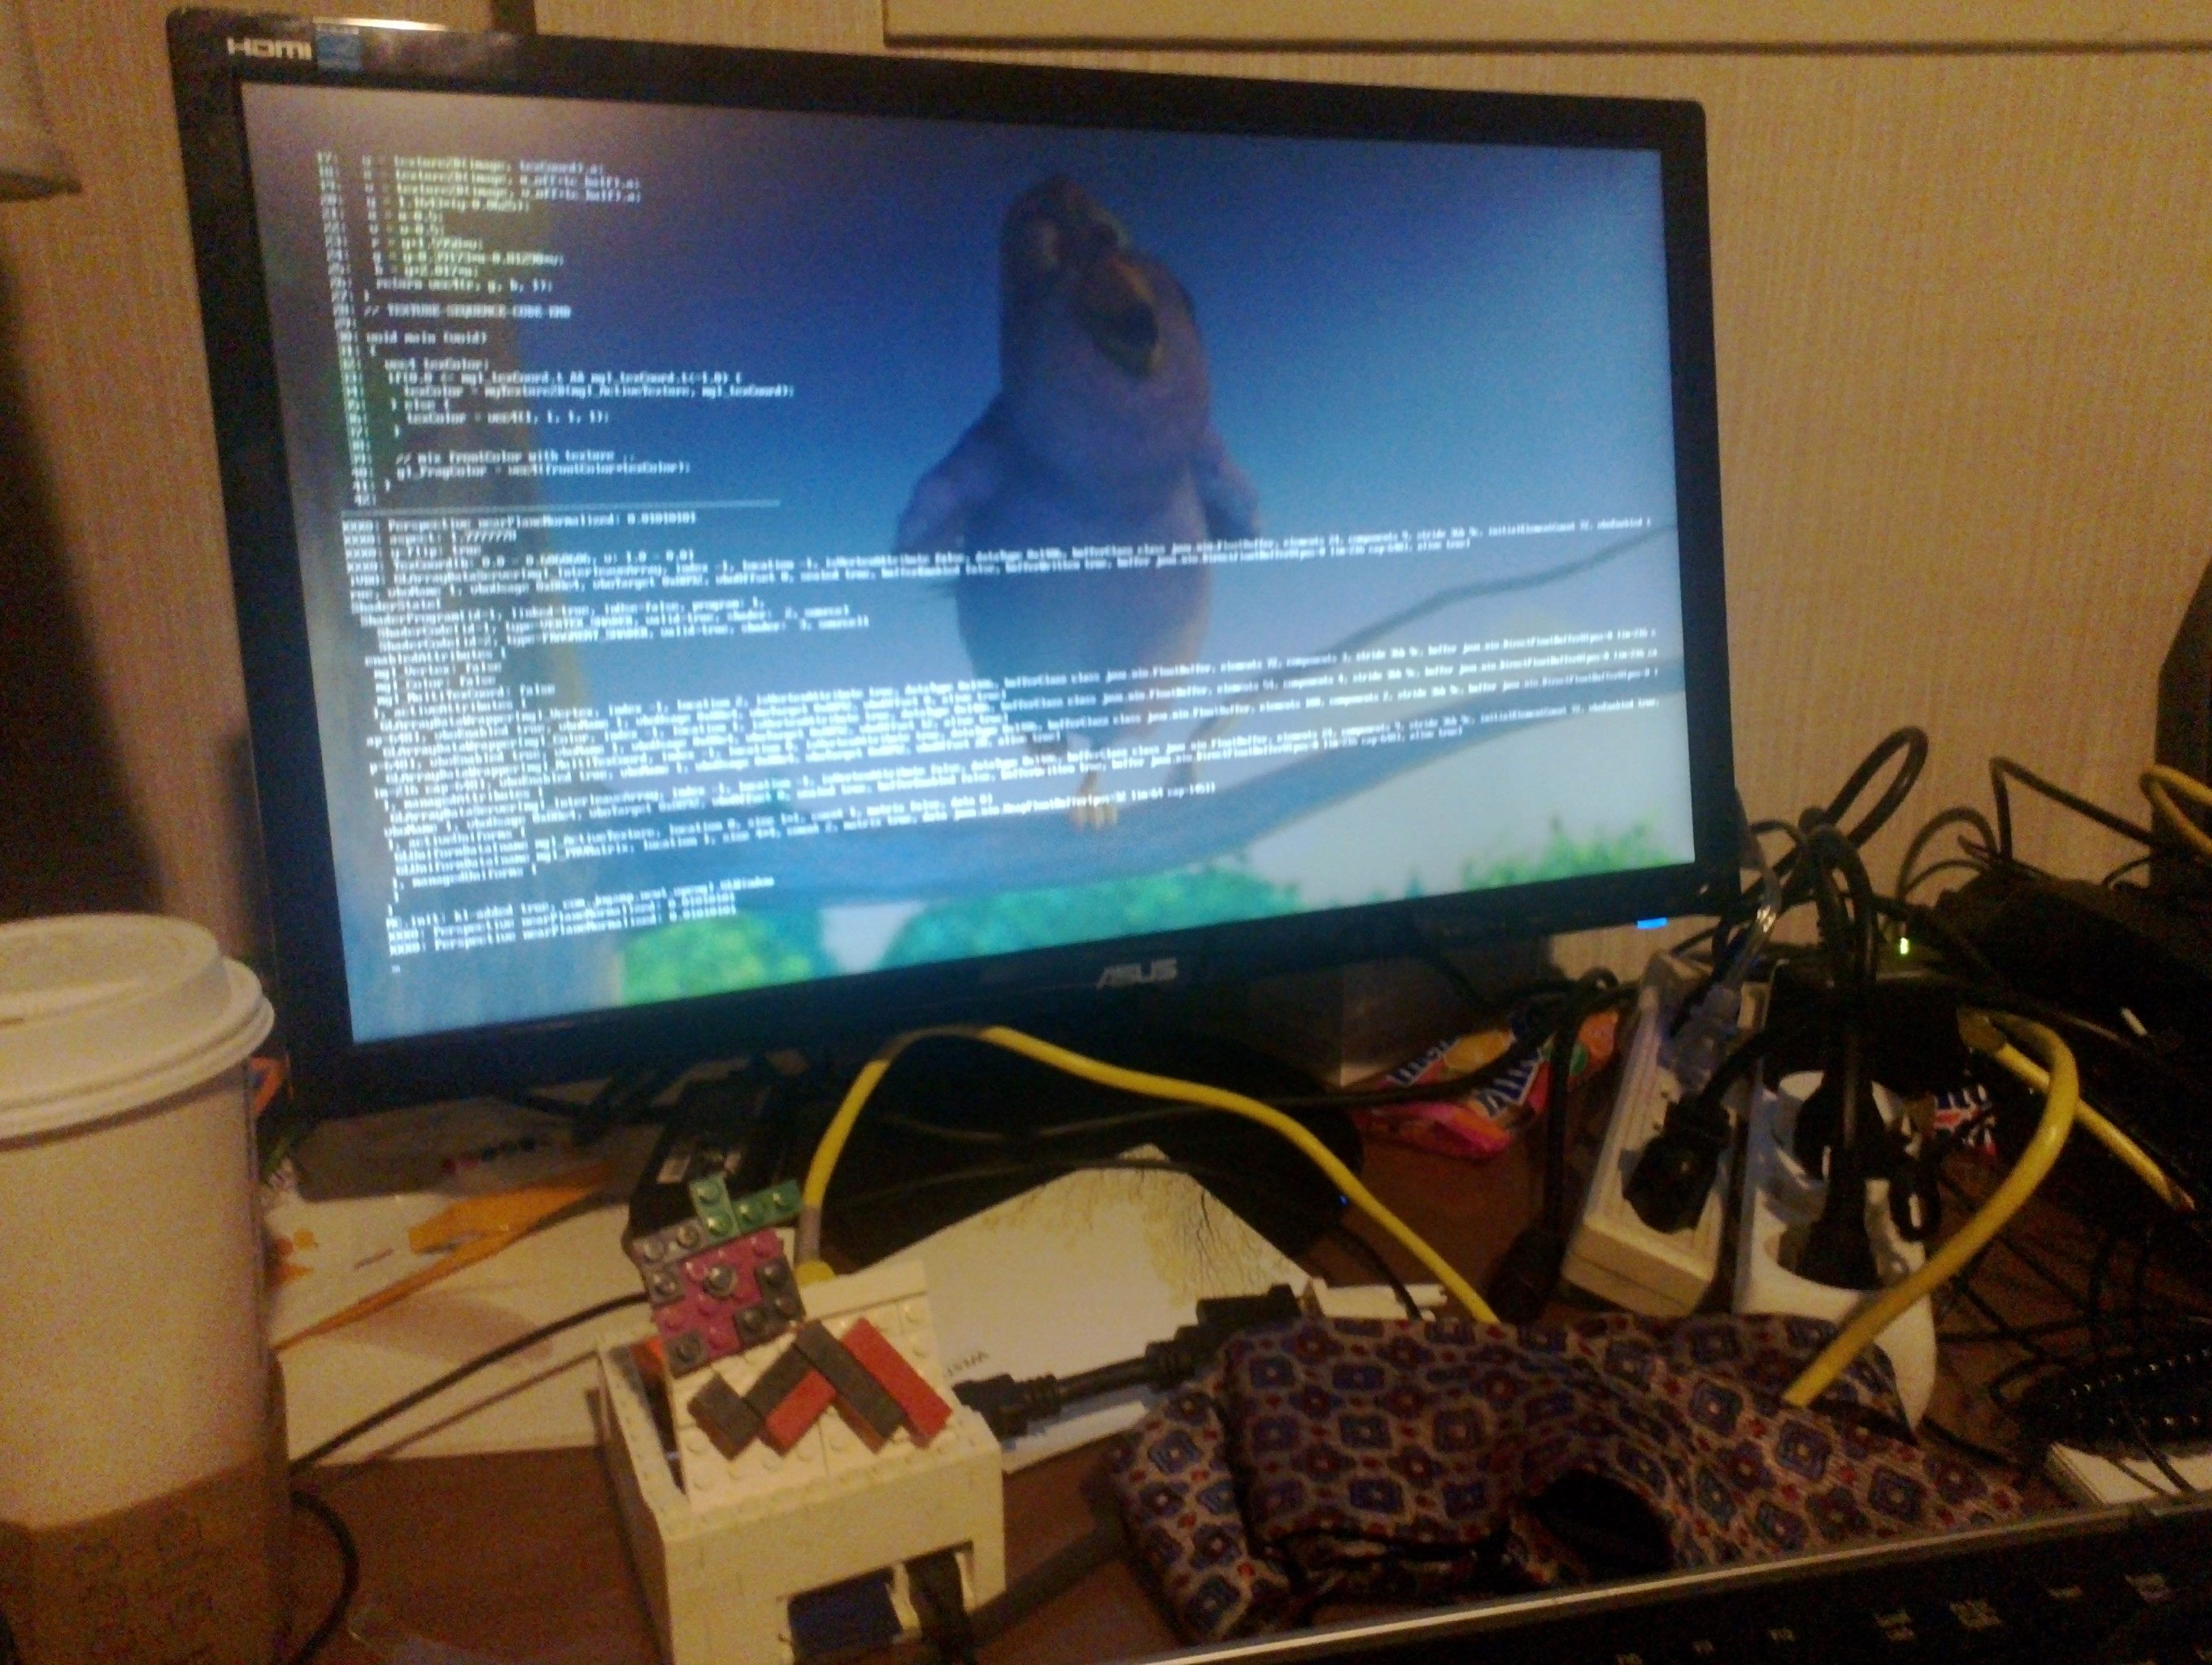
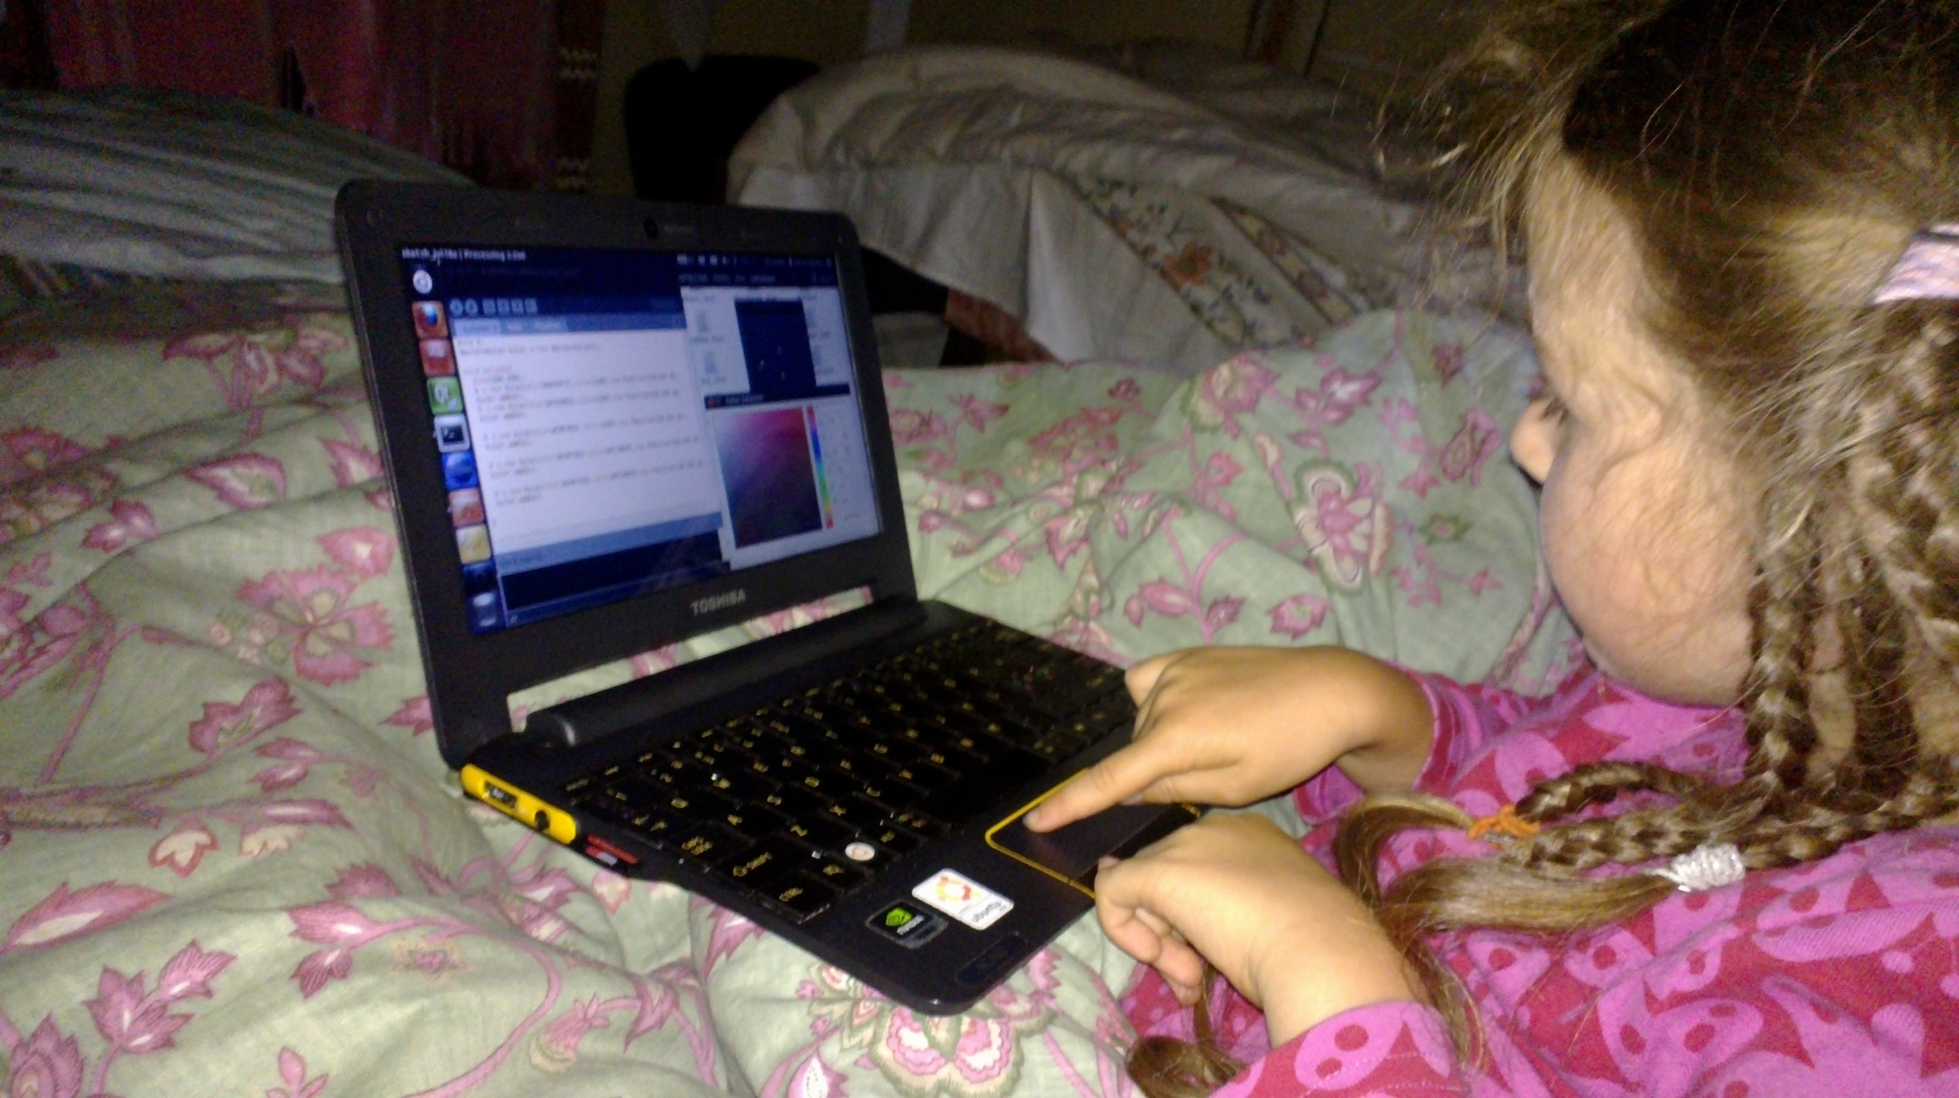
Raspberry Pi, AC-100

Slide 93
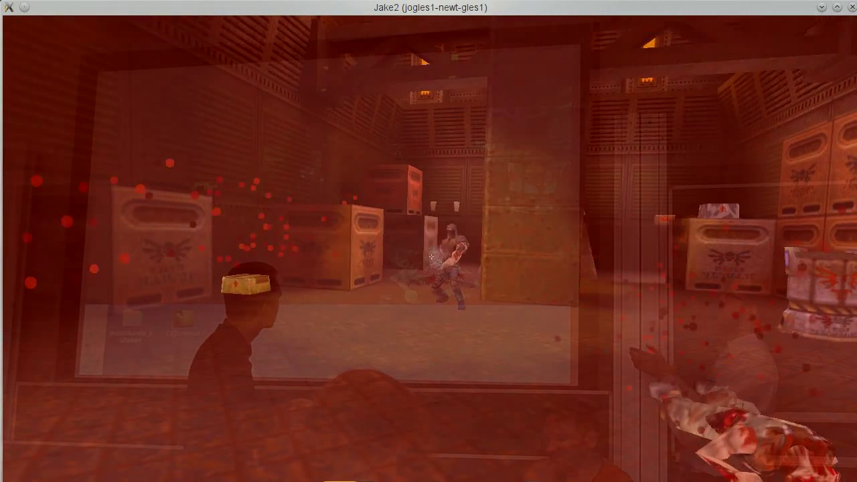
Games

Slide 94
Why JogAmp on Java?
Availability:
  Java, OpenGL, OpenCL, OpenAL, ..
  Multiple Vendors
    OpenJDK / IcedTea
    Oracle JDK
    IBM J9, ..
    PhoneME
    JamVM
    CacaoVM
    Dalvik
  x86, arm, ppc, sh4, ..
  GNU/Linux, Android, BSD, Mac OSX, Solaris/OpenIndiana, MS Windows

Slide 95
Why JogAmp on Java?
Managed Code
  Common API for
    Windowing
    GLDrawable / GLContext / GLSL
    I/O, Resource Handling (Texture, Code, ..)
    Rendering
  OpenGL Pipelining / Debugging / Trace
  Access to vast number of API / Middleware

Slide 96
JogAmp Continuity / Usage
Usage http://jogamp.org
  Ardor3D
  C3D Studio http://c3d.com
  Elflight Engine
  Processing
  Gephi
  NASA Worldwind
  Java3D
  ...

Slide 97
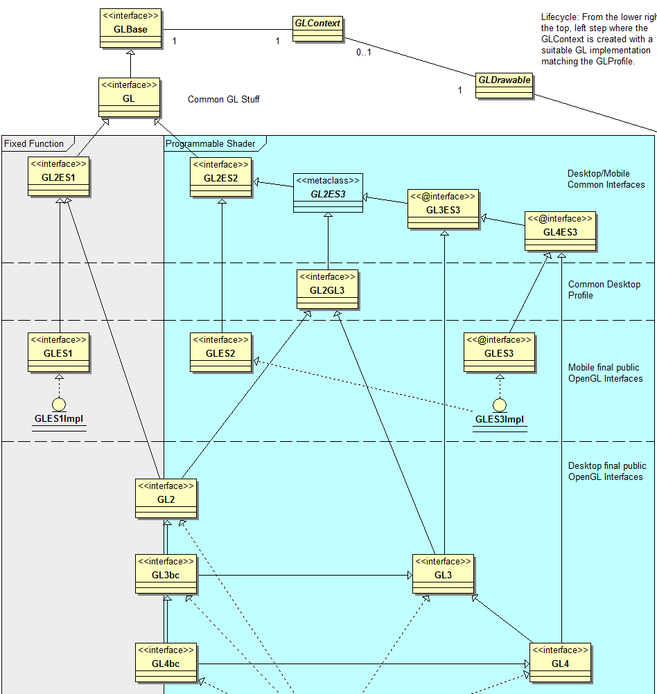
OpenGL Profiles

Slide 98
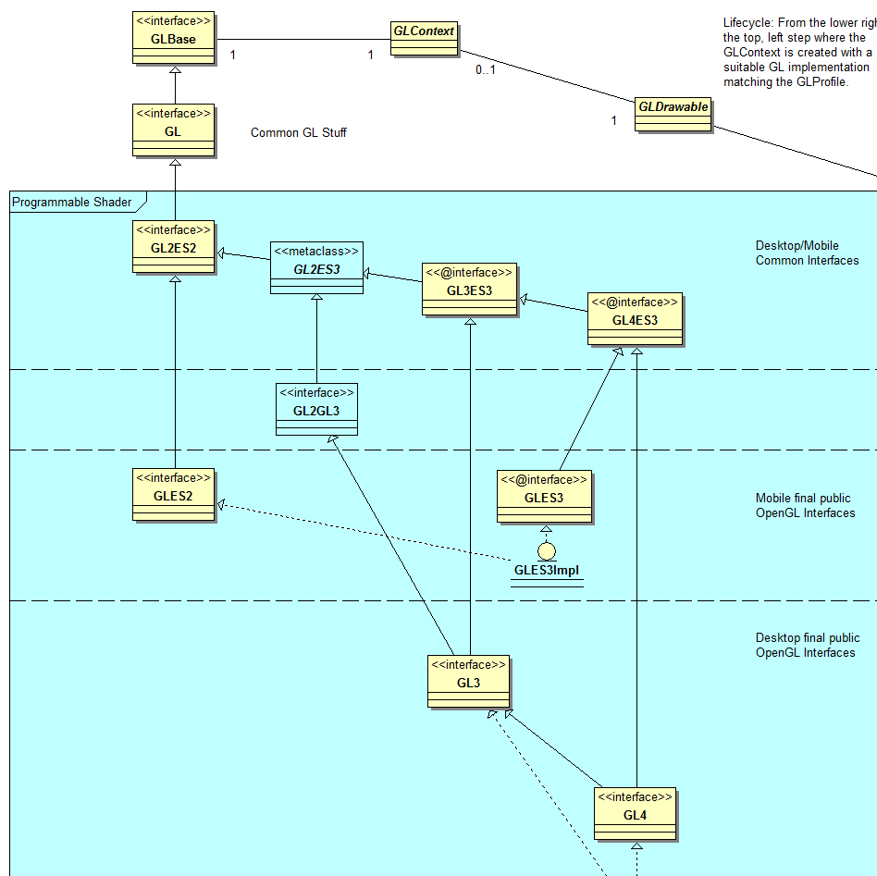
OpenGL Profiles

Slide 99
Windowing Toolkits
Native Window
Native Surface
X11
(Unix)
GDI
(Windows)
Android
Coco
(MacOSX)
SWT
(SWT Canvas)
AWT
(AWT Canvas)
GLX
WGL
EGL
CGL
GL

Slide 100
2011 – 2012 Enhancements
GLMediaPlayer
  Uses OpenMAX on Android via ICS's MediaPlayer / libstagefright
  Uses libav/libffmpeg where available
    Missing [OpenAL] audio output
  Missing native implementation for Win32 / OSX
Graph API for Curve & Text rendering via GPU
  Experimental UI
Mobile Bindings (Android Intel/ARM, Linux ARM)
Stability
NEWT AWT / SWT Enhancement
Documentation & Tutorials
Higher Community Participation

Slide 101
NEWT
Seamless integration w/ native Windowing System
  Multithreaded Access to Window Surface
  Lock free event handling
  Transparency, decoration and offscreen control
  Screen Mode API (fullscreen, resolution & rotation)
  X11, Win32, OSX, Android, OpenKD, .. implementation
  AWT and SWT integration via native re-parenting
  Desktop & Mobile

Slide 102
JOGL Android Binding
Why?
  Short Development Cycles
  No device specific development
  Supports NEWT (Multitouch, Surface, ...)
  Same code compiled for all – almost Android agnostic.
Deployment:
  adb install jogl.apk
  adb install myFancyapplication.apk
  Manual Daisy Chained ClassLoader, if desired.

Slide 103
UI Requirements (WIP)
Generic UI Rendering
  Rendering shall be performed using native rendering TKs (JOGL, ..)
  Render primitives on an offscreen 2D plane to be
    integrated into a custom 3D scenegraph
    rendered as a HUD.
Generic User Input
  Input events should be delegated from the custom scenegraph to the UI input module.

Slide 104
JOGL on Embedded Devices
Development Env:
  Beagleboard / Pandaboard w/ ARM7l / PowerVR
    Linux
    Android
  Platform based Unit tests
  Continuous Integration with auto-builds.
  Cross platform compilation/building
  Utilizing HW accelerated GL if available (EGL/ES)

Slide 105
JOGL Android Binding
Details:
  Enhanced EGL binding
  Exposing GLES1 and GLES2 native profiles
  GL2ES1 and GL2ES2 profiles for Desktop/Mobile
  Using Android SDK/NDK
    Requires SDK Level 9, Android 2.3 Gingerbread for NIO Surface access
  Tested with:
    Pandaboard - PowerVR
    Samsung Galaxy S2 – Arm/Mali
    Samsung Galaxy S – PowerVR
    Samsung Tablet / ASUS TF2 – Tegra2
    ASUS TF3 - Tegra3

Slide 106
JOGL Android Binding
Cross platform builds/tests with Linux host
Scripts provided in source code repository
NEWT Helper class (NewtActivity)
  Android Surface / NEWT Window mapping
  Android Input Event / NEWT translation

Slide 107
JogAmp's Ecosystem
Middle and high level APIs
  Scenegraphs: Ardor3D, Java3D, JMonkeyEngine, JReality, Aviatrix3D, 3DzzD, Avengina, Xith3D, MSG
  UI frameworks: FengGUI, Nifty GUI
  Visualization frameworks: LibGDX, Jzy3D, GLG2D, Gephi, …
  Sound framework: Paul Lamb Sound Library
Low level APIs & bindings
  JOGL, JOCL, JOAL, JInput for JogAmp

Slide 108
Ardor3D
Java based retained mode 3D engine
Runs on top of JOGL, SWT OpenGL binding…
Supports GLSL
Skeletal animation
Supports Android
Hardware accelerated UI
Terrain system (with geometry and texture clipmaps, level of details, ...)

Slide 109
Ardor3D
Pros:
  Actively maintained
  Most reliable JOGL based renderers
  Abstracts rendering details but does not prevent you from extending its features with or without renderer independence
  Render delegates used for legacy OpenGL code
  Supports shaders (but still supports OpenGL 1.3)
  Both community and paid support

Slide 110
Ardor3D
Cons:
  Focused on rendering (no sound, no physics, no networking, no state machines)
  Lacks tutorials and very elaborated examples
  Lacks importers (only Collada, OBJ and MD2)
  Not yet any fully shader-based architecture (planned in Ardor3D 2.0)
  No integrated game development environment
  No build-in spatial partitioning

Slide 111
Q&A
Whats Next?
Why is neither Swing nor AWT recommended?
What are the supported IDEs?

Slide 112


Thank You & Love You
Rami Santina
Sven Gothel
Xerxes Ranby
Julien Gouesse
Wade Walker
Demoscene Passivist
Mark Raynsford
Michael Bien
… all the many contributors & users

