Slide 1
3D & Multimedia Across Platforms and Devices Using JOGL
Siggraph 2010 - LA Convention Center
July 27, 2010

Slide 2
Who/What is JogAmp?
Java Graphics, Audio, Media & Processing
High Performance Bindings
  JOGL → OpenGL
  JOCL → OpenCL
  JOAL → OpenAL
  TODO → OpenMax
One Stop Community Platform
  SCM, Bugtracking, Buildserver, Mailinglist/Forum,..
BSD License
Commercial Support
http://jogamp.org

Slide 3
Why Java?
Availability:
  Java, OpenGL, OpenCL, OpenAL, ..
  Multiple Vendors
    OpenJDK / IcedTea
    Oracle JDK
    IBM J9, ..
    PhoneME
    JamVM
    CacaoVM
    Dalvik
  x86, arm, ppc, sh4, ..
  GNU/Linux, BSD, MacOSX, MS Windows, QNX

Slide 4
Why Java?
Managed Code
  Common API for
    Windowing
    GLContext
    Rendering
    SwapBuffer
  OpenGL Pipelining / Debugging / Trace
  Access to vast number of API / Middleware

Slide 5
Continuity / Usage
Usage http://jogamp.org/jogl/
  Ardor3D
  C3D Studio http://c3d.com
  Elflight Engine
  Field/Processing
  Gephi
  NASA Worldwind
  ...

Slide 6
Continuity / Maturity
Maturity
  Version 1
    JSR-231
  Version 2
    OpenGL Profiles (ES 1+2, GL 2 + 3 + 4 )
    Windowing Toolkit Abstraction
    Continuity Build/Test Server http://jogamp.org/chuck/
Community Contributions
  FreeBSD Port
  JOAL Fixes
  JOCL Project
  Bugzilla Entries and Test Cases
  Code Reviews

Slide 7
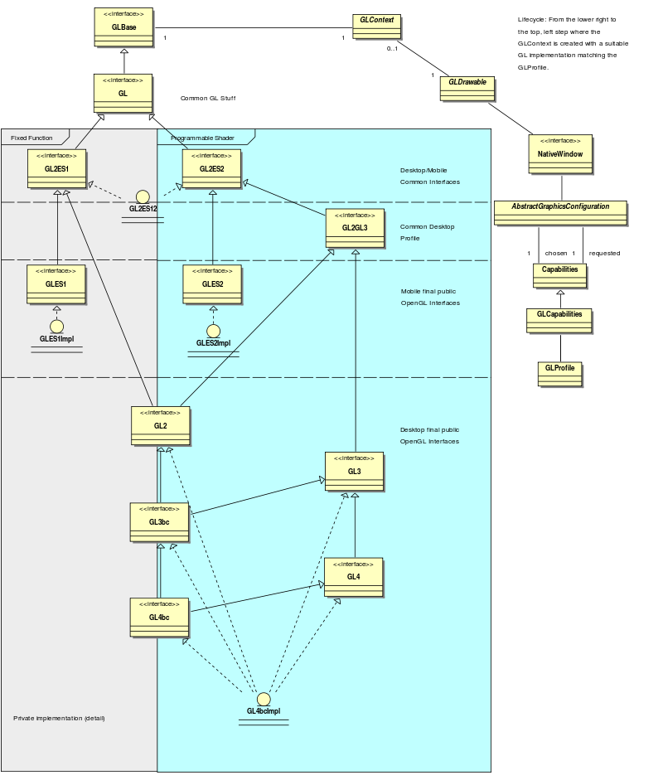
OpenGL Profiles

Slide 9
Flexible GL Profile Coding
import javax.media.opengl.*; // Common JOGL
import com.jogamp.newt.*; // Common NEWT
public void run() {
GLProfile glp = GLProfile.getDefault(); // Get the platforms default GL profile
GLCapabilities caps = new GLCapabilities(glp);
GLDrawable drawable = GLWindow.create(caps);
...
GL gl = drawable.getGL();
int programs[] = new int[1];
if( gl.isExtensionAvailable("GL_VERSION_2_0") ) {
// able to use OpenGL 2.0 functionality
programs[0] = gl.getGL2().glCreateProgram();
...
}
if( gl.isExtensionAvailable("GL_ARB_vertex_program") ||
gl.isFunctionAvailable("glGenProgramsARB”) ) {
gl.getGL2().glGenProgramsARB(1, programs, 0);
}
..

Slide 10
Flexible GL Profile Coding
...
GL gl = drawable.getGL();
...
// The following can be queried on a GL instance or the GLProfile itself
If ( gl.isGL4bc() ) {
// OpenGL 4 Backward Compatible Profile Engine
GL4bc gl4bc = gl.getGL4bc();
...
} else if ( gl.isGL4() ) {
// OpenGL 4 Core Profile Engine
} else if ( gl.isGL3bc() ) {
// OpenGL 3 Backward Compatible Profile Engine
} else if ( gl.isGL3() ) {
// OpenGL 3 Core Profile Engine
} else if ( gl.isGL2() ) {
// OpenGL 2 Profile Engine
} else if ( gl.isGLES1() ) {
// OpenGL ES 1 Profile Engine
} else if ( gl.isGLES2() ) {
// OpenGL ES 2 Profile Engine
} else {
Throw new RuntimeException(“No Engine Available For Unknown GL Profile: ”+glp);
}
}

Slide 11
Windowing Toolkits
JOGL
Xyz
NativeWindow Interface
SWT
AWT
NEWT
X11
(Unix)
GDI
(Windows)
Coco
(MacOSX)
Framebuffer
(Mobile)

Slide 12
JOGL Example: AWT
96 GLCapabilities config = new GLCapabilities(GLProfile.get(GLProfile.GL2)); //1
97 config.setSampleBuffers(true); //2
98 config.setNumSamples(4); // 4x anti aliasing (just as example) //2
99
100 GLCanvas canvas = new GLCanvas(config); // something to render to //3
101 canvas.addGLEventListener(this); //4
103
104 JFrame frame = new JFrame("JOGL-JOCL Interoperability Example");
105 frame.setDefaultCloseOperation(JFrame.EXIT_ON_CLOSE);
106 frame.add(canvas); //5
107 frame.setSize(width, height);
108 frame.setVisible(true);
109
110 // start rendering thread
111 Animator animator = new Animator(canvas); //6
112 animator.start(); //6
Chose GL Profile
Config GL Capabilities
Create GLDrawable (AWT)
Hook GLEventListener to GLDrawable
Add GLDrawable to Window
Animator Thread

Slide 13
JOGL Example: GLEventListener
96 GLCapabilities config = new GLCapabilities(GLProfile.get(GLProfile.GL2));
97 config.setSampleBuffers(true);
98 config.setNumSamples(4); // 4x anti aliasing (just as example)
99
100 GLCanvas canvas = new GLCanvas(config); // something to render to
101 canvas.addGLEventListener(this);
...
114 public void init(GLAutoDrawable drawable) {
...
134 // enable GL error checking using the composeable pipeline
135 GL gl = drawable.getGL();
136 gl = gl.getContext().setGL(
137 GLPipelineFactory.create("javax.media.opengl.Debug", GL2.class, gl, null) );
138
139 gl.setSwapInterval(1);
...
14x }
198 public void display(GLAutoDrawable drawable) {
199
200 GL2 gl = drawable.getGL().getGL2();
201 gl.glClear(...);
...

Slide 14
AWT Agnostic Coding
import javax.media.opengl.*; // Common JOGL
import com.jogamp.newt.Window; // Common NEWT
import com.jogamp.newt.event.*; // Generic NEWT Event Handling
import com.jogamp.newt.event.awt.*; // NEWT → AWT Adapter
import java.awt.Component; // Identify if GLDrawable is AWT (GLCanvas)
class GearsMouseAdapter extends MouseAdapter {
public void mousePressed(MouseEvent e) {
..
}
}
public void init(GLAutoDrawable drawable) {
…
MouseListener gearsMouse = new GearsMouseAdapter();
if (drawable instanceof Component) {
Component comp = (Component) drawable;
new AWTMouseAdapter(gearsMouse).addTo(comp);
} else if (drawable instanceof Window) {
Window window = (Window) drawable;
window.addMouseListener(gearsMouse);
}
…
}

Slide 15
NEWT Requirements (done)
Seamless integration into the platform's
  Creation/Destruction of top level and child windows
  Multithreaded Access to Window Surface
  Re - Parenting
  Decorated- and Undecorated - Windows
  Passive Fullscreen Mode, no change of display mode
  Event handling, at least per creation thread

Slide 16
NEWT Requirements (todo)
Transparency (API prepared)
Active Fullscreen Mode
(change display mode, API prepared)
Drag & Drop (Pending)

Slide 17
UI Requirements (todo)
Should be abstracted from the windowing toolkit
Should support multithreading
Seamless integration into
  A native window (HUD)
  A custom Scenegraph (2D plane within 3D)

Slide 18
UI Requirements (todo)
Generic UI Rendering
  Rendering shall be performed using native rendering TKs (JOGL, ..)
  Render primitives on an offscreen 2D plane to be
    integrated into a custom 3D scenegraph
    rendered as a HUD.
Generic User Input
  Input events should be delegated from the custom scenegraph to the UI input module.

Slide 19
JOCL Introduction
JOCL is an OpenCL language binding for the Java platform.
OpenCL allows to run high performance tasks within a heterogeneous system.
OpenCL performs well on data parallelism, hence it differs from the thread and task based models.
Implementations are provided in form of graphics drivers, compilers or within the operation system.

Slide 20
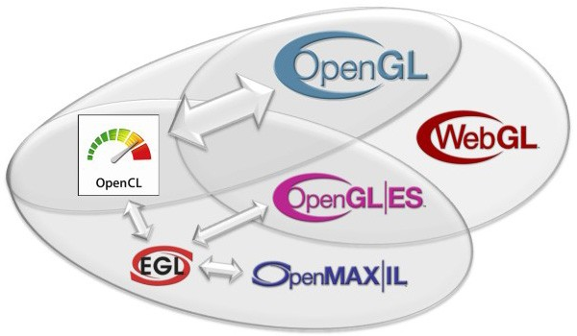
Context sharing

Slide 21
Hello World with JOCL
Sum array A and B (per element) and write the result into array C. (“VectorAdd”)
Procedure:
OpenCL Context creation (Platform and device selection)
OpenCL Program compilation and upload
A and B initialization with random numbers
A and B data upload
Execute the OpenCL Kernel of the program
Download C when result is available

Slide 22
Hello JOCL
A+B=C
24 public static void main(String[] args) throws IOException {
25
26 int elementCount = 11444777;
27 int localWorkSize = 256;
28 int globalWorkSize = roundUp(localWorkSize, elementCount);
29
30 // set up
31 CLContext context = CLContext.create();
32
33 CLProgram program = context.createProgram(HelloJOCL.class.getResourceAsStream("VectorAdd.cl")).build();
34
35 CLBuffer<FloatBuffer> clBufferA = context.createFloatBuffer(globalWorkSize, READ_ONLY);
36 CLBuffer<FloatBuffer> clBufferB = context.createFloatBuffer(globalWorkSize, READ_ONLY);
37 CLBuffer<FloatBuffer> clBufferC = context.createFloatBuffer(globalWorkSize, WRITE_ONLY);
38
Context creation for
default Platform + all Devices
1 // VectorAdd.cl
2 // OpenCL Kernel Function for element by element vector addition
3 kernel void VectorAdd(global const float* a, global const float* b, global float* c, int numElements) {
4
5 // get index into global data array
6 int iGID = get_global_id(0);
7
8 // bound check (equivalent to the limit on a 'for' loop for standard/serial C code
9 if (iGID >= numElements) {
10 return;
11 }
12
13 // add the vector elements
14 c[iGID] = a[iGID] + b[iGID];
15 }
16
Compile + link OpenCL Program
for all devices of the context.

Slide 23
Hello JOCL
A+B=C
24 public static void main(String[] args) throws IOException {
25
26 int elementCount = 11444777; // Length of arrays to process (random number)
27 int localWorkSize = 256; // Local work size dimensions
28 int globalWorkSize = roundUp(localWorkSize, elementCount); // rounded up to the nearest
29 // multiple of the localWorkSize
30 // set up
31 CLContext context = CLContext.create();
32
33 CLProgram program = context.createProgram(HelloJOCL.class.getResourceAsStream("VectorAdd.cl")).build();
34
35 CLBuffer<FloatBuffer> clBufferA = context.createFloatBuffer(globalWorkSize, READ_ONLY);
36 CLBuffer<FloatBuffer> clBufferB = context.createFloatBuffer(globalWorkSize, READ_ONLY);
37 CLBuffer<FloatBuffer> clBufferC = context.createFloatBuffer(globalWorkSize, WRITE_ONLY);
38
Create Java FloatBuffer
+ OpenCL Buffer
Buffer length
Access mode;
allowing misc. optimizations

Slide 24
Hello JOCL
A+B=C
35 CLBuffer<FloatBuffer> clBufferA = context.createFloatBuffer(globalWorkSize, READ_ONLY);
36 CLBuffer<FloatBuffer> clBufferB = context.createFloatBuffer(globalWorkSize, READ_ONLY);
37 CLBuffer<FloatBuffer> clBufferC = context.createFloatBuffer(globalWorkSize, WRITE_ONLY);
...
46 // get a reference to the kernel functon with the name 'VectorAdd'
47 CLKernel kernel = program.createCLKernel("VectorAdd");
48 // and map the buffers to its input parameters.
49 kernel.putArgs(clBufferA, clBufferB, clBufferC).putArg(elementCount);
1 // VectorAdd.cl
2 // OpenCL Kernel Function
3 kernel void VectorAdd(global const float* a, global const float* b, global float* c, int elements) {
...
15 }
16
Hint:
putArg(arg) increments internal index, rewind() resets it to 0.
setArg(index, arg) uses the explicit index.

Slide 25
Hello JOCL
A+B=C
Command Queue
of fastest device.
51 // create command queue on fastest device.
52 CLCommandQueue queue = context.getMaxFlopsDevice().createCommandQueue();
53
54 // asynchronous write of data to GPU device, blocking read later to get the computed results back.
56 queue.putWriteBuffer(clBufferA, false)
57 .putWriteBuffer(clBufferB, false)
58 .put1DRangeKernel(kernel, 0, globalWorkSize, localWorkSize)
59 .putReadBuffer(clBufferC, true);
61
62 // cleanup all resources associated with this context.
63 context.release();
“blocking read”
1
2 // OpenCL Kernel Function for element by element vector addition
3 kernel void VectorAdd(global const float* a, global const float* b, global float* c, int numElements) {
4
5 // get index into global data array (0 means first dimension)
6 int iGID = get_global_id(0);
7
8 // bound check (equivalent to the limit on a 'for' loop for standard/serial C code
9 if (iGID >= numElements) {
10 return;
11 }
12
13 // add the vector elements
14 c[iGID] = a[iGID] + b[iGID];
15 }
16
work item index
… result available in buffer C

Slide 26
Deployment
Preinstalled Bundles
  Applications
  Mobile / Embedded Devices
Online / Cached
  Applet
    Classical
    JNLP
  Webstart (JNLP)

Slide 27
Items in Progress
JOAL test/demos
NEWT MacOSX test/finish
JOCL Stabilization/MacOSX
Applets
Mobile Platform
  OpenJDK, Oracle's ARM Hotspot, ..
  Snapdragon (ATI), Omap (PowerVR), ..
  Linux and WinCE
OpenGL 4.1

Slide 28
Roadmap
OpenMAX (A/V)
  HW Implementation (mobile)
  SW Implementations (desktop)
    LIMOA - LIM OpenMAX Implementation
    Bellagio
Text Rendering
  Loop/Blinn, BSpline, GLSL, ..
Generic UI

Slide 29
Q&A
How to use GLSL?
Is Cg supported?
Why is neither Swing nor AWT recommended?
How to write AWT agnostic code?
Is there any IDE supported?

Slide 30



Thank You
Dominik aka DemoscenePassivist
Kenneth Russell
Michael Bien
Rami Santina
Rayan Jreije
.. and all the many contributors and sponsors

