Slide 1
JogAmp: 2D/3D & Multimedia across Devices
Siggraph 2011 - Vancouver Convention Center
August 9, 2011
Presented by: Sven Gothel
Rami Santina

Slide 2


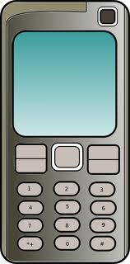
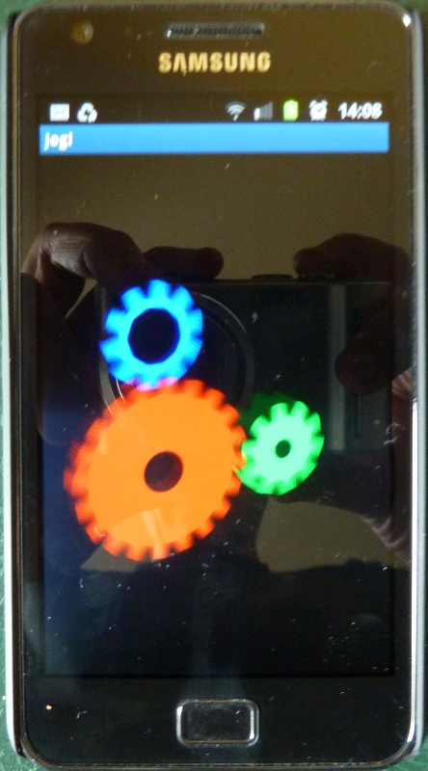

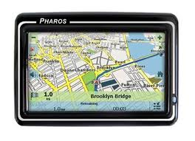
What is JogAmp?
JogAmp
JOGL – JOCL – JOAL ...

Slide 3

Example Usage
C3D – Visual Project Control
C3D Viewer
C3D Studio
C3D Mobile
Scenario Creation
Data Integration
Vertical Application Dev.
...
Model Visualization
OnSite progress update
...
Model Visualization
Project Progress Update
4D Animation
Report Generation
Design Review
http://c3d.com

Slide 4
Looking back: 2010 - Roadmap
OpenMAX (A/V)
  HW Implementation (mobile)
  SW Implementations (desktop)
    LIMOA - LIM OpenMAX Implementation
    Bellagio
Text Rendering
  Loop/Blinn alternative, GLSL, ..
Generic UI
Android Binding
Linux ARM Binding
API Maturity (currently: 300+ unit tests)
AWT Parenting Enhancement
Documentation & Tutorials

Slide 5
About US
Open!
BSD License
Java Graphics, Audio, Media & Processing
High Performance Bindings
One Stop Community Platform
  SCM, Bugtracking, Build Server, Mailinglist/Forum,..
Commercial Support
http://jogamp.org

Slide 6
Why Java?
Availability:
  Java, OpenGL, OpenCL, OpenAL, ..
  Multiple Vendors
    OpenJDK / IcedTea
    Oracle JDK
    IBM J9, ..
    PhoneME
    JamVM
    CacaoVM
    Dalvik
  x86, arm, ppc, sh4, ..
  GNU/Linux, BSD, MacOSX, MS Windows, QNX

Slide 7
Why Java?
Managed Code
  Common API for
    Windowing
    GLContext
    Rendering
    SwapBuffer
  OpenGL Pipelining / Debugging / Trace
  Access to vast number of API / Middleware

Slide 8
Continuity / Usage
Usage http://jogamp.org
  Ardor3D
  C3D Studio http://c3d.com
  Elflight Engine
  Field/Processing
  Gephi
  NASA Worldwind
  ...

Slide 9
Deployment
Preinstalled Bundles
  Modularized JARs
  Android APKs
Online / Cached
  Applet
    Classical
    JNLP
  Webstart (JNLP)

Slide 10
Continuity / Maturity
Maturity
  Version 1
    JSR-231
  Version 2
    OpenGL Profiles (ES 1+2, GL 2 + 3 + 4 )
    Windowing Toolkit Abstraction
    Continuity Build/Test Server http://jogamp.org/chuck/
Community Contributions
  FreeBSD Port
  JOAL Fixes
  JOCL Project
  Bugzilla Entries and Test Cases
  Code Reviews

Slide 11
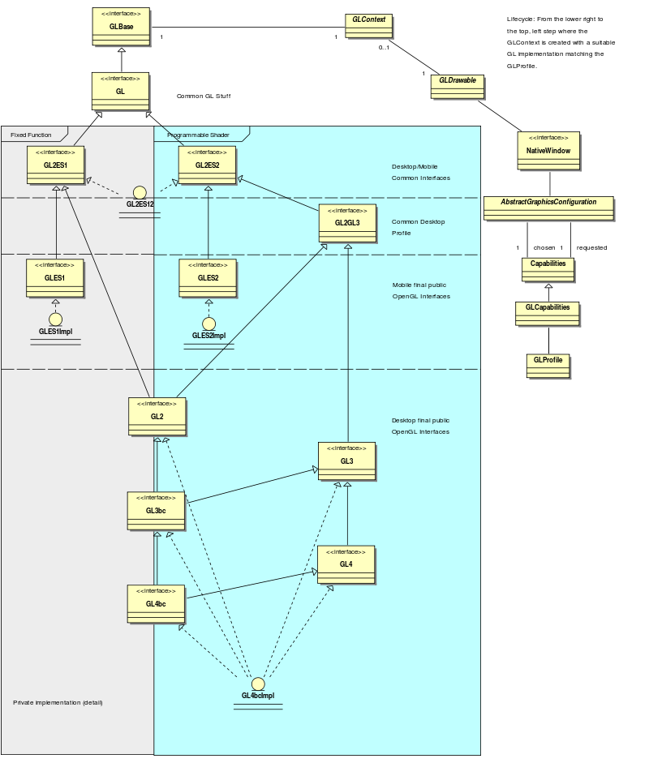
OpenGL Profiles

Slide 13
Windowing Toolkits
Native Window
Native Surface
X11
(Unix)
GDI
(Windows)
Android
Coco
(MacOSX)
SWT
(SWT Canvas)
AWT
(AWT Canvas)
GLX
WGL
EGL
CGL
GL

Slide 14
NEWT
Seamless integration into the platform's
  Creation/Destruction of top level and child windows
  Multithreaded Access to Window Surface
  Re - Parenting
  Decorated- and Undecorated - Windows
  Exclusive Full screen Mode
  Screen Mode API
  Event handling

Slide 15
NEWT Requirements (todo)
Transparency (API prepared)
Drag & Drop (Pending)
Enhance SWT Parenting
Enhance Android Parenting

Slide 16
New Stuff...

Slide 17
Graph API
Resolution Independent
Shapes and Curves

Slide 18

Resolution Independent Curve Rendering API
Based on Paper:
  R Santina, “Resolution Independent NURBS Curve Rendering using Programmable Graphics Pipeline”, to be presented in GraphiCon2011.
NOT Loop/Blinn
Patent Free
Can Render Bezier, Bsplines, NURBS

Slide 19
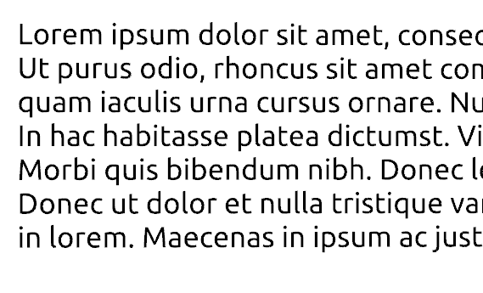

Resolution Independent Curve Rendering API
Why?
  Resolution Independent Text Rendering
  GPU based - Fast
  Seamless integration into Renderer (Scenegraph,...)
  New User Interface – across devices
  http://jogamp.org/deployment/jogamp-current/jogl-test-applets.html
  http://www.youtube.com/watch?v=Rqsu46ifMaw

Slide 20
JOGL Graph API
Outline → OutlineShapes → GLRegion
Renderer
  RegionRenderer
  TextRenderer (same as RegionRender)
    Helper methods for texts and fonts.
outline.addVertex(x, y, z, w, onCurve);
….
outlineShape.addOutline(outline);
outlineShape.addOutline(outline2);
region = GLRegion.create(outlineShape, getRenderModes());
region.render(gl, outlineShape,...);

Slide 21
JOGL Graph API
Initializing:
  Read Outlines ( from font, svg, application, ...)
  Modified Constrained Delaunay Triangulation
  Generate Region
Rendering:
  VBO buffers
  Realtime manipulation – weights
  Transformation....

Slide 22
GPU based Resolution Independent UI
Abstracted from the windowing toolkit
Support multithreading
Seamless integration into
  A native window (HUD)
  A custom Scenegraph (2D plane within 3D)
High Quality rendering
Super Fast

Slide 23
JOGL Graph.UI API
UIShape
UISceneController
Add/removeShape
GetSelected
getActiveUI
...
UITextShape
RIButton
RILabel
UIGroup
UITextBox
UITextArea
...
GLEventListener
Graph.curve API
MouseListener

Slide 24
UI Requirements (WIP)
Generic UI Rendering
  Rendering shall be performed using native rendering TKs (JOGL, ..)
  Render primitives on an offscreen 2D plane to be
    integrated into a custom 3D scenegraph
    rendered as a HUD.
Generic User Input
  Input events should be delegated from the custom scenegraph to the UI input module.

Slide 25
JOGL on Embedded
Devices

Slide 26
JOGL on Embeded Devices
Development Env:
  Beagleboard Devkit with ARM7l / PowerVR
    Linux
    Android
  Platform based Unit tests
  Continuous Integration with auto-builds.
  Cross platform compilation/building

Slide 27
JOGL on Linux ARM

Slide 28
JOGL on Linux ARM
EGL binding
Tested with Ubuntu for embedded Devices.
Demo!

Slide 29
JOGL on Android

Slide 30
JOGL Android Binding
Why?
  Short Development Cycles
  No device specific development
  Multitouch actions captured by Newt EDT
  Same code compiled for all.
Deployment:
  adb install jogl.apk
  adb install myFancyapplication.apk
  Manual Daisy Chained ClassLoader.

Slide 31
JOGL Android Binding
Details:
  Enhanced EGL binding
  Exposing GLES1 and GLES2 native profiles
  GL2ES1 and GL2ES2 profiles for Desktop/Mobile
  Using Android SDK/NDK
    Requires SDK Level 9, Android 2.3 Gingerbread for NIO Surface access
  Tested with:
    Beagleboard with TI-rowboat gingerbread
    Samsung Galaxy SII – Arm/Mali
    Samsung Galaxy S
    More soon with CI hook-up.

Slide 32
JOGL Android Binding
Cross platform builds/tests with Linux host
Scripts provided in source code repository
NEWT Helper class (NewtActivity)
  Android Surface / NEWT Window mapping
  Android Input Event / NEWT translation

Slide 33
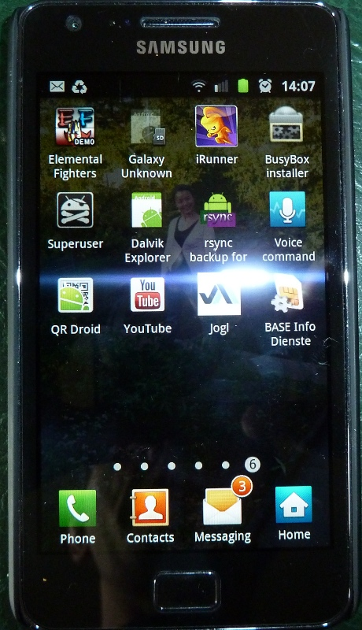
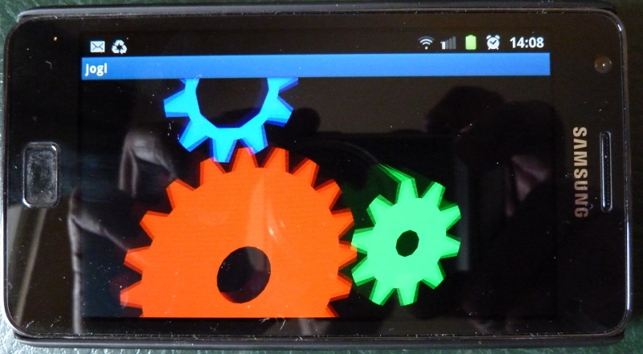
JOGL Android Binding
http://www.youtube.com/watch?v=VHxtVT4tWjM

Slide 34
Multitouch
com.jogamp.newt.MouseEvent extended!
  e.getPointerCount()
  e.getX(int index)
  e.getY(int index)
  e.getPointerId(int index)
  e.getPressure(int index)

Slide 35
Q&A
Whats Next?
Why is neither Swing nor AWT recommended?
What are the supported IDEs?

Slide 36


Thank You
Sven Gothel
Rami Santina
Dominik aka DemoscenePassivist
Wade Walker
and all the many contributors!

