Slide 1
JogAmp Fast Media & Processing
Across devices – Desktop & Mobile
SIGGRAPH 2013 – Anaheim
July 23, 2013
Presented by: Sven Gothel
Rami Santina
Xerxes Ranby
Julien Gouesse

Slide 2
General Love
Dedicated Love
Intel x32, amd64
ARM 32 and 64 bit
SuperH
PowerPC
Sparc
MIPS
Immaginative Technologies PowerVR SGX
ARM Mali
Qualcomm Andreno
Vivante
BCM VideoCore
Nvidia Tegra
Special DSPs (Audio/Video)
Heterogenous CPUs (big.LITTLE)
Java
OpenGL, OpenCL, OpenAL, ..

Slide 3

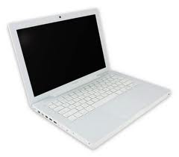

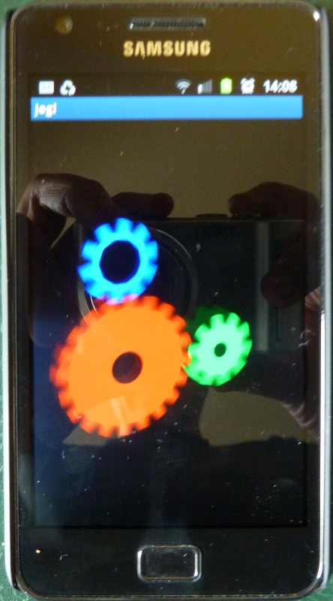

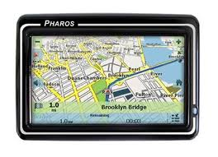
Love in all Shapes & Colors ..
JogAmp
JOGL – JOCL – JOAL ...

Slide 4
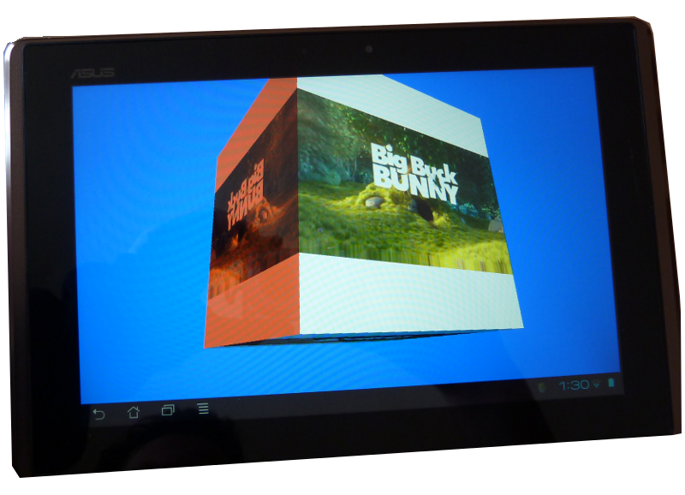
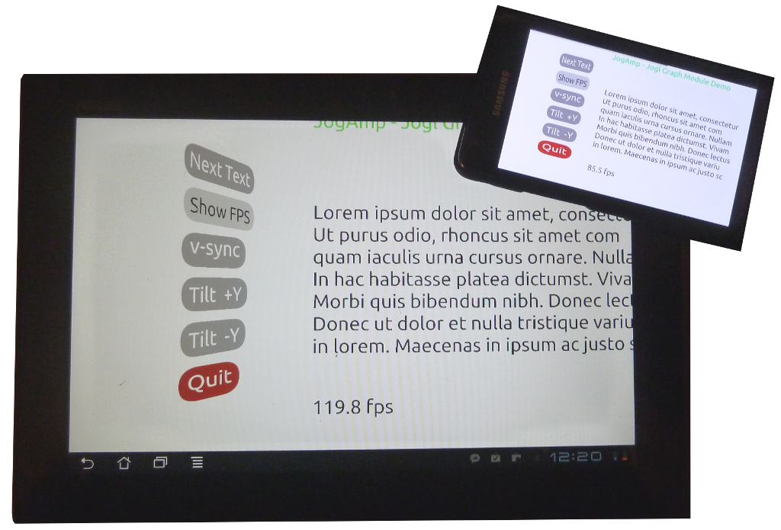
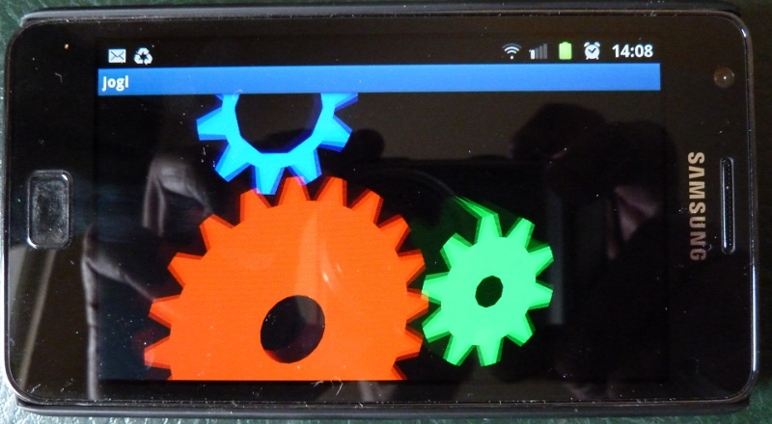
Android

Slide 5
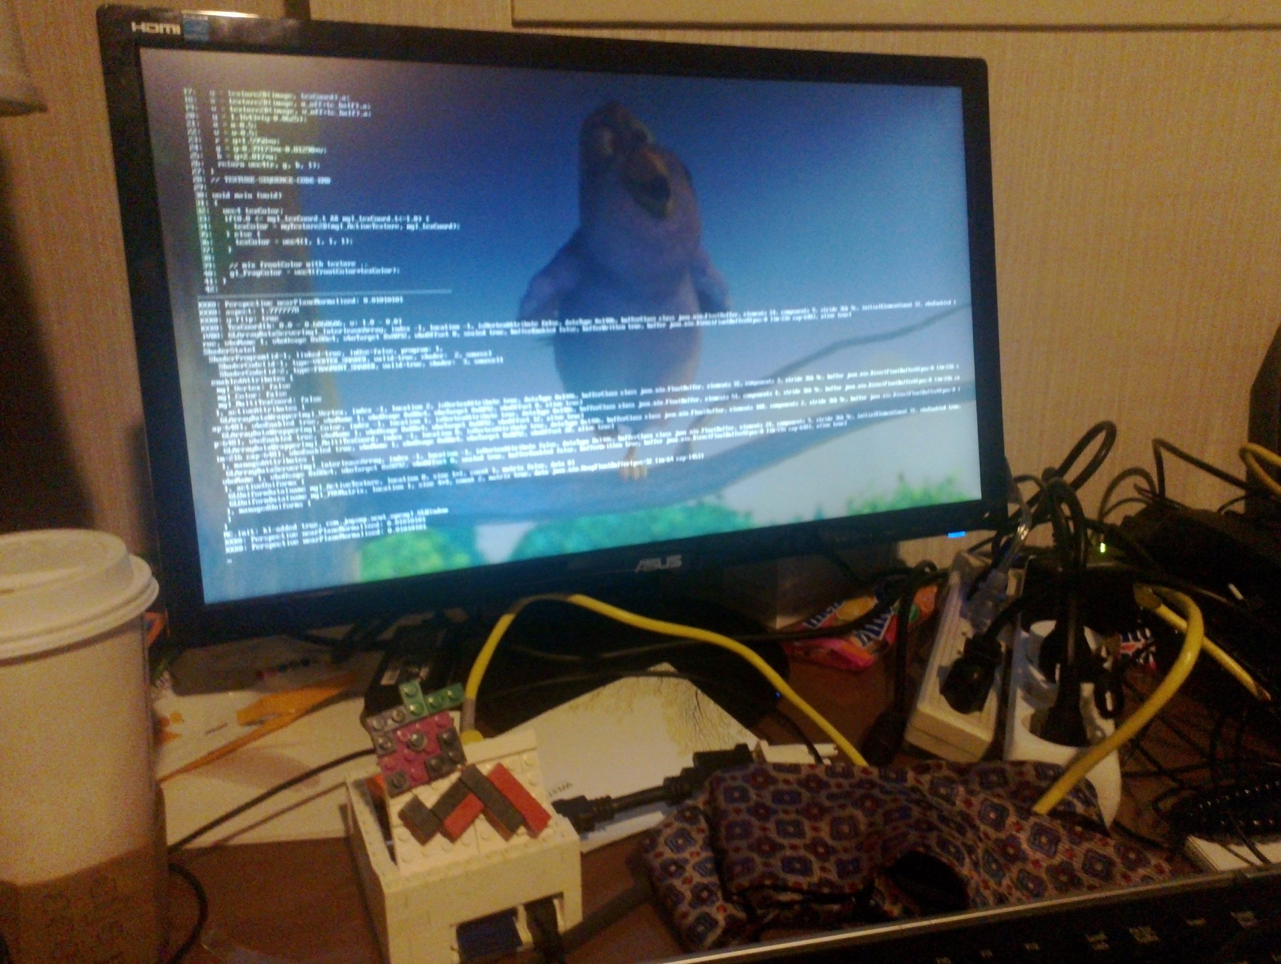
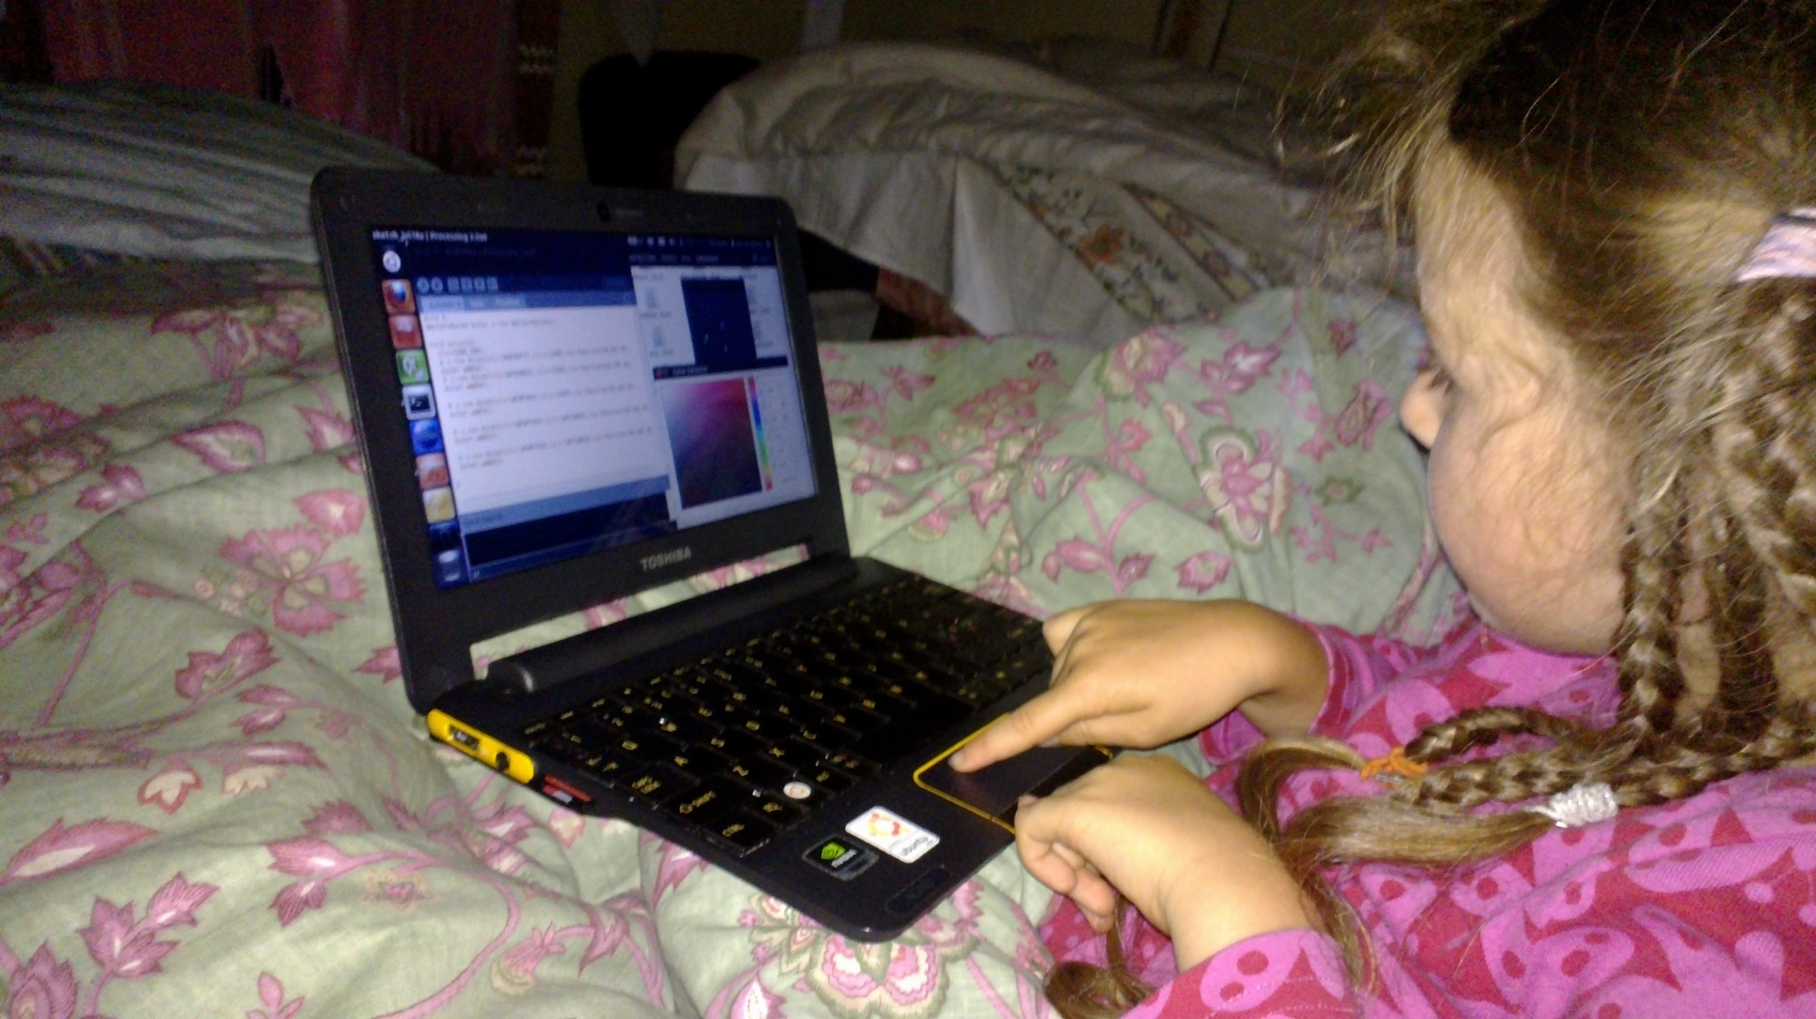
Raspberry Pi, AC-100

Slide 6

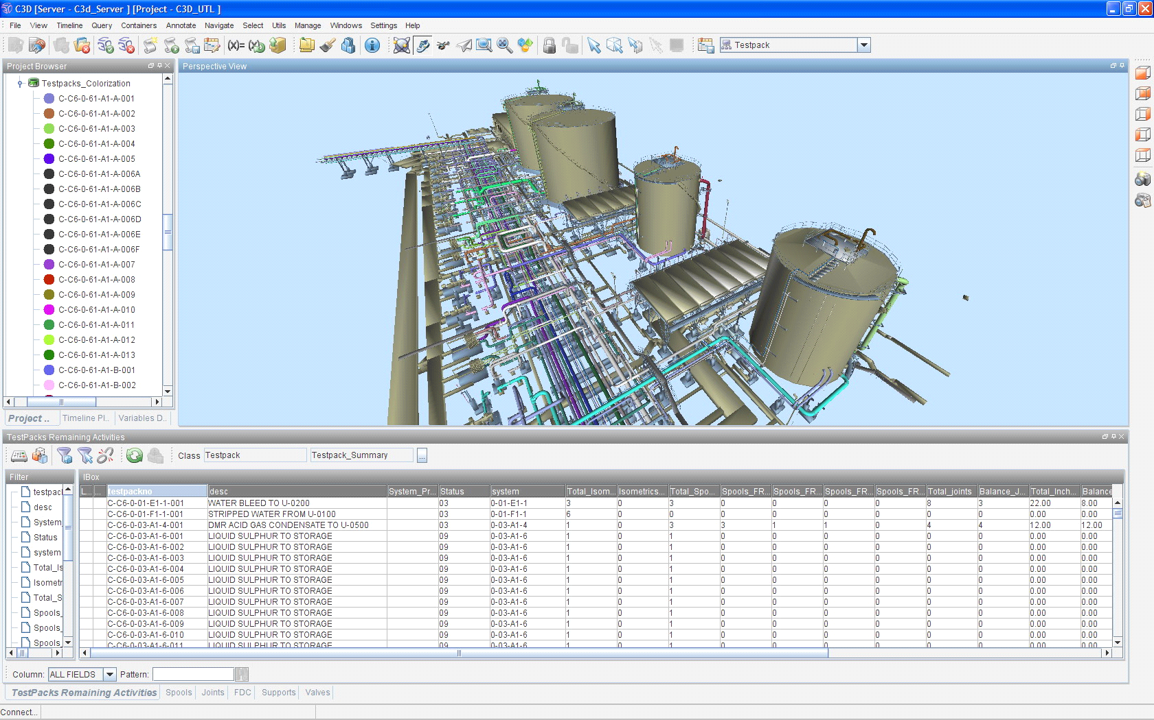
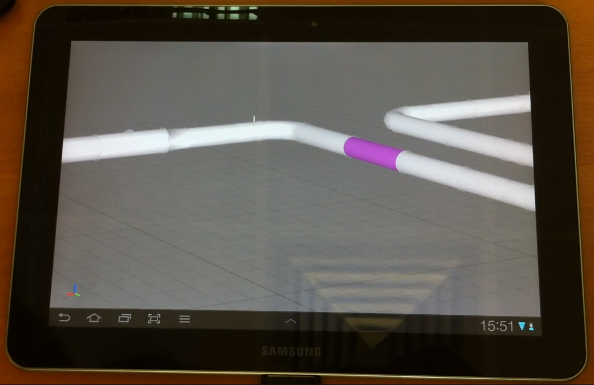
CAD Models
From Desktop to Mobile

Slide 7
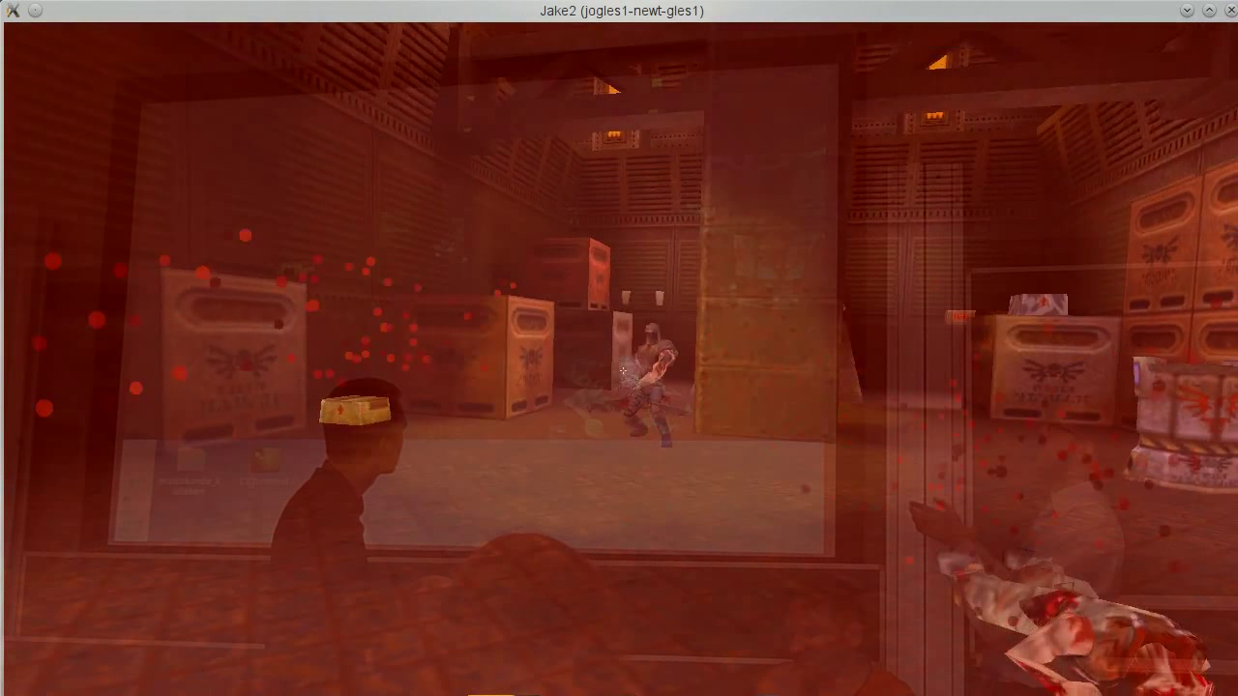
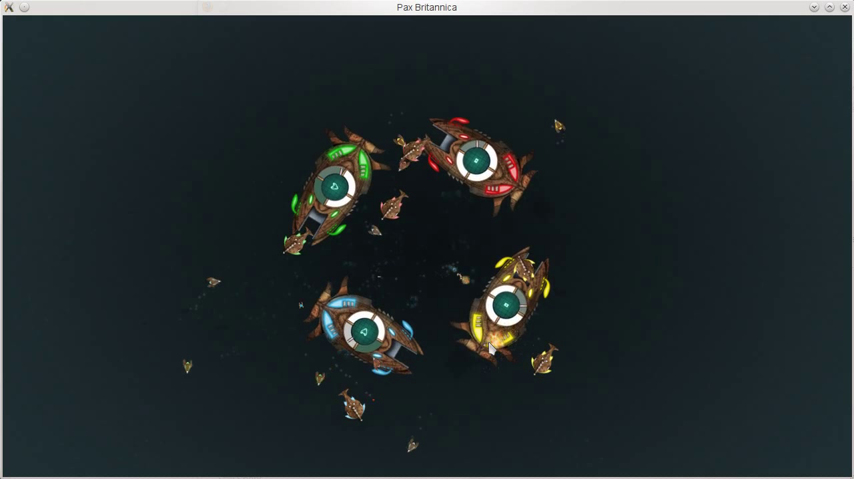
Games

