Slide 1
JogAmp: 2D/3D & Multimedia across Devices
SIGGRAPH 2012 – Los Angeles Convention Center
August 7, 2012
Presented by: Sven Gothel
Rami Santina
Xerxes Ranby
Wade Walker
Julien Gouesse

Slide 2
JOGL Android Binding
Why?
  Short Development Cycles
  No device specific development
  Supports NEWT (Multitouch, Surface, ...)
  Same code compiled for all – almost Android agnostic.
Deployment:
  adb install jogl.apk
  adb install myFancyapplication.apk
  Manual Daisy Chained ClassLoader, if desired.

Slide 3


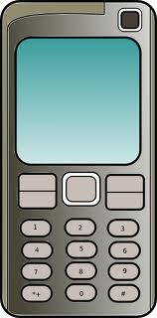
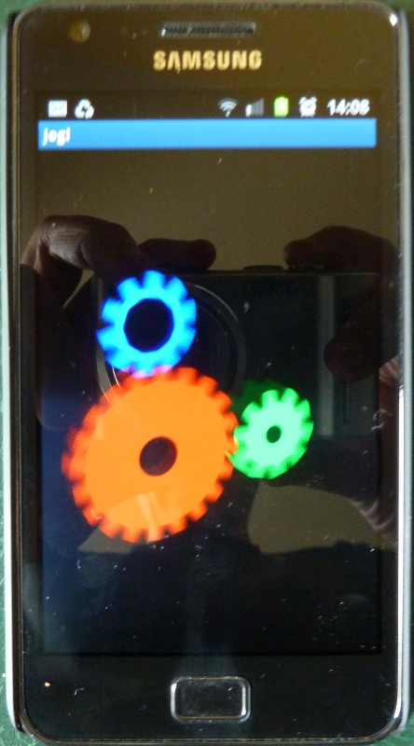

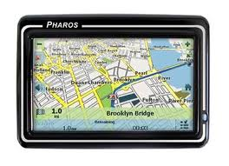
What is JogAmp?
JogAmp
JOGL – JOCL – JOAL ...

Slide 4

Cross Platform & Device Use Case
Visual Project Control
C3D Studio
C3D Viewer
C3D Mobile
Scenario Creation
Data Integration
Vertical Application Dev.
...
Model Visualization
On-site progress update
...
Model Visualization
Project Progress Update
4D Animation
Report Generation
Design Review
http://c3d.com

Slide 5
Art / Hartverdrahtet

Slide 6
About US
Open & Vendor Independent
BSD License
Java Graphics, Audio, Media & Processing
High Performance Bindings
One Stop Community Platform
  SCM, Bugtracking, Build Server, Mailinglist/Forum,..
Commercial Support
http://jogamp.org

Slide 7
Why JogAmp on Java?
Availability:
  Java, OpenGL, OpenCL, OpenAL, ..
  Multiple Vendors
    OpenJDK / IcedTea
    Oracle JDK
    IBM J9, ..
    PhoneME
    JamVM
    CacaoVM
    Dalvik
  x86, arm, ppc, sh4, ..
  GNU/Linux, Android, BSD, Mac OSX, Solaris/OpenIndiana, MS Windows

Slide 8
Why JogAmp on Java?
Managed Code
  Common API for
    Windowing
    GLDrawable / GLContext / GLSL
    I/O, Resource Handling (Texture, Code, ..)
    Rendering
  OpenGL Pipelining / Debugging / Trace
  Access to vast number of API / Middleware

Slide 9
JogAmp Continuity / Usage
Usage http://jogamp.org
  Ardor3D
  C3D Studio http://c3d.com
  Elflight Engine
  Processing
  Gephi
  NASA Worldwind
  Java3D
  ...

Slide 10
JogAmp Continuity / Maturity
Maturity
  Version 1
    JSR-231
  Version 2
    OpenGL Profiles (ES 1+2, GL 2 + 3 + 4 )
    Windowing Toolkit Abstraction
    Continuity Build/Test Server http://jogamp.org/chuck/
    86 GlueGen + 278 JOGL Unit Tests
Community Effort
  Ports [FreeBSD, ARM-HF, ..]
  Engine & Device Support
  Bug Entries, Test Cases & Fixes
  Code Reviews, Communication & General Help

Slide 11
JogAmp Deployment
Preinstalled Bundles
  Modularized JARs
  Android APKs (modular, or all-in-one)
  Maven
Online / Cached
  Automatic Native-JAR loading support
  Applet
    Classical
    JNLP
  Webstart (JNLP)

Slide 12
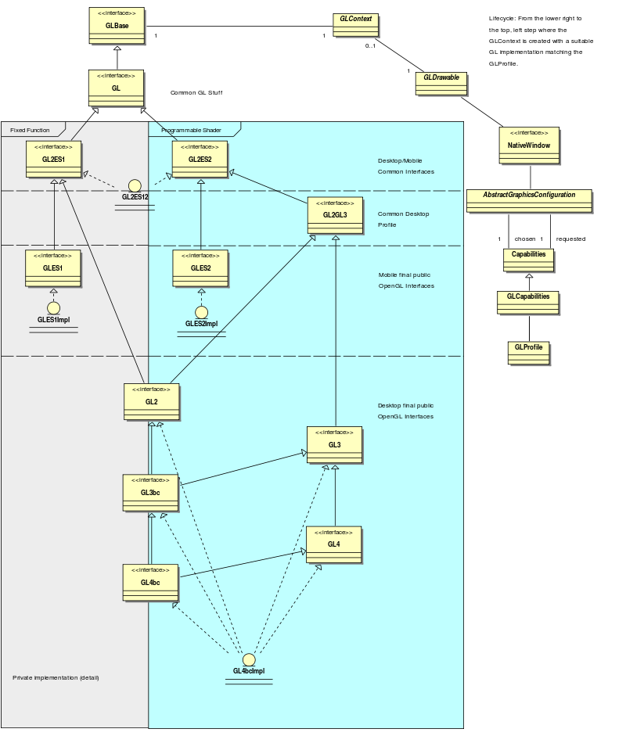
OpenGL Profiles

Slide 14
Windowing Toolkits
Native Window
Native Surface
X11
(Unix)
GDI
(Windows)
Android
Coco
(MacOSX)
SWT
(SWT Canvas)
AWT
(AWT Canvas)
GLX
WGL
EGL
CGL
GL

Slide 15
2011 – 2012 Enhancements
GLMediaPlayer
  Uses OpenMAX on Android via ICS's MediaPlayer / libstagefright
  Uses libav/libffmpeg where available
    Missing [OpenAL] audio output
  Missing native implementation for Win32 / OSX
Graph API for Curve & Text rendering via GPU
  Experimental UI
Mobile Bindings (Android Intel/ARM, Linux ARM)
Stability
NEWT AWT / SWT Enhancement
Documentation & Tutorials
Higher Community Participation

Slide 16
NEWT
Seamless integration w/ native Windowing System
  Multithreaded Access to Window Surface
  Lock free event handling
  Transparency, decoration and offscreen control
  Screen Mode API (fullscreen, resolution & rotation)
  X11, Win32, OSX, Android, OpenKD, .. implementation
  AWT and SWT integration via native re-parenting
  Desktop & Mobile

Slide 17
Graph API
Resolution Independent
Shapes and Curves

Slide 18

Resolution Independent Curve Rendering API
Based on Paper:
  R Santina, “Resolution Independent NURBS Curve Rendering using Programmable Graphics Pipeline”, presented in GraphiCon2011.
NOT Loop/Blinn
Patent Free
Can Render Bezier, Bsplines, NURBS

Slide 19
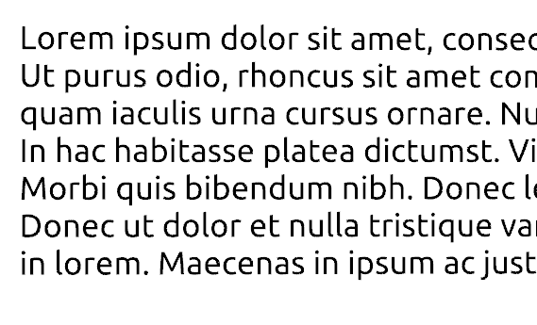

Resolution Independent Curve Rendering API
Why?
  Resolution Independent Text Rendering
  GPU based - Fast
  Seamless integration into Renderer (Scenegraph,...)
  New User Interface – across devices
  http://jogamp.org/deployment/jogamp-current/jogl-test-applets.html
  http://www.youtube.com/watch?v=Rqsu46ifMaw

Slide 20
JOGL Graph API
Outline → OutlineShapes → GLRegion
Renderer
  RegionRenderer
  TextRenderer (same as RegionRender)
    Helper methods for texts and fonts.
outline.addVertex(x, y, z, w, onCurve);
….
outlineShape.addOutline(outline);
outlineShape.addOutline(outline2);
region = GLRegion.create(outlineShape, getRenderModes());
region.render(gl, outlineShape,...);

Slide 21
JOGL Graph API
Initializing:
  Read Outlines ( from font, svg, application, ...)
  Modified Constrained Delaunay Triangulation
  Generate Region
Rendering:
  VBO buffers
  Realtime manipulation – weights
  Transformation....

Slide 22
GPU based Resolution Independent UI
Abstracted from the windowing toolkit
Support multithreading
Seamless integration into
  A native window (HUD)
  A custom Scenegraph (2D plane within 3D)
High Quality rendering
Super Fast

Slide 23
JOGL Graph.UI API
UIShape
UISceneController
Add/removeShape
GetSelected
getActiveUI
...
UITextShape
RIButton
RILabel
UIGroup
UITextBox
UITextArea
...
GLEventListener
Graph.curve API
MouseListener

Slide 24
UI Requirements (WIP)
Generic UI Rendering
  Rendering shall be performed using native rendering TKs (JOGL, ..)
  Render primitives on an offscreen 2D plane to be
    integrated into a custom 3D scenegraph
    rendered as a HUD.
Generic User Input
  Input events should be delegated from the custom scenegraph to the UI input module.

Slide 25
JOGL on Embeded Devices
Development Env:
  Beagleboard / Pandaboard w/ ARM7l / PowerVR
    Linux
    Android
  Platform based Unit tests
  Continuous Integration with auto-builds.
  Cross platform compilation/building
  Utilizing HW accelerated GL if available (EGL/ES)

Slide 26
JOGL Android Binding
Details:
  Enhanced EGL binding
  Exposing GLES1 and GLES2 native profiles
  GL2ES1 and GL2ES2 profiles for Desktop/Mobile
  Using Android SDK/NDK
    Requires SDK Level 9, Android 2.3 Gingerbread for NIO Surface access
  Tested with:
    Pandaboard - PowerVR
    Samsung Galaxy S2 – Arm/Mali
    Samsung Galaxy S – PowerVR
    Samsung Tablet / ASUS TF2 – Tegra2
    ASUS TF3 - Tegra3

Slide 27
JOGL Android Binding
Cross platform builds/tests with Linux host
Scripts provided in source code repository
NEWT Helper class (NewtActivity)
  Android Surface / NEWT Window mapping
  Android Input Event / NEWT translation

Slide 28
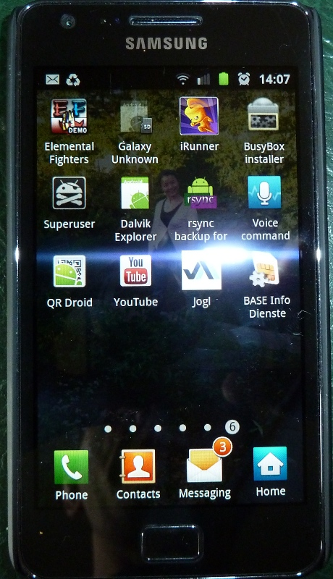
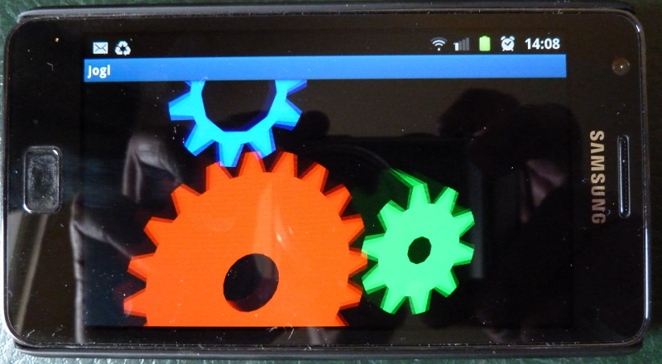
JOGL Android Binding
http://www.youtube.com/watch?v=VHxtVT4tWjM

Slide 29
JogAmp's Ecosystem
Middle and high level APIs
  Scenegraphs: Ardor3D, Java3D, JMonkeyEngine, JReality, Aviatrix3D, 3DzzD, Avengina, Xith3D, MSG
  UI frameworks: FengGUI, Nifty GUI
  Visualization frameworks: LibGDX, Jzy3D, GLG2D, Gephi, …
  Sound framework: Paul Lamb Sound Library
Low level APIs & bindings
  JOGL, JOCL, JOAL, JInput for JogAmp

Slide 30
Nifty GUI
UI framework
Layout in XML or Java
Some build-in widgets, effects and styles
Focused on easing controls creation rather than on providing tons of “standard” widgets

Slide 31
Java3D
Object oriented and scenegraph based API
Runs on top of JOGL
Supports GLSL
Spatial sound

Slide 32
Java3D
Pros:
  Quite easy to learn
  Lots of tutorials and examples
  Importers for some mainstream formats
  Supports some “exotic” devices (multiple screen projectors, gloves, headsets, …)

Slide 33
Java3D
Cons:
  Very dependent on AWT (hard to port to NEWT)
  Bad reputation (only minor maintenance loads for years, replaced by Prism in JavaFX)
  Performance concerns (memory, speed)
  Lacks lots of “common” features already implemented in other popular engines

Slide 34
Ardor3D
Java based retained mode 3D engine
Runs on top of JOGL, SWT OpenGL binding…
Supports GLSL
Skeletal animation
Supports Android
Hardware accelerated UI
Terrain system (with geometry and texture clipmaps, level of details, ...)

Slide 35
Ardor3D
Pros:
  Actively maintained
  Most reliable JOGL based renderers
  Abstracts rendering details but does not prevent you from extending its features with or without renderer independence
  Render delegates used for legacy OpenGL code
  Supports shaders (but still supports OpenGL 1.3)
  Both community and paid support

Slide 36
Ardor3D
Cons:
  Focused on rendering (no sound, no physics, no networking, no state machines)
  Lacks tutorials and very elaborated examples
  Lacks importers (only Collada, OBJ and MD2)
  Not yet any fully shader-based architecture (planned in Ardor3D 2.0)
  No integrated game development environment
  No build-in spatial partitioning

Slide 37
T.U.E.R
(Graphically rudimentary) first person shooter
Project started in October 2006
Has used 4 different 3D engines
  D3Caster (software rendering, raycasting)
  My own engine (JOGL, optimized for flat mazes)
  JMonkeyEngine 2 (with “my” custom JOGL renderer)
  Ardor3D (with “my” JOGL 2 renderer)
Focused on performance

Slide 38
T.U.E.R
Relying on several third party libraries
  JOGL 2.0
  JOAL 1.1.3
  JOrbis
  Ardor3D 0.8
  Paul Lamb's Sound Library
  Fettle API (state machine framework)

Slide 39
T.U.E.R
Main aspects about performance
  Careful threading
    Tick, update, render
    No interruption in rendering code
    No OpenGL context switch (when possible)
  Careful use of native resources
    Slicing of direct NIO buffers
    Destruction of useless direct NIO buffers

Slide 40
T.U.E.R
Main aspects about performance
  Mesh optimization: merge of coplanar adjacent right triangles whose all 2D texture coordinates are canonical
  Spatial partitioning
    BSP trees (wip)
    cells and portals (wip, only working on “flat” mazes)

Slide 41
T.U.E.R
JFPSM, WYSIWYG FPS editor
  3D visualizer and editor
  Designed for rapid prototyping
  Focused on the editing of the game design by combining existing models and the packaging rather than on the modeling (Blender is better for that)
  Allows to create “simple” 3D meshes from 2D maps and 3D patches

Slide 42
Q&A
Whats Next?
Why is neither Swing nor AWT recommended?
What are the supported IDEs?

Slide 43


Thank You
Rami Santina
Sven Gothel
Xerxes Ranby
Julien Gousse
Wade Walker
Demoscene Passivist
Mark Raynsford
Michael Bien
… all the many contributors & users

