Slide 1

Introduction and Optimizations

Slide 2
Topics Covered
Part I: What is Nifty GUI?
  A short Introduction to Nifty
  Showcase video of usage in games
Part II: Optimize OpenGL Performance
  General OpenGL Performance principles
  How we've applied them in the latest Nifty (1.3.3)
  Demonstration using JOGL

Slide 3
Part I
What is Nifty GUI?

Slide 4
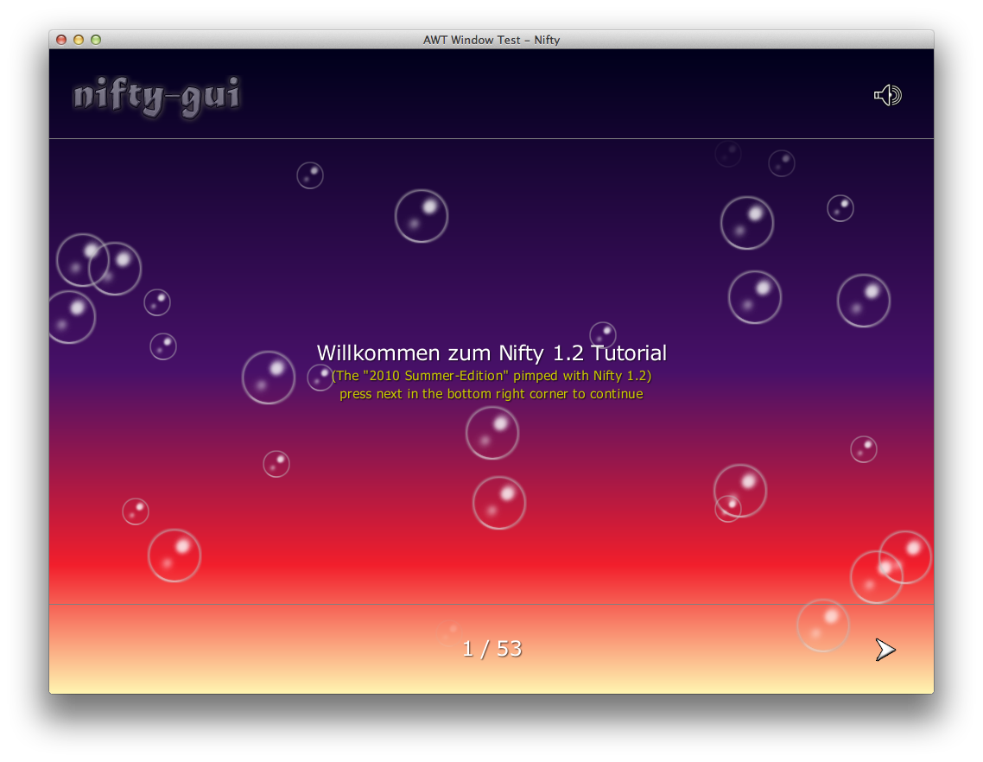
Live Demo: Nifty 1.2 Tutorial

Slide 5
What is Nifty GUI?
Java Library in Development since 2007
  Open source at Sourceforge since April 2008
  Several major releases so far (latest: 1.3.3)
  BSD-License
Use it to build interactive user interfaces for games and other interactive applications
  Can be extended and styled easily and provides many visual effects
  However, it is different from AWT/Swing or your other usual GUI framework

Slide 6
What is Nifty GUI?
Think of Nifty as a scenegraph
  At it's core Nifty only knows a limited number of core elements:
    Panel: a rectangle area with a plain color or gradient
    Image: an Image that can be displayed
    Text: used to output bitmap fonts
    Control: A combination of the above to form an abstraction like a Button, Textfield, ListBox and so on
  Nifty is used to layout and display these elements and handles keyboard and mouse events

Slide 7
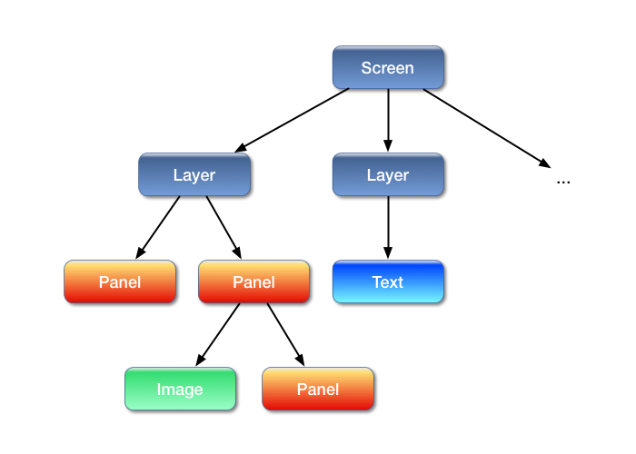
What is Nifty GUI?
Example Scenegraph structure:

Slide 8
What is Nifty GUI?
Scenegraph is stored in XML
  XML-Schema (XSD) available for validation and tool support
Scenegraph can be build from Java as well (using Java Builder Pattern)
Can be dynamically modified at runtime
  Add elements
  Remove elements
  Move elements

Slide 9
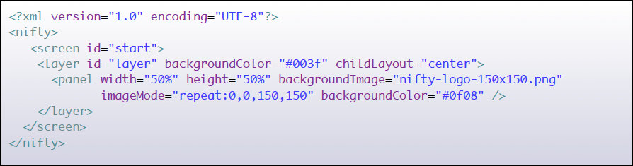
What is Nifty GUI?
Nifty XML example:

Slide 10
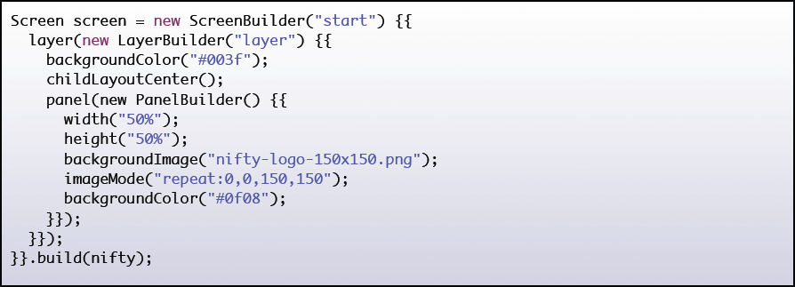
What is Nifty GUI?
The same example in Java:

Slide 11
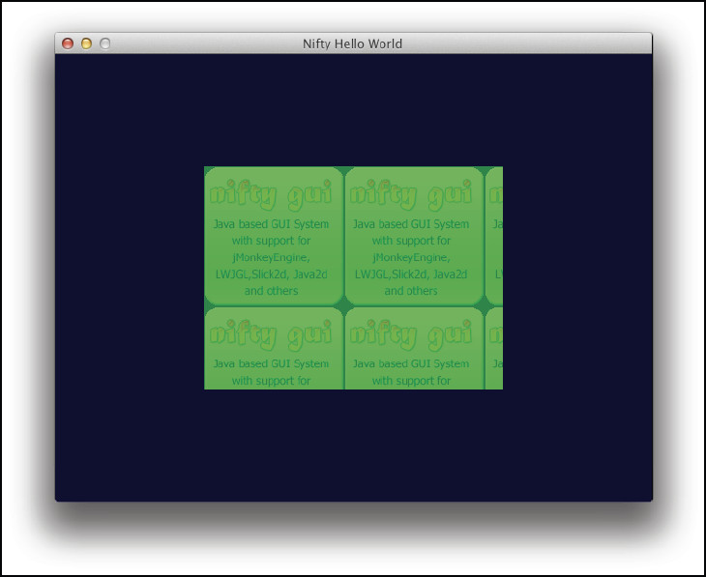
What is Nifty GUI?
Result: Panel with repeated background image

Slide 12
What is Nifty GUI?
Nifty is very versatile
  It doesn't rely on a specific graphics framework
  Existing adapters to several libaries available:
    JOGL, LWJGL, jMonkeyEngine, Slick2D, Java2D
    Need a different one? a SPI (Service Provider Interface) is available and can be easily implemented by yourself!
  Easy to integrate into your code
    It doesn't take over your complete rendering
    Just call nifty.render() when you want it to render and nifty.update() to let it update internal state

Slide 13
What is Nifty GUI?
General use-cases for Nifty:
  Interactive Menus and Displays
  Game Option screens
  In-Game HUD Displays
  Anything that displays icons or text with Java and wants to do that in a somewhat nifty way ;)
Let's show some real world examples of Nifty next as its being used in actual games...

Slide 14
Nifty in Games
Video Showcase

Slide 15
Nifty GUI – More Information
Nifty GUI – The Missing Manual
  Tutorial and reference documentation
  Everything you ever wanted to know about Nifty
  100+ Pages
  Available as a free PDF-Download
    http://sourceforge.net/projects/nifty-gui/files/nifty-gui/1.3.2/nifty-gui-the-manual-1.3.2.pdf/download

Slide 16


Nifty GUI – More Information
Project Pages:
  Github:
  https://github.com/void256/nifty-gui
  Sourceforge: https://sourceforge.net/projects/nifty-gui/
  Twitter:
  https://twitter.com/niftygui
  Blog:
  http://nifty-gui.lessvoid.com/

Slide 17
Part II
OpenGL Performance
Optimization
Explained and Applied with
Nifty GUI 1.x

Slide 18
Overview
Now we'll go a bit more into details:
  Introduction to the Nifty Renderer and why it performed not so optimal
  What can you do in general to speed up OpenGL rendering and how that was applied to Nifty
Results of the improved Renderer
Additional benefits of the new way to render

Slide 19
Nifty SPI

Slide 20
Nifty SPI
Nifty provides Java Interfaces for:
  Rendering
  Inputevents (Keyboard + Mouse)
  Sound output
Everything Nifty needs is abstracted into these interfaces
Nifty is build on top of the SPI

Slide 21
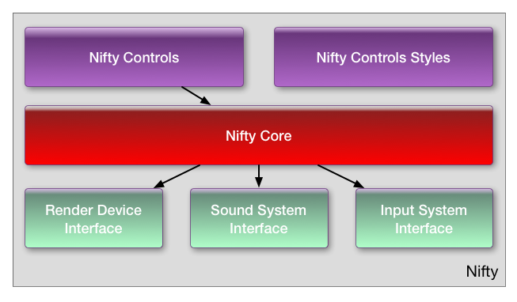
Nifty SPI
Overview of components and the SPI (in green)

Slide 22
Nifty RenderDevice
A closer look at the RenderDevice SPI:
  Java interface de.lessvoid.nifty.spi.render.RenderDevice
  Tasks:
    provide screen dimensions to Nifty, load images/fonts
    Methods called when render frame begins and ends
    Set (OpenGL) states like blend mode and clipping
    Main task: render colored quads, images and text
  At the end all Nifty-GUI elements end up as quads, images and text

Slide 23
Nifty RenderDevice
Here are the interesting render*() methods
public interface RenderDevice {
...
void renderQuad(int x, int y, int width, int height, Color color);
void renderQuad(int x, int y, int width, int height, Color topLeft, Color topRight, Color bottomRight, Color bottomLeft);
void renderImage(RenderImage image, int x, int y, int width, int height, Color color, float imageScale);
void renderImage(RenderImage image, int x, int y, int w, int h, int srcX, int srcY, int srcW, int srcH, Color color, float scale, int centerX, int centerY);
void renderFont(RenderFont font, String text, int x, int y, Color fontColor, float sizeX, float sizeY);
...
}

Slide 24
Nifty RenderDevice
Typical Nifty rendering looks like this:
  renderDevice.beginFrame();
    renderDevice.setBlendMode(BlendMode.BLEND);
    renderDevice.renderQuad(...);
    renderDevice.renderImage(..);
    renderDevice.enableClip(...);
    renderDevice.renderQuad(...);
    … and so on
  renderDevice.endFrame();

Slide 25
So …
What's wrong with the existing implementation?

Slide 26
Rendering – What's wrong
The current implementation took a somewhat naive, brute-force approach:
  Vertex submission is using immediate mode with many calls to GL: glBegin, glVertex, …
  OpenGL state is changed in every render* method
    Texturing is enabled/disabled all the time and the current texture is switched to different textures
    clipping rectangle is changed/enabled with glScissors
    Blendmode is change with glBlendMode as needed

Slide 27
We can do better:
General OpenGL Performance Tips

Slide 28
General OpenGL wisdom
f.i. found in: „OpenGL Insights, Chapter 25“ or „OpenGL Programming Guide for Mac“:
  Avoid glBegin/glEnd calls: function call and data copying overhead. Better use VBO or at least client-side vertex arrays.
  Avoid redundant state changes: Save time by removing unnecessary calls to GL
  Group primitives together so that they can be rendered with as few draw calls as possible

Slide 29
General OpenGL wisdom
f.i. found in: „OpenGL Insights, Chapter 25“ or „OpenGL Programming Guide for Mac“:
  Avoid glBegin/glEnd calls: function call and data copying overhead. Better use VBO or at least client-side vertex arrays.
  Avoid redundant state changes: Save time by removing unnecessary calls to GL
  Group primitives together so that they can be rendered with as few draw calls as possible
So actually, Nifty did that all wrong ;-)

Slide 30
Let's fix the renderer!
One Issue at a time

Slide 31
Step 1: Optimize vertex submission

Slide 32
Step 1: Optimize vertex submission
Use Vertex Arrays (really a no brainer)
  Available since early OpenGL 1.1 days (1995)
  Store all vertices in an array and give OpenGL a pointer to that array
This helps because:
  There are no individual glBegin/glVertex/glEnd calls for each quad anymore. This saves us thousands of OpenGL calls for complex GUIs.

Slide 33
Step 1: Optimize vertex submission
Usage in Nifty:
  The optimized RenderDevice keeps a single FloatBuffer for all Quads that need to be rendered
  The render* methods will now simply add four vertices of the current quad to this FloatBuffer
  In the endFrame method Nifty draws them all with a single glDrawArrays(GL_QUADS...) call
This reduces the number of OpenGL draw calls significantely

Slide 34
Step 2: Optimize Texture State

Slide 35
Step 2: Optimize Texture State
Trick: Let texturing enabled all the time so we don't have to switch it always on and off ;)
  Always submit textured quads
  How to render a plain colored quad then?
    Simply render a special prepared area of the texture that contains solid white colored pixels
    Stretching a single white pixel to the size of the quad will fill the quad with white color
    Can be combined with vertex colors as well

Slide 36
Step 2: Optimize Texture State
How to render different images?
  Combine all individual images into one big texture and keep this texture always active!
Texture Atlas ftw!
  solution is simple in theory but was quite involved
  In most cases you would combine textures as a pre-process but for Nifty it needs to be dynamic
    Images can be loaded / disposed at any time and are likely to change between Nifty Screens

Slide 37
Step 2: Optimize Texture State
Let’s enter the world of texture packing:
  Is actually a huge topic
    see PhD Thesis of Andrea Lodi: „Algorithms for Two Dimensional Bin Packing and Assignment Problems“
  Looking for a simple solution:
    Popular „Lightmap Packing Algorithm by Black Pawn“:
    http://www.blackpawn.com/texts/lightmaps/
    Java port already available by lukaszdk:
    https://github.com/lukaszdk/texture-atlas-generator
      Modified for Nifty to separate algorithm from graphics handling
      Results available as TextureAtlasGenerator class (single self-contained class in Nifty repo but with no Nifty dependencies)

Slide 38
Step 2: Optimize Texture State
Nifty texture atlas algorithm overview:
  Each Nifty Screen starts with an empty texture (2k texture worked well)
  Nifty tracks which image belongs to which Screen when images are first accessed
  Position in the texture atlas will be determined by TextureAtlasGenerator algorithm so that all required images are added to the atlas
  Switching images is then simply a modification of the texture coordinates of individual quads

Slide 39
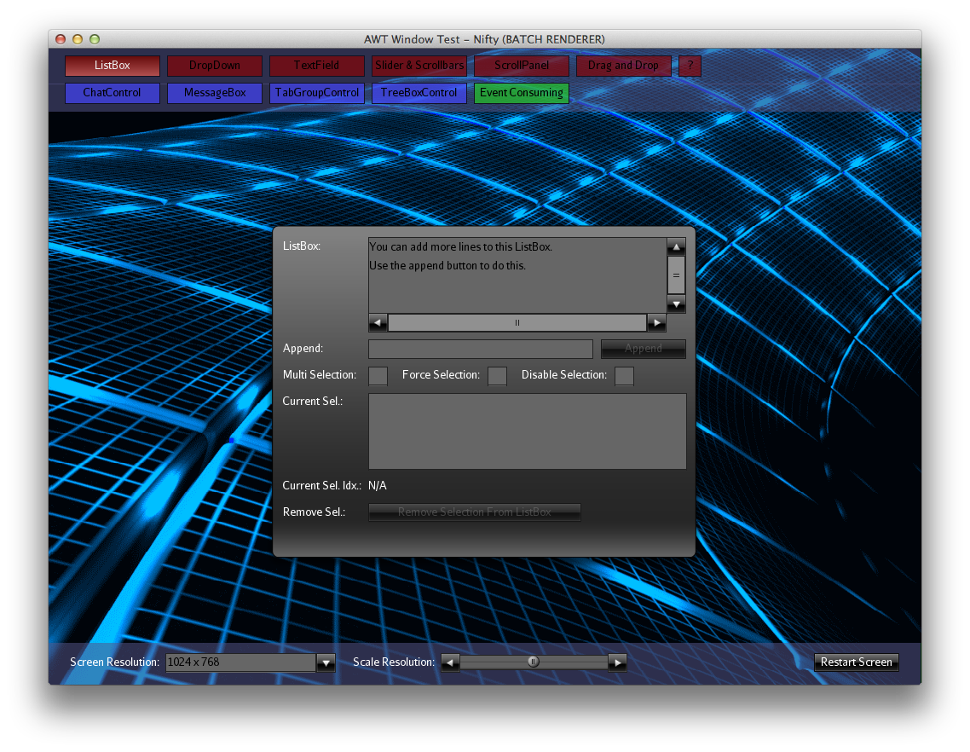
Step 2: Optimize Texture State
Example: Nifty Standard Controls Demo

Slide 40
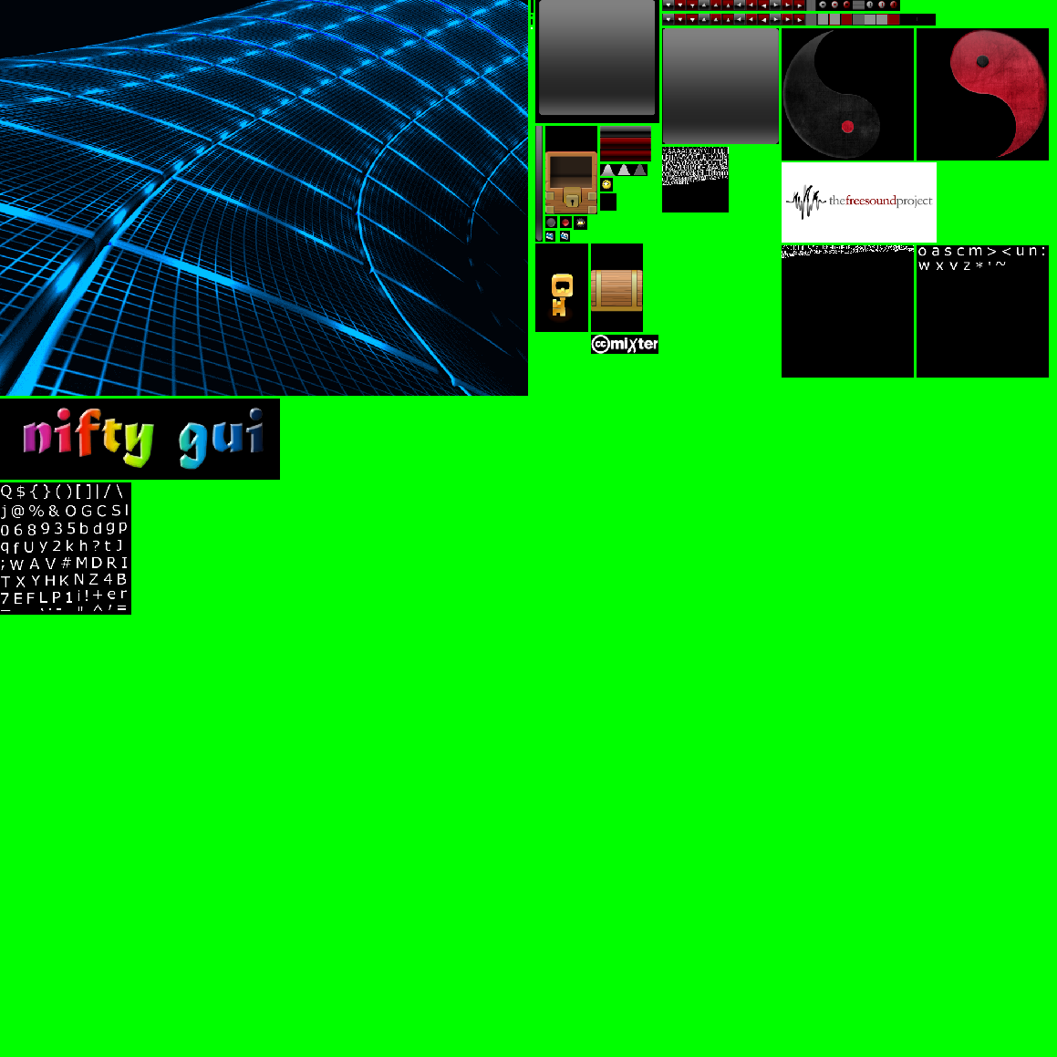
Step 2: Optimize Texture State
On the fly generated texture atlas (2048x2048)

Slide 41
Step 2: Optimize Texture State
Things to consider:
  When accessing images while a screen is already active, Nifty needs to upload the texture on the fly
    glSubImage* is used to update parts of the texture
    You can get away with a couple of sub texture uploads per frame but would be best if most images are known when the Nifty screen is initialized
  If the image does not fit into the atlas Nifty will complain in the log but will continue working
  The texture atlas is reset when you switch from one screen to another

Slide 42
3. Optimize Clipping

Slide 43
3. Optimize Clipping
Nifty allows you to specify a „childClip“ attribute
  All child elements will then be clipped to the parent
glScissors is used for this but can't be used in between a single glDrawArrays call
Solution: Clip on the CPU!
  It's only 2d so it's easy
  Already clipped quads will be added to the vertex array
  Result: no changes to glScissors necessary!

Slide 44
4. Optimize Blendmode

Slide 45
4. Optimize Blendmode
Only two blendmodes supported by Nifty:
  Standard: regular alpha transparency blending
    glBlendFunc(GL_SRC_ALPHA, GL_ONE_MINUS_SRC_ALPHA)
  Optional blendmode multiply (for special effects):
    glBlendFunc(GL_DST_COLOR, GL_ZERO)
Can't change blendmode while rendering VA
Compromise: Nifty will create a new batch (new vertex array) when blendmode changes
  Rendering some batches still better than hundreds

Slide 46
Put everything together:
Unified RenderDevice

Slide 47
Unified RenderDevice
All of the discussed steps required to be supported in all adapter implementations:
  Batched JOGL, Batched LWJGL, Batched JME3 and so on
  These implementations have to solve the exact same problems (Texture atlas, Batching, …)
  Not a very clever approach
Better solution: solve it once for all adapters:
  Provide a unified batched RenderDevice impl!

Slide 48
Unified RenderDevice
Default implementation for the RenderDevice:
  de.lessvoid.nifty.batch.BatchRenderDevice handles everything we've discussed so far
Specific adapters still needed but now:
  Much simpler
  Will just receive the quads and have to cache them so that they can be rendered in one step later
  New: need to be able to replace subtextures

Slide 49
Unified RenderDevice
Additional benefits:
  Text rendering is now handeled inside of Nifty
    Each glyph is just a simple quad
    Kerning, text string width calculations as well as text encoded colors are handled in the same way
    Text finally looks exactly the same in all libs
Replacing existing RenderDevice with the new one is very easy
  Just use the BatchRendererDevice now and provide the BatchRendererDevice with the adapter impl

Slide 50
One more thing...

Slide 51
OpenGL Core Profile Support
Up until now only legacy OpenGL support
  Couldn't really use Nifty when you use Core Profile
  Simpler Interface made support now easy
Can finally use modern OpernGL with Nifty too
OpenGL ES support using JOGL currently work in progress but should be available soon

Slide 52
Optimization Results

Slide 53
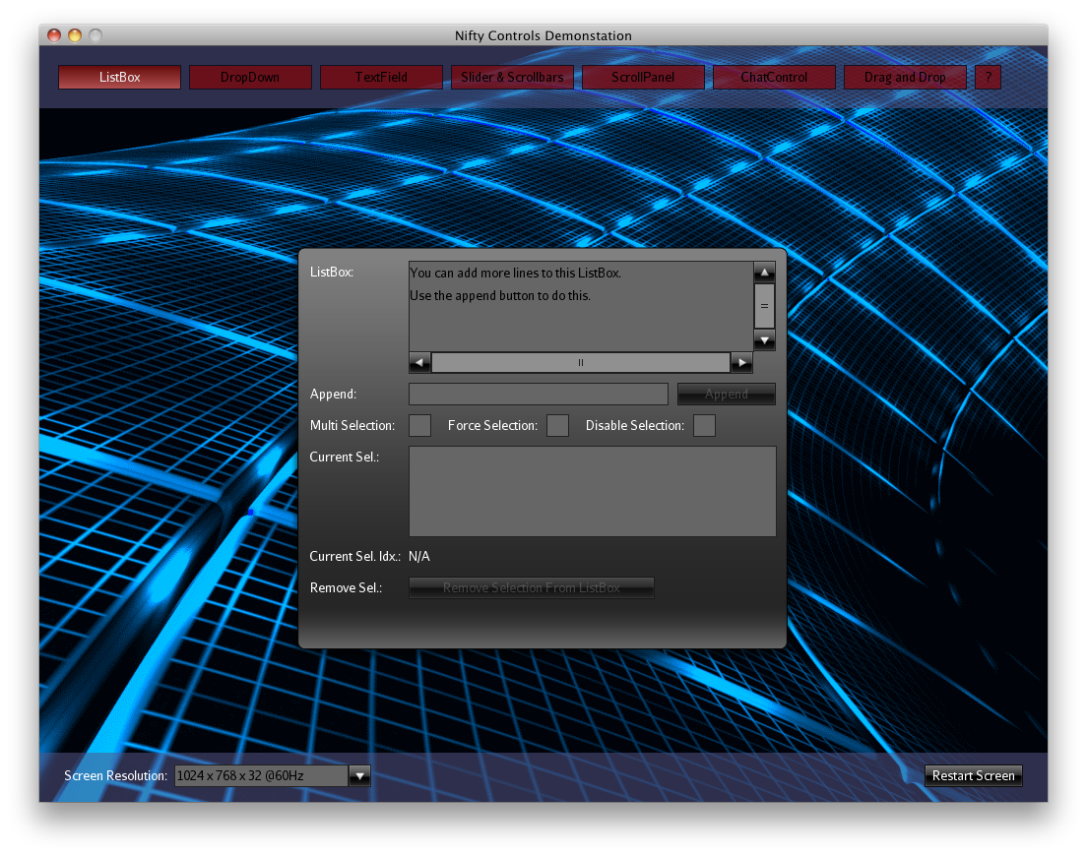
Results of the improved Renderer
Test: Nifty Standard Controls Demo

Slide 54
Results of the improved Renderer
Test: Nifty Standard Controls Demo
  ~600 Quads, ~2400 Vertices
Mac Pro, Early 2009, OS X 10.8.4
  2 x 2,26 Ghz Quad-Core, 8 GB RAM
  ATI Radeon HD 5870 1024 MB
Results (Rendertime Nifty in ms):
Old Renderer | Batched | Batched Core Profile
1.736 ms | 0.617 ms | 0.642 ms

Slide 55
Results of the improved Renderer
How much you gain depends on the complexity of your GUI
  Very few elements: you don't gain a lot since there is not much overhead
  Many elements/complex GUI: batched renderer works a lot better (more FPS, less frametime)

Slide 56
Live Test/Demo
Using Controls Demo

Slide 57
Nifty GUI
Future Plans

Slide 58
Nifty GUI – Future
Nifty 2.0!
  Apply everything we've learned so far to make Nifty better (and we've learned a lot in the last 5 years ;)
  But keep the basic concepts the same
    Layout algorithms, Elements, Controls
Provide better performance
  If nothing has changed don't render anything at all
  (Dirty rectangle optimizations)
  Render to Texture support
    cache element content

Slide 59
Nifty GUI – Future
More Features
  Provide canvas support
    Render points and lines, maybe curves too
    Generate content instead of fixed images
  Provide real transformation matrix per Nifty Element
  (rotate elements, scale, perspective distortion, 3d ..)
  Provide fragment shader effects (Shadow, Gaussian blur and so on)

Slide 60
Nifty GUI – Future
API changes
  Make core API simpler
    Remove need to call layoutElements() manually
  Provide clean public API
    Internals and public API kinda mixed in current generation Nifty 1.x – pretty confusing at times
ETA
  Preview version Christmas 2013
  Final version 2014

Slide 61
Nifty GUI
Contact

Slide 62
Nifty GUI - Contact
Software Development Jens Hohmuth
  Commercial Nifty GUI support available
E-Mail: jens.hohmuth@gmx.de
Twitter: https://twitter.com/void256

Slide 63
Thanks!

