Slide 1
JogAmp Fast Media & Processing
Across devices – Desktop & Mobile
SIGGRAPH 2013 – Anaheim
July 24, 2013
Dominik Ströhlein
Erik Brayet
Jens Hohmuth
Julien Gouesse
Mark Raynsford
Alan Sambol
Harvey Harrison
Rami Santina
Sven Gothel
Wade Walker
Xerxes Ranby

Slide 2
Info
Slides and BOF Video
will be made available
on
Jogamp.org.

Slide 3
10 Years ...
2003-06-06 GlueGen, JOGL, JOAL
2008-04-30 JOGL Release 1.1.1
2009-07-24 JOCL
2009-11-09 Independent Project
2010-05-07 JogAmp Project Name, Server, ..
2010-11-23 JogAmp RC 2.0-rc1
2013-07-17 JogAmp Release 2.0.2

Slide 4
… used by
GLG2D, Java3D (Vzome, SweetHome3d, XTour), Jake2, ...
JMonkey3, libGDX, Ardor3D, ...
Catequisis, Ticket to Ride
Nifty GUI, Graph, MyHMI, ...
Jspatial, SciLab, GeoGebra, BioJava, WorldWind, FROG, jReality, Gephi, Jzy3D, dyn4J, Processing, JaamSim, C3D, ...

Slide 5
GLG2D
Legacy
Problem:
  Traditional Java2D uses a CPU based rendering engine.
  Modern Java2D uses a hidden GPU based rendering engine.
Replaces CPU Java2D rendering engine with painting using OpenGL.
Accelerate the most common ways that applications use Java2D drawing.
Uses the latest JogAmp JOGL libraries for the OpenGL implementation.
GLG2D

Slide 6
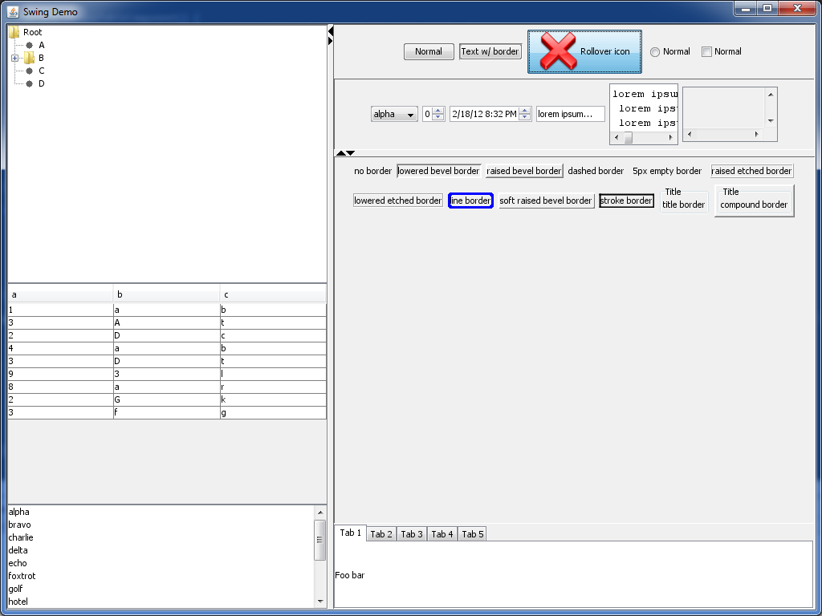
GLG2D
Legacy
Swing behaves exactly as before, except that it' being painted to an OpenGL canvas instead.
GLG2D

Slide 7

GLG2D
Legacy
– More Information
Project Pages:
  Github:
  https://github.com/brandonborkholder/glg2d
  Homepage: http://brandonborkholder.github.io/glg2d/
GLG2D

Slide 8
Java3D – I'm not Dead!
Legacy
Work underway as early as 1997
1.5.2 released Feb2008, GPLv2 w/ classpath
Abandoned in 2008 for JavaFX...coming soon?
Native OpenGL, D3D backends and Jogl 1.1
1.6 devel branch in SVN....with a handful of fixes – vecmath, j3dcore, j3dutils but no release
No longer functions on contemporary OSX
Java3D

Slide 9
Jogl2 Port Feb 2012
Legacy
Julien Gouesse did initial work
August Lammersdorf gave invaluable advice
Harvey Harrison current victim maintainer
Pure Java project, all native backends removed
Jogl2 is the only supported backend
Assume Java6 minimum (remove Java 1.3 compat code – not kidding)
Java3D

Slide 10
The Future
Legacy
Very mature API
NO API CHANGES
Drop in replacement for 1.5.2
Support existing users, advise others to start with something more 'alive'
1.6.0-final when contemporary OSX regressions are fixed
Java3D

Slide 11
RTFS
Legacy
Harvey Harrison <harvey.harrison@gmail.com>
PGP 0x40A76BC6
https://github.com/hharrison/vecmath
https://github.com/hharrison/j3dcore
https://github.com/hharrison/j3dutils
http://jogamp.org/deployment/java3d/
http://forum.jogamp.org
Java3D

Slide 12
Sweethome3d
Legacy
http://www.sweethome3d.com
Used for the applet version on Java7/MacOSX
Mostly a drop-in replacement
Wider use expected after Java7u40
Java3D

Slide 13
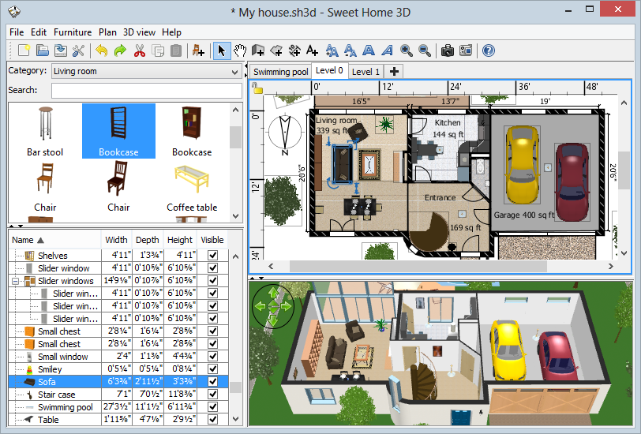
Sweethome3d
Legacy
Java3D

Slide 14
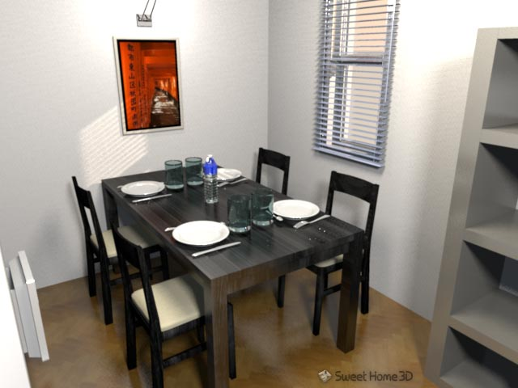
Sweethome3d
Legacy
Java3D

Slide 15
VZome
Legacy
http://vzome.com/
Worked well out of the box
Worked with webstart even with recent JVM updates
Java3D

Slide 16
VZome
Legacy
Java3D

Slide 17
XTour
Legacy
Planning software for VIMS instrument on the Cassini Probe orbiting Saturn
Used to plan observation, visualize likely results from a given command stream
Client-Server solution
Java3D

Slide 18
XTour
Updated Java3d removed need for installation on client machines
Worked out of the box, drop in replacement
Avoided rewriting application
Java3D

Slide 19
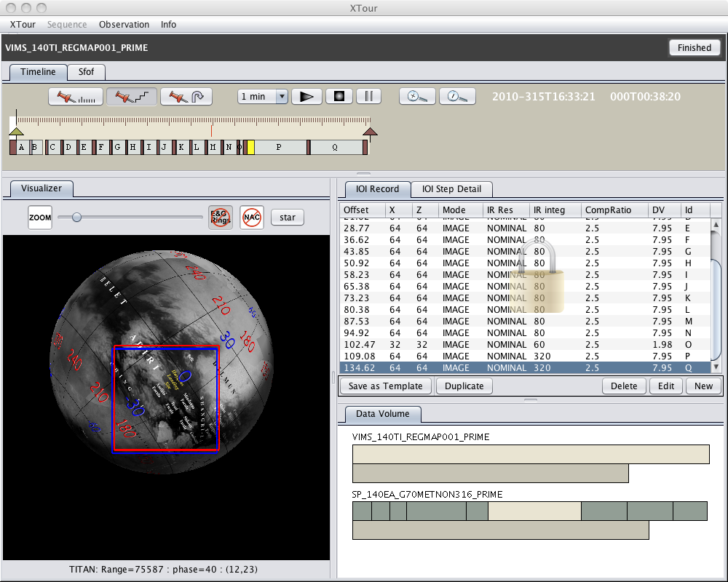
XTour
Legacy
Java3D

Slide 20
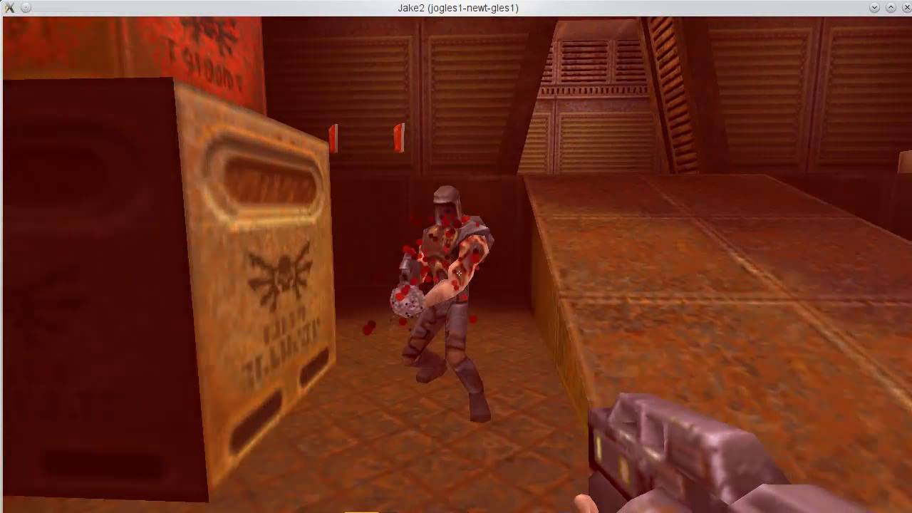
Jake2
Legacy
Port of id Software's Quake II to Java by bytonic software.
JOGL enables Jake2 to run on mobile and desktop.
FFP emulation on ES2 hardware
JOAL / JOGL testbed
Deployment (NApplet / Webstart)
JOGL1 to JOGL2 porting example
Napplet Demo
Jake2

Slide 21

Games
Cross-platform API for game and real-time application development.
Flexible workflow, NOT one size fit all.
Availability on desktop and mobile utilizing the JogAmp backend.
Released under the Apache 2.0 license.

Slide 22
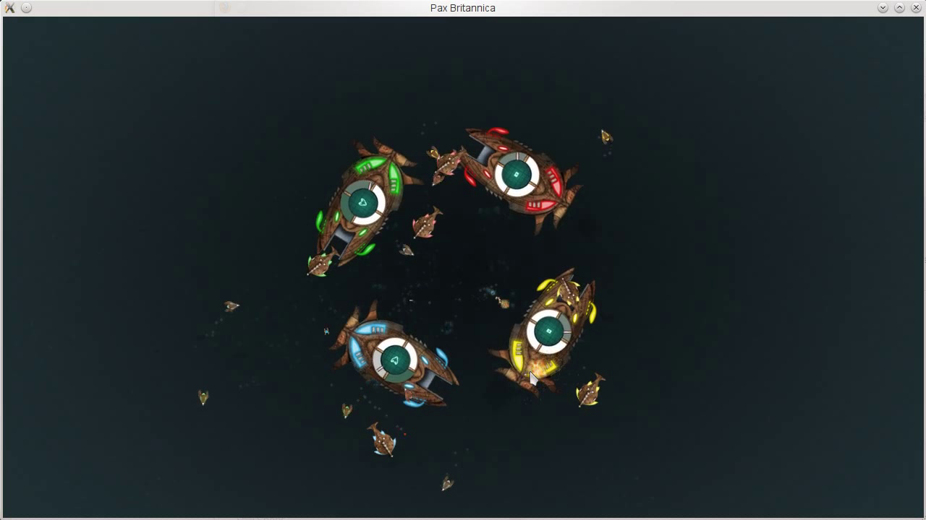
Games

Slide 23
Games
– More Information
Project Pages:
  Github:
  https://github.com/libgdx/libgdx
  Homepage: http://libgdx.badlogicgames.com/
  Twitter:https://twitter.com/badlogicgames
  Blog:
  http://www.badlogicgames.com/

Slide 24

Games
Project Pages:
  Homepage: http://jmonkeyengine.org

Slide 25



Games
http://www.catequesis.eu/

Slide 26
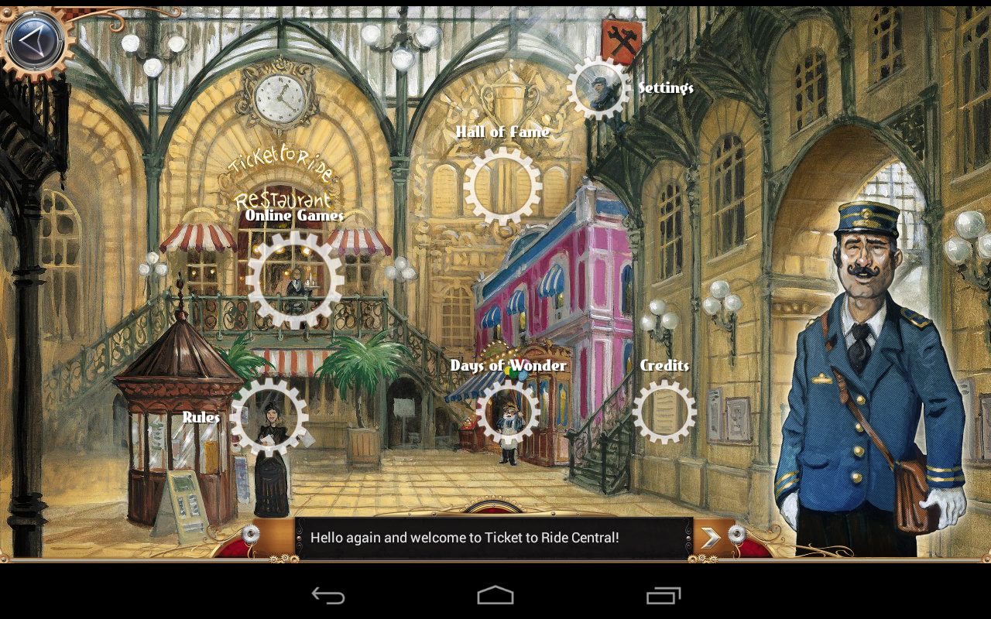
Ticket to Ride
Games

Slide 27
Ticket to Ride
Games
Video game adapted from the board game
Solo game offline
Multiplayers game online
  Client and server written in Java
Available as Java applet, plain installer, via Steam (Windows, MacOS, Linux), via Google Play, via Amazon App store

Slide 28
Ticket to Ride
Games
Java + JOGL + JOAL
Runs (almost) everywhere:
  Applet (no JOGL, but code shared with other clients)
  Desktop (Windows, MacOS, Linux)
  Mobile & tablets (Android) with a few platform-specific optimizations like native image loading
Passed Google Android Validation

Slide 29

UI
Java Library in Development since 2007
  Open source at Sourceforge since April 2008
  Several major releases so far (latest: 1.3.3)
  BSD-License
Use it to build interactive user interfaces for games and other interactive applications
  Can be extended and styled easily and provides many visual effects
  However, it is different from AWT/Swing or your other usual GUI framework

Slide 30
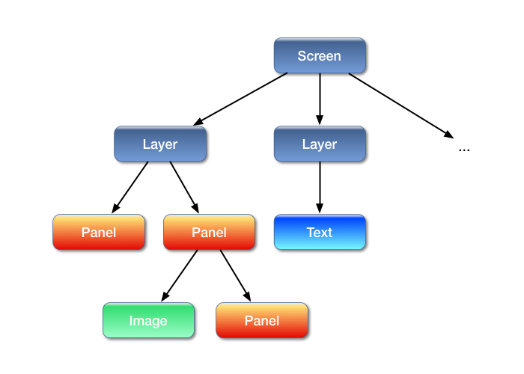
UI
Think of Nifty as a scenegraph

Slide 31
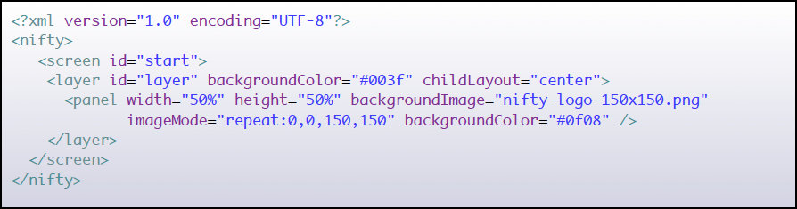
UI
Scenegraph is stored in XML
Can be dynamically modified at runtime

Slide 32
UI
Existing adapters to several libaries available:
  JOGL, LWJGL, jMonkeyEngine, Slick2D, Java2D
  Need a different one? a SPI (Service Provider Interface) is available and can be easily implemented by yourself!
  Seamless integration with your rendering workflow
General use-cases for Nifty:
  Interactive Menus and Displays
  Game Option screens
  In-Game HUD Displays
  Anything that displays icons or text with Java and wants to do that in a somewhat nifty way ;)

Slide 33
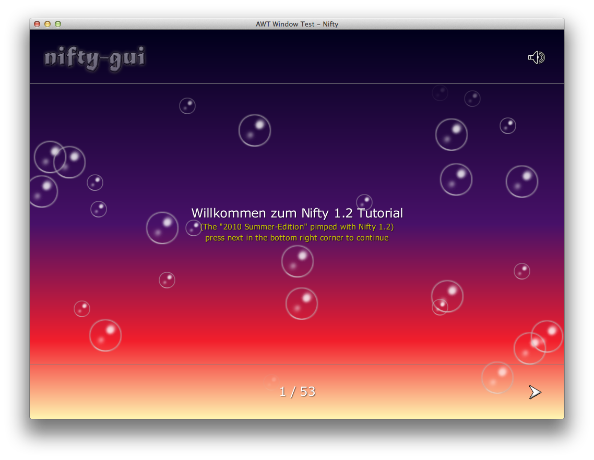
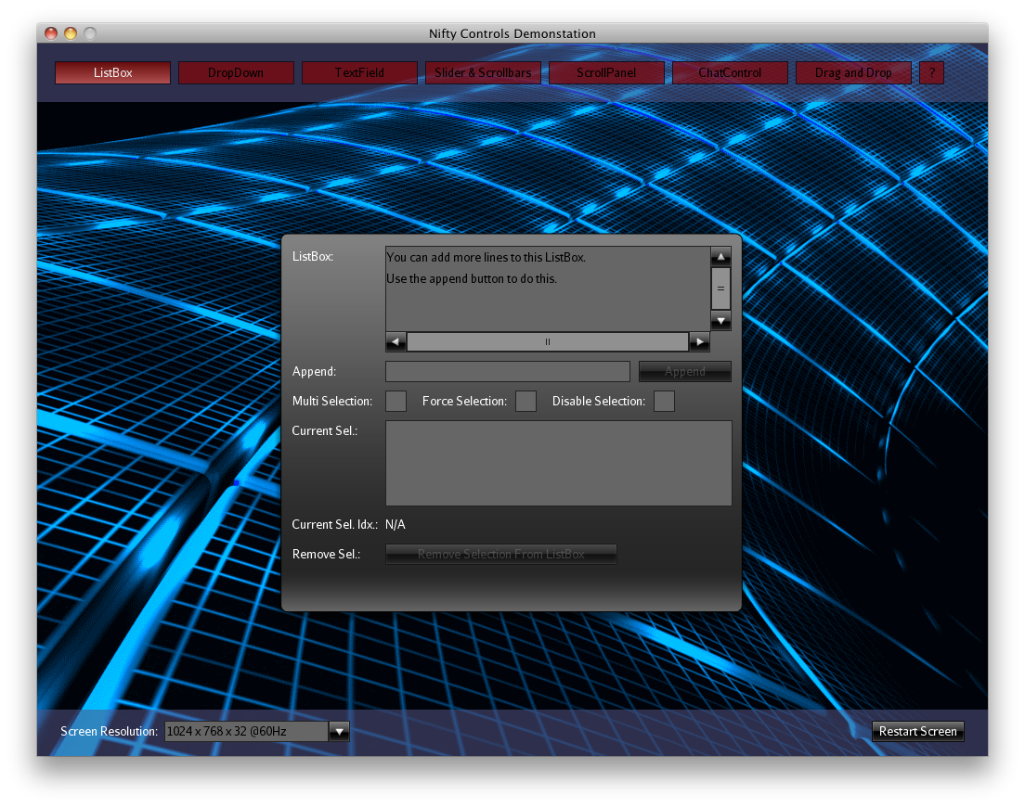

Slide 34

UI
– More Information
Project Pages:
  Github:
  https://github.com/void256/nifty-gui
  Sourceforge: https://sourceforge.net/projects/nifty-gui/
  Twitter:
  https://twitter.com/niftygui
  Blog:
  http://nifty-gui.lessvoid.com/

Slide 35
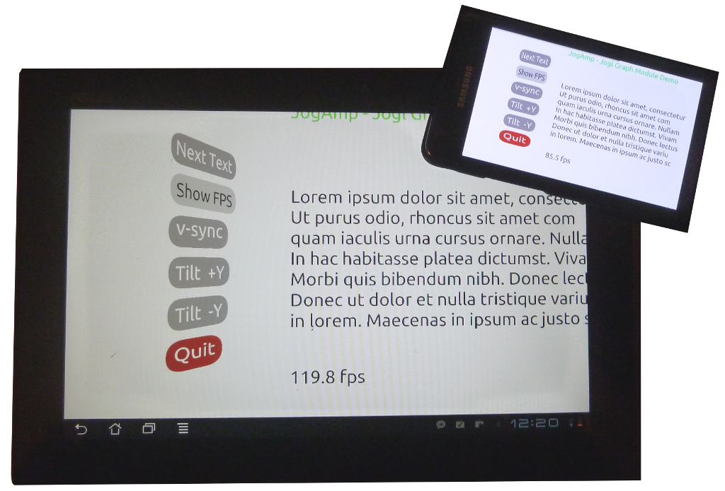
Graph API
Resolution Independent
Shapes and Curves
UI
Napplet Demo
Graph

Slide 36

Resolution Independent Curve Rendering API
UI
Based on Paper:
  R Santina, “Resolution Independent NURBS Curve Rendering using Programmable Graphics Pipeline”, presented in GraphiCon2011.
NOT Loop/Blinn
Patent Free
Can Render Bezier, Bsplines, NURBS
Graph

Slide 37
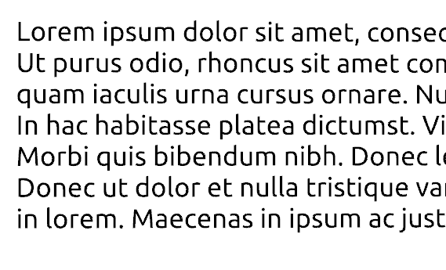

Resolution Independent Curve Rendering API
UI
Why?
  Resolution Independent Text Rendering
  GPU based - Fast
  Seamless integration into Renderer (Scenegraph,...)
  New User Interface – across devices
  http://jogamp.org/deployment/jogamp-current/jogl-test-applets.html
  http://www.youtube.com/watch?v=Rqsu46ifMaw
Graph

Slide 38
GPU based Resolution Independent UI
UI
Abstracted from the windowing toolkit
Support multithreading
Seamless integration into
  A native window (HUD)
  A custom Scenegraph (2D plane within 3D)
High Quality rendering
Super Fast
Graph

Slide 39

MyHMI
UI
Primary guidance in MyHMI framework development:
  vehicle infotainment and instrument cluster applications
extensions of those applications
  automation and process control industries

Slide 40
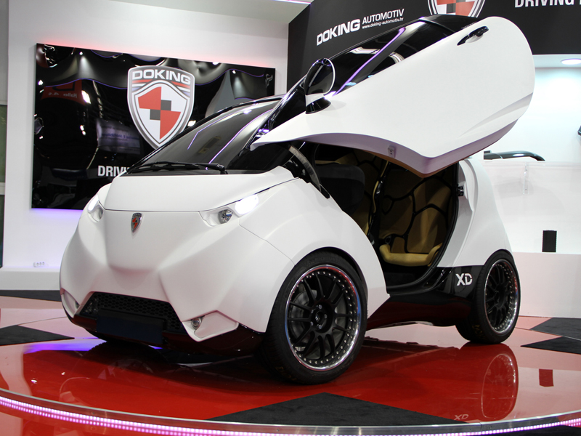
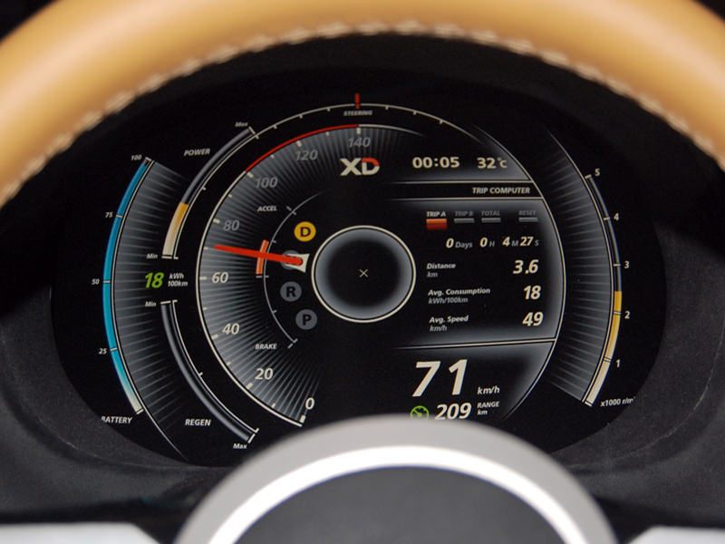
Beginnings of MyHMI development
UI

Slide 41
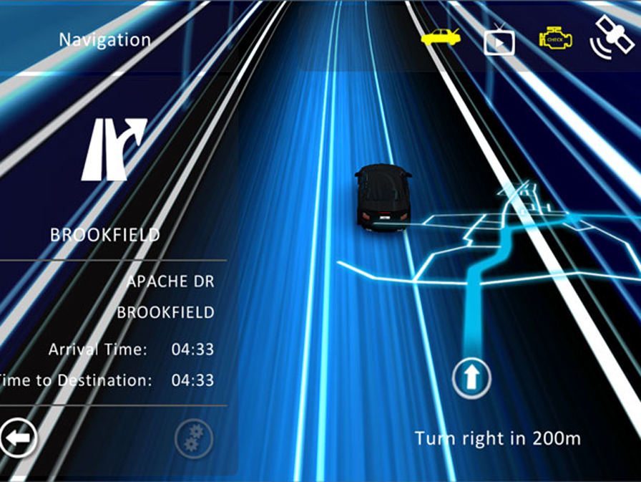
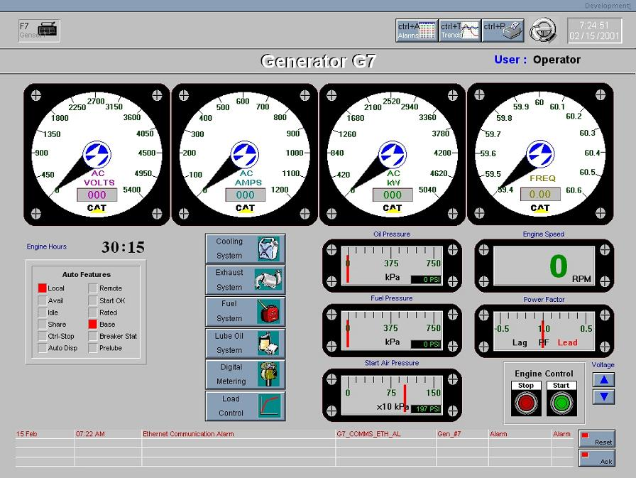
What HMI trends resulted in?
UI
Deep gap in HMIs market:
Graphically expressive HMI solutions, with proprietary communication
and processing mechanisms
Solutions with vast processing and communication possibilities, but plain graphics

Slide 42
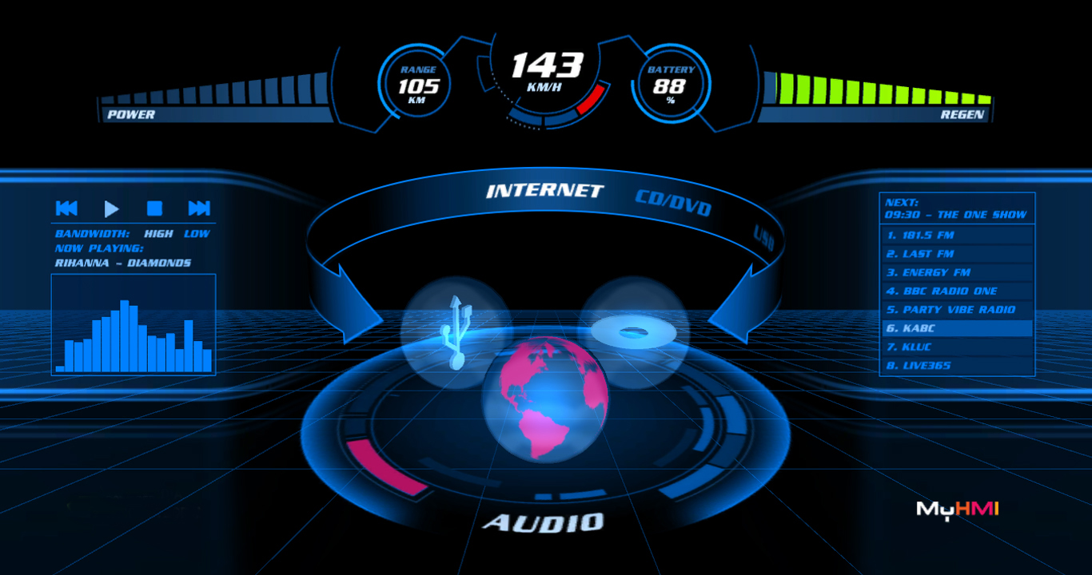
Bridging the gap
UI

Slide 43
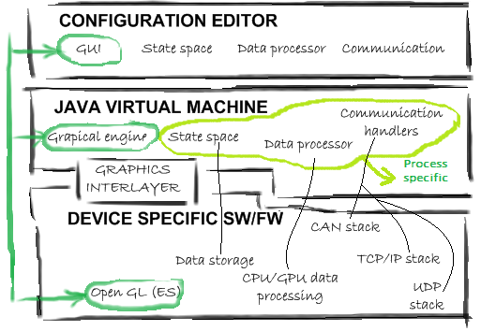
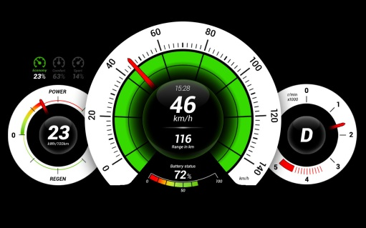
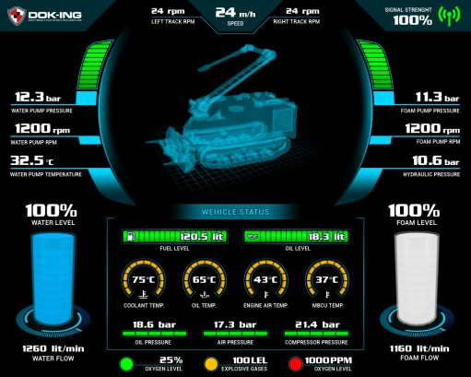
MyHMI & Jogamp
UI
Designed as a multiplatform framework
  Java → CPU agnostic development
  Jogamp's Jogl → GPU agnostic development

Slide 44
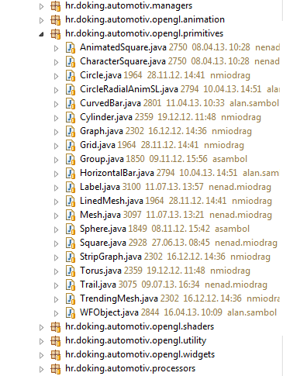
MyHMI framework
UI
Modules
  Display (widgets, primitives, animations)
  Communication (UDP, TCP/IP, CAN, serial...)
  Data processing

Slide 45
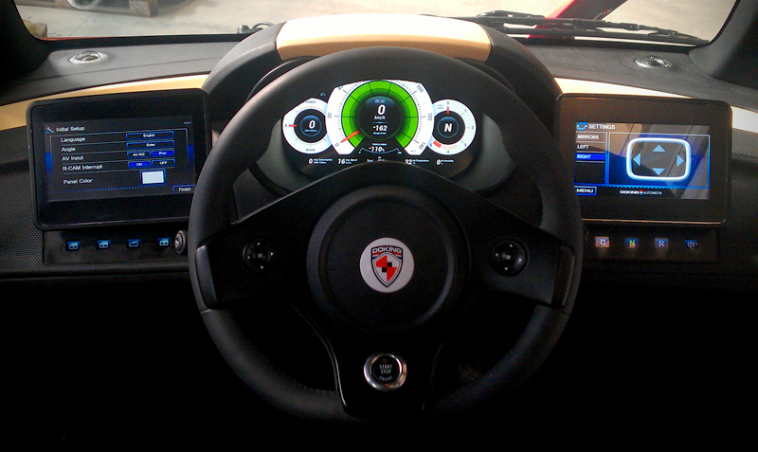
MyHMI approvals in industries
LOOX instrument cluster
UI

Slide 46
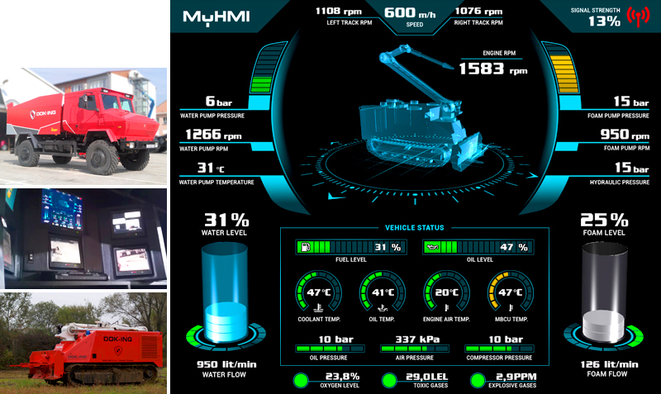
MyHMI approvals in industries
UNIMOG control center
UI

Slide 47
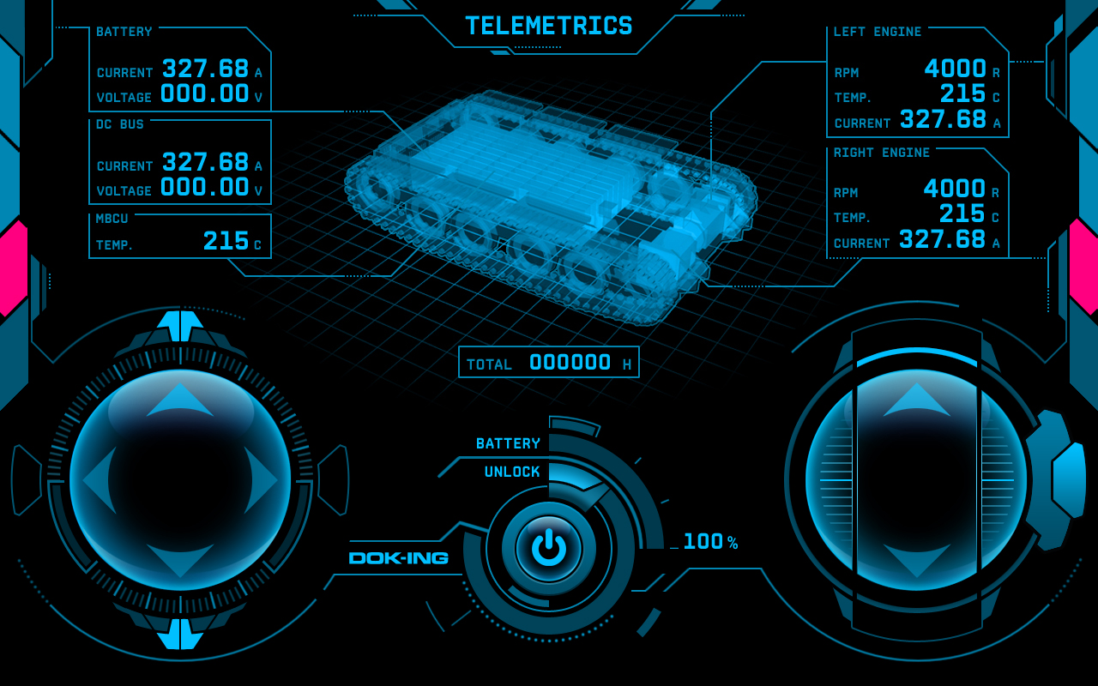
MyHMI approvals in industries
SCADA / remote control
UI

Slide 48
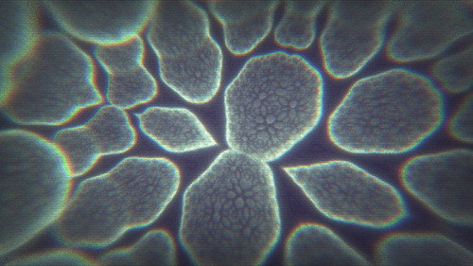
Kohlenstoffeinheit
jspatial
Art / Science
Winner Revision 2013, PC 4k competition
Raymarched fractals
Additional complex post effects
Visuals and tunes squeezed into 4096 bytes
Dominik Ströhlein
a.k.a
Demoscene Passivist

Slide 49
jSpatial
jspatial
Art / Science
Offers multiple implementations of Quad-tree and Oct-tree data structures.
Functionalities:
Divide your 2D/3D world into smaller spatial regions.
Fast Object insertion and deletion with no preprocessing.
Raycast queries
Optional min spatial size limit.

Slide 50
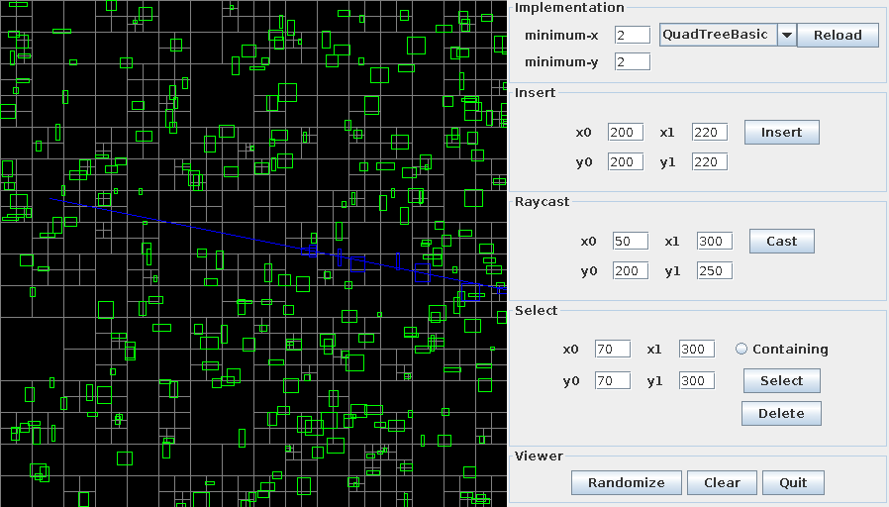
jSpatial
jspatial
Art / Science
Quad-tree example with a ray cast

Slide 51
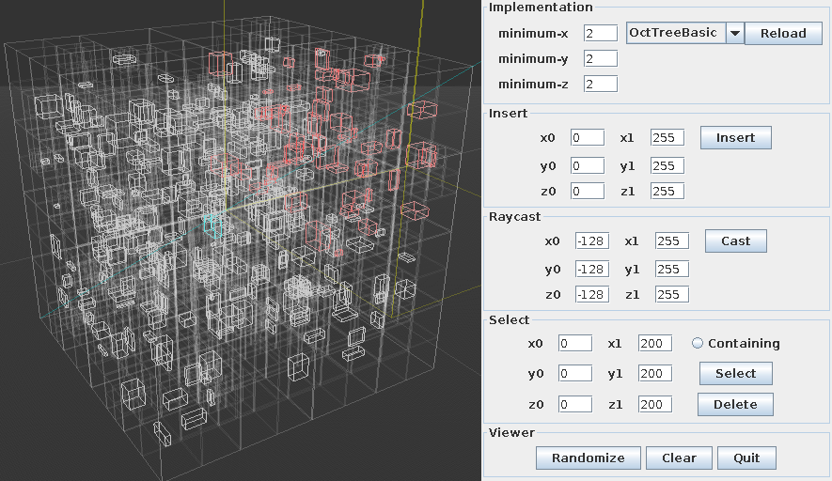
jSpatial
jspatial
Art / Science
Oct-tree example with a ray cast

Slide 52
jspatial
Art / Science
Thanks!
Mark Raynsford
http://io7m.com/
code@io7m.com
PGP: 0x60824220

Slide 53
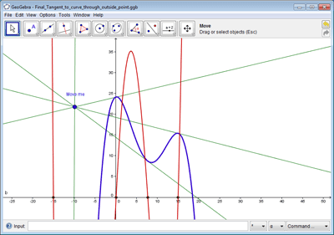

GeoGebra
Art / Science
Free and multi-platform dynamic mathematics software for all levels of education that joins in one easy-to-use package:
Geometry
Algebra
Tables
Graphing
statistics
calculus

Slide 54
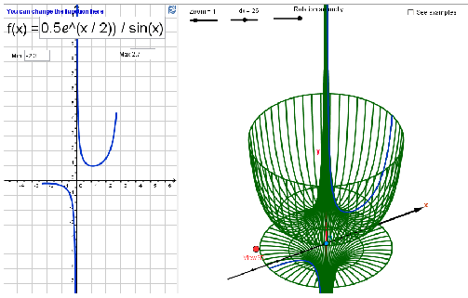
GeoGebra
Art / Science
Facts:
Graphics, algebra and tables are connected and fully dynamic
Easy-to-use interface, yet many powerful features
Authoring tool to create interactive learning materials as web pages
Available in many languages for our millions of users around the world
webstart example
http://www.geogebra.org/

Slide 55

SciLab
Art / Science
Scilab is free and open source software for numerical computation providing a powerful computing environment for engineering and scientific applications.
Functionalities is included in Scilab:
  Maths & Simulations
  2D & 3D Visualizations
  Optimization
  Statistics
  Control System Design & Analysis
  Single Processing
  Application Development

Slide 56
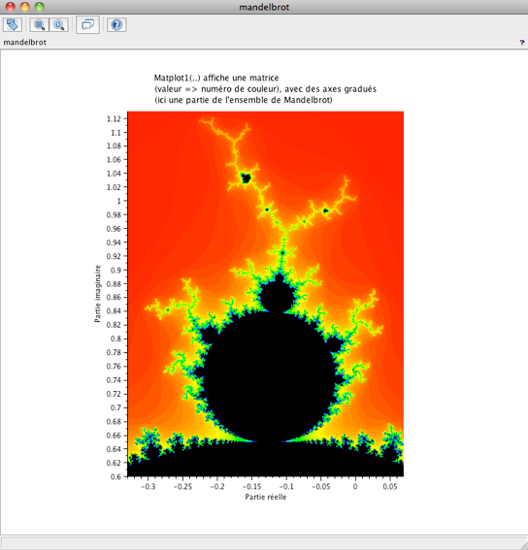
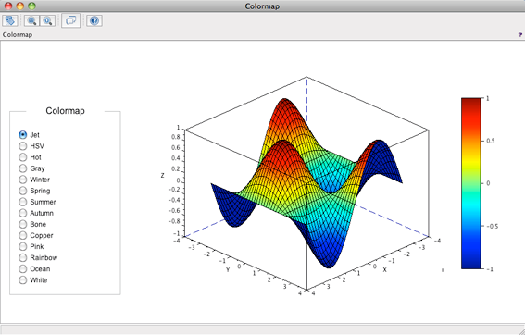
SciLab
Art / Science
Visualization: Matrix Plot
Visualization: Function

Slide 57
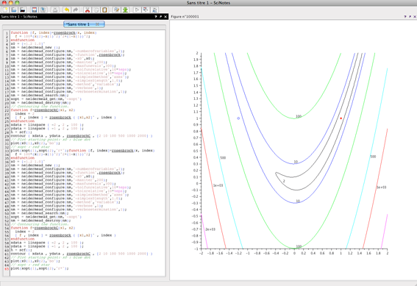
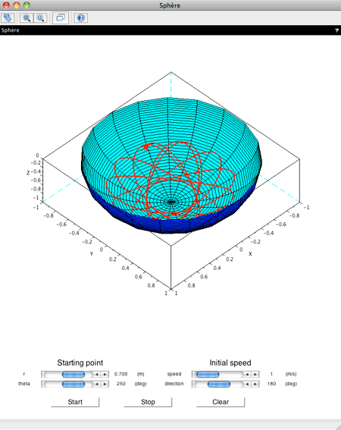
SciLab
Art / Science
Optimization: Nelder–Mead
Simulation: Particle Flow

Slide 58
Art / Science
jReality
jReality is a full-featured 3D scene graph package designed for 3D visualization and specialized in mathematical visualization.
Webstart Examples.

Slide 59
Art / Science
BioJava
BioJava is a framework for processing biological data.
It provides analytical and statistical routines, parsers for common file formats and allows the manipulation of sequences and 3D structures.
The RCSB Viewers suite of frameworks provides the capability of creating 3-d viewing applications.
Example: RCSB Protein Data Bank.

Slide 60

WorldWind
Art / Science
WorldWind
NASA World Wind Java provides a suite of open-source 3-D virtual globe technologies for Java applications, which can be utilized in user applications.
Version 2.0 now uses JOGL 2. It provides a rich set of features for displaying and interacting with geographic data and representing a wide range of geometric objects. Online demos are available, as well as an F-16 Flight Simulator from Disti.

Slide 61

Processing
Art / Science
rocessing is an open source programming language and environment for people who want to program images, animation, and interactions.

Slide 62
Art / Science
Processing – More Information
Project Pages:
  Homepage: http://processing.org/

Slide 63
JaamSim
Art / Science
Ausenco opensource simulation environment
Not just a library, full modelling environment
Internal modelling group of 16 professionals
Licensed by large external customers

Slide 64
JaamSim - Features
Art / Science
Graphical user interface
Drag and drop model building
3D visualization of engineering assets
End-user documentation generated from code
Interactive Input editor, Output viewer
Units required throughout

Slide 65
JaamSim
Art / Science
Originally conceived with a Java3D renderer
New Jogl2 based renderer started April 2012
Assume OpenGL 3.0 as minimum functionality
Collada loader/importer
Zero install – single exe distribution
http://github.com/AusencoSimulation/JaamSim

Slide 66
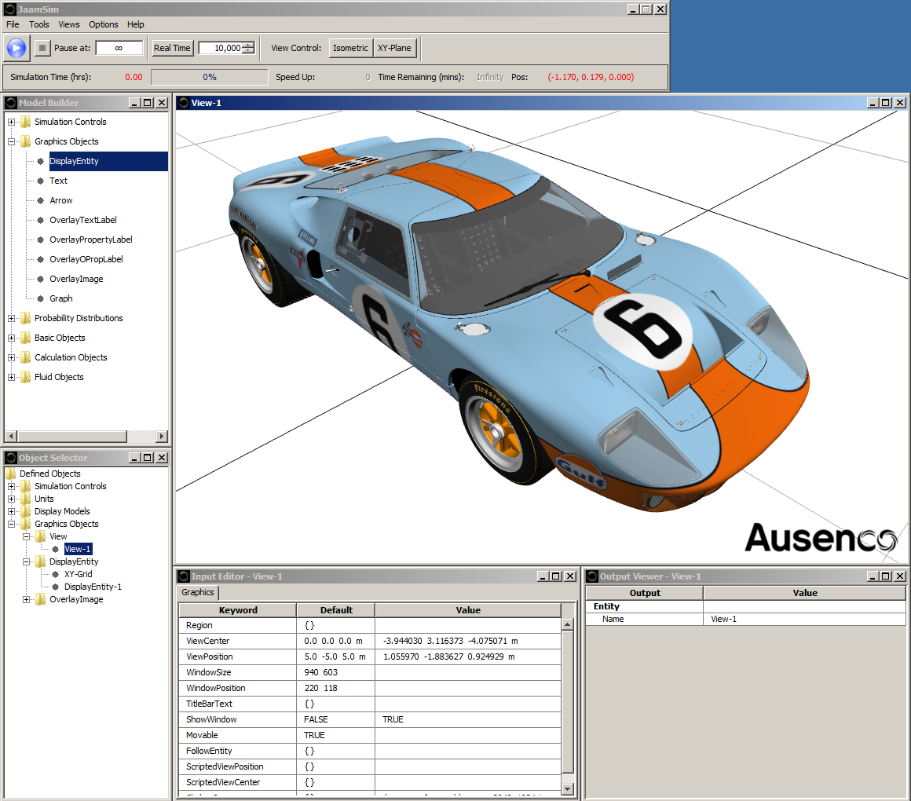
JaamSim
Art / Science

Slide 67
C3D
Art / Science

Slide 68

Jogamp
Webstart Examples
OpenCL

Slide 69


Jogamp

Slide 70
Jogamp
JOAL is a Java binding of the OpenAL API
OpenAL provides:
  Spatial Sound
  Low level audio buffer control / Streaming
  Mixing of streams, incl. Doppler Effect
Using and providing OpenAL-Soft on all platforms but OSX.

Slide 71
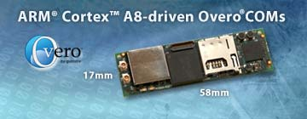
Recreational Laser-Gun Use Case
Jogamp
Low-latency: Max. 10 ms from stimulus to sound
High fidelity: Quality audio is a must in order to create a realistic user experience.
Using miniature devices such as Overo (ARM), running GNU/Linux.
Headless mode.
Low RAM footprint.

Slide 72
Recreational Laser-Gun Use Case
Jogamp
Search for a sound backend:
  We tried a number of audio solutions before settling on JOAL, most of which we ran with Paul Lamb's 3D Sound System library.
  JJack: Memory footprint too high.
  LWJGL: Graphical dependencies forbidding headless usage.
  Java Sound: Inconsistent latency between 2ms and 30ms.
  JOAL: Perfect blend of resource efficiency, ease of use, platform compatibility and low latency.

Slide 73
JOAL
Jogamp
– More Information
Project Pages:
  Demo code and tutorialshttps://jogamp.org/joal-demos/www/
  Homepage: https://jogamp.org/joal

Slide 74
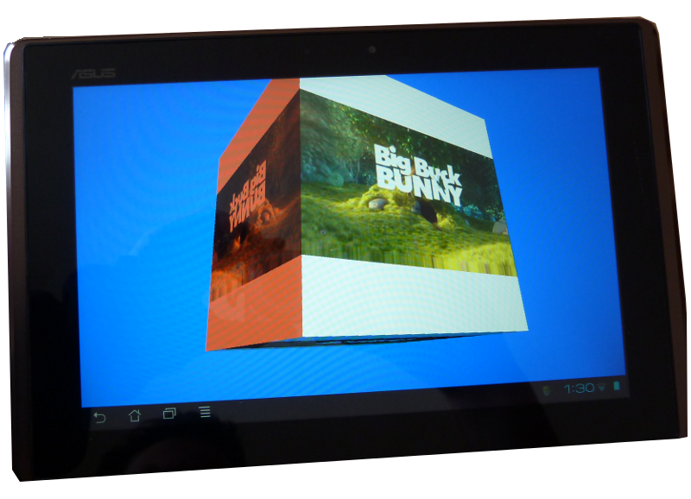
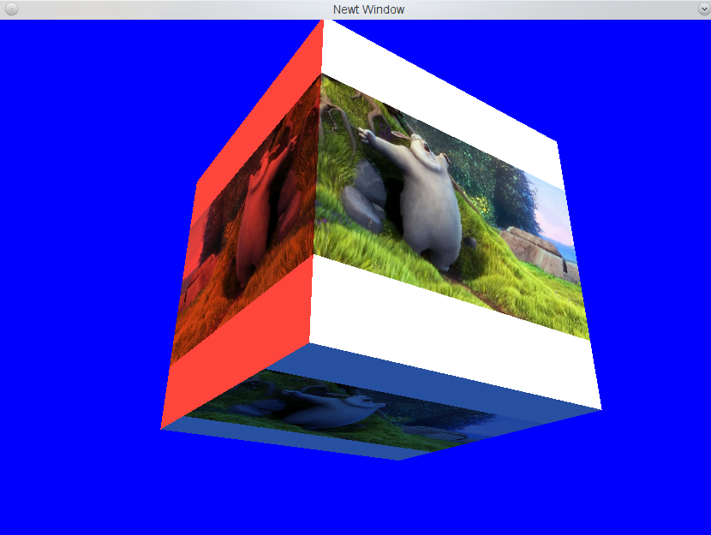
GLMediaPlayer
Jogamp
Platform agnostic API
Backends:
  Android
  FFMPEG / libav*
  OpenMAX (wip)
  JOAL
NApplet demo
* Binds to system library, providing libav is WIP.

Slide 75
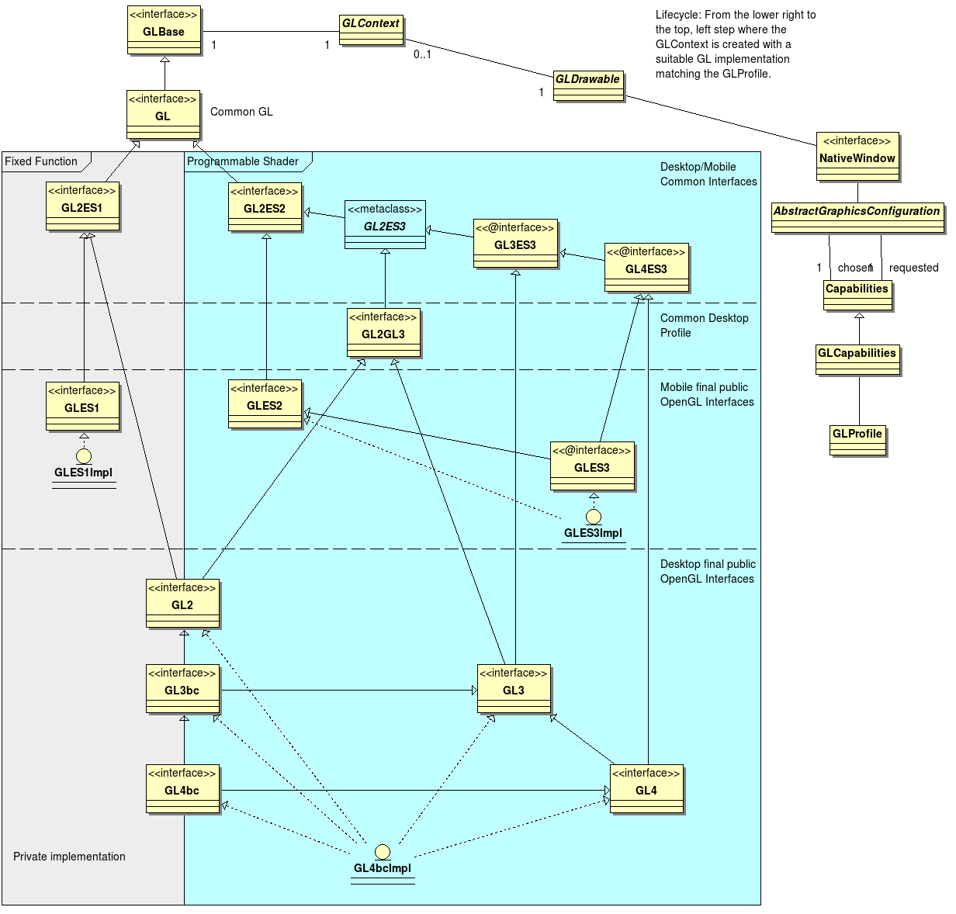
OpenGL Profiles
Jogamp

Slide 76
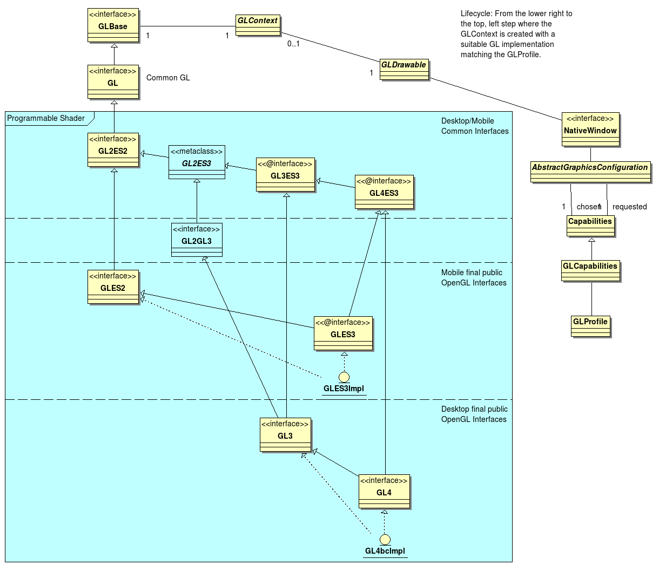
OpenGL Profiles
Jogamp

Slide 77
Windowing Toolkits
Jogamp
Native Window
NEWT
(Window)
AWT
(AWT Canvas)
SWT
(SWT Canvas)
Native Surface
X11
(Unix)
GDI
(Windows)
Android
Coco
(MacOSX)
GLX
WGL
EGL
CGL
GL

Slide 78
NEWT
Jogamp
  Cross Platform & Devices
  Multithreaded Surface Access
  Lock free event handling
Windowing Features
Create / Destroy
Native Parenting
  NEWT
  AWT, SWT, …
Fullscreen & Transparency
Monitor
  Multiple Devices
  Mode Change
Input Events
Output Events
Keybd
Pointer
Monitor
Backends
X11
(Unix)
GDI
(Windows)
Android
Coco
(MacOSX)

Slide 79
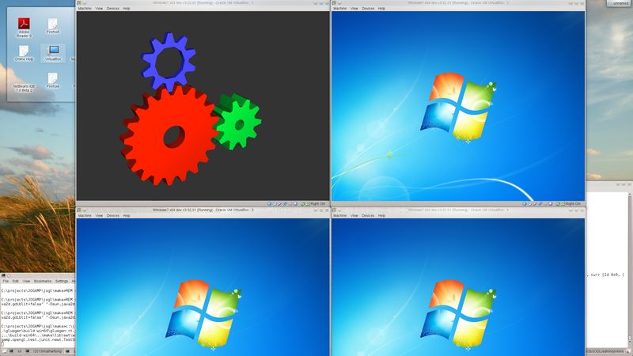
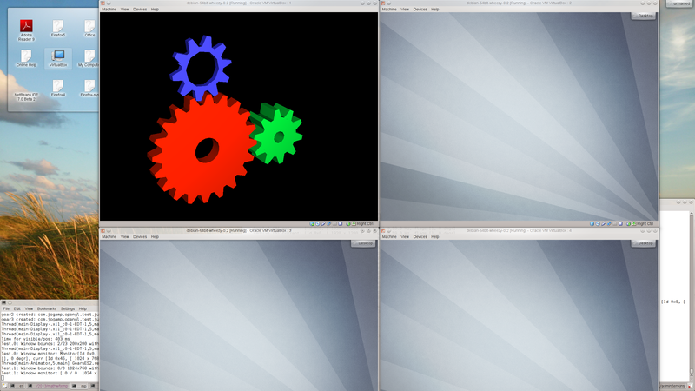
NEWT
Jogamp

Slide 80
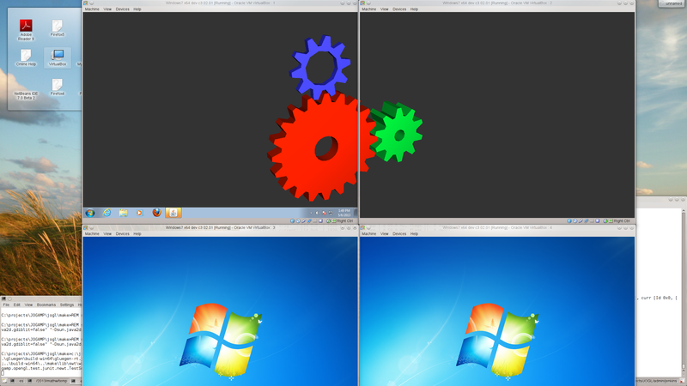
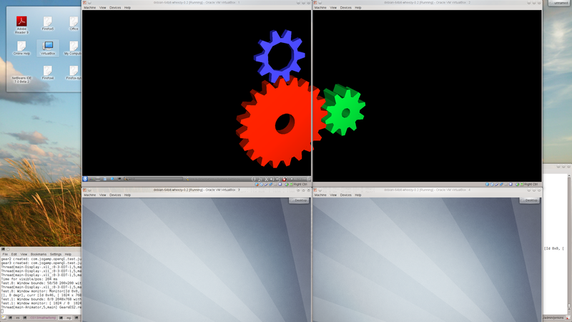
NEWT
Jogamp

Slide 81
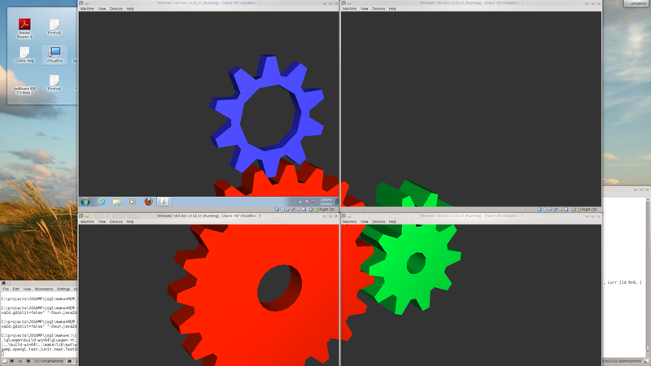
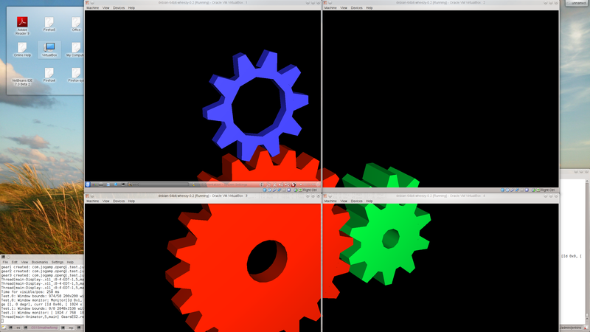
NEWT
Jogamp

Slide 82

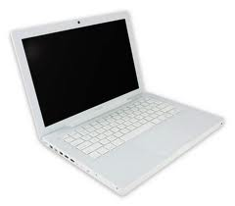

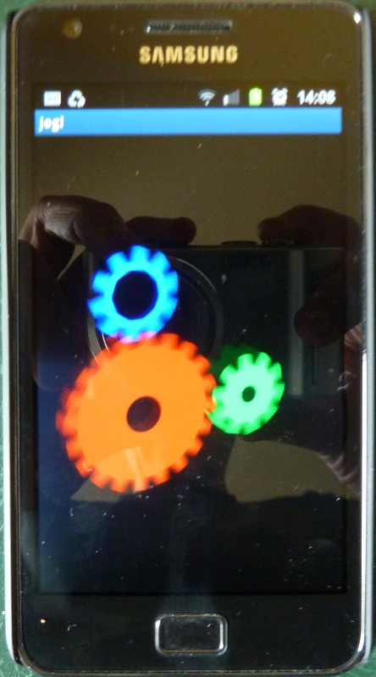

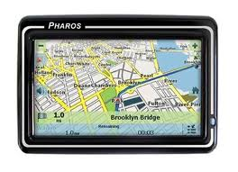
Love in all shapes & Colors ..
Jogamp
JogAmp
JOGL – JOCL – JOAL ...

Slide 83
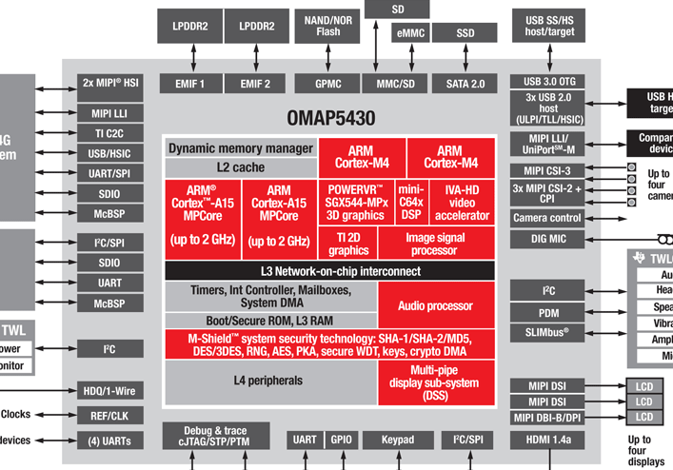
General Love
Jogamp
Agnostic CPU for general purpose

Slide 84
Dedicated Love
Jogamp
Fast Discrete Graphics, Audio, Video ...

Slide 85
General Love
Dedicated Love
Jogamp
Intel x32, amd64
ARM 32 and 64 bit
SuperH
PowerPC
Sparc
MIPS
Immaginative Technologies PowerVR SGX
ARM Mali
Qualcomm Adreno
Vivante
BCM VideoCore
Nvidia Tegra
Special DSPs (Audio/Video)
Heterogenous CPUs (big.LITTLE)
Java
OpenGL, OpenCL, OpenAL, ..

Slide 86
JogAmp Deployment
Jogamp
Preinstalled Bundles
  Modularized JARs
  Android APKs (modular, or all-in-one)
  Maven
Online / Cached
  Automatic Native-JAR loading support
  Applet
    Classical
    JNLP
  Webstart (JNLP)

Slide 87
Maven
The JogAmp project currently distributes Jar files and .7z archives containing compiled code, source code, and documentation
June 2012 - Stable versions and release candidates are released to the Central Repository, and bleeding edge packages are published to a testing repository at http://jogamp.org/deployment/maven
Maven

Slide 88
Android
The JogAmp project provides an abstraction known as the GLEventListener that allows one to write applications in a renderer and display independent manner. That is, the programmer writes their program using GLEventListener and does not need to modify it to run on Android, or on other platforms that do not provide programming interfaces that look like typical Java programs.
Maven

Slide 89
Android
Writing a program that works unmodified on both traditional Java desktop/workstation systems and Android devices is simply a matter of providing trivial frontend code to the bulk of your application written using the GLEventListener abstraction.
Maven

Slide 90


Android
The desktop code specifies dependencies on the standard JOGL packages, and the Android code specifies dependencies on the published JOGL Android packages.
Maven

Slide 91



Thank You & Love You
Rami Santina
Jens Hohmuth
Sven Gothel
Mr. Max
Emmanuel Puybaret
Xerxes Ranby
Scott Vorthmann
Julien Gouesse
Andres Colubri
Harvey Harrison
Wade Walker
Demoscene Passivist
Mark Raynsford
Alan Sambol & MyHMI Team
Virgina Pasek, Dyer Lytle
Erik Brayet & DoW Team
… all the many contributors & users

Slide 92
Why JogAmp on Java?
Jogamp
Availability:
  Java, OpenGL, OpenCL, OpenAL, ..
  Multiple Vendors
    OpenJDK / IcedTea
    Oracle JDK
    IBM J9, ..
    PhoneME
    JamVM
    CacaoVM
    Dalvik
  x86, arm, ppc, sh4, ..
  GNU/Linux, Android, BSD, Mac OSX, Solaris/OpenIndiana, MS Windows

Slide 93
About US
Jogamp
Open & Vendor Independent
BSD License
Java Graphics, Audio, Media & Processing
High Performance Bindings
One Stop Community Platform
  SCM, Bugtracking, Build Server, Mailinglist/Forum,..
Commercial Support
http://jogamp.org

