Slide 1
jspatial
jspatial
http://io7m.com/software/jspatial
code@io7m.com

Slide 2
jspatial
jspatial
Why?
Computers lack spatial awareness!
Example: For efficiency reasons, when implementing collision detection for physical simulations, we want to limit comparisons between pairs of bodies to those that are in close proximity to each other.
By subdividing the world into small spaces, and only comparing the pairs of bodies within those spaces, we reduce the number of necessary comparisons by orders of magnitude.

Slide 3
Trees
jspatial
The jspatial package offers multiple implementations of quadtree and octtree data structures.

Slide 4
Quadtrees
jspatial
Quadtrees recursively divide a 2D space into quadrants.
A quadtree initially contains one cell and is divided into smaller cells upon insertion of an arbitrarily-sized object.

Slide 5
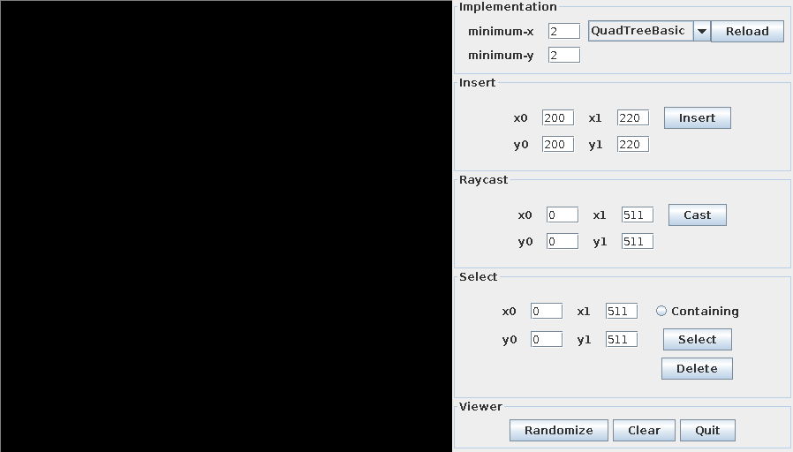
Quadtrees
jspatial

Slide 6
Quadtrees
jspatial
Note how the space has been divided into quads...

Slide 7
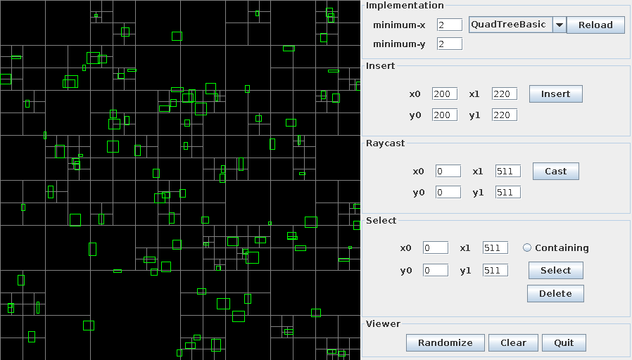
Quadtrees
jspatial
Object insertion is fast and requires no preprocessing

Slide 8
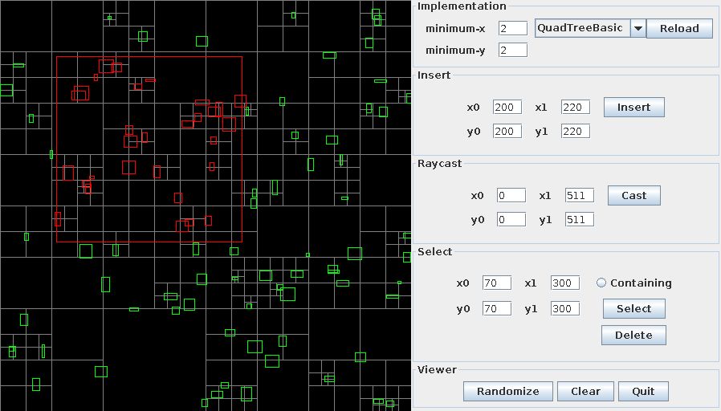
Quadtrees
jspatial
Determining which objects are contained or overlapped by an area is efficient

Slide 9
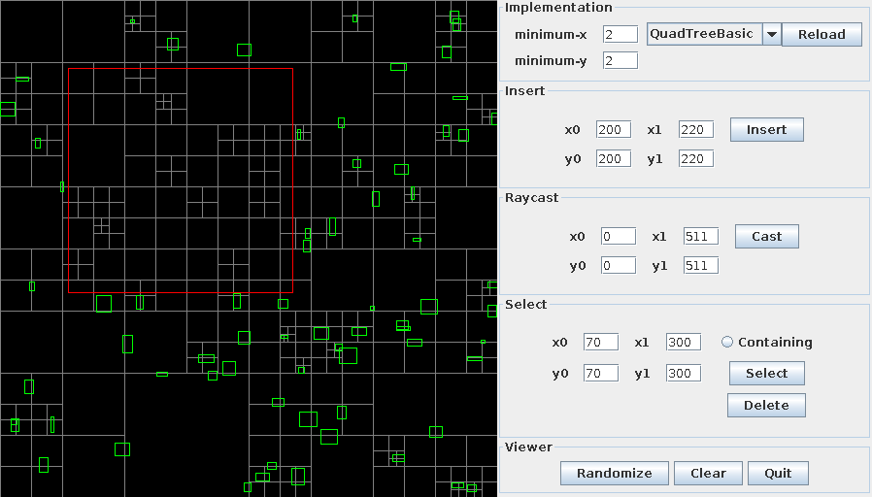
Quadtrees
jspatial
Objects may be removed from the tree efficiently

Slide 10
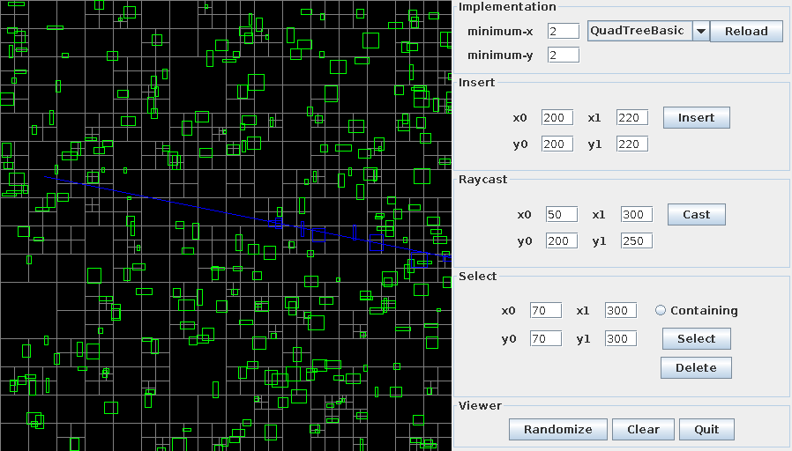
Quadtrees
jspatial
Ray casting queries are supported

Slide 11
Quadtrees
jspatial
Multiple variations on the basic quadtree algorithm are included.

Slide 12
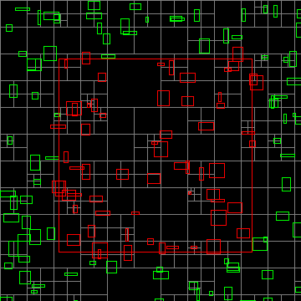
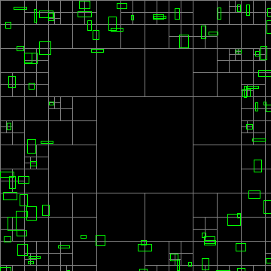
QuadTreePrune
jspatial
The QuadTreePrune algorithm aggressively removes empty tree cells

Slide 13
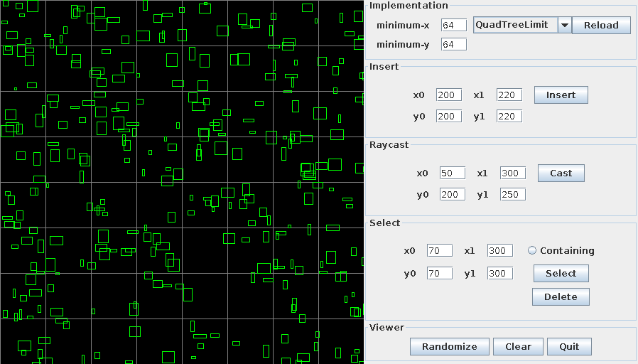
QuadTreeLimit
jspatial
The QuadTreeLimit algorithm places a lower bound on the size of cells

Slide 14
Quadtrees
jspatial
The jspatial package does not pretend to know which algorithm is right for you.
The implementations share common interface types, meaning that developers can choose from any of the implementations without needing to modify code.

Slide 15
Octtrees
jspatial
Interestingly, the Quadtree algorithms generalize to three dimensions.

Slide 16
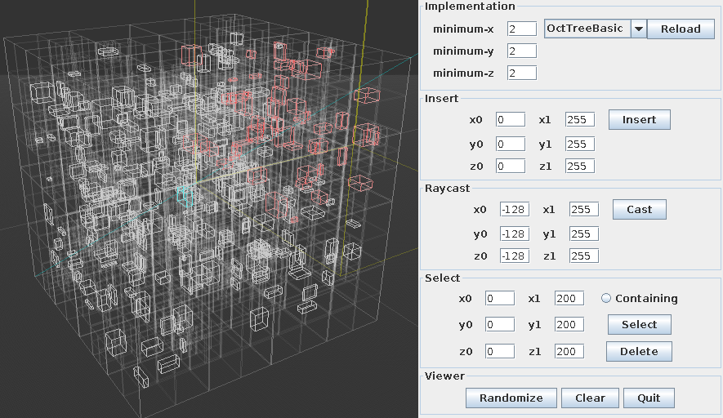
Octtrees
jspatial
All of the previous queries are supported in three dimensions

Slide 17
Octtrees
jspatial
As with quadtrees, the jspatial package does not pretend to know which algorithm is right for you.
The implementations share common interface types, meaning that developers can choose from any of the implementations without needing to modify code.
Deja vu!

Slide 18
Usage
jspatial
Have your object implement either of the QuadTreeMember or OctTreeMember interfaces (or both, if you're that way inclined).
The interfaces consist of a pair of trivial functions that request the axis-aligned bounds of the object.

Slide 19
Usage
jspatial
Initialize a quadtree or octtree using the available constructors.
Insert your objects into a tree.
Query the tree.
You're done!

Slide 20
jspatial
Thanks!
Mark Raynsford
http://io7m.com/
code@io7m.com
PGP: 0x60824220

