Slide 1
JogAmp Fast Media & Processing
Across devices – Desktop & Mobile
SIGGRAPH 2014 – Vancouver
August 11, 2014
Julien Gouesse
Mark Raynsford
Harvey Harrison
Rami Santina
Sven Gothel
Wade Walker

Slide 2
Info
Slides and BOF Video
will be made available
on
Jogamp.org.

Slide 3



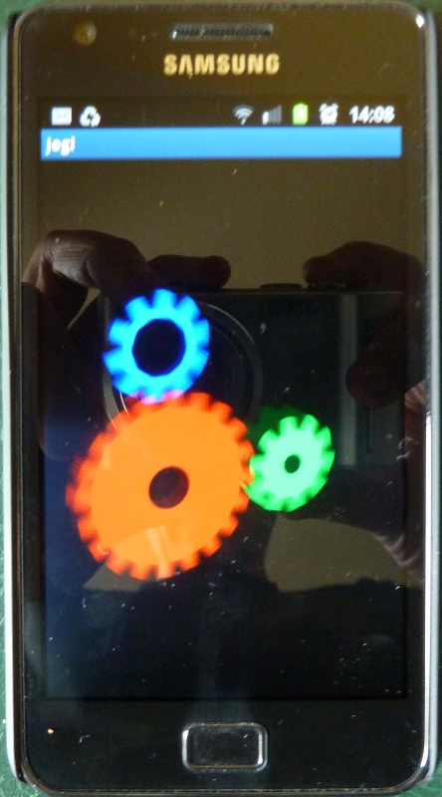

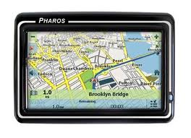
What is it?
Jogamp
JogAmp
GlueGen - JOGL – JOCL – JOAL ...
What is it?

Slide 4
Technology Enabler ..
Technology enabler across Platforms for
high performance:
Feature | Module | Native API
Audio | JOAL | OpenAL
Graphics | JOGL | OpenGL
Multimedia | JOGL | FFMpeg / libAV, ...
Compute / Processing | JOCL | OpenCL
What is it?

Slide 5
.. on top of a VM
Running on top of a virtual machine for
CPU Abstraction
Basic access to OS features
  Multithreading
  I/O incl. Network
  …
JogAmp complements the VM with access to named hardware functionality via standardized open APIs.
What is it?

Slide 6
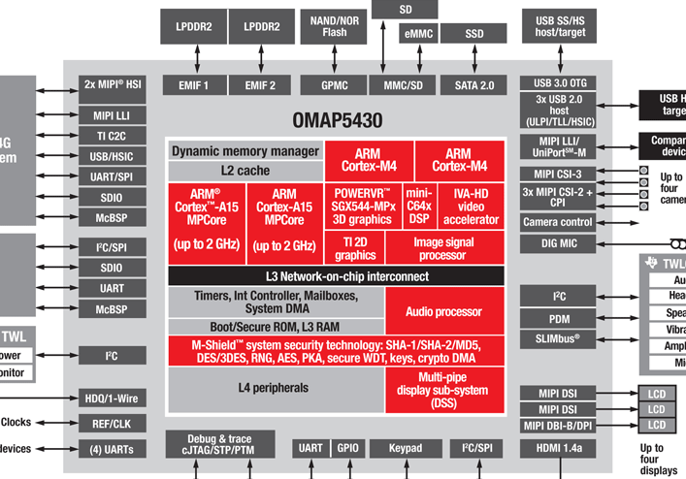
CPU Abstraction
Jogamp
What is it?

Slide 7
Feature Abstraction
Jogamp
What is it?

Slide 8
Doing it for 11 years ..
2003-06-06 GlueGen, JOGL, JOAL
2008-04-30 JOGL Release 1.1.1
2009-07-24 JOCL
2009-11-09 Independent Project
2010-05-07 JogAmp Project Name, Server, ..
2010-11-23 JogAmp RC 2.0-rc1
2013-07-17 JogAmp Release 2.0.2
2014-08-07 JogAmp Release 2.2.0
Used by many clients, lots of apps,
see last years BOF and webpage.
What is it?

Slide 9


Slide 10
Who does it?
Jogamp
As we have a core team developing JogAmp,
only a fine line distinguishes them from the users:
Software Developer
  independent
  employees
  students
Interest Groups
  Research / Science
  Product-Dev. / Companies
  Education
What is it?

Slide 11
Legal / Risks of it
Jogamp
New BSD License, and similar ..
No vendor risk (End of Business → EOL)
Free to maintain yourself, costly but possible
Available source code
  Documentation
  Debugging / Security
  Maintenance
What is it?

Slide 12
Motivation doing it?
Jogamp
Ideology
  Freedom to chose target platform
  Run anywhere ...
Interesting Problems
  Efficiency / High Performance
  Platform abstractions
  Graphics, Audio, Multimedia & Computing
  Use cases across domains ..
Interesting People
  .. across domains
  .. different level of expertise
What is it?

Slide 13
How do we do it?
Jogamp
Free and Open Tools
  GIT SCM
  Bugzilla Bugtracking
  Jenkins Build Server
  Mailinglist/Forum,..
Quality
  Unit Test Coverage
  Public Bugreports
  Publicly suggested new Use Cases
What is it?

Slide 14
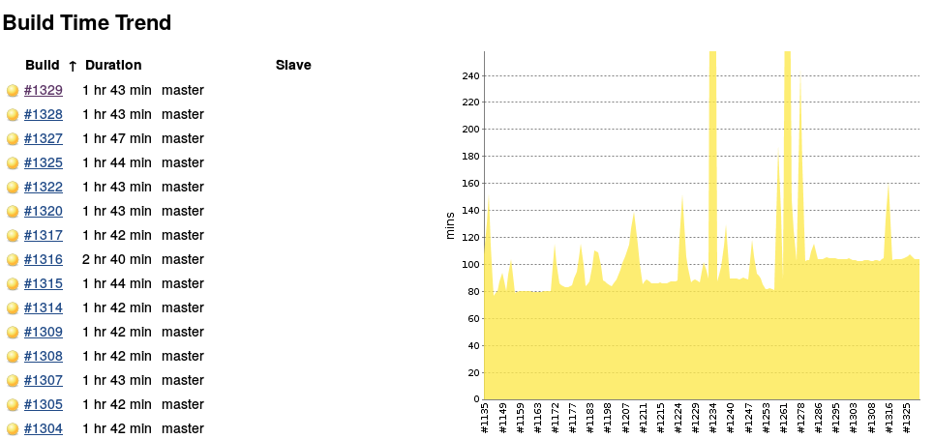
How do we do it?
Jogamp
Overall Build Monitoring
What is it?

Slide 15
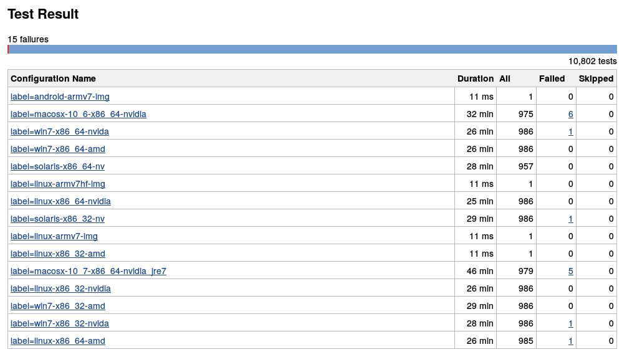
How do we do it?
Jogamp
Overall Build Monitoring
What is it?

Slide 16
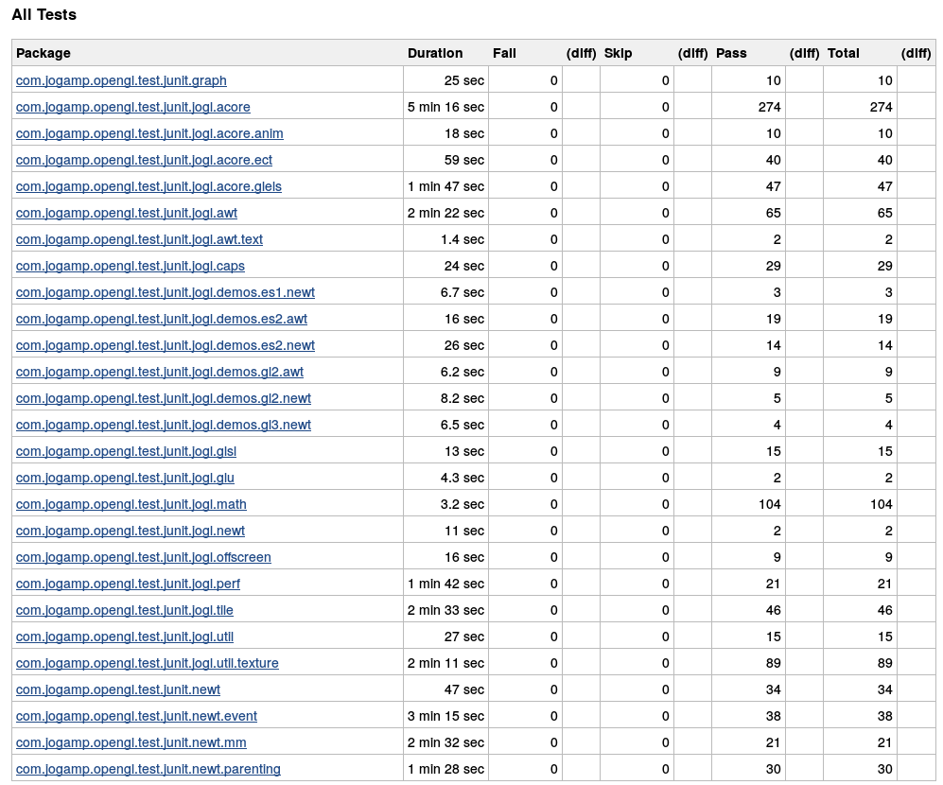
How do we do it?
Jogamp
Unit Test Monitoring
What is it?

Slide 17
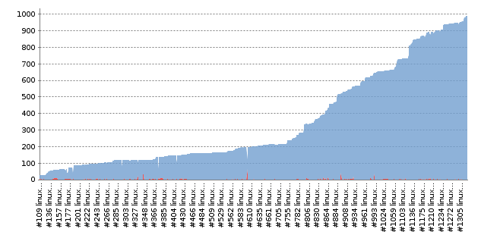
How do we do it?
Jogamp
No performance regressions ...
What is it?

Slide 18
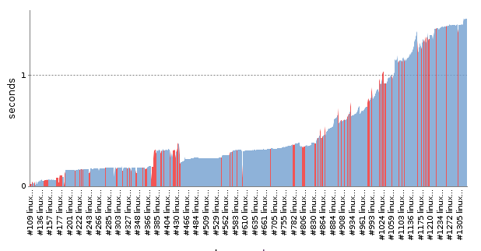
How do we do it?
Jogamp
No performance regressions ...
What is it?

Slide 19
How do we do it?
Jogamp
No breach of modularization, aka monolithic growths
SHOW LOC modules/code vs tests!
What is it?

Slide 20
GlueGen
Often neglected, no logo, not mentioned,
However, GlueGen is core part of all JogAmp modules :)
Compiler
  Producing Java and Native Glue-Code
  from C Header files
Runtime Tools
  Native JAR locating and loading
  Essential Glue-Code Utilities
  Concurrency, I/O Helper, etc
GlueGen

Slide 21

Jogamp
Webstart Examples
OpenCL

Slide 22
Picked up maintenance
Aligned Build System w/ GlueGen, JOGL, ..
Added Runtime Version Information like JOGL
Added Android support
In process of zero unit test failures
No new features
OpenCL

Slide 23


Jogamp

Slide 24


Slide 25
Jogamp
JOAL is a Java binding of the OpenAL API
OpenAL provides:
  Spatial Sound
  Low level audio buffer control / Streaming
  Mixing of streams, incl. Doppler Effect
Using and providing OpenAL-Soft on all platforms but OSX.

Slide 26
JOAL
Jogamp
– More Information
Project Pages:
  Demo code and tutorialshttps://jogamp.org/joal-demos/www/
  Homepage: https://jogamp.org/joal

Slide 27
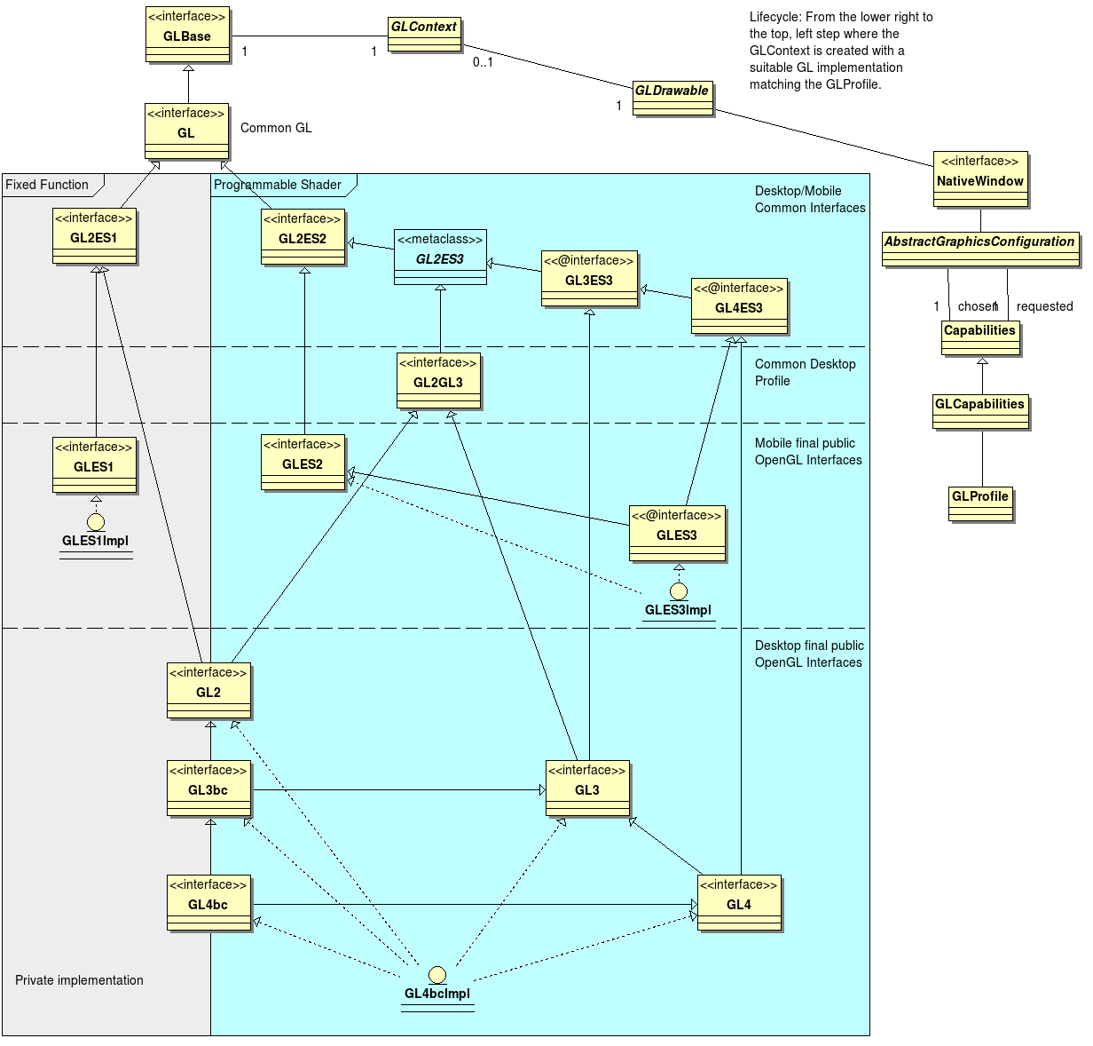
OpenGL Profiles
Jogamp

Slide 28
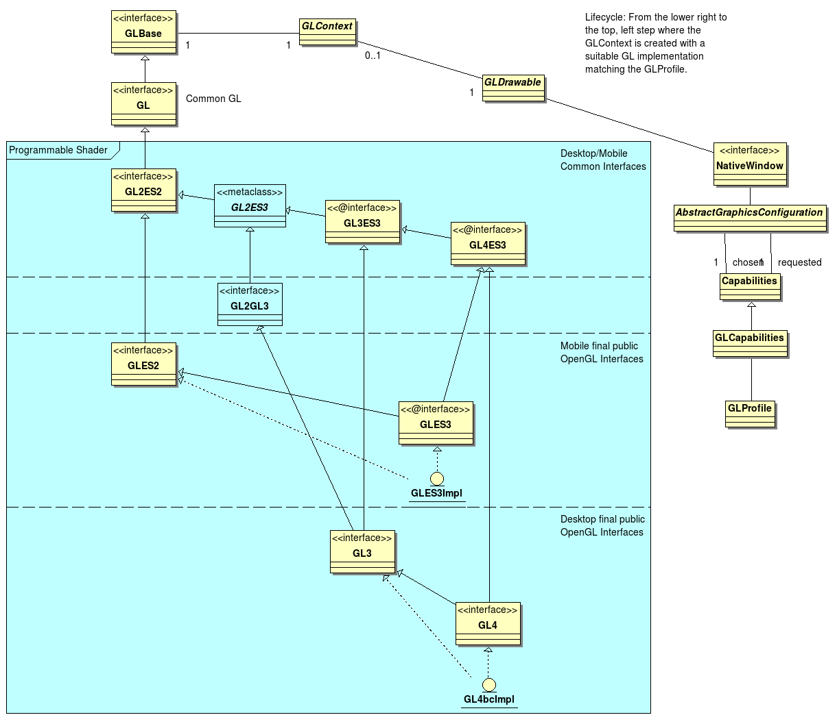
OpenGL Profiles
Jogamp

Slide 29
Windowing Toolkits
Jogamp
Native Window
NEWT
(Window)
AWT
(AWT Canvas)
SWT
(SWT Canvas)
Native Surface
X11
(Unix)
GDI
(Windows)
Android
Coco
(MacOSX)
GLX
WGL
EGL
CGL
GL

Slide 30
NEWT
Jogamp
  Cross Platform & Devices
  Multithreaded Surface Access
  Lock free event handling
Windowing Features
Create / Destroy
Native Parenting
  NEWT
  AWT, SWT, …
Fullscreen & Transparency
Monitor
  Multiple Devices
  Mode Change
Input Events
Output Events
Keybd
Pointer
Monitor
Backends
X11
(Unix)
GDI
(Windows)
Android
Coco
(MacOSX)

Slide 31
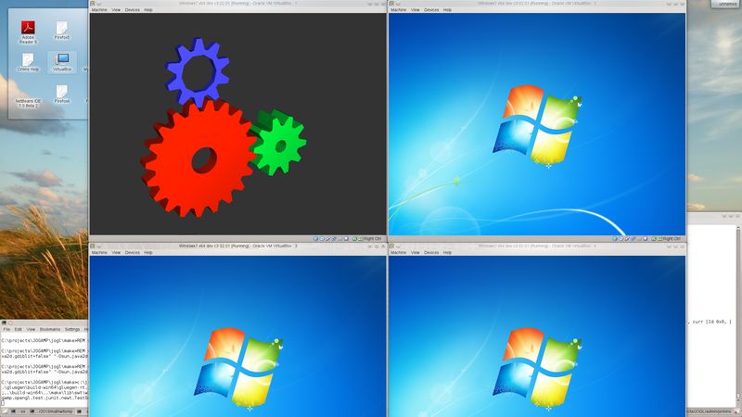
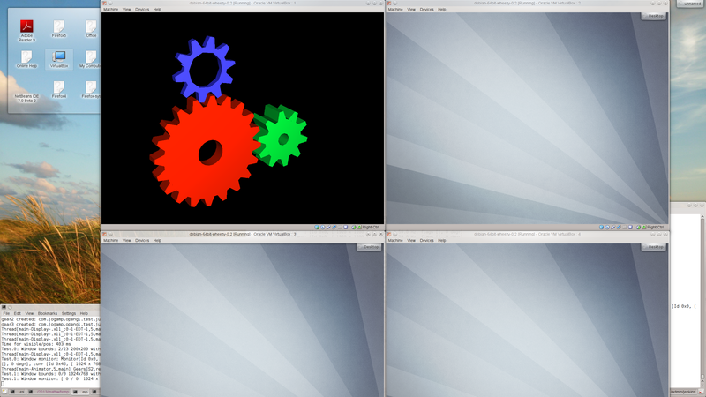
NEWT
Jogamp

Slide 32
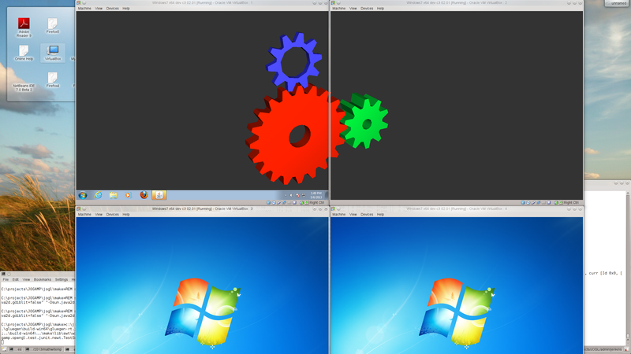
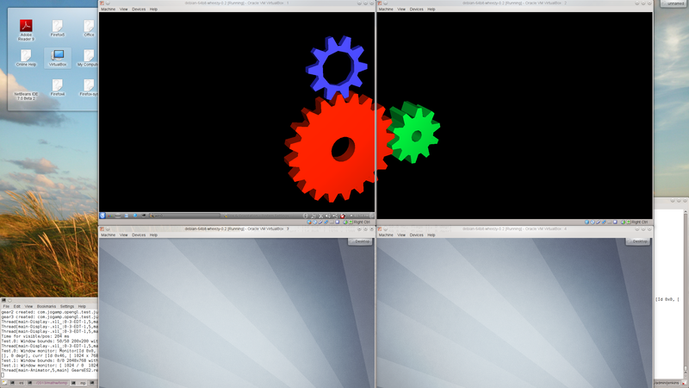
NEWT
Jogamp

Slide 33
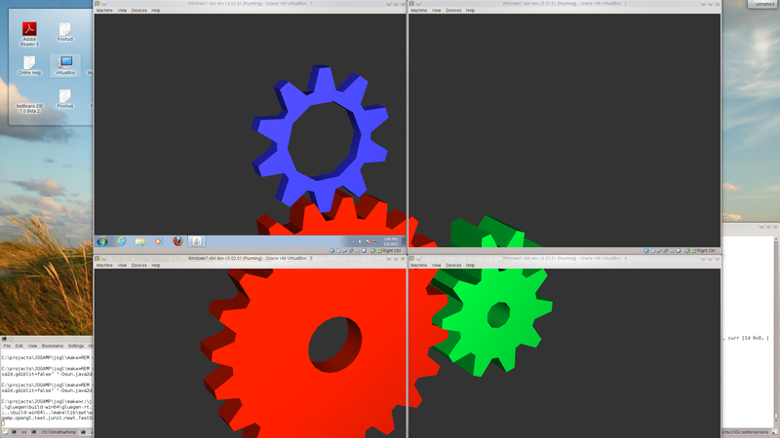
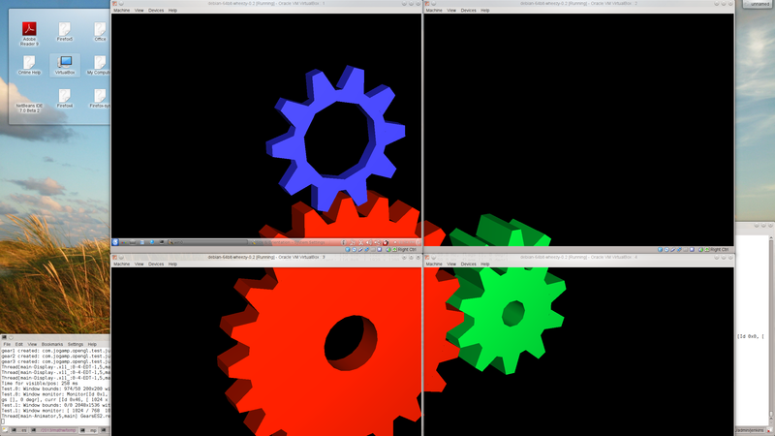
NEWT
Jogamp

Slide 34
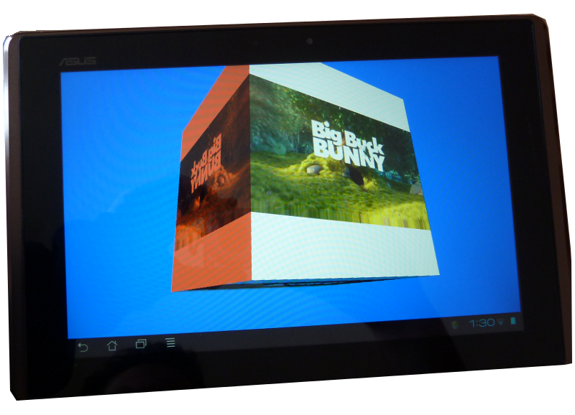
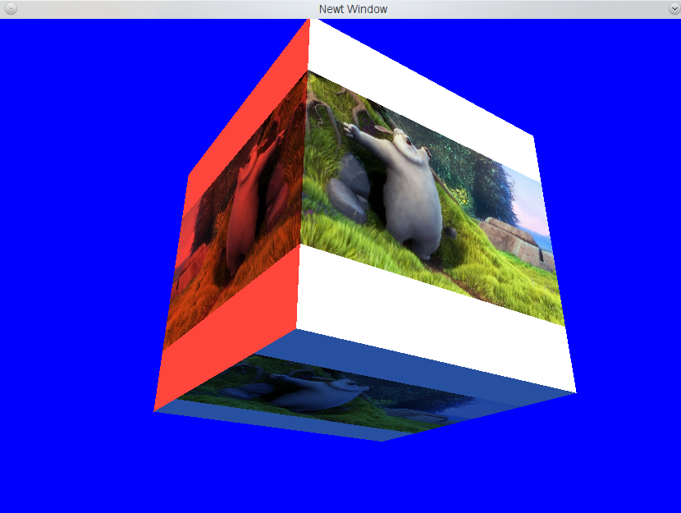
GLMediaPlayer
Jogamp
Platform agnostic API
Backends:
  Android
  FFMPEG / libav*
  OpenMAX (wip)
  JOAL
NApplet demo
* Binds to system library, providing libav is WIP.

Slide 35
JogAmp Deployment
Jogamp
Preinstalled Bundles
  Modularized JARs
  Android APKs (modular, or all-in-one)
  Maven
Online / Cached
  Automatic Native-JAR loading support
  Applet
    Classical
    JNLP
  Webstart (JNLP)

Slide 36
Maven
The JogAmp project currently distributes Jar files and .7z archives containing compiled code, source code, and documentation
June 2012 - Stable versions and release candidates are released to the Central Repository, and bleeding edge packages are published to a testing repository at http://jogamp.org/deployment/maven
Maven

Slide 37
Maven
Traditionally JogAmp locates native JAR files derived from it's java JAR URL without utilizing the classpath for performance reasons.
As of 2.2.0, the JogAmp attempts to loading native JAR files referenced from the classpath as a fallback. This allows users to place them in arbitrary URL locations.
As a result, JogAmp Maven packages can now be used from Gradle!
Maven

Slide 38
Maven
As of 2.2.0, all (previously incomplete) packages have been updated and all atomics are now deployed to Maven Central.
Extra atomic packages have been added to make it easier to pull in atomics for all platforms. For example, depending on nativewindow-main will create a dependency on the nativewindow atomics for all platforms.
Maven

Slide 39
Maven
As of 2.2.0, all packages are subjected to validation tests before being published to Maven Central.
The 2.1.5 release had a mistake that broke the packages (corrected in 2.1.5-01). The new unit tests prevent this kind of error from occurring.
Maven

Slide 40
Android
The JogAmp project provides an abstraction known as the GLEventListener that allows one to write applications in a renderer and display independent manner. That is, the programmer writes their program using GLEventListener and does not need to modify it to run on Android, or on other platforms that do not provide programming interfaces that look like typical Java programs.
Maven

Slide 41
Android
Writing a program that works unmodified on both traditional Java desktop/workstation systems and Android devices is simply a matter of providing trivial frontend code to the bulk of your application written using the GLEventListener abstraction.
Maven

Slide 42
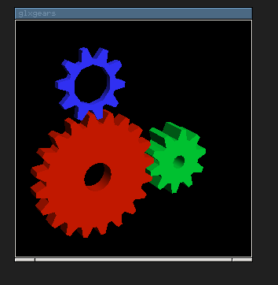
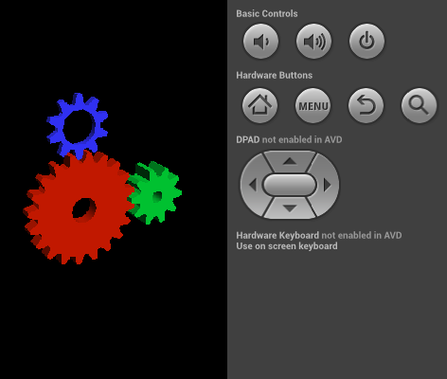
Android
The desktop code specifies dependencies on the standard JOGL packages, and the Android code specifies dependencies on the published JOGL Android packages.
Maven

Slide 43


Thank You & Love You
Rami Santina
Jens Hohmuth
Sven Gothel
Mr. Max
Emmanuel Puybaret
Xerxes Ranby
Julien Gouesse
Harvey Harrison
Wade Walker
Mark Raynsford
Andres Colubri
… all the many contributors & users

