Slide 1
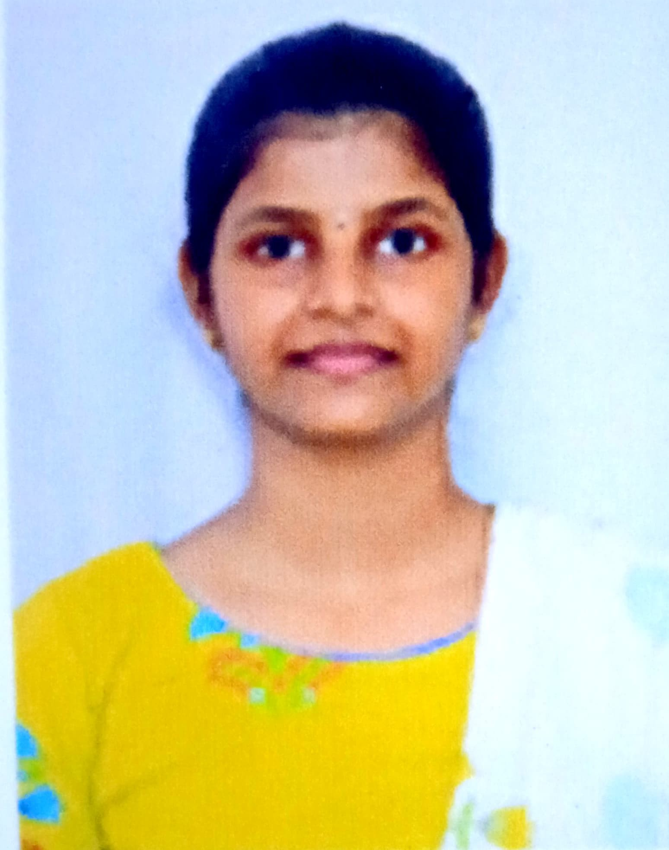

Student Details
name: JOGI DHANESWARI
Roll no: 21X41A0591
EMAIL: jogidhaneswari1@gmail.com
BRANCH: CSE
COLLEGE: SRK INSTITUTE OF TECHNOLOGY, Andhra pradesh.

Slide 2
STEGANOGRAPHY
Steganography is the practice of concealing information within another message or physical object or hiding methods to avoid detection. Steganography can be used to hide virtually any type of digital content, including text, image, video, or audio content. That hidden data is then extracted at its destination.
Text steganography involves hiding information inside text files. This includes changing the format of existing text, changing words within a text, using context-free grammars to generate readable texts, or generating random character sequences.
DEFINITITON : Steganography is the art of hiding secret information within a non-secret message, image, or other medium.

Slide 3
STEGANOGRAPHY AGENDA
Whereas cryptography is the practice of protecting the contents of a message alone, steganography is concerned with concealing both the fact that a secret message is being sent and its contents. Steganography includes the concealment of information within computer files.
Steganography includes the concealment of information within computer files. In digital steganography, electronic communications may include steganographic coding inside of a transport layer, such as a document file, image file, program, or protocol.
Media files are ideal for steganographic transmission because of their large size. For example, a sender might start with an innocuous image file and adjust the color of every hundredth pixels to correspond to a letter in the alphabet. The change is so subtle that someone who is not specifically looking for it is unlikely to notice the chang

Slide 4
PROJECT OVERVIEW
Design a steganography system that can hide sensitive text data within a digital image
in such a way that:
➢ The hidden data can only be extracted by authorized personnel with the correct
decryption key.
➢ The image remains visually unchanged and appears identical to the original image.
➢ The system can accommodate hiding at least 1KB of text data within a single image
➢ The system should be robust against common image processing operations like
compression, scaling, and cropping.

Slide 5
WHO ARE THE END USERS of this project?
Security and Intelligence Agencies
Corporate Entities
Military Organizations
Journalists and Activists.
Research and Development

Slide 6
YOUR SOLUTION AND ITS VALUE PROPOSITION
•SOLUTION:
Develop a steganography system that utilizes a combination of advanced image processing
techniques and encryption methods to hide text data in images. The system will be designed to
meet the requirements and constraints outlined in the problem statement.
Security and Stealth: My solution ensures high levels of security by hiding information within the least significant bits of the cover media, making it extremely difficult for unauthorized users to detect the hidden data without the proper decryption key or algorithm.
Versatility: It supports embedding various types of data formats (text, binary files, etc.) into different types of media files, ensuring flexibility and applicability across different use cases.
Efficiency: The embedding process is efficient and does not significantly alter the original media file's quality or characteristics, preserving its integrity and minimizing the chances of detection.

Slide 7
Process :
Algorithm Selection and Enhancement: I would carefully select and possibly enhance steganographic algorithms to ensure they meet modern security standards while optimizing them for efficiency and robustness. This might involve implementing newer algorithms or improving existing ones to handle larger data payloads or to be more resistant to statistical analysis.
User Interface and Experience: Designing an intuitive and user-friendly interface is crucial. I would customize the user interface to make the embedding and extraction processes straightforward, possibly integrating drag-anddrop functionality, progress indicators, and clear instructions to enhance usability.
Integration of Security Measures: Apart from embedding data, ensuring the security of the embedded information is paramount. I would integrate strong encryption techniques (like AES) for encrypting the data before embedding it, ensuring that even if the carrier file is compromised, the embedded information remains secure.
Performance Optimization: Optimizing the performance of the steganography operations is essential for real-world usability. This could involve minimizing computational overhead during embedding and extraction, optimizing memory usage, and ensuring that the process runs efficiently on various hardware configurations.
Customization and Extensibility: Providing options for customization allows users to tailor the steganography process to their specific needs. This might include adjustable parameters for embedding density (how much data to embed relative to the cover media), support for different file formats, and the ability to choose different embedding algorithms depending on the desired level of security versus invisibility.
Documentation and Support: Clear documentation and responsive support channels are crucial for users to understand and effectively use the steganography tool. Customizing the documentation to include detailed examples, FAQs, and troubleshooting tips would enhance user confidence and satisfaction.
Testing and Validation: Rigorous testing and validation are essential to ensure the reliability and security of the steganography solution. Customizing the testing process to include comprehensive test cases, security audits, and performance benchmarks would validate the effectiveness of the solution.

Slide 8
MODELLING
Data Model: This involves defining how data will be represented and manipulated within the steganography system. It includes decisions on data formats (text, binary, etc.), encoding schemes, and how data will be structured for embedding and extraction.
Embedding Model: This specifies the technique or algorithm used to embed hidden data into a cover media (such as an image or audio file). Modeling here involves determining how to modify the carrier file to embed the hidden information while minimizing perceptible changes and maintaining cover media integrity.
Extraction Model: This defines the method for extracting hidden data from the carrier media. Modeling the extraction process ensures that the embedded information can be accurately retrieved, even after potential alterations to the carrier file.

Slide 9
Results
Efficient and Secure Data Embedding: By meticulously designing the embedding model, the project ensures that hidden data can be seamlessly integrated into cover media while maintaining the media's integrity and quality. This efficiency reduces the likelihood of detection and preserves the secrecy of the embedded information.
Accurate Data Extraction: Through a well-defined extraction model, the project enables the precise retrieval of hidden data from the carrier media. This accuracy ensures that authorized users can access the concealed information without errors or loss of data integrity.
Robust Security Measures: A comprehensive security model strengthens the project's defenses against unauthorized access and detection. Techniques such as encryption of hidden data before embedding, selection of advanced steganographic algorithms, and validation mechanisms contribute to safeguarding the confidentiality and integrity of sensitive information.
Optimized Performance: The performance model focuses on optimizing computational resources and operational efficiency. This optimization minimizes processing.

Slide 10
Links
https://github.com/Jogi2004/cybersecurity

