Slide 1
HYPERTEXT, INFERENCE AND HOOKS
How far can one Web architect’s vision go?
Hypertext, inference, and hooks: determinism around a model.
Look
Think
Act
One loop, for a person and for an agent.
Notes:
The question for the next half hour: if we take one Web architect's 2008 vision at its word, with today's tools, how far does it go? Two halves: running (hypertext lets a model find a path once, then a script replays it), and building (hooks put determinism around the model that wrote the code).

Slide 2
FRAMING · HOW THIS WAS BUILT
Walk the dog, ship the feature
When there’s no time left to type code: family, a new dog, a phone in one hand and a leash in the other.
Remote Control
Please give me an update
Claude Code Remote Control on the phone, a personal Max account at home.
Test first, every change: Gherkin, a red run, the code, a green run, a gated commit.
Evidence, not trust: the gates log every step, so what passed is on record when I get home.
The result: repeatable, reliable RISE behaviour, built a few sentences at a time.
Red run logged. Writing the fix.
How’s it going?
Green. pre-commit: TDD ordering check passed.
Illustrative, not a transcript. The two questions are the real ones, every evening.
Notes:
The honest frame. Free time collapsed: family, a new dog. Typing code stopped being possible. What remained: Claude Code's Remote Control on a phone, a personal Max account, and a test-first discipline strong enough that the code can be trusted while I'm out on a walk. The humor is real: the messages really were that short.

Slide 3

20 OCTOBER 2008 · FIELDING’S FRUSTRATION
Our question: how far can we take his vision today?
“
I am getting frustrated by the number of people calling any HTTP-based interface a REST API.
Roy T. Fielding, “REST APIs must be hypertext-driven”, 20 Oct 2008
Not “who got it wrong”. How far can we go if we take one Web architect’s vision at its word, with the tools we have now?
Notes:
Not 'who got REST wrong'. The question is constructive: take the 2008 post at its word, with today's models and tools, and see how far it goes.

Slide 4
WHY THE WEB SCALED
HATEOAS: Fielding’s explanation, not his invention
A description, not a proposal
At the application layer, perhaps the most depended-upon and consequential network constraint of all time
Hypermedia as the engine of application state: the name his dissertation (2000) gave to why the Web scaled so fast.
Every page carries its own next steps, its links and forms.
So a browser needs no prior knowledge of any site, and never ships an update when a site changes.
for the human web.
Every link followed and every form sent, by billions of people, every day.
Notes:
Hypermedia as the engine of application state is the name the 2000 dissertation gave to what the Web already did. It explains why one generic program, the browser, could use every site. At the application layer, it is arguably the most depended-upon and consequential network constraint of all time, for the human web.

Slide 5
WHY THIS TEAM CARES
The Web made LLMs possible, and only half of it
Links everywhere
A corpus
The missing half
The Web’s architecture made every page reachable from another. A crawler needs no map.
Filtered Common Crawl was the largest share of GPT-3’s training mix.
Crawlers read. They never send a form, so the Web’s transactions were never learned from.
The transactional half of the Web is where agents now have to work.
Notes:
Brief. The same architecture made a crawlable corpus. Filtered Common Crawl was the largest share of GPT-3's training mix. But crawlers only read: they follow links, they never submit forms. The transactional half of the Web was never in the corpus.

Slide 6
FIELDING, IN THE COMMENTS ON HIS 2008 POST
Information and controls, presented together
“
When I say hypertext, I mean the simultaneous presentation of information and controls such that the information becomes the affordance through which the user (or automaton) obtains choices and selects actions.
Roy T. Fielding, comment, 20 October 2008
information
+
controls
=
affordance
On the human web they were married: the page and its forms arrive together.
Notes:
This is the marriage. On the human web, the page and its forms arrive together; the information itself is how you find out what you can do.

Slide 7
THE MACHINE WEB
The divorce: data in the response, controls elsewhere
The response
The controls, out of band
13.5 MB
Data only. Status, ids, timestamps. Nothing says what you may do next.
Docs and SDKs
OpenAPI descriptions
MCP tool lists
GitHub’s OpenAPI description, as one file. An agent given it reads every operation, whatever state the pull request is in.
“
Failure here implies that out-of-band information is driving interaction instead of hypertext.
Roy T. Fielding, “REST APIs must be hypertext-driven”, 2008
Notes:
APIs kept the information and moved the controls out of band: docs, SDKs, OpenAPI, and now MCP tool lists. Agents inherit the divorce: every tool and endpoint is loaded into the context window up front, whatever the current state allows.

Slide 8
ONE LOOP, TWO READERS
Look, Think, Act = Sync, Reason, Act
A person
ARTIE
Look
Sync
Read the representation: the state and the controls offered now.
Think
Reason
Choose among what’s offered. The only place a model sits, and a kept script can stand in for it.
Act
Act
Send the form: method, target, fields, If-Match, signed.
“
Typed relations, specific media types, and action-specific elements provide the guidance needed for automated agents.
Roy T. Fielding, comment, 2008
Notes:
A person in a browser and ARTIE run the same loop. Sync and Act are plain code. Reason is the only place a model sits, and a kept script can stand in for it on every later run.

Slide 9
PUTTING THEM BACK TOGETHER
HEART, RISE and ARTIE
HEART
RISE
ARTIE
Hypermedia Enforced Agentic Reliable Transactions
Reciprocal Interface for State Exchange
Autonomous Restful Traversal and Interactive Engine
Each answer carries the state plus the forms valid now (HAL Schema Forms), with typed relations, If-Match guards and signed acts.
Replies for asynchronous work: a watcher or a build answers back when it’s ready.
One generic client for all of it, coupled to the media type, never to a domain.
Built test-first under the bdd-gates skill: Claude Code hooks plus git hooks.
Notes:
Three names, briefly. HEART is the media type and its rules; RISE is how asynchronous work answers back; ARTIE is the one generic client. All built test-first under the bdd-gates skill.

Slide 10
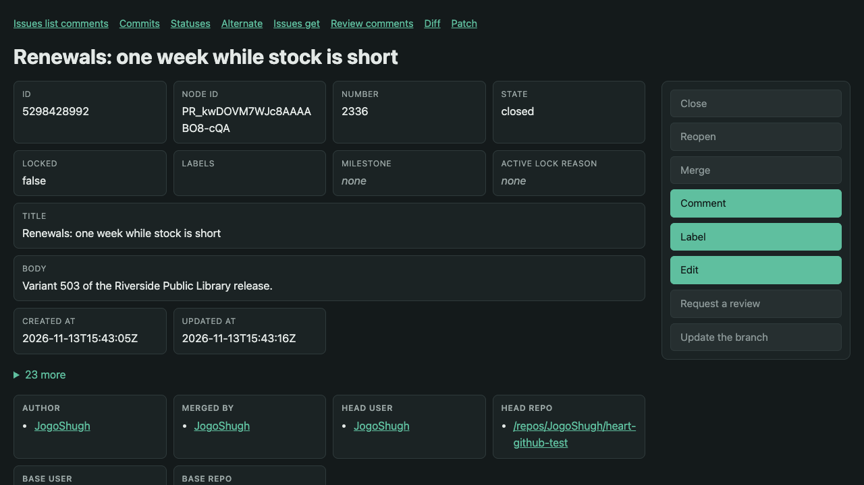
PUTTING THEM BACK TOGETHER
State-scoped affordances
What this resource, in this state, lets you do now, and nothing else.
Merged: Comment, Label and Edit are offered. Merge, Close and Reopen are not.
One answer, two readers: the same state, as HAL Schema Forms, is what ARTIE reads.
No giant context window of tools or OpenAPI: the model reads only what applies.
Real GitHub pull request #2336, merged, through the gateway as text/html. Screenshot, 13 Nov 2026.
Notes:
The gateway's own text/html for the merged pull request #2336 on real GitHub. Close, Reopen, Merge and the others are shown but not offered; Comment, Label and Edit are. That's the same answer ARTIE reads as HAL Schema Forms. No context window full of tools: the service returns what can be done now.

Slide 11
“BUT ISN’T HYPERMEDIA BLOATED?”
L0, L1, L2: one page, three ways to deliver it
Like a page with its CSS and JavaScript inlined, or linked and cached.
Requests on the network, per release | 1st | 2nd | 3rd | 4th | 5th
L0 | 59 | 59 | 59 | 56 | 59
L2, a fresh cache each release | 112 | 112 | 111 | 106 | 112
L2, one cache kept | 112 | 61 | 59 | 58 | 59
L0
State, forms and schemas in one answer
Simple and correct: like a page with everything inlined.
L1
Prefer: forms=link
Real GitHub, five releases, no model calls. A warm release sends about 53 fewer requests: the form sets and schemas never leave ARTIE’s memory.
The form set is its own content-addressed link, cached.
51.2M
34.6 GB
L2
Prefer: forms=link, schema=link
Schemas linked too: immutable, shared across forms, states and resources.
requests never sent, over 1,000,000 releases (GitHub)
bytes not received at that scale: 23% on GitHub, 60% on GitLab
“L0 buys correctness, L2 buys economy.” HTTP caching does the scaling, as it always has on the Web.
Bytes: JSON bodies before compression, headers excluded. Extrapolated from the measured warm release.
Notes:
The analogy: a web page with all its CSS and JavaScript inlined, versus the same page with linked, cached files. Same page, different delivery. L0 inlines everything; L1 links the form set; L2 links the schemas too, content-addressed and immutable for a year. The numbers are from five real releases per forge, with no model calls. From the second release on, about 50 form-set and schema reads per release never reach the network: ARTIE's cache answers them. Resources themselves still revalidate by ETag and answer 304.

Slide 12

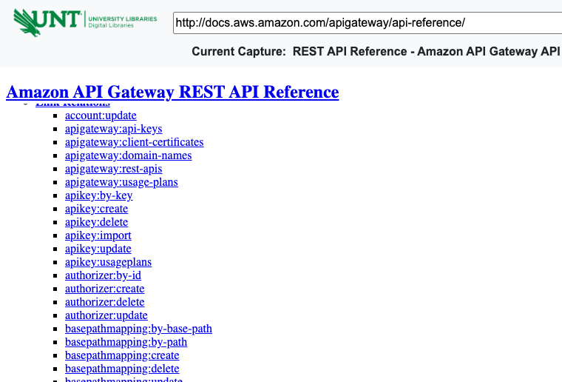
NOT NEW, NOT NICHE
Hypermedia is already in production
Okta
The password expired, so the answer’s _links offer next: changePassword, and cancel. Nothing else.
Amazon API Gateway
Documented as HAL, with its own typed link relations: restapi:deployments, apikey:create…
API Gateway REST API Reference, archived 21 Jan 2017.
Spring HATEOAS, for agents: Adib Saikali, “REST is for Agents”, Spring I/O 2026. HEART adds schemas, guards and typed relations.
Okta Authentication API: expired password.
Notes:
Okta's Authentication API answers with HAL: _embedded for the user and policy, _links for what can be done next, here changePassword or cancel, because the password expired. Amazon API Gateway's management API documented its own typed link relations (2017 archive). Spring HATEOAS is being pitched for agents now: Adib Saikali, Spring I/O 2026. What HEART adds: forms with JSON Schema, guards, and typed relations.

Slide 13
THE TOKENOMICS SLIDE
Capture once with a model, replay with none
# release.goal.md: the goal, in words
- Open pull request {pull} of {owner}/{repo} `as pr`
- At {watcher}, ask to be told when {pr}
offers scm:merge `as watch`
- Once {watch} is answered, at {pr},
merge it by squashing `as merged`
- At {jenkins}, build commit
{merged.merge_commit_sha} `as build`
- … run the smoke script it links … `as smoke`
- If {smoke.passed}, at {dev}, promote …
Otherwise, at {pr}, act scm:comment …
20
33,140
model calls, once: the capture on real GitHub
input tokens, plus 2,980 output, once
0
2
model calls in every replay since
forges replayed: real GitHub, and GitLab on this machine
Pins hold the replay to what was offered. If a form changes, the replay stops, and only then is the model called again, to repair.
Notes:
One Claude capture on real GitHub at rung L2: 20 model calls, 33,140 input and 2,980 output tokens. Then the kept script ran ten releases on two forges, and five more three ways for the cache numbers: zero model calls. Pins stop a replay that no longer fits, so the model is called only to repair.

Slide 14


PROOF
One script, real GitHub and a local GitLab
Real GitHub: pull request #2336, merged by the replay.
Local GitLab: merge request !503, merged by the same script.
On the wire, compatible because of the typed relation. One YAML connector per forge maps its native API to scm:merge, scm:comment… The GitLab runs make no cloud calls and no model calls.
Notes:
Same kept script, same scm: relations. GitHub is the real cloud service; GitLab runs locally with no cloud calls. Each forge has one YAML connector in the gateway that maps its native API to the same typed relations, so scm:merge means the same on both. On the wire, compatible because of the typed relation.

Slide 15
HOW IT WAS BUILT · DETERMINISM THROUGH HOOKS
Instructions are advisory. Hooks are not.
Gate | Where | What it holds
Gherkin first | PreToolUse | No production code until a scenario says what it must do
Red, logged | PostToolUse | A failing test run is recorded before the first src/main write
Green to stop | Stop | The session can’t end with the suite red
Ordering at commit | git pre-commit | The log must show feature, red, code, green, in that order
Gate protection | PreToolUse | The gates and their log can’t be edited by the model
0
model calls to enforce them. The gates are scripts the harness runs, not instructions the model may forget.
Claude Code hooks guard the edits; git hooks guard the history.
Notes:
The bdd-gates skill. A model can be told to write the test first; it can't be trusted to always do it. Hooks make it a property of the environment. They cost zero tokens.

Slide 16
HOW IT WAS BUILT · RED FIRST, LIVE
The scenario, then the failing run
Scenario: A step that only reads is kept in the
script when a later step names what it read
`as NAME` on a read is no detour when a later step
names it: the watch is asked about ${front.@self}
Given the file "named-read.goal.md" is
- Search the desk's releases that are {state}
`as front`
- At {watcher}, ask to be told when {front}
offers desk:release `as watch`
…
Then the script has a line with
"- act: desk:search-releases"
# the red run, logged by the gate
496 tests completed, 1 failed,
41 skipped
testcase: A step that only reads
is kept in the script when …
Red on behaviour, not on a compile error. The gate logs the run; only then may src/main change.
Notes:
A real one from this work. The real-GitHub capture dropped the step that opens the pull request, because nothing read a value from it; a later step only named it. The scenario says so first, and the run fails on behaviour before any code is written.

Slide 17

HOW IT WAS BUILT · CODE, GREEN, COMMIT
The fix, the green run, the gated commit
// Detours.kt: keep a read another step names
private fun named(capture: Capture): Set<Int> {
val marks = capture.steps.associateWith {
capture.marks(it) }
return marks.filter { (step, own) ->
val name = own["as"]?.toString()
?: return@filter false
val mention = Regex("""\{$name[.}]""")
marks.any { (other, its) -> other.line !=
step.line && its.values.any {
mention.containsMatchIn("$it") } }
}.keys.map { it.number }.toSet()
artie-cli test report: 198 tests, 0 failures.
Then the replay, on real GitHub and local GitLab, with the regenerated script.
pre-commit: TDD ordering check passed.
# then the capture again, and the open-PR step stays
Notes:
The fix in Detours.kt: keep a step whose `as` name another step mentions. Then green, then the commit, which the git pre-commit hook checks for ordering. The report beside it is the module's real test report.

Slide 18
HOW IT WAS BUILT · WHEN THE GATE SAYS NO
The gates hold, even against the model
Blocked
The protect-gate hook stopped the model reading the gate’s own event log. It didn’t try another way.
Human’s switch
Refactor mode, the only time src/main may change with no new red, is switched on by the person, never the model.
Redone
An edit made outside Claude Code’s edit tool was redone through it, so the log records every change.
The model doesn’t have to be trustworthy for the process to be.
Notes:
Three moments from this work. The protect-gate hook blocked the model from reading its own event log; it didn't retry. Refactor mode is the human's switch, never the model's. And an edit made outside Claude Code's edit tool was redone through it, so the log saw it.

Slide 19
FOUNDATIONS
Standing on these shoulders
Roy T. Fielding the dissertation (2000) and the 2008 post
Mike Kelly HAL
Mike Amundsen HAL-FORMS
J. Badeau HAL Schema Forms, the base of HEART’s media type
J. Badeau HyperBench, a hypermedia-driven workbench
Kin Lane API Evangelist
Adib Saikali “REST is for Agents”, Spring I/O 2026
W3C Autonomous Agents on the Web Community Group
Ciortea, Mayer, Gandon, Boissier, Ricci, Zimmermann “A Decade in Hindsight”, AAMAS 2019: one of numerous papers
Others speaking now on hypermedia and agents include Rohit Bhardwaj (“From REST to Reasoning Agents”) and Michael Carducci (“Hypermedia APIs and the Future of AI Agentic Systems”), NFJS.
Notes:
Links only. Fielding; Mike Kelly's HAL; Mike Amundsen's HAL-FORMS; J. Badeau's HAL Schema Forms, the base of HEART's media type, and HyperBench; Kin Lane; Adib Saikali; the W3C Autonomous Agents on the Web Community Group; and one of numerous research papers, Ciortea et al. at AAMAS 2019.

Slide 20
CLOSE
The Web gave us the model. Hypertext and hooks let us stop paying it for the same path twice.
Running
Building
Both
Driven by hypertext: only what’s offered now. Found once with a model, replayed with none.
Gated by hooks: Gherkin, red, code, green, commit. No model call to enforce.
Move work from tokens to processes, where it costs nothing to repeat.
Notes:
Building is gated by hooks. Running is driven by hypertext and replayed from kept scripts. Both move work from tokens to processes.

