Slide 1
HYPERTEXT, INFERENCE AND HOOKS
How far can one Web architect’s vision go?
Hypertext, inference, and hooks: determinism around a model.
Look
Think
Act
One loop, for a person and for an agent.
Notes:
The question for the next half hour: if we take one Web architect's 2008 vision at its word, with today's tools, how far does it go? Two halves: running (hypertext lets a model find a path once, then a script replays it), and building (hooks put determinism around the model that wrote the code).

Slide 2
FRAMING · HOW THIS WAS BUILT
Walk the dog, ship the feature
When there’s no time left to type code: family, a new dog, a phone in one hand and a leash in the other.
Remote Control
Please give me an update
Claude Code Remote Control on the phone, a personal Max account at home.
Test first, every change: Gherkin, a red run, the code, a green run, a gated commit.
Evidence, not trust: the gates log every step, so what passed is on record when I get home.
The result: repeatable, reliable RISE behaviour, built a few sentences at a time.
Red run logged. Writing the fix.
How’s it going?
Green. pre-commit: TDD ordering check passed.
Illustrative, not a transcript. The two questions are the real ones, every evening.
Sources: Claude Code Remote Control · Claude Code hooks · bdd-gates skill
Notes:
The honest frame. Free time collapsed: family, a new dog. Typing code stopped being possible. What remained: Claude Code's Remote Control on a phone, a personal Max account, and a test-first discipline strong enough that the code can be trusted while I'm out on a walk. The humor is real: the messages really were that short.

Slide 3

20 OCTOBER 2008 · FIELDING’S FRUSTRATION
Our question: how far can we take his vision today?
“
I am getting frustrated by the number of people calling any HTTP-based interface a REST API.
Roy T. Fielding, “REST APIs must be hypertext-driven”, 20 Oct 2008
Not “who got it wrong”. How far can we go if we take one Web architect’s vision at its word, with the tools we have now?
Sources: Fielding, REST APIs must be hypertext-driven (2008)
Notes:
Not 'who got REST wrong'. The question is constructive: take the 2008 post at its word, with today's models and tools, and see how far it goes.

Slide 4
WHY THE WEB SCALED
HATEOAS: Fielding’s explanation, not his invention
A description, not a proposal
At the application layer, perhaps the most depended-upon and consequential network constraint of all time
Hypermedia as the engine of application state: the name his dissertation (2000) gave to why the Web scaled so fast.
Every page carries its own next steps, its links and forms.
So a browser needs no prior knowledge of any site, and never ships an update when a site changes.
for the human web.
Every link followed and every form sent, by billions of people, every day.
Sources: Fielding, dissertation, ch. 5: REST
Notes:
Hypermedia as the engine of application state is the name the 2000 dissertation gave to what the Web already did. It explains why one generic program, the browser, could use every site. At the application layer, it is arguably the most depended-upon and consequential network constraint of all time, for the human web.

Slide 5
WHY THIS TEAM CARES
The Web made LLMs possible, and only half of it
Links everywhere
A corpus
The missing half
The Web’s architecture made every page reachable from another. A crawler needs no map.
Filtered Common Crawl was the largest share of GPT-3’s training mix.
Crawlers read. They never send a form, so the Web’s transactions were never learned from.
The transactional half of the Web is where agents now have to work.
Sources: Brown et al., Language Models are Few-Shot Learners (GPT-3), Table 2.2 · Common Crawl
Notes:
Brief. The same architecture made a crawlable corpus. Filtered Common Crawl was the largest share of GPT-3's training mix. But crawlers only read: they follow links, they never submit forms. The transactional half of the Web was never in the corpus.

Slide 6
FIELDING, IN THE COMMENTS ON HIS 2008 POST
Information and controls, presented together
“
When I say hypertext, I mean the simultaneous presentation of information and controls such that the information becomes the affordance through which the user (or automaton) obtains choices and selects actions.
Roy T. Fielding, comment, 20 October 2008
information
+
controls
=
affordance
On the human web they were married: the page and its forms arrive together.
Sources: Fielding, 2008 post and its comments
Notes:
This is the marriage. On the human web, the page and its forms arrive together; the information itself is how you find out what you can do.

Slide 7
THE MACHINE WEB
The divorce: data in the response, controls elsewhere
The response
The controls, out of band
13.5 MB
Data only. Status, ids, timestamps. Nothing says what you may do next.
Docs and SDKs
OpenAPI descriptions
MCP tool lists
GitHub’s OpenAPI description, as one file. An agent given it reads every operation, whatever state the pull request is in.
“
Failure here implies that out-of-band information is driving interaction instead of hypertext.
Roy T. Fielding, “REST APIs must be hypertext-driven”, 2008
Sources: Fielding (2008) · GitHub OpenAPI description
Notes:
APIs kept the information and moved the controls out of band: docs, SDKs, OpenAPI, and now MCP tool lists. Agents inherit the divorce: every tool and endpoint is loaded into the context window up front, whatever the current state allows.

Slide 8
ONE LOOP, TWO READERS
Look, Think, Act = Sync, Reason, Act
A person
ARTIE
Look
Sync
Read the representation: the state and the controls offered now.
Think
Reason
Choose among what’s offered. The only place a model sits, and a kept script can stand in for it.
Act
Act
Send the form: method, target, fields, If-Match, signed.
“
Typed relations, specific media types, and action-specific elements provide the guidance needed for automated agents.
Roy T. Fielding, comment, 2008
Sources: Fielding, 2008 post and its comments
Notes:
A person in a browser and ARTIE run the same loop. Sync and Act are plain code. Reason is the only place a model sits, and a kept script can stand in for it on every later run.

Slide 9
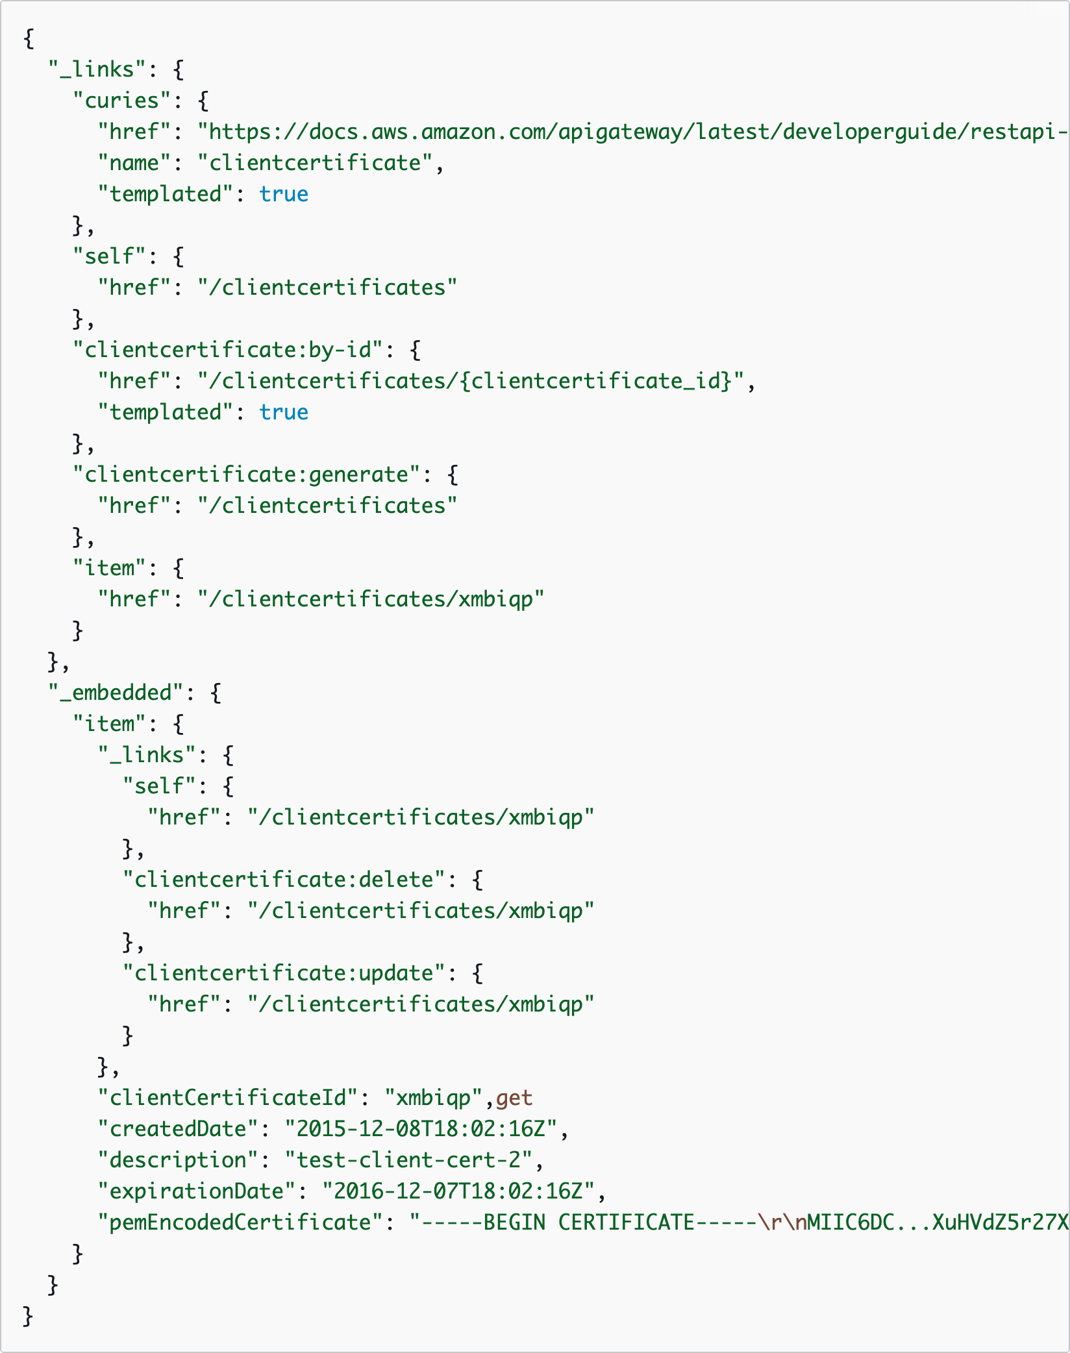
A PRECURSOR, STILL LIVE
Amazon API Gateway: relations that name the acts
The relation names the act…
# HAL Schema Forms adds the form
_forms:
scm:merge:
_links:
target: {href: …/merge}
method: PUT
contentType: application/json
schema:
type: object
properties:
method:
enum: [merge, squash,
rebase]
# HEART: only while it applies
clientcertificate:generate on the list.
clientcertificate:delete and update on each certificate, beside its data.
curies link each relation to its docs page.
…but not how to do it.
No method, no fields, no schema. The client still reads the curie’s docs page: out of band.
GetClientCertificates, sample response.
Sources: AWS: GetClientCertificates · HAL (Kelly) · HAL Schema Forms (Badeau)
Notes:
Live, current AWS documentation: GetClientCertificates. HAL: curies point each relation to its docs page; typed relations name what you can do: by-id, generate, and on each embedded certificate delete and update. What it lacks: the method, the fields, the schema. A client still reads the docs page the curie points to. HAL Schema Forms, the base of HEART's media type, puts exactly that in the response: method, content type, JSON Schema. HEART then scopes the forms to state.

Slide 10
PUTTING THEM BACK TOGETHER
HEART, RISE and ARTIE
HEART
RISE
ARTIE
Hypermedia Enforced Agentic Reliable Transactions
Reciprocal Interface for State Exchange
Autonomous Restful Traversal and Interactive Engine
Each answer carries the state plus the forms valid now (HAL Schema Forms), with typed relations, If-Match guards and signed acts.
Replies for asynchronous work: a watcher or a build answers back when it’s ready.
One generic client for all of it, coupled to the media type, never to a domain.
Built test-first under the bdd-gates skill: Claude Code hooks plus git hooks.
Sources: artie: HEART, RISE, ARTIE · HAL Schema Forms · JSON Schema 2020-12 · RFC 9421 HTTP Message Signatures
Notes:
Three names, briefly. HEART is the media type and its rules; RISE is how asynchronous work answers back; ARTIE is the one generic client. All built test-first under the bdd-gates skill.

Slide 11
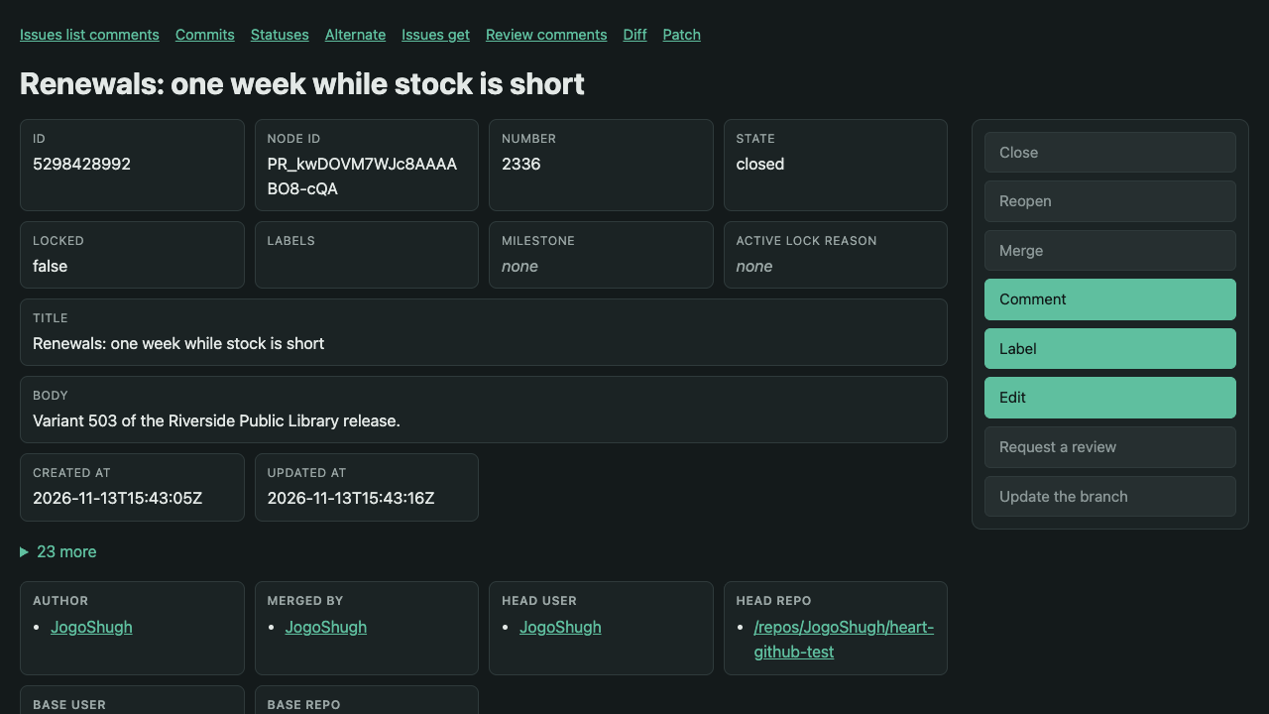
PUTTING THEM BACK TOGETHER
State-scoped affordances
What this resource, in this state, lets you do now, and nothing else.
Merged: Comment, Label and Edit are offered. Merge, Close and Reopen are not.
One answer, two readers: the same state, as HAL Schema Forms, is what ARTIE reads.
No giant context window of tools or OpenAPI: the model reads only what applies.
Real GitHub pull request #2336, merged, through the gateway as text/html. Screenshot, 13 Nov 2026.
Sources: Pull request #2336 · Report: Real GitHub, Local GitLab
Notes:
The gateway's own text/html for the merged pull request #2336 on real GitHub. Close, Reopen, Merge and the others are shown but not offered; Comment, Label and Edit are. That's the same answer ARTIE reads as HAL Schema Forms. No context window full of tools: the service returns what can be done now.

Slide 12
“BUT ISN’T HYPERMEDIA BLOATED?”
L0, L1, L2: one page, three ways to deliver it
Like a page with its CSS and JavaScript inlined, or linked and cached.
Requests on the network, per release | 1st | 2nd | 3rd | 4th | 5th
L0 | 59 | 59 | 59 | 56 | 59
L2, a fresh cache each release | 112 | 112 | 111 | 106 | 112
L2, one cache kept | 112 | 61 | 59 | 58 | 59
L0
State, forms and schemas in one answer
Simple and correct: like a page with everything inlined.
L1
Prefer: forms=link
Real GitHub, five releases, no model calls. A warm release sends about 53 fewer requests: the form sets and schemas never leave ARTIE’s memory.
The form set is its own content-addressed link, cached.
51.2M
34.6 GB
L2
Prefer: forms=link, schema=link
Schemas linked too: immutable, shared across forms, states and resources.
requests never sent, over 1,000,000 releases (GitHub)
bytes not received at that scale: 23% on GitHub, 60% on GitLab
“L0 buys correctness, L2 buys economy.” HTTP caching does the scaling, as it always has on the Web.
Bytes: JSON bodies before compression, headers excluded. Extrapolated from the measured warm release.
Sources: RFC 9111 HTTP Caching · Report: the cache, release by release
Notes:
The analogy: a web page with all its CSS and JavaScript inlined, versus the same page with linked, cached files. Same page, different delivery. L0 inlines everything; L1 links the form set; L2 links the schemas too, content-addressed and immutable for a year. The numbers are from five real releases per forge, with no model calls. From the second release on, about 50 form-set and schema reads per release never reach the network: ARTIE's cache answers them. Resources themselves still revalidate by ETag and answer 304.

Slide 13

NOT NEW, NOT NICHE
Hypermedia is already in production
Okta
Spring HATEOAS, for agents
The password expired, so the answer’s _links offer next: changePassword, and cancel. Nothing else. State, then controls, in one answer.
Adib Saikali (Broadcom), “REST is for Agents: Rediscovering Spring HATEOAS”, Spring I/O 2026.
Amazon API Gateway
What HEART adds: forms with JSON Schema, If-Match guards, typed relations, and only the forms that apply now.
HAL with typed relations, in its current API reference (the slide before).
Okta Authentication API: expired password.
Sources: Okta Authentication API · AWS: GetClientCertificates · Spring I/O 2026: REST is for Agents
Notes:
Okta's Authentication API answers with HAL: _embedded for the user and policy, _links for what can be done next, here changePassword or cancel, because the password expired. Amazon API Gateway, the slide before. Spring HATEOAS is being pitched for agents now: Adib Saikali, Spring I/O 2026. What HEART adds: forms with JSON Schema, guards, and typed relations.

Slide 14
THE TOKENOMICS SLIDE
Capture once with a model, replay with none
# release.goal.md: the goal, in words
- Open pull request {pull} of {owner}/{repo} `as pr`
- At {watcher}, ask to be told when {pr}
offers scm:merge `as watch`
- Once {watch} is answered, at {pr},
merge it by squashing `as merged`
- At {jenkins}, build commit
{merged.merge_commit_sha} `as build`
- … run the smoke script it links … `as smoke`
- If {smoke.passed}, at {dev}, promote …
Otherwise, at {pr}, act scm:comment …
20
33,140
model calls, once: the capture on real GitHub
input tokens, plus 2,980 output, once
0
2
model calls in every replay since
forges replayed: real GitHub, and GitLab on this machine
Pins hold the replay to what was offered. If a form changes, the replay stops, and only then is the model called again, to repair.
Sources: Report: Real GitHub, Local GitLab · artie (repository)
Notes:
One Claude capture on real GitHub at rung L2: 20 model calls, 33,140 input and 2,980 output tokens. Then the kept script ran ten releases on two forges, and five more three ways for the cache numbers: zero model calls. Pins stop a replay that no longer fits, so the model is called only to repair.

Slide 15
WHAT GETS KEPT
A kept script is data, not a program
# release.heart.yaml (excerpt), kept by artie generate
heart: 1
kind: kept
steps:
- act: scm:pulls-get
fields: {owner: ${owner}, repo: ${repo},
pull_number: ${pull}}
then: [keep-as: pr]
- enter: ${watcher}
steps:
- ask: watcher:watch
fields: {resource: ${pr.@self},
offers: scm:merge}
- once-answered: {reply: watch, steps: […
- act: scm:merge
fields: {method: squash}
# release.pins.yaml: what each form was, by hash
scm:merge: {method: PUT,
integrity: sha256-sGUdrPfH…}
Kept YAML (ARTIE)
Code Mode
Data. No loops, imports or eval to review.
Every act names a relation the server must still offer.
Pinned by hash: a changed form stops the replay.
Runs with no model, in any HEART client.
The model writes TypeScript or Python against tool APIs.
What you keep is a program: code review, sandbox, dependencies.
It can call anything its bindings expose, in any order.
A real step up from tool lists in context.
Sources: Cloudflare: Code Mode (2025) · Anthropic: Code execution with MCP · artie (repository)
Notes:
Code Mode (Cloudflare, September 2025; Anthropic's code execution with MCP, November 2025) has the model write TypeScript against tool APIs and runs it in a sandbox. That's a real improvement on stuffing tool lists into context. But what you keep is a program: it needs code review, a sandbox, dependency hygiene, and it can call anything its bindings expose. ARTIE keeps YAML: no loops you didn't capture, no imports, no eval. Every act names a relation, and before it's sent ARTIE checks the form is still offered and still matches its pin. A review is reading data.

Slide 16


PROOF
One script, real GitHub and a local GitLab
Real GitHub: pull request #2336, merged by the replay.
Local GitLab: merge request !503, merged by the same script.
On the wire, compatible because of the typed relation. One YAML connector per forge maps its native API to scm:merge, scm:comment… The GitLab runs make no cloud calls and no model calls.
Sources: Pull request #2336 · Report: Real GitHub, Local GitLab · Report: One Script, Two Forges
Notes:
Same kept script, same scm: relations. GitHub is the real cloud service; GitLab runs locally with no cloud calls. Each forge has one YAML connector in the gateway that maps its native API to the same typed relations, so scm:merge means the same on both. On the wire, compatible because of the typed relation.

Slide 17

PROOF, CLOSER · REAL GITHUB
What each scm: relation did, on GitHub’s own page
1
scm:pulls-get
Read pull request 2337, kept as pr.
2
state, merged
state: closed, merged: true, read after the act.
3
head.sha
The head the view had: GitHub merges only if it’s still there.
4
scm:merge {method: squash}
Squashed into library/main as 1361304.
5
scm:comment {body}
“Not promoted to Dev: smoke scenarios S3 failed.”
Sources: Pull request #2337 · GitHub: merge a pull request · GitHub: create an issue comment
Notes:
Pull request #2337 on real GitHub, variant 504: merged, then the smoke test failed scenario S3, so it wasn't promoted and the script commented. Each box is something one scm: relation read or did. The page is GitHub's; ARTIE never saw it, only the gateway's HAL Schema Forms.

Slide 18

PROOF, CLOSER · LOCAL GITLAB
The same relations, on GitLab’s page
1
scm:pulls-get
Read merge request 504, kept as pr.
2
state, merged
GitLab’s merged becomes state: closed, merged: true.
3
head.sha
GitLab’s sha: it merges only if the source head is still there.
4
scm:merge {method: squash}
“Changes merged into main with 8ef9444b (commits were squashed).”
5
scm:comment {body}
The same comment, as a GitLab note.
Sources: GitLab: merge requests API · GitLab: notes API
Notes:
Merge request !504 on the GitLab running on this machine, the same variant, the same script. Same five things, different words on the page: GitLab says merge request, Merged, pr-504 into main, commits were squashed. ARTIE read and sent the same scm: relations on both.

Slide 19
PROOF, CLOSER · ONE RELATION, TWO NATIVE CALLS
How each scm: relation maps to each forge
scm: relation | ARTIE sends, either forge | GitHub, natively | GitLab, natively
scm:pulls-get | act scm:pulls-get {owner, repo, pull_number} | GET /repos/{o}/{r}/pulls/2337 | GET /projects/acme%2Fweb/merge_requests/504
state, merged | state: closed merged: true | state, merged (as is) | state: merged → closed, true
mergeable_state | clean, blocked, dirty, behind… | mergeable_state (as is) | detailed_merge_status: mergeable → clean, conflict → dirty
scm:merge | PUT the form's target If-Match: "seq-0.hsf.L2.…" {method: squash} | PUT /repos/{o}/{r}/pulls/2337/merge {merge_method: squash, sha: head.sha} | PUT /projects/acme%2Fweb/merge_requests /504/merge {squash: true, sha}
scm:comment | POST the form's target {body} | POST /repos/{o}/{r}/issues/2337/comments {body} | POST /projects/acme%2Fweb/merge_requests /504/notes {body}
Stale or refused, the same on both: the forge’s 409 (head moved) becomes 412, and its 405 (can’t merge now) a refusal, so ARTIE handles one set of answers.
Sources: GitHub: pulls · GitHub: comments · GitLab: merge requests · GitLab: notes
Notes:
Every row is from the recorded runs: ARTIE's request to the gateway, and the gateway's call upstream, joined by traceparent. ARTIE sends the same thing to both gateways. Only the connector's YAML knows the forge.

Slide 20
FOR THE ENGINEERS · THE CONNECTORS
scm:merge, written once per forge
# github-scm/pull.resource.yaml
merge:
operation: pulls/merge
fields: [commit_title, commit_message]
inputs:
method:
enum: [merge, squash, rebase]
values:
method:
merge: {merge_method: merge}
squash: {merge_method: squash}
rebase: {merge_method: rebase}
bind: {sha: /head/sha}
stale: 409
refused: 405
# gitlab/pull.resource.yaml
merge:
operation: pulls/merge
fields: [merge_commit_message]
inputs:
method:
enum: [merge, squash]
values:
method:
merge: {squash: false}
squash: {squash: true}
bind: {sha: /sha}
stale: 409
refused: 405
# + normal: state, merged, mergeable_state
Sources: artie (repository) · GitHub OpenAPI description · GitLab merge requests API
Notes:
The merge act in each connector. Same relation, same input (method), same guard (the head sha the view had), same stale and refused codes. The upstream operation, the field names and the values differ, and only here.

Slide 21
HOW IT WAS BUILT · DETERMINISM THROUGH HOOKS
Instructions are advisory. Hooks are not.
Gate | Where | What it holds
Gherkin first | PreToolUse | No production code until a scenario says what it must do
Red, logged | PostToolUse | A failing test run is recorded before the first src/main write
Green to stop | Stop | The session can’t end with the suite red
Ordering at commit | git pre-commit | The log must show feature, red, code, green, in that order
Gate protection | PreToolUse | The gates and their log can’t be edited by the model
0
model calls to enforce them. The gates are scripts the harness runs, not instructions the model may forget.
Claude Code hooks guard the edits; git hooks guard the history.
Sources: bdd-gates skill · Claude Code hooks · Git hooks
Notes:
The bdd-gates skill. A model can be told to write the test first; it can't be trusted to always do it. Hooks make it a property of the environment. They cost zero tokens.

Slide 22
FOR THE ENGINEERS · THE PROMPT
The skill tells the model the loop, and that the gates win
# SKILL.md, the opening
Instructions are advisory. A model can drift
past them. These gates are real processes with
real exit codes, so they hold even when
attention slips. This skill installs them and
explains the loop they enforce. **The skill
never replaces the hooks**: if a gate blocks
you, satisfy it; never edit it away.
# SKILL.md, the work loop
1. Write or change the .feature scenario.
Use Scenario Outlines and data tables,
not repeated Given/When/Then blocks.
2. Run the BDD suite (native command, or
.claude/bdd-gates/bdd-run.sh on wrapper
stacks). See it fail for the right
reason: BDD_RUN FAIL.
3. Write step definitions, then production
code. The gate now allows it.
4. Run the suite until BDD_RUN PASS. Fix
lint findings as they appear.
5. End the turn. The Stop gate runs the
full check.
Sources: bdd-gates skill (repository) · Claude Code hooks · Gherkin reference
Notes:
The bdd-gates skill's own words, from SKILL.md. The skill is instructions, and instructions are advisory; that's why it installs hooks and says, in its first paragraph, that the hooks win.

Slide 23
FOR THE ENGINEERS · THE WIRING
Five hook events, each a shell script
// core/hooks.json (abridged)
"PreToolUse": [
{ "matcher": "*",
…/protect-gate.sh },
{ "matcher": "Edit|Write|MultiEdit",
…/gherkin-first.sh },
{ "matcher": "Bash",
…/gate-bash.sh } ],
"PostToolUse": [
{ "matcher": "Edit|Write|MultiEdit",
…/log-event.sh, …/lint.sh } ],
"Stop": [
…/check.sh (timeout 600) ],
"UserPromptSubmit": [
…/refactor-prompt.sh ]
Exit 2 blocks the call and hands stderr to the model.
Blocked in this very session, word for word:
Blocked: this command reaches the
TDD gate or refactor mode.
Blocked: run tests through
.claude/bdd-gates/bdd-run.sh [extra
args] so the BDD_RUN result is logged.
The second stopped a raw test run that would have left no BDD_RUN line in the log.
Sources: bdd-gates: core/hooks.json · Claude Code hooks reference
Notes:
core/hooks.json, merged into .claude/settings.json by install.sh. protect-gate runs before every tool; gherkin-first before every edit; gate-bash before every shell command; log-event and lint after every edit; check.sh when the model tries to stop. Exit code 2 blocks the call and sends stderr back to the model.

Slide 24
FOR THE ENGINEERS · GHERKIN FIRST
No production write until a feature file changes
# core/gherkin-first.sh (PreToolUse)
rel=$(bdd_rel "$file_path")
bdd_is_prod "$rel" || exit 0
bdd_features_dirty && exit 0
# The author switched refactor mode on
bdd_refactor_on && exit 0
cat >&2 <<EOF
Blocked: about to modify production code
($rel) with no feature file change in this
changeset yet. Write or update the Gherkin
scenario first, run the BDD suite to see it
fail, then implement.
EOF
exit 2
# core/log-event.sh (PostToolUse)
if bdd_is_prod "$rel"; then
bdd_append "MAIN_WRITE $rel"
elif bdd_is_feature "$rel"; then
bdd_append "FEATURE_WRITE $rel"
fi
# core/bdd-run.sh: every run, pass or fail
if [ $ec -eq 0 ]; then
bdd_append "BDD_RUN PASS exit=0"
else
bdd_append "BDD_RUN FAIL exit=$ec"
fi
Sources: bdd-gates: core/
Notes:
gherkin-first.sh runs before every Edit or Write. If the file is production code and no feature file has an in-flight change, it exits 2 with a message the model reads. log-event.sh, after every edit, appends a fact to the event log, which the pre-commit check reads in order.

Slide 25
FOR THE ENGINEERS · THE COMMIT
git pre-commit reads the log in order
# .githooks/pre-commit (abridged)
feature=$(first_line ' FEATURE_WRITE ')
fail=$(first_line "${run_re}FAIL")
main=$(first_line ' MAIN_WRITE ')
[ -n "$feature" ] || reasons+=("no FEATURE_WRITE
since the last commit")
[ -n "$fail" ] || reasons+=("no failing BDD run
since the last commit (the scenario was never
seen red)")
[ "$fail" -gt "$main" ] && reasons+=("production
code was written before the BDD suite was
seen failing")
case "$last_run" in *" PASS"*) ;; *) reasons+=(
"the latest BDD run … is not PASS") ;; esac
echo "pre-commit: TDD ordering check passed."
Three facts, in order
FEATURE_WRITE
↓
BDD_RUN FAIL
↓
MAIN_WRITE …
↓
BDD_RUN PASS
Works for a plain terminal git commit too. --no-verify and git commit -n are blocked for the model by protect-gate.sh.
Sources: bdd-gates: core/pre-commit · Git hooks
Notes:
The git pre-commit hook works for any committer, not just Claude Code. Since the last commit, the event log must show a feature write before the first production write, a failing BDD run before the first production write, and a passing final run. Order comes from line order in the append-only log, so events in the same second compare correctly.

Slide 26
HOW IT WAS BUILT · RED FIRST, LIVE
The scenario, then the failing run
Scenario: A step that only reads is kept in the
script when a later step names what it read
`as NAME` on a read is no detour when a later step
names it: the watch is asked about ${front.@self}
Given the file "named-read.goal.md" is
- Search the desk's releases that are {state}
`as front`
- At {watcher}, ask to be told when {front}
offers desk:release `as watch`
…
Then the script has a line with
"- act: desk:search-releases"
# the red run, logged by the gate
496 tests completed, 1 failed,
41 skipped
testcase: A step that only reads
is kept in the script when …
Red on behaviour, not on a compile error. The gate logs the run; only then may src/main change.
Sources: Gherkin reference · artie (repository)
Notes:
A real one from this work. The real-GitHub capture dropped the step that opens the pull request, because nothing read a value from it; a later step only named it. The scenario says so first, and the run fails on behaviour before any code is written.

Slide 27

HOW IT WAS BUILT · CODE, GREEN, COMMIT
The fix, the green run, the gated commit
// Detours.kt: keep a read another step names
private fun named(capture: Capture): Set<Int> {
val marks = capture.steps.associateWith {
capture.marks(it) }
return marks.filter { (step, own) ->
val name = own["as"]?.toString()
?: return@filter false
val mention = Regex("""\{$name[.}]""")
marks.any { (other, its) -> other.line !=
step.line && its.values.any {
mention.containsMatchIn("$it") } }
}.keys.map { it.number }.toSet()
artie-cli test report: 198 tests, 0 failures.
Then the replay, on real GitHub and local GitLab, with the regenerated script.
pre-commit: TDD ordering check passed.
# then the capture again, and the open-PR step stays
Sources: artie (repository) · bdd-gates skill
Notes:
The fix in Detours.kt: keep a step whose `as` name another step mentions. Then green, then the commit, which the git pre-commit hook checks for ordering. The report beside it is the module's real test report.

Slide 28
HOW IT WAS BUILT · WHEN THE GATE SAYS NO
The gates hold, even against the model
Blocked
The protect-gate hook stopped the model reading the gate’s own event log. It didn’t try another way.
Human’s switch
Refactor mode, the only time src/main may change with no new red, is switched on by the person, never the model.
Redone
An edit made outside Claude Code’s edit tool was redone through it, so the log records every change.
The model doesn’t have to be trustworthy for the process to be.
Sources: bdd-gates: protect-gate.sh, refactor mode
Notes:
Three moments from this work. The protect-gate hook blocked the model from reading its own event log; it didn't retry. Refactor mode is the human's switch, never the model's. And an edit made outside Claude Code's edit tool was redone through it, so the log saw it.

Slide 29
FOUNDATIONS
Standing on these shoulders
Roy T. Fielding the dissertation (2000)
Roy T. Fielding “REST APIs must be hypertext-driven” (2008)
Mike Kelly HAL
Mike Amundsen HAL-FORMS
J. Badeau HAL Schema Forms, the base of HEART’s media type
J. Badeau HyperBench, a hypermedia-driven workbench
Kin Lane API Evangelist
Adib Saikali “REST is for Agents”, Spring I/O 2026
Rohit Bhardwaj (Salesforce) “From REST to Reasoning Agents”
Michael Carducci “Hypermedia APIs and the Future of AI Agentic Systems”
W3C Autonomous Agents on the Web Community Group
Ciortea et al. “A Decade in Hindsight”, AAMAS 2019: one of numerous papers
Notes:
Links only. Fielding; Mike Kelly's HAL; Mike Amundsen's HAL-FORMS; J. Badeau's HAL Schema Forms, the base of HEART's media type, and HyperBench; Kin Lane; Adib Saikali; Rohit Bhardwaj and Michael Carducci on hypermedia and agents; the W3C Autonomous Agents on the Web Community Group; and one of numerous research papers, Ciortea et al. at AAMAS 2019.

Slide 30
CLOSE
The Web gave us the model. Hypertext and hooks let us stop paying it for the same path twice.
Running
Building
Both
Driven by hypertext: only what’s offered now. Found once with a model, replayed with none.
Gated by hooks: Gherkin, red, code, green, commit. No model call to enforce.
Move work from tokens to processes, where it costs nothing to repeat.
Notes:
Building is gated by hooks. Running is driven by hypertext and replayed from kept scripts. Both move work from tokens to processes.

