Slide 1
Take HEART
FIELDING, HYPERMEDIA AND THE GENERIC CLIENT
How the Web put controls next to information, how JSON APIs threw them away, and how HEART puts them back, so every client and every AI agent sees only what it may do right now.
Water the bed
Thaw the bed
Harvest
Only the controls that apply now.
Notes:
This deck tells one story: hypermedia put controls next to information; the Web proved it; Fielding named it; the API industry dropped it; HEART puts it back. The buttons are the motif: only the ones that apply right now are lit.

Slide 2
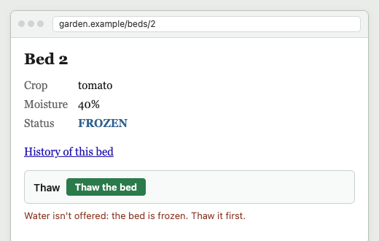
The Web never asked a person to guess
THE ONE IDEA
Each page showed the information and, beside it, the forms that applied to it now. One generic program, the browser, could use every site, because every page told it what it could do next.
Machines deserve the same.
With AI agents, they need it.
The thread through this deck: a generic client is coupled to a media type, never to the domain. That is true of the browser, and it is true of ARTIE.
Frame 4: the bed froze overnight. Water is gone, Thaw is offered, and the page says why.
Notes:
State the thesis early. The browser never needs updating when a site changes, because each page carries its own controls. The rest of the deck earns this claim for machine clients.

Slide 3
Information you can act on from where you stand
ACT I · FOUNDATIONS OF HYPERMEDIA
1945
1965
1968
Vannevar Bush
Ted Nelson
Douglas Engelbart
“As We May Think”. The Memex: a desk of documents joined by trails a reader follows and adds to.
Coins “hypertext”: text that branches, where the reader chooses the path.
The demonstration: links, windows and a mouse, live, with information you could click and change.
Three decades before the Web: hypertext was always about acting on information, not just reading it.
Notes:
Bush 1945, Nelson 1965, Engelbart 1968. The common thread is a reader who moves through information by choosing among the paths it offers.

Slide 4
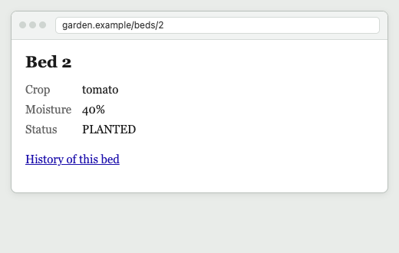
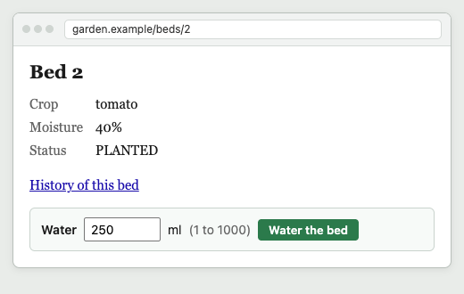
Pages stopped only showing, and started offering
ACT II · THE EARLY SUCCESS OF THE WEB
1989–91
Tim Berners-Lee
A proposal at CERN, then the first browser and server. Any page can link to any other.
Frame 2: a link
Frame 3: a form
1993–95
Forms
The browser is the proof.
It knows nothing about any one site, and never needs updating when a site changes, because every page tells it what it can do next.
Mosaic adds fill-out forms; HTML 2.0 (RFC 1866) makes them standard.
A link gave you an address you didn’t build. A form said where it goes, what it needs, and the limits.
Notes:
Links and then forms. With forms, the page offers actions and describes them: target, fields, limits. That is the seed of everything HEART does.

Slide 5
The browser is coupled to HTML, not to your bank
ACT II · WHY ONE BROWSER FITS EVERY SITE
An online bank
Web browser
one generic client
text/html + HTTP
links, forms, fields, methods, status codes
A wiki
A shop
Ships once. Never updated for a site.
Any site not yet built
Coupled to: the media type and the protocol. Not coupled to: account numbers, URL layouts, overdraft rules, or which buttons exist today.
Notes:
This is the coupling to keep in mind for the whole deck. A browser is tightly coupled to HTML and HTTP, and has zero coupling to any site's domain. That is why the bank can change its forms tonight and nobody updates their browser.

Slide 6
REST, and its least-followed constraint
ACT III · 2000: FIELDING’S DISSERTATION
“
REST is defined by four interface constraints: identification of resources; manipulation of resources through representations; self-descriptive messages; and, hypermedia as the engine of application state.
Identification of resources
Manipulation through representations
Self-descriptive messages
Roy T. Fielding, Architectural Styles and the Design of Network-based Software Architectures, 2000, §5.1.5
Hypermedia as the engine of application state
The architecture of the Web, written down: the browser’s generality was a design property, not luck.
The client moves from state to state by choosing among the controls each response carries.
Notes:
Quote is verbatim from section 5.1.5. Point at the fourth constraint, HATEOAS: the one that makes the client generic, and the one the industry dropped.

Slide 7
“REST” became the name for every web API
ACT III · THE EXPLOSION
“
Implementations are decoupled from the services they provide, which encourages independent evolvability.
Kept
Dropped
Resources and URIs
HTTP methods
Status codes
Caching
JSON payloads
Links in the response
Forms: what you can do now
Server-provided choices
The generic client
Fielding, 2000, §5.1.5, on the uniform interface
That promise is why the word spread. But most of what got called REST kept the nouns and verbs, and left the engine behind.
Notes:
Independent evolvability is what the uniform interface buys. It only holds if the client takes its choices from the responses. Without hypermedia, the client hard-codes the server's URLs and rules, and the two can no longer evolve independently.

Slide 8
Data on the wire, the rules in a document
ACT IV · THE FORGOTTEN CONSTRAINT
GET /beds/2
Accept: application/json
{ "id": 2, "label": "bed-2",
"status": "PLANTED",
"cropName": "tomato",
"moistureLevel": 40 }
// client code, written from the docs
// (illustrative)
if (bed.status === "PLANTED")
showButton("Water")
post(`/beds/${bed.id}/actions/water-cell`,
{ milliliters: 250 })
Frame 1 again: information, no controls.
Every address, rule and field is copied into the client by a person reading docs.
Out-of-band knowledge. The client is now coupled to the domain: its URLs, its fields, its rules. It learns the rules by failing.
Notes:
This is what most 'REST APIs' became: JSON documents plus human documentation. Every rule the server enforces must be re-implemented in every client, and the client finds out it was wrong from a 4xx.

Slide 9
“REST APIs must be hypertext-driven”
ACT IV · 20 OCTOBER 2008: THE REBUKE
“
I am getting frustrated by the number of people calling any HTTP-based interface a REST API.
“
In other words, if the engine of application state (and hence the API) is not being driven by hypertext, then it cannot be RESTful and cannot be a REST API. Period.
Roy T. Fielding, “REST APIs must be hypertext-driven”, Untangled, 20 October 2008
Eight years after the dissertation, the author had to say it out loud.
Notes:
Both quotes verbatim from the 2008 post. 'Period.' is his.

Slide 10
What a REST API must and must not do
ACT IV · FROM THE SAME POST
Rule 3
“A REST API should spend almost all of its descriptive effort in defining the media type(s) used for representing resources and driving application state, or in defining extended relation names and/or hypertext-enabled mark-up for existing standard media types.”
Rule 4
“A REST API must not define fixed resource names or hierarchies (an obvious coupling of client and server).”
Rule 5
“A REST API should never have ‘typed’ resources that are significant to the client.”
Rule 6
“A REST API should be entered with no prior knowledge beyond the initial URI (bookmark) and set of standardized media types that are appropriate for the intended audience (i.e., expected to be understood by any client that might use the API).”
“From that point on, all application state transitions must be driven by client selection of server-provided choices that are present in the received representations or implied by the user’s manipulation of those representations.”
Notes:
All verbatim from the 2008 post's numbered rules. Rule 3 is the coupling rule: put the effort into media types and relations, so clients couple to those. Rules 4 and 5 forbid coupling to URL layouts and resource types. Rule 6 adds: a bookmark and media types are all the client may know in advance. The rule ends with the bracketed note: 'Failure here implies that out-of-band information is driving interaction instead of hypertext.'

Slide 11
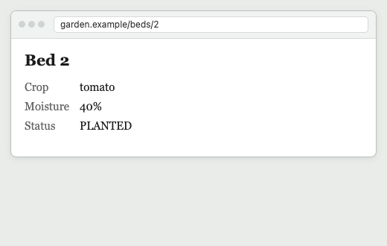
From read-only to affordances
ACT V · ONE WEB PAGE, FOUR FRAMES
1. Information
2. A link
3. A form
4. Forms follow state
Look, nothing more.
You can go somewhere.
You can do something.
Frozen: Thaw, and why.
Frame 4 is Fielding’s definition of hypertext, word for word. The information itself carries the choices, and the choices change when the state does. Nothing in the browser changed between frames 3 and 4.
Notes:
Walk the four frames. The jump from 3 to 4 is the important one: the server decides what is offered, per state, and explains what is not.

Slide 12
What he meant by hypertext
ACT V · FIELDING, IN THE COMMENTS ON HIS 2008 POST
“
When I say hypertext, I mean the simultaneous presentation of information and controls such that the information becomes the affordance through which the user (or automaton) obtains choices and selects actions.
Roy T. Fielding, comment, 20 October 2008
information
+
controls
=
affordance
Note “or automaton”. He wasn’t only talking about people.
Notes:
Verbatim from Fielding's own comment on the post, 20 Oct 2008, 7:44 am. 'Simultaneous' matters: controls arrive in the same response as the information they apply to.

Slide 13
Data only: what a typical JSON API sends
ACT VI · BUILDING BACK UP A JSON API · STEP 1 OF 7
Data
Self & vocabulary
Forms
Schema
Why not
Headers & ETag
New state
Information, no controls.
The client must already know every address, every rule and every field, from documentation written for people.
Frame 1
GET /beds/2
Accept: application/json
{
"id": 2,
"label": "bed-2",
"widthFt": 4,
"lengthFt": 8,
"status": "PLANTED",
"cropName": "tomato",
"growthPoints": 80,
"moistureLevel": 40
}
Notes:
Every response from here on is the garden's real answer about bed 2, served by HEART. We add one control at a time.

Slide 14
It names itself and its vocabulary
ACT VI · BUILDING BACK UP A JSON API · STEP 2 OF 7
Data
Self & vocabulary
Forms
Schema
Why not
Headers & ETag
New state
A self link, and CURIEs.
garden: words are defined in the garden’s profile; hr: words in HEART’s. Like a page’s address, and a page that’s about something.
Frame 2
{ "id": 2, "label": "bed-2", …
"status": "PLANTED", …
"_links": {
"self": { "href": "/beds/2" },
"curies": [
{ "name": "garden",
"href": "/profiles/garden#{rel}",
"templated": true },
{ "name": "hr",
"href": "https://w3id.org/heart-rise/
rels/{rel}",
"templated": true }
]
}
}
Notes:
The vocabulary links are what let a client look up what a relation like garden:water-cell means, without that meaning being compiled in.

Slide 15
Forms: what you can do now, and where
ACT VI · BUILDING BACK UP A JSON API · STEP 3 OF 7
Data
Self & vocabulary
Forms
Schema
Why not
Headers & ETag
New state
The act is keyed by its meaning,
garden:water-cell, with a title and description for people and models, a method and a target.
Frame 3: the form and its button
{ "id": 2, … "status": "PLANTED", …
"_links": { "self": …, "curies": […] },
"_forms": {
"garden:water-cell": {
"title": "Water the bed",
"description": "Pours water into every
cell of a planted bed. Enough water
makes it ready to harvest.",
"_links": { "target":
{ "href": "/beds/2/actions/water-cell" } },
"method": "POST",
"contentType": "application/json"
}
}
}
Notes:
The client no longer builds the URL. The server gave it the target, and only offered this one act because it is the only one allowed now.

Slide 16
What the act needs, embedded
ACT VI · BUILDING BACK UP A JSON API · STEP 4 OF 7
Data
Self & vocabulary
Forms
Schema
Why not
Headers & ETag
New state
Its JSON Schema, inline:
the one required field, its limits, and an example to start from.
Frame 3’s “250 ml (1 to 1000)”
"garden:water-cell": { "title": …, "method": …,
"schema": {
"$schema": "https://json-schema.org/
draft/2020-12/schema",
"title": "Water Cell",
"type": "object",
"required": [ "milliliters" ],
"properties": {
"milliliters": {
"title": "Water per cell",
"description": "Millilitres of water
poured into each cell",
"type": "integer",
"minimum": 1, "maximum": 1000,
"examples": [ 250 ] } },
"$id": "/schemas/7f232c04c52671dd"
} } } }
Notes:
A generic client can render a field, a label, a range and a default from the schema alone. When the limit tightens to 800, the client learns it from the next response.

Slide 17
Why the other acts are absent
ACT VI · BUILDING BACK UP A JSON API · STEP 5 OF 7
Data
Self & vocabulary
Forms
Schema
Why not
Headers & ETag
New state
A link to the explanation,
pinned by its integrity. The server says, in its own words, why each missing act is missing.
Frame 4’s red line
"_links": { …,
"hr:unavailable": {
"href": "/unavailable/3257a9132e2fdd0b",
"type": "application/json",
"integrity": "sha256-MlepEy4v3Qt2z8jIohU…" } }
GET /unavailable/3257a9132e2fdd0b
{ "unavailable": [
{ "title": "Sow a seed",
"reason": "The bed is already planted." },
{ "title": "Harvest the crop",
"reason": "The crop is not ready yet;
it needs more water to grow." },
{ "title": "Thaw the bed",
"reason": "The bed is not frozen." } ] }
Notes:
Each entry also carries its rel, e.g. /profiles/garden#sow-seed; trimmed here for space. An agent asked to harvest can now say why it can't, instead of trying and failing.

Slide 18
The whole response, with its headers
ACT VI · BUILDING BACK UP A JSON API · STEP 6 OF 7
Data
Self & vocabulary
Forms
Schema
Why not
Headers & ETag
New state
The dialect, the profile, and a validator.
no-cache means check every time. An act must send the ETag back as If-Match; a write that landed first is a 412, never a silent overwrite.
HTTP/1.1 200 OK
Content-Type: application/hal+json
ETag: "seq-3.hsf.L0.da0109b4d9380b72"
Cache-Control: no-cache
Link: <https://w3id.org/heart-rise/hal-schema-forms>;
rel="profile",
<https://w3id.org/heart-rise>; rel="profile"
Vary: Accept, Prefer, Accept-Profile
{ … data, _links, _forms, schema … }
POST /beds/2/actions/water-cell
If-Match: "seq-3.hsf.L0.da0109b4d9380b72"
{ "milliliters": 250 }
→ 412 if the bed changed first
The contract with the client
Content-Type and the profile Link name the media type. That is all a generic client is coupled to.
Notes:
Content-Type plus the profile Link is the whole contract with the client: this is HAL with HEART's schema-forms. That is the media-type coupling, made explicit on every response.

Slide 19
After the frost: the server changed, the client didn’t
ACT VI · BUILDING BACK UP A JSON API · STEP 7 OF 7
Data
Self & vocabulary
Forms
Schema
Why not
Headers & ETag
New state
Status, validator, explanation, and the one form a frozen bed allows.
Nothing on the client changed. Water is gone; Thaw arrives with its own target and schema.
Frame 4
ETag: "seq-4.hsf.L0.2247f81de1740d4c"
{ … "status": "FROZEN", …
"_links": { …, "hr:unavailable":
{ "href": "/unavailable/5afcf05b76af098e" … } },
"_forms": {
"garden:thaw": {
"title": "Thaw the bed",
"description": "Covers a frozen bed with
fleece. The bed becomes planted again.",
"_links": { "target":
{ "href": "/beds/2/actions/thaw" } },
"method": "POST", … } } }
// why not water?
"The bed is frozen; watering now would split
the roots. Thaw it first."
Notes:
This is HATEOAS in one slide: the same client, the same code, a different state, different controls. The response tells the client what is possible.

Slide 20
Shared affordance sets: L0, L1, L2
ACT VI · MAKING IT CHEAP
L0
Everything embedded
Preference-Applied: forms=link
"hr:forms": {
"href": "/affordance-sets/0f79a6afa3aecc62",
"profile": "https://w3id.org/heart-rise/
hal-schema-forms",
"integrity": "sha256-D3mmr6OuzGJMBtgJ9k…" }
// the set: public, max-age=31536000, immutable
"target": { "href": "/beds/{id}/actions/
water-cell", "templated": true }
"hr:templatePointers": { "id": "/id" }
Forms and schemas inline in every response. A generic client renders whatever comes.
L1
Prefer: forms=link
Forms move to an hr:forms link: one set per state, shared by every bed in that state, cached forever.
L2
forms=link, schema=link
The set’s schemas become $ref links too, each pinned by integrity.
The response about the bed shrinks back toward plain data plus one link, and the forms cost nothing to re-fetch.
Notes:
Optional detail for technical audiences. The point: HEART doesn't have to cost bandwidth. Same semantics, cacheable and content-addressed.

Slide 21
ARTIE is to HEART what a browser is to HTML
ACT VII · ARTIE, THE GENERIC CLIENT
Web browser
speaks
text/html + HTTP
serves
a bank, a wiki, a shop: none of them known in advance
ARTIE
speaks
application/hal+json + HEART profile + HTTP
serves
the garden natively, its OpenAPI twin through the gateway, the next service
Both render whatever controls arrive. Neither has a line of code about any one site. Both are updated for the media type, never for a server.
Notes:
ARTIE knows HAL, the HEART schema-forms profile, JSON Schema and HTTP's validators. It does not know what a bed is. Show it a different HEART server and it renders that one too.

Slide 22
Think of it in terms of the Web
ACT VII · FIELDING, ON GENERIC CLIENTS
“
Think of it in terms of the Web. How many Web browsers are aware of the distinction between an online-banking resource and a Wiki resource? None of them. They don’t need to be aware of the resource types. What they need to be aware of is the potential state transitions — the links and forms — and what semantics/actions are implied by traversing those links.
Roy T. Fielding, comment, 20 October 2008
Swap “Web browsers” for ARTIE, and “online-banking” and “Wiki” for a garden bed and a pull request.
Notes:
Verbatim, Fielding's comment of 20 Oct 2008, 9:22 am. This is the coupling argument in his own words: the client knows transitions (links and forms), not resource types.

Slide 23
Fielding described ARTIE’s job
ACT VII · “OR AUTOMATON”
“Machines can follow links when they understand the data format and relationship types.”
ARTIE understands one data format (HAL with HEART’s schema-forms) and looks relation types up through their CURIEs.
Fielding, comment, 20 Oct 2008
“Typed relations, specific media types, and action-specific elements provide the guidance needed for automated agents.”
garden:water-cell is the typed relation; application/hal+json plus its profile is the media type; _forms with a schema is the action-specific element.
Fielding, comment, 20 Oct 2008
“All it needs to know is the meaning of those instructions and some idea of what it wants to do next, whether that purpose be user-driven, configuration-driven, or some sort of AI-driven.”
“Ask ARTIE” supplies the purpose; the response supplies the instructions. AI-driven, named eighteen years before agents.
Fielding, comment, 8 Nov 2008
Notes:
All three are Fielding's own replies in the comment thread of the 2008 post; the third is from 8 Nov 2008. Right-hand column maps each one onto what ARTIE actually does.

Slide 24
Coupled to the media type, not the domain
ACT VII · THE COUPLING THAT MATTERS
 | Web browser | ARTIE
Coupled to | HTML, its links and forms; HTTP | HAL + HEART schema-forms; JSON Schema; HTTP: ETag, If-Match, Prefer
Learns at run time | Addresses, fields, labels, which forms exist | Links, _forms, targets, schemas, titles, reasons
Never coded in | Your bank’s URLs, account fields, overdraft rules | /beds/{id}, moistureLevel, “no watering when frozen”
Survives, unchanged | A redesign, a new field, a moved page | A moved URL, a renamed field, a tighter limit, a new required input
This is the same coupling a browser has, and the same coupling it doesn’t. ARTIE depends on the HEART media type the way a browser depends on HTML. It has no dependency on beds, plants, pull requests, their shapes or their rules: those arrive in each response.
Notes:
The key slide. Coupling is not eliminated; it is moved to the one place that is standardized and shared: the media type. Fielding's rule 3: spend the descriptive effort on media types and relation names. Rules 4 and 5: no fixed resource names, no typed resources significant to the client.

Slide 25
Change the API, and see who breaks
ACT VII · EVIDENCE: SIX WEDNESDAY CHANGES
Change | Generated from description | ARTIE native | ARTIE via gateway | Scripted native | Scripted via gateway
move-url | 404 | watered | watered | watered | watered
rename-field | watered | watered | watered | watered | watered
rename-act | watered | watered | watered | not found | not found
retitle | watered | watered | watered | watered | watered
tighter-limit | 422 at 800 ml | watered | watered | watered | watered
new-required-input | 422 | watered | watered | 422 | 422
“Scripted” is ARTIE driven by code
that names the act garden:water-cell and its field.
The moment code names the domain, the coupling comes back: rename the act, and it’s not found.
Each client, unchanged since Monday, tries to water bed 2 after one release changes the API. Run on 16 October 2026.
Notes:
The generic client is coupled only to the media type and survives all six. The scripted client couples to a domain relation name and breaks on rename-act. The generated client couples to the description's shapes and breaks on three. Through the gateway, every result matches native HEART.

Slide 26
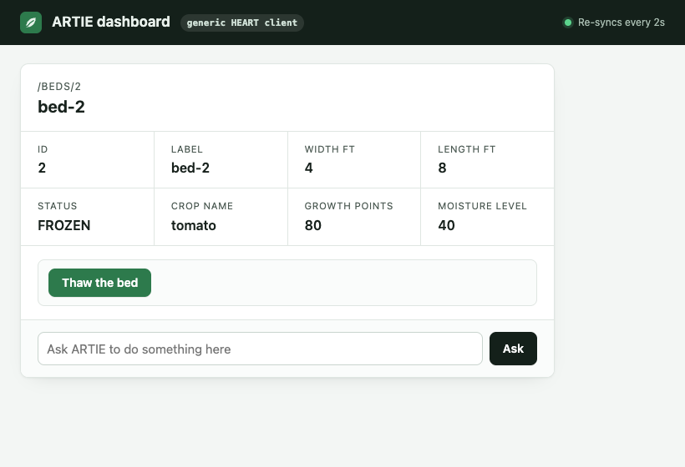
Change the state, and see who keeps up
ACT VII · EVIDENCE: TUESDAY’S FROST
ARTIE through the gateway, after the frost: only Thaw. The client didn’t change.
A description can list everything a service can ever do. Only the response can say what this bed allows now.
Notes:
Monday, every client except the live description reader got 3 of 3. Tuesday's frost is a change of state, not of the API, and only clients that take their controls from the response keep up.

Slide 27
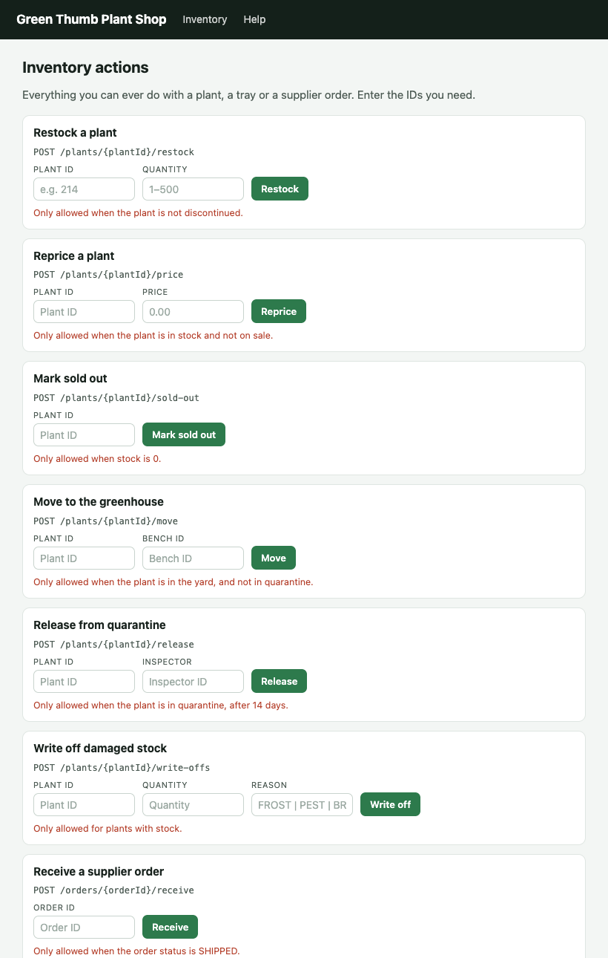
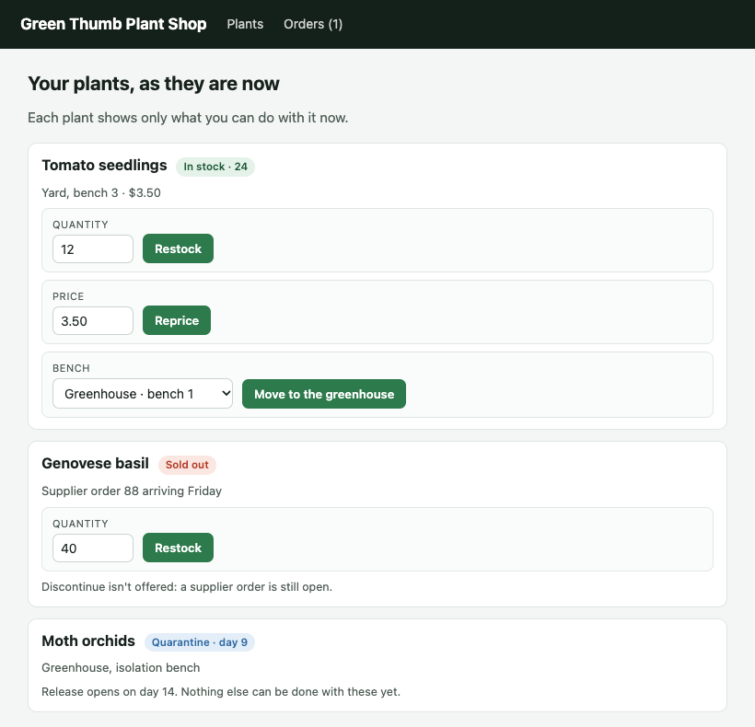
…the page with every form on it
ACT VIII · MEANWHILE, THE INDUSTRY CHOSE…
An OpenAPI description is the left-hand page.
Each form card is an operation; each blank ID a path parameter; each red sentence a description. It lists everything a service can ever do, and does it well.
What it can’t say is which of those this plant, or this bed, allows now.
Your plants, as they are now.
Every form, for everyone.
Notes:
Plant shop pages are mock-ups. OpenAPI is design-time and static: every operation, every state. Pressing Release on day 9 gets a 409.

Slide 28
OpenAPI in, HEART out
ACT VIII · THE GATEWAY
OpenAPI service
plain JSON + one per-resource signal
Gateway
reads the spec; learns what’s allowed now
HEART
forms, schemas, reasons, ETag, profile
ARTIE
unchanged: any HEART client, any agent
23/23
26
0
HEART conformance checks, through the gateway
scenarios against a door service that knows nothing of HEART
changes to ARTIE
The per-resource signal can be a HEART Link header, the allowed-actions an API already returns (Drive, Box, PayPal, OData), or as a last resort a rules table in the gateway.
Notes:
Test design: start from a HEART server, flatten it to OpenAPI, and see if the gateway rebuilds HEART. The native garden is the answer key. Limits: without the service's own If-Match the gateway re-reads before acting but can't catch a write landing in between; it calls the service as itself for now.

Slide 29
GitHub, with a client that knows nothing about it
PREVIEW · A WELL-KNOWN SHARED DOMAIN
Not a garden we invented: GitHub’s own published OpenAPI description, live, on a scratch repository. Issues, branches, commits, pull requests, merges.
What the entry point offered, at run time
What ARTIE knew before it started
One entry address
The HEART media type, JSON Schema and HTTP
Nothing about repositories, issues, pull requests, branches or merge rules. No GitHub code, no GitHub SDK, no generated client.
github:pulls-list
github:pulls-get
github:issues-list-for-repo
github:issues-get
github:repos-list-for-user
github:repos-get
github:issues-list-comments
github:issues-get-comment
github:repos-list-branches
github:repos-get-branch
Every other act (open issue, branch, commit, open PR, merge, comment, close) appeared only on the resource, in the state, where GitHub would accept it.
Notes:
Proof of the coupling claim on a domain everyone knows. ARTIE is the same generic client that drove the garden. The gateway read GitHub's published OpenAPI description; ARTIE read only what the gateway offered, response by response.

Slide 30
Ten steps in words, chosen from what’s offered
PREVIEW · REASON ONCE
# github-task.intent.heart.yaml (excerpt)
steps:
- intent: open the repository ${owner}/${repo}
then:
- intent: open an issue titled "Crash when a bed …"
then:
- keep-as: issue
- intent: open the branch main of ${owner}/${repo}
then:
- intent: start a new branch from here, …
then:
- intent: commit a file named …
- intent: "open a pull request into main …"
then:
- keep-as: pull
- until:
offered: github:merge
- intent: merge it, squashing its commits
- intent: open issue ${issue.number} in ${owner}/${repo}
then:
- intent: "comment on it: Fixed in 1.2 by #${pull.number}."
- intent: close it, since the fix is done
Claude chose, one model call each:
github:repos-get
github:open-issue
github:repos-get-branch
github:branch-from-here
github:commit-file
github:open-pull-request
github:merge (squash)
github:issues-get
github:comment
github:close
10
7
53 s
model calls, none retried
writes, none refused
end to end
Merge is waited for as an offer, never attempted and refused.
Notes:
Real run of github-task.intent.heart.yaml, a script held as data, against JogoShugh/heart-github-test through the gateway, 5 November 2026: issue #2174, PR #2175, 24 steps. artie run runs the YAML directly: no Kotlin, no compiler. Each intent step is one model call (Claude Sonnet 5.5), choosing among the forms and links the gateway offered; ARTIE checked each choice before sending. Two more runs that day took 51 and 54 s, with the same ten choices.

Slide 31
artie generate pins the run, still guarded
PREVIEW · …THEN REPLAY WITH NO MODEL
# github-task.heart.yaml (excerpt)
- act: github:open-pull-request
fields:
base: main
title: Refuse a bed with no name (reasoned)
body: "Relates to #${issue.number}"
then:
- sync: true
- keep-as: pull
- until:
offered: github:merge
- act: github:merge
fields:
merge_method: squash
 | Reasoned | Replayed
Model calls | 10 | 0
Time | 53 s | 32 s
Steps | 24 | 28, with 2 more checks
Each act checked | against offers | strictly, to lock
Values to review | — | 0 of 19
Live result | #2174, PR #2175 | #2178, PR #2179
# github-task.pins.yaml (lock file)
github:merge:
integrity: sha256-uJuM7+5OJxJsXKNcZdbk…
act: sha256-rIPDcwcEW99MvpphQzxb…
The lock file pins each form’s integrity, and its act with the target set aside. A strict replay refuses a form no longer offered, or changed in any way.
Notes:
artie generate --format yaml read the capture of a reasoned run of this task (issue #2172, PR #2173) and wrote the script as data: every selection named, each value read again as a reference (${issue.number}, ${pull.number}, ${stamp}), 19 fields and 0 to review, with a lock file of what was offered. It ran live with no model, guard strict, 5 November 2026: issue #2178, PR #2179, 32 seconds. After each act that changed what it acted on, the replay checks the change: two more steps than the reasoned run. A run of a YAML script doesn't yet record enough for artie generate to read its values back as references, so the kept script was generated from a run of the same steps written in Kotlin.

Slide 32
Three ways through GitHub
PREVIEW · INFERENCE WHERE IT EARNS ITS PLACE
Scripted
0
model calls
17.8 s
median run
Every action and field written down. No model.
Intent
10
model calls
49.4 s
median run
Every move said in words (intent:); Claude picks the form and fields from what’s offered.
Hybrid
1
model calls
27.1 s
median run
Most of the time is GitHub’s: each write takes it 1–3 s, and a new pull request needs a moment before it can be merged. Ten intent steps add about 32 s; the hybrid’s one adds about 8 s.
Written where nothing varies; intent only for the one judgement call.
All 9 runs finished: 9 issues opened and closed, 9 pull requests merged, every committed file read back from GitHub. Kotlin scripts, 18 October; in YAML on 5 November: 53 s, 32 s and 38 s.
Notes:
Live runs, 18 October 2026, scratch repository JogoShugh/heart-github-test, with the scripts in Kotlin. Ranges: scripted 17.6-18.2 s, intent 45.9-49.6 s, hybrid 24.2-30.1 s. Reasoner: Claude Sonnet 5.5. In every intent run Claude made the same ten choices. The same three as YAML, one live run each on 5 November 2026: intent 53 s (10 model calls), kept 32 s (0), hybrid 38 s (1). Those times include a walk of three pages of open pull requests the scratch repository now holds.

Slide 33
Hybrid: judgement only where it’s wanted
PREVIEW · INFERENCE WHERE IT EARNS ITS PLACE
# github-task.hybrid.heart.yaml (excerpt)
- act: github:issues-get
fields:
issue_number: ${issue.number}
then:
- act: github:comment
fields:
body: "Fixed in 1.2 by #${pull.number}."
- intent: "close it the right way: the fix shipped in 1.2"
- check:
- field: state_reason
is: completed
GitHub offers three ways to close an issue: close (completed), close-not-planned and close-duplicate. Which one is right is a judgement about what happened, so that one step is left as intent.
Claude chose github:close in every run, and the check confirmed GitHub recorded it as completed. Every other step ran exactly as written.
Hybrid run | Claude chose | Step time
5 November | github:close | 9.1 s
Pin what you don’t expect to vary. Leave intent where judgement is the point, and let the offered forms bound it.
Notes:
The hybrid is the kept YAML that artie generate wrote, with one step put back in words: intent: instead of act: github:close. Live, 5 November 2026: issue #2180, PR #2181, 38 s, one model call; the close step took 9.1 s, the model's choice and GitHub's answer together. In October's three Kotlin hybrid runs, the model's one call took 5.5 to 9.8 seconds.

Slide 34
The in-between: let inference write the routine once
PREVIEW · INFERENCE WHERE IT EARNS ITS PLACE
Write intent
intent: … for each step; the model maps words to the forms offered
Check it ran right
every pick validated against offers and schema before sending
Pin it
artie generate adds the affordance name and derived fields, plus a lock file
Replay it
no model, no tokens, about scripted speed, still guarded
Routine you don’t expect to vary
Writing it as intent can author it faster and more accurately than hand-mapping relations and fields; then pin it and replay.
Mostly routine, one judgement call
Hybrid: pin the routine, keep intent: … for the call that needs judgement.
Novel or exploratory
Intent throughout; the offered forms and the guard keep every move inside what’s allowed.
Notes:
Inference is not all or nothing. It is most valuable at authoring time and at judgement points.

Slide 35
Part 3: GitHub as HEART, end to end
COMING NEXT · THE DEEP DIVE
1
Gateway on GitHub’s OpenAPI
how merge, close and reopen are offered by state, and how every act is guarded
2
The reasoned run
every exchange, every upstream call, every model choice
3
artie generate
derivation rules: inputs, answers, words, paraphrase, names put back
4
Lock files and guards
integrity, affordance sets, lenient versus strict
5
Reason once, replay forever
scripted, reasoned and hybrid steps: when to reason, when to pin, what a refused replay tells you
Notes:
Set up the third, longer technical session.

Slide 36
Agents get frame 4
THE WEB DID IT FOR PEOPLE
Couple the client to the media type. Let every response carry what is possible now, and why the rest isn’t.
Next, Part 3: the GitHub deep dive.
Notes:
Close on the frame. Part 3 is the longer technical deep dive on GitHub: the reasoned run, artie generate, lock files and model-free replay.

Slide 37
Quotes and references
SOURCES
Roy T. Fielding, Architectural Styles and the Design of Network-based Software Architectures, doctoral dissertation, UC Irvine, 2000, ch. 5 (§5.1.5).
Roy T. Fielding, “REST APIs must be hypertext-driven”, Untangled, 20 October 2008: roy.gbiv.com/untangled/2008/rest-apis-must-be-hypertext-driven. Rules 3–6 from the post; comment quotes are Fielding’s replies of 20 Oct 2008 (7:44 am, 9:22 am) and 8 Nov 2008.
Vannevar Bush, “As We May Think”, The Atlantic, 1945. Ted Nelson, “Complex information processing”, ACM, 1965. Douglas Engelbart, demonstration, 1968.
Tim Berners-Lee, “Information Management: A Proposal”, CERN, 1989. HTML 2.0, RFC 1866, 1995.
Take HEART, Part 1 (16 October 2026): garden responses, test runs and screenshots. Plant shop and bed pages are mock-ups.
Three ways through GitHub: scripted, intent and hybrid runs in Kotlin, 3 live runs each, issues #49–#65 and PRs #50–#66, 18 October 2026; gateway e171027, ARTIE f494ff4, reasoner Claude Sonnet 5.5.
GitHub preview, as YAML: github-task.intent.heart.yaml (issue #2174, PR #2175), github-task.heart.yaml replayed strictly with its lock file (#2178, PR #2179), and github-task.hybrid.heart.yaml (#2180, PR #2181), on JogoShugh/heart-github-test, 5 November 2026. Scripts and runs: exhibits/github-task-yaml.

