Slide 1
Bólkur 6
ER-Diagram
Table-Diagram
GUI

Slide 2
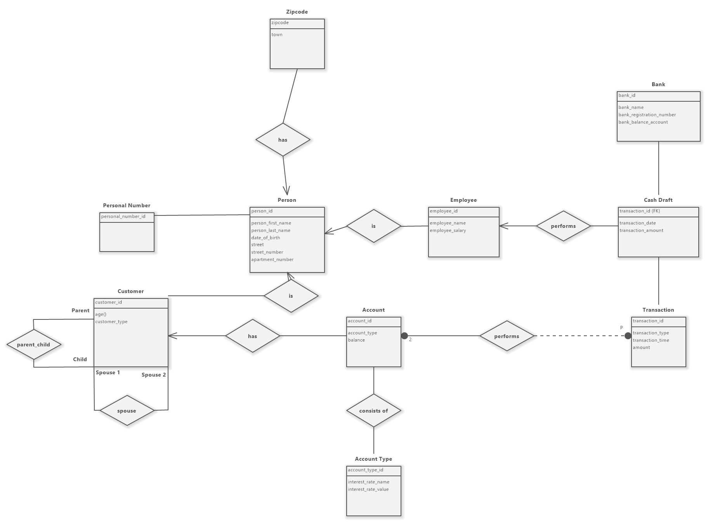

Slide 3
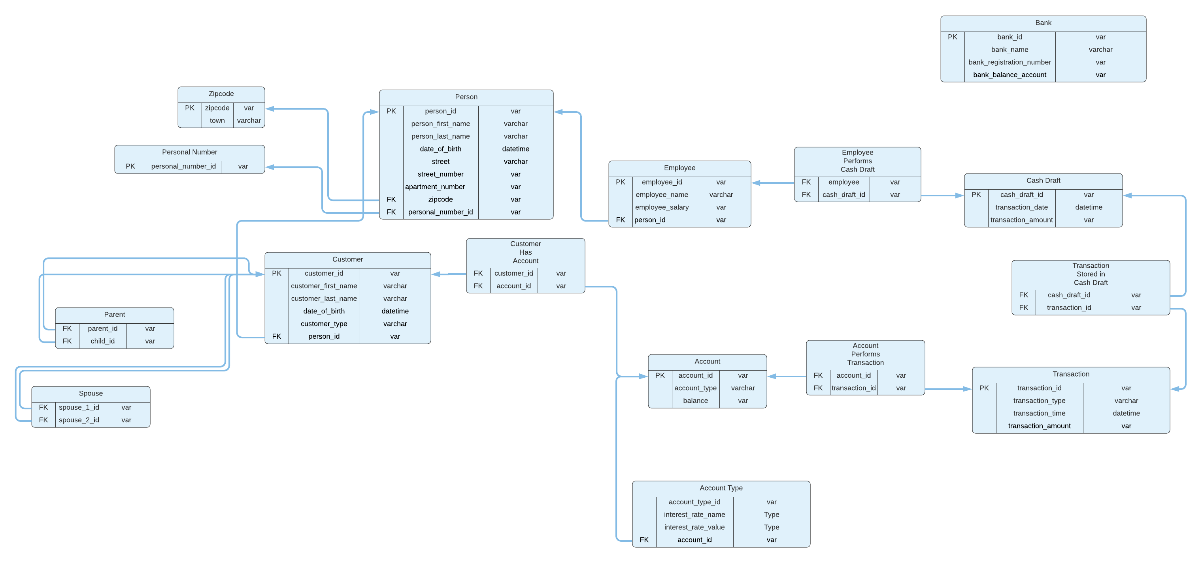

Slide 4
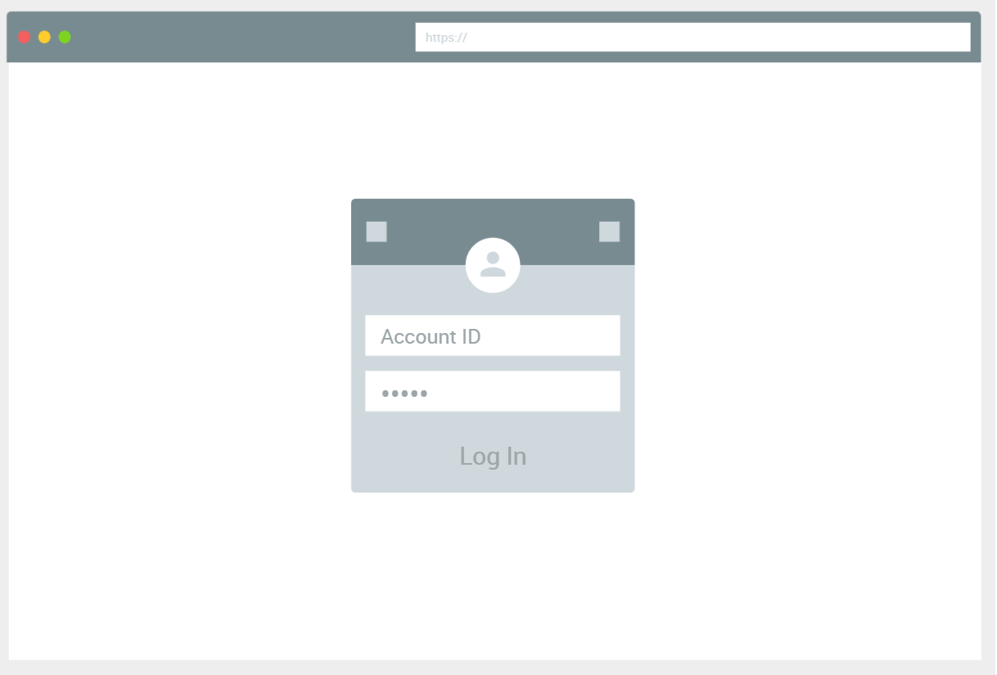

Slide 5
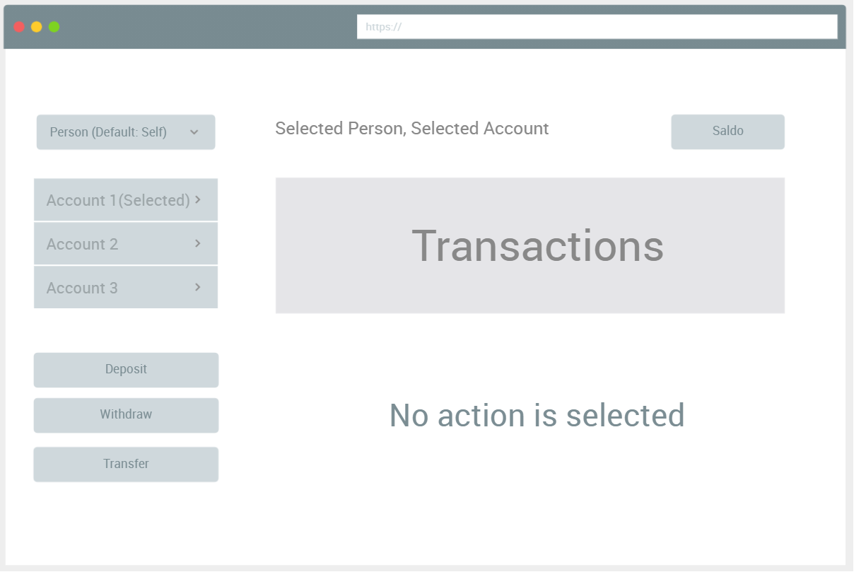

Slide 6
