Slide 1


cornXplain
Maninder Singh Dhillon
Johannes Mast

Slide 2
Overview
Goal: Make explainable crop modeling accessible
Method: Interactive App
Design goals: Interactivity and speed

Slide 3
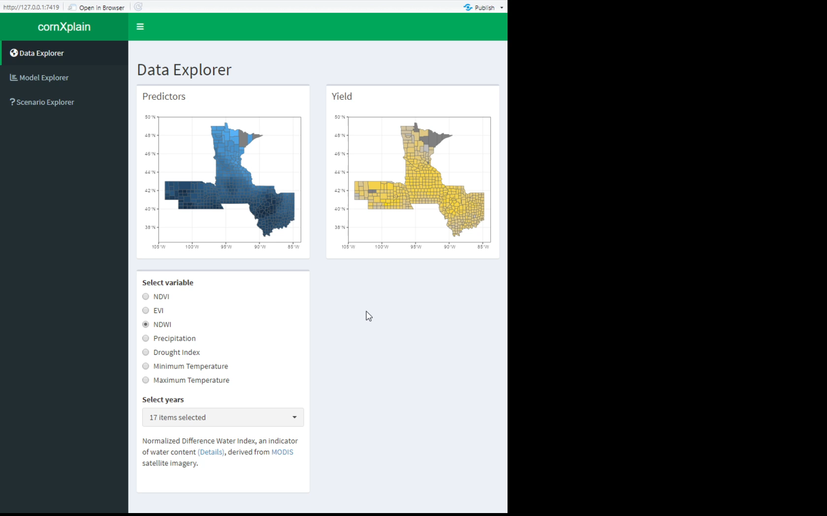
Demo

Slide 4
Thanks for the hackathon
It was fun.
We hope you like our idea.

