Slide 1
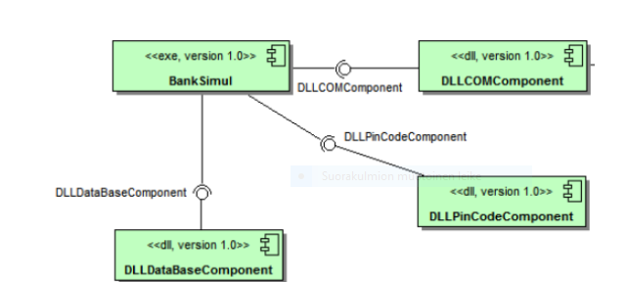
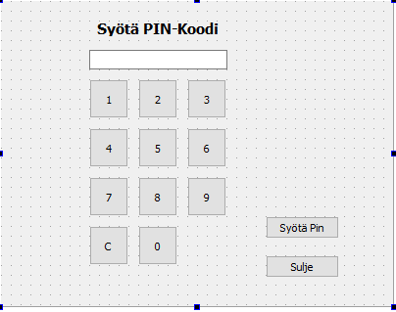
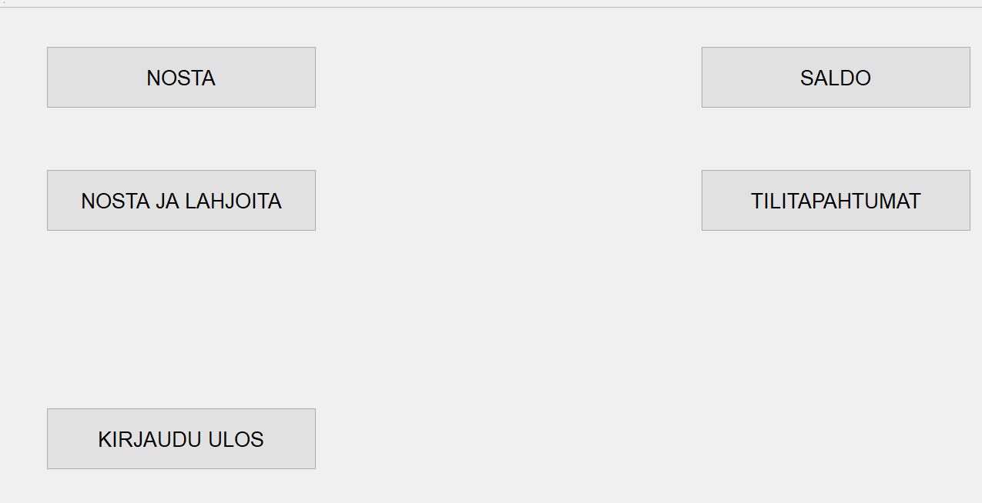
Banksimul
Janne Lampela, Juha Lallukka, Johannes Törmänen, Jani Nukari, TVT18SPO
Information Technology, Software Development
Introduction
The project is desktop application made with Qt creator. The aims of this project were to make a touch screen controlled ATM (Automatic Teller Machine) simulation and to learn skills required to develop such applications.
Objectives
The basic aims included a money withdrawal, the bank accounts balance checking and checking recent transactions..
The device is used through a touchscreen. The application allows the user to withdraw money from the account with an additional option of donating money to charity, check balance and check recent transactions.
FIGURE 1. The Application user interface.
Methods
The program has one main application, that uses three dynamic-link libraries (DLL). One DLL is used to read the RFID-card (Radio frequency identification), one to ask the user for PIN-code (personal identification number) as shown in the figure 2 below and one to maintain the database and interact with it.
FIGURE 2. The PIN-code user interface
Results
The system worked exactly as planned. After a withdrawal was made, if the bank accounts balance allowed it, the chosen amount was subtracted from the bank account in real time. Also the balance and recent transaction checking worked as intented.
FIGURE 3. The component diagram
Conclusions
At the time of writing this poster, the ATM simulator worked as expected.
There are still some minor adjustments left to do on the user interface.
References
Qt libraries and tutorials
https://www.qt.io/
C++ tutorials
https://stackoverflow.com/
UML-diagrams
https://www.lucidchart.com/
Software development Application Project
ECTS credits: 6
Date of publication: 2019, Spring
Instructors: Pertti Heikkilä

