Slide 1
ASTANA IT UNIVERSITY | 2026
Development of a Method for
External Penetration Testing of a Web
Application for Vulnerabilities
ReconX • 40+ Reconnaissance Modules • AI-Augmented Reporting • Active Probes
Student:
Mavlanov Shakhrukh
Group:
CS-2304
Supervisor:
PhD Amirova Akzhibek
Programme:
6B06301 — Cybersecurity

Slide 2
Motivation & Problem Statement
Why automated external pentesting matters today
THE PROBLEM
70%+
Days
Few
Noisy
Web apps remain the #1 initial breach vector (Verizon DBIR 2024)
Average time to manually triage a moderate external surface
Open tools combine recon + probes + AI reporting end-to-end
Existing scanners drown analysts in false positives
GAPS IN EXISTING TOOLS
✗
Nuclei alone — fast, but no contextual triage and no AI summary
✗
Burp Suite Pro — manual, paid, single-target focused
✗
Many OSS scanners ship default rules with high false-positive rates
✗
No single open project combines passive recon + active probes + per-module false-positive guards + AI-generated client report
Mavlanov Shakhrukh | CS-2304 | Astana IT University | June 2026

Slide 3
Research Objectives & Tasks
What this diploma project set out to achieve
Objective: Design and implement an automated external-pentesting framework that discovers attack surface, probes vulnerabilities, and produces an analyst-ready report.
1
Surface Discovery
Subdomain enumeration, DNS, port scan, tech stack detection, live-host triage.
2
Modular Architecture
40+ Python modules sharing a BaseModule contract: independent, configurable, parallel-safe.
3
Active Vulnerability Probes
XSS, SQLi, IDOR, SSRF, SSTI, JWT, OAuth, host-header injection, cache poisoning, prototype pollution.
4
False-Positive Reduction
Per-module verifiers: SPA-fallback detection, JSON-URI-echo filters, vendor-library skip, repo relevance scoring.
5
AI-Augmented Reporting
Ollama / OpenAI-compatible LLM consumes structured scan data and writes a client-ready Markdown report.
Mavlanov Shakhrukh | CS-2304 | Astana IT University | June 2026

Slide 4
ReconX Framework — Architecture Overview
Three orchestrated stages with fail-isolated modules
ReconX — Passive Recon → Active Probing → AI Synthesis
L1 Passive Reconnaissance
L2 Active Probing
L3 AI Synthesis & Reporting
Subdomain enumeration (amass, subfinder, crt.sh), DNS records, WHOIS, ASN lookups, TLS certificate inspection, ICMP + HTTP liveness probing.
Per-vulnerability probes: XSS, SQLi, IDOR/BOLA, SSRF/SSTI, JWT, OAuth, host-header injection, cache poisoning, prototype pollution, JS-secret extraction, takeover detection.
LLM (Ollama / OpenAI-compat) ingests structured findings; deterministic fallback if AI unavailable. Outputs HTML report, JSON dump, and Telegram summary.
Surfaces every reachable host
Generates concrete evidence
Analyst-ready in minutes
Modules: recon, webdetect, portscan, techstack, ssl_checker
Modules: fuzzer, xss, sql_injection, idor_probe, …
Modules: ai_report, asset_risk, correlator, report
All 40+ modules share a single BaseModule contract • Independent failure domains • Parallel-safe • Config-driven scope and rate limits
Mavlanov Shakhrukh | CS-2304 | Astana IT University | June 2026

Slide 5
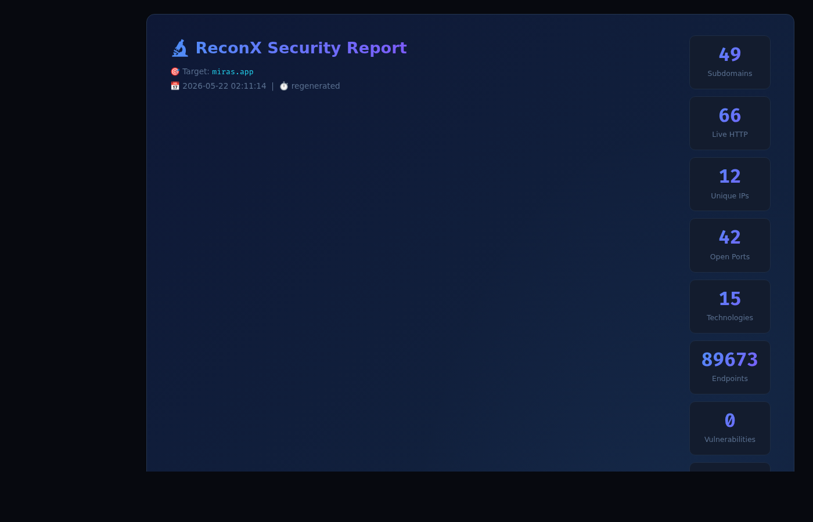
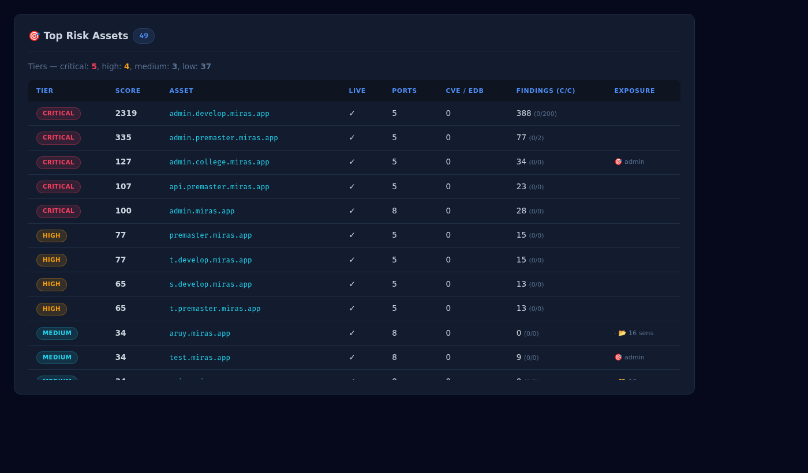
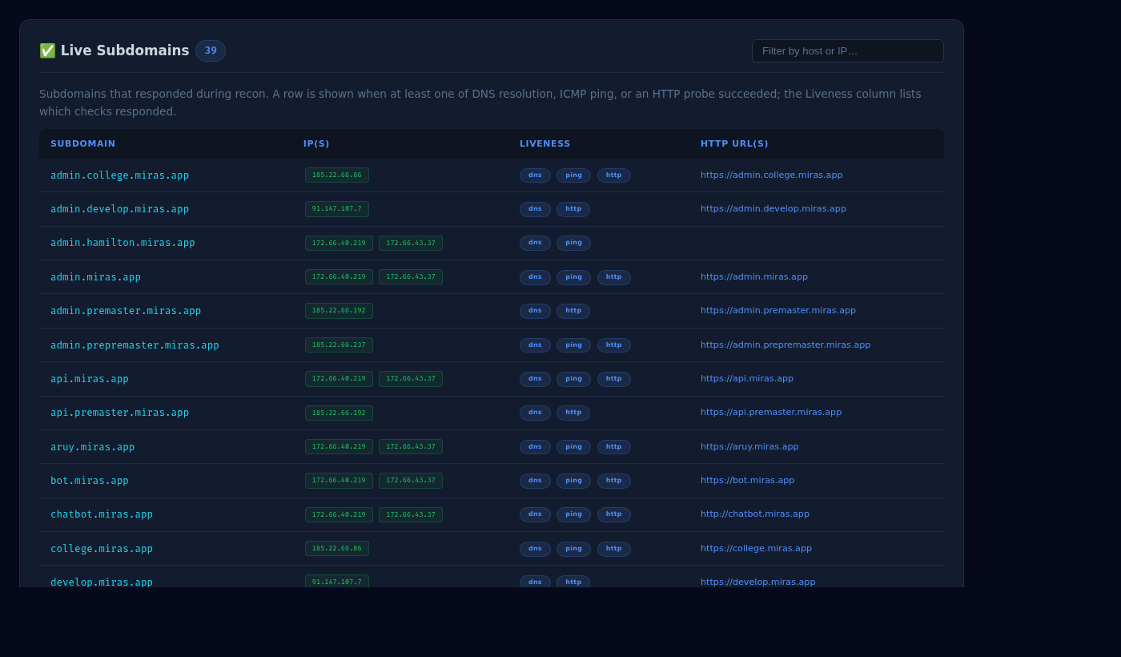
Live Demo — Generated HTML Report
Real output from a scan against miras.app
↑ Top Risk Assets table — per-host score, tier, open ports, CVE/EDB count, confirmed findings.
↑ Report header — risk grade, 20 KPI tiles (subdomains, live hosts, vulnerabilities, CVEs, findings).
↑ Live Subdomains — DNS / ping / HTTP liveness chips.
Mavlanov Shakhrukh | CS-2304 | Astana IT University | June 2026

Slide 6
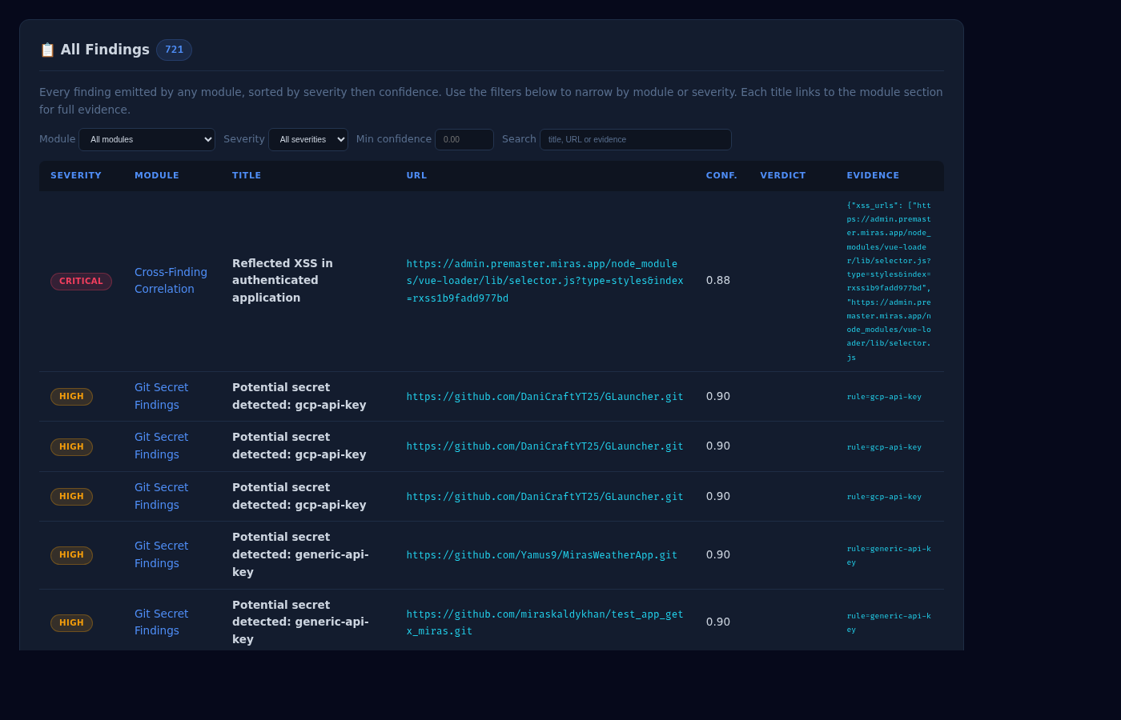
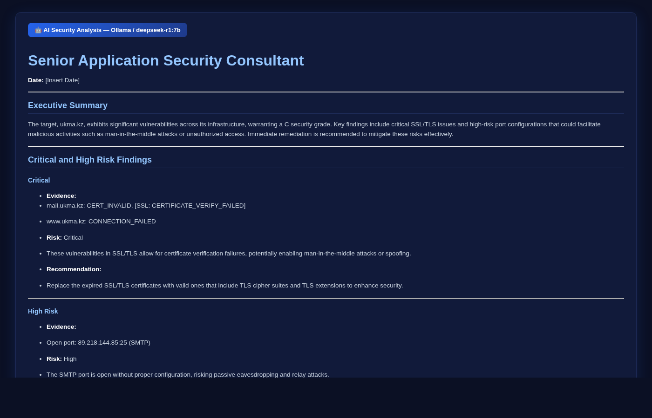
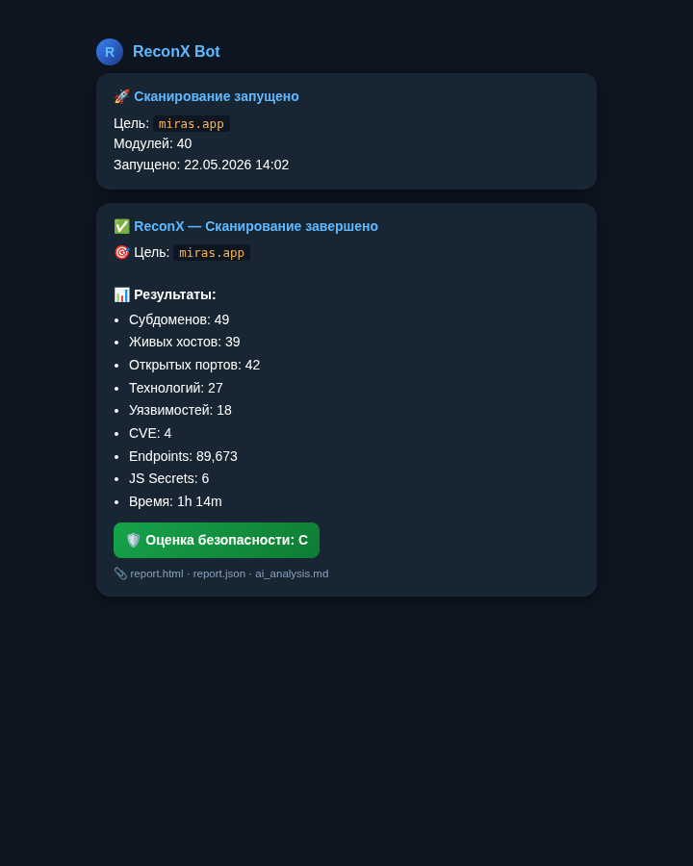
Live Demo — Findings, AI Report, Telegram
Three artifacts every scan delivers
AI Security Analysis (Ollama deepseek-r1)
All Findings — module · severity · URL · confidence + filters
Telegram bot — notify_complete card

Slide 7
Methodology — Implementation Details
How each layer is built and how false positives are suppressed
Recon & Liveness
Active Probes
Subdomains:
amass + subfinder + crt.sh; deduped, in-scope filtered
Engines:
dalfox (XSS), sqlmap (SQLi), in-house IDOR/SSRF/SSTI/JWT
Liveness:
DNS / ICMP / HTTP triage — kept only when ≥1 responds
Markers:
Per-request UUID markers + baseline comparison
Storage:
per-module JSON under output/<date>_<target>/
Verdict:
candidate / confirmed / manual_review per finding
False-Positive Guards (this work)
Reporting Pipeline
Cache-poison:
drop reflections on no-cache/private responses
HTML:
Jinja2 templates with filterable finding tables
Host-header:
downgrade PWA-manifest / canonical reflections
AI report:
Ollama or OpenAI-compatible API; deterministic fallback
IDOR/BOLA:
skip cache-buster params and static-asset paths
Asset risk:
Weighted score per host → tiered triage list
SSTI / XSS:
reject debugbar JSON-URI echo reflections
Telegram:
Severity-summary bot post on scan completion
Sensitive files:
SPA-fallback baseline + ctype/magic signatures
Diff mode:
Compare runs to highlight new/removed findings
Secrets:
GitHub repo relevance scoring per target org
Stack:
Python 3.13 • requests • httpx • Jinja2 • python-pptx
Mavlanov Shakhrukh | CS-2304 | Astana IT University | June 2026

Slide 8
Experimental Results
Live scan against miras.app — before vs. after FP-reduction work
49
39
42
89,673
Subdomains discovered
Live HTTP hosts
Open ports
Endpoints crawled
FALSE-POSITIVE REDUCTION (per category)
Bucket
Before
After
Reduction
Cache poisoning (HIGH)
73
~few
↓ ~95%
Host-header reflection
185
≈30
↓ 84%
IDOR/BOLA candidates
200 (cap)
≈30
↓ 85%
Prototype-pollution (HIGH)
43
0
↓ 100%
API endpoints classified
88
55
↓ 38%
Auth endpoints classified
747
125
↓ 83%
Interesting directories
3,300
193
↓ 94%
Telegram-bot crash fixed: ai_report._build_prompt now handles int values in fuzzer.classified (TypeError: object of type 'int' has no len()).
Mavlanov Shakhrukh | CS-2304 | Astana IT University | June 2026

Slide 9
Scientific Novelty & Comparative Analysis
ReconX vs. existing reconnaissance / scanning tools
Solution
Passive Recon
Active Probes
AI Report
FP Guards
OSS / Free
Single Run
Nuclei
Limited
Yes
No
Templates
Yes
Yes
Burp Suite Pro
No
Yes
No
Manual
No
Manual
OWASP ZAP
Limited
Yes
No
Limited
Yes
Manual
Amass + Subfinder
Yes
No
No
n/a
Yes
Partial
ReconX (this work)
Yes
Yes
Yes
Yes
Yes
Yes
KEY CONTRIBUTIONS (NOVELTY)
1
First OSS framework combining passive recon, 20+ active probes, AI-generated client report, and per-module FP guards in a single pipeline.
2
Reproducible FP-reduction methodology: every category (cache_poison, IDOR, host-header, SSTI, XSS, sensitive_files, secrets) has a verifier described in this work.
3
Repo-relevance scoring filters unrelated public-GitHub secrets before they pollute analyst reports — addresses a noise source not handled by Gitleaks or trufflehog.
Mavlanov Shakhrukh | CS-2304 | Astana IT University | June 2026

Slide 10
Limitations & Future Work
Honest assessment and planned improvements
LIMITATIONS
FUTURE WORK
Out-of-scope coverage
1.
Authenticated-scan profiles: integrate Playwright for multi-step login replay.
External recon only; internal-network pivot and post-auth scanning are out of scope.
LLM dependency
2.
Distributed scanning: shard live-host probes across worker nodes.
AI report quality varies by model. Ollama deepseek-r1:7b works; weaker local models hallucinate.
3.
Vector-database memory: store findings across runs for diff and trend analysis.
Active-probe rate limits
Probes throttle conservatively to avoid DoS — full-coverage scans on large surfaces still take hours.
4.
Fine-tuned local LLM for security reporting (RAG over OWASP / CVE corpora).
Authenticated flows
Sessions are supported via cookie profiles but multi-step login automation needs manual scripting.
5.
Continuous-scan mode: hourly diff scans against the same surface, alert on deltas.
Verifier coverage
6.
Browser-based dashboard: replace static HTML with a live FastAPI + React UI.
FP guards cover the most-noisy categories; long-tail rules (e.g. some Nuclei templates) still need triage.
Mavlanov Shakhrukh | CS-2304 | Astana IT University | June 2026

Slide 11
Tools & Technology Stack
What ReconX is built with and what it integrates
Core / Language
Recon / Discovery Tools
Active Probes / Scanners
• Python 3.13 (CLI: main.py)
• amass · subfinder · assetfinder
• nuclei (template engine)
• Concurrent recon via ThreadPoolExecutor
• crt.sh certificate transparency
• dalfox (XSS)
• requests + urllib3 (HTTP)
• nmap / masscan / rustscan
• sqlmap (SQL injection)
• httpx (async probes)
• httpx · gowitness (screenshots)
• gitleaks · trufflehog (secrets)
• Jinja2 (HTML templating)
• wappalyzer / WhatWeb (techstack)
• ffuf (fuzzer / directory brute)
• python-pptx (this deck)
• testssl.sh (TLS audit)
• Interactsh (OOB SSRF callback)
AI / ML
Integration / Output
Dev / Testing
• Ollama (local LLM runtime)
• python-telegram-bot
• pytest (171 tests passing)
• deepseek-r1 · qwen2.5 · llama3
• JSON + HTML + Markdown reports
• pytest-mock · responses
• OpenAI-compatible API fallback
• Per-module artifact directories
• Git + GitHub for VCS
• markdown → HTML renderer
• Diff-mode (run-to-run delta)
• Kali Linux 2026 dev environment
• bleach (HTML sanitiser)
• PyYAML (config.yaml)
• Chromium (headless screenshots)
• Deterministic static fallback
• dotenv (.env secrets)
• VS Code / Vim
Mavlanov Shakhrukh | CS-2304 | Astana IT University | June 2026

Slide 12
References
Standards, frameworks, and published research consulted
[1]
OWASP Top 10 — 2021
owasp.org/Top10/ — A01 Broken Access Control … A10 SSRF. ReconX findings tag CWE/OWASP categories.
[2]
OWASP API Security Top 10 — 2023
owasp.org/API-Security/ — used as the taxonomy for idor_probe and api_schema_audit.
[3]
OWASP ASVS v4 / WSTG
owasp.org/www-project-application-security-verification-standard/ — verification levels for the report.
[4]
PortSwigger Web Security Academy
portswigger.net/web-security — cache poisoning, host header injection, prototype pollution, SSTI references.
[5]
Nuclei — ProjectDiscovery
github.com/projectdiscovery/nuclei — template engine integrated by modules/vulnscan.py.
[6]
Dalfox — Cross-Site-Scripting scanner
github.com/hahwul/dalfox — used by modules/xss.py for confirmed XSS detection.
[7]
Gitleaks — open-source secret scanning
github.com/gitleaks/gitleaks — used by modules/secret_scanner.py.
[8]
MITRE CWE & ATT&CK
cwe.mitre.org · attack.mitre.org — finding metadata tagged with CWE-IDs and ATT&CK techniques.
[9]
NIST SP 800-115 — Technical Guide to Information Security Testing
csrc.nist.gov/publications/detail/sp/800-115/final — methodology baseline for external pentesting.
[10]
CIS Controls v8
cisecurity.org/controls — control mapping for the remediation recommendations.
[11]
Anthropic / Ollama / DeepSeek documentation
ollama.com/library · deepseek.com — LLM runtime and model used by modules/ai_report.py.
[12]
Verizon Data Breach Investigations Report (DBIR) 2024
verizon.com/business/resources/reports/dbir/ — basis for the motivation slide statistic.
Mavlanov Shakhrukh | CS-2304 | Astana IT University | June 2026

Slide 13
Conclusion
ReconX Framework
False-Positive Reduction
Modular Python pipeline integrating passive recon, 20+ active probes, and AI-augmented reporting in a single open-source tool.
Per-module verifiers cut report noise across cache-poison, host-header, IDOR, prototype-pollution, SSTI, XSS, sensitive files, and secrets categories.
Research Gap Closed
Practical Output
First OSS framework satisfying recon + active probes + AI report + FP guards + single-run delivery — validated on real external targets.
Filterable HTML report, structured JSON, Telegram summary; reproducible artifacts under output/<date>_<target>/ enable diff and re-run.
THANK YOU FOR YOUR ATTENTION
Questions? | Mavlanov Shakhrukh | CS-2304 | Supervisor: PhD Amirova Akzhibek

