Slide 1



TEAM
ERROR 404
Anjela Joseph — Backend and system integration
Jose Mathew Moolayil — Frontend and UI/UX design
Johaan Liju James — AI, machine learning and API logic

Slide 2
PROBLEM STATEMENT & THEME
Problem
MCX gold futures are sold as several contracts (GOLDM, GOLDTEN, GOLDGUINEA, GOLDPETAL). Each has its own lot size, price unit, purity and expiry date, so their prices cannot be compared directly.
Impact
Comparing by hand is risky. You can mix up expiry dates, miss unit or purity differences, or accidentally use future data. This creates false "arbitrage" signals (fake chances of easy profit) and misleading backtests (tests on past data).
Theme alignment
GoldLens is an analytics tool that runs on your own computer. It converts every contract to a common price per gram, flags unusual price gaps (spreads) with simple explanations, and tests them in a clear practice backtest that includes trading costs.

Slide 3
SOLUTION
Solution overview
An app on your own computer that compares MCX gold futures fairly. Pick contracts by exact expiry, compare prices and spreads, look into unusual gaps and simulate trades.
Key features
Converts every contract to INR per gram (999 purity) so prices match
Pairs contracts only when expiry dates match exactly
Signals that show how unusual a spread is, using only past data
Clear statuses: investigate, no signal or not enough data
Practice backtest that includes costs and lists every trade
A banner that always shows when sample (synthetic) data is used
Unique value
Easy to trust: every signal shows its evidence and caveats, never uses future data and never claims risk free arbitrage.

Slide 4
ARCHITECTURE
Tech stack:
Next.js + TypeScript + Tailwind — dashboard UI
Recharts — price, spread and z score charts
FastAPI + Pydantic — API with clearly defined data formats
Pandas / NumPy — normalization and statistics
SQLite + SQLAlchemy — local data storage
pytest — tests that check pricing, signals and backtest are correct
Data flow:
Daily prices (CSV or sample data) → validation → normalization → exact expiry matching → spread and z score signals → backtest → decision report
APIs used:
REST endpoints: /health, /contracts, /prices, /spreads, /signals, POST /backtest
MCX bhavcopy CSV (daily price file from MCX) loaded through a checked importer; a fixed sample dataset for the demo
Daily prices
Validation
Normalization
Exact expiry matching
Spread and z score signals
Backtest
Decision report

Slide 5
MARKET RESEARCH/ANALYSIS
Target users:
Individual and company commodity traders
Analysts and researchers studying gold futures
Brokerages and fintech apps that need analytics tools
Finance students and educators
Market focus:
India’s MCX gold futures (GOLDM, GOLDTEN, GOLDGUINEA, GOLDPETAL). We have not yet researched how big the market is and will check this later.
Potential revenue model
Paid subscription for analytics access
Premium features such as alerts and downloadable decision reports
Licensing for brokerages and educational institutions
Differentiation:
Clear and correct results instead of black box signals: every comparison shows exact contract dates, caveats and where the data came from.

Slide 6
FUTURE SCOPE
Real MCX data loaded from checked daily MCX files, with verified contract details
Expected basis modelling to adjust spreads for the time left until expiry
Advanced charting with TradingView Lightweight Charts
Richer backtests that include margin, liquidity and tests on fresh data
Alerts when a pair’s status changes to investigate
Decision reports that can be downloaded for every accepted or rejected trade idea

Slide 7
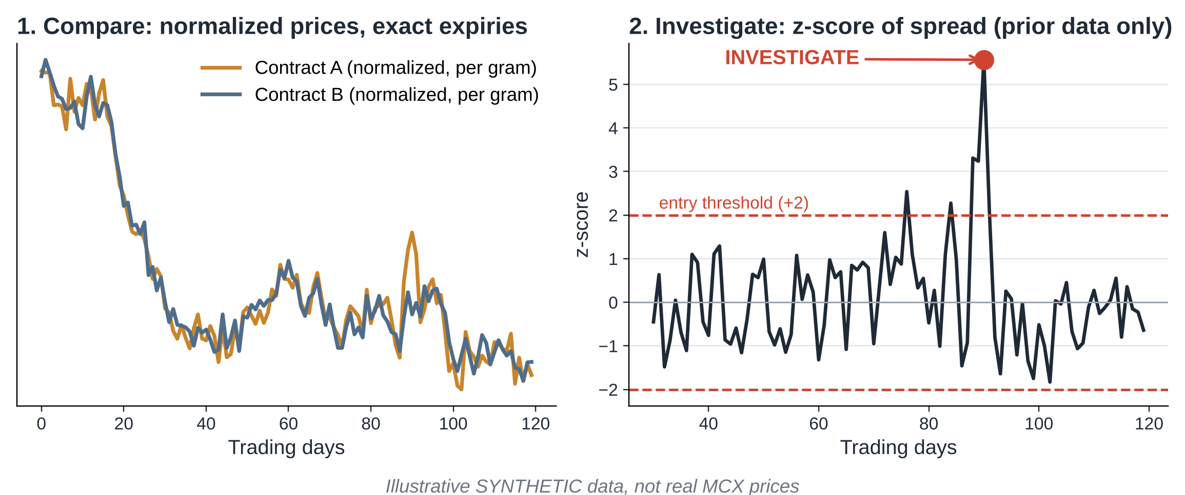
DEMO FLOW & GUARDRAILS
  Demo flow: compare → investigate → simulate → decision report
  Guardrails: no made up data, no use of future data, no risk free claims

Slide 8
Thank
you!

