Slide 1



TEAM
ERROR 404
Anjela Joseph — Backend and system integration
Jose Mathew Moolayil — Frontend and UI/UX design
Johaan Liju James — AI, machine learning and API logic

Slide 2
PROBLEM STATEMENT & THEME
Problem
MCX gold futures are sold as several contracts (GOLDM, GOLDTEN, GOLDGUINEA, GOLDPETAL). Each has its own lot size, price unit, purity and expiry date, so their prices cannot be compared directly.
Impact
Comparing by hand is risky. You can mix up expiry dates, miss unit or purity differences, or accidentally use future data. This creates false "arbitrage" signals (fake chances of easy profit) and misleading backtests (tests on past data).
Theme alignment
GoldLens is an analytics tool that runs on your own computer. It converts every contract to a common price per gram, flags unusual price gaps (spreads) with simple explanations, and tests them in a clear practice backtest that includes trading costs.

Slide 3
SOLUTION
1
2
3
4
5
6
Ingest & validate
Normalize
Pair exactly
Score the spread
Cost filter
Paper alert
Source, unit, currency, observed and available time
Every quote to INR per gram at 999 purity
Same exact expiry date. Never inferred from a month
Z-score vs ten prior common sessions only
BASE, STRESS and SEVERE cost scenarios
In-app notice, then follow its outcome
What makes it different
Point-in-time
Fails closed
Honest by design
Only records observed and available at the cutoff. Contract specs are immutable versions.
Missing, stale or unevaluated inputs give no alert. Real data never falls back to synthetic.
No probability until calibration is evaluated. Costs and liquidity are always shown.
Notes:
GoldLens is a pipeline, not a black box. Each step is a module in the backend and each can be inspected in the UI. The three tiles are our unique value: we only use what was knowable at the chosen time, we refuse to alert on bad inputs, and we never show a probability we have not calibrated.

Slide 4
ARCHITECTURE
Tech stack:
Next.js + TypeScript + Tailwind — dashboard UI
Recharts — price, spread and z score charts
FastAPI + Pydantic — API with clearly defined data formats
Pandas / NumPy — normalization and statistics
SQLite + SQLAlchemy — local data storage
pytest — tests that check pricing, signals and backtest are correct
Data flow:
Daily prices (CSV or sample data) → validation → normalization → exact expiry matching → spread and z score signals → backtest → decision report
APIs used:
REST endpoints: /health, /contracts, /prices, /spreads, /signals, POST /backtest
MCX bhavcopy CSV (daily price file from MCX) loaded through a checked importer; a fixed sample dataset for the demo
Tinyfish: We also plan on including tinyfish to keep a conitnous monitor on our datasets which we fetch nonstop by scrapping and accessing various sources.
Daily prices
Validation
Normalization
Exact expiry matching
Spread and z score signals
Backtest
Decision report

Slide 5
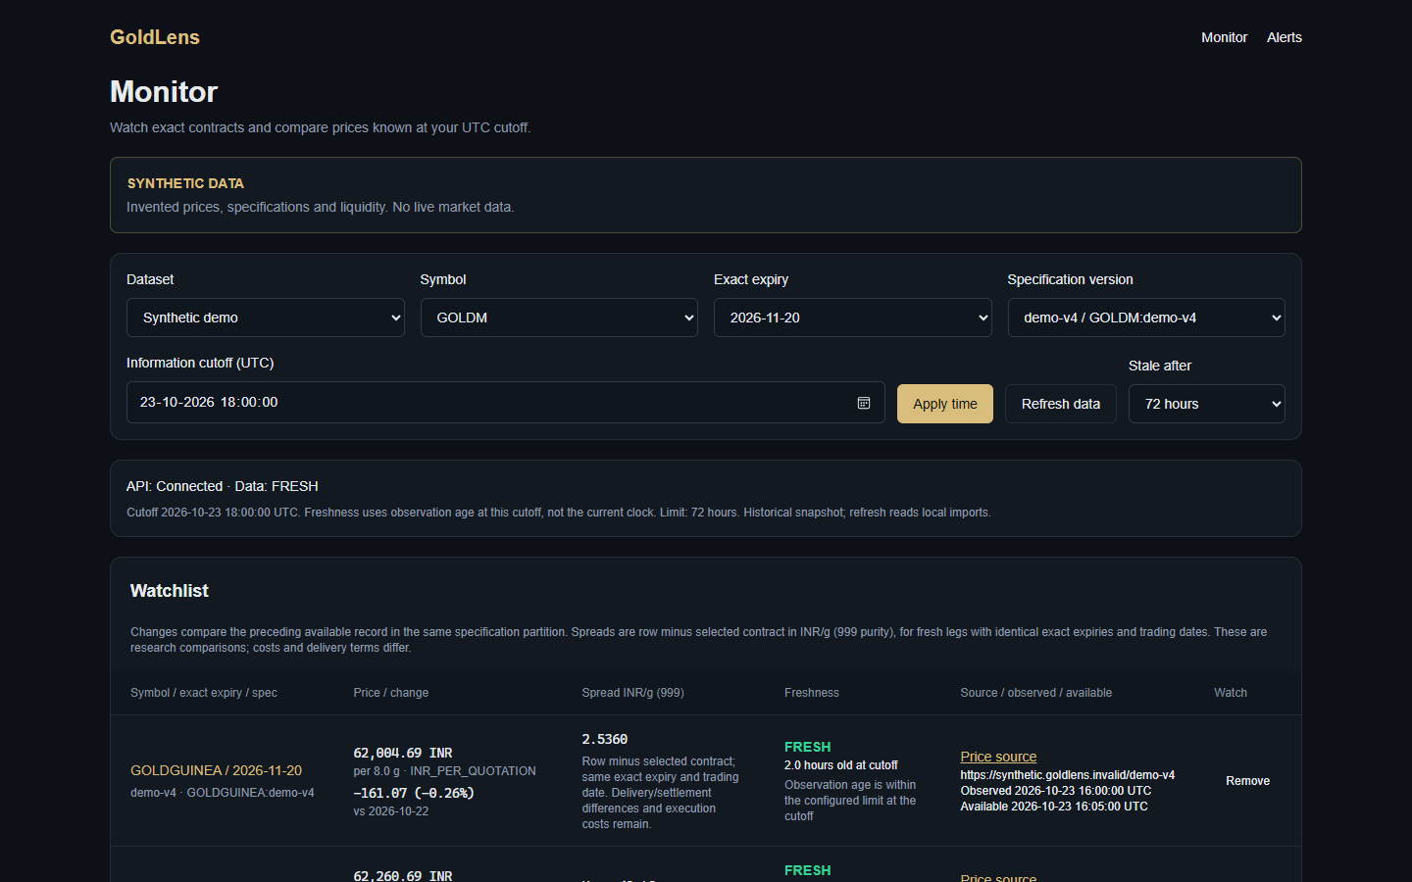
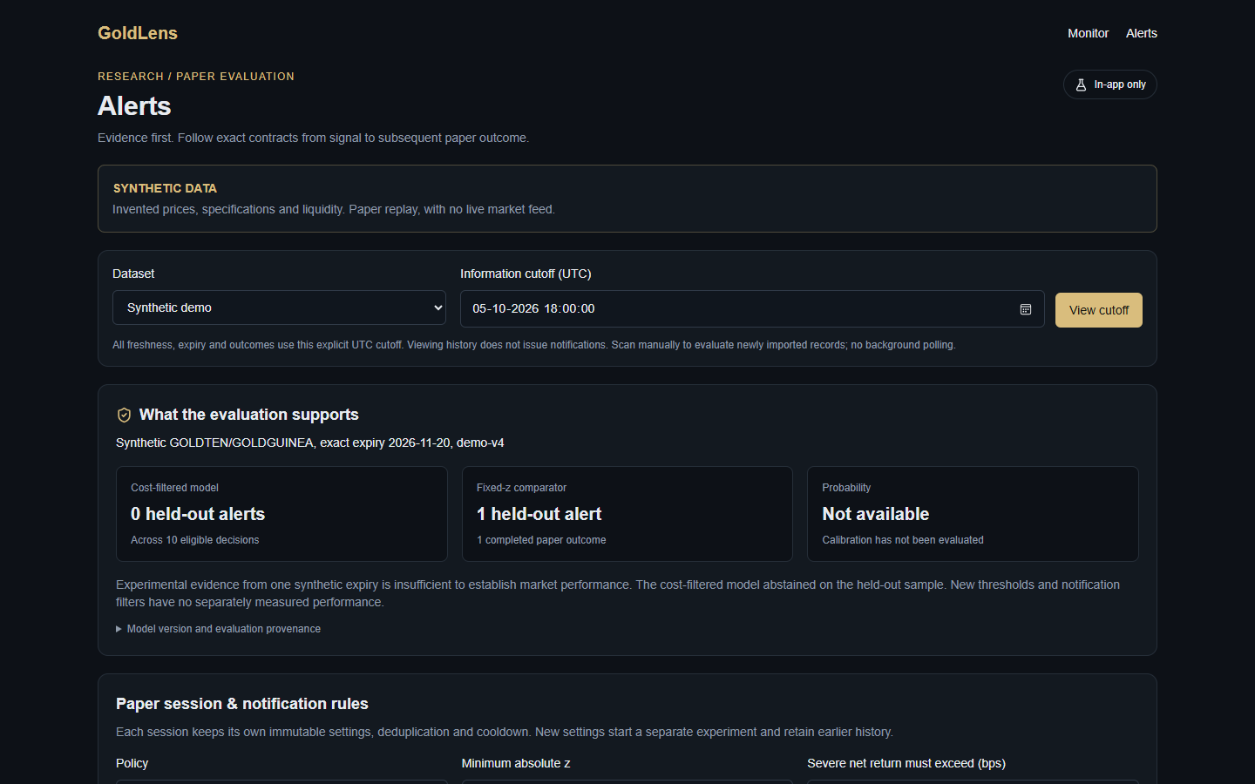
TWO SCREENS, ONE WORKFLOW
Monitor
Alerts
Watchlist by exact expiry, with freshness, source and availability time
What the evaluation supports, plus rules for each paper session
Watch exact contracts
Set alert rules
Scan at a cutoff
Review evidence
Follow paper outcome
Notes:
This is the real running prototype, captured from the browser. Left is Monitor: watchlist with exact expiry, freshness and source time. Right is Alerts: what the evaluation supports, then session rules. Walk the five-step flow at the bottom. The synthetic banner is always visible.

Slide 6
MARKET RESEARCH/ANALYSIS
Target users:
Individual and company commodity traders
Analysts and researchers studying gold futures
Brokerages and fintech apps that need analytics tools
Finance students and educators
Market focus:
India’s MCX gold futures (GOLDM, GOLDTEN, GOLDGUINEA, GOLDPETAL). We have not yet researched how big the market is and will check this later.
Potential revenue model
Paid subscription for analytics access
Premium features such as alerts and downloadable decision reports
Licensing for brokerages and educational institutions
Differentiation:
Clear and correct results instead of black box signals: every comparison shows exact contract dates, caveats and where the data came from.

Slide 7
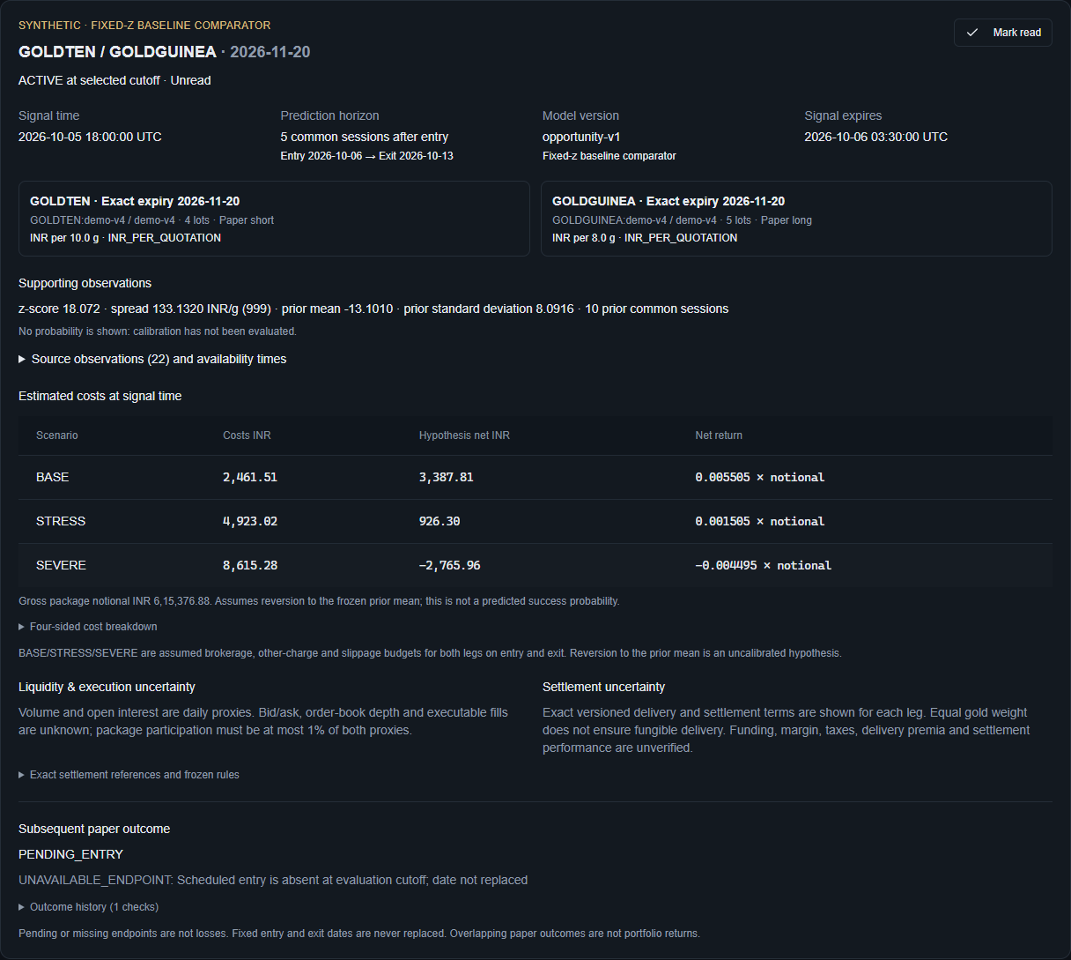
HOW THE PROTOTYPE WORKS
1
Identity and timing
Both contracts, exact expiry, signal time, five-session horizon, model version, expiry of the signal
2
Supporting observations
Z-score, spread and ten prior sessions. 22 source records with observed and available times. No probability: calibration is unevaluated
3
Estimated costs
BASE, STRESS and SEVERE, itemised for both legs, entry and exit
4
Liquidity and settlement uncertainty
Daily proxies only. Delivery terms shown per leg. Nothing implied as guaranteed
5
Paper outcome
Pending until entry and exit dates are observed. Missing data is never counted as a loss
Notes:
This is one real alert, from the synthetic demo. The z-score is large because the synthetic data has an injected anomaly, which we state openly. Point at each numbered part: identity and timing, the supporting observations, costs under three scenarios, uncertainty text, and the follow-up paper outcome. Note that no probability is shown.

Slide 8
CURRENT PROGRESS
165
17
2
1
backend tests passing
browser check groups passing: 10 Alerts, 7 Monitor
screens: Monitor and Alerts
evaluated model: opportunity-v1
Built and verified
Not done yet
Monitor with exact-expiry watchlist and freshness
Load verified real MCX specifications and prices
Versioned specs and point-in-time storage
Evaluate across several expiries and market regimes
Deterministic model with walk-forward evaluation
Calibrate probabilities, only if evidence supports it
In-app paper alerts: dedup, cooldown, expiry, outcome history
Measure real costs and liquidity; add scheduled scans
Real-data failures stay failures, with no synthetic fallback
Notes:
Progress is stated as facts we have verified. The four tiles are test results from our build log. The right column is deliberately honest: real verified MCX data has not been loaded yet, so calibration and real cost evidence are still open.

Slide 9
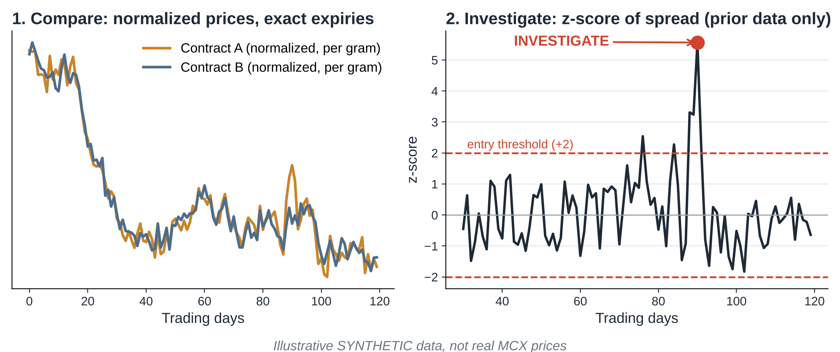
DEMO FLOW & GUARDRAILS
  Demo flow: compare → investigate → simulate → decision report
  Guardrails: no made up data, no use of future data, no risk free claims

Slide 10
Thank
you!

