Slide 1

Charity Match
Fredrik Svensson
Jakob Willforss
Johan Philipsson
Martín Basterrechea
Zuzanna Sadowska

Slide 2

Case
How to find your non-profit?
You want to give money or help out
There are a lot of charities
How do you know which fits you?

Slide 3

Our solution
Matching you with an organisation you believe in
Web service for givers and nonprofits
Web service for users and
Provide link to smaller organizations

Slide 4
Demonstration!
http://randomramblings.nfshost.com

Slide 5
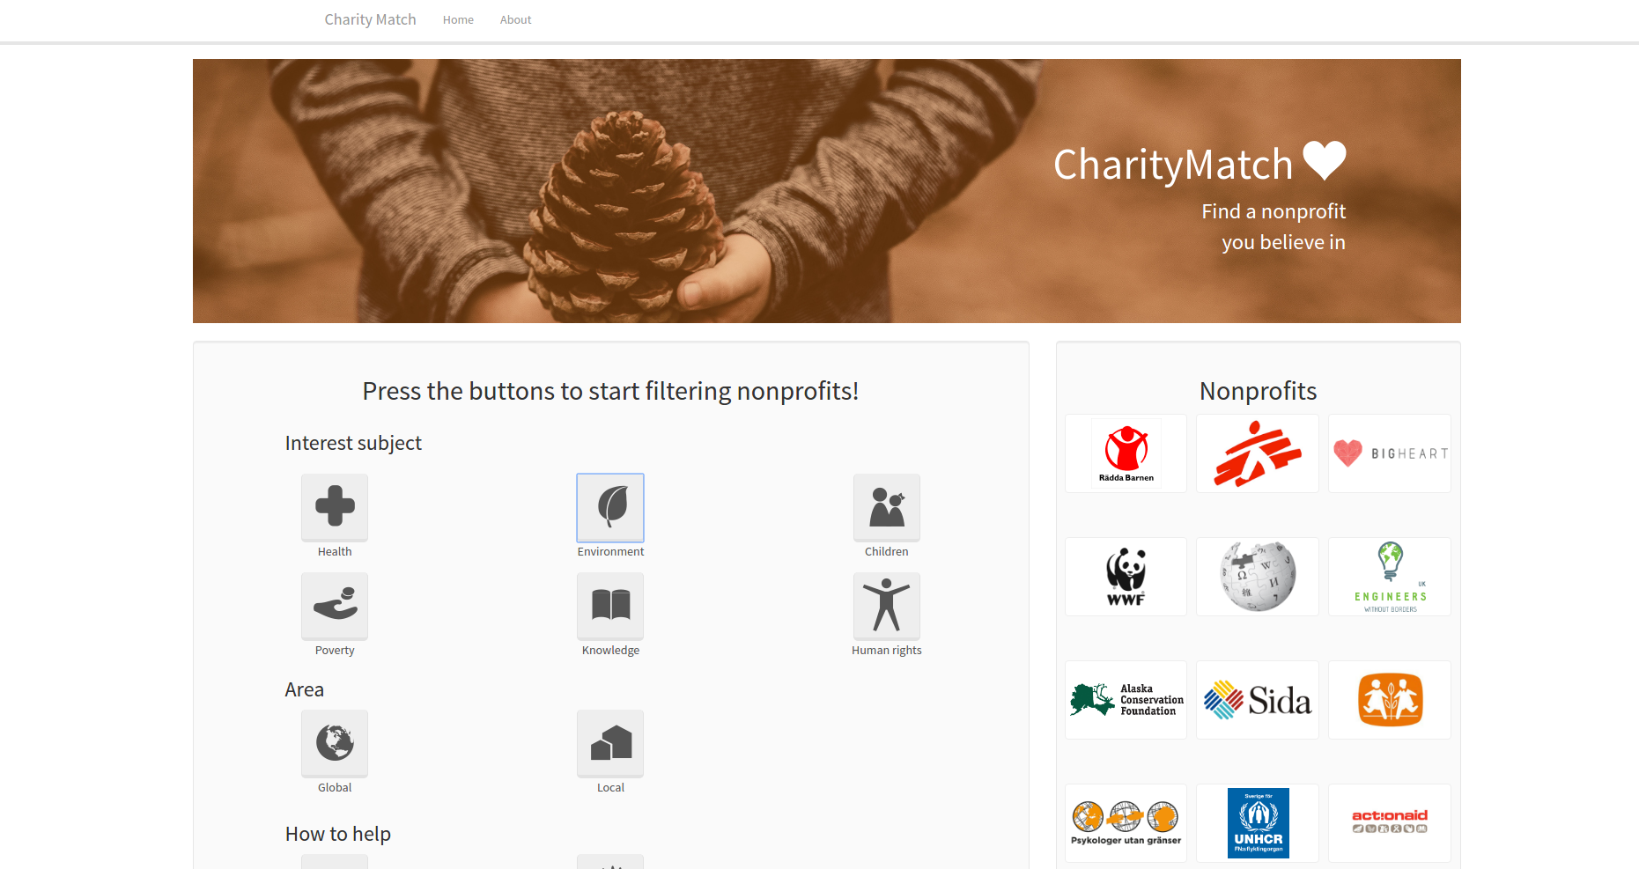

Slide 6
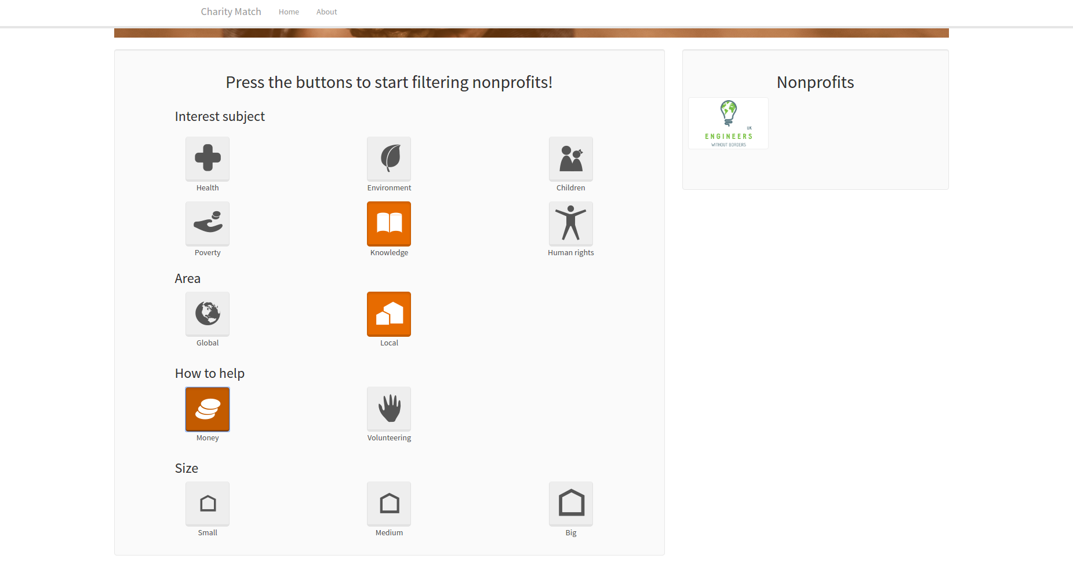

Slide 7
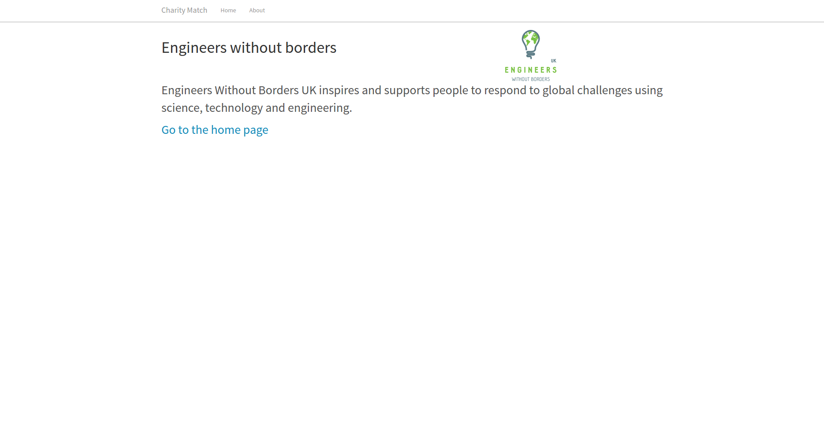

Slide 8
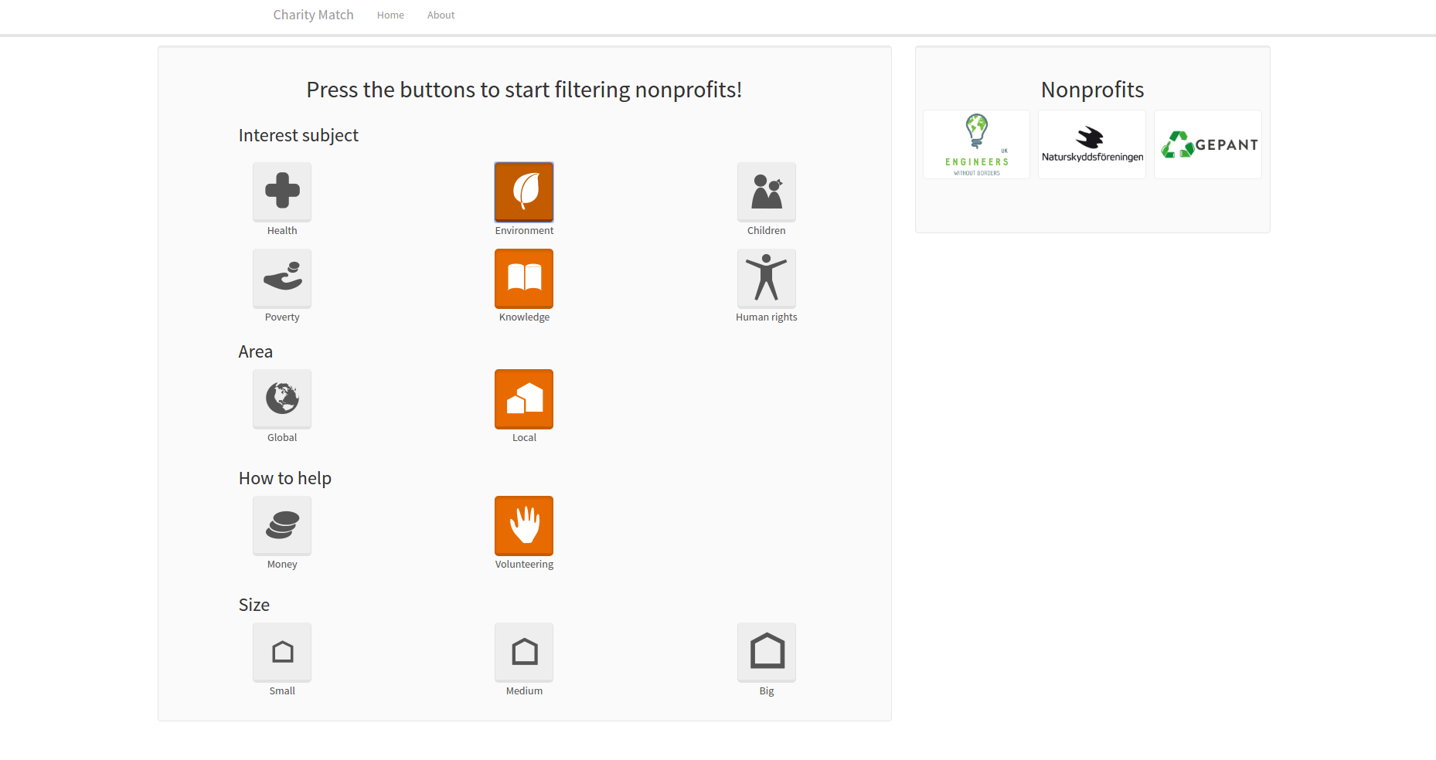

Slide 9
Outlook

