Slide 1

Data Analytics + Python
Welcome to Day 1

Slide 2

A little bit about me
Education background
Transportation industry
Social Media Marketing
Business owner

Slide 3


What is a programmer?
What is an analyst?
A creator
A problem solver
A thinker
A creator
A problem solver
A thinker
That is why they fit so well together!

Slide 4
What will you learn along the way?
Think methodically
Solve Problems
Create small programs to practice

Slide 5
Why did you choose Data Analytics + Python and what is your end goal?

Slide 6





What Classes will look like
Lecture
Practice
Discussion
Group Projects
Coursera & Capstone Work

Slide 7
Algorithms
What is an algorithm?
Programming is the skill that allows a computer scientist to take an algorithm (those steps to solving a problem) and represent that solution in what’s called a notation (aka program) that can be followed by a computer! Those programs are written in programming languages such as Python, html, JavaScript etc.
Series of steps to solve the problem at hand

Slide 8

PYTHON
Considered a high-level language
It’s easier to use a high-level language
Programs must be processed before they can run
Low-level languages are known as Machine Learning which is encoding of instructions in binary are easily executed by the computer.
Takes less time to write
Shorter and easier to read
More likely to be correct

Slide 9
Two Programs to Process Code
Interpreter
Compiler
Reads a high-level program and executes it, meaning it does what the program says.
Processes a little at a time, reading lines and performing computations
Reads the program and translates it completely before starting to run it.

Slide 10


Two Ways to use the Python
Shell
Files

Slide 11
Common Vocabulary
Value – a number or string (or other things to be named later) that can be stored in a variable or computed in an expression.
Variable – a name that refers to a value
Variable Name - A name given to a variable. Variable names in Python consist of a sequence of letters and digits that begins with a letter. In best programming practice, variable names should be chosen so that they describe their use in the program, making the program self documenting.

Slide 12
Str = a Python data type that holds a string of characters
Operators = special symbols that represent a simple computation
Data Type = a set of values
Comment = information in a program that is meant for other programmers (used with ## infront)
Input = a command in a program that prompts the user to put in an answer
Output = the result of a program

Slide 13

You’ve chosen to learn another language!

Slide 14

Types of Languages
Natural
Formal
Form on their own
Are designed by people!
Programming languages fall under this
There are rules about syntax

Slide 15
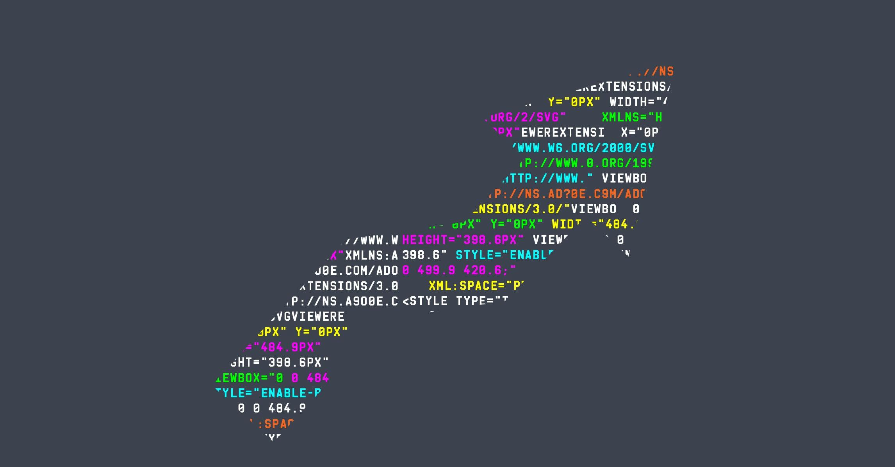
Your First Program!

