Slide 1

Data Analytics + Python Day 3
You made it to the end of week 1!

Slide 2

Questions?

Slide 3
Ice Breaker
How do you learn best?
If your life was a movie, who would play you and why?

Slide 4
Practice
Basic print program from yesterday (including input)
Math Module
Random Module
Writing different functions
Challenge
Use two or more at the same time creating a program

Slide 5
Variable Names
Containers for storing data values
No command for declaring a variable
YOU create it as soon as you assign a value to it!
x = 8
y = brothers
print(x)
print(y)

Slide 6
Multi Word Variable Names
fruits = [“apple”, “banana”, “cherry”]
x = y = z = fruits
print(x)
print(y)
print(z)
x, y, z = “Orange”, “Banana”, “Cherry”
print(x)
print(y)
print(z)
x = y = z = “Orange”
print(x)
print(y)
print(z)

Slide 7
Output Variables
x = “awesome”
print(“Python is “ + x)
x = “Python is “
y = “awesome”
z = x + y
print(z)
x = 5
y= 10
print(x+y)
x = 5
y = “John”
Print(x + y)

Slide 8
Global Variables
x = "awesome" def myfunc(): print("Python is " + x) myfunc()
x = "awesome"
def myfunc():
x = "fantastic"
print("Python is " + x)
myfunc()
print("Python is " + x)

Slide 9
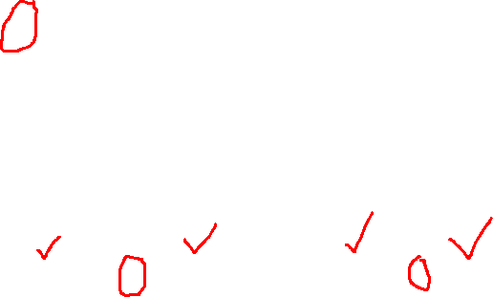
Data Types
x = “Hello World” string (str)
x = 20 integer (int)
x = 20.5 float
x = [“apple”, “banana”, “cherry”] list
x = (“apple”, “banana”, “cherry”) tuple
x = range(5) range
x = {“name” : “John”, “age” : 36} dictionary (dict)
x = True boolean

Slide 10
You can put the data type in front if you want to specify
x = str(“hello, world!”)
x = int(20)
x = float(20.5)
Integer (int) = a whole number, positive or negative, w/o decimals
Float = a number, positive or negative, containing one or more decimals
You can check the data type of a value by writing this:
x = 1
y = 4.5
print(type(x))
print(type(y))

Slide 11

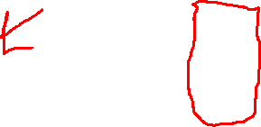
Casting: When you want to specify a type on to a variable
x = int(1)
y = int(2.8)
z = int(“3”)
x = float(1)
y = float(2.8)
z = float(“3”)
x = str("s1") y = str(2) z = str(3.0)

Slide 12
Strings
are surrounded by either single quotation marks or double
You can assign a variable to them a = “Hello”
print(a)
Multi-line strings are designated with “””””/”””” or ‘’’/’’’

Slide 13
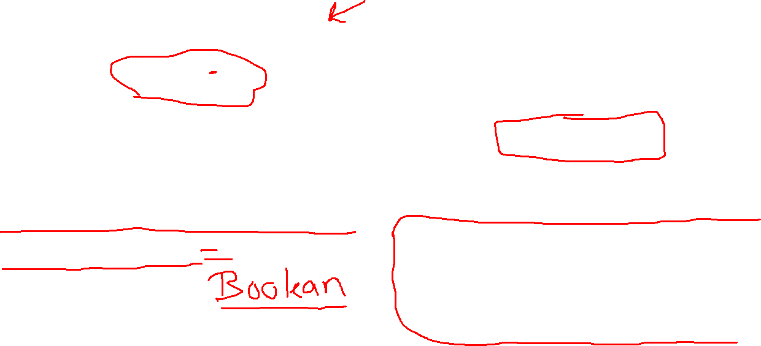
Getting the character
position of a string
Finding the length of a string
a = “Hello World!”
print(a[1])
a = “Hello World!”
print(len(a))
Checking a string
txt = “The best class in Saint Louis”
Print(“best” in txt)
txt = “The best class in Saint Louis”
if “best” in txt:
print(“Yes, ‘best’ is present.”)

Slide 14
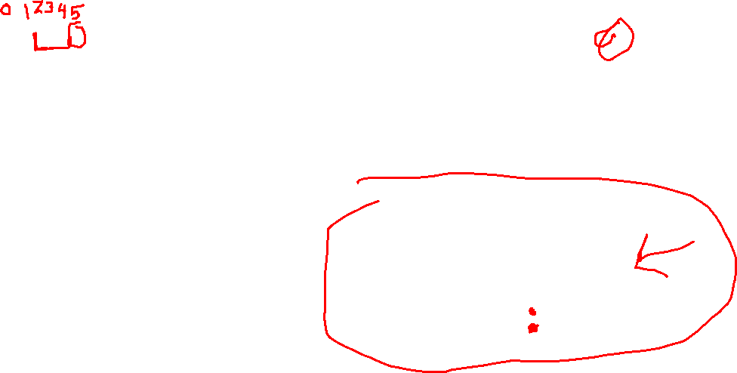
Slicing a string:
Return a range of characters
Slicing a string
From the start
b = “Hello World!”
print(b[2:5])
b = “Hello World!”
print(b[:5])
Slicing to the end
Negative Indexing
b=“Hello World!”
print(b[2:])
b=“Hello World!”
print(b[-5;-2])

Slide 15
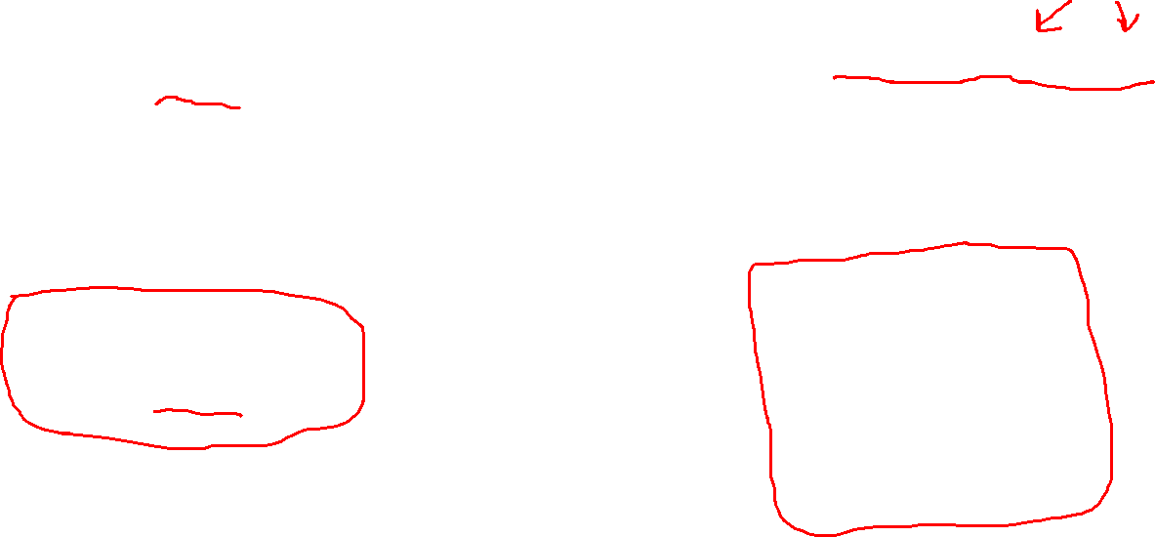
Replace in a string
Removing Whitespace
c = “Hello World!”
print(c.replace(“H” , “J”))
c = “ Hello World! ”
print(c.strip())
Concatenation
Split a string
a = "Hello" b = "World" c = a + b print(c)
b=“Hello World!”
print(b.split(“,”)

Slide 16
Formatting a String
age = 36 txt = "My name is John, I am " + age print(txt)
age = 36 txt = "My name is John, and I am {}" print(txt.format(age))
quantity = 3 itemno = 567 price = 49.95 myorder = "I want {} pieces of item {} for {} dollars." print(myorder.format(quantity, itemno, price))

