Slide 1
We are starting with Coursera tonight.
I am here if you need me

Slide 2
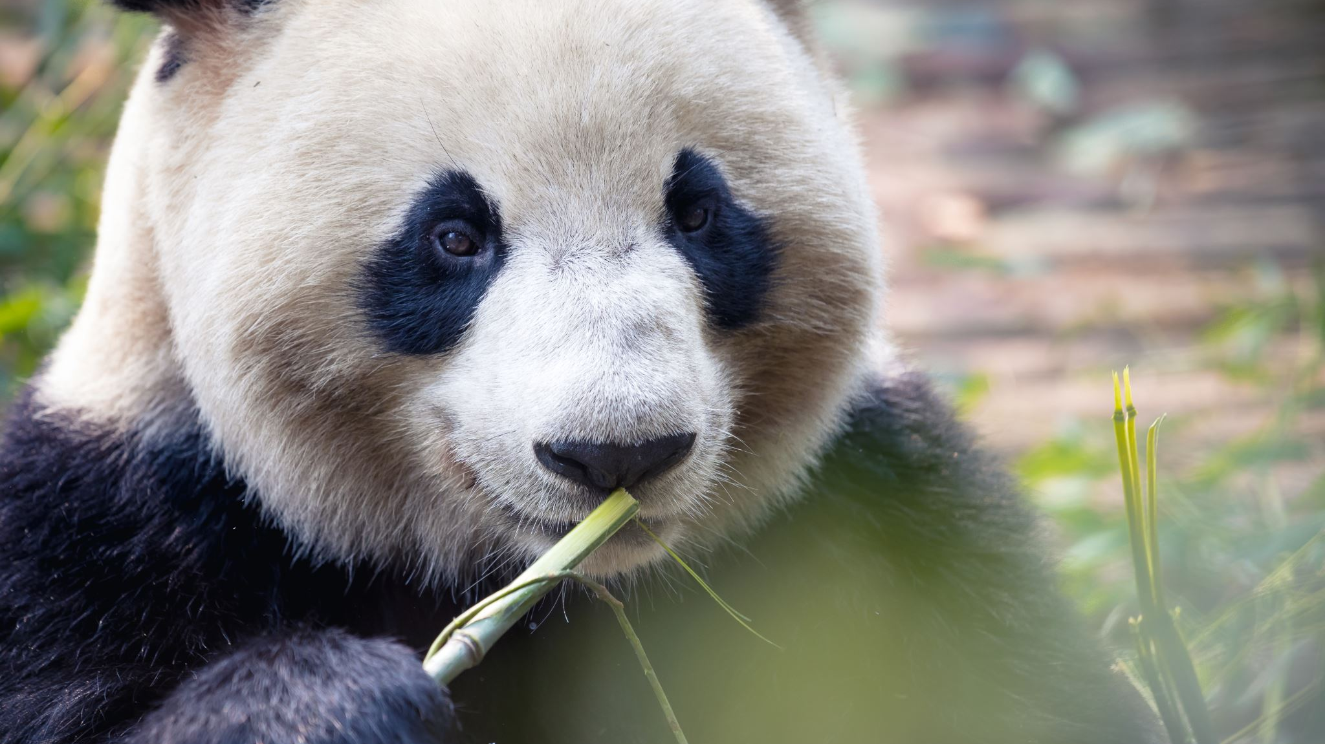
Pandas
Week 6

Slide 3
What is Pandas
An open-source Python package that is most widely used for data science/data analysis and machine learning tasks. It is built on top of NumPy which provides support for multi-dimensional arrays.
References both “Panel Data” and “Python Data Analysis” – created by Wes McKinney in 2008

Slide 4
Pandas vs NumPy
NumPy provides objects for multi-dimensional arrays but Pandas is capable of offering an in-memory 2d table object called a DataFrame.
NumPy consumes less memory compared to Pandas

Slide 5
What can Pandas do?
Data Cleansing
Data fill
Data normalization
Merges and joins
Data visualization
Statistical analysis
Data inspection
Loading and saving data

Slide 6
Remember: Pandas is a Module
You have to install it first:
pip install pandas
You have to import it at the beginning of every file:
import pandas as pd

Slide 7
DataFrames & Series
DataFrames
Series
2-dimensional data structure
2-dimensional array
Table with rows & columns
Column within a table
1 dimensional array holding data of any types.

Slide 8

DataFrame Example (create a Python file named week6a)
import pandas as pd
Report = {"Classes": ["Math", "Science", "Spanish", "History", "Health"],
"Grades": [75, 80, 95, 60, 100]}
results = pd.DataFrame(Report)
print(results)

Slide 9

You should have
Classes Grades
0 Math 75
1 Science 80
2 Spanish 95
3 History 60
4 Health 100

Slide 10
Finding the location
import pandas as pd
Report = {"Classes": ["Math", "Science", "Spanish", "History", "Health"],
"Grades": [75, 80, 95, 60, 100]}
results = pd.DataFrame(Report)
print(results.loc[3])

Slide 11

You should have
Classes History
Grades 60
Name: 3, dtype: object

Slide 12

More than 1 line
import pandas as pd
Report = {"Classes": ["Math", "Science", "Spanish", "History", "Health"],
"Grades": [75, 80, 95, 60, 100]}
results = pd.DataFrame(Report)
print(results.loc[[2, 3]])

Slide 13
You should have
Classes Grades
2 Spanish 95
3 History 60

Slide 14
Naming the Rows
import pandas as pd
Report = {"Classes": ["Math", "Science", "Spanish", "History", "Health"],
"Grades": [75, 80, 95, 60, 100]}
results = pd.DataFrame(Report, index = ["week1", "week2", "week3", "week4", "week5"])
print(results)

Slide 15
You should have
Classes Grades
week1 Math 75
week2 Science 80
week3 Spanish 95
week4 History 60
week5 Health 100

Slide 16
Locating a specific row
import pandas as pd
Report = {"Classes": ["Math", "Science", "Spanish", "History", "Health"],
"Grades": [75, 80, 95, 60, 100]}
results = pd.DataFrame(Report, index = ["week1", "week2", "week3", "week4", "week5"])
print(results.loc[“week3”])

Slide 17
You should have
Classes Spanish
Grades 95
Name: week3, dtype: object

Slide 18
Series Example (create a Python file named week6b)
import pandas as pd
age = [20, 40, 60]
years = pd.Series(age)
print(years)

Slide 19
Finding the location
import pandas as pd
age = [20, 40, 60]
years = pd.Series(age)
print(age[0])

Slide 20
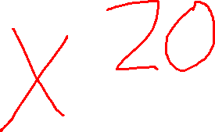
You should have
40

Slide 21
Naming the Rows
import pandas as pd
age = [20, 40, 60]
years = pd.Series(age, index = ["Me", "My Brother", "My Sister"])
print(years)

Slide 22
You should have
Me 20
My Brother 40
My Sister 60
dtype: int64

Slide 23

Locating a specific row
import pandas as pd
age = [20, 40, 60]
years = pd.Series(age, index = ["Me", "My Brother", "My Sister"])
print(years["My Sister"])

Slide 24
You should have
60

Slide 25
Now, Let’s try in Jupyter Notebook

Slide 26
Sorting dataframes
df.sort_values(by=[‘x’], inplace=True)
df.sort_values(by=[‘x’], inplace=True, ascending=False)
df.sort_values(by=[‘first column’, ‘second column’,…], inplace=True)

Slide 27
Reading .csv files

Slide 28
What is a .CSV file???
A file that contains plain text
Common file extension for data sets
You can open it in Notepad but the format will be off

Slide 29
We can use Pandas to read *Create python file week6c*
import pandas as pd
df = pd.read_csv(‘data.csv’)
print(df.to_string())
You get the WHOLE dataframe

Slide 30
import pandas as pd
df = pd.read_csv(‘data.csv’)
print(df)
You get the first 5 lines & the last 5 lines
With the row & column count

Slide 31
max_rows
import pandas as pd
df = pd.read_csv(‘data.csv’)
print(pd.options.display.max_rows)
You will get the max rows set on your system

Slide 32
max_rows cont.
import pandas as pd
pd.options.display.max_rows = 9999
df = pd.read_csv(‘data.csv’)
print(df)
You will get the whole dataframe

Slide 33

Viewing the FIRST 10 rows
import pandas as pd
df = pd.read_csv(‘data.csv’)
print(df.head(10))
If you have an empty head command,
you get the first 5

Slide 34

Viewing the LAST 10 rows
import pandas as pd
df = pd.read_csv(‘data.csv’)
print(df.tail(10))
If you have an empty head command,
you get the last 5

Slide 35
Information about the data
import pandas as pd
df = pd.read_csv(‘data.csv’)
print(df.info())
If you have an empty head command,
you get the last 5

Slide 36

<class 'pandas.core.frame.DataFrame'>
RangeIndex: 169 entries, 0 to 168
Data columns (total 4 columns):
# Column Non-Null Count Dtype
--- ------ -------------- -----
0 Duration 169 non-null int64
1 Pulse 169 non-null int64
2 Maxpulse 169 non-null int64
3 Calories 164 non-null float64
dtypes: float64(1), int64(3)
memory usage: 5.4 KB
Explanation of type of object
How many rows
and columns
Name of each column
with data type
Total number of data types
Memory used for the data frame

Slide 37
# Column Non-Null Count Dtype
--- ------ -------------- -----
0 Duration 169 non-null int64
1 Pulse 169 non-null int64
2 Maxpulse 169 non-null int64
3 Calories 164 non-null float64
There are 5 rows in the Calories column without data
Nulls are bad
Nulls = the wrong result when you analyze data

Slide 38
Let’s find the Nulls
import pandas as pd
df = pd.read_csv(‘data.csv’)
print(df.to_string())
17 27 91 118 141

Slide 39

Dropping the nulls #1
import pandas as pd
df = pd.read_csv(‘data.csv’)
new_df = df.dropna()
print(new_df.to_string())
This DOES NOT change the
original dataframe
BECAUSE
You are using new_df

Slide 40

Dropping the nulls #2
import pandas as pd
df = pd.read_csv(‘data.csv’)
df = df.dropna(inplace = True)
print(new_df.to_string())
This changes
the ORIGINAL

Slide 41

Replacing Nulls
import pandas as pd
df = pd.read_csv(‘data.csv’)
df = df.fillna(130, inplace = True)
print(df.to_string())

Slide 42
Replacing Nulls in Specific Columns
import pandas as pd
df = pd.read_csv(‘data.csv’)
df[“Calories”].fillna(130, inplace = True)
print(df.to_string())

Slide 43
Replace the Nulls Using mean, median, mode
Mean = the average value
Median = the value in the middle, after you have sorted all the values ascending
Mode = the value that appears most frequently

Slide 44

MEAN
import pandas as pd df = pd.read_csv('data.csv') x = df["Calories"].mean() df["Calories"].fillna(x, inplace = True)
Print(df.to_string())

Slide 45
MEDIAN
import pandas as pd df = pd.read_csv('data.csv') x = df["Calories"].median() df["Calories"].fillna(x, inplace = True)
Print(df.to_string())

Slide 46
MODE
import pandas as pd df = pd.read_csv('data.csv') x = df["Calories"].mode()[0] df["Calories"].fillna(x, inplace = True)
print(df.to_string())

Slide 47
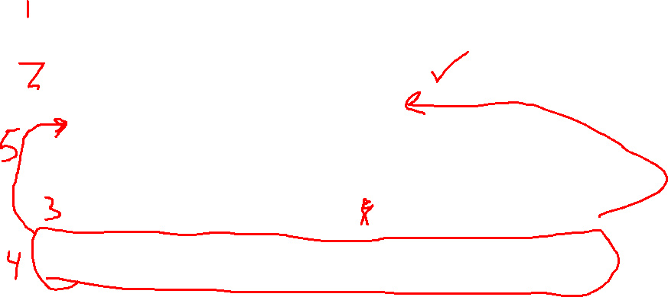
Fixing dates
import pandas as pd df = pd.read_csv('data1.csv')
print(df.to_string())
df[‘Date’] = pd.to_datatime(df[‘Date’])
df.dropna(subset=[‘Date’], inplace = True)

Slide 48

Fixing wrong info
import pandas as pd df = pd.read_csv('data1.csv')
print(df.to_string())
We want to change line 9 Duration to be 45
df.loc[9, ‘Duration’] = 45

Slide 49

Fixing wrong info in LARGE sets
import pandas as pd
df = pd.read_csv('data.csv')
for x in df.index:
if df.loc[x, "Duration"] > 120:
df.loc[x, "Duration"] = 120
print(df.to_string())

Slide 50
Removing rows in LARGE sets
import pandas as pd
df = pd.read_csv('data.csv')
for x in df.index:
if df.loc[x, "Duration"] > 120:
df.drop(x, inplace = True)
print(df.to_string())

Slide 51
Dealing with Duplicates
import pandas as pd
df = pd.read_csv('data1.csv')
print(df.duplicated())

Slide 52
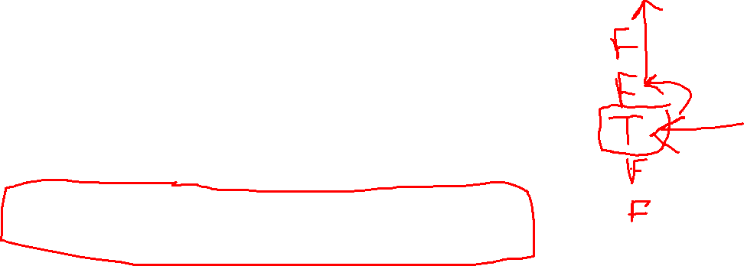
Dealing with Duplicates
import pandas as pd
df = pd.read_csv('data1.csv’)
df.drop_duplicates(inplace = True)
print(df.duplicated())

Slide 53
Plotting & Practice with Pandas

Slide 54
Plotting directly from a .csv
import pandas as pd
import matplotlib.pyplot as plt
df = pd.read_csv(“data.csv”)
df.plot()
plt.show()

Slide 55
Creating a scatter plot
import pandas as pd
import matplotlib.pyplot as plt
df = pd.read_csv(‘data.csv’)
df.plot(kind = “scatter”, x = “Duration”, y = “Calories”)
plt.show()

Slide 56
Creating a Histogram plot
import pandas as pd
import matplotlib.pyplot as plt
df = pd.read_csv("data.csv")
df["Duration"].plot(kind ='hist')
plt.show()

Slide 57
Practice with .csv files
First, we need to gather our data
import pandas as pd
titanic_data = pd.read_csv(“titanic.csv”)
print(titanic_data.head())

Slide 58

Practice with .csv files
If you wanted to use the data straight from the web
import pandas as pd
titanic_data = pd.read_csv(“https://raw.githubusercontent.com/datasciencedojo/datasets/master/titanic.csv”)
print(titanic_data.head())

Slide 59

Customizing Headers
import pandas as pd
col_names = ["Id",
"Survived",
"Passenger Class",
"Full Name",
"Gender",
"Age",
"SibSp",
"Parch",
"Ticket Number",
"Price",
"Cabin",
"Station"]
titanic_data = pd.read_csv(r"C:\Users\User\Desktop\DAP2022\titanic.csv", names=col_names)
print(titanic_data.head())

Slide 60
Skipping Rows
import pandas as pd
col_names = ["Id",
"Survived",
"Passenger Class",
"Full Name",
"Gender",
"Age",
"SibSp",
"Parch",
"Ticket Number",
"Price",
"Cabin",
"Station"]
titanic_data = pd.read_csv(r"C:\Users\User\Desktop\DAP2022\titanic.csv", names=col_names, skiprows=[0])
print(titanic_data.head())

Slide 61
Saving to a new .csv file
import pandas as pd
col_names = ["Id",
"Survived",
"Passenger Class",
"Full Name",
"Gender",
"Age",
"SibSp",
"Parch",
"Ticket Number",
"Price",
"Cabin",
"Station"]
titanic_data = pd.read_csv(r"C:\Users\User\Desktop\DAP2022\titanic.csv", names=col_names, skiprows=[0])
titanic_data.to_csv('use_titanic.csv', index=False)

Slide 62
Creating a .csv from scratch
import pandas as pd
cities = pd.DataFrame([["St. Louis", "Missouri"], ["Atlanta", "Georgia"]], columns=["City", "State"])
cities.to_csv('cities.csv')

Slide 63
Viewing the file
import pandas as pd
cities = pd.DataFrame([["St. Louis", "Missouri"], ["Atlanta", "Georgia"]], columns=["City", "State"])
df = pd.read_csv('cities.csv')
print(df)

Slide 64
Saving the file without indexes
import pandas as pd
cities = pd.DataFrame([["St. Louis", "Missouri"], ["Atlanta", "Georgia"]], columns=["City", "State"])
cities.to_csv('cities.csv’, index=False)
df = pd.read_csv('cities.csv')
print(df)

Slide 65
Individual Practice
Create your own .csv file with data and save it
Make a change to it and save it with a different name and send me both in a Slack message

Slide 66
Quick Housekeeping Items
You’ve made it halfway! Congrats!
Come up with 2-3 questions that you want Xavier to answer tomorrow & send them to him in Slack
Need to have some capstone data that you can work with next week
Your Data Structure document is due by next Thursday

