Slide 1
aggregations
Process of converting a set of values into a single value.
Done based on Measures & Dimensions
Aggregating Measures can be added to relational data sources
Aggregating Dimensions can be done by Minimum, Maximum, Count or Count(Distinct)

Slide 2
Let’s use the Sample Superstore Source
Drag “Sales” to Rows, Columns, or Text (inside Marks box)
Default is SUM
Right-click on SUM(Sales)
Choose Measure(SUM) & select desired aggregation from list (avg)
You can change the aggregation of any measure by clicking on a measure from the left-hand side, select Default Properties and Aggregation & select one

Slide 3
pivot
Select columns that need to be manipulated & formatting them into a typical dataset
Need to REMEMBER to pivot from Columns to Rows ( tall v. wide)
Data not formatted exactly in preview pane:
Select all columns in the file
Select pivot from pop-up menu

Slide 4
Data interpreter
Automatically cleans and prepares data
Available under Connections Pane whenever a unique format is detected.

Slide 5
split
String function used to split a column into multiple ones
Used to make data analysis easier
Offers both Automatic Split and Custom Split
Automatic: done by detecting a common separator
Custom: max of 10 new fields based on a separator in original field
Can split columns by clicking on column in preview pane and selecting
Example: Moving “City, State: Denver, CO” to two different cells

Slide 6
Data types inside tableau
Text Values
Date Values
Date and time Values
Numerical Values
Boolean Values
Geographic Values

Slide 7
Data roles
Dimensions v. Measures
Data is both textual & numerical, automatically segregated into either role
Dimensions: produce a header when added to row/column, categorical
Measures: produce an axes when added to row/column, numeric
Discrete v. Continuous
Every field is categorized as either discrete or continuous

Slide 8
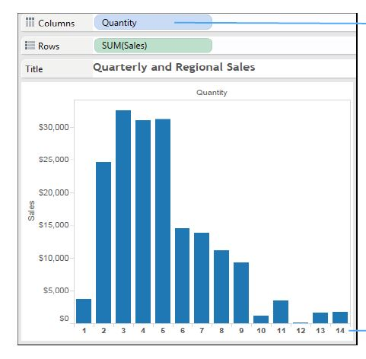
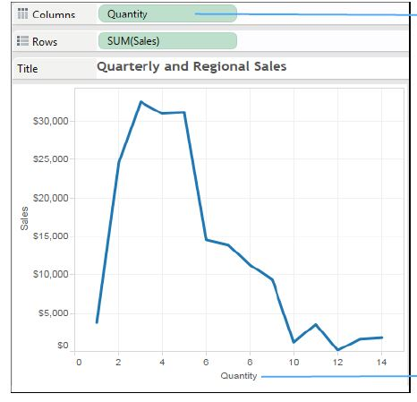
Discrete: every quantity as a header at the bottom
Continuous: quantity values are shown in a continuous axis

Slide 9
Working w/ metadata
Rename: sheet, column names
Hide: columns you don’t want to use
Unhide
Sort

Slide 10
Working with default fields
Adding a comment to a field
Changing a decimal number to a whole number
Right-click on field
Select Default Properties
Select Comment
You can view the comment when you put your cursor over the field
Right-click on field
Select Default Properties
Select Number Format
Select Number (Customer)
Set Decimal Place to Zero

Slide 11
Working with default fields
Change the Fiscal Year!
Changing a decimal number to a whole number
Right click on field
Select Default Properties
Select Fiscal Year Start
Select Month needed
Right-click on field
Select Default Properties
Select Number Format
Select Number (Customer)
Set Decimal Place to Zero

Slide 12
You can create aliases!
Right-click on any column and select Aliases
Update the alias name and click okay
Second Class would be where you would rename

Slide 13
You can filter your data

Slide 14
Dimension filter
General: selects one or multiple members from the domain
Wildcard: Matches values based on the presence of a string, the same starting and ending characters, or the same set of characters.
Condition: Matches values based on field or formula
Top: Highlights top values by field or formula

Slide 15
practice
Click on Entire View
Click on the sort option
Drag Sub-Category to Filters area
Create filter
You can remove filter by dragging Sub-Category outside of the filters area
Connect the SuperStore dataset
Drag “Orders” over to Canvas & go to Worksheet
Put SUM(Sales) in Columns
Put Sub-Category in Rows
Drag Sales to Label

Slide 16
Measure filter
Range of values: filter to identify sales representatives within a range of sales totals
At least: filter to identify sales reps with sales ABOVE a certain level
At most: filter to identify sales reps with sales BELOW a certain level
Special: filter to identify all values, null values and non-null values

Slide 17
practice
Drag Sales to filters
Click next
Set your filter
You can remove filter by dragging Sales outside of the filters area
Connect the SuperStore dataset
Drag “Orders” over to Canvas & go to Worksheet
Put Sub-Category in Rows
Put Sales in Text
Resize for visibility
Sort in descending order

Slide 18
Date filter
Relative Dates: can specify range of dates that is updated based on the date and time.
Range of Dates: can specify a range of dates to define a fixed range of dates to filter.
Discrete Dates: can specify a discrete date value in the dialog box
Individual Dates: can select individual dates to filter specific dates from the view
Additional date filter Options: can select null dates, non-null dates or all dates by specifying a start/end date.

Slide 19
practice
Restructure it by adding Year to Column
Drag Order Date to Filters
Click on Range of Dates
Click on Individual Dates
Connect Sample Superstore
Drag orders to canvas
Add Order Date to Rows
Add Sales to Text
Expand Order Date to Quarter and Month

Slide 20
Visual filter
Filters that are applied straight from Tables, Maps and Charts

Slide 21
practice
Connect Sample Superstore
Drag orders to canvas
Sub-Category > Rows
Sales > Columns & Text
Sort in descending order
Select Sub-Category & apply inclusion filter.

Slide 22
Context filter
The ONLY filter that is independent & used for:
Improving the performance of Tableau reports
Creating a dependent numerical filter
Any other filter defined alongside this one is a dependent one:
It’s dependent on the output of the context filter

Slide 23
practice
Add Sales to Label
Drag Category to Filters
Click on Furniture
Drag Sub-Category to Filters
Apply the filter
Connect Sample Superstore
Drag Orders to canvas
Drag Sub-Category to Rows
Drag Sales to Columns
Click on Entire View and sort in descending order

Slide 24
Data source filter
Applied to data sources that are connected to Tableau to make the worksheet work more efficiently.
The changes are done across ALL worksheets
Considered an efficient way to limit scope of data for performance/security purposes.

Slide 25
Extract filters are the same as data source filters, just applied to the extract connection.
Worksheet filters
Field Types
Dimensions (Region or product name)
Measures (Sales or profit)
Dates (Year or month)

Slide 26
practice
Click on Data Source & Add
Select add in the box
Click on City & OK & OK again
Can View entire worksheet filter in the top right corner.
Connect Sample Superstore
Drag orders to canvas
Add Regions to Rows
Add Sales to Text
Drag Region to Color
Sub-Category to Rows
Sales to Text & Columns

Slide 27
Interactive Filter
Allows users to interact with the data via Drop-down, List, Radio Button or Checkbox
Can be applied to: numbers, dates and strong

Slide 28
practice
Connect Sample Superstore
Drag orders to canvas
Drag Sub-Category to Rows
Sales to Columns & Label
Sort in Descending order
Select Sub-Category and click on show filter

Slide 29
Let’s do some sorting
Based on data course order, field, ABC order or manual
On a measure, can be applied through a dimensional sort

Slide 30
groups
Aggregate the data of dimension members
Example: top 5 sales reps by total salary are in a single row
Once grouped, can be used inside of any filters

Slide 31
sets
Custom fields that define a subset of data based on some conditions
Example: customers with sales over a certain level
CONSTANT sets: do not change after they are created
COMPUTED sets: types of sets that change with the change in data
COMBINED sets: two sets combined to compare different members
BUILDING sets: created through manual selection, condition, ranking

Slide 32
bins
Equal-sized containers that store data values that correspond to or fit within the bin size.
Can use any discrete field to create them
Right click on field, select Create and then Bins
Create new field name & designate size
Press OK

Slide 33
Hierarchies
An arrangement where entities are present at various levels
Created by adding one dimension as a level under the principal one
Example: Category & Sub-Category in Rows and SUM(Sales) in Text
Can be used as dimensions
Right-click, click Hierarchy > Create Hierarchy > Add Hierarchy
> Add dimensions

Slide 34
Creating charts
Easier to understand then tables with numbers
Click on “Show Me” button on upper right corner
Working with Sample-Superstore dataset
Orders sheet on Canvas

Slide 35
Text table & cross table
Drag Sub-Category to Rows
Drag Region to Columns
Drag Sales to Text under Marks

Slide 36
Highlight tables
Region > Columns
Sub-Category > Rows
SUM(Sales) > Text
Change drop-down to Square
Sales > Colors in Marks Card
Edit Colors > Select color palette

Slide 37
Heat maps
2-D representation of data that uses colors to convey info
As the density of records per mark increases, the color intensity increases.
Sub-Category > Rows & Region > Columns
Marks > Square
SUM(Sales) on Color in Marks Card and edit it

Slide 38
Stacked bar chart
Used to highlight one measure against several other values
Each category is divided into subcategories for detailed analysis
Can split bar into categories
Sub-category > Columns & SUM(Sales) > Rows
Region > Color under Marks Card

Slide 39
Line chart
Shows trend of data over a period of time
Normally used when there’s a date data type
Order Date > Columns
Sales > Rows (Marks type should change automatically to line)
Date can be discrete or continuous (Right-click on Order Date)

