Slide 1
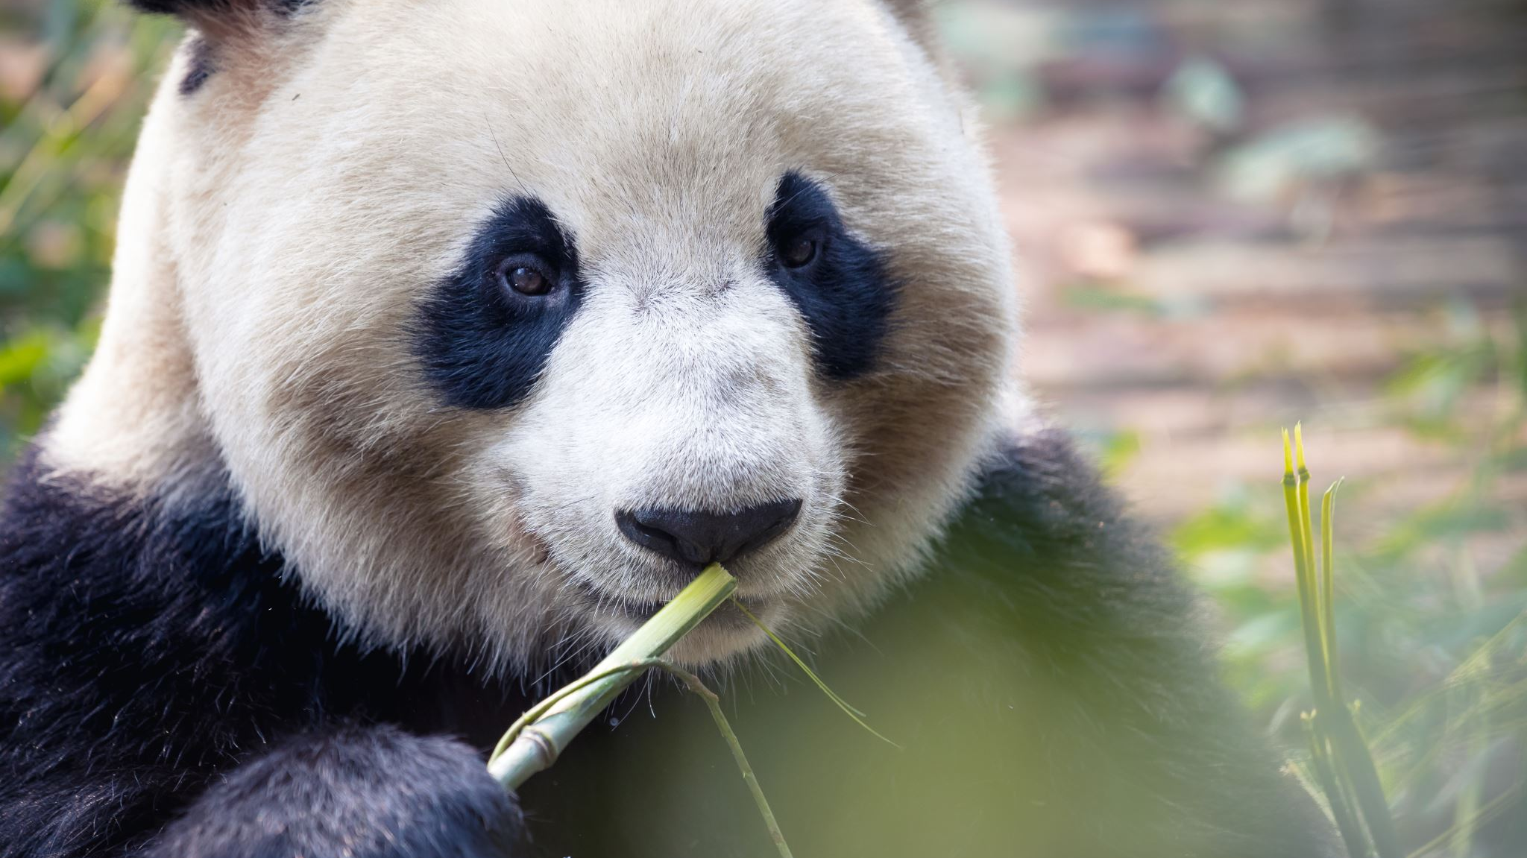
Pandas

Slide 2
What is Pandas
An open-source Python package that is most widely used for data science/data analysis and machine learning tasks. It is built on top of NumPy which provides support for multi-dimensional arrays.
References both “Panel Data” and “Python Data Analysis” – created by Wes McKinney in 2008

Slide 3
Pandas vs NumPy
NumPy provides objects for multi-dimensional arrays but Pandas is capable of offering an in-memory 2d table object called a DataFrame.
NumPy consumes less memory compared to Pandas

Slide 4
What can Pandas do?
Data Cleansing
Data fill
Data normalization
Merges and joins
Data visualization
Statistical analysis
Data inspection
Loading and saving data

Slide 5
Remember: Pandas is a Module
You have to install it first:
pip install pandas
You have to import it at the beginning of every file:
import pandas as pd

Slide 6
DataFrames & Series
DataFrames
Series
2-dimensional data structure
2-dimensional array
Table with rows & columns
Column within a table
1 dimensional array holding data of any types.

Slide 7
DataFrame Example (create a Python file named week6a)
import pandas as pd
Report = {"Classes": ["Math", "Science", "Spanish", "History", "Health"],
"Grades": [75, 80, 95, 60, 100]}
results = pd.DataFrame(Report)
print(results)

Slide 8
You should have
Classes Grades
0 Math 75
1 Science 80
2 Spanish 95
3 History 60
4 Health 100

Slide 9
Finding the location
import pandas as pd
Report = {"Classes": ["Math", "Science", "Spanish", "History", "Health"],
"Grades": [75, 80, 95, 60, 100]}
results = pd.DataFrame(Report)
print(results.loc[3])

Slide 10
You should have
Classes History
Grades 60
Name: 3, dtype: object

Slide 11
More than 1 line
import pandas as pd
Report = {"Classes": ["Math", "Science", "Spanish", "History", "Health"],
"Grades": [75, 80, 95, 60, 100]}
results = pd.DataFrame(Report)
print(results.loc[[2, 3]])

Slide 12
You should have
Classes Grades
2 Spanish 95
3 History 60

Slide 13
Naming the Rows
import pandas as pd
Report = {"Classes": ["Math", "Science", "Spanish", "History", "Health"],
"Grades": [75, 80, 95, 60, 100]}
results = pd.DataFrame(Report, index = ["week1", "week2", "week3", "week4", "week5"])
print(results)

Slide 14
You should have
Classes Grades
week1 Math 75
week2 Science 80
week3 Spanish 95
week4 History 60
week5 Health 100

Slide 15
Locating a specific row
import pandas as pd
Report = {"Classes": ["Math", "Science", "Spanish", "History", "Health"],
"Grades": [75, 80, 95, 60, 100]}
results = pd.DataFrame(Report, index = ["week1", "week2", "week3", "week4", "week5"])
print(results.loc[“week3”])

Slide 16
You should have
Classes Spanish
Grades 95
Name: week3, dtype: object

Slide 17
Series Example (create a Python file named week6b)
import pandas as pd
age = [20, 40, 60]
years = pd.Series(age)
print(years)

Slide 18
Finding the location
import pandas as pd
age = [20, 40, 60]
years = pd.Series(age)
print(age[0])

Slide 19
You should have
20

Slide 20
Naming the Rows
import pandas as pd
age = [20, 40, 60]
years = pd.Series(age, index = ["Me", "My Brother", "My Sister"])
print(years)

Slide 21
You should have
Me 20
My Brother 40
My Sister 60
dtype: int64

Slide 22
Locating a specific row
import pandas as pd
age = [20, 40, 60]
years = pd.Series(age, index = ["Me", "My Brother", "My Sister"])
print(years["My Sister"])

Slide 23
You should have
60

Slide 24
Reading .csv files

Slide 25
What is a .CSV file???
A file that contains plain text separated by commas (comma separated values)
Common file extension for data sets
You can open it in Notepad but the format will be off (use Excel or VS Code)

Slide 26
We can use Pandas to read *Create python file week6c*
import pandas as pd
df = pd.read_csv(‘data.csv’)
print(df.to_string())
You get the WHOLE dataframe

Slide 27
import pandas as pd
df = pd.read_csv(‘data.csv’)
print(df)
You get the first 5 lines & the last 5 lines
With the row & column count

Slide 28
max_rows
import pandas as pd
df = pd.read_csv(‘data.csv’)
print(pd.options.display.max_rows)
You will get the max rows set on your system

Slide 29
max_rows cont.
import pandas as pd
pd.options.display.max_rows = 9999
df = pd.read_csv(‘data.csv’)
print(df)
You will get the whole dataframe

Slide 30
Viewing the FIRST 10 rows
import pandas as pd
df = pd.read_csv(‘data.csv’)
print(df.head(10))
If you have an empty head command,
you get the first 5

Slide 31
Viewing the LAST 10 rows
import pandas as pd
df = pd.read_csv(‘data.csv’)
print(df.tail(10))
If you have an empty tail command,
you get the last 5

Slide 32
Information about the data
import pandas as pd
df = pd.read_csv(‘data.csv’)
print(df.info())

Slide 33
<class 'pandas.core.frame.DataFrame'>
RangeIndex: 169 entries, 0 to 168
Data columns (total 4 columns):
# Column Non-Null Count Dtype
--- ------ -------------- -----
0 Duration 169 non-null int64
1 Pulse 169 non-null int64
2 Maxpulse 169 non-null int64
3 Calories 164 non-null float64
dtypes: float64(1), int64(3)
memory usage: 5.4 KB
Explanation of type of object
How many rows
and columns
Name of each column
with data type
Total number of data types
Memory used for the data frame

Slide 34
# Column Non-Null Count Dtype
--- ------ -------------- -----
0 Duration 169 non-null int64
1 Pulse 169 non-null int64
2 Maxpulse 169 non-null int64
3 Calories 164 non-null float64
There are 5 rows in the Calories column without data
Nulls are bad
Nulls = the wrong result when you analyze data

Slide 35
Let’s find the Nulls
import pandas as pd
df = pd.read_csv(‘data.csv’)
print(df.to_string())
17 27 91 118 141

Slide 36
Dropping the nulls #1
import pandas as pd
df = pd.read_csv(‘data.csv’)
new_df = df.dropna()
print(new_df.to_string())
This DOES NOT change the
original dataframe
BECAUSE
You are using new_df

Slide 37
Dropping the nulls #2
import pandas as pd
df = pd.read_csv(‘data.csv’)
df = df.dropna(inplace = True)
print(df.to_string())
This changes
the ORIGINAL

Slide 38
Replacing Nulls
import pandas as pd
df = pd.read_csv(‘data.csv’)
df = df.fillna(130, inplace = True)
print(df.to_string())

Slide 39
Replacing Nulls in Specific Columns
import pandas as pd
df = pd.read_csv(‘data.csv’)
df[“Calories”].fillna(130, inplace = True)
print(df.to_string())

Slide 40
Replace the Nulls Using mean, median, mode
Mean = the average value
Median = the value in the middle, after you have sorted all the values ascending
Mode = the value that appears most frequently

Slide 41
MEAN
import pandas as pd df = pd.read_csv('data.csv') x = df["Calories"].mean() df["Calories"].fillna(x, inplace = True)
Print(df.to_string())

Slide 42
MEDIAN
import pandas as pd df = pd.read_csv('data.csv') x = df["Calories"].median() df["Calories"].fillna(x, inplace = True)
Print(df.to_string())

Slide 43
MODE
import pandas as pd df = pd.read_csv('data.csv') x = df["Calories"].mode()[0] df["Calories"].fillna(x, inplace = True)
print(df.to_string())

Slide 44
Fixing dates
import pandas as pd df = pd.read_csv('data1.csv')
print(df.to_string())
df[‘Date’] = pd.to_datatime(df[‘Date’])
df.dropna(subset=[‘Date’], inplace = True)
Put THIS in between

Slide 45
Fixing wrong info
import pandas as pd df = pd.read_csv('data1.csv')
print(df.to_string())
We want to change line 9 Duration to be 45
df.loc[9, ‘Duration’] = 45

Slide 46
Fixing wrong info in LARGE sets
import pandas as pd
df = pd.read_csv('data.csv')
for x in df.index:
if df.loc[x, "Duration"] > 120:
df.loc[x, "Duration"] = 120
print(df.to_string())

Slide 47
Removing rows in LARGE sets
import pandas as pd
df = pd.read_csv('data.csv')
for x in df.index:
if df.loc[x, "Duration"] > 120:
df.drop(x, inplace = True)
print(df.to_string())

Slide 48
Dealing with Duplicates
import pandas as pd
df = pd.read_csv('data1.csv')
print(df.duplicated())

Slide 49
Dealing with Duplicates
import pandas as pd
df = pd.read_csv('data1.csv’)
df.drop_duplicates(inplace = True)
print(df.duplicated())

Slide 50
Practice with .csv files
First, we need to gather our data
import pandas as pd
titanic_data = pd.read_csv(“titanic.csv”)
print(titanic_data.head())

Slide 51
Practice with .csv files
If you wanted to use the data straight from the web
import pandas as pd
titanic_data = pd.read_csv(“https://raw.githubusercontent.com/datasciencedojo/datasets/master/titanic.csv”)
print(titanic_data.head())

Slide 52
Customizing Headers
import pandas as pd
col_names = ["Id",
"Survived",
"Passenger Class",
"Full Name",
"Gender",
"Age",
"SibSp",
"Parch",
"Ticket Number",
"Price",
"Cabin",
"Station"]
titanic_data = pd.read_csv(r"C:\Users\User\Desktop\DAP2022\titanic.csv", names=col_names)
print(titanic_data.head())

Slide 53
Skipping Rows
import pandas as pd
col_names = ["Id",
"Survived",
"Passenger Class",
"Full Name",
"Gender",
"Age",
"SibSp",
"Parch",
"Ticket Number",
"Price",
"Cabin",
"Station"]
titanic_data = pd.read_csv(r"C:\Users\User\Desktop\DAP2022\titanic.csv", names=col_names, skiprows=[0])
print(titanic_data.head())

Slide 54
Saving to a new .csv file
import pandas as pd
col_names = ["Id",
"Survived",
"Passenger Class",
"Full Name",
"Gender",
"Age",
"SibSp",
"Parch",
"Ticket Number",
"Price",
"Cabin",
"Station"]
titanic_data = pd.read_csv(r"C:\Users\User\Desktop\DAP2022\titanic.csv", names=col_names, skiprows=[0])
titanic_data.to_csv('use_titanic.csv', index=False)

Slide 55
Creating a .csv from scratch
import pandas as pd
cities = pd.DataFrame([["St. Louis", "Missouri"], ["Atlanta", "Georgia"]], columns=["City", "State"])
cities.to_csv('cities.csv')

Slide 56
Viewing the file
import pandas as pd
df = pd.read_csv('cities.csv')
print(df)

Slide 57
Saving the file without indexes
import pandas as pd
cities = pd.DataFrame([["St. Louis", "Missouri"], ["Atlanta", "Georgia"]], columns=["City", "State"])
cities.to_csv('cities.csv’, index=False)
df = pd.read_csv('cities.csv')
print(df)

Slide 58
Individual Practice
Create your own .csv file with data and save it
Make a change to it and save it with a different name and send me both in a Slack message

