Slide 1
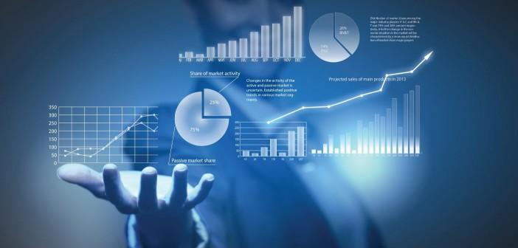
Data Analytics

Slide 2
It’s HOT right now!
Effectively make decisions
Develop new revenue
Companies are looking for people who can maintain their data and analyze it to:
Decrease Operational costs

Slide 3
Who are Data Analysts?
Take data from their organizations
Use that data to answer questions
Communicate the results
Some Titles
Business Analyst, Operations Analyst
Business Intelligence Analyst, Database Analyst
Marketing Analyst

Slide 4





What Classes will look like
Lecture
Practice
Discussion
Group Projects
Coursera & Capstone Work

Slide 5
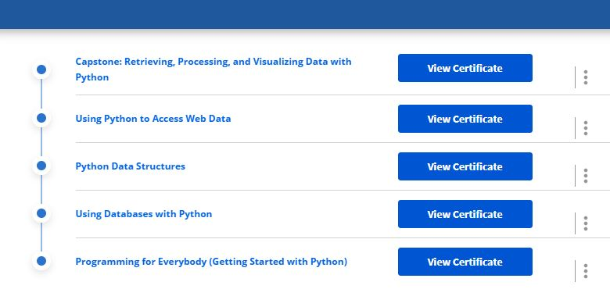

Slide 6
The end project: Your Capstone
Showcases what you have covered over this 12-week period
15 – 20 minutes in length
You need to come up with a topic
Clean it and analyze it to get your answer
Create a question with that topic
Locate raw data on that topic
Create your story!

Slide 7
Data Wrangling
The process of cleaning and unifying messy and complex data sets for easy access and analysis.
Organizing and processing data

Slide 8
Examples of Wrangling
Joining together multiple data sets into one
Finding gaps and filling/deleting them
Getting rid of data that is unnecessary
Identifying extreme outliers & either explaining them or getting rid of them

Slide 9
Step #1 - Discovery
Become familiar with your data so that you know how you will end up using it.
You can identify trends, patterns and some cells that might cause issues in analysis.

Slide 10
Step #2 - Structuring
Take your raw data and transforming it to what you can work with.

Slide 11
Step #3 - Cleaning
You begin to remove data that might not be useful because it could hurt your analysis.

Slide 12
Step #4 - Enriching
The process of looking at the data that you currently have and deciding whether you are needing to add to it.

Slide 13
Step #5 - Validating
Making sure that the data that you have is of the quality necessary to complete your project.

Slide 14
Step #6 - Publishing
Creating your analysis for the public.

Slide 15
Goals
Shows a "deeper intelligence" by getting data from several different sources
Provide accurate, actionable data to clients in good timing
Reduces time spent collecting and organizing raw data before it can be used
Allows data scientists and analysts to focus on the analysis
Pushes for better decision-making skills by senior leaders

Slide 16
What’s the Difference?
DATA WRANGLING
DATA CLEANING
Changing the data’s format by making the raw data into something more useable.
**Prepares data’s structure for modeling**
Removing data that will not help in your analysis because it contains errors or misinformation.
**Enhances data’s accuracy and integrity**

Slide 17
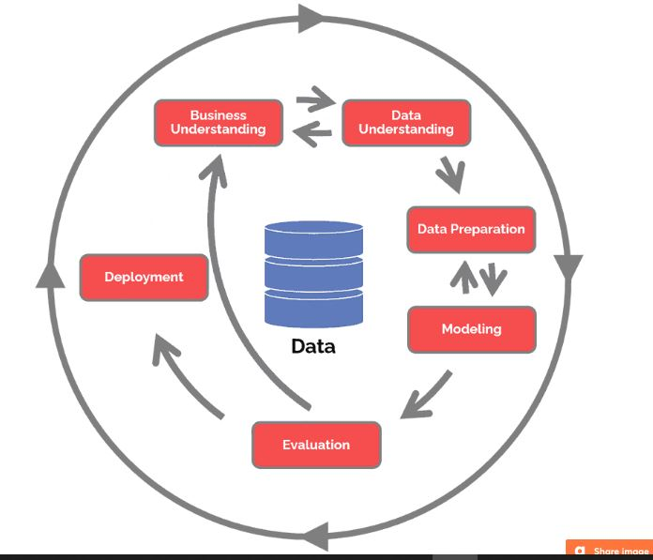
Crisp-DM
CRoss
Industry
Standard
Process for
Data
Mining

Slide 18
Data Science Life Cycle
Business Understanding What does the business need?
Data Understanding What data do we have / need? Is it clean?
Data preparation How do we organize the data for modeling?
Modeling
What modeling techniques should we apply?
Evaluation
Which model best meets the business objectives?
Deployment
How do stakeholders access the results?

Slide 19
The end project: Your Capstone
Showcases what you have covered over this 12-week period
15 – 20 minutes in length
You need to come up with a topic
Clean it and analyze it to get your answer
Create a question with that topic
Locate raw data on that topic
Create your story!

