Slide 1
It’s HOT right now!
Effectively make decisions
Develop new revenue
Companies are looking for people who can maintain their data and analyze it to:
Decrease Operational costs

Slide 2
Who are Data Analysts?
Take data from their organizations
Use that data to answer questions
Communicate the results
Some Titles
Business Analyst, Operations Analyst
Business Intelligence Analyst, Database Analyst
Marketing Analyst

Slide 3





What Classes will look like
Lecture
Practice
Discussion
Group Projects
Coursera & Capstone Work

Slide 4
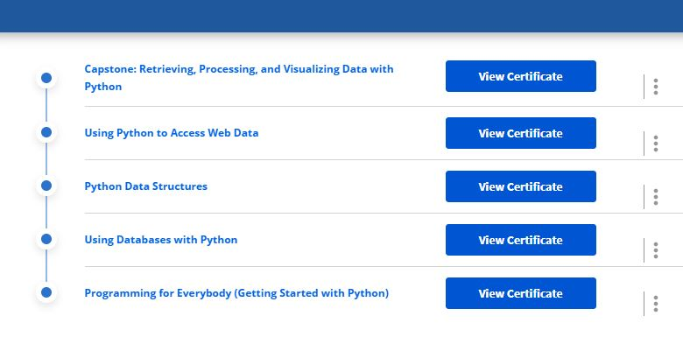

Slide 5
The end project: Your Capstone
Showcases what you have covered over this 12-week period
15 – 20 minutes in length
You need to come up with a topic
Clean it and analyze it to get your answer
Create a question with that topic
Locate raw data on that topic
Create your story!

Slide 6
Data Wrangling
The process of cleaning and unifying messy and complex data sets for easy access and analysis.
Organizing and processing data

Slide 7
Examples of Wrangling
Joining together multiple data sets into one
Finding gaps and filling/deleting them
Getting rid of data that is unnecessary
Identifying extreme outliers & either explaining them or getting rid of them

Slide 8
Step #1 - Discovery
Become familiar with your data so that you know how you will end up using it.
You can identify trends, patterns and some cells that might cause issues in analysis.

Slide 9
Step #2 - Structuring
Take your raw data and transforming it to what you can work with.

Slide 10
Step #3 - Cleaning
You begin to remove data that might not be useful because it could hurt your analysis.

Slide 11
Step #4 - Enriching
The process of looking at the data that you currently have and deciding whether you are needing to add to it.

Slide 12
Step #5 - Validating
Making sure that the data that you have is of the quality necessary to complete your project.

Slide 13
Step #6 - Publishing
Creating your analysis for the public.

Slide 14
Goals
Shows a "deeper intelligence" by getting data from several different sources
Provide accurate, actionable data to clients in good timing
Reduces time spent collecting and organizing raw data before it can be used
Allows data scientists and analysts to focus on the analysis
Pushes for better decision-making skills by senior leaders

Slide 15
What’s the Difference?
DATA WRANGLING
DATA CLEANING
Changing the data’s format by making the raw data into something more useable.
**Prepares data’s structure for modeling**
Removing data that will not help in your analysis because it contains errors or misinformation.
**Enhances data’s accuracy and integrity**

Slide 16
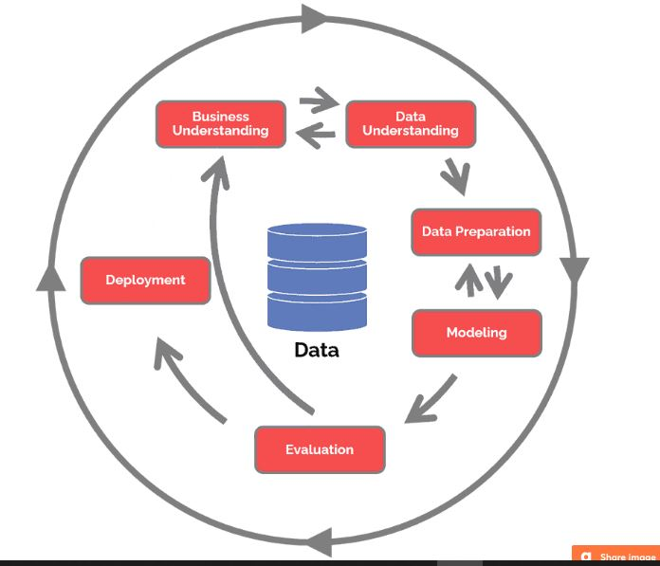
Crisp-DM
CRoss
Industry
Standard
Process for
Data
Mining

Slide 17
Data Science Life Cycle
Business Understanding What does the business need?
Data Understanding What data do we have / need? Is it clean?
Data preparation How do we organize the data for modeling?
Modeling
What modeling techniques should we apply?
Evaluation
Which model best meets the business objectives?
Deployment
How do stakeholders access the results?

Slide 18
The end project: Your Capstone
Showcases what you have covered over this 12-week period
15 – 20 minutes in length
You need to come up with a topic
Clean it and analyze it to get your answer
Create a question with that topic
Locate raw data on that topic
Create your story!

Slide 19

Excel & Data Analytics

Slide 20
What is Excel?
A program by Microsoft that is used for recording, analyzing and visualizing data in the form of a spreadsheet.

Slide 21
Why Excel?
- Perform various math functions on large data sets
- You can search, sort, filter; makes it easier to clean
- Beautify data and present with charts & tables
- Reporting, accounting & analysis is easier
- Provides security

Slide 22
Excel is HUGE
LET’S PLAY

Slide 23
Functions
AND
AND USING IF
=AND([logical1], [logical2], ...)
If a number is greater than or smaller than another number or is equal to something.
Produces “True” or “False”
=IF(logical_test, [value_if_true], [value_if_false])
Produces whatever outcome you need it to read if you don’t want “True” or “False”

Slide 24
=AVERAGEIFS(C27:C38, B27:B38, F28, D27:D38,G28)
AVERAGEIF
AVERAGEIFS
Combine averages from different cells
=AVERAGEIF(range, criteria, [average_range])
Calculates the average of a range based on one or more true/false conditions
=AVERAGEIFS(average_range, criteria_range1, criteria1, ...)

Slide 25
Functions
COUNT
COUNTA
Calculates number of cells used within a range that have numbers
=COUNT(value1:value2)
Calculates number of cells used within a range that have both numbers and letters
=COUNTA(value1:value2)

Slide 26
Functions
COUNTBLANK
COUNTIF
Calculates number of cells used within a range that are blank
=COUNTBLANK(value1:value2)
Calculates number of cells as specified
Have to use a $ for absolute values to be counted
=COUNTA($value$1:$value$2,criteria)

Slide 27
Functions
COUNTIFS
Counts cells in a range based on one or more true or false conditions
=COUNTIFS(criteria_range1, criteria1, [criteria_range2, criteria2], ...)

Slide 28
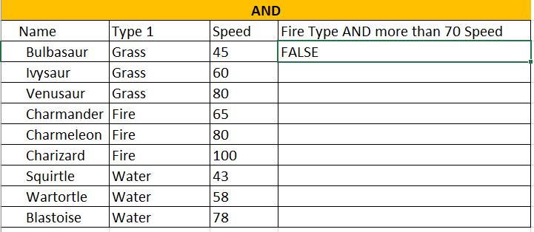
Reading a function in Excel
=AND(B3=“Fire”,C3>70)

Slide 29
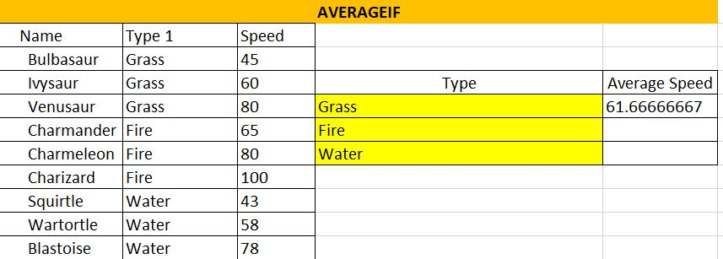
Reading a function in Excel
=AVERAGEIF(B15:B23,D17,C15:C23)

Slide 30
Functions
IF (EQUAL TO)
Returns values based on a true or false condition
Click on D105
=IF(B105="Grass", "Yes", "No")

Slide 31
Functions
IF (GREATER THAN)
IFS
Counts cells in a range based on one or more true or false conditions
I105
=IF(H105>500, "Yes", "No")
Returns values based on one or more true/false conditions
D117
=IFS(C117>90,"Fast",C117>50,"Normal",C117<=50,"Slow")

Slide 32
Functions
MEDIAN
MODE
Returns the middle value in the data
=MEDIAN(F117:K117)
Used to find the number seen most times.
=MODE.SNGL(B129:E134)

Slide 33
Functions
OR WITH IF
OR
Let's you check multiple conditions for the if function
=IF(OR(H140="water",C140>60),"Yes","No")
Returns true/false based on two or more conditions.
=OR(B140="Water",C140>60)

Slide 34
Functions
STDEV.P
STDEV.S
Calculates the Standard Deviation for the entire population
=STDEV.P(D152:D173)
Measures how far a ‘typical’ observations is from the average of the data.
*Ignores cells with text and logic
Calculates the Standard Deviation for a sample
=STDEV.S(L152:L171)

Slide 35
Functions
SUMIF
SUMIFS
Calculates the sum of values in a range based on true/false conditions.
=SUMIF(C177:C185,F178,D177:D185)
Calculate the sum of a range based on one or more true/false condition
=SUMIFS($D$189:$D$201,$C$189:$C$201,G189,$E$189:$E$201,H189)

Slide 36
Functions
VLOOKUP
XOR
Allows searches across columns
=VLOOKUP(G207,A205:E226,2,1)
Returns true/false based on two or more conditions
=XOR(B231="fire",C231<60)

Slide 37
Charts & Pivot Tables

Slide 38
Charts
Compare information inside of your data
Once your data is filled out
- highlight the information you want to use
- Click Insert in the ribbon
-Bring up chart options
- Pick the one you want
Go to the Loans Tab on Excel Spreadsheet

Slide 39
Pivot Tables
A summary of a large dataset that usually includes the total figures, average, minimum, maximum, etc.
Once you bring up your spreadsheet
- Click on pivot table
- dataset should already be selected
- Select “new worksheet”
- Choose the values that you want
- Analyze your data
Open Up Sales Spreadsheet

Slide 40
Sales Exercise
- Select Insert
- Select PivotChart
- Table/Range should be picked already
- Select: CompanyName, ProductName, UnitPrice, Quantity and SubTotal
- Select the Row Labels drop down, remove the “select all” tick, select Ana Trujiullo, press ok

Slide 41
Sales Exercise
- Go back to Insert and choose pivot table
- Make sure table is selected
- Choose FirstName
- Choose CompanyName
- Choose SubTotal and drag to values
- Select recommended Charts

Slide 42
Keyboard Shortcuts
WINDOWS
SHORTCUTS
CTRL + Z undo
CTRL + W close
CTRL + A Select all
ALT + TAB Switch apps
ALT + F4 Close apps
WIN + D Show/Hide Desktop
CTRL + X Cut
CTRL + C Copy
CTRL + V Paste
WIN + L/R Arrow compare windows
WIN + up/down arrow
WIN + double up/down
ESC
WIN + PrtScn save screenshot
Shift + arrows highlight text
CTRL + B/I/U customize font

Slide 43
Keyboard Shortcuts
Command + C = Copy
Command + X = cut
Command + V = paste
Control+Command+F: Fullscreen
Command + Mission Control = desktop
MAC SHORTCUTS

