Slide 1
User storys
1. “As a user, I want to be able to log out of the system securely and efficiently in order to protect my privacy and ensure the security of my information”
2. As a user, I want to be able to create customer accounts so that I can manage and keep track of my customers effectively.
3. As a user, I want quotes to have an automatic numbering system that can be modified so that I can keep track of my quotes efficiently and make changes as needed
4. As a user, I want the dashboard to display a graph that summarizes the total values quoted for each day of the past week so that I can easily track and understand my performance.
Requirments
1. “A user must be able to log out”
2. "A user must be able to modify accounts."
3. Quotes must contain an automatic numbering system that is modifiable
4. The dashboard (the initial screen after logging in) must display a graph summarizing the total values quoted for each day of the past week

Slide 2
Requirements IOYNE
Item | Admin | Manag
Modify own password | X | X
Modify password of manager and administrator | X
Create user (admin, manag) | X
Assign roles | X
Block account (3 failed attempts) | X | X
Log out | X | X
Create clients and products | X | X
Modify clients and products | X | X
Read clients and products | X | X

Slide 3
TRELLO ASSIGNMENTS
https://trello.com/invite/b/yfhljg2C/ATTI55626a52b786edaf59b2664abca15e123E18D268/crm-ioyne

Slide 4
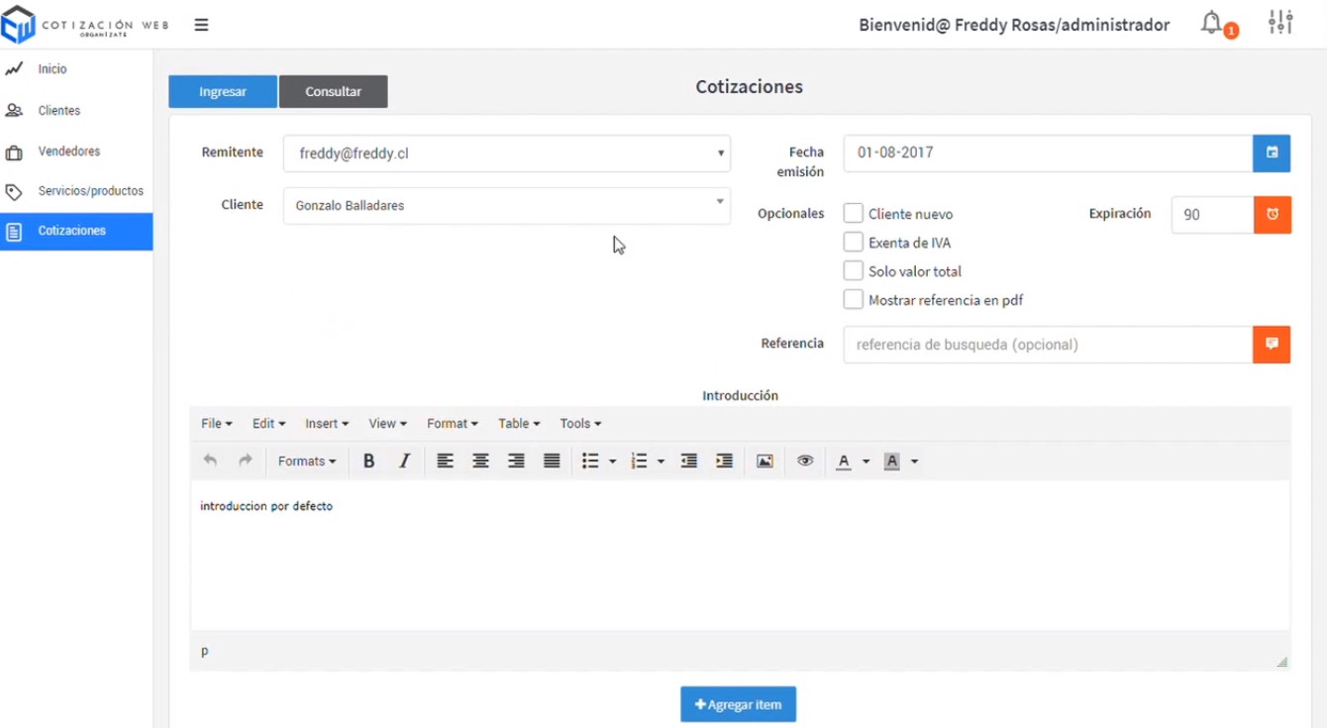
Examples
https://www.youtube.com/watch?v=G1F5zhc2PsA

Slide 5
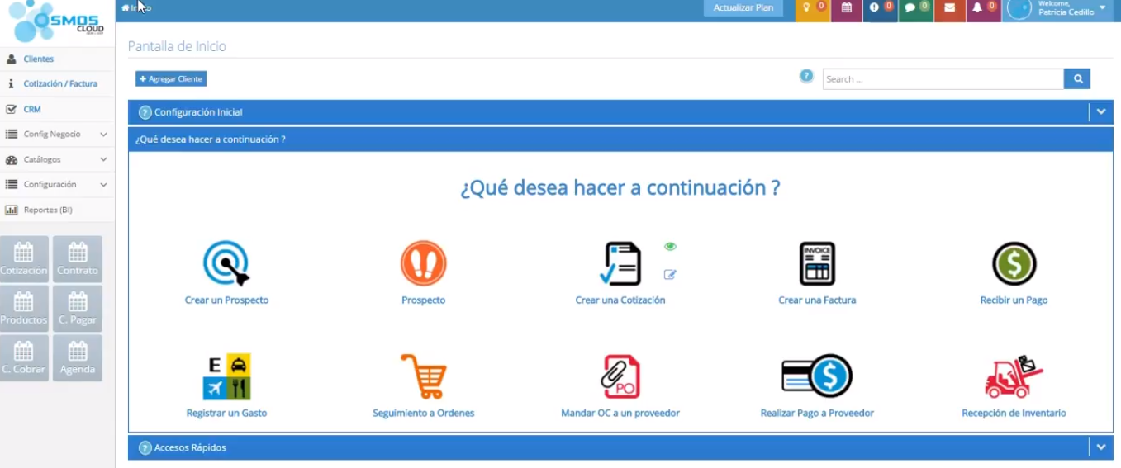
Examples
https://www.youtube.com/watch?v=ImU8pJgbemI

Slide 6
Ventas semana
IOYNE
CLIENTS
PRODUCTS
PRICE

Slide 7


FIGMA DESIGN
https://www.figma.com/file/IXb7XsnnxXMvUDWBAKUawx/CRM---DOMOTICA-APP?node-id=0%3A1&t=3w5BCOMb8pHqj9Wz-1

Slide 8
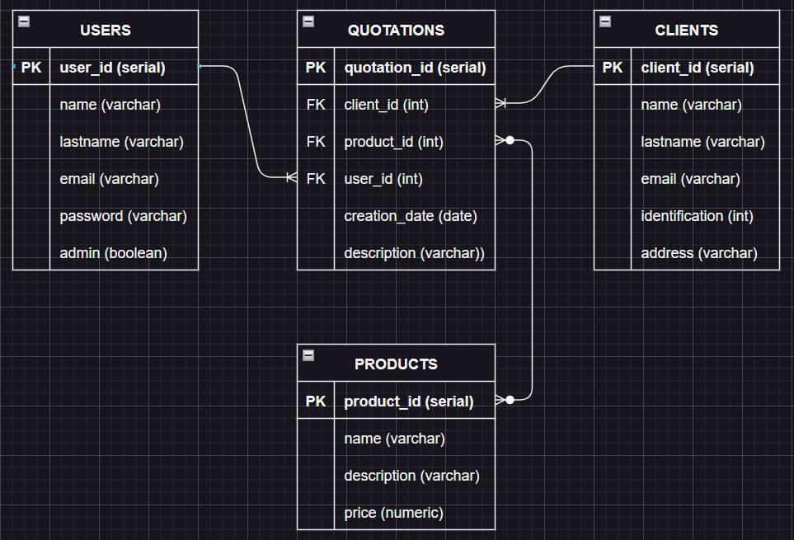
DB STRUCTURE OP1

Slide 9
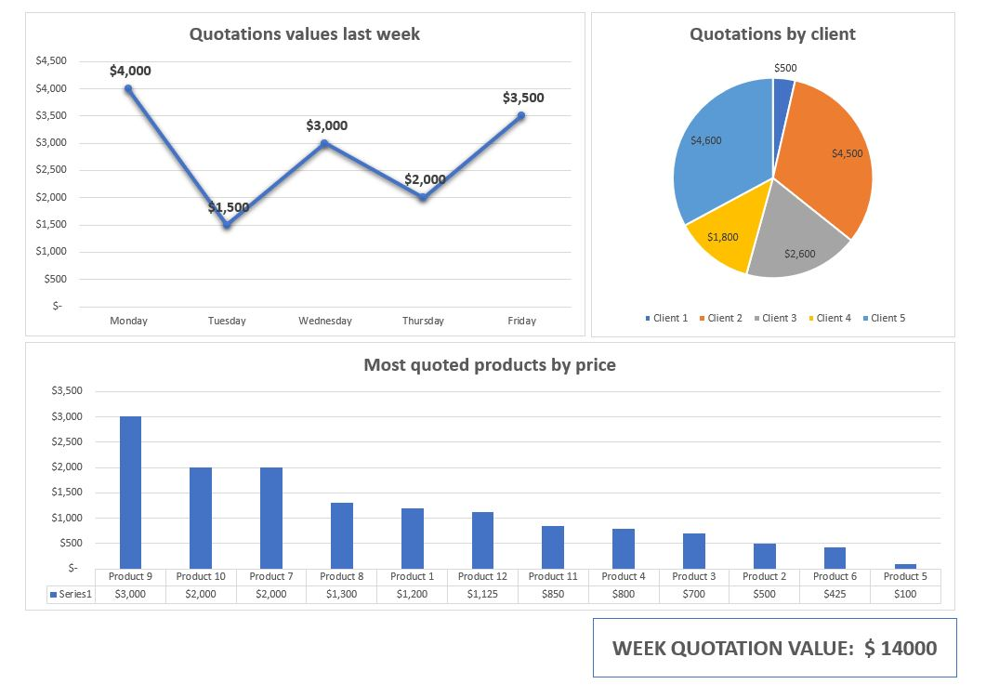

Slide 10
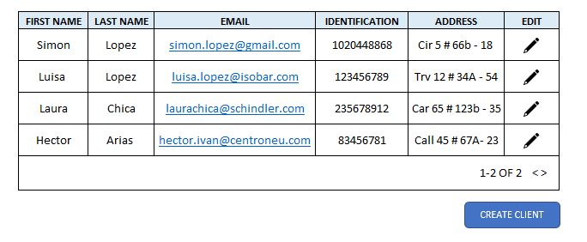

Slide 11
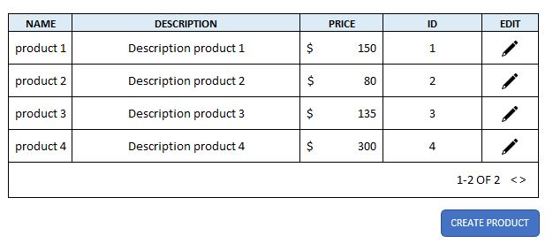

Slide 12
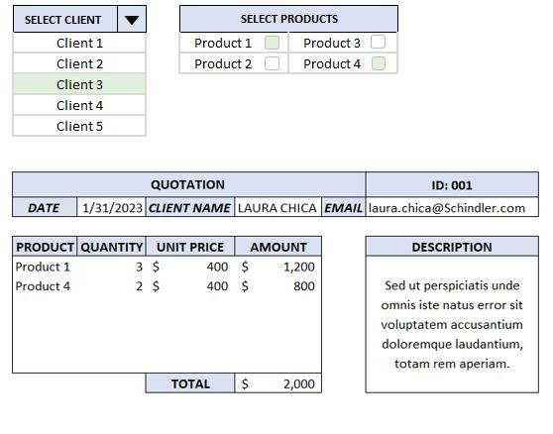

Slide 13
