Slide 1
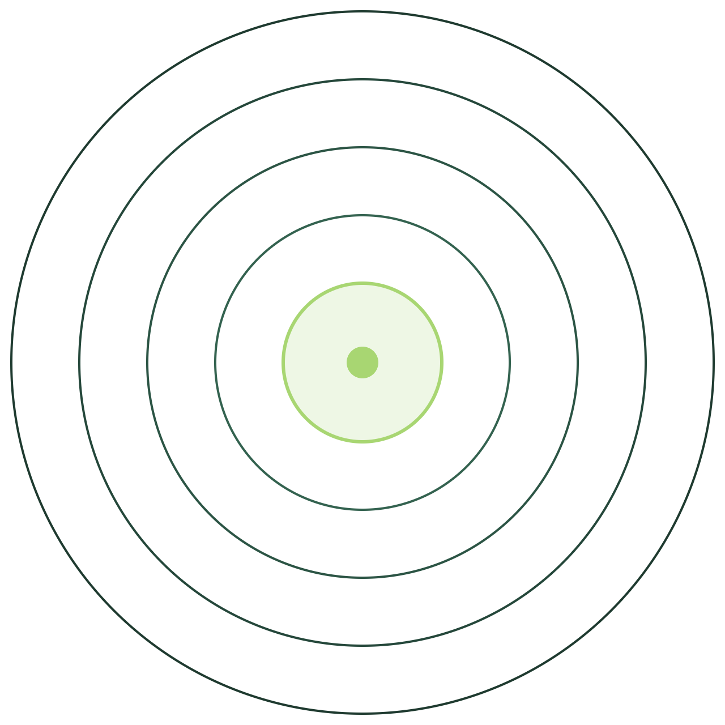
Design Patterns in Mycodo
23CSE455 DESIGN PATTERNS · CASE STUDY
TEAM B10 · AIE
Johan Rajesh
Aadarsh Jayan Nair
Dano Aby Alex
P Arya
AM.SC.U4AIE23038
AM.SC.U4AIE23003
AM.SC.U4AIE23029
AM.SC.U4AIE23140
Notes:
Introduce the team and the case study: we studied the design patterns inside Mycodo, an open-source environmental controller, and used it as an agriculture management application. The talk follows our three parts: finding the patterns, evolving the code with three farm features, and re-implementing the patterns in four languages.

Slide 2

Mycodo: a farm controller in Python
THE APPLICATION
An open-source monitoring and regulation system: a Flask web UI plus a daemon of controller threads. We use it as an agriculture manager that reads the soil, decides, and waters the crop.
Reading thread
Irrigation logic
Soil sensor
Time series
Pump
AbstractInput
InputController
InfluxDB
DaemonControl
B10 · Design Patterns in Mycodo
2
Notes:
Mycodo is a Raspberry-Pi style controller: input modules read sensors, controller threads schedule readings, values go to InfluxDB, and functions such as the bang-bang controller switch outputs like a pump. We scoped 24 files that form this irrigation path, at release v8.17.0, commit ee70a111. Walk the flow left to right: soil sensor, InputController thread, InfluxDB, the bang-bang irrigation logic, and the pump switched through DaemonControl, an RPC client to the daemon.

Slide 3
What is already inside Mycodo?
PART 1 · PATTERN DISCOVERY
8
13
18
28
pattern types
confirmed instances
concrete classes
candidates rejected (23) or uncertain (5)
A pattern counted only when the collaboration was visible in the code: who calls whom, who extends whom, at which line. A class name alone was never enough.
Notes:
Our totals at the baseline: 8 distinct pattern types, 13 independent instances, 18 concrete participant classes. Just as important are the 28 candidates we did not accept: 23 rejected, such as Singleton, Facade and Repository, and 5 uncertain, such as Observer for output triggers, where part of the collaboration sits outside our scope. Every role in every instance is mapped to a file and line range, and a script checked all 112 ranges.

Slide 4
Template Method carries the design
PATTERN INVENTORY
Template Method
6
Strategy
1
6 of 13
Command
1
instances are Template Method: a base class fixes the algorithm and each device module fills in one step.
Adapter
1
Proxy
1
Plugin
1
Layer Supertype
1
Plugin, Layer Supertype and Active Record shape the architecture around them.
Active Record
1
GoF behavioral
GoF structural
Enterprise (Fowler)
B10 · Design Patterns in Mycodo
5
Notes:
Template Method dominates with six separate collaborations: sensor measurement acquisition, module initialisation with retry, the controller thread lifecycle, output actuation, formula setpoint sampling and date/daily setpoint interpolation. Every other type has exactly one instance. Five are classic GoF patterns; Plugin, Layer Supertype and Active Record come from Fowler's enterprise patterns and describe how modules are loaded, what they inherit, and how users and roles are stored.

Slide 5



One skeleton, many sensors
HIGHLIGHT · TEMPLATE METHOD
The base class owns the algorithm; subclasses never call it in the wrong order.
AbstractInput
read() — fixed skeleton: errors, retries, storing values
get_measurement() — the one step a sensor fills in
A new sensor is one subclass; the controller does not change.
extends
extends
The same shape repeats for initialisation, thread loops, outputs and setpoints.
adafruit_i2c_soil
weather_openweathermap
soil moisture over I²C
city weather over HTTP
inputs/base_input.py:115-146
B10 · Design Patterns in Mycodo
6
Notes:
AbstractInput.read is the template method: it calls get_measurement, classifies errors and stores the values. The soil sensor and the weather module each override only get_measurement: one talks to the Adafruit Seesaw driver over I2C, the other calls OpenWeatherMap over HTTP. InputController only ever calls next or read, so a new sensor needs no controller change. The same skeleton-plus-hook shape gives us the other five Template Method instances.

Slide 6


Swappable schedules, hidden network
HIGHLIGHTS · STRATEGY AND PROXY
STRATEGY
PROXY
Setpoint Schedule Calculation
Daemon RPC Client
Pick the algorithm by type; callers only ask for the setpoint.
Looks like the daemon; every call travels over Pyro5 RPC.
type = 'DailySine'
bang_bang.loop()
create_method_handler()
DaemonControl.output_on()
DailySineMethod.calculate_setpoint()
Pyro5 Proxy → daemon process
B10 · Design Patterns in Mycodo
7
Notes:
Strategy: the setpoint schedules (Date, Daily, DailySine, DailyBezier, Duration, Cascade) all answer calculate_setpoint; create_method_handler picks one by its type name, and CascadeMethod even combines other strategies through the same interface. Proxy: DaemonControl has the same methods as the daemon, but each call is forwarded through a Pyro5 proxy to another process, so modules like the bang-bang controller never see network code. Two more instances complete the set: Command for automation actions and Adapter for sensor drivers.

Slide 7
Three features a farmer would ask for
PART 2 · EVOLUTION AND REFACTORING
CH01
CH02
CH03
Crop types
Irrigation strategies
Sensor alerts
Choose tomato, rice or wheat; the target moisture comes from the crop.
Water only in time windows, skip when it rains, and stack the rules.
Warn when the soil is critically dry or the sensor goes silent.
Switch Statements → Replace Conditional with Polymorphism
Duplicated Code → Extract Method
Long Method → Extract Method
utils/crop_profiles.py
utils/irrigation_strategies.py
utils/sensor_alerts.py
Notes:
Part 2 grows the application the way a real farm would need. CH01 lets the farmer pick a crop instead of typing raw setpoints. CH02 adds irrigation policies: only water inside time windows, skip while it is raining, and combine the two. CH03 raises alerts when the soil is critically dry or the sensor stops reporting. Each change also fixes a real code smell first, shown in green: duplicated band calculations, a switch on the direction string, and an over-long loop method.

Slide 8


Irrigation policies become objects
CH02 · STRATEGY + DECORATOR
IrrigationStrategy
decide(ctx) → pump on, off or no change
RaiseHysteresisStrategy
LowerHysteresisStrategy
TimeWindowStrategy
RainSkipStrategy
strategy · water when dry
strategy · drain when wet
decorator · only in HH:MM windows
decorator · skip while raining
Decorators wrap any strategy and stack
loop() complexity after refactoring
RainSkip(TimeWindow(RaiseHysteresis()))
CCN 14 → 7
B10 · Design Patterns in Mycodo
10
Notes:
Before CH02, loop() switched on the direction string with two mirrored if-branches. We replaced that conditional with polymorphism: RaiseHysteresisStrategy and LowerHysteresisStrategy implement decide, and loop just asks self.strategy. The new policies are decorators: they extend IrrigationRestriction, hold an inner strategy, and only add their rule, so they can wrap either direction and wrap each other. That is two new pattern instances, Strategy and Decorator. Invalid configuration falls back to plain hysteresis, so a crop is never left unwatered.

Slide 9



Readings turn into alerts
CH03 · OBSERVER
LogAlertListener
bang_bang.loop()
always attached
SensorAlertNotifier
detects a missing reading or critically dry soil
subject: attach · detach · raise_alert · clear
EmailAlertListener
when recipients are set
Once per episode; recovery re-arms it
A failing listener never stops irrigation
Also fixes a crash on empty readings
B10 · Design Patterns in Mycodo
11
Notes:
CH03 first shortened loop() with Extract Method, pulling out the period check, the reading and the missing-measurement handling. The feature is a classic Observer: SensorAlertNotifier is the subject with attach and detach; listeners implement on_alert. The log listener is always attached, the e-mail listener only when recipients are configured, and it uses Mycodo's existing send_email path. Alerts fire once per episode and re-arm when the reading recovers. Errors in one listener are caught so they never stop the irrigation loop. The new reading helper also fixed a real baseline crash when the database returned an empty result.

Slide 10
EVOLUTION RESULTS
Snapshot | Types | Instances | Concrete classes | New patterns | Tests
Original code | 8 | 13 | 18 | none | 25
After CH01 | 8 | 13 | 18 | none | 42
After CH02 | 9 | 15 | 22 | Strategy, Decorator | 64
After CH03 | 10 | 16 | 24 | Observer | 83
B10 · Design Patterns in Mycodo
12
Notes:
Pattern counts per snapshot: CH01 changed no pattern counts, CH02 added Strategy and Decorator, CH03 added Observer, giving 16 instances of 10 types. No original instance was removed or replaced; two were marked modified because their participating code changed. The irrigation loop dropped from cyclomatic complexity 14 to 5. Lines of code grew by about ten percent, but that is three small new modules; more or fewer lines alone does not prove a better design, which is why we also report complexity and tests. Metrics are lizard 1.24.1 on the same 24 scope files plus the new modules.

Slide 11
One problem per pattern, four languages
PART 3 · CROSS-LANGUAGE COMPARISON
8
×
4
=
32
32/32
patterns
languages
programs
test runners pass
Java · OpenJDK 21
Python · 3.12
JavaScript · Node 23
C++14 · g++ 6.3
Each language reads the same CSV of 9–12 cases, including error cases, so every implementation is judged on identical inputs and expected outputs.
Notes:
For each of the 8 confirmed pattern types we picked one representative instance, mostly the one that is pure logic, and rebuilt its small problem in Java, Python, JavaScript and C++, standard library only. A shared specification and a shared CSV of test cases mean every language is tested on exactly the same inputs. All 32 test runners pass. Next we compare their size, complexity and run time.

Slide 12
STATIC MEASURES
Mean source lines per production file (8 patterns)
Python
62
BIGGEST GAP: PROXY
60
111
JavaScript
76
Java
98
Python
Java
__getattr__ and the JavaScript Proxy object forward any call; Java and C++ must declare and repeat every method of the interface.
C++
102
dynamic typing
static typing
Highest function complexity per file stays close: Python 6–19 · JavaScript 5–22 · Java 7–23 · C++ 7–25.
B10 · Design Patterns in Mycodo
14
Notes:
Averaged over the eight patterns, the dynamically typed languages need fewer lines: Python 62 and JavaScript 76, against Java 98 and C++ 102. The extra lines are declarations: interfaces, types and constructors. The highest function complexity in each file stays within a few points across languages, so static typing costs size, not logic. The largest gap is the Proxy: Python's __getattr__ and JavaScript's Proxy object forward any method automatically, while Java and C++ must spell out every forwarded method. Larger complexity differences come from library gaps, for example hand-written date parsing in JavaScript and C++.

Slide 13



LLMs drafted, we verified
LLM USE AND VERIFICATION
Each member ran all three parts with their own prompt
112/112
115 tests
Prompts, inputs and raw outputs kept in every llm/ folder
Part 1 line ranges checked by script
83 Part 2 + 32 Part 3, re-run after every change
Every claim graded in llm.csv: correct, partial or cannot confirm
Rebuilt
Fixed
result CSVs regenerated from raw tool output
mislabelled totals, a lizard pass that skipped .hpp files
B10 · Design Patterns in Mycodo
16
Notes:
We used an LLM for drafting, never as the final authority. Each of us ran every part with our own prompt; the exact prompts, inputs and raw outputs are kept in each part's llm folder, and llm.csv grades every output. Verification was mechanical where possible: a script checked all 112 Part 1 line ranges, the evolution and cross-language CSVs are regenerated from raw lizard, test and timing output, and all 83 plus 32 tests were re-run after the final changes. Real corrections we made include mislabelled sub-totals in Part 1 and a lizard run that silently skipped the C++ header files.

Slide 14
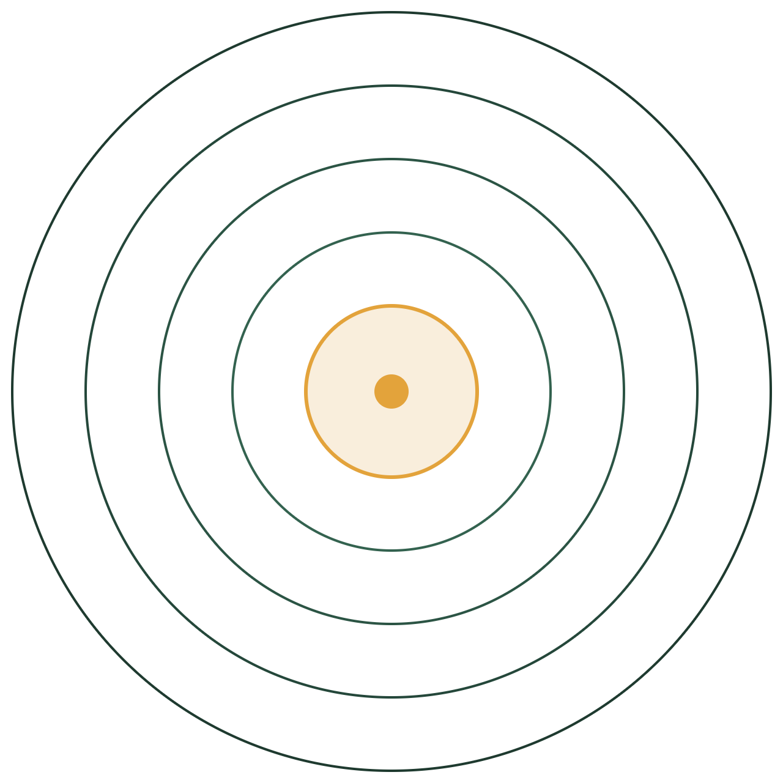
Thank you
TEAM B10 · DESIGN PATTERNS IN MYCODO
Questions?
Report, data and code
github.com/aswathymohan-amrita/23CSE455_DP_CaseStudy · B10/
Johan Rajesh · Aadarsh Jayan Nair · Dano Aby Alex · P Arya
Notes:
Thank the audience and invite questions. Everything shown is in the B10 folder of the course repository: the report, the pattern CSVs, the Part 2 code with its commits as patches, the 32 Part 3 implementations, and every test log and LLM record.

