Slide 1
Landing Gear System
UPPAAL
Ciprian Teodorov

Slide 2
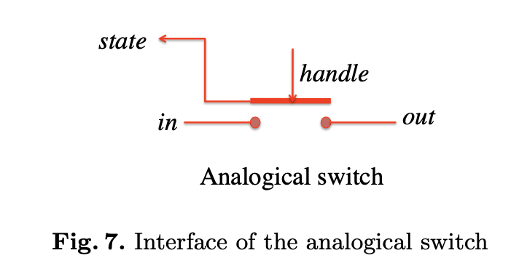
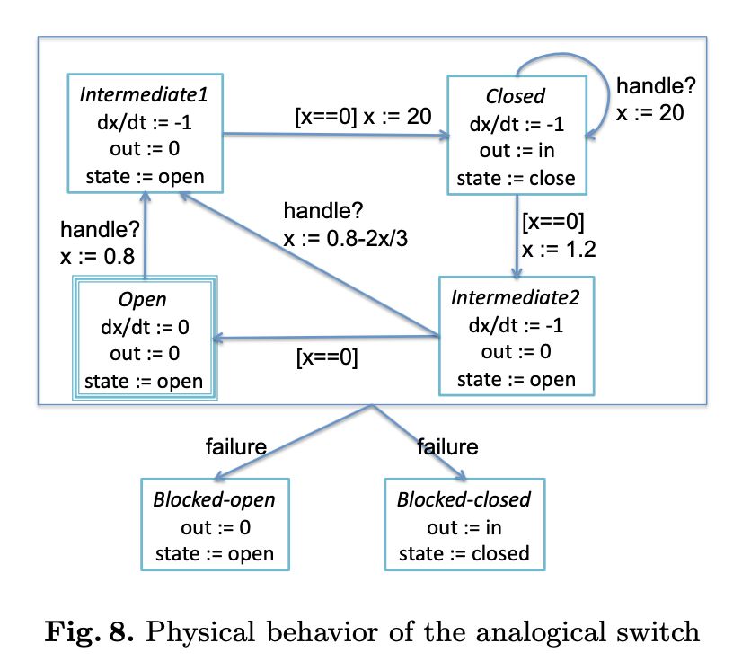
Analog Switch
The aim of this switch is to protect the system against abnormal behavior of the digital part. In order to prevent inadvertent order to the electro-valves, the general electro-valve can be stimulated only if this switch is closed. The switch is closed each time the “Up/Down” handle is moved by the pilot, and it remains closed 20 seconds. After this duration, the switch automatically becomes open. In the closed position, the switch transmits the electrical order from the digital part to the general electro-valve. In the open position, no electrical order is sent to the electro-valve. In that case, the oil pressure in the hydraulic circuit becomes down.
Because of inertial reasons, the transition from the two states closed and open takes a given amount of time:
  from open to closed: 0.8 second,
  from closed to open 1.2 seconds,
In addition to this normal behavior, the analogical switch can fail. We con- sider only permanent failures: the switch remains blocked in the closed or in the open position. A failure can occur at any time.
The global behavior of the switch, including failures, is specified by the model of Figure 7 and the hierarchical hybrid automaton of Figure 8. In this specification, in stands for the input value of the switch. In the global architecture of Figure 4, the in port of the analogical switch is connected to the general EV output of the digital part (i.e., in = general EV). The variable out stands for the electrical output of the switch. It is connected to the electrical port of the general electro-valve. The variable state is the logical output of the switch. It belongs to the set {open, closed}. It is connected to the input port analogical switch of the digital part. Note that this output value is triplicated as explained in section 2.3. The event handle? stands for the detection of a movement of the pilot handle. This event is received each time the pilot moves the handle. And finally, x is an internal continuous variable that evolves according to the differential equation in each state. The aim of this variable is to count the time in each state. For instance, in the state Open, x does not evolve, state is set to open, and out is set to 0 whatever the value of in. When handle is received, x is set to 0.8, the state Intermediate1 is reached and x begins to decrease. The values of state and out remain unchanged. 0.8 seconds later, x reached the null value. The transition from Intermediate1 to Close is fired and x is set to 20. state is now set to closed and out is set to in. And so on. The initial state of the automaton is Open.
Note that the switch is independent of the digital part.

Slide 3
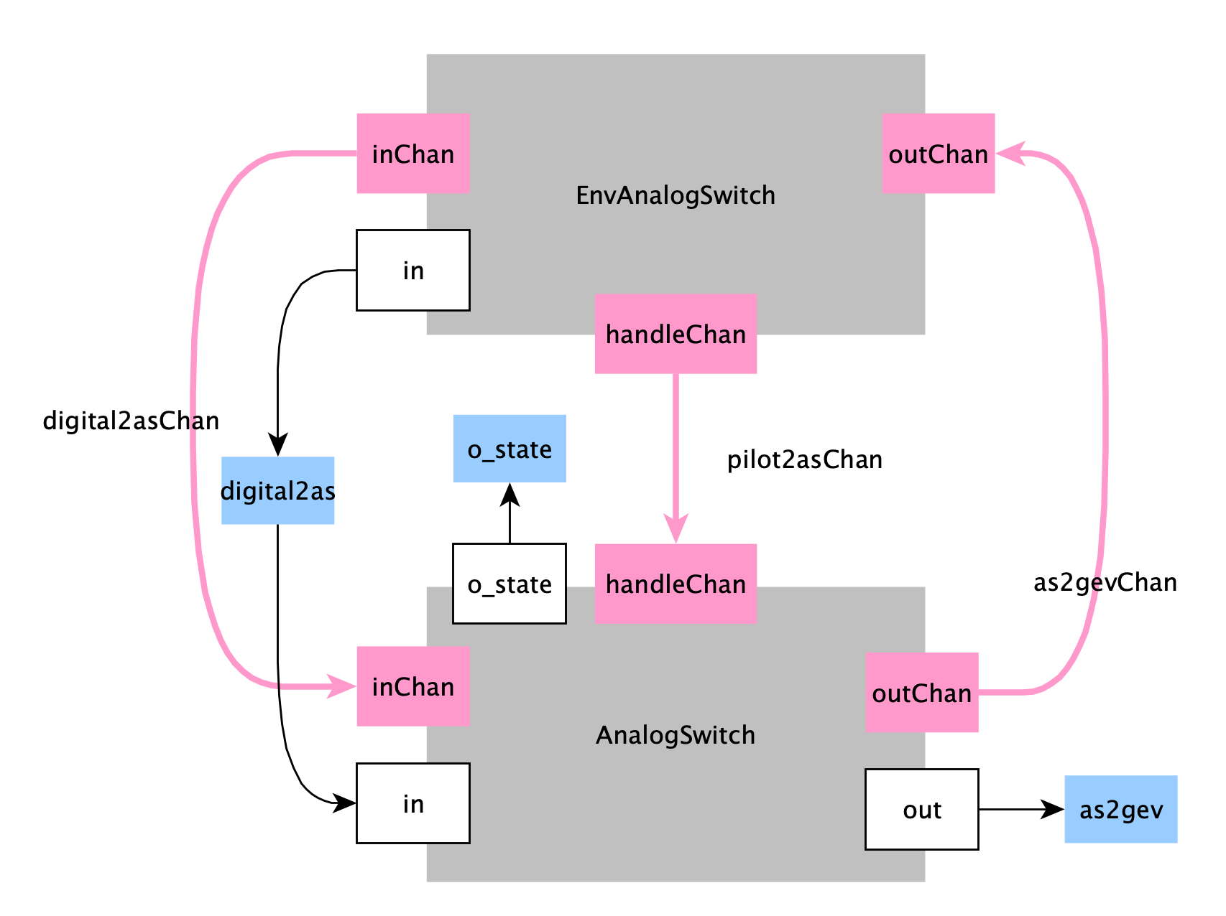
Analog Switch – No Time

Slide 4
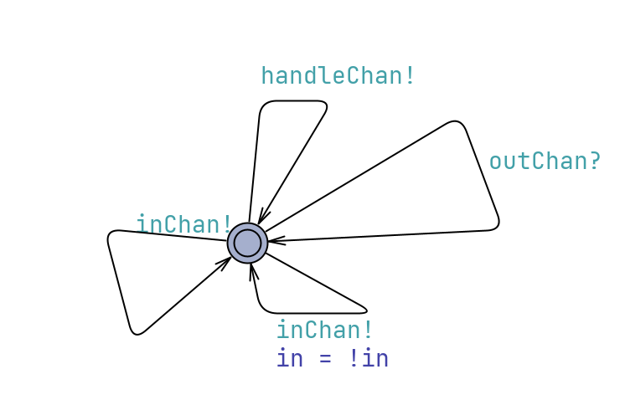
EnvAnalogSwitch

Slide 5
AnalogSwitch Parameters

Slide 6
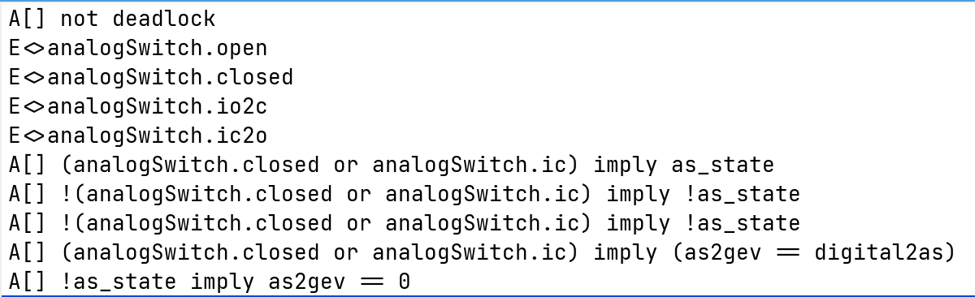
Analog Switch – No Time

Slide 7
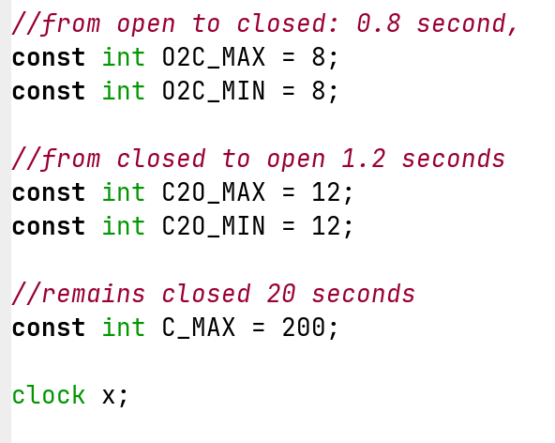
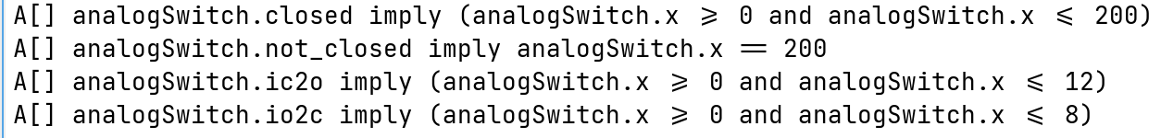
Analog Switch - Timed

