Slide 1
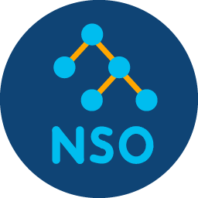
Northbound API
NSO CLI or WebUI
NETCONF, CLI, REST, …
Notes:
services-intro.png

Slide 2
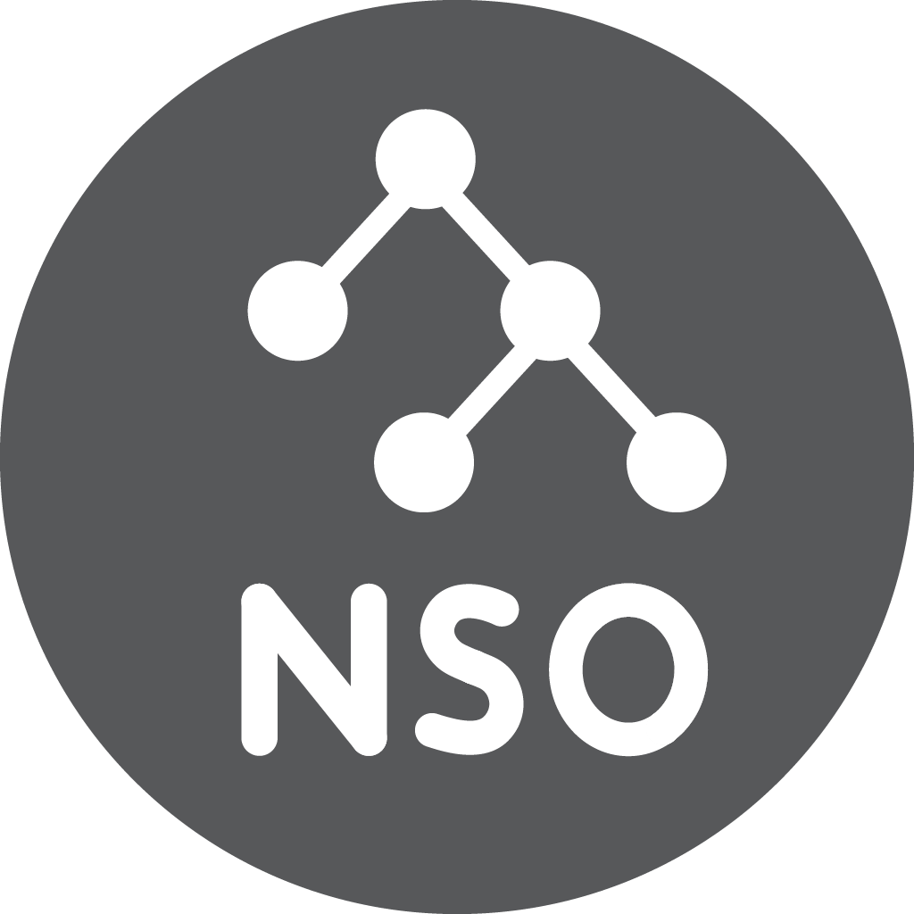
Service Request
Service YANG Model
Mapping
NED Device YANG Model
NETCONF, CLI, REST, …
Notes:
services-mapping.png

Slide 3
Sample instance
parameters
YANG model
Sample CLI input
dns-v2 [list – service]:
name [string]
target-device [string]
dns-server-ip [ip-address]
"dns-for-c2"
dns-v2 dns-for-c2
target-device c2
dns-server-ip 192.0.2.115
"c2"
192.0.2.115
XML template
Service dev. config. output
<…>
<…>{/target-device}</…>
<…>{/dns-server-ip}</…>
</…>
devices device c2 config
ip name-server 192.0.2.115
Notes:
services-template.png

Slide 4
<…>
<address>192.168.5.1</address>
<mask>255.255.255.0</mask>
</…>
Sample configuration (XML)
<…>
<address>{/ip-address}</address>
<mask>255.255.255.0</mask>
</…>
Templatized configuration (XML)
Notes:
services-extract-model.png

Slide 5
<…>
<address>192.168.5.1</address>
<mask>255.255.255.0</mask>
</…>
Sample configuration (XML)
<…>
<address>{/ip-address}</address>
<mask>255.255.255.0</mask>
</…>
Templatized configuration (XML)
ip-address [inet:ip-address type]
Definition and contraints for
parameters (YANG)
Notes:
services-extract-model2.png

Slide 6
Template-only service
Code and template service
Service model
Service model
Instance data
Mapping code
Instance data
Instance data &
additional variables
XML template
XML template
Notes:
services-code-template.png

Slide 7
Service Request
Notes:
services-multidevice.png

Slide 8
Service Request
Notes:
services-multidevice2.png

