Slide 1
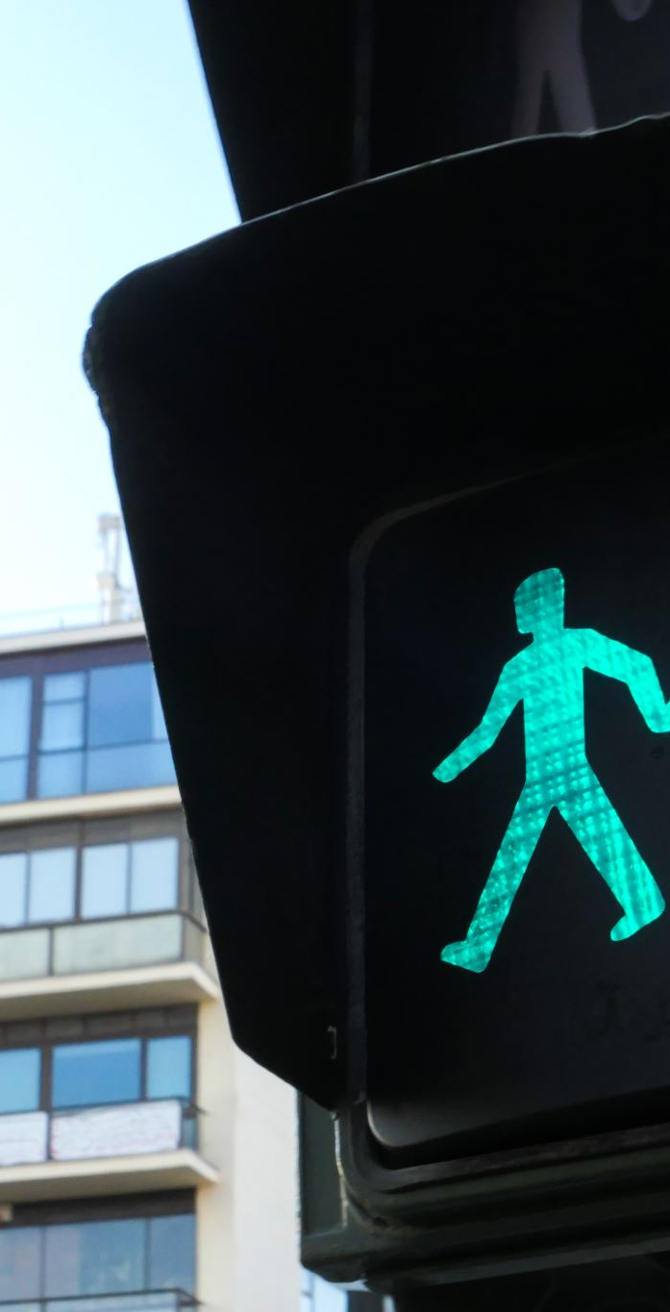
Air Quality and Traffic Volume in Auckland City Centre (2018-2023)
Capstone Project – Data Analytics
Presented by: Johana Orellana & Mohamed Eltantawi
Internal Supervisor: Dr. Harshvardhan Tiwar
External Supervisor: Louis Boamponsem
New Zealand Skills and Education College

Slide 2

Introduction
Study analyzes air quality, traffic, and pedestrian activity in Auckland CBD.
Focus on key pollutants (PM2.5, PM10, NO₂) and their trends from 2018-2023.
Uses data analytics and machine learning to uncover insights.

Slide 3
Research Questions
Why is Auckland City Centre particularly susceptible to elevated air pollution?
What are the air quality trends in Auckland City Centre?
How does traffic volume correlate with key air pollutants?
What are the pedestrian count dynamics in the city centre?

Slide 4





Methodology
Data Sources: Auckland Council environmental sensors.
Data Cleaning: including Handling missing values (forward and backward filling) & Inconsistent Data and Outliers and Detecting, Removing Duplicates.
Use of Python. Some Libraries: Numpy, Pandas, Seaborn, matplotlib
ML: Random Forest, XGBoost, LSTM, LightGB.
Visualization: Graphs, heatmaps, trend analysis.

Slide 5






Why is Auckland City Centre prone to pollution?
Street canyon effect limits air circulation, trapping pollutants.
High traffic congestion leads to increased emissions.
Economic activities contribute to pollution from businesses and transport.
Proximity to the port adds emissions from ships and cargo handling.
CBD construction projects generate dust and machinery emissions.

Slide 6
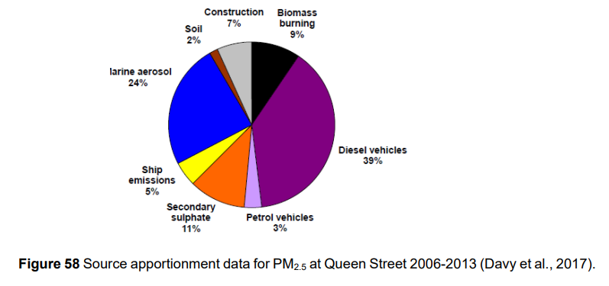
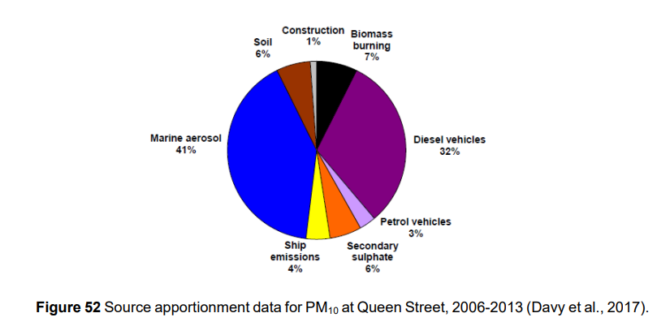

Slide 7
Air Quality Trends in Auckland CBD (2018-2023)
NO₂, PM2.5, and PM10 levels show a decreasing trend due to regulations and cleaner fuel.
Pollution peaks during winter due to heating and stagnant air conditions.
COVID-19 lockdowns caused temporary reductions in pollution levels.
Wind direction impacts pollutant concentration; SE and SW winds increase NO₂ and PM levels.

Slide 8
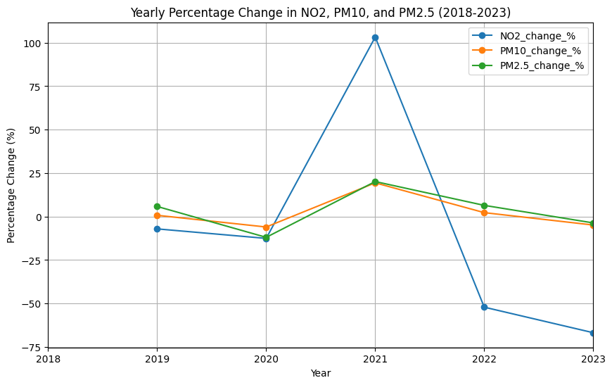
Decreasing Trends in Key Pollutants (2018-2023)
PM10, PM2.5, and NO2 levels declined due to fuel improvements, engine tech, and regulations, with a temporary spike during COVID-19 (2020-2021).

Slide 9
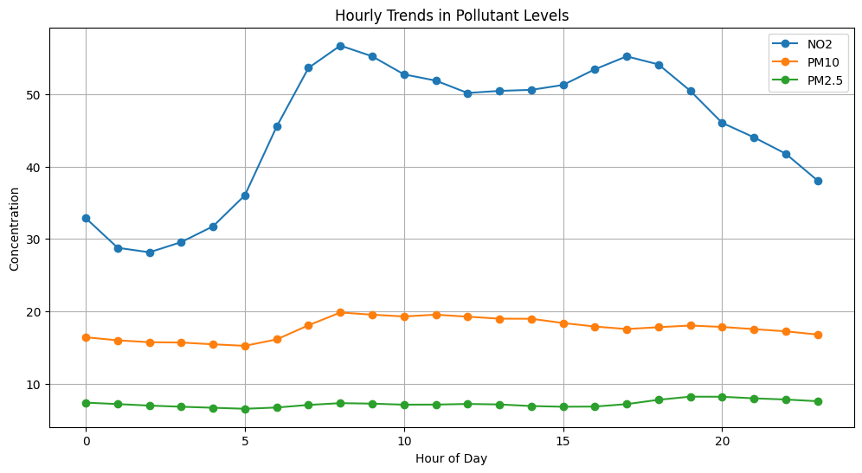
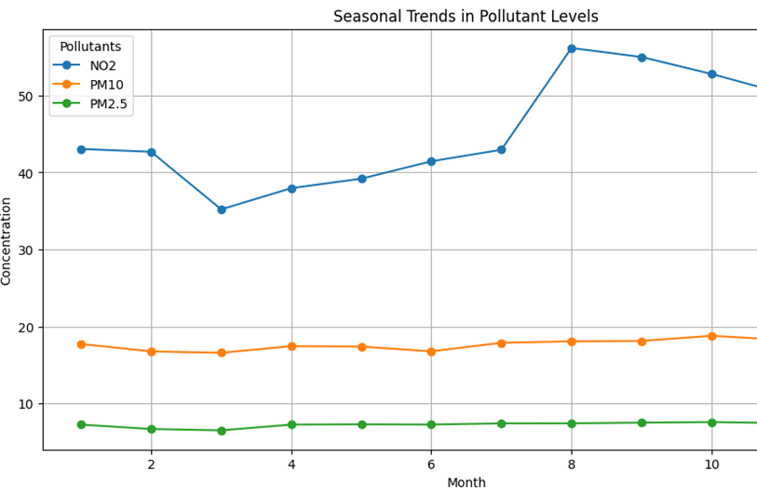
Daily Patterns of Air Pollutants
Pollutants peak during morning (7-9 am) and late afternoon (5-9 pm) traffic hours, with higher concentrations on weekdays compared to weekends.

Slide 10
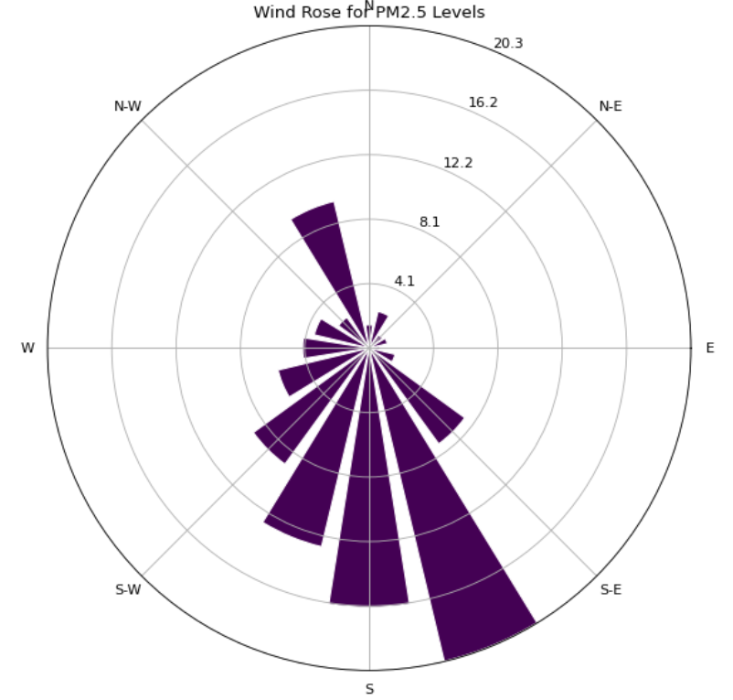
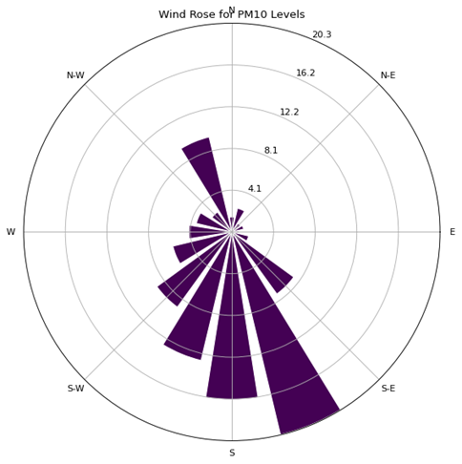
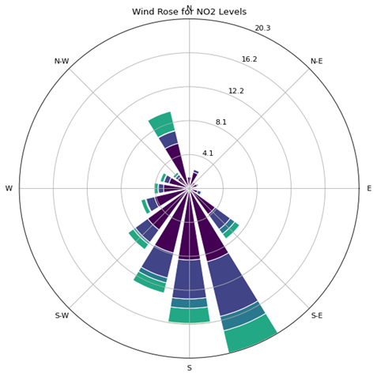
Wind Direction and Air Pollution
Pollutant levels (NO2, PM10, PM2.5) rise when wind direction ranges between SW and SE.

Slide 11
Traffic and Pollution Correlation
Strong correlation between traffic volume and PM2.5, PM10.
NO₂ levels showed weaker correlation due to industrial and meteorological influences.
Peak traffic hours (7-9 AM, 5-9 PM) coincide with increased pollution.
COVID-19 lockdowns provided evidence of reduced emissions during low traffic periods.

Slide 12
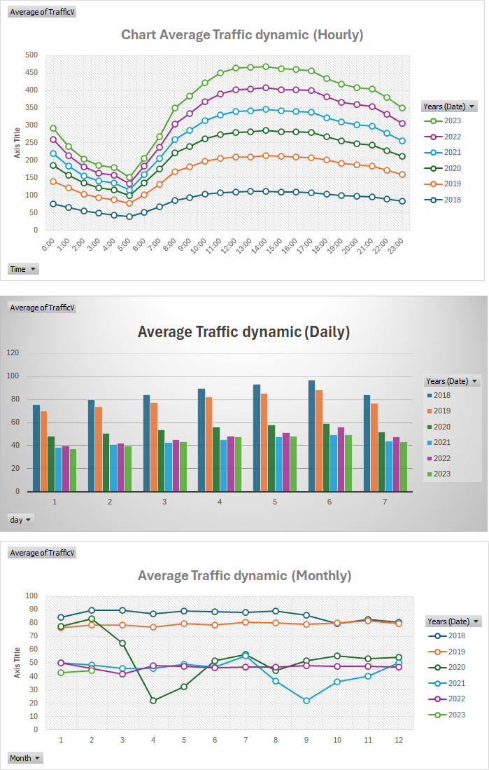
Average Traffic Volume Trends
Daily peaks at 12:00 PM, highest on Saturdays, lowest on Sundays, with sharp declines during COVID-19 lockdowns (April & September 2021).

Slide 13
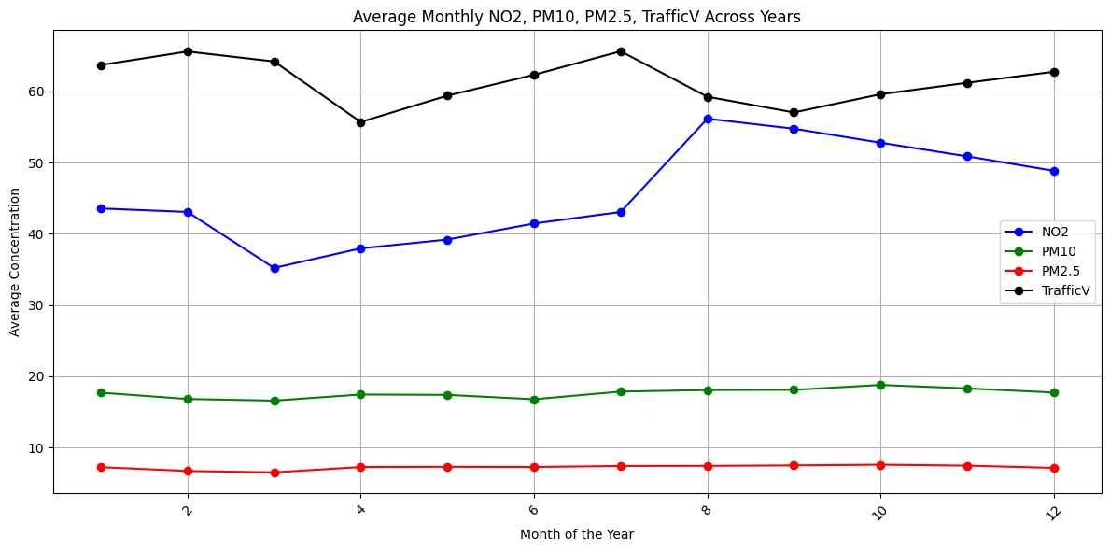
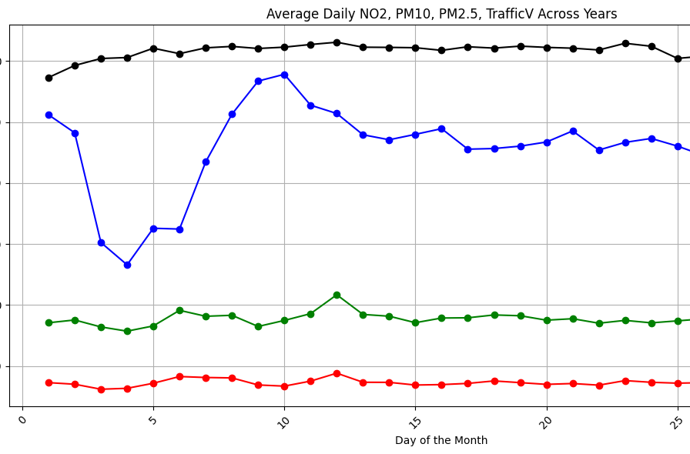
Traffic Volume and Air Pollutants Relationship
PM2.5 and PM10 correlate strongly with daily/monthly traffic, while NO2 shows weak correlation, suggesting non-traffic sources influence its levels. Hourly trends lack strong alignment with traffic peaks.

Slide 14
Pedestrian Count Dynamics in Auckland CBD
Pedestrian traffic highest on weekdays, peaking during commuting hours.
Weekend foot traffic increases on Saturdays, lowest on Sundays.
Seasonal impact: Winter has higher pedestrian activity due to indoor shopping and events.
COVID-19 led to major drops in pedestrian traffic, changing long-term trends.

Slide 15
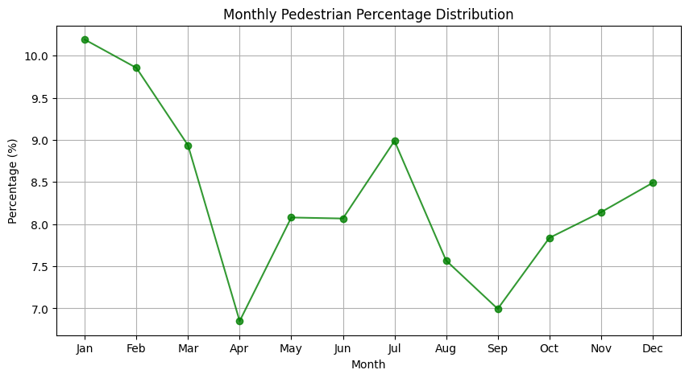
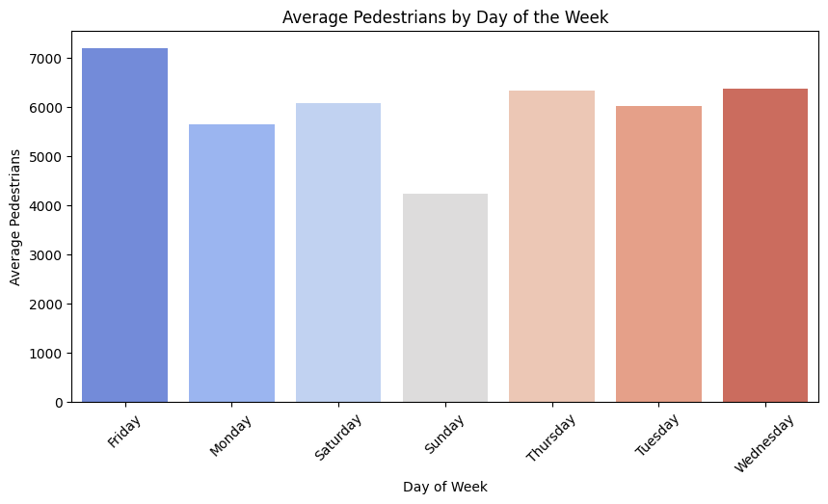
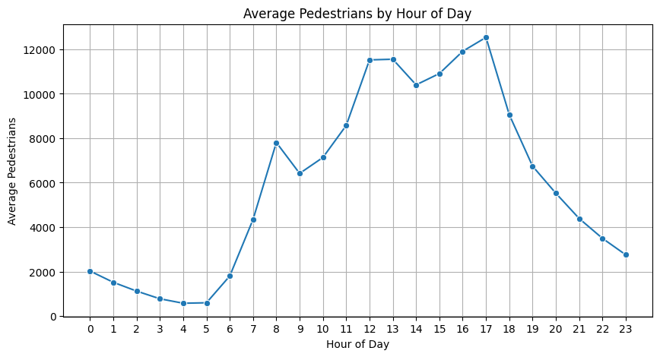

Slide 16
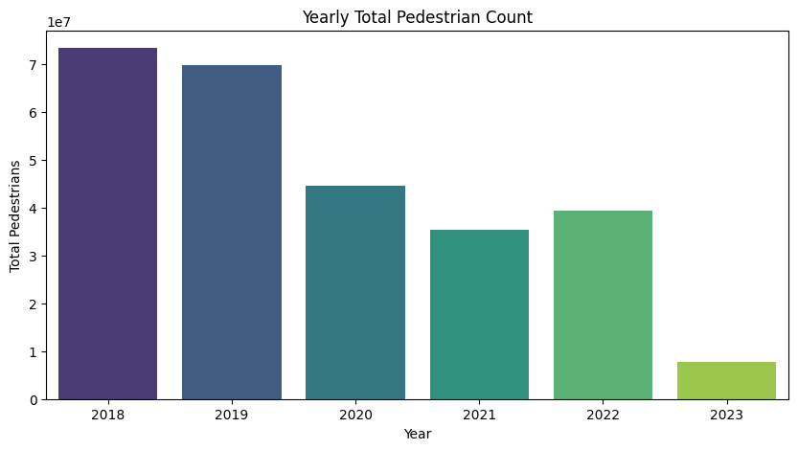
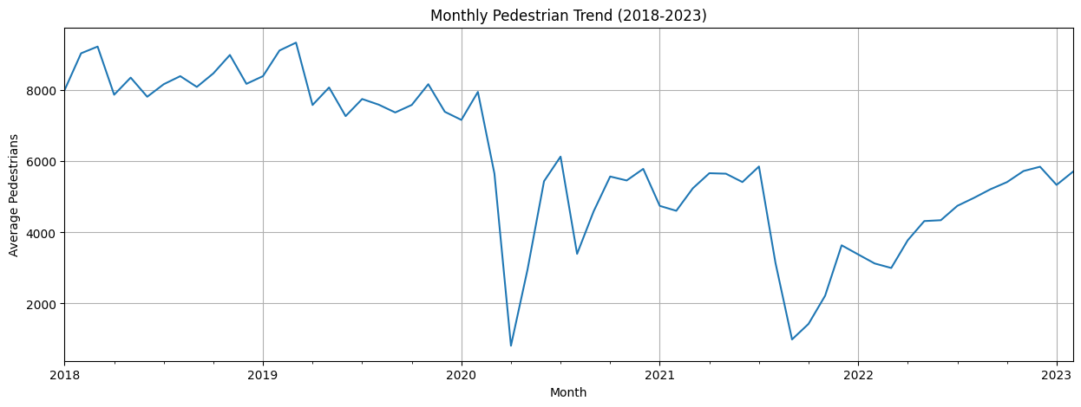

Slide 17

Machine Learning Insights
Models used: Random Forest, Optimized Random Forest, XGBoost, LSTM.
Best Performing Models:
NO₂ Prediction: R² = 0.95 (Highly accurate)
PM10 Prediction: R² = 0.815 (Good)
PM2.5 Prediction: R² = 0.883 (Strong predictive power)
Traffic Volume: R² = 0.966
Pedestrian Flow: R² = 0.980

Slide 18



Challenges & Solutions
High missing data in initial datasets – Resolved with better data selection.
Complex air pollution dynamics – Used AI models to improve accuracy.
Data security & ethics – Complied with privacy regulations.

Slide 19
Recommendations: Traffic & Pollution Control
1
2
3
4
Implement congestion pricing to reduce vehicle emissions.
Encourage public transport and cycling infrastructure.
Promote electric vehicles and low-emission zones.
Increase urban green spaces to absorb pollutants.

Slide 20




Recommendations: Pedestrian & Urban Planning
ENHANCE PEDESTRIAN-FRIENDLY INFRASTRUCTURE TO REDUCE VEHICLE DEPENDENCY.
IMPROVE REAL-TIME MONITORING OF POLLUTION FOR PUBLIC AWARENESS.
ADJUST URBAN PLANNING TO MITIGATE STREET CANYON EFFECTS.
STRENGTHEN POLICIES TO REDUCE EMISSIONS FROM CONSTRUCTION ACTIVITIES.

Slide 21



Conclusion
Air quality is improving but still fluctuates due to traffic and seasonal factors.
Strong correlation between pollution and vehicular emissions.
Predictive models provide valuable insights for urban planning.
Future research needed on post-pandemic mobility and pollution dynamics.

Slide 22

Thank You

