Slide 1


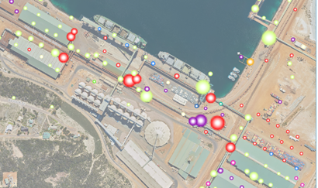
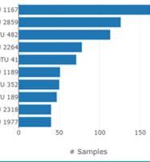
Week13,Project 2,Week14,Week 15
https://github.com/JohanfromEsperance
https://github.com/vn02063007
TOP 10 Asset List
Basemap and one overlay
Southern Ports Datafile
Use ESPERANCE
Johan
Minh
Asset 1
Asset 2
Asset 3
Asset 10
Basemap
Geograhpy Overlay
Relation Ship diagram
Clean and load to SQL version
Select Tob 10 assets
HTML – INDEX
App.js
CSV Read in, Clean
CSV - JSON
LEAFLET
CSV Manipulations
OVERLAY
MARKERS
Marker data setup
Week15
DOWNLOAD SQl DATAFILE
GOOD
Need Repair
URGENT repairs
Replace
LOAD and READ SQL link
Connect Link to HTML
Ability to download the SQL file
Week8,9,19-0, Project2
LEGEND for State data
Check downloaded file
https://johanfromesperance.github.io/Project-3-DataVisualization/

