Slide 1
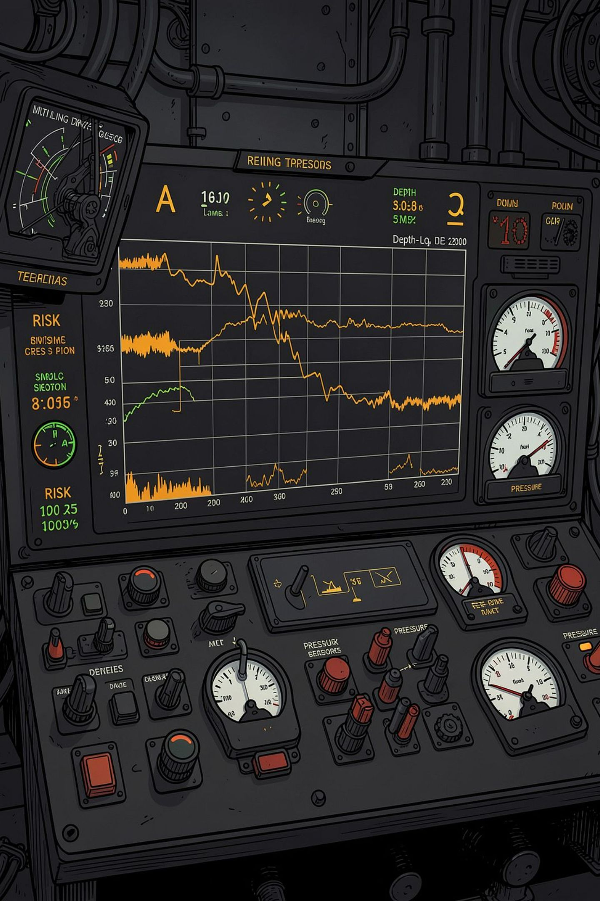
RISKLENS · DRILLING INTELLIGENCE
RiskLens for Drilling
Non-Productive Time is a real-time risk problem — not an operational afterthought. This deck is the response to your AI Implementation Engineer task.
DHANRAJ DESHMUKH · AI IMPLEMENTATION ENGINEER, OIL & GAS

Slide 2
20–25%
of all drilling time is lost to NPT — industry-wide, every year
Three failure modes account for the majority: stuck pipe, well control incidents, and lost circulation. Each one is predictable. None are being caught early enough.

Slide 3
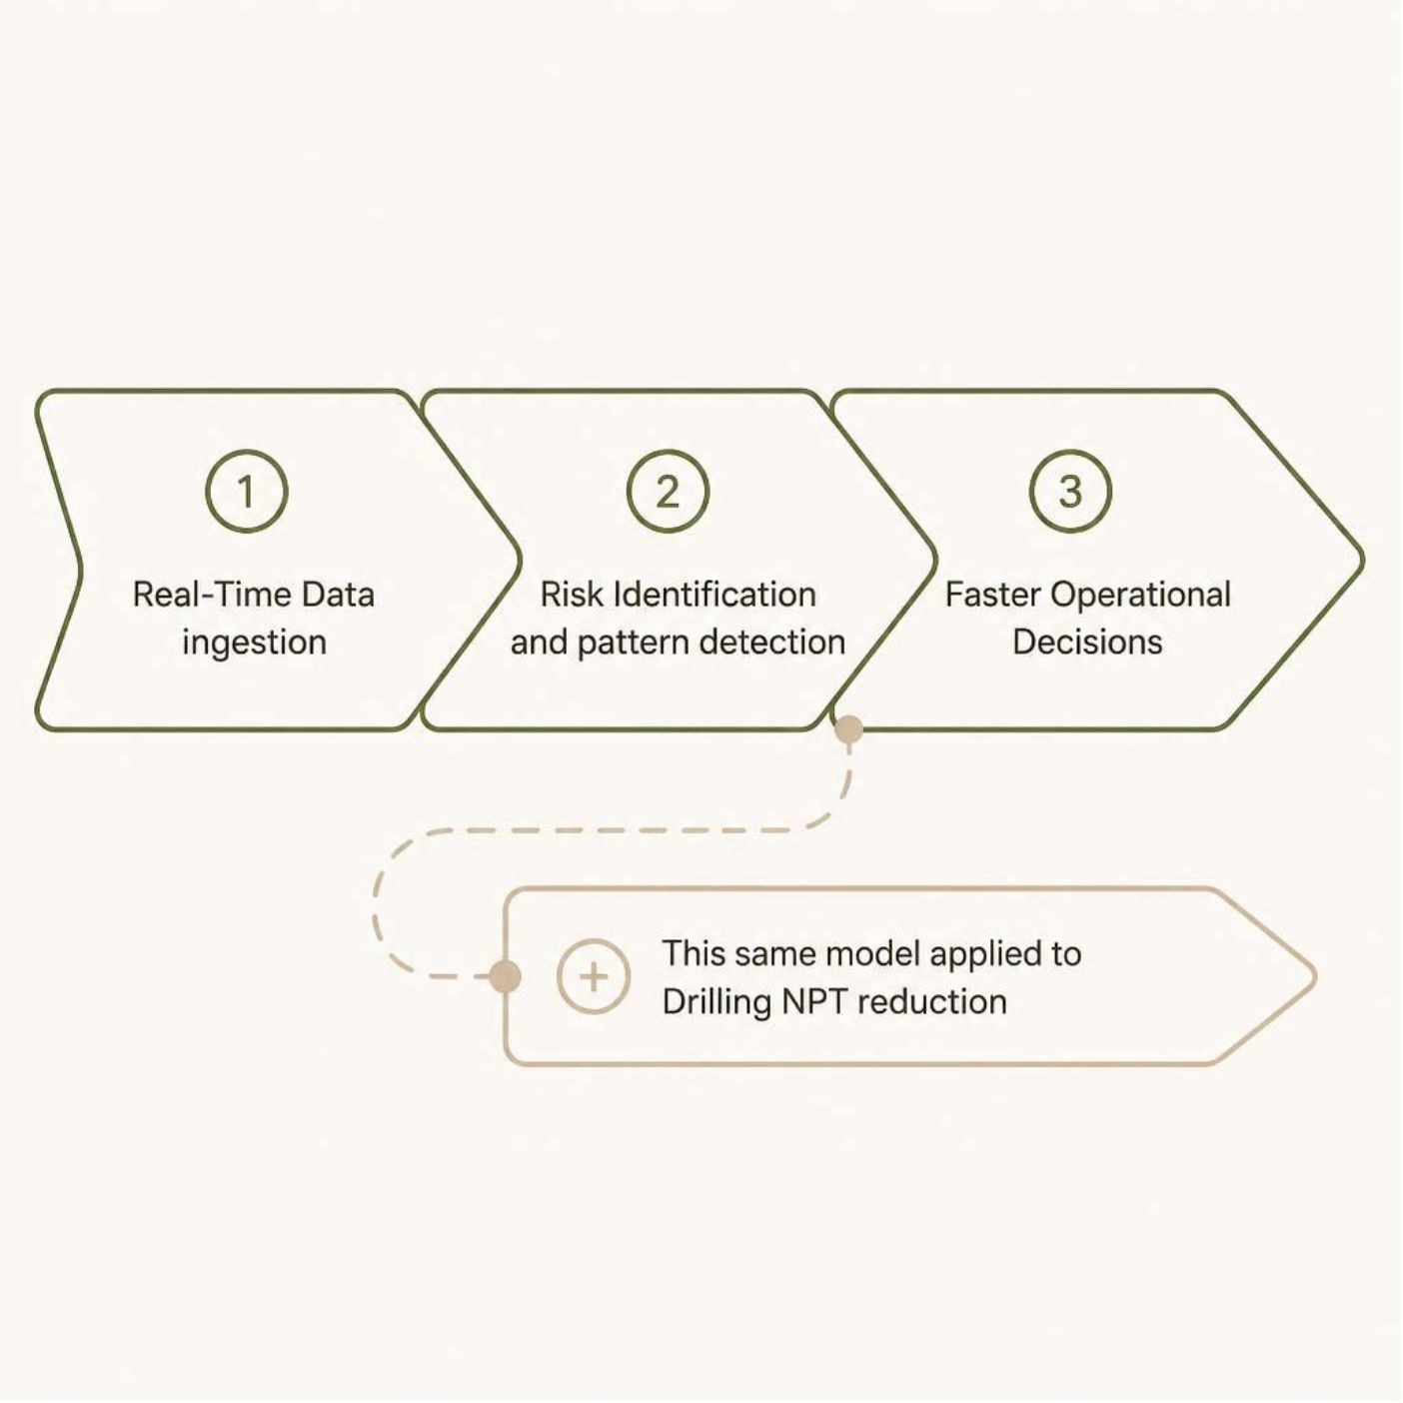

THE INSIDER MOVE
Same Model. New Vertical.
RiskLens Already Does This
Real-time data → risk identification → faster decisions. That is the core product model.
RiskLens for Drilling is not a new idea — it is the natural next vertical. The architecture is identical. The data sources are available. The use cases are proven.
This is an extension, not a pivot.

Slide 4
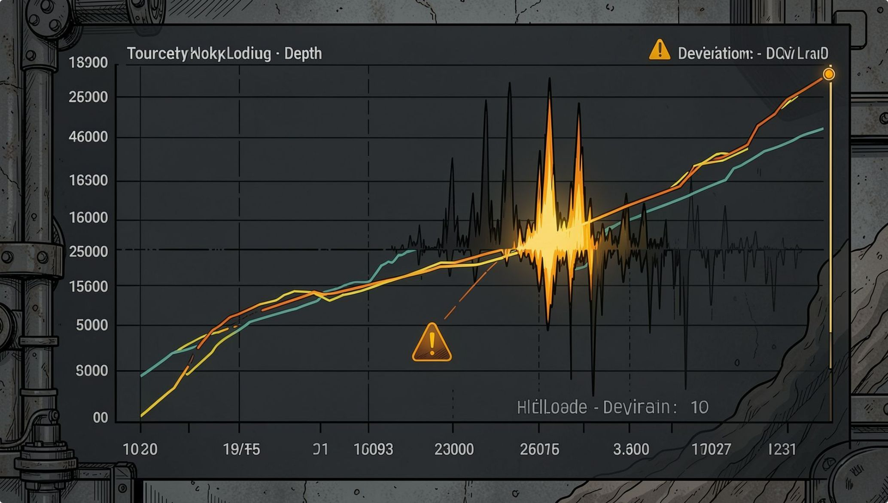
MODULE 1
Stuck-Pipe Early Warning
Mechanism
ML monitors torque, hookload, and flow-in vs. flow-out in real time. Deviations from the baseline pattern trigger an alert before the pipe sticks — not after.
Proof
Saudi Aramco deployed an ML-based stuck-pipe early-warning system, reducing NPT events significantly on horizontal wells.
Aramco Journal of Technology, 2020

Slide 5
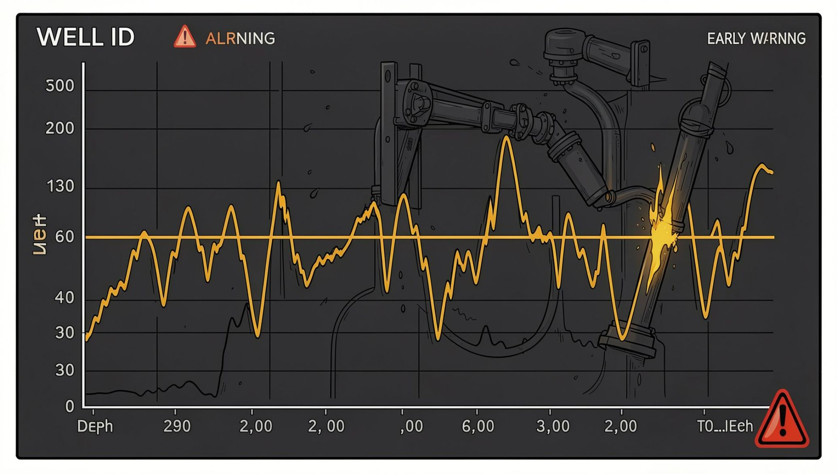
MODULE 2
Well-Control Early Warning
Mechanism
LSTM-autoencoder models detect abnormal flow and pressure signatures — catching kick influx 9.2 minutes earlier than conventional threshold alarms.
Proof
Pason Systems: ML-based alarm system detected 33 of 33 kicks early across 80,000 rig-hours — zero misses.
Petroleum Science, 2026 · Pason Systems Field Study

Slide 6
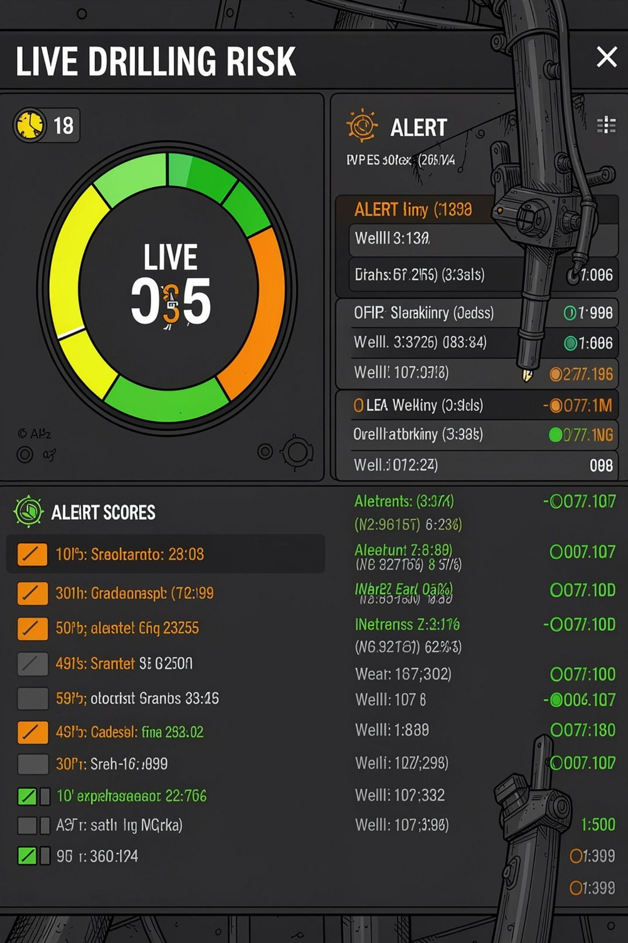
Live Risk Console
One screen. All active wells. Risk scored, prioritized, and actionable — before the driller asks.
Concept interface — illustrative

Slide 7
EVIDENCE
Not a Bet — A Pattern Already Proven
60%
9.2min
ROP Increase
Earlier Kick Detection
SLB / Equinor autonomous drilling, Peregrino C platform
LSTM-autoencoder model, Petroleum Science, 2026
33/33
weeks→hrs
Kicks Caught Early
NPT Report Review
Pason Systems ML study, 80,000 rig-hours
Provectus GenAI analytics case study, 2025

Slide 8
HONEST RISK
The Real Risk — and How We'd De-Risk It
The Risk
The De-Risk Move
Data quality gaps and driller trust in a new system. No model works on bad inputs — and no alert works if the crew ignores it.
Deploy in advisory-only mode on 1–2 rigs for 90 days. No automated actions. Pure visibility. Let the data earn trust before the system takes control.
Baseline NPT hours tracked from Day 1
Driller feedback loop built into alert tuning
Escalation to automated response only after validation

Slide 9
The Ask
A 90-day advisory-mode pilot on one rig.
Measured against baseline NPT hours. Zero automated actions. Pure risk visibility — and a clear before/after story at the end.
Dhanraj Deshmukh · AI Implementation Engineer, Oil & Gas

