Slide 1
CLARA: Cloud-Linked Evaluation and Risk Assessment using Predictive Analytics and Business Intelligence
A Unified Platform for Multi-Cloud Observability, Multi-Modal Anomaly Detection, FinOps Rightsizing, and Generative AI Operational Guidance
Manipal Institute of Technology Bengaluru — Department of Computer Science & Engineering
CSE 4191: Minor Specialization Mini Project (Data Analytics) — Final Phase Review
Date: November 3, 2026 | Academic Year: 2026–2027
Students: Johann Mathew Sajan (235890104), Nandan Murali (235890114), Abhijay Gupta (235890206), Arshia Gali (235890070)
Under the Supervision of: Dr. Geetabai S Hukkeri, Assistant Professor, Dept. of CSE, MIT Bengaluru
CLARA — Final Phase Project Review (CSE 4191) | MIT Bengaluru | Slide 1 of 18

Slide 2
Presentation Outline
Systematic Walkthrough of Problem, Methodology, Results, and Verification
• 1. Problem Statement & Motivation — The Multi-Cloud Operational Dilemma
• 2. Project Objectives & Architectural Boundaries (Advisory Decision-Support)
• 3. Literature Review & Comparative Analysis of Existing Platforms
• 4. System Architecture & Architectural Evolution from Phase 1 Proposal
• 5. Synthetic Multi-Cloud Data Generation & Embedded DuckDB Warehouse
• 6. Multi-Modal Anomaly Detection Engine (11 Features + Isolation Forest)
• 7. Explainable Security Posture & FinOps Rightsizing Engines
• 8. Composite Risk Formulation & Centralized Operational Severity Tiers
• 9. Dual-Engine GenAI Advisory Architecture (Gemini 3.8 Flash + Offline Fallback)
• 10. Presentation Layer: Interactive Multi-Page Streamlit Dashboard
• 11. Experimental Results: Confusion Matrix, Honest Recall Breakdown, and Cost Waste
• 12. Automated Test Suite, Test Isolation Architecture, and Statement Coverage
• 13. System Limitations, Ethical Governance, Future Roadmap, and Conclusion
CLARA — Final Phase Project Review (CSE 4191) | MIT Bengaluru | Slide 2 of 18

Slide 3
Problem Statement & Motivation
The Trilemma of Multi-Cloud Observability, Security Risk, and Cloud Spend
• Multi-Cloud Heterogeneity: Enterprise workloads span AWS, Azure, and GCP, resulting in fragmented dashboards, incompatible metric schemas, and isolated IAM policies.
• Alert Fatigue & Naive Thresholds: Traditional monitoring systems generate hundreds of false alarms daily, overwhelming DevOps teams while masking gradual memory leaks and low-profile brute-force activity.
• Detached FinOps: Cloud billing tools track financial overruns post-facto without correlating wasted spend to idle instances or misconfigured infrastructure.
• Ungrounded GenAI: Standard LLM chatbots hallucinate non-existent resource IDs, lack structured schemas, and fail during external API downtime.
• Core Opportunity: A unified platform that ingests multi-cloud telemetry into an embedded analytical warehouse, executes explainable ML risk scoring, and pairs structured Gemini recommendations with deterministic offline fallbacks.
CLARA — Final Phase Project Review (CSE 4191) | MIT Bengaluru | Slide 3 of 18

Slide 4
Project Objectives & Design Boundaries
Core Technical Deliverables and Human-in-the-Loop Operational Scope
• Objective 1: Multi-Cloud Telemetry Ingestion — Model 300 instances across AWS, Azure, and GCP over a 90-day window (27,000 metrics records) with 15 injected anomaly scenarios.
• Objective 2: Embedded Analytical Warehousing — Deploy DuckDB (clara.db) for in-process vectorized OLAP queries without external server daemons.
• Objective 3: Multi-Modal Anomaly Detection — Engineer 11 rolling time-series features with Isolation Forest to achieve ≥ 80% Precision and ≥ 85% Recall on isolated ground-truth data.
• Objective 4: Explainable FinOps & Security Scoring — Unsupervised K-Means clustering for rightsizing and deterministic posture scoring based on observable indicators.
• Objective 5: Dual-Engine GenAI Advisory Architecture — Modern Google GenAI SDK (gemini-3.8-flash) with Pydantic validation, provenance tracking, and deterministic offline rule fallback.
• Critical Design Boundary: CLARA is strictly an ADVISORY DECISION-SUPPORT SYSTEM. It provides explainable guidance and projected savings; human cloud engineers retain ultimate operational authority over infrastructure changes.
CLARA — Final Phase Project Review (CSE 4191) | MIT Bengaluru | Slide 4 of 18

Slide 5
Literature Review & Research Gaps
Benchmarking CLARA Against Commercial and Open-Source Management Tools
• Commercial Telemetry (Datadog, Dynatrace): Excellent metric ingestion via proprietary agents, but lacks integrated multi-cloud compliance scoring and structured generative AI runbooks.
• Cloud Security Posture Management (Prisma Cloud, Wiz): Comprehensive CVE and IAM posture evaluation, but lacks real-time time-series telemetry anomaly detection and FinOps rightsizing.
• Dedicated FinOps (Kubecost, CloudHealth): Focuses strictly on cost allocation post-facto; does not correlate spend to security vulnerabilities or runtime performance degradation.
• Basic LLM Chatbots: Produce unstructured natural language prone to hallucinating resource IDs, unable to operate offline, and lack schema guarantees.
• Identified Research Gap: Lack of a unified, lightweight platform that combines embedded columnar warehousing, multi-modal time-series anomaly detection, explainable risk scoring, and structured GenAI advisory playbooks with offline fallback.
CLARA — Final Phase Project Review (CSE 4191) | MIT Bengaluru | Slide 5 of 18

Slide 6
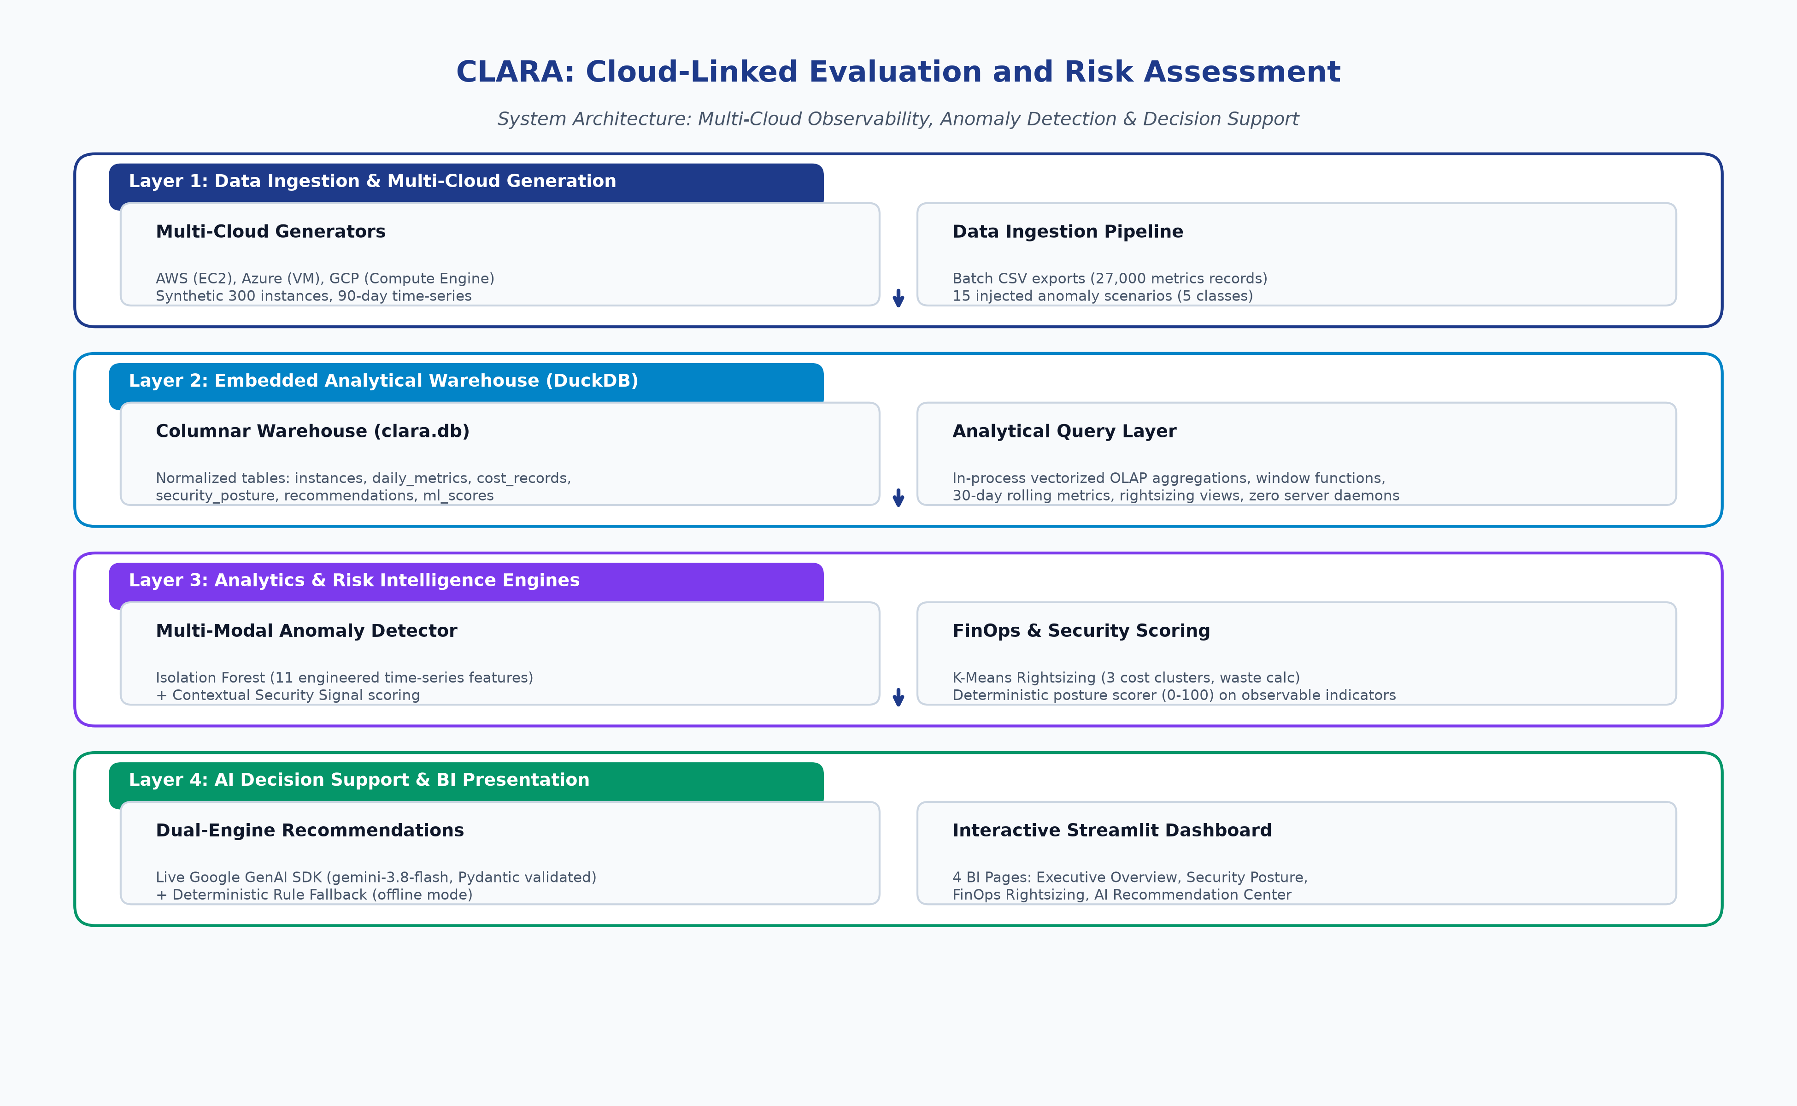
System Architecture Overview
Four-Tier Decoupled Platform: Ingestion, Warehouse, Analytics, Presentation
• Tier 1: Multi-Cloud Ingestion — AWS, Azure, GCP synthetic telemetry generation with diurnal curves, noise, and 15 ground-truth anomaly injections.
• Tier 2: Embedded Analytical Warehouse — In-process DuckDB columnar store executing vectorized analytical aggregations with zero server daemons.
• Tier 3: Analytics & Risk Engines — 11-feature Isolation Forest anomaly detector, K-Means FinOps rightsizing, and deterministic security posture scorer.
• Tier 4: Presentation & AI Advisory — Modern Google GenAI SDK (gemini-3.8-flash) + offline fallback engine, visual 4-page Streamlit BI dashboard.
CLARA — Final Phase Project Review (CSE 4191) | MIT Bengaluru | Slide 6 of 18

Slide 7
Architectural Evolution: Proposal vs Implemented
Engineering Justification for Strategic Refinements Across Project Phases
• Data Warehouse: Phase 1 proposed PostgreSQL + SQLAlchemy. Evolved to Embedded DuckDB (clara.db) for in-process OLAP, zero network daemon overhead, and seamless test isolation.
• Anomaly Detection: Phase 1 proposed supervised Random Forest and River online learning. Evolved to Isolation Forest + 11 engineered time-series features for unsupervised anomaly isolation without requiring labeled production training data.
• Security Risk Scorer: Phase 1 proposed opaque classifier with SHAP explainability. Evolved to deterministic posture scoring based on observable encryption, IAM, exposure, vulnerability-age and security-event indicators.
• Cost Optimization: Phase 1 proposed linear regression. Evolved to K-Means clustering (3 clusters) to categorize over-provisioned vs balanced vs constrained instances and compute actionable monthly waste.
• GenAI Integration: Phase 1 used deprecated google-generativeai. Modernized to official google-genai SDK (gemini-3.8-flash) with Pydantic validation, application-controlled provenance, and deterministic offline rule fallback.
CLARA — Final Phase Project Review (CSE 4191) | MIT Bengaluru | Slide 7 of 18

Slide 8
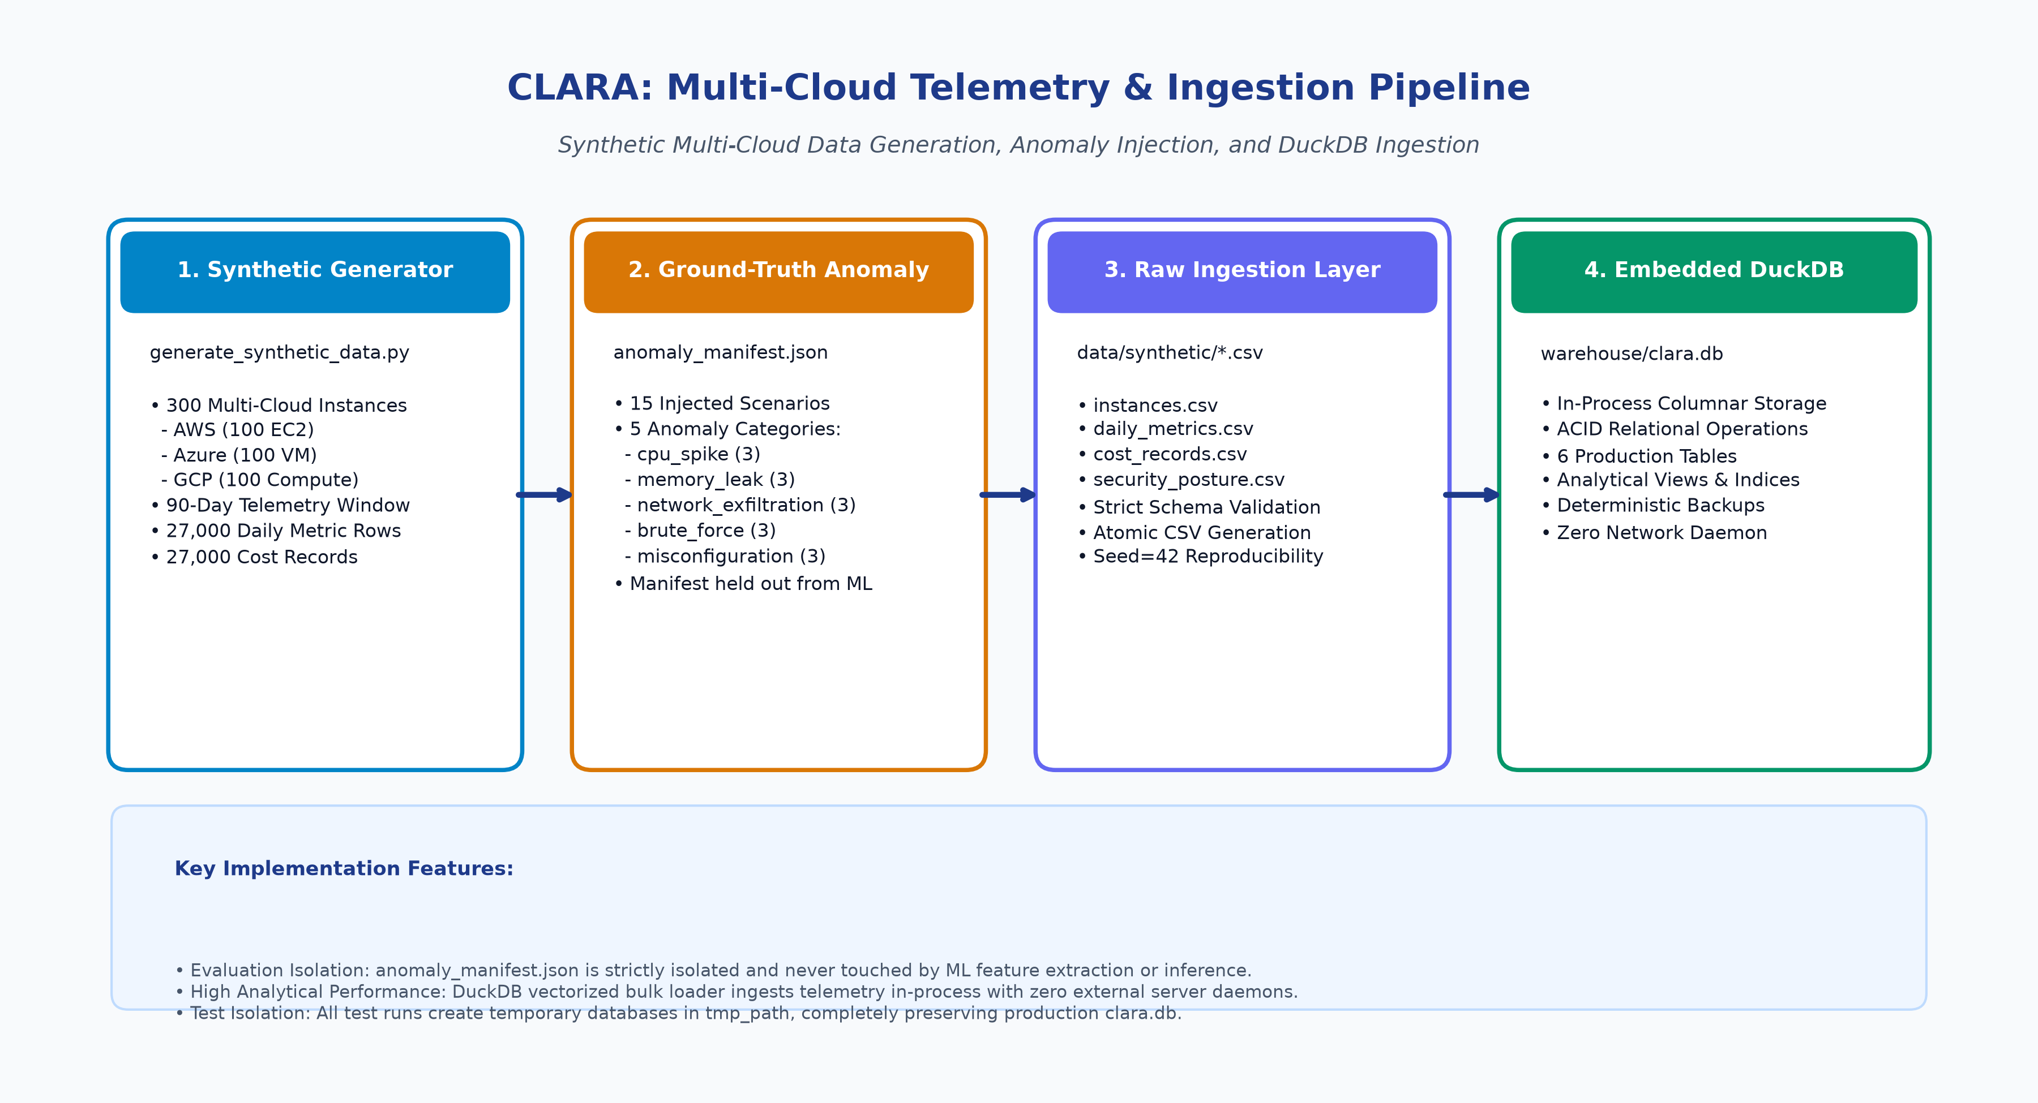
Synthetic Multi-Cloud Dataset & Ingestion
Realistic Multi-Provider Simulation with Isolated Ground-Truth Anomaly Corpus
• Fleet Diversity: 300 instances (AWS 155 / Azure 88 / GCP 57) spanning general, compute, and memory instance families.
• Telemetry Volume: 90 days of daily metrics (27,000 records) tracking CPU, RAM, Network In/Out, and Disk IOPS with diurnal patterns and stochastic noise.
• 15 Injected Anomaly Scenarios (5 Categories): cpu_spike (3), brute_force (3), network_exfiltration (3), misconfiguration (3), and memory_leak (3).
• Strict Evaluation Isolation: anomaly_manifest.json is stored separately and is NEVER accessed during feature engineering, training, or inference.
CLARA — Final Phase Project Review (CSE 4191) | MIT Bengaluru | Slide 8 of 18

Slide 9
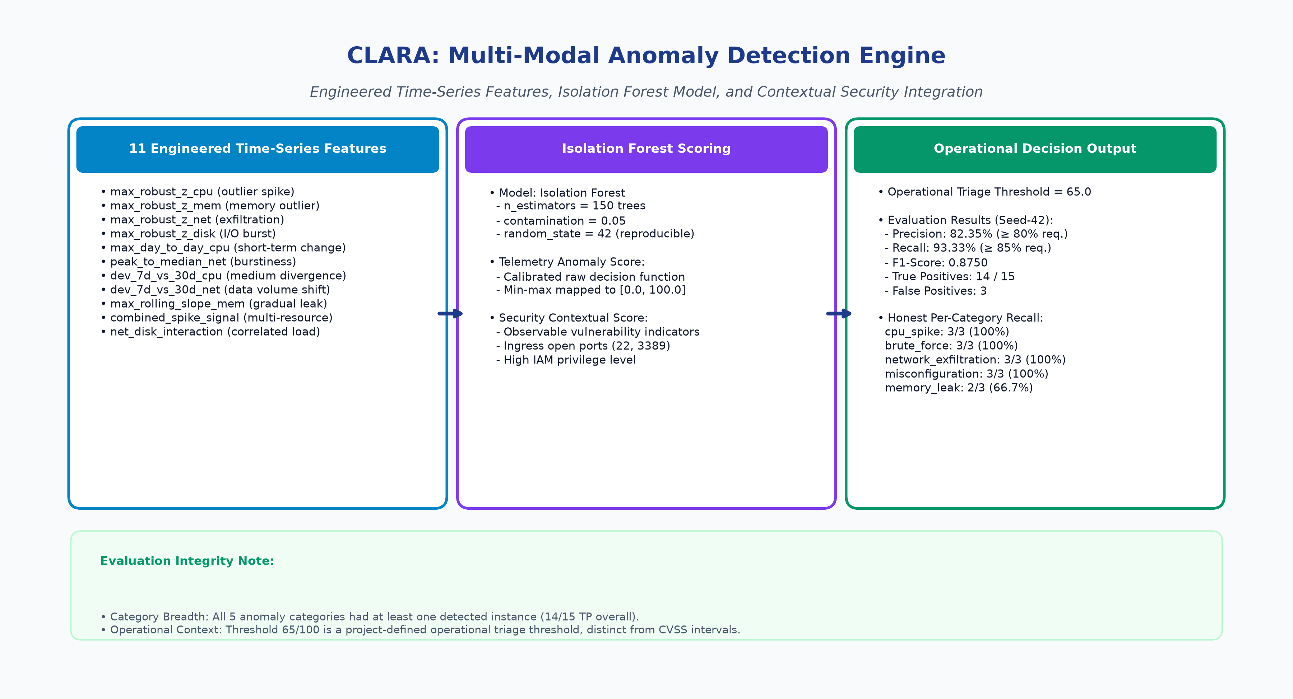
Multi-Modal Anomaly Detection Engine
11 Engineered Time-Series Features + Isolation Forest + Security Signals
• 11 Rolling Features: Captures short-term shocks (robust z-score, day-to-day diff), medium-term drift (7-day vs 30-day dev), burstiness (peak-to-median net), and slow leaks (14-day rolling linear slope).
• Isolation Forest Architecture: 150 decision trees, contamination=0.05, random_state=42 (fixed for reproducibility, zero hardcoded rules).
• Multi-Modal Fusion: Combines calibrated telemetry score with contextual security signals (unpatched vulnerabilities, open ports, IAM level).
• Operational Decision: Instance flagged as an anomaly if combined score ≥ 65.0 (project-defined operational triage threshold, distinct from CVSS).
CLARA — Final Phase Project Review (CSE 4191) | MIT Bengaluru | Slide 9 of 18

Slide 10
FinOps Rightsizing & Cost Optimization
Unsupervised K-Means Clustering for Fleet-Wide Cost Waste Identification
• Feature Dimensions: 30-day rolling average CPU, peak CPU, average memory utilization, and daily baseline cost.
• K-Means Clustering (k=3): Partitions fleet into Cluster 0 (Over-Provisioned/Idle), Cluster 1 (Balanced Workloads), and Cluster 2 (Constrained/High-Load).
• Actionable Waste Calculation: Waste = (1 - max(AvgCPU/50, AvgRAM/60)) * ProjectedMonthlySpend for over-provisioned instances.
• Actionable Waste Isolated: Identifies $184.58 in cost/right-sizing savings and $220.87 across all recommendation types.
• Cluster 2 Insights: Identifies constrained instances operating at high utilization as candidates for proactive upsizing to prevent SLA violations.
CLARA — Final Phase Project Review (CSE 4191) | MIT Bengaluru | Slide 10 of 18

Slide 11
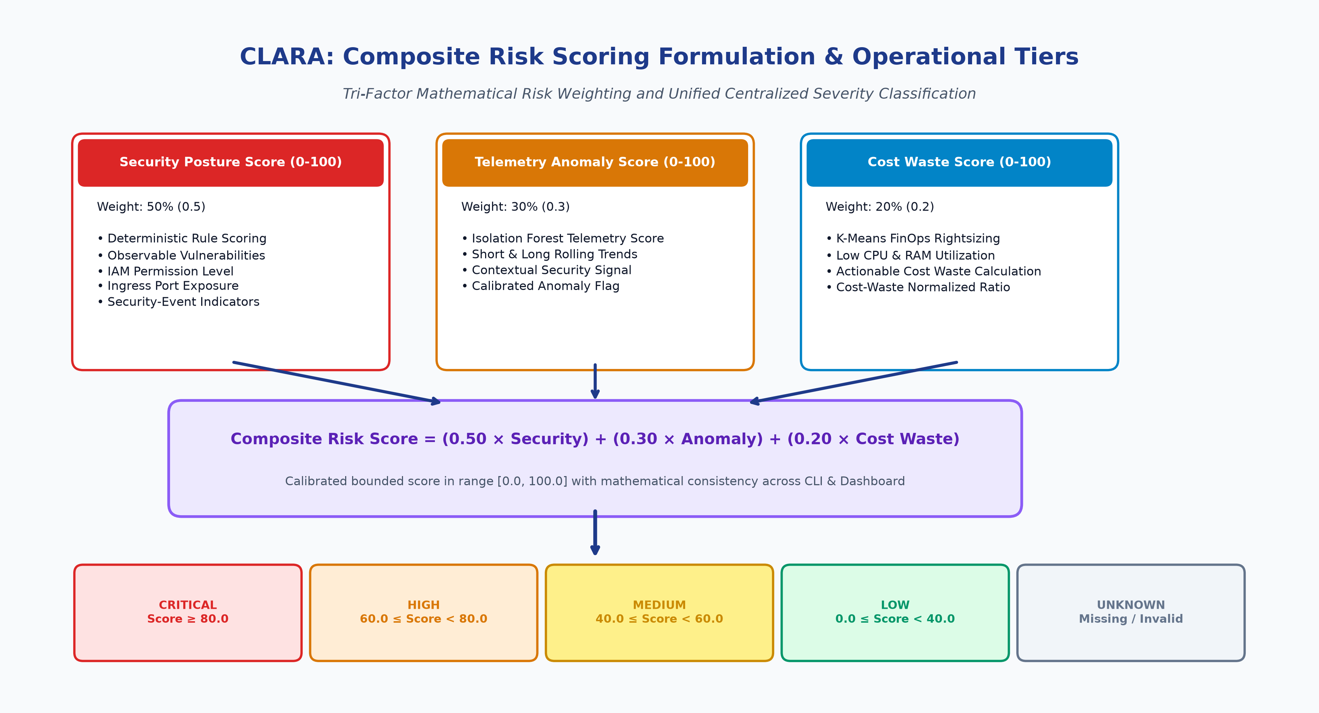
Composite Risk Formulation & Severity Tiers
Unified Mathematical Weighting and Centralized Operational Classification
• Composite Risk Formula: Overall Risk = (0.50 * Security Score) + (0.30 * Anomaly Score) + (0.20 * Cost Waste Score).
• Deterministic Security Posture: Scored (0-100) based on observable encryption, IAM, exposure, vulnerability-age and security-event indicators.
• Centralized Operational Tiers: Critical (≥ 80.0, red), High (60.0–79.9, orange), Medium (40.0–59.9, yellow), Low (0.0–39.9, green).
• Missing-Risk Semantics: NULL, NaN, non-numeric, or negative scores classified as UNKNOWN (slate gray), preventing silent misclassification as Low.
CLARA — Final Phase Project Review (CSE 4191) | MIT Bengaluru | Slide 11 of 18

Slide 12
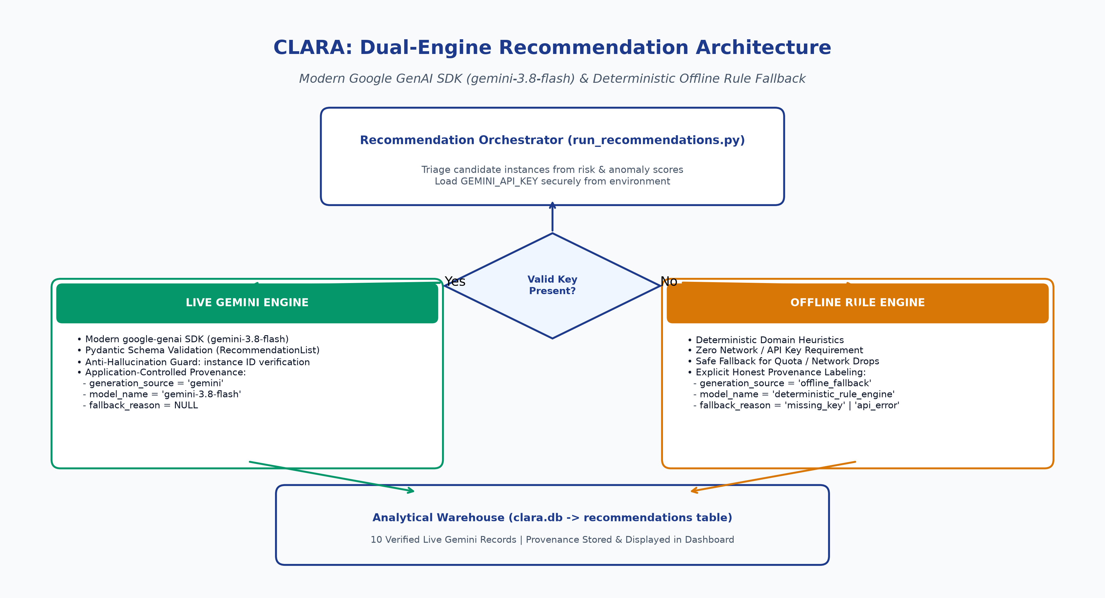
Dual-Engine GenAI Advisory Architecture
Modern Google GenAI SDK (gemini-3.8-flash) + Deterministic Offline Fallback
• Modern GenAI SDK: Integrates google-genai (gemini-3.8-flash endpoint) with structured system instructions.
• Strict Schema Validation: Enforces Pydantic RecommendationList contract (action title, category, priority, savings, justification, remediation steps).
• Anti-Hallucination Guard: Validates that returned instance IDs strictly exist in the triage candidate set; rejects fabricated IDs.
• Application-Controlled Provenance: Application code explicitly stamps generation_source, model_name, and fallback_reason into DuckDB.
• Operational Resilience: The pipeline remains operational in the tested missing-key and API-failure scenarios by using a clearly labelled deterministic fallback.
CLARA — Final Phase Project Review (CSE 4191) | MIT Bengaluru | Slide 12 of 18

Slide 13
Presentation Layer: Streamlit BI Dashboard
Interactive Multi-Page Analytics with Dynamic Filtering and Provenance Badges
• Page 1: Executive Overview — Fleet KPI metric cards ($184.58 cost savings, $220.87 all recommendations, 17 predicted anomalies, 1 critical, 6 high), multi-provider filters, risk distribution charts, and fleet inventory tables.
• Page 2: Security Analysis — Deep vulnerability breakdown, public ingress SSH/RDP analysis, wildcard IAM permissions, and posture distribution.
• Page 3: Cost Analysis — FinOps rightsizing scatter plots, spend vs waste trends, and downsizing recommendation tables.
• Page 4: AI Recommendations — Interactive recommendation cards with color-coded provenance badges ('Gemini 3.8 Flash' vs 'Deterministic Rule Fallback'), technical justifications, and remediation steps.
CLARA — Final Phase Project Review (CSE 4191) | MIT Bengaluru | Slide 13 of 18

Slide 14
Experimental Results & Model Evaluation
Evaluation Against Ground-Truth Corpus Under Strict Data Isolation
• Evaluation Protocol: Evaluated on seed-42 corpus with anomaly_manifest.json completely held out during feature engineering, training, and threshold selection.
• Confusion Matrix: True Positives (TP) = 14, False Positives (FP) = 3, False Negatives (FN) = 1, True Negatives (TN) = 282.
• Quantitative Performance: Precision = 82.35% (exceeds ≥ 80% requirement), Recall = 93.33% (exceeds ≥ 85% requirement), F1-Score = 0.8750.
• Category Detection Breadth: All 5 anomaly categories had at least one detected instance:
• • brute_force: 3/3 (100.0%) • cpu_spike: 3/3 (100.0%)
• • network_exfiltration: 3/3 (100.0%) • misconfiguration: 3/3 (100.0%)
• • memory_leak: 2/3 (66.7%)
• Gemini Verification: 10 live Gemini recommendations generated and verified in DuckDB; 100% schema conformance, zero hallucinated instances, immutable provenance.
CLARA — Final Phase Project Review (CSE 4191) | MIT Bengaluru | Slide 14 of 18

Slide 15
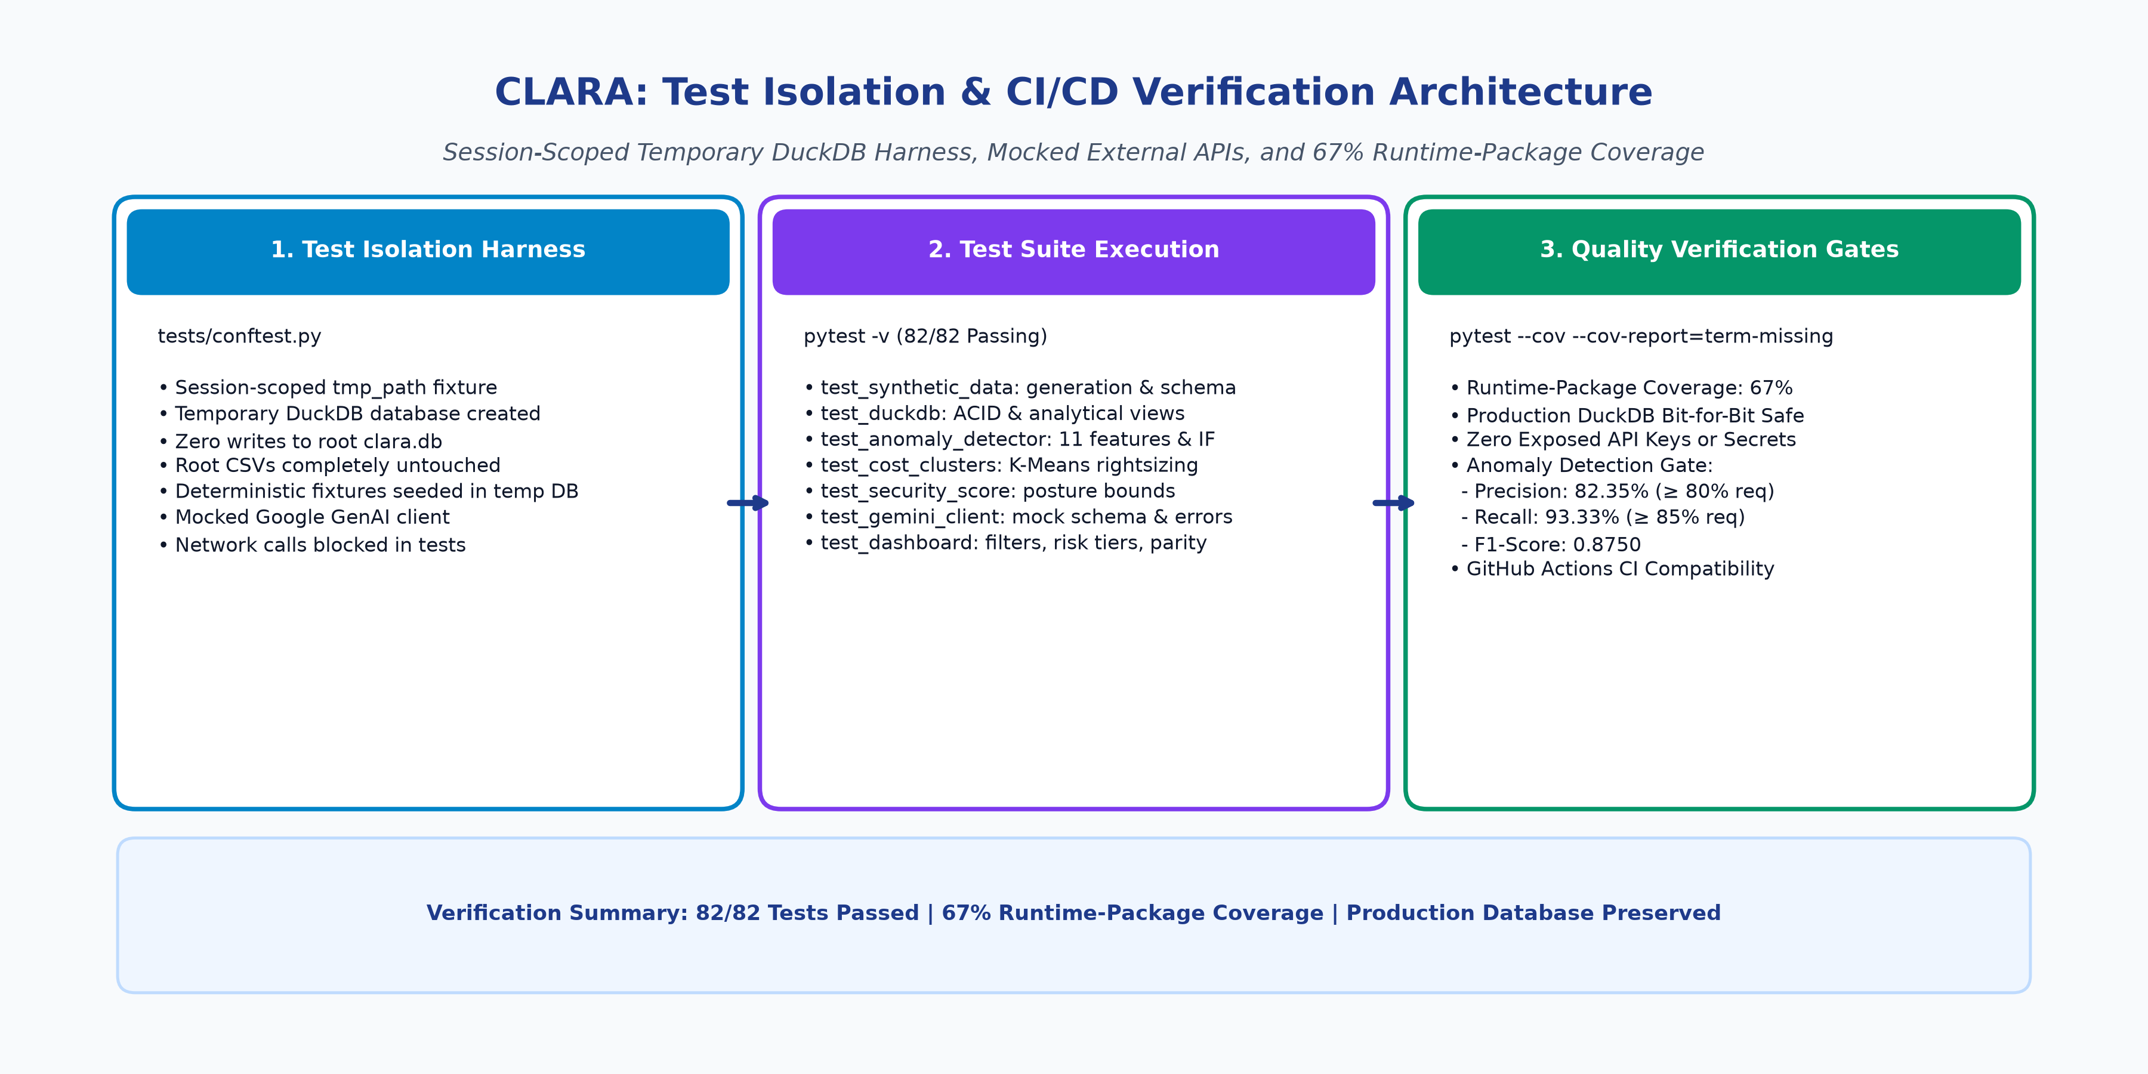
Automated Testing & Test Isolation
82 Passing Tests, 67% Runtime-Package Coverage, Zero Production Data Mutation
• Strict Test Isolation: Session-scoped pytest tmp_path fixtures create isolated DuckDB instances; root clara.db and CSVs are completely untouched.
• Full Test Suite: 82 unit, integration, release, and UI tests passing (100% pass rate).
• Verified Coverage: 67% statement coverage across explicitly scoped runtime packages: data generation, warehousing, analytics, GenAI, and dashboard.
• Mocked External Dependencies: Tests execute offline without requiring internet access or live API keys; external Gemini calls mocked.
• Database Hash Preserved: Root production database verified bit-for-bit unchanged (SHA256: de271ea91da0df6c2a22c9d967684574fbd3f63fe25b6cab8a5c07c7b91f6bd8).
CLARA — Final Phase Project Review (CSE 4191) | MIT Bengaluru | Slide 15 of 18

Slide 16
Limitations & Ethical Governance
Transparent Appraisal of Simulation Boundaries and Responsible AI Safeguards
• Synthetic Simulation vs Live APIs: Synthetic telemetry models diurnal curves and stochastic noise accurately, but live clouds exhibit unpredictable edge cases (DNS throttling, hypervisor reboots).
• Advisory Scope: CLARA provides decision support; it deliberately does not execute autonomous IAM or instance modifications to avoid catastrophic service interruptions.
• API Latency: Gemini 3.8 Flash requires 1.5–3.5s per batch; real-time low-latency alerting relies on the deterministic rule engine.
• Responsible AI Governance: Zero credential exposure (keys stored in .env, never in repos or logs); immutable provenance transparency; human-in-the-loop review before any cloud remediation.
CLARA — Final Phase Project Review (CSE 4191) | MIT Bengaluru | Slide 16 of 18

Slide 17
Future Scope & Engineering Roadmap
Planned Enhancements for Production Deployment and Closed-Loop Automation
• Live Cloud Connector Adapters: Implement read-only connectors via AWS Boto3, Azure SDK for Python, and GCP Client Libraries to stream live telemetry.
• Reinforcement Learning from Human Feedback (RLHF): Capture operator feedback (thumbs up/down, executed/dismissed) to dynamically tune prompts and risk weights.
• Infrastructure-as-Code (IaC) Integration: Automatically generate reviewable Terraform / Ansible pull requests for operator-approved downsizing or security patching.
• Multi-Tenant Role-Based Access Control (RBAC): Departmental quota enforcement, compliance audit logging, and SSO identity integration.
CLARA — Final Phase Project Review (CSE 4191) | MIT Bengaluru | Slide 17 of 18

Slide 18
Conclusion & Review Details
Summary of Deliverables, Academic Review, and Open Q&A Session
CLARA successfully delivers an end-to-end, multi-cloud evaluation and risk assessment platform.
Combines embedded DuckDB warehousing, 11-feature Isolation Forest anomaly detection, K-Means FinOps rightsizing, and modern Gemini 3.8 Flash recommendations.
Evaluation Verified: 82.35% Precision, 93.33% Recall, 82/82 passing tests, 67% runtime-package coverage.
We express our sincere gratitude to Dr. Geetabai S Hukkeri, Dr. Rashmi R, and the Department of CSE, MIT Bengaluru.
Thank you. We now invite questions, critiques, and feedback from the evaluators.
CLARA — Final Phase Project Review (CSE 4191) | MIT Bengaluru | Slide 18 of 18

