Slide 1
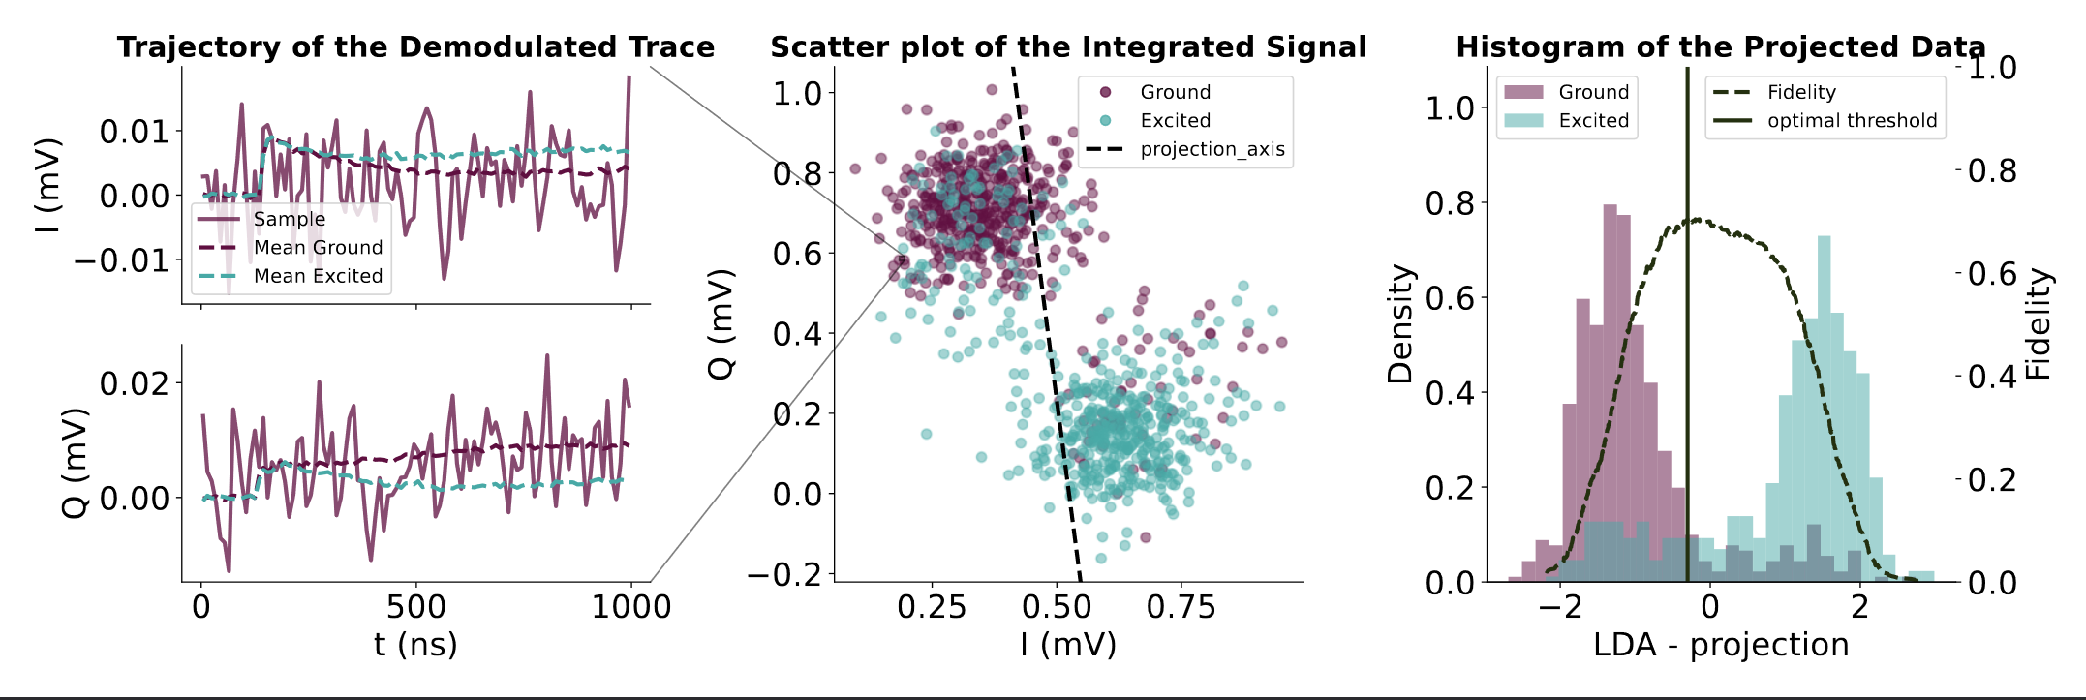
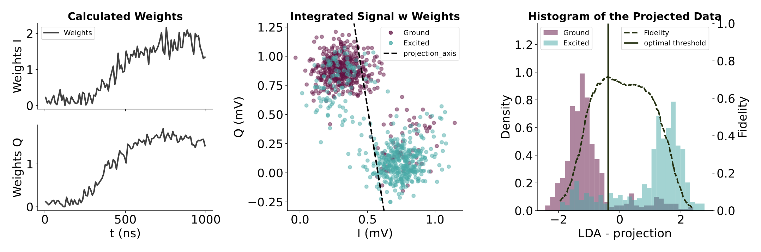
Group Meeting Update 4/10-2023
Budget and Improvements of Readout by Simulation
Experiments
ADC traces can be demodulated and summed
We can calculate optimal weights to separate.

Slide 2
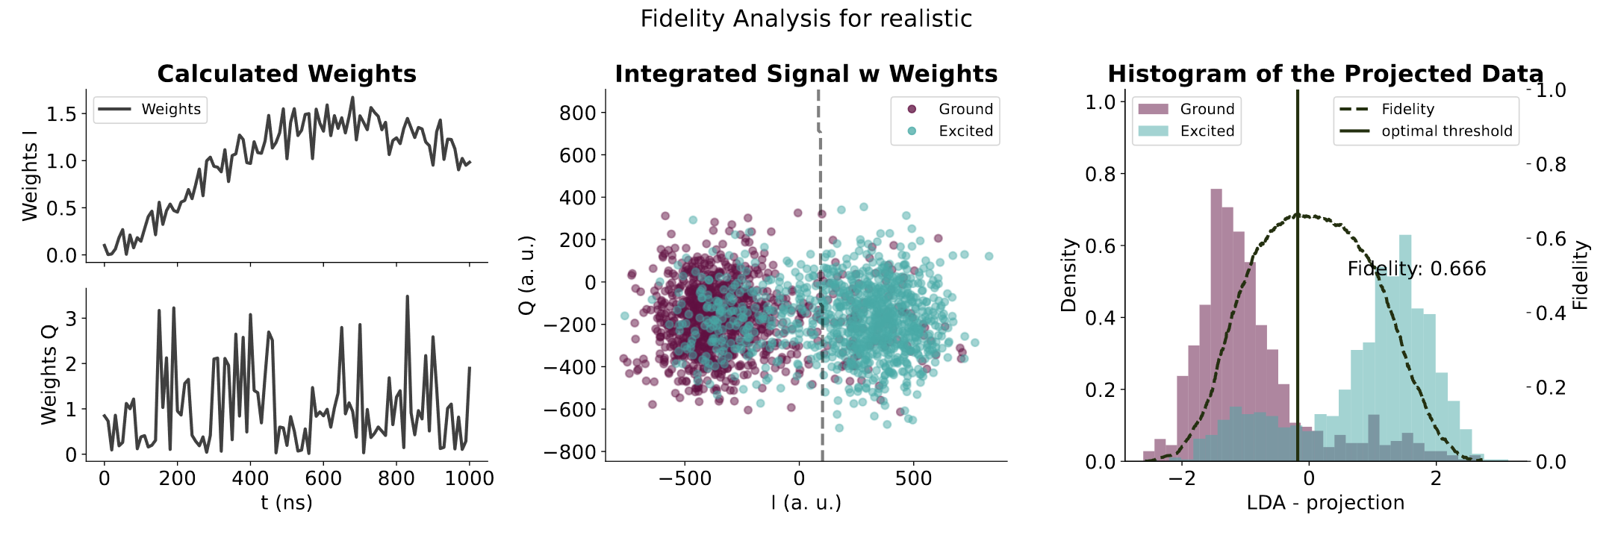
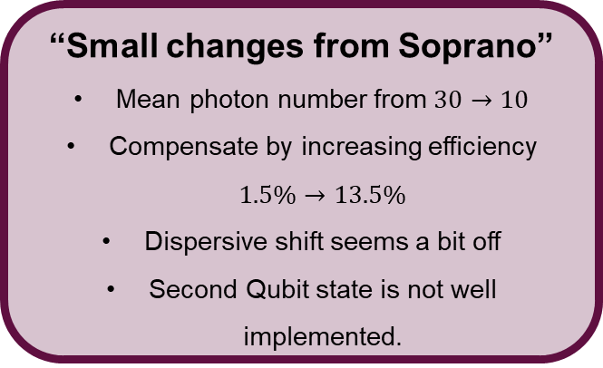
Readout in Simulation
Realistic Model
Simulations
Calibrate the Qubit and implement in Simulation.
Run Stochastic Master Equation to get simulated trajectories
“Small changes from Soprano”
Mean photon number from $30→10$
Compensate by increasing efficiency $1.5\%→13.5\%$
Dispersive shift seems a bit off
Second Qubit state is not well implemented.

Slide 3
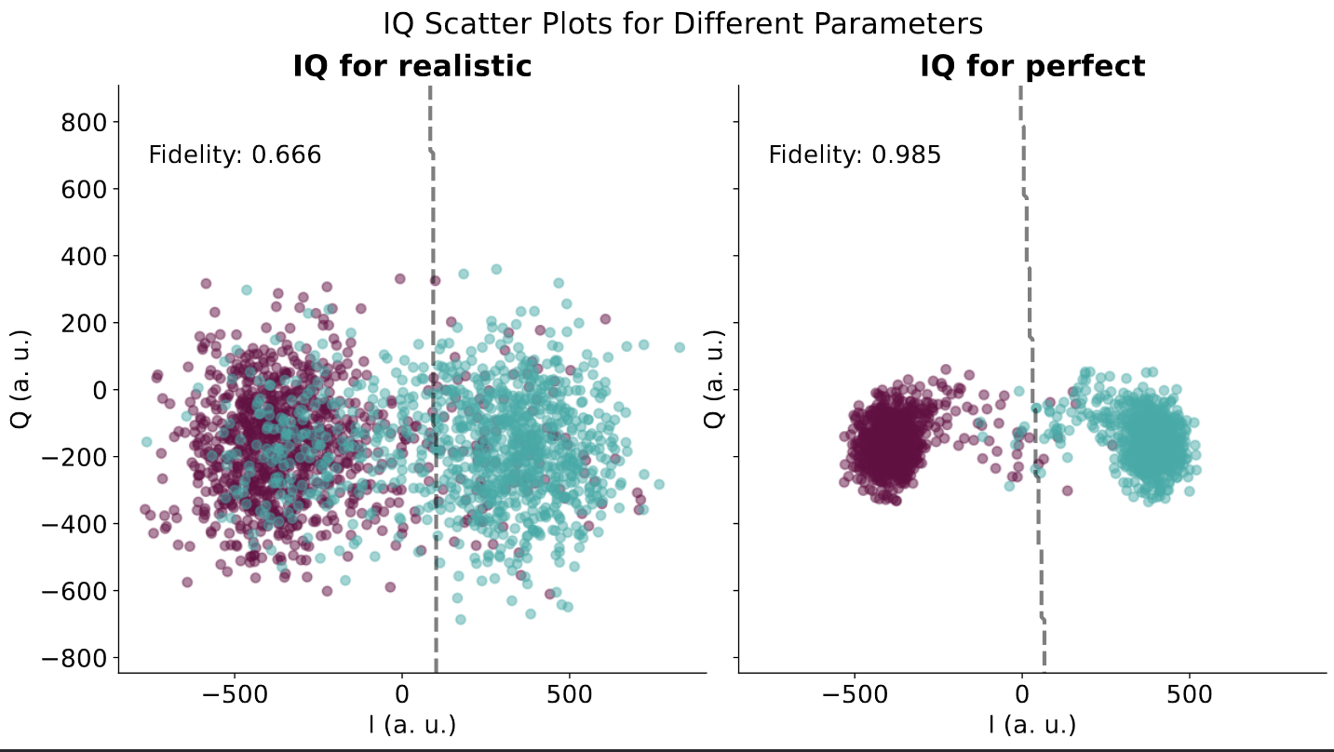
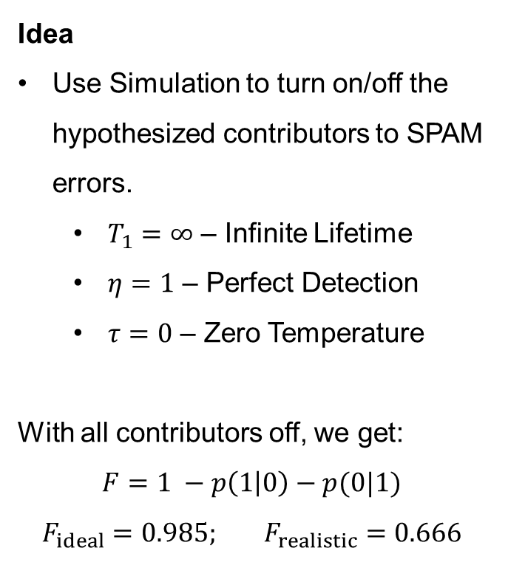
Readout in Simulation
Realistic/Ideal Model
Idea
Use Simulation to turn on/off the hypothesized contributors to SPAM errors.
$T_{1}=∞$ – Infinite Lifetime
$η=1$ – Perfect Detection
$τ=0$ – Zero Temperature
With all contributors off, we get:
$$F=1 −p\left(1 | 0\right)−p(0|1)$$
$$F_{ideal}=0.985; F_{realistic}=0.666$$

Slide 4
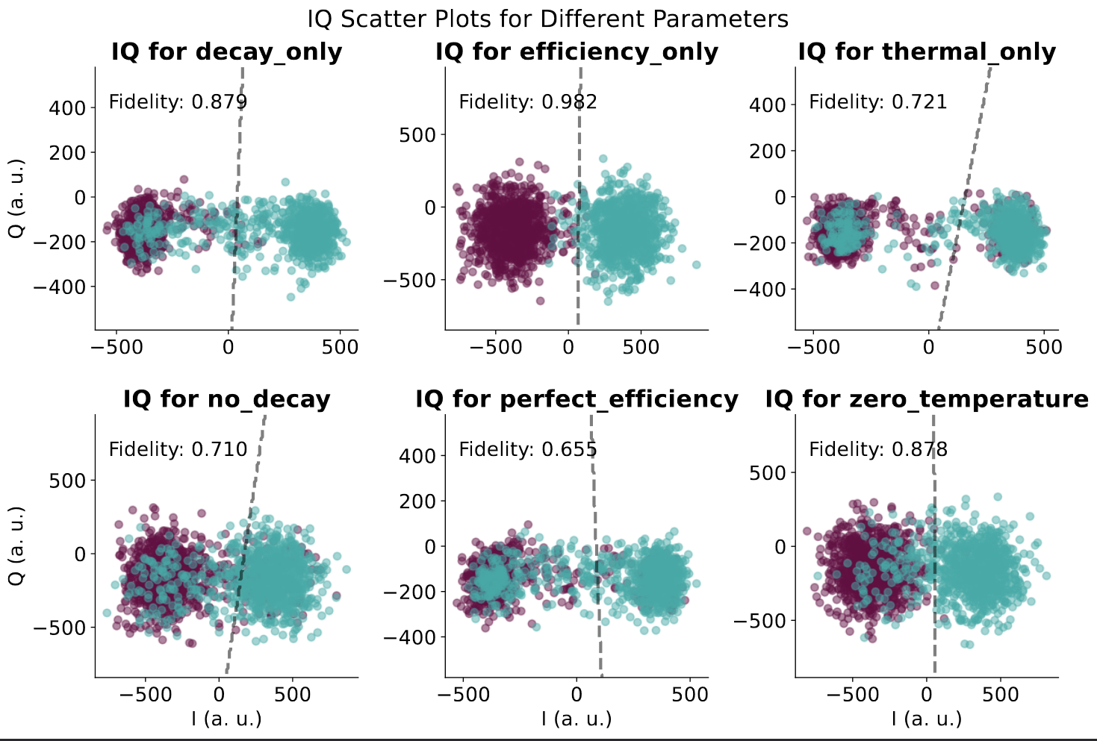
Readout in Simulation
Combinations

Slide 5
SPAM contributions
Decay
12.1%
+ Decay
12.2% (+10.4%)
Temperature 27.9%
Efficiency 1.8%
+ Efficiency
12.2% (+0.1%)
+ Temp
34.5% (+22.4%)
+ Efficiency
29.0% (+1.1%)
+ Decay
34.5%(+6.6%)
+ Temperature
29.0% (+27.2%)
+Efficiency
33.4%(+0.1%)
+Temp
33.4%(+21.2%)
+Efficiency
33.4%(-0.9%)
+Decay
33.4%(+4.4%)
+Temperature
33.4%(+21.2%)
+Decay
33.4%(+4.4%)

Slide 6
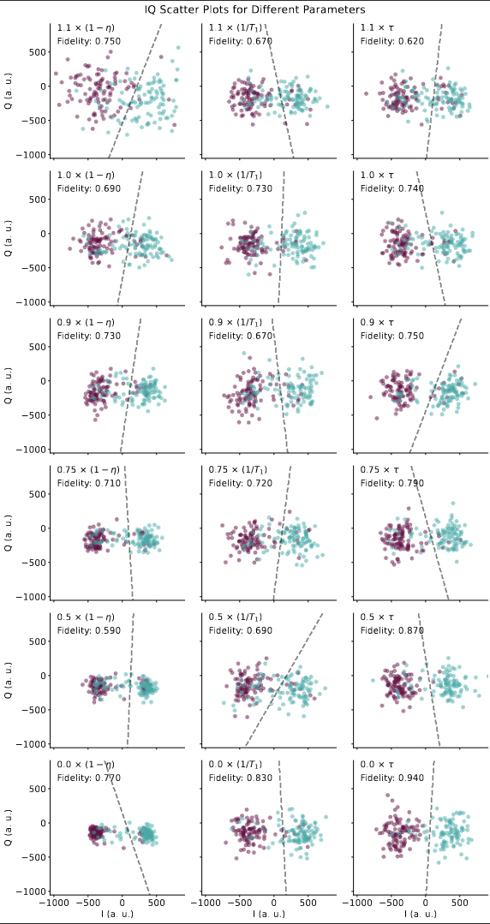
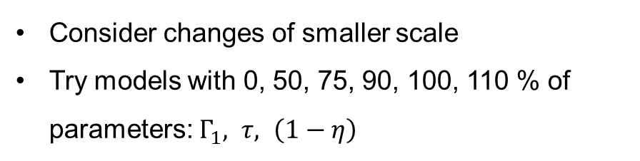
Not Realistic Improvements…
Consider changes of smaller scale
Try models with 0, 50, 75, 90, 100, 110 % of parameters: $Γ_{1}, τ, \left(1−η\right)$

Slide 7
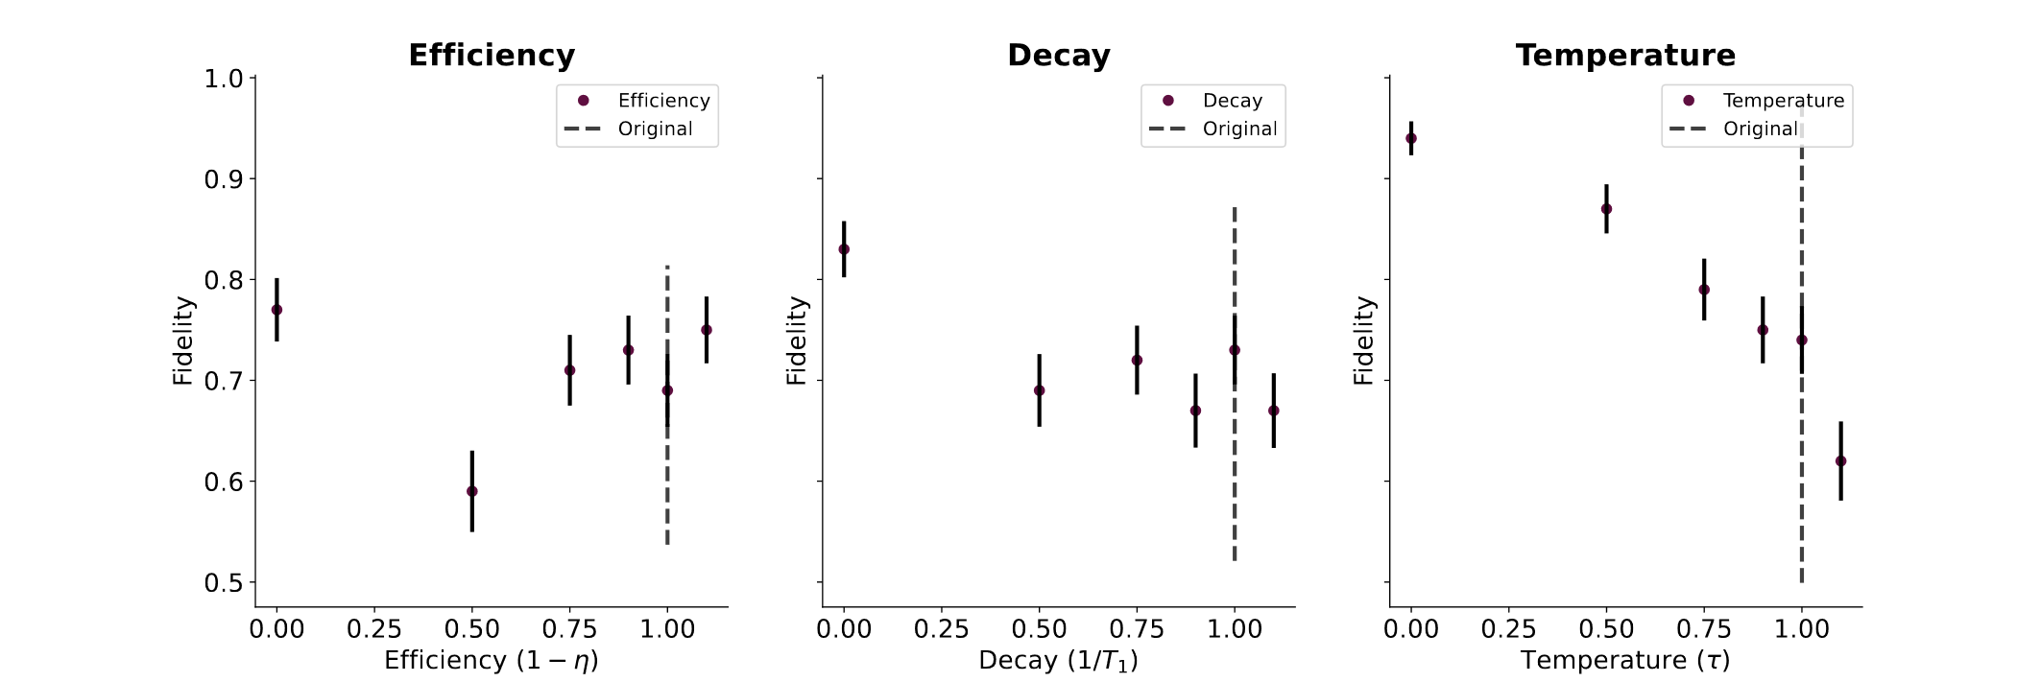
Not Realistic Improvements…

Slide 8
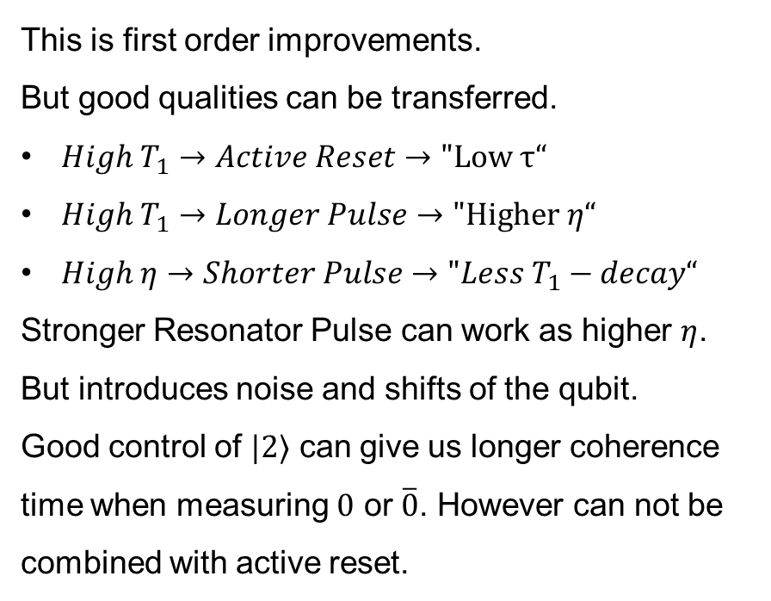
Not Realistic Improvements…
This is first order improvements.
But good qualities can be transferred.
$High T_{1}→Active Reset→\text{"}\text{Low} τ“$
$High T_{1}→Longer Pulse→\text{"}\text{Higher} η“$
$High η→Shorter Pulse→"Less T_{1}−decay“$
Stronger Resonator Pulse can work as higher $η$. But introduces noise and shifts of the qubit.
Good control of $|2⟩$ can give us longer coherence time when measuring $0$ or $\overline{0}$. However can not be combined with active reset.

Slide 9
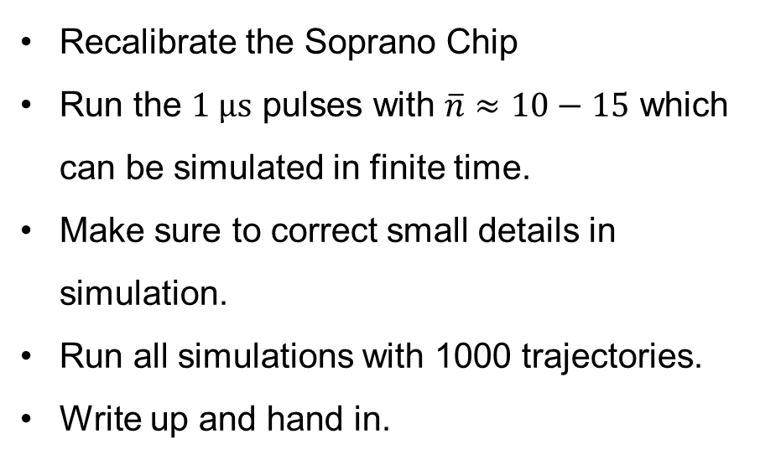
Next Steps Now
Recalibrate the Soprano Chip
Run the $1 µs$ pulses with $\overline{n}≈10−15$ which can be simulated in finite time.
Make sure to correct small details in simulation.
Run all simulations with 1000 trajectories.
Write up and hand in.

