Slide 1
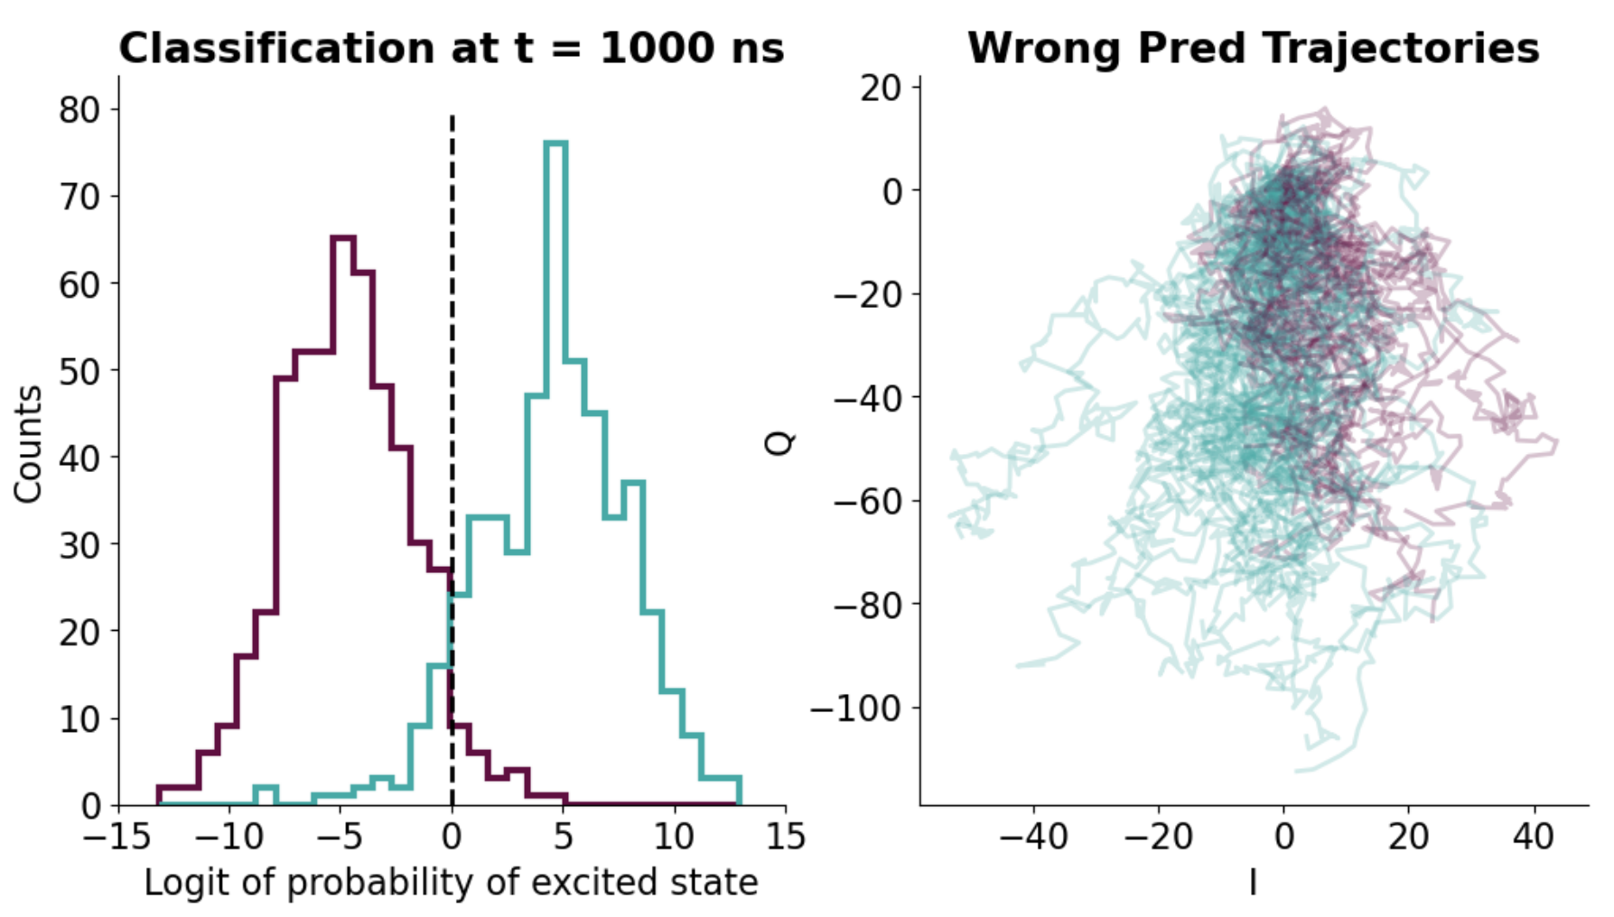
Group Meeting Update 19/4-23
Johann Bock Severin
How does errors in the simulation look

Slide 2
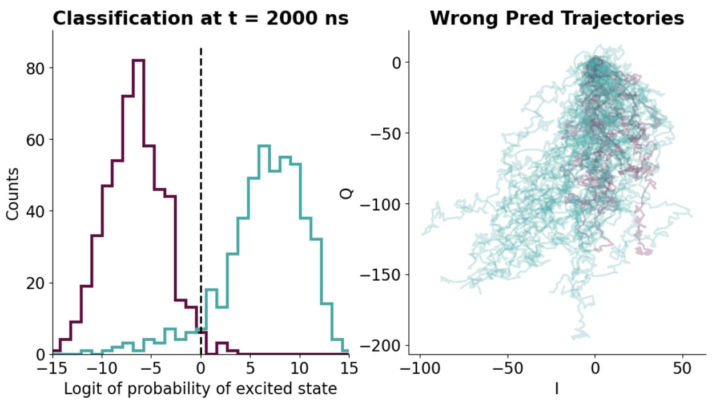
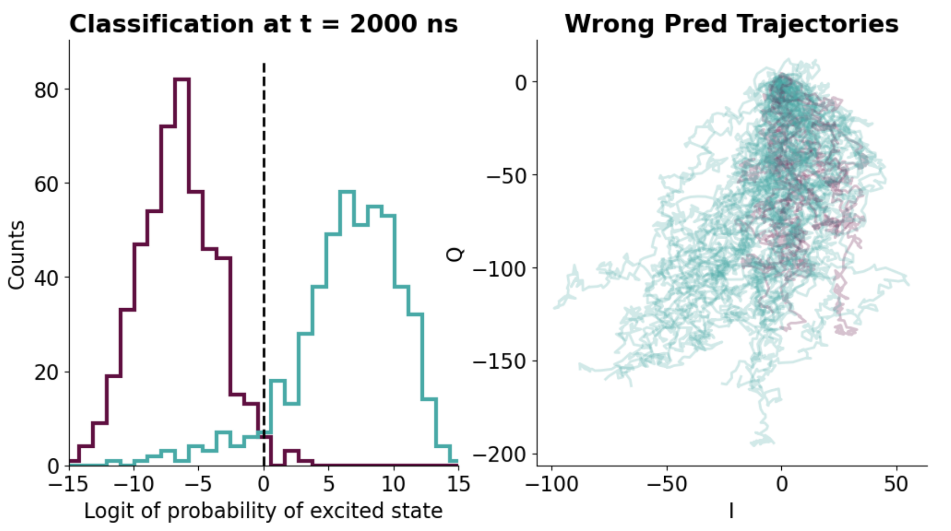
Group Meeting Update 19/4-23
Johann Bock Severin
How does errors in the simulation look

Slide 3
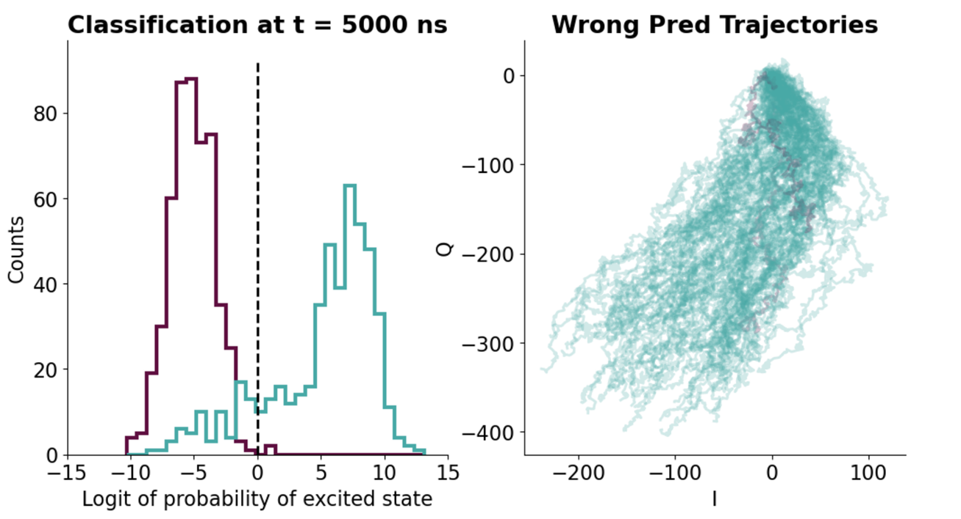
Group Meeting Update 19/4-23
Johann Bock Severin
How does errors in the simulation look

Slide 4
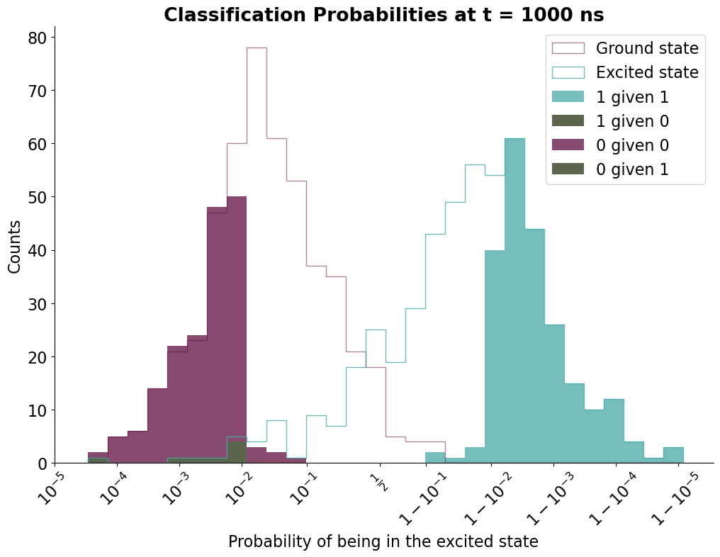
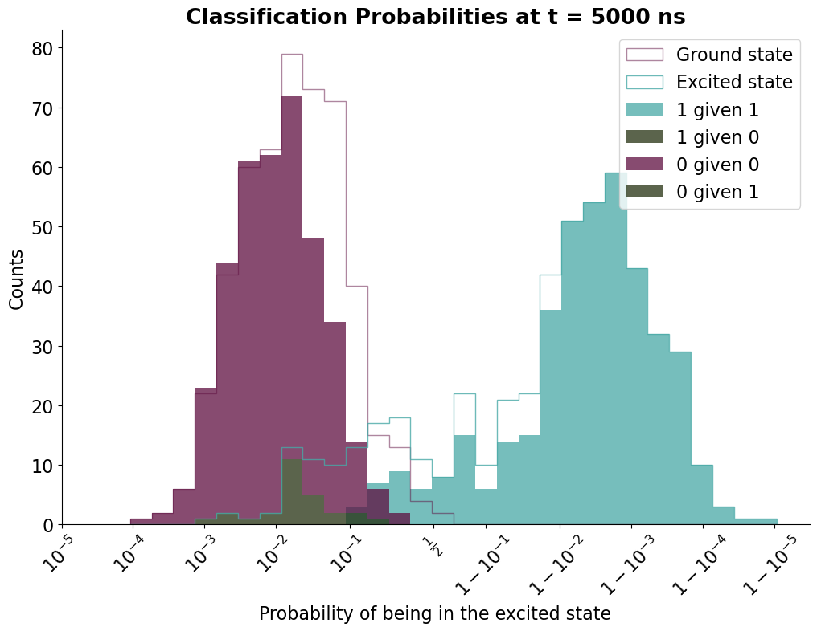
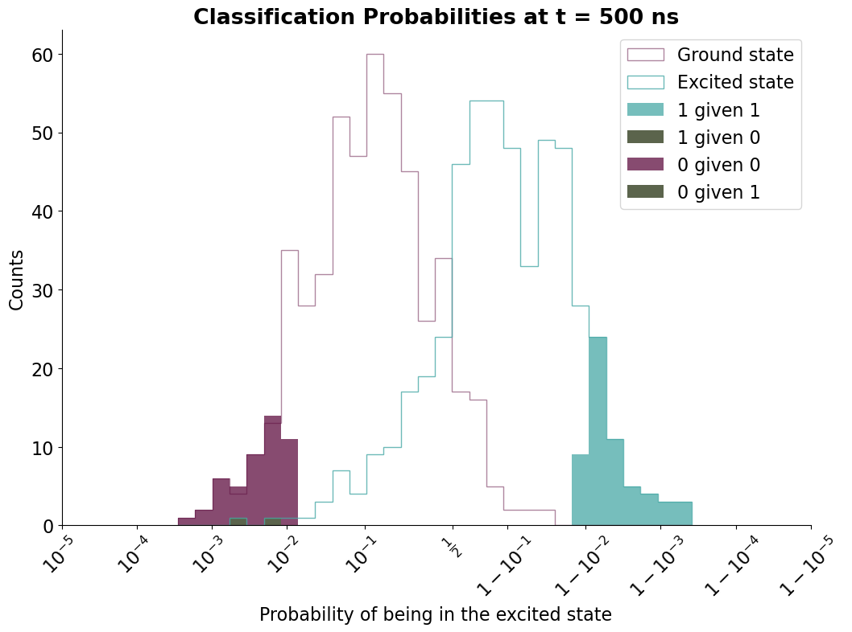
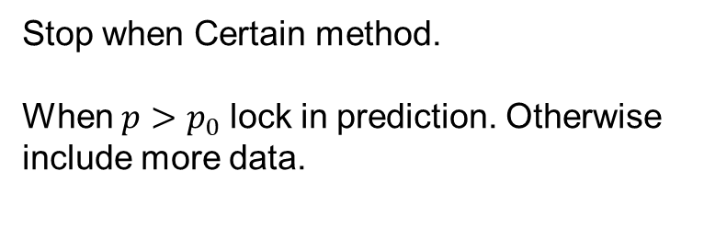
Group Meeting Update 19/4-23
Johann Bock Severin
Stop when Certain method.
When $p>p_{0}$ lock in prediction. Otherwise include more data.

Slide 5

Group Meeting Update 19/4-23
Johann Bock Severin
Stop when Certain method.
When $p>p_{0}$ lock in prediction. Otherwise include more data.

Slide 6

Group Meeting Update 19/4-23
Johann Bock Severin
Stop when Certain method.
When $p>p_{0}$ lock in prediction. Otherwise include more data.

Slide 7
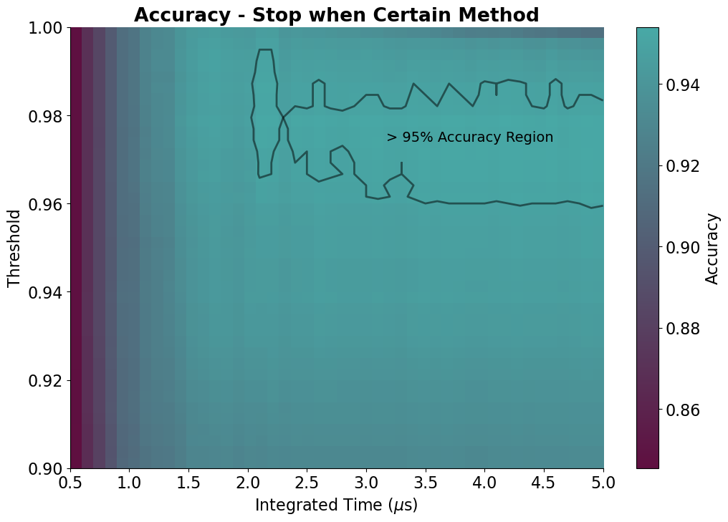
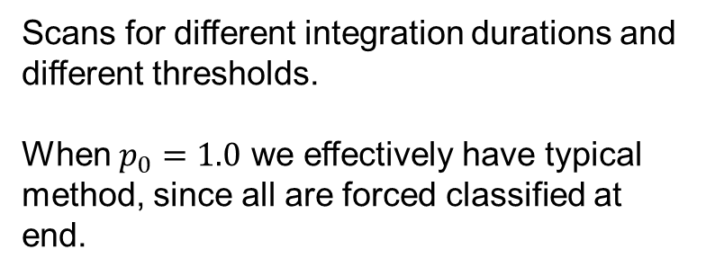
Group Meeting Update 19/4-23
Johann Bock Severin
Scans for different integration durations and different thresholds.
When $p_{0}=1.0$ we effectively have typical method, since all are forced classified at end.

Slide 8
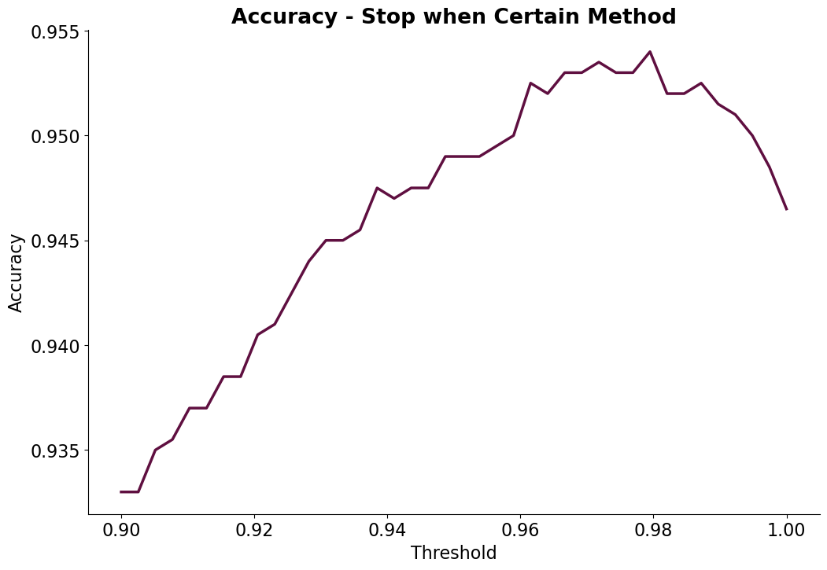
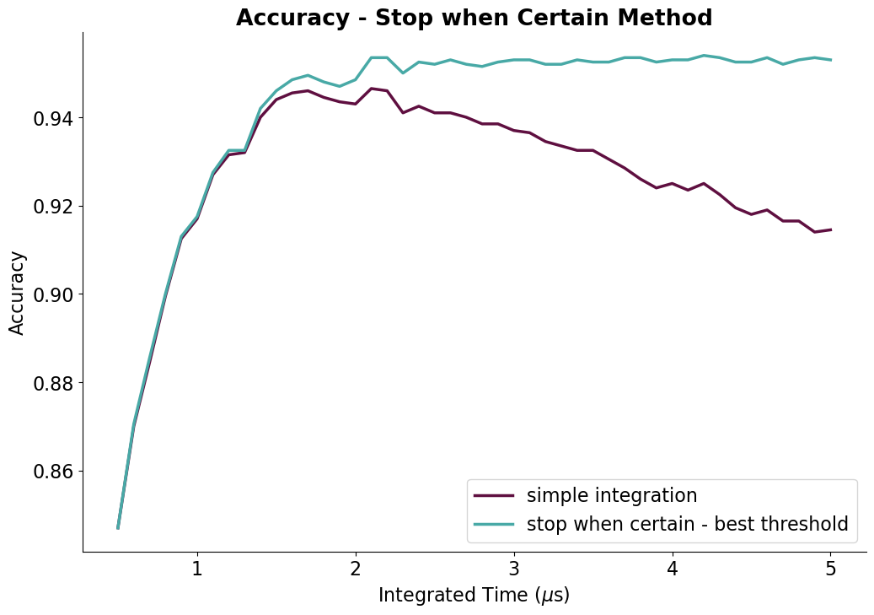
Group Meeting Update 19/4-23
Johann Bock Severin

