Slide 1
Group Meeting Update 24/5-23
Johann Bock Severin
Device
Transmon
Resonator
Pulses
System
Resonator + Qubit
Resonator + Qubit (Dispersive)
Experiment
Unitary
Lindblad
Quantum Device Simulations
Module
Parent Classes
Actual Physics

Slide 2
Group Meeting Update 24/5-23
Johann Bock Severin
Module
Quantum Device Simulations
Creating a module to create reusable elements

Slide 3
Group Meeting Update 24/5-23
Johann Bock Severin
Parent Classes
Device
System
Experiment
Parent classes to manage data storage and sweeping:
Devices: Physical things on the chip
Systems: The chip which contains list of devices
Experiments: The simulation container to handle data input and sweeping. Simulation function should be subclassed.

Slide 4
Group Meeting Update 24/5-23
Johann Bock Severin
Actual Physics
Transmon
Resonator
Pulses
Resonator + Qubit
Resonator + Qubit (Dispersive)
Unitary
Lindblad
Goal is to only write physics classes.
Example: Implement qubit cloaking should only be done by implementing a new pulse class.

Slide 5
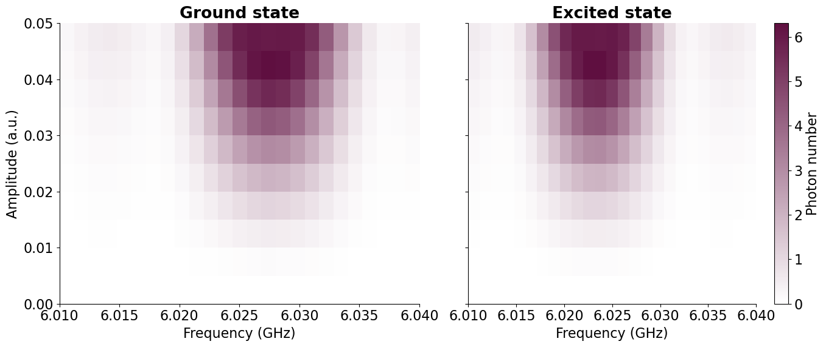
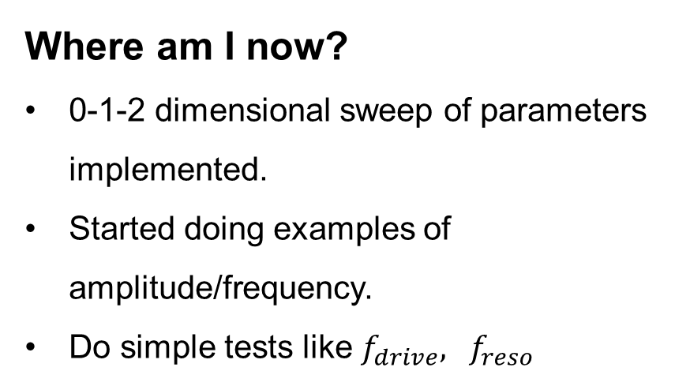
Group Meeting Update 24/5-23
Johann Bock Severin
Where am I now?
0-1-2 dimensional sweep of parameters implemented.
Started doing examples of amplitude/frequency.
Do simple tests like $f_{drive}, f_{reso}$

