Slide 1
Group Meeting Update 31/5-23
Johann Bock Severin
Work done:
Doing structural changes after talk with Ramus
Adding Qubit Drive
Trying use-case:
Filling resonator to move qubit frequency (Jakob)

Slide 2
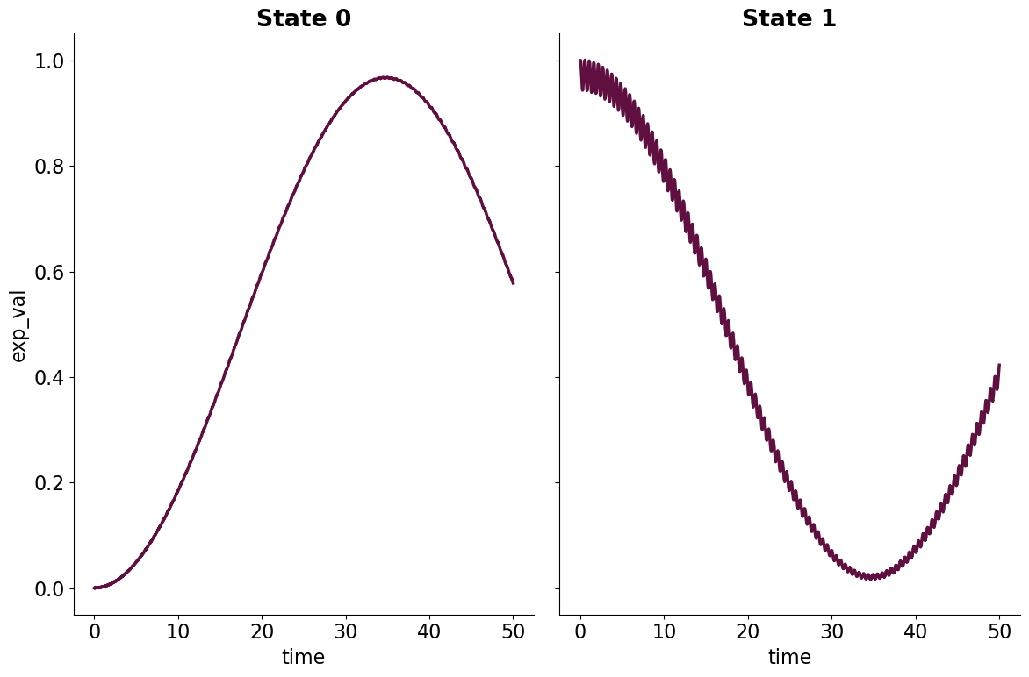
Qubit Drive
Group Meeting Update 31/5-23
qubit_drive = SquareCosinePulse(
frequency=7.86,
amplitude=0.1,
phase=0.0,
duration=50,
)
system = QubitResonatorSystem(
qubit,
resonator,
coupling_strength=2 * np.pi * 0.250,
qubit_pulse=qubit_drive,
)
# Create experiment
ground_state = system.get_states(0, 0)
excited_state = system.get_states(1, 0)
times = np.linspace(0, 50, 2000)
experiment = SchroedingerExperiment(
system,
[ground_state, excited_state],
times,
store_states=False,
only_store_final=False,
expectation_operators=[system.qubit_state_operator()],
save_path=experiment_path,
)
results = experiment.run()
analysis = automatic_analysis(results)

Slide 3
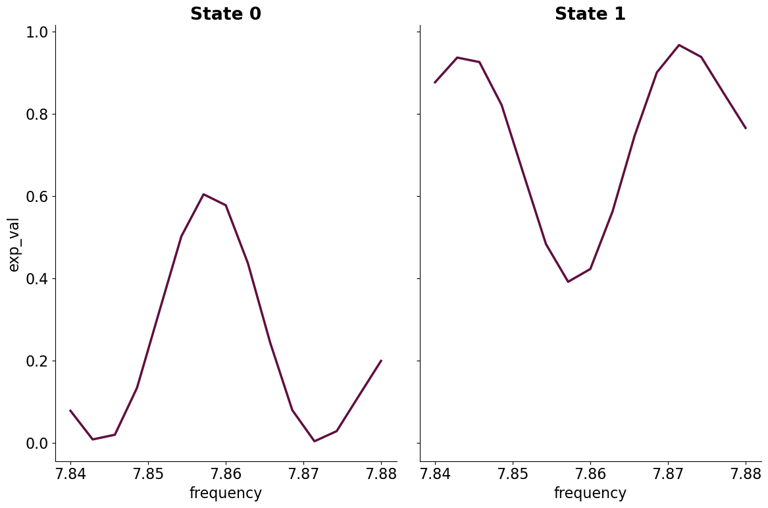
Qubit Drive
Group Meeting Update 31/5-23
qubit_drive = SquareCosinePulse(
frequency=np.linspace(7.84, 7.88, 15),
amplitude=0.1,
phase=0.0,
duration=50,
)
system = QubitResonatorSystem(
qubit,
resonator,
coupling_strength=2 * np.pi * 0.250,
qubit_pulse=qubit_drive,
)
# Create experiment
ground_state = system.get_states(0, 0)
excited_state = system.get_states(1, 0)
times = np.linspace(0, 50, 2000)
experiment = SchroedingerExperiment(
system,
[ground_state, excited_state],
times,
store_states=False,
only_store_final=True,
expectation_operators=[system.qubit_state_operator()],
save_path=experiment_path,
)
results = experiment.run()
analysis = automatic_analysis(results)

Slide 4
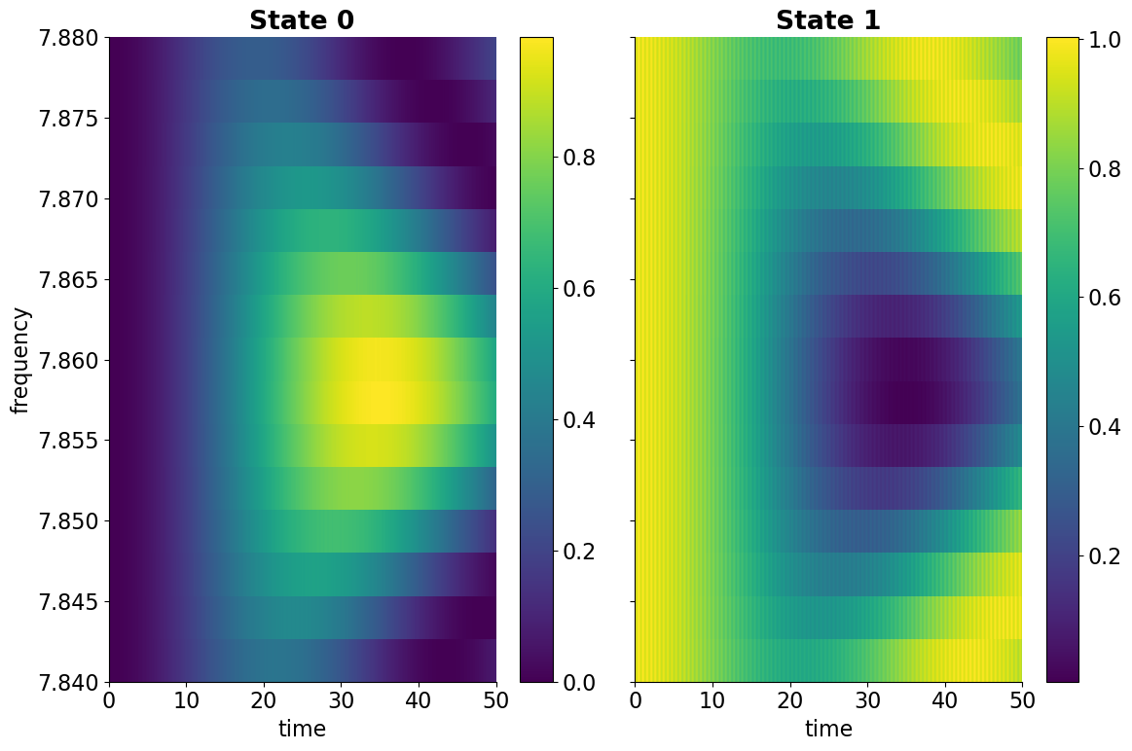
Qubit Drive
Group Meeting Update 31/5-23
qubit_drive = SquareCosinePulse(
frequency=np.linspace(7.84, 7.88, 15),
amplitude=0.1,
phase=0.0,
duration=50,
)
system = QubitResonatorSystem(
qubit,
resonator,
coupling_strength=2 * np.pi * 0.250,
qubit_pulse=qubit_drive,
)
# Create experiment
ground_state = system.get_states(0, 0)
excited_state = system.get_states(1, 0)
times = np.linspace(0, 50, 2000)
experiment = SchroedingerExperiment(
system,
[ground_state, excited_state],
times,
store_states=False,
only_store_final=False,
expectation_operators=[system.qubit_state_operator()],
save_path=experiment_path,
)
results = experiment.run()
analysis = automatic_analysis(results)

Slide 5
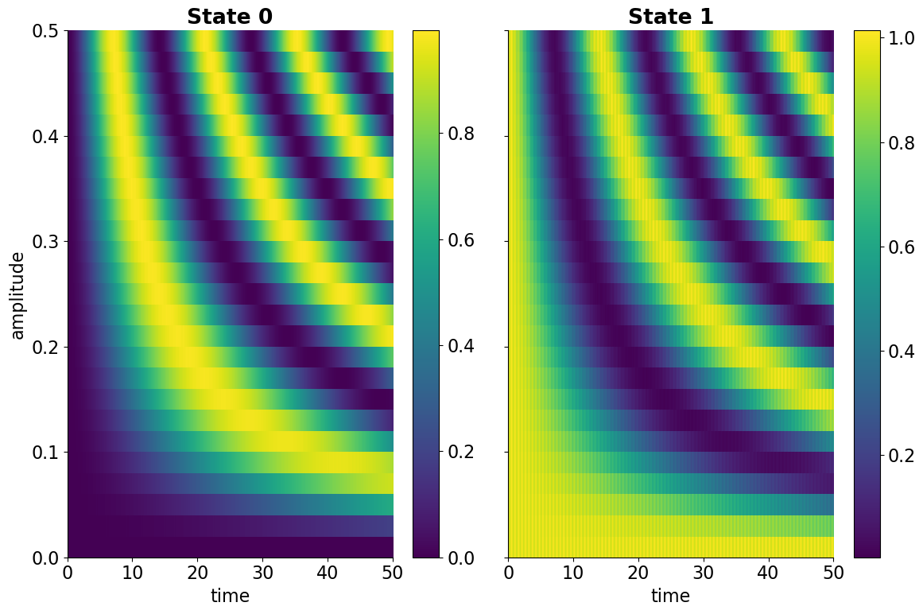
Qubit Drive
Group Meeting Update 31/5-23
qubit_drive = SquareCosinePulse(
frequency=7.86,
amplitude=np.linspace(0, 0.5, 15),
phase=0.0,
duration=50,
)
system = QubitResonatorSystem(
qubit,
resonator,
coupling_strength=2 * np.pi * 0.250,
qubit_pulse=qubit_drive,
)
# Create experiment
ground_state = system.get_states(0, 0)
excited_state = system.get_states(1, 0)
times = np.linspace(0, 50, 2000)
experiment = SchroedingerExperiment(
system,
[ground_state, excited_state],
times,
store_states=False,
only_store_final=False,
expectation_operators=[system.qubit_state_operator()],
save_path=experiment_path,
)
results = experiment.run()
analysis = automatic_analysis(results)

Slide 6
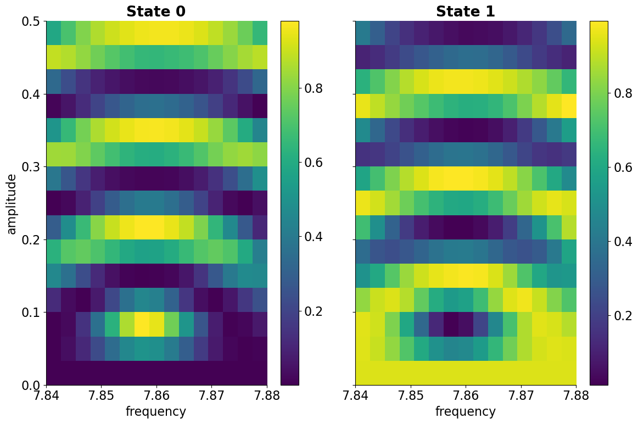
Qubit Drive
Group Meeting Update 31/5-23
qubit_drive = SquareCosinePulse(
frequency=np.linspace(7.84, 7.88, 15),
amplitude=np.linspace(0, 0.5, 15),
phase=0.0,
duration=50,
)
system = QubitResonatorSystem(
qubit,
resonator,
coupling_strength=2 * np.pi * 0.250,
qubit_pulse=qubit_drive,
)
# Create experiment
ground_state = system.get_states(0, 0)
excited_state = system.get_states(1, 0)
times = np.linspace(0, 50, 2000)
experiment = SchroedingerExperiment(
system,
[ground_state, excited_state],
times,
store_states=False,
only_store_final=False,
expectation_operators=[system.qubit_state_operator()],
save_path=experiment_path,
)
results = experiment.run()
analysis = automatic_analysis(results)

Slide 7
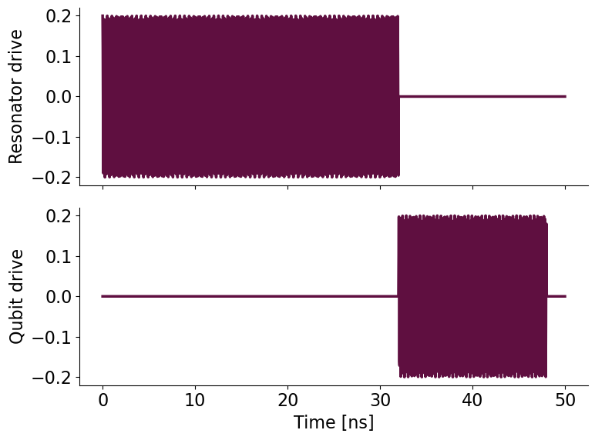
Use Case
Group Meeting Update 31/5-23
resonator_drive = SquareCosinePulse(
frequency=5.985,
amplitude=0.2
phase=0.0,
start_time=0,
duration=32,
)
qubit_drive = SquareCosinePulse(
frequency=7.86,
amplitude=0.2,
phase=0.0,
start_time=32,
duration=16,
)

Slide 8
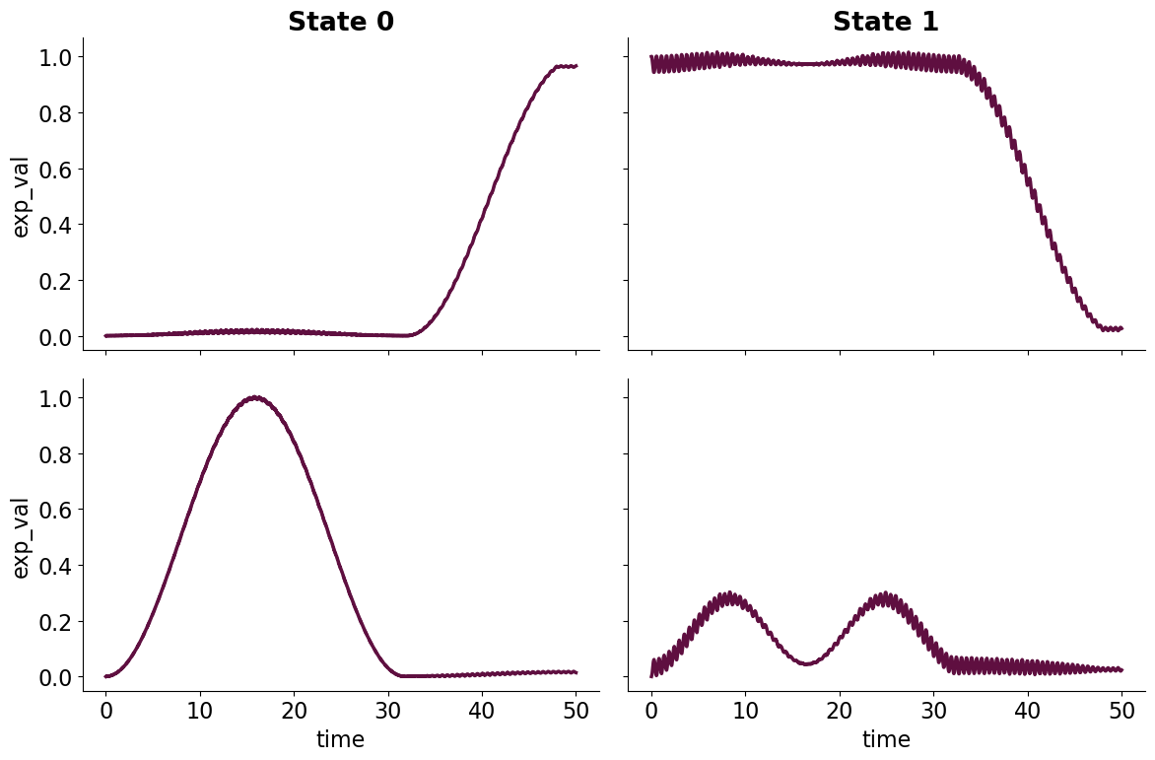
Use Case
Group Meeting Update 31/5-23

Slide 9
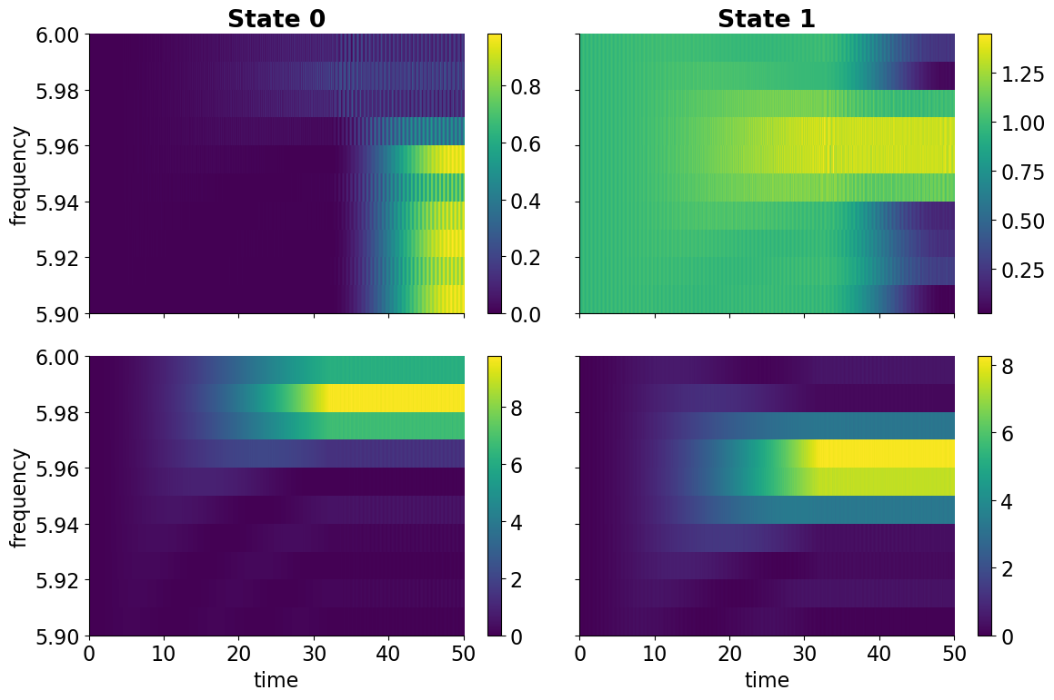
Use Case
Group Meeting Update 31/5-23

Slide 10
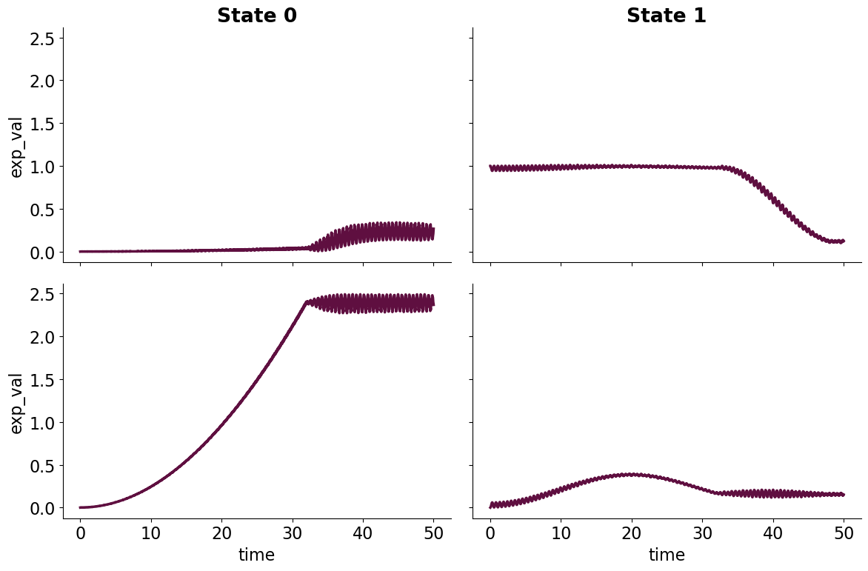
Use Case
Group Meeting Update 31/5-23

Slide 11
Use Case
Group Meeting Update 31/5-23

Slide 12
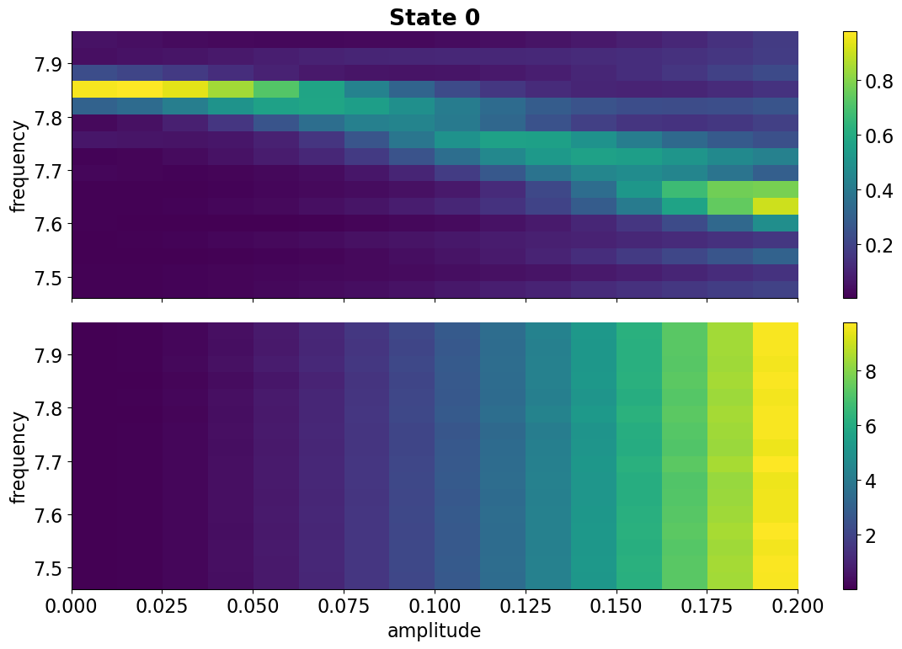
Use Case
Group Meeting Update 31/5-23
resonator_drive = SquareCosinePulse(
frequency=5.985,
amplitude=np.linspace(0.0, 0.2, 2),
phase=0.0,
start_time=0,
duration=32,
)
qubit_drive = SquareCosinePulse(
frequency=7.86 + np.linspace(-0.4, 0.1, 2),
amplitude=0.2,
phase=0.0,
start_time=32,
duration=16,
)

