Slide 1
Group Meeting Update 14/6-23
Johann Bock Severin
Cloaking
$$H=Σ_{k}ω_{k}|k⟩⟨k|+ω_{r}a^{†}a+H_{drive}+H_{int}$$

Slide 2
Cloaking
Johann Bock Severin
$$H=Σ_{k}ω_{k}|k⟩⟨k|+ω_{r}a^{†}a+H_{drive}+H_{int}$$
$$H_{int}=g \hat{n} |i⟩⟨j|(a+a^{†})$$

Slide 3
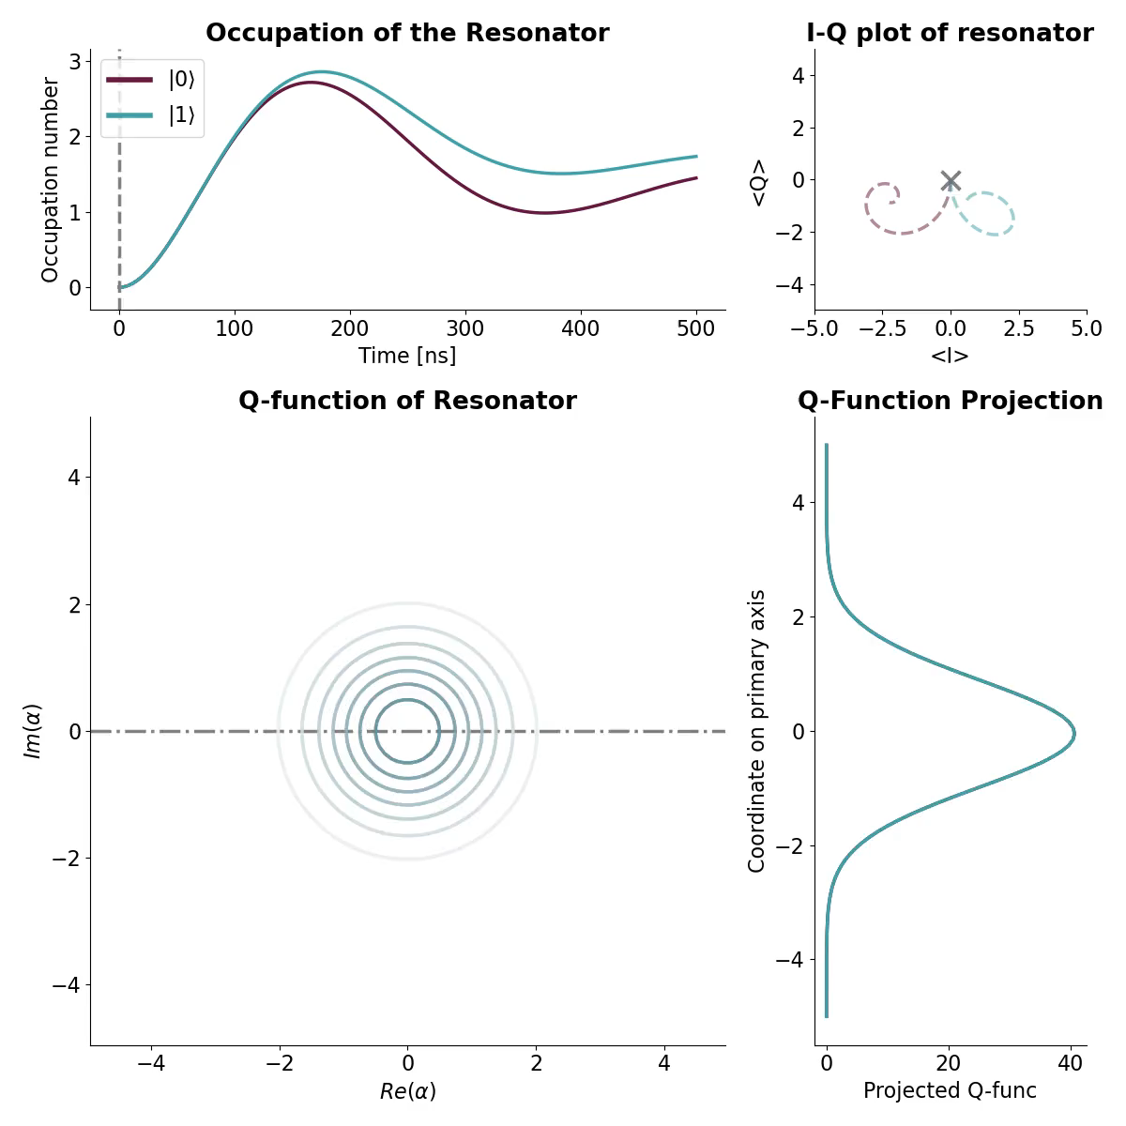
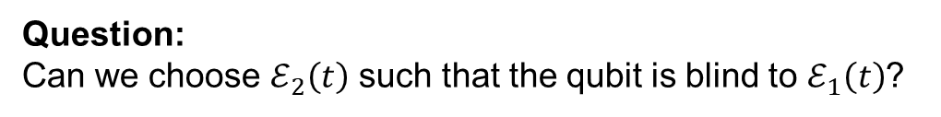


Cloaking
Johann Bock Severin
Hamiltonians:
Capacitively coupled to feed line:
$H=Σ_{k}ω_{k}|k⟩⟨k|+ω_{r}a^{†}a+g\hat{n}(a+a^{†})$
$H_{D}^{R}\left(t\right)=ℰ_{1}(t)(a+a^{†})$
$$H_{D}^{Q}\left(t\right)=ℰ_{2}\left(t\right)\hat{n}$$
Question:
Can we choose $ℰ_{2}\left(t\right)$ such that the qubit is blind to $ℰ_{1}\left(t\right)$?

Slide 4
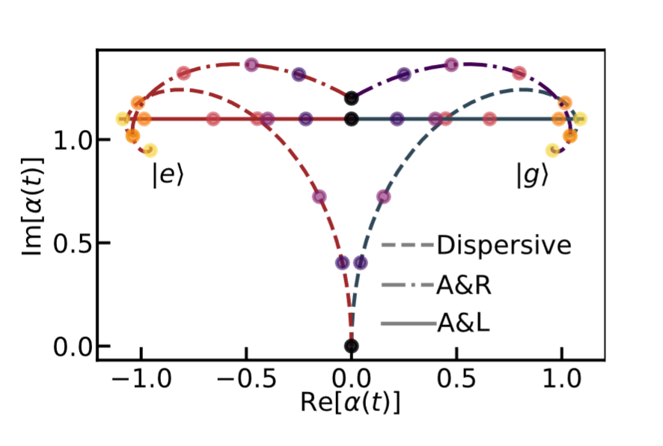
Cloaking
Johann Bock Severin
Hamiltonians:
Capacitively coupled to feed line:
$H=Σ_{k}ω_{k}|k⟩⟨k|+ω_{r}a^{†}a+g\hat{n}(a+a^{†})$
$H_{D}^{R}\left(t\right)=ℰ_{1}(t)(a+a^{†})$
$$H_{D}^{Q}\left(t\right)=ℰ_{2}\left(t\right)\hat{n}$$
Question:
Can we choose $ℰ_{2}\left(t\right)$ such that the qubit is blind to $ℰ_{1}\left(t\right)$?
Muñoz-Arias, Lledó and Blais, 2023

Slide 5

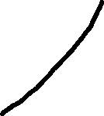


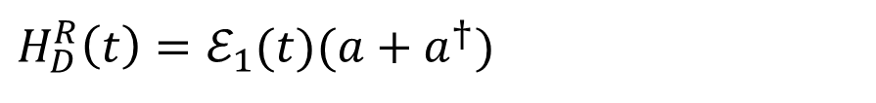

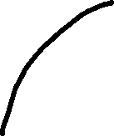
Cloaking
Johann Bock Severin
Displacement Operator:
Hamiltonians:
Capacitively coupled to feed line:
$$𝒟\left(α_{t}\right)a𝒟^{†}\left(α_{t}\right)=a+α_{t}$$
$H=Σ_{k}ω_{k}|k⟩⟨k|+ω_{r}a^{†}a+g\hat{n}(a+a^{†})$
$H_{D}^{R}\left(t\right)=ℰ_{1}(t)(a+a^{†})$
$$H_{D}^{Q}\left(t\right)=ℰ_{2}\left(t\right)\hat{n}$$
Question:
Can we choose $ℰ_{2}\left(t\right)$ such that the qubit is blind to $ℰ_{1}\left(t\right)$?
Idea:
Enter a reference frame where the resonator is always in the “vacuum” state.

Slide 6
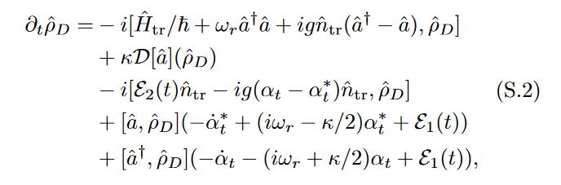


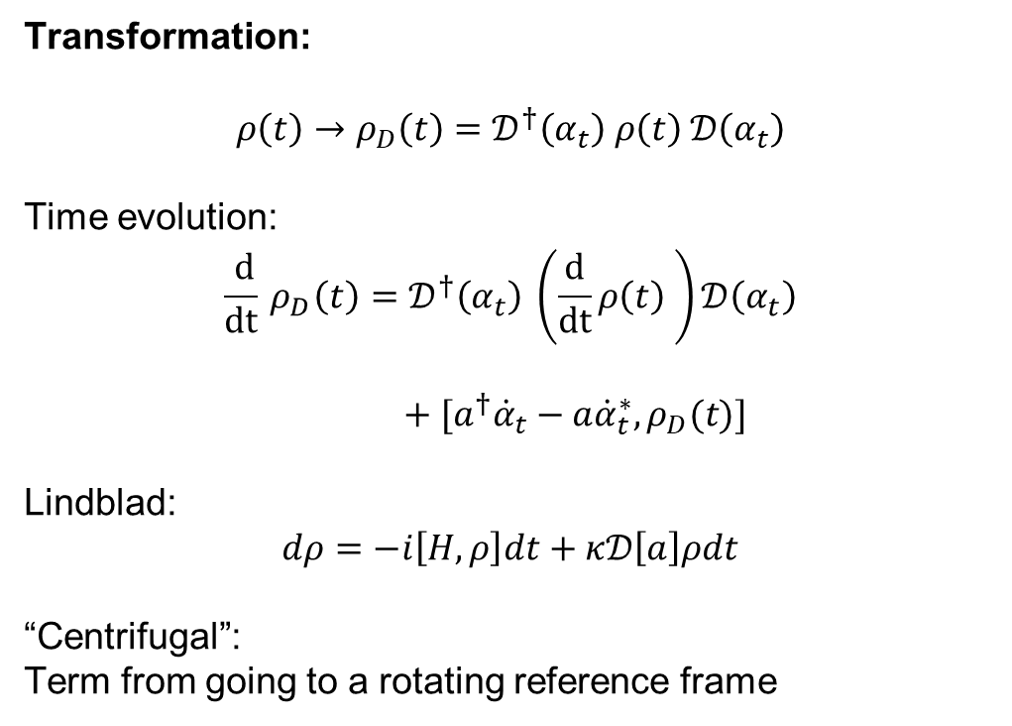

Cloaking
Johann Bock Severin
Hamiltonians:
Transformation:
$$ρ\left(t\right)→ρ_{D}\left(t\right)=𝒟^{†}\left(α_{t}\right) ρ\left(t\right) 𝒟\left(α_{t}\right)$$
Time evolution:
$$\frac{ d}{dt}{ ρ}_{D}\left(t\right)=𝒟^{†}\left(α_{t}\right) \left(\frac{d}{dt}ρ\left(t\right) \right)𝒟\left(α_{t}\right)$$
$+ [a^{†}{\dot{α}}_{t}−a{\dot{α}}_{t}^{∗},ρ_{D}(t)]$
Lindblad:
$$dρ=−i\left[H, ρ\right]dt+κ𝒟\left[a\right]ρdt$$
“Centrifugal”:
Term from going to a rotating reference frame
$H=Σ_{k}ω_{k}|k⟩⟨k|+ω_{r}a^{†}a+g\hat{n}(a+a^{†})$
$H_{D}^{R}\left(t\right)=ℰ_{1}(t)(a+a^{†})$
$$H_{D}^{Q}\left(t\right)=ℰ_{2}\left(t\right)\hat{n}$$
Time evolution:
Cristóbal Lledó et al.

Slide 7




Cloaking
Johann Bock Severin
Time evolution:
Regular Interacting Hamiltonian
Decay
Effective Qubit Drive
Effective Resonator Drive

Slide 8
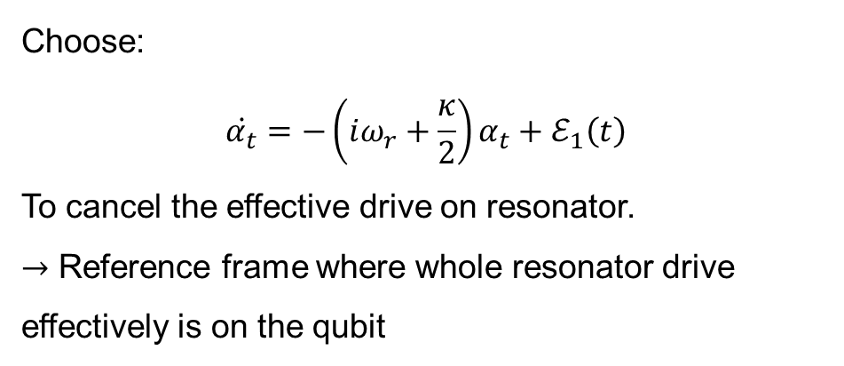
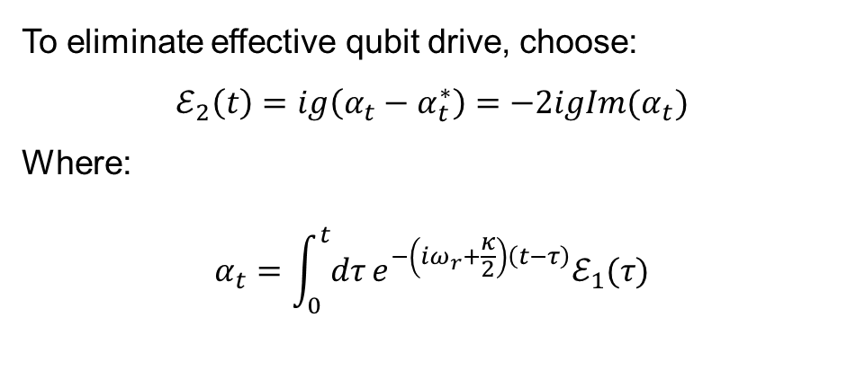
Cloaking
Johann Bock Severin
To eliminate effective qubit drive, choose:
$$ℰ_{2}\left(t\right)=ig\left(α_{t}−α_{t}^{∗}\right)=−2igIm(α_{t})$$
Where:
$$α_{t}=\int_{0}^{t}{dτ}e^{−\left(iω_{r}+\frac{κ}{2}\right)\left(t−τ\right)}ℰ_{1}(τ)$$
Time evolution:
Choose:
$$\dot{α_{t}}=−\left(iω_{r}+\frac{κ}{2}\right)α_{t}+ℰ_{1}\left(t\right)$$
To cancel the effective drive on resonator.
$→$ Reference frame where whole resonator drive effectively is on the qubit

Slide 9
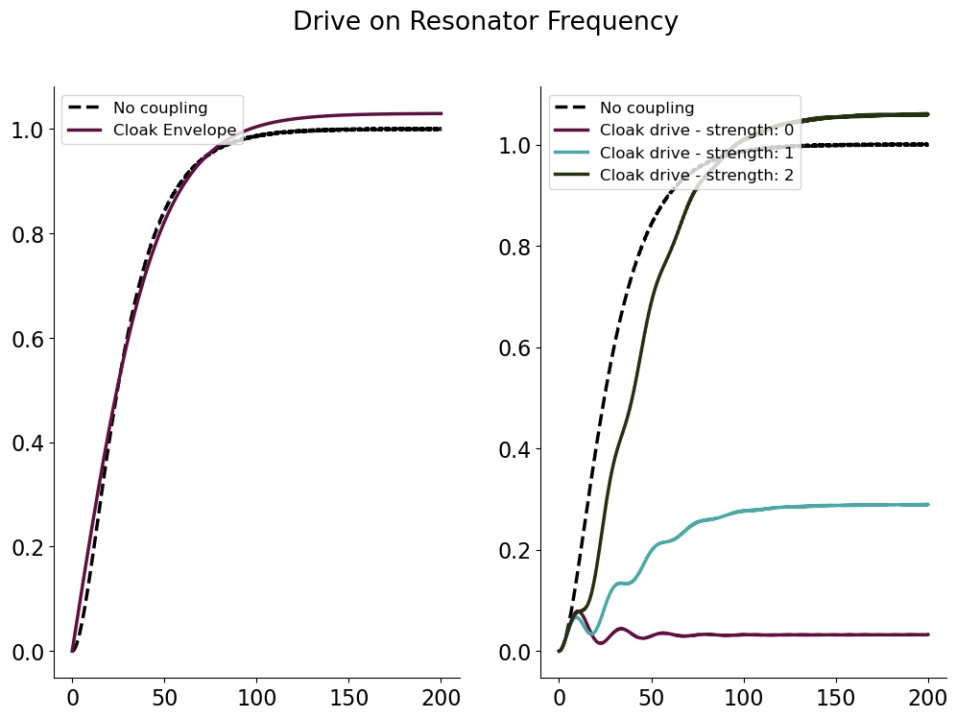
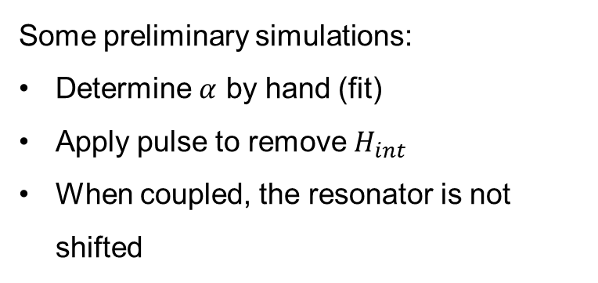
Cloaking
Johann Bock Severin
Some preliminary simulations:
Determine $α$ by hand (fit)
Apply pulse to remove $H_{int}$
When coupled, the resonator is not shifted
Cavity Photon Number
Time (ns)
Time (ns)

Slide 10
Cloaking
Johann Bock Severin
Some preliminary simulations:
Determine $α$ by hand (fit)
Apply pulse to remove $H_{int}$
When coupled, the resonator is not shifted

Slide 11
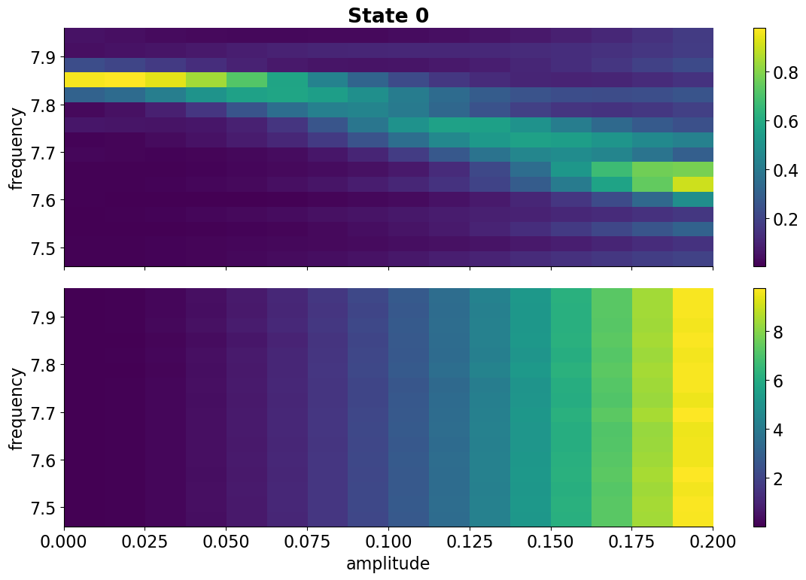
Cloaking
Johann Bock Severin

