Slide 1
Chapter 1
The Foundations: Logic and Proofs
1.1 Propositional Logic
1.2 Applications of Propositional Logic
1.3 Propositional Equivalences
1.4 Predicates and Quantifiers
1.5 Nested Quantifiers
1.6 Rules of Inference
1.7 Introduction to Proofs
1.8 Proof Methods and Strategy

Slide 2

Predicate
【Definition】A predicate (propositional function) is a statement that contains variables. Once the values of the variables are specified, the function has a truth value.
: n-place (n-ary) predicate
Examples
  P(x)=“x>3”
  Q(x,y)=“x is the best player of team y”
  R(x,y,z)=“x+y=z”

Slide 3
Predicate
Examples
  Let P(x) denote the statement "x > 0." What are the truth values of P(-3), P(0) and P(3)?
  P(-3)=“-3>0” F
  P0)=“0>0” F
  P(3)=“3>0” T
  Let Q(x, y) denote the statement “x < y.” What are the truth values of Q(4, 3) and Q(2, 7) ?
  Q(4, 3) =“4 < 3” F
  Q(2, 7) = “2 < 7” T

Slide 4
Quantifiers
Quantifications
  Every computer connected to the university network is functioning properly.
  Students in this class are smart.
Universal quantification
Existential quantification
Predicate logic (calculus): the area of logic that deals with predicate and quantifiers.

Slide 5
Universal Quantification
【Definition】A universal quantification of P(x), denoted by ∀ x P(x), is the statement “P(x) for all values of x in the domain. ”
∀ : universal quantifier
Domain (domain of discourse / universe of discourse): range of the possible values of the variable x
An element for which P(x) is false is called a counterexample of ∀ x P(x)
Example:
Let P(x) be the statement “x>0.” In the domain of all integers, x= -1 is a counterexample for ∀ x P(x).

Slide 6
Universal Quantification
Many ways to express universal quantification:
  For all
  For every
  All of
  For each
  Given any
  For arbitrary
  For any

Slide 7
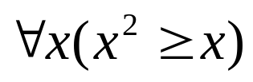
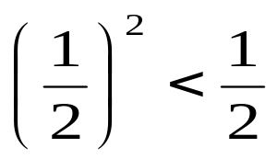
Universal Quantification
Examples:
What is the truth value of if the domain consists of all real numbers? What is the truth value of this statement if the domain consists of all integers?
Solution:
  If the domain consists of all real numbers.
  Because , is false
  If the domain consists of all integers.
  is true

Slide 8


Universal Quantification
Examples:
Express the following statement as a universal quantification: “All lions are fierce.”
Solution:
Let Q(x) denote the statement “x is fierce”.
  Assuming that the domain is the set of all lions.
  Assuming that domain is the set of all creatures.
Let P(x) denote the statement “x is a lion”.

Slide 9




Universal Quantification
Examples:
What is the truth value of ∀ x P(x), where P(x) is the statement “x<3” and the domain is ?
Solution:
Because P(3), which is the statement “3<3,” is false,
it follows that ∀ x P(x) is false.
Remark: Given the domain as ,

Slide 10
Existential Quantification
【Definition】An existential quantification of P(x), denoted by ∃ x P(x), is the statement “There exists an element x in the domain such that P(x). ”
∃ : existential quantifier
Other expressions:
For some x P(x)
There is an x such that P(x)
There is at least one x such that P(x)

Slide 11


Existential Quantification
Examples:
Express the following statement as an existential quantification. “Some real numbers are rational numbers. ”
Solution:
Let Q(y): y is a rational number
Assuming that the domain is the set of all real numbers.
(2) Assuming that the domain is the set of all complex numbers. Let R(y): y is a real number

Slide 12


Existential Quantification
Examples:
What is the truth value of ∃ x P(x), where P(x) is the statement “x<3” and the domain is ?
Solution:
Because P(1), which is the statement “1<3,” is true,
it follows that ∃ x P(x) is true.
Remark: Given the domain as ,

Slide 13
Quantifiers
Statement | When true? | When false?
∀x P(x) | P(x) is true for every x. | There is an x for which P(x) is false.
∃x P(x) | There is an x for which P(x) is true. | P(x) is false for every x.
Other Quantifiers
  Uniqueness quantifier: ∃! or ∃₁
  ∃! P(x)or ∃₁P(x): There exists a unique x such that P(x) is true.

Slide 14
Quantifiers with Restricted Domains
Example: What do the statements ∀ x<0 ( x²>0), ∃ y>0 (y²=2) mean, where the domain in each case consists of the real numbers?
Solution:
∀ x<0 ( x²>0)
For every real number x with x<0, x²>0
∃ y>0 (y²=2)
There exists a real number y with y>0 such that y²=2

Slide 15
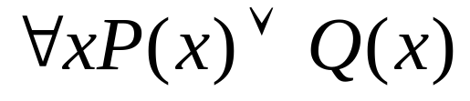
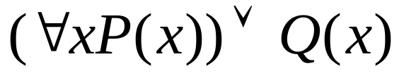
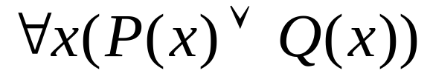
Precedence of Quantifiers
The quantifiers ∃ and ∀ have higher precedence than all logical operators from propositional calculus.
Example:
√
X

Slide 16
Binding Variables
Bound variable: a variable is bound if it is known or quantified.
Free variable: a variable neither quantified nor specified with a value
All the variables in a propositional function must be quantified or set equal to a particular value to turn it into a proposition.
Scope of a quantifier: the part of a logical expression to which the quantifier is applied
Examples
∃x (x+y)=1
∃x (P(x) ∧ Q(x)) ∨ ∀x R(x)

Slide 17
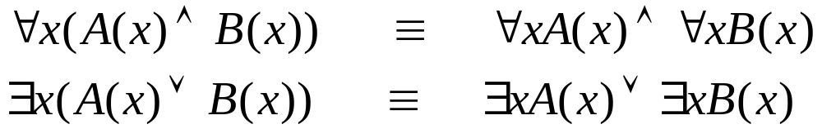
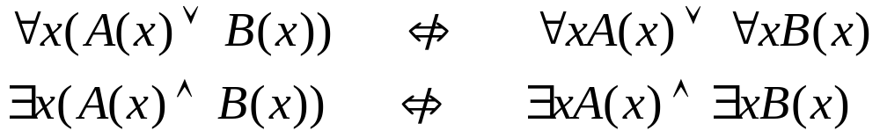
Logical Equivalences Involving Quantifiers
【Definition】 Statements involving predicates and quantifiers are logically equivalent iff they have the same truth
      for every predicate substituted into these statements and
      for every domain of discourse used for the variables in the expressions.
S≡T : two statements S and T involving predicates and quantifiers are logically equivalent.
Examples (Assuming all variables are in the same domain):

Slide 18
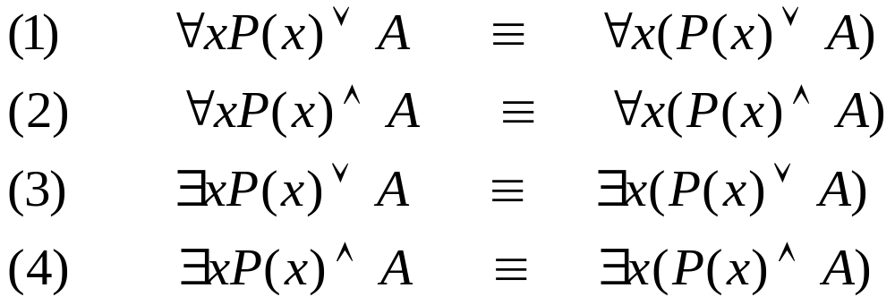
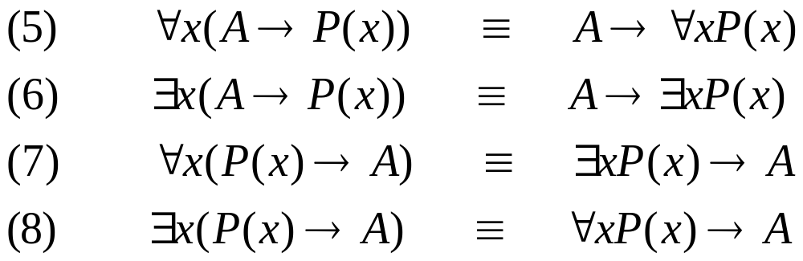



Logical Equivalences Involving Quantifiers
x is not occurring in A.
Proof:

Slide 19
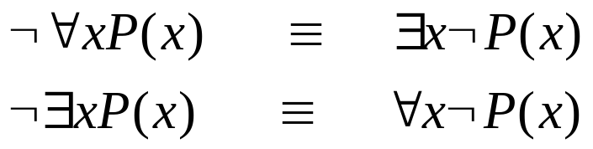




Negating Quantified Expressions
De Morgan’s laws for quantifiers
Example
Let P(x) be the statement “Student x has taken calculus.” Assume the domain consists of the students in our class.
  Express ∀x P(x) and its negation.
  Express ∃x P(x) and its negation.
Solution:
∀x P(x) : Every student in our class has taken calculus.
: There is a student in our class who has not taken calculus. ( )
∃ x P(x): There is a student in our class who has taken calculus.
: Every student in our class has not taken calculus. ( )

Slide 20
De Morgan’s Laws for Quantifiers
Negation | Equivalent Statement | When is Negation True? | When False?
¬∃x P(x) | ∀x ¬P(x) | P(x) is false for every x | There is an x for which P(x) is true
¬∀x P(x) | ∃x ¬P(x) | There is an x for which P(x) is false | P(x) is true for every x

Slide 21
Translating from English into Logical Expressions
Goal: To produce a logical expression that is simple and can be easily used in subsequent reasoning.
Steps:
  Clearly identify the appropriate quantifier(s)
  Introduce variable(s) and predicate(s)
  Translate using quantifiers, predicates, and logical operators
There can be many ways to translate a particular sentence.

Slide 22
Example
C(x): x is a CS student, E(x): x is a Math student, S(x): x is a smart student, and the domain consists of all students in our class
1) Everyone is a CS student.
2) Nobody is a Math student.
3) All CS students are smart students.
4) Some CS students are smart students.
∀x C(x)
∀x ¬ E(x) or ¬ ∃x E(x)
∀x (C(x) → S(x))
∃x (C(x) ∧ S(x))

Slide 23
Example
C(x): x is a CS student, E(x): x is an Math student, S(x): x is a smart student, and the domain consists of all students in our class
5) No CS student is an Math student.
  If x is a CS student, then that student is not a Math student.
  ∀x (C(x) → ¬ E(x))
  There does not exist a CS student who is also a Math student.
  ¬ ∃x [C(x) ∧ E(x)]
6) If any Math student is a smart student then he is also
a CS student.
  ∀x ((E(x) ∧ S(x)) → C(x))

Slide 24
Examples from Lewis Carroll [1]
“All lions are fierce”
“Some lions do not drink coffee”
“Some fierce creatures do not drink coffee”
Let P(x), Q(x), and R(x) be the statements “x is a lion”, “x is fierce”, and “x drinks coffee”, respectively. Assume the domain consists of all creatures.
∀x (P(x) → Q(x))
∃x (P(x) ∧ ¬ R(x))
∃x (Q(x) ∧ ¬ R(x))

Slide 25
Examples from Lewis Carroll [2]
“All hummingbirds are richly colored”
“No large birds live on honey”
“Birds that do not live on honey are dull in color”
“Hummingbirds are small”
Let P(x), Q(x), R(x), and S(x) be the statements “x is a hummingbird”, “x is large”, “x lives on honey”, and “x is richly colored”, respectively. Assume the domain consists of all birds.
∀x (P(x) → S(x))
¬∃x (Q(x) ∧ R(x))
∀x (¬R(x) → ¬S(x))
∀x (P(x) → ¬Q(x))

Slide 26
Translating from English into Logical Expressions
Tips
  All S(x) are O(x) : ∀x (S(x) → O(x))
  No S(x) are O(x) : ∀x (S(x) → ¬ O(x))
  Some S(x)’s are O(x) : ∃x (S(x) ∧ O(x))
  Some S(x) are not O(x) : ∃x (S(x) ∧ ¬ O(x))
Where S(x) and O(x) are propositional functions of variable x

Slide 27
Homework
Due on Mar. 9 (Monday)
Sec. 1.4
6(c,d,e,f), 9(b,d), 20(e), 24(b,d), 40(b), 44, 49(a), 60

