Slide 1
Chapter 1
The Foundations: Logic and Proofs
1.1 Propositional Logic
1.2 Applications of Propositional Logic
1.3 Propositional Equivalences
1.4 Predicates and Quantifiers
1.5 Nested Quantifiers
1.6 Rules of Inference
1.7 Introduction to Proofs
1.8 Proof Methods and Strategy

Slide 2
Valid Arguments
An argument is a sequence of statements that end with a conclusion
Proofs in mathematics are valid arguments
By valid, we mean the conclusion must follow from the truth of the preceding statements (premises)
We use rules of inference to construct valid arguments

Slide 3
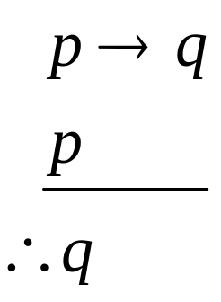
Valid Arguments in Propositional Logic
Example:
Determine whether the following is a valid argument
“If you have a current password, then you can log onto the network.”
“You have a current password.”
“You can log onto the network.”
Premises
Conclusion
Let p: “You have a current password”
q: “You can log onto the network”
Argument form:
therefore

Slide 4

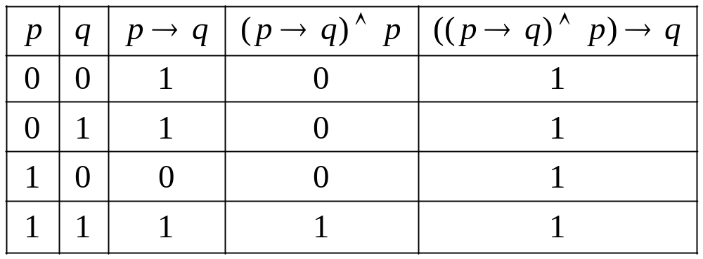
Valid Arguments in Propositional Logic
Example:
tautology
is a valid argument form
The sequence of propositions is a valid argument.

Slide 5
Valid Arguments in Propositional Logic
【Definition】
An argument in propositional logic is a sequence of propositions.
All but the final proposition in the argument are called premises and the final proposition is called the conclusion.
An argument is valid if the truth of all its premises implies that the conclusion is true.
An argument form in propositional logic is a sequence of compound propositions involving propositional variables.
An argument form is valid if no matter which particular propositions are substituted for the propositional variables in its premises, the conclusion is true if the premises are all true.

Slide 6
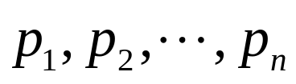

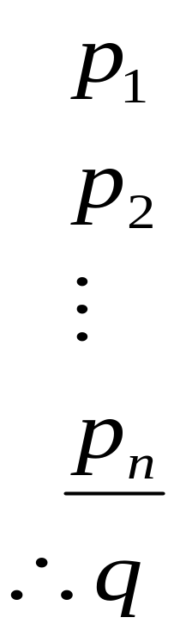
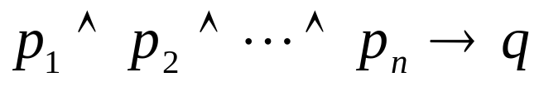
Valid Arguments in Propositional Logic
The argument form with premises and conclusion
therefore
is valid when is a tautology
An argument in propositional logic is valid when its argument form is valid.

Slide 7
Rules of Inference for Propositional Logic
Rules of inference are simple argument forms whose correctness we can establish with truth tables.

Slide 8
Rules of Inference for Propositional Logic
Modus ponens (Latin for mode that affirms)
p
p→q
∴q
It is snowing today
If it snows today, then we will go skiing
∴ We will go skiing

Slide 9
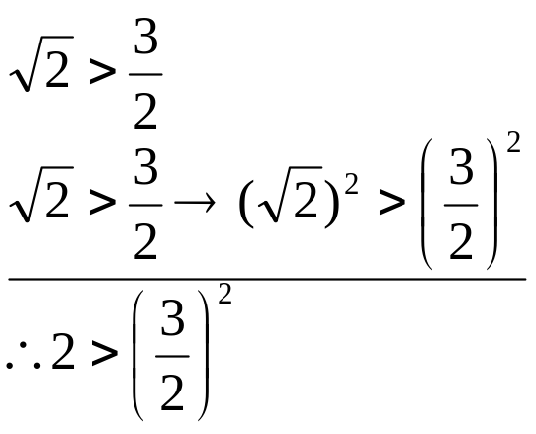
Rules of Inference for Propositional Logic
Modus ponens (Latin for mode that affirms)
p
p→q
∴q
A valid argument can lead to an incorrect conclusion if one of its premises is wrong/false!

Slide 10
Rules of Inference for Propositional Logic
Modus tollens (Latin for mode that denies)
¬ q
p→q
∴ ¬ p
We will not go skiing today
If it snows today, then we will go skiing
∴ It doesn’t snow today

Slide 11

Rules of Inference for Propositional Logic
Modus tollens (Latin for mode that denies)
¬ q
p→q
∴ ¬ p
Is this a tautology?
p | q | ¬q | p → q | ¬p
T | T | F | T | F
T | F | T | F | F
F | T | F | T | T
F | F | T | T | T

Slide 12
Rules of Inference for Propositional Logic
Modus tollens (Latin for mode that denies)
¬ q
p→q
∴ ¬ p
p | q | ¬q | p → q | ¬p
T | T | F | T | F | F T F
T | F | T | F | F | F T F
F | T | F | T | T | F T T
F | F | T | T | T | T T T

Slide 13
Rules of Inference for Propositional Logic
Modus tollens (Latin for mode that denies)
1. ¬ q
2. p→q
3. ¬ q→ ¬ p
4. ¬ p
Equivalence of Contrapositive, 2
Modus ponens, 1,3

Slide 14



Rules of Inference for Propositional Logic
Hypothetical Syllogism
p→q
q→ r
∴p→ r
Disjunctive syllogism
p∨q
¬p
∴ q
Addition
p
∴ p∨q

Slide 15



Rules of Inference for Propositional Logic
Simplification
p∧q
∴p
Conjunction
p
q
∴ p∧q
Resolution
p∨q
¬p∨r
∴ q∨r

Slide 16
Using Rules of Inference to Build Arguments
An argument is valid if
  whenever all premises are true, the conclusion is also true
To prove that an argument is valid:
  Assume the premises are true
  Use the rules of inference and logical equivalences to determine that the conclusion is true

Slide 17
Using Rules of Inference to Build Arguments
Example: Show that the premises “It is not sunny this afternoon,” “We will go swimming only if it is sunny,” “If we do not go swimming, then we will take a canoe trip,” and “If we take a canoe trip, then we will be home by sunset” lead to the conclusion “We will be home by sunset.”
Solution:
Construct an argument by using rules of inference and logical equivalences
Let p “It is sunny this afternoon”; r “We will go swimming”
s “We will take a canoe trip”; t “We will be home by sunset”
Step Reason
¬p Premise
r→ p Premise
¬r→ s Premise
s→ t Premise
¬r Modus tollens, 1,2
s Modus ponens, 3,5
t Modus ponens, 4,6
The argument form is
¬p
r→ p
¬r→ s
s→ t
∴ t

Slide 18
Using Rules of Inference to Build Arguments
Example: Show that ¬ w logically follows from the premises
Solution:
  Step Reason
  1. (w ∨ r)→ v Premise
  v→(c ∨ s) Premise
  s→u Premise
  ¬c ∧¬u Premise
  5. (w ∨ r) →(c ∨ s) Hypothetical syllogism, 1,2
  6. ¬u Simplification, 4
  7. ¬s Modus tollens, 3, 6
  8. ¬c Simplification, 4
  9. ¬s ∧ ¬c Conjunction, 7,8
  10. ¬ (c ∨ s) 9 and De Morgan’s law
  11. ¬ (w ∨ r) Modus tollens, 5,10
  12. ¬ w ∧ ¬r 10 and De Morgan’s law
  13. ¬ w Simplification, 12

Slide 19
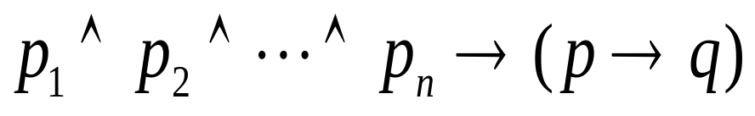
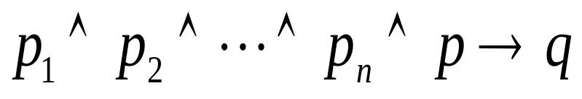
Using Rules of Inference to Build Arguments
Note
If the conclusion is given in a form of p → q, we can convert the argument
to
Because

Slide 20

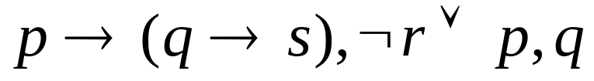
Using Rules of Inference to Build Arguments
Example: Show that logically follows from the premises
Solution:
  Step Reason
  ¬ r ∨ p Premise
  p → (q→ s) Premise
  q Premise
  4. r Additional premise
  5. p Disjunctive syllogism,1,4
  6. q→ s Modus ponens, 2, 5
  7. s Modus ponens, 3,6
  8. r → s

Slide 21
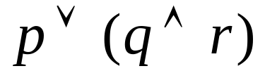


Using Rules of Inference to Build Arguments
Resolution rule
Construct arguments in propositional logic using resolution as the
only rule of inference
  Write the premises and the conclusion as clauses
  Use resolution rule
【Definition】A clause is a disjunction of variables or negations of the these variables
Example
proposition can be written as
two clauses and

Slide 22
Using Rules of Inference to Build Arguments
Resolution rule
Example: Show that the premises (p ∧ q) ∨ r and r → s imply the conclusion p ∨ s.
Solution:
(p ∧ q) ∨ r ≡ (p ∨ r) ∧ ( q ∨ r)
r → s ≡ ¬ r ∨ s
((p ∨ r) ∧(¬ r ∨ s )) → p∨s

Slide 23
Fallacies
Examples
If you overslept, you’ll be late.
You didn’t oversleep.
Therefore: You aren’t late.
p→q
¬ p
∴ ¬ q
Fallacy of denying the hypothesis
If you are in China, you’re in Asia.
You are in Asia.
Therefore: You are in China.
p→q
q
∴ p
Fallacy of affirming the conclusion

Slide 24
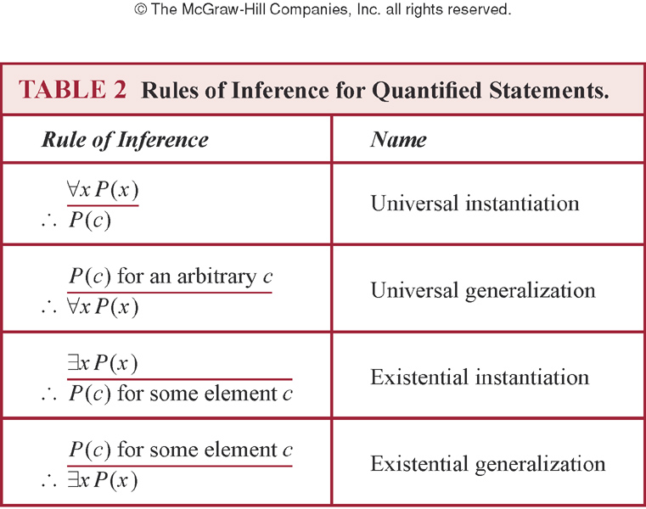
Rules of Inference for Quantified Statements

Slide 25
Rules of Inference for Quantified Statements
Examples:
Everyone in the discrete math class has taken a CS course. Marla is a student in the discrete class. Therefore, Marla has taken a CS course. Assume the domain consists of all people.
Solution:
∀x(D(x) → C(x))
D(Marla)
∴ C(Marla)
Let D(x): x is in the discrete math class
C(x): x has taken a CS course
∀x(D(x) → C(x)) Premise
D(Marla) Premise
3. D(Marla) → C(Marla) UI, 1
4. C(Marla) Modus ponens, 2,3

Slide 26













Rules of Inference for Quantified Statements
Examples:
Each member of the committee is teacher and expert. Some members of the committee are young. Therefore, some members of the committee are young experts.
Solution:
Step Reason
Let F(x) be “x is a member of the committee,” G(x) be “x is an expert,” H(x) be “x is a teacher”, R(x) be “ x is young.”
Premises
Premise
EI, 1
UI, 2
Simplification, 3
Modus ponens, 4,5
Simplification, 6
Simplification ,2
Conjunction,5,7,8
EG,9

Slide 27
Combining Rules of Inference for Propositions and Quantified Statements
Universal modus ponens
  ∀ x(P(x)→Q(x))
  P(a), where a is a particular element in the domain
  ∴ Q(a)
Example:
Assume that “For all positive integers n, if n is greater than 4,then n² is less than 2^{n}” is true. Use universal modus ponens to show that 100²<2¹⁰⁰.

Slide 28
Combining Rules of Inference for Propositions and Quantified Statements
Universal modus tollens
  ∀ x(P(x)→Q(x))
  ¬ Q(a), where a is a particular element in the domain
  ∴ ¬ P(a)

Slide 29





Combining Rules of Inference for Propositions and Quantified Statements
Example: Determine whether the following argument is valid.
Premise
UI using Step 1
EI using Step 2
UG using Step 3
EG using Step 3

Slide 30
Homework
Sec. 1.6 Due on Mar. 16 (Mon.)
12, 14(d), 18, 24, 29, 34(a)

