Slide 1
CHAPTER 10 Graphs
10.1 Graphs and Graph Models
10.2 Graph Terminology and Special Types of Graphs
10.3 Representing Graphs and Graph Isomorphism
10.4 Connectivity
10.5 Euler and Hamilton Paths
10.6 Shortest Path Problems
10.7 Planar Graphs
10.8 Graph Coloring

Slide 2
10.2 Graph Terminology and Special Types of Graphs
1. Basic Terminology
a
d
f
Undirected Graphs G=(V, E)
b
e
c
Vertex, edge
Two vertices, u and v in an undirected graph G are called adjacent (or neighbors) in G, if {u, v} is an edge of G.
An edge e connecting u and v is called incident with vertices u and v, or is said to connect u and v.
The vertices u and v are called endpoints of edge {u, v}.
loop
The degree of a vertex in an undirected graph is the number of edges incident with it, except that a loop at a vertex contributes twice to the degree of that vertex
Notation: deg(v)
  If deg(v) = 0, v is called isolated.
  If deg(v) = 1, v is called pendant.

Slide 3
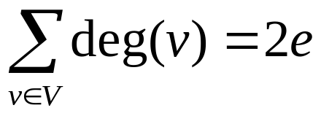
10.2 Graph Terminology and Special Types of Graphs
【 Theorem 1】 The Handshaking Theorem
Let G = (V, E) be an undirected graph with e edges. Then
The sum of the degrees over all the vertices is twice the number of edges.
Proof:
Each edge contributes twice to the degree count of all vertices.
Note:
This applies even if multiple edges and loops are present.

Slide 4
10.2 Graph Terminology and Special Types of Graphs
Qusetions:
If a graph has 5 vertices, can each vertex have degree 3? 4?
  The sum is 3•5 = 15 which is an odd number.
  Not possible.
  The sum is 20 = 2 | E | and 20/2 = 10.
  Possible.

Slide 5

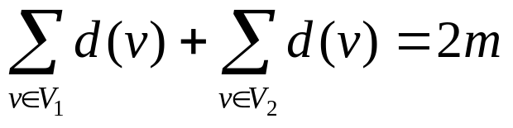
10.2 Graph Terminology and Special Types of Graphs
【 Theorem 2】 An undirected graph has an even number of
vertices of odd degree.
Proof:
Let be the set of vertices of even degree and the set of vertices of odd degree, respectively.

Slide 6
10.2 Graph Terminology and Special Types of Graphs
a
Directed Graphs G=(V, E)
d
b
e
c
Let (u, v) be an edge in G. Then u is an initial vertex and is adjacent to v and v is a terminal vertex and is adjacent from u.
The in degree of a vertex v, denoted deg⁻(v) is the number of edges which terminate at v.
Similarly, the out degree of v, denoted deg⁺(v), is the number of edges which initiate at v.
underlying undirected graph

Slide 7
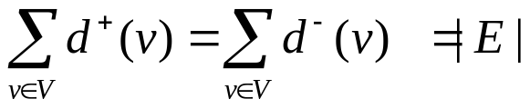
10.2 Graph Terminology and Special Types of Graphs
【 Theorem 3】 Let G = (V, E) be a graph with direct edges.
Then

Slide 8
10.2 Graph Terminology and Special Types of Graphs
2. Some Special Simple Graphs
(1) Complete Graphs - K_{n}: the simple graph with
  - n vertices
  - exactly one edge between every pair of distinct vertices.
The graphs K_{n} for n=1,2,3,4,5.
K₁
K₂
K₃
K₄
K₅
Qusetion:
The number of edges in K_{n} ?

Slide 9
10.2 Graph Terminology and Special Types of Graphs
(2) Cycles C_{n} (n>2)
C₃
C₄
C₅
C₆

Slide 10
10.2 Graph Terminology and Special Types of Graphs
(3) Wheels W_{n} (n>2)
Add one additional vertex to the cycle C_{n} and add an edge from each vertex in C_{n} to the new vertex to produce W_{n}.
W₃
W₄
W₅
W₆

Slide 11
10.2 Graph Terminology and Special Types of Graphs
(4) n-Cubes Q_{n} (n>0)
Q_{n} is the graph with 2^{n} vertices representing bit strings of length n. An edge exists between two vertices that differ in exactly one bit position.
110
111
10
11
100
101
010
011
0
1
00
01
000
001
Q₁
Q₂
Q₃

Slide 12
10.2 Graph Terminology and Special Types of Graphs
3. Bipartite Graphs
A simple graph G is bipartite if V can be partitioned into two disjoint subsets V₁ and V₂ such that every edge connects a vertex in V₁ and a vertex in V₂.
Note:
There are no edges which connect vertices in V₁ or in V₂.
For example,
v₁
v₂
v₃
v₅
v₄

Slide 13
10.2 Graph Terminology and Special Types of Graphs
〖Example 1〗 Is C₃ bipartite?
v₁
v₂
v₃
No.

Slide 14
10.2 Graph Terminology and Special Types of Graphs
〖Example 2〗 Is C₆ bipartite?
v₁
v₆
v₂
v₅
v₃
v₄
Yes. Because we can display C₆ like this:
v₁
v₆
v₅
v₂
v₃
v₄

Slide 15
10.2 Graph Terminology and Special Types of Graphs
The complete bipartite graph is the simple graph that has its vertex
set partitioned into two subsets V₁ and V₂ with m and n vertices,
respectively, and every vertex in V₁ is connected to every vertex in
V₂, denoted by K_{m,n}, where m = | V₁ | and n = | V₂ |.
For example,
A Star network is a K_{1,n}
(2) K_{3,2}

Slide 16
10.2 Graph Terminology and Special Types of Graphs
【 Theorem 4】 A simple graph is bipartite if and only if it is
possible to assign one of two different colors to each vertex
of the graph so that no two adjacent vertices are assigned the
same color.
Proof:
Suppose that G=(V, E) is a bipartite simple graph. Then V=V₁∪V₂,where V₁,V₂ are disjoint sets and every edge in E connects a vertex in V₁ and a vertex in V₂ .
Suppose that it is possible to assign colors to the vertices of the graph using just two colors so that no two adjacent vertices are assigned the same color.

Slide 17

10.2 Graph Terminology and Special Types of Graphs
Regular graph
A simply graph is called regular if every vertex of this graph has the same degree.
A regular graph is called n-regular if every vertex in this graph has degree n.
For example,
(1) is a (n-1)-regular.
(2) For which values of m and n is K_{m,n} regular?

Slide 18
10.2 Graph Terminology and Special Types of Graphs
4. Some applications of special types of graphs
〖Example 3〗 Local Area Networks.
Star topology
Ring topology
Hybrid topology

Slide 19


10.2 Graph Terminology and Special Types of Graphs
5. New Graphs from Old
【Definition】 G= (V, E) , H= (W, F)
H is a subgraph of G if .
subgraph H is a proper subgraph of G if H≠G.
H is a spanning subgraph of G if .
For example,
subgraph of K₅
K₅

Slide 20
10.2 Graph Terminology and Special Types of Graphs
〖Example 4〗 How many subgraphs with at least one vertex does W₃ have?
Solution:

Slide 21
10.2 Graph Terminology and Special Types of Graphs
The union of G₁and G₂
The union of two simple graphs G₁ = ( V₁ , E₁ ) and G₂ = ( V₂ , E₂ ) is the simple graph with vertex set V = V₁ ∪ V₂ and edge set E = E₁ ∪ E₂ .
Notation: G₁ ∪ G₂
For example,
e
e
a
d
a
d
a
d
b
c
b
c
b
c
G₁
G₂
G₁ ∪ G₂ = K₅

Slide 22
Homework: (Due on May 18 )
Sec. 10.2 5, 24, 25, 42(b, f, h), 53, 60

Slide 23
CHAPTER 10 Graphs
10.1 Graphs and Graph Models
10.2 Graph Terminology and Special Types of Graphs
10.3 Representing Graphs and Graph Isomorphism
10.4 Connectivity
10.5 Euler and Hamilton Paths
10.6 Shortest Path Problems
10.7 Planar Graphs
10.8 Graph Coloring

Slide 24
10.3 Representing Graphs and Graph Isomorphism
1. Representing Graphs
Methods for representing graphs:
  Graphs
  Adjacency lists
  -- lists that specify all the vertices that are adjacent to each vertex
  Adjacency matrices
  Incidence matrices
An adjacency list for a directed graph
Initial vertex | terminal vertices
a b c d e | b,c,d,e b,d a,c,e b,c,d
An adjacency list for a simple graph
vertex | Adjacent vertices
a b c d e | b,c,e a a,d,e c,e a,c,d

Slide 25

10.3 Representing Graphs and Graph Isomorphism
2. Adjacency Matrices
A simple graph G = (V, E) with n vertices ( ) can be represented by its adjacency matrix, A, with respect to this listing of the vertices, where
a_{ij} = 1 if {v_{i}, v_{j}} is an edge of G,
a_{ij} = 0 otherwise.
Note: An adjacency matrix of a graph is based on the ordering chosen for the vertices.

Slide 26
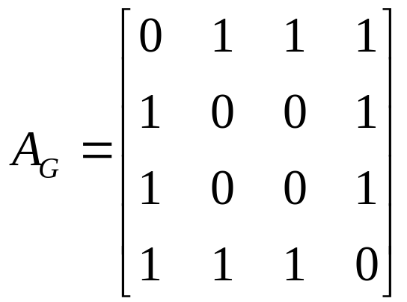
10.3 Representing Graphs and Graph Isomorphism
Note: Adjacency matrices of undirected graphs are always symmetric.
〖Example 1〗 What is the adjacency matrix A_{G} for the following graph G based on the order of vertices a, b, c, d ?
a
Solution:
b
d
c

Slide 27
10.3 Representing Graphs and Graph Isomorphism
  The adjacency matrix of a multigraph or pseudograph
For the representation of graphs with multiple edges, we can no longer use zero-one matrices.
Instead, we use matrices of nonnegative integers.
The (i, j)th entry of such a matrix equals the number of edges that are associated to {v_{i}, v_{j}}.

Slide 28
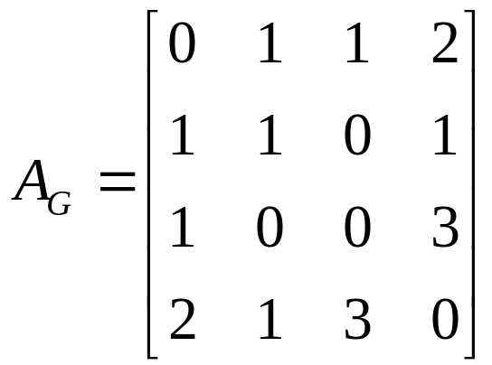
10.3 Representing Graphs and Graph Isomorphism
〖Example 2〗 What is the adjacency matrix A_{G} for the following graph G based on the order of vertices a, b, c, d ?
a
Note: For undirected multigraph or pseudograph , adjacency matrices are symmetric.
b
d
c
Solution:

Slide 29
10.3 Representing Graphs and Graph Isomorphism
  The adjacency matrix of a directed graph
Let G = (V, E) be a directed graph with |V| = n. Suppose that the vertices of G are listed in an arbitrary order as v₁, v₂, …, v_{n}.
The adjacency matrix A (or A_{G}) of G, with respect to this listing of the vertices, is the n×n zero-one matrix with 1 as its (i, j)th entry when there is an edge from v_{i} to v_{j}, and 0 otherwise.
In other words, for an adjacency matrix A = [a_{ij}],
a_{ij} = 1 if (v_{i}, v_{j}) is an edge of G,
a_{ij} = 0 otherwise.

Slide 30
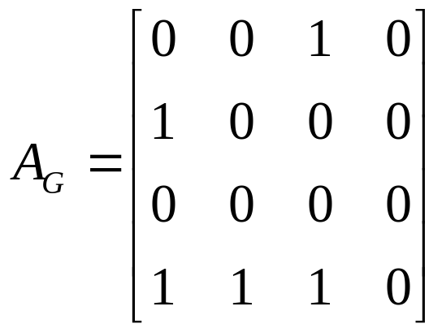
10.3 Representing Graphs and Graph Isomorphism
〖Example 3〗 What is the adjacency matrix A_{G} for the following graph G based on the order of vertices a, b, c, d ?
a
b
d
c
Solution:

Slide 31
10.3 Representing Graphs and Graph Isomorphism
Question:
What is the sum of the entries in a row of the adjacency matrix for an undirected graph?
a
b
d
c

Slide 32
10.3 Representing Graphs and Graph Isomorphism
Question:
What is the sum of the entries in a row of the adjacency matrix for an undirected graph?
The number of edges incident to the vertex i, which is the same as degree of i minus the number of loops at i.
For a directed graph?
a
b
d
c

Slide 33
10.3 Representing Graphs and Graph Isomorphism
Question:
What is the sum of the entries in a row of the adjacency matrix for an undirected graph?
The number of edges incident to the vertex i, which is the same as degree of i minus the number of loops at i.
For a directed graph?
deg⁺(v_{i})
What is the sum of the entries in a column of the adjacency matrix for an undirected graph?
The number of edges incident to the vertex i, which is the same as degree of i minus the number of loops at i.
For a directed graph?
deg⁻(v_{i})

Slide 34


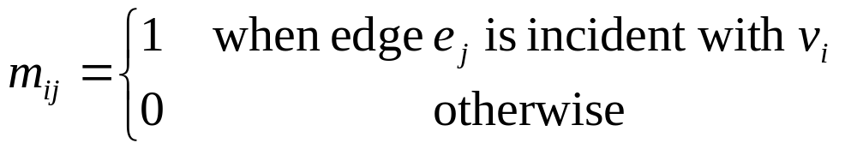
10.3 Representing Graphs and Graph Isomorphism
3. Incidence matrices
Let G = (V, E) be an undirected graph. Suppose that
are the vertices and are the edges of G. Then the incidence matrix with respect to this ordering of V and E is n×m matrix , where

Slide 35
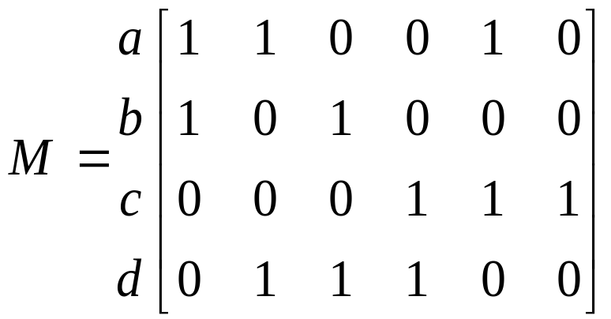
9.3 Representing Graphs and Graph Isomorphism
〖Example 4〗 What is the incidence matrix M for the following graph G based on the order of vertices a, b, c, d and edges 1, 2, 3, 4, 5, 6?
a
1
2
b
d
3
5
4
c
Solution:
6
Note:
Incidence matrices of undirected graphs contain two 1s per column for edges connecting two distinct vertices and one 1 per column for loops.

Slide 36
10.3 Representing Graphs and Graph Isomorphism
4. Isomorphism of Graphs
Graphs with the same structure are said to be isomorphic.
Formally, two simple graphs G₁= (V₁, E₁) and G₂= (V₂, E₂) are isomorphic if there is a 1-1 and onto function f from V₁ to V₂ such that for all a and b in V₁, a and b are adjacent in G₁ iff f(a) and f(b) are adjacent in G₂.
Such a function f is called an isomorphism.
In other words, when two simple graphs are isomorphic, there is a one-to-one correspondence between vertices of the two graphs that preserves the adjacency relationship.

Slide 37
10.3 Representing Graphs and Graph Isomorphism
For example,
a
a' (b)
b
d‘(d)
d
c
c' (a)
b' (c)

Slide 38
10.3 Representing Graphs and Graph Isomorphism
Question:
How to determine whether two simple graphs are isomorphic?
It is usually difficult since there are n! possible 1-1 correspondence between the two vertex sets with n vertices. However, some properties (called invariants) in the graphs may be used to show that they are not isomorphic.
invariants
-- things that G₁ and G₂ must have in common to be isomorphic.

Slide 39
10.3 Representing Graphs and Graph Isomorphism
Important invariants in isomorphic graphs:
  the number of vertices
  the number of edges
  the degrees of corresponding vertices
  if one is bipartite, the other must be
  if one is complete, the other must be
  if one is a wheel, the other must be
  etc.

Slide 40
10.3 Representing Graphs and Graph Isomorphism
〖Example 5〗 Are the following two graphs isomorphic?
a
a
b
e
e
b
c
d
c
d
Solution:
They are isomorphic, because they can be arranged to look identical.
You can see this if in the right graph you move vertex b to the left of the edge {a, c}. Then the isomorphism f from the left to the right graph is:
f(a) = e, f(b) = a,
f(c) = b, f(d) = c, f(e) = d.

Slide 41
10.3 Representing Graphs and Graph Isomorphism
〖Example 6〗 Show that the following two graphs are isomorphic.
u₁
u₂
v₁
v₂
u₅
v₅
v₃
u₃
v₄
u₄
Proof:
Try to find an 1-1 and onto function f
Show that f isomorphism (preserves adjacency relation)
- The adjacency matrix of a graph G is the same as the adjacency matrix of another graph H, when rows and columns are labeled to correspond to the images under f of the vertices in G that are the labels of these rows and columns in the M_{G}

Slide 42
10.3 Representing Graphs and Graph Isomorphism
〖Example 7〗 Determine whether the given pair of graphs is isomorphic?
(1)
(2)
(3)

Slide 43
Homework: (Due on May 18)
Sec. 10.3 8, 15, 17, 34-37

