Slide 1
CHAPTER 11 Trees
11.1 Introduction to Trees
11.2 Applications of Trees
11.3 Tree Traversal
11.4 Spanning Trees
11.5 Minimum Spanning Trees

Slide 2
1. Traversal Algorithms
11.3 Tree Traversal
A traversal algorithm is a procedure for systematically visiting every vertex of an ordered rooted tree.
Tree traversals are defined recursively.
Three traversals are named:
      preorder,
      inorder,
      postorder.

Slide 3
PREORDER Traversal Algorithm
11.3 Tree Traversal
【Definition】 Let T be an ordered tree with root r. If T has only r, then r is the preorder traversal of T. Otherwise, suppose T₁, T₂ , …, T_{n} are the subtrees at r from left to right in T. The preorder traversal begins by visiting r. Then traverses T₁ in preorder, then traverses T₂ in preorder, and so on, until T_{n} is traversed in preorder.
Note:
Preorder traversal of an binary ordered tree
    Visit the root.
    Visit the left subtree, using preorder.
    Visit the right subtree, using preorder.

Slide 4
Preorder Traversal:
11.3 Tree Traversal
J E A H T M Y
Visit first.
ROOT
‘J’
‘E’
‘T’
‘A’
‘H’
‘M’
‘Y’
Visit left subtree second
Visit right subtree last

Slide 5
INORDER Traversal Algorithm
11.3 Tree Traversal
【Definition】 Let T be an ordered tree with root r. If T has only r, then r is the inorder traversal of T. Otherwise, suppose T₁, T₂,…, T_{n} are the left to right subtrees at r. The inorder traversal begins by traversing T₁ in inorder. Then visits r, then traverses T₂ in inorder, and so on, until T_{n} is traversed in inorder.
Note:
Inorder traversal of an binary ordered tree
  Visit the left subtree, using inorder.
  Visit the root.
  Visit the right subtree, using inorder.

Slide 6
Inorder Traversal:
11.3 Tree Traversal
A E H J M T Y
Visit second
ROOT
‘J’
‘E’
‘T’
‘A’
‘H’
‘M’
‘Y’
Visit left subtree first
Visit right subtree last

Slide 7
POSTORDER Traversal Algorithm
11.3 Tree Traversal
【Definition】 Let T be an ordered tree with root r. If T has only r, then r is the postorder traversal of T. Otherwise, suppose T₁, T₂,…, T_{n} are the left to right subtrees at r. The postorder traversal begins by traversing T₁ in postorder. Then traverses T₂ in postorder, until T_{n} is traversed in postorder, finally ends by visiting r.
Note:
Postorder traversal of an binary ordered tree
    Visit the left subtree, using postorder.
    Visit the right subtree, using postorder.
    Visit the root.

Slide 8
11.3 Tree Traversal
Postorder Traversal:
A H E M Y T J
Visit last
ROOT
‘J’
‘E’
‘T’
‘A’
‘H’
‘M’
‘Y’
Visit left subtree first
Visit right subtree second

Slide 9
11.3 Tree Traversal
〖Example 1〗 In which order does a preorder, inorder or postorder traversal visit the vertices in the ordered rooted tree shown in the following figure?
a
b
c
d
f
e
g
h
i
Preorder traversal : a, b, d, c, e, g, f, h, i
Inorder traversal : d, b, a, e, g, c, h, f, i
Postorder traversal : d, b, g, e, h, i, f, c, a

Slide 10
2. Infix, prefix, and postfix notation
11.3 Tree Traversal
Complicated expressions can be represented using ordered rooted trees, such as
      Compound propositions
      Combinations of sets
      Arithmetic expressions

Slide 11
A Binary Expression Tree is . . .
11.3 Tree Traversal
A special kind of binary tree in which:
1. Each leaf node contains a single operand,
2. Each nonleaf node contains a single operator, and
3. The left and right subtrees of an operator node represent subexpressions that must be evaluated before applying the operator at the root of the subtree.

Slide 12
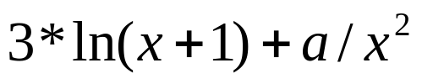
11.3 Tree Traversal
〖Example 2〗 What is the ordered tree that represents the expression ?
Solution:
+
*
/
3
ln
a
↑
+
x
2
x
1

Slide 13
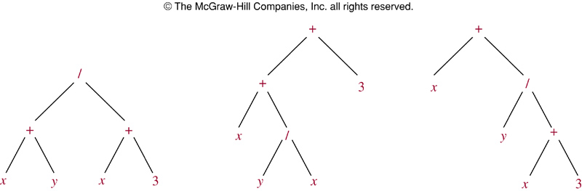

Slide 14
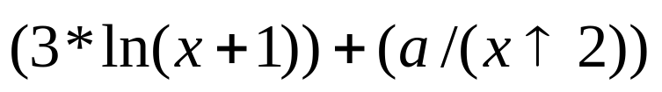
Infix Form
11.3 Tree Traversal
The fully parenthesized expression obtained by an inorder traversal of the binary tree is said to be in infix form.
For example,
+
*
/
3
ln
a
↑
+
x
2
x
1
Infix form:

Slide 15

Prefix Form
10.3 Tree Traversal
The expression obtained by an preorder traversal of the binary tree is said to be in prefix form (Polish notation ).
For example,
+
*
/
3
ln
a
↑
+
x
2
x
1
Prefix form:

Slide 16

Postfix Form
10.3 Tree Traversal
The expression obtained by an postorder traversal of the binary tree is said to be in postfix form (reverse Polish notation ).
For example,
+
*
/
3
ln
a
↑
+
x
2
x
1
Postfix form:

Slide 17
Evaluate the binary expression tree
11.3 Tree Traversal
When a binary expression tree is used to represent an expression, the levels of the nodes in the tree indicate their relative precedence of evaluation.
Operations at higher levels of the tree are evaluated later than those below them. The operation at the root is always the last operation performed.

Slide 18
Evaluate this binary expression tree
11.3 Tree Traversal
‘*’
‘-’
‘/’
‘8’
‘5’
‘+’
‘3’
‘4’
‘2’
Prefix form: * - 8 5 / + 4 2 3
Note:
We can evaluate this expression from right to left.

Slide 19
Evaluate this binary expression tree
11.3 Tree Traversal
‘*’
‘-’
‘/’
‘8’
‘5’
‘+’
‘3’
‘4’
‘2’
Postfix form: 8 5 - 4 2 + 3 / *
Note:
We can evaluate this expression from left to right.

Slide 20
Homework (Due on June 8):
Sec. 10.3 8, 16

