Slide 1
CHAPTER 2
Basic Structures: Sets, Functions, Sequences, and Sums
2.1 Sets
2.2 Set Operations
2.3 Functions
2.4 Sequence and Summations
2.5 Cardinality of Sets

Slide 2
2.3 Functions
【Definition】 Let A and B be nonempty sets. A function (mapping or transformations) f from A to B:
f : A→B
∀a(a ∈A → ∃!b (b ∈B ∧ f (a)=b))
A is called the domain of f , B is called the codomain of f .
f(a) = b
  b is called the image of a under f
  a is called a preimage of b
f(A): the range of f is the set of all images of elements in A under f.
If f is a function from A to B, we say that f maps A to B.

Slide 3
2.1 Sets
〖Example 1〗Suppose that each student in a class is assigned a letter grade from the set {A,B,C,D,F}. Let g be the function that assigns a grade to a student.
Zhao
Qian
Sun
Li
Zhou
A
B
C
D
F
Domain
Codomain
Range

Slide 4
2.3 Functions
【Definition】 Let f₁ and f₂ be functions from A to R. Then f₁ + f₂ and f₁f₂ are also functions from A to R defined by
(f₁ + f₂)(x) = f₁(x)+ f₂(x)
(f₁f₂)(x) = f₁(x) f₂(x)
【Definition】 Let f be a function from A to B and let S be a subset of A. The image of S is the subset of B that consists of the images of the elements of S. We denote the image of S by f(S), so that
f (S) = { f(s) | s∈S }
f(∅) = ∅
f({a}) = {f(a)}
f(A U B) = f(A) U f(B)
f(A ∩ B) ⊆ f(A) ∩ f(B)

Slide 5
2.3 Functions
The Graphs of Functions
Let f be a function from the set A to the set B. The graph of the function f is the set of ordered pairs
{(a, b)∣a∈A and f (a) = b}.
〖Example 2〗 Display the graph of the function f(x) = x² from Z to Z.
(-2,4)
(2,4)
(-1,1)
(1,1)
(0,0)

Slide 6

2.3 Functions
One-to-One and Onto Functions
1) One-to-One Functions
A function f is one-to-one (denoted 1-1), or injective
Note:
  This means that if x ≠ y then f(x) ≠ f(y).
  A function is said to be an injection if it is 1-1.

Slide 7
2.1 Sets
〖Example 3〗Determine whether the function f from {a, b, c, d} to {1, 2, 3, 4, 5} with f(a) = 4, f(b) = 5, f(c) = 1, and f(d) = 3 is one-to-one.
a
1
b
2
3
c
4
d
5
  Questions:
  f(x) = x² from the set of integers to the set of integers
  f(x) = x+1
X
√

Slide 8

2.3 Functions
2) Onto Functions
A function f from A to B is called onto, or surjective
Note:
  This means that for every b in B there must be an a in A such that f(a) = b.
  Every b in B has a preimage.
  A function is called a surjection if it is onto.

Slide 9
2.1 Sets
〖Example 4〗 Let f be the function from {a, b, c, d} to {1, 2, 3} defined by f(a) = 3, f(b) = 2, f(c) = 1, and f(d) = 3. Is f an onto function?
a
1
b
2
c
d
3
  Questions:
  f(x) = x² from the set of integers to the set of integers
  f(x) = x+1
X
√

Slide 10
2.3 Functions
3) One-to-one Correspondence Functions
The function f is a one-to-one correspondence, or a bijection, if it is both one-to-one and onto.
For example,
a
1
b
2
c
3
Note:
  Whenever there is a bijection from A to B, the two sets must have the same number of elements or the same cardinality.

Slide 11
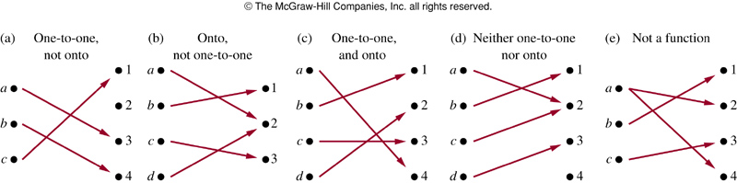

Slide 12
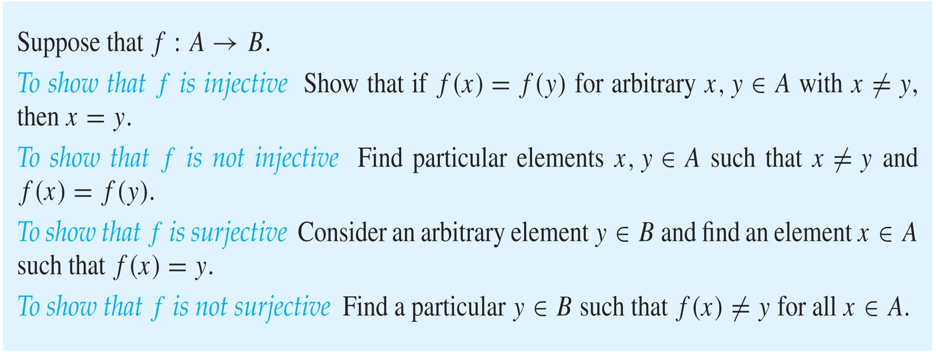
Showing that f is one-to-one or onto

Slide 13


2.3 Functions
Monotonic Functions
A monotonic function f is
  either monotonically (strictly) increasing
  or monotonically (strictly) decreasing

Slide 14
2.3 Functions
Inverse Functions
Let f be a bijection from A to B. Then the inverse function of f, denoted as f ⁻¹, is the function from B to A defined as
f ⁻¹(y) = x iff f(x) = y
Note:
  No inverse function exists unless f is a bijection.
  Function f is invertible if f f is bijective
f ⁻¹
a = f ⁻¹(b)
b = f(a)
A
f
B

Slide 15
2.1 Sets
〖Example 5〗Let f be the function from the set of integers to the set of integers such that f(x) = x+1. what is its inverse?
f is one-to-one √
onto √
bijection √
f ⁻¹(y) = y –1
〖Example 6〗Let f be the function from Z to Z with f(x) = x². Is f invertible?
f is one-to-one X
No inverse function

Slide 16
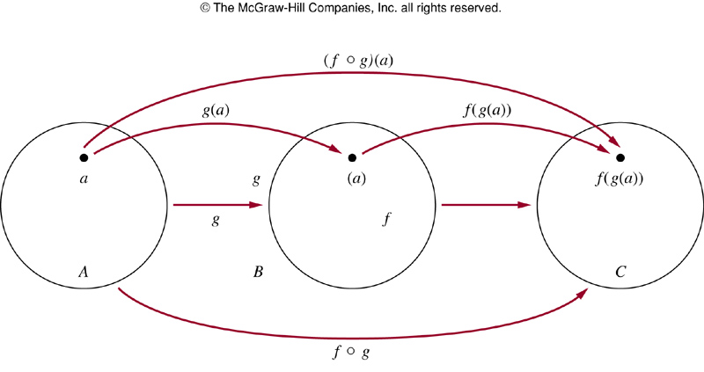
2.3 Functions
Compositions of Functions
Let g be a function from the set A to the set B and let f be a
function from the set B to the set C. The composition of the
functions f and g, denoted by f ° g, is defined by:
  f ° g(a) = f (g(a))
Note:
f ° g can’t be defined unless the range of g is a subset of the domain of f.

Slide 17
2.1 Sets
〖Example 5〗 f(x) = 2x + 3, g(x) = 3x + 2.
What is the composition of f and g?
What is the composition of g and f?
f ° g(x) =f (g(x)) = f (3x+2)
= 2(3x+2)+3 = 6x+7
g ° f(x) =g (f(x)) = g(2x+3)
= 3(2x+3)+2 = 6x+11

Slide 18
2.3 Functions
5. Some Important Functions
The floor function
The ceiling function

Slide 19
2.3 Functions
【Definition 】The floor function f (x) is the largest integer less than or equal to the real number x.
Notation:
⎣ x ⎦
For example:
⎣0.5⎦ =
The floor function is often also called the greatest integer function. It is often denoted by [x].
0
⎣1.5⎦ =
1
⎣2⎦ =
2
⎣-0.5⎦ =
−1

Slide 20
2.3 Functions
【Definition 】The ceiling function f (x) is the smallest integer greater than or equal to the real number x.
Notation:
⎡ x ⎤
For example:
⎡0.5 ⎤ =
1
⎡1.5 ⎤ =
2
⎡2 ⎤ =
2
⎡-0.5 ⎤ =
0

Slide 21
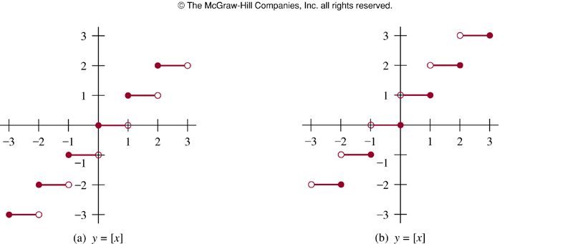

Slide 22
2.3 Functions
Useful Properties of the Floor and Ceiling Functions
(1a) ⎣ x ⎦ = n iff n ≤ x < n + 1 where n is an integer
(1b) ⎡ x ⎤ = n iff n – 1 < x ≤ n where n is an integer
(1c) ⎣ x ⎦ = n iff x – 1 < n ≤ x where n is an integer
(1d) ⎡ x ⎤ = n iff x ≤ n < x + 1 where n is an integer
(2) x – 1 < ⎣ x ⎦ ≤ x ≤ ⎡ x ⎤ < x + 1
(3a) ⎣ -x ⎦ = - ⎡ x ⎤
(3b) ⎡ -x ⎤ = - ⎣ x ⎦
(4a) ⎣ x + m ⎦ = ⎣ x ⎦ + m where m is an integer
(4b) ⎡ x + m ⎤ = ⎡ x ⎤ + m where m is an integer

Slide 23
Proving Properties of Functions
Example: Prove that x is a real number, then
⌊2x⌋= ⌊x⌋ + ⌊x + 1/2⌋
Solution: Let x = n + ε, where n is an integer and 0 ≤ ε< 1.
Case 1: ε < ½
  2x = 2n + 2ε and ⌊2x⌋ = 2n, since 0 ≤ 2ε< 1.
  ⌊x + 1/2⌋ = n, since x + ½ = n + (1/2 + ε ) and 0 ≤ ½ +ε < 1.
  Hence, ⌊2x⌋ = 2n and ⌊x⌋ + ⌊x + 1/2⌋ = n + n = 2n.
Case 2: ε ≥ ½
  2x = 2n + 2ε = (2n + 1) +(2ε − 1) and ⌊2x⌋ =2n + 1, since 0 ≤ 2 ε - 1< 1.
  ⌊x + 1/2⌋ = ⌊ n + (1/2 + ε)⌋ = ⌊ n + 1 + (ε – 1/2)⌋ = n + 1 since 0 ≤ ε – 1/2< 1.
  Hence, ⌊2x⌋ = 2n + 1 and ⌊x⌋ + ⌊x + 1/2⌋ = n + (n + 1) = 2n + 1.

Slide 24
CHAPTER 2
Basic Structures: Sets, Functions, Sequences, and Sums
2.1 Sets
2.2 Set Operations
2.3 Functions
2.4 Sequence and Summations
2.5 Cardinality of Sets

Slide 25
2.4 Sequence and Summations
【Definition】 A sequence is a function from a subset of the set of integers (usually either the set {0, 1, 2, …} or the set {1, 2, 3, …}) to a set S. We use the notation a_{n} to denote the image of the integer n. We call a_{n} a term of the sequence.
Note:
  Notation of sequence: {a_{n}}
  sequence of {a_{n}}: a₁, a₂, …, a_{n}, …
  The order in a sequence matters.

Slide 26
2.4 Sequence and Summations
Geometric Progression
A geometric progression is a sequence of the form
a, ar, ar², …, ar^{n}, …
where the initial term a and the common ratio r are real numbers.
〖Example 1〗 The sequence of {a_{n}} with a_{n} = 2•5^{n} is a geometric progression with initial term and common ratio equal to 2 and 5 respectively, if we start at n = 0 . Thus, we can express this sequence with
2, 10, 50, 250, 1250, …

Slide 27
2.4 Sequence and Summations
Arithmetic Progression
An arithmetic progression is a sequence of the form
a, a+d, a+2d, …, a+nd , …
where the initial term a and the common difference d are real
numbers.
〖Example 2〗 The sequence of {a_{n}} with a_{n} = -1+4n is an arithmetic progression with initial term and common difference equal to -1 and 4 respectively, if we start at n = 0 . Thus, we can express this sequence with
-1, 3, 7, 11, …,

Slide 28
2.4 Sequence and Summations
Special Integer Sequences
A common problem in discrete mathematics is finding a formula or a general rule for constructing the terms of a sequence.
〖Example 3〗 How can we produce the terms of a sequence if the first 10 terms are 5, 11, 17, 23, 29, 35, 41, 47, 53, 59?

Slide 29
2.4 Sequence and Summations
Special Integer Sequences
Deduce a possible formula or rule for the terms of a sequence from the initial terms.
  Are there runs of the same value?
  Are terms obtained from previous terms by adding the same amount or an amount that depends on the position in the sequence?
  Are terms obtained from previous terms by multiplying by a particular amount?
  Are terms obtained by combining previous terms in a certain way?
  Are there cycles among the terms?

Slide 30
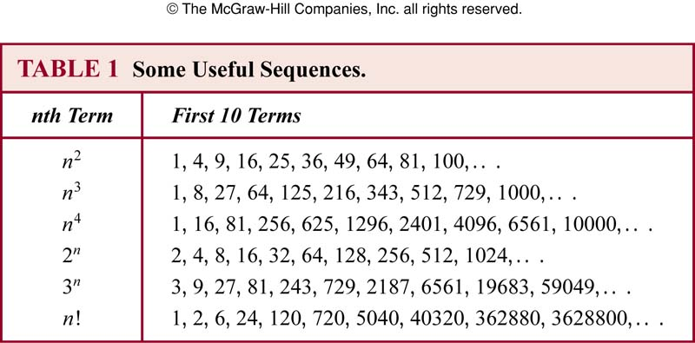
2.4 Sequence and Summations
Special Integer Sequences

Slide 31
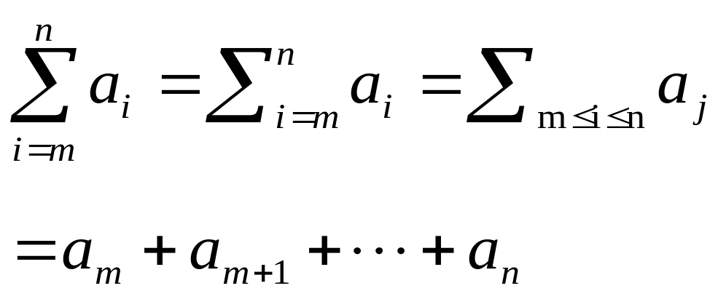
2.4 Sequence and Summations
Summations
Note:
i: index of summation
m: lower limit
n: upper limit

Slide 32
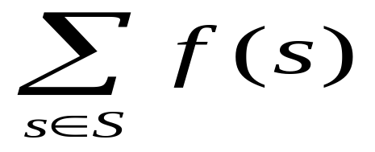
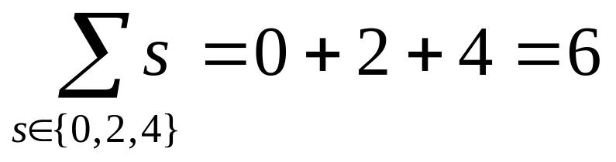
2.4 Sequence and Summations
Summations
S: the subset of the domain of the function f
〖Example 4〗

Slide 33
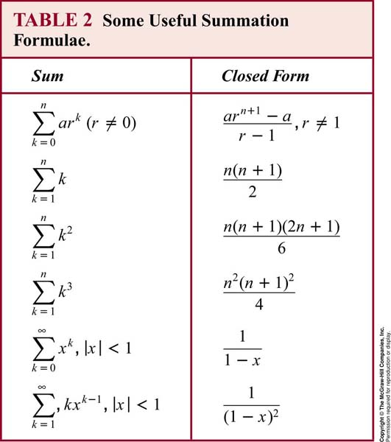
2.4 Sequence and Summations

Slide 34
CHAPTER 2
Basic Structures: Sets, Functions, Sequences, and Sums
2.1 Sets
2.2 Set Operations
2.3 Functions
2.4 Sequence and Summations
2.5 Cardinality of Sets

Slide 35
2.5 Cardinality of Sets
The cardinality of an infinite set
Some interesting questions:
  How to count the number of elements in an infinite set?
  Are the cardinalities of all infinite sets same?
  Is the number of positive integers double the number of positive even integers?
  Is the number of real numbers in (a,b) more than the number of real numbers in (0,1)?
  Are there same number of rational numbers and real numbers in (0,1)?

Slide 36


2.5 Cardinality of Sets
【Definition 1】 The cardinality of a set A is equal to the cardinality of a set B, denoted | A | = | B |, iff there exists a bijection from A to B.
【Definition 2】 If there is an injection from A to B, the cardinality of A is less than or the same as the cardinality of B and we write |A| ≤ |B|. When |A| ≤ |B| and A and B have different cardinality, we say that the cardinality of A is less than the cardinality of B and write |A| < |B|.
Question 1
〖Example 1〗 let A be the set of 26 lowercase English alphabets. B={1,2,…,26}. Then | A | = | B |.
〖Example 2〗 The set of positive integers is denoted by . . Then | Z⁺ | = | M |.

Slide 37
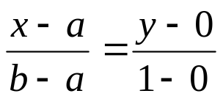
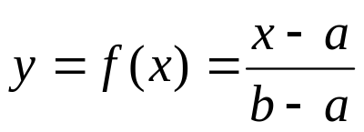
2.5 Cardinality of Sets
〖Example 3〗 Let A be the set of real numbers between a and b (a<b), and B be the set of real numbers between 0 and 1. Show that | A | = | B |.
Question 4
Proof:
Let f be a function from A to B.
Then y is a bijection from (a, b) to (0,1).
Hence, | A | = | B |.

Slide 38
2.5 Cardinality of Sets
【Definition 】A set that is either finite or has the same cardinality as the set of positive integers called countable.
A set that is not countable is called uncountable.
When an infinite set S is countable, we denote the cardinality of S by ℵ₀ ( aleph null ).
If |A| = | Z⁺ |, the set A is countable infinite.

Slide 39
2.5 Cardinality of Sets
Some Countable Infinite Sets
1) The set E of even positive integers
Let f(x) = 2x. Then, f is a bijection from Z⁺ to E .
1 2 3 4 5 6 . . .
2 4 6 8 10 12 . . .
Question 3
Note :
  E is countable infinite.
  The numbers of positive even integers is the same as positive integers
  E is a proper subset of Z⁺, but |E| = | Z⁺ |.

Slide 40

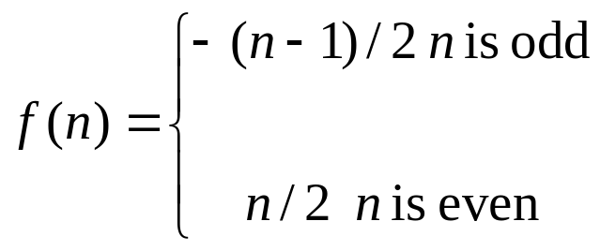
2.5 Cardinality of Sets
2) The set of integers Z
f is a bijection from Z⁺ to Z .
Hence, Z is countable infinite set。

Slide 41
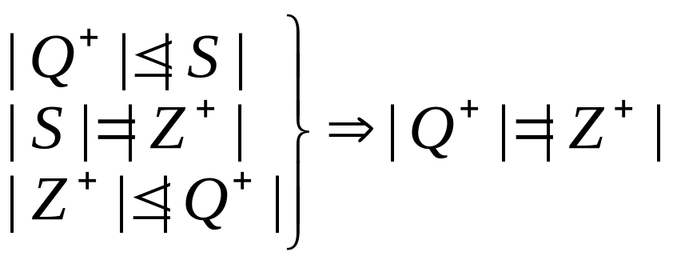
2.5 Cardinality of Sets
The set of positive rational numbers Q⁺
∀x ∈ Q⁺, x = p/q, p, q ∈ Z⁺
Let S={ (p, q)| p, q∈ Z⁺ } = Z⁺ × Z⁺.

Slide 42
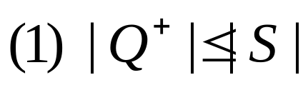
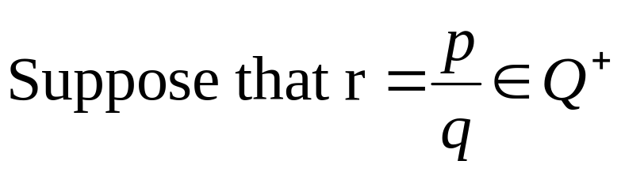
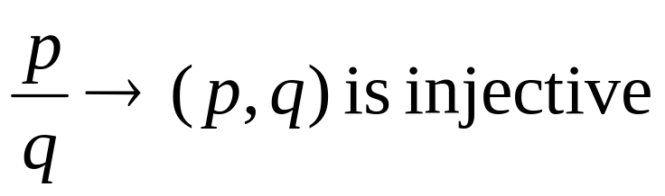
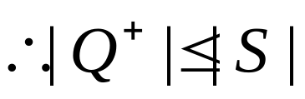
2.5 Cardinality of Sets

Slide 43

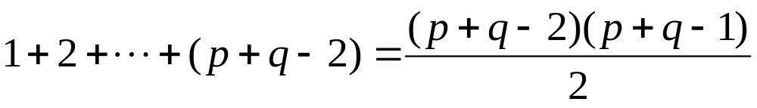
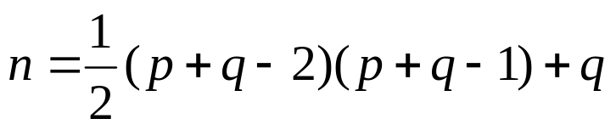
2.5 Cardinality of Sets
An infinite set is countable iff it is possible to list all the elements of the set in a sequence
1 2 3 … p …
1
2
3
…
q
…
(1,1) (2,1) (3,1) … (p,1) …
(1,2) (2,2) (3,2) … (p,2) …
(1,3) (2,3) (3,3) … (p,3) …
…
(1,q) (2,q) (3,q) … (p,q) …
…

Slide 44
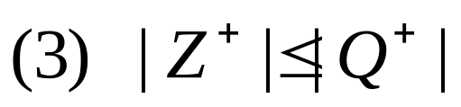
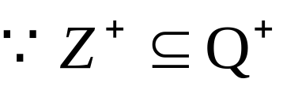
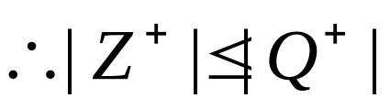
2.5 Cardinality of Sets
Note :
(1) There are the same number of positive rational numbers and positive integers.
(2) The set of all rational numbers Q, positive and negative, is countable infinite.

Slide 45
2.5 Cardinality of Sets
The properties of the countable sets:
No infinite set has a smaller cardinality than a countable set.
The union of two countable sets is countable.
The union of finite number of countable sets is countable.
The union of a countable number of countable sets is countable.

Slide 46
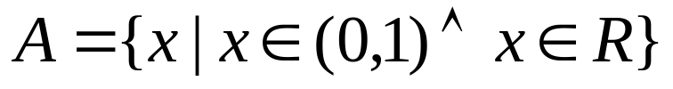
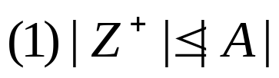
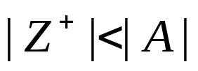
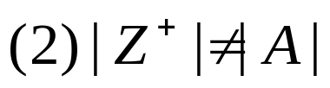
2.5 Cardinality of Sets
3. Cantor Diagonalization Argument
---- An important technique used to construct an object which is not a member of a countable set of objects
【Theorem】 The set of real numbers between 0 and 1 is
uncountable.
Proof:
Question 2

Slide 47
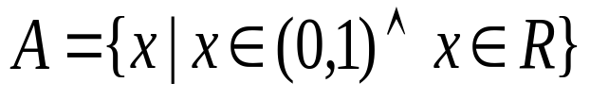
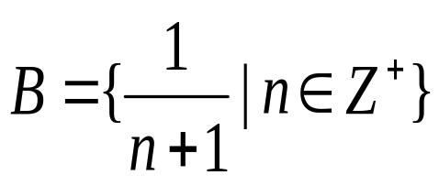

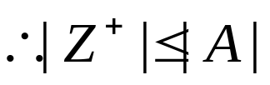
2.5 Cardinality of Sets

Slide 48

2.5 Cardinality of Sets
Assume A is countable, then let A={r₁ , r₂ , r₃ ,… , r_{n} ,… }
Represent each real number in the list using its decimal expansion.
e.g.,1/3 = .3333333........, 1/2 = .5000000........= .4999999........
THE LIST....
r₁ = 0.d₁₁d₁₂d₁₃d₁₄d₁₅d₁₆. . . . .
r₂ = 0.d₂₁d₂₂d₂₃d₂₄d₂₅d₂₆ . . . .
r₃ = 0.d₃₁d₃₂d₃₃d₃₄d₃₅d₃₆ . . . .
…
Now construct the number x = 0.x₁x₂x₃x₄x₅x₆x₇. . . .
x_{i} = 3 if d_{ii} ≠ 3
x_{i} = 4 if d_{ii} = 3
Then x is not equal to any number in the list.
Hence, no such list can exist and hence the interval (0,1) is uncountable .

Slide 49

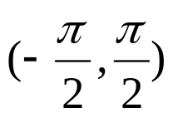
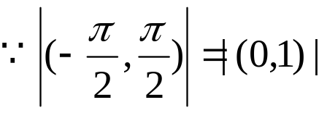
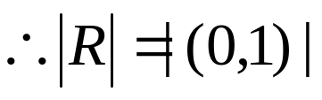
2.5 Cardinality of Sets
【Theorem】The set of real numbers has the
same cardinality as the set (0,1) .
Proof:
Let f(x)=tg(x).
f(x) is a bijection from to .
|R|= ℵ₁

Slide 50

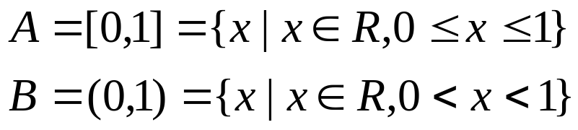

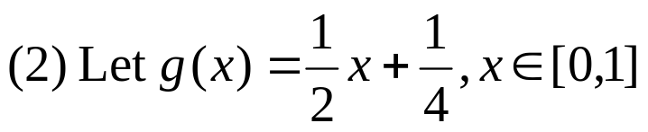

2.5 Cardinality of Sets
〖Example 4〗 Suppose that . Show that the cardinality of this set is ℵ₁.
Proof:
Hence, g(x) is a bijection from [0,1] to [1/4,3/4].

Slide 51
2.5 Cardinality of Sets
Computability
We say that a function is computable if there is a computer program in some programming language that finds the values of this function. If a function is not computable we say it is uncomputable.
.

Slide 52
2.5 Cardinality of Sets
〖Example 5〗 Show that the set of finite strings S over a finite alphabet A is countably infinite.
Proof:
Assume an alphabetical ordering of symbols in A. Show that the strings can be listed in a sequence. First list
All the strings of length 0 in alphabetical order.
Then all the strings of length 1 in lexicographic (as in a dictionary) order.
Then all the strings of length 2 in lexicographic order.
And so on.
This implies a bijection from N to S and hence it is a countably infinite set.

Slide 53
2.5 Cardinality of Sets
〖Example 6〗 Show that the set of all Java programs is countable.

Slide 54



2.5 Cardinality of Sets
【Schrőder-Bernstein Theorem】If A and B are sets with
and then . In other words,
if there are one-to-one functions f from A to B and g from B
to A, then there is a one to –one correspondence between
a A and B.
【Theorem】The cardinality of the power set of an arbitrary
set has a greater cardinality than the original arbitrary set.
The Continuum Hypothesis
The continuum hypothesis (CH) asserts that there is no cardinal number a such that ℵ₀ < a < ℵ₁.

Slide 55
Homework: (Due on March 23)
Sec. 2.3 22(c), 34, 40(a), 72, 74(c,d)
Sec. 2.5 4(c,d), 28 , 36, 38

